Slide 1
LEFT BUNDLE BRANCH BLOCK
MINHA AYISHA

Slide 2
Normal cardiac conduction
Electrical impulse travels through the heart via specific conduction pathway
SA node : acts as the initial pacemaker
Impulse spreads throughout the atria and and reaches AV node
Depolarisation wave travels through the hearts septum via bundle of his and purkinje fibres
These are organised into right bundle branch (RBB) and left bundle branch (LBB)
RV is depolarised by RBB and LV is depolarised by LBB
The septum is depolarised by LBB the depolarisation spreads from L–> R

Slide 3
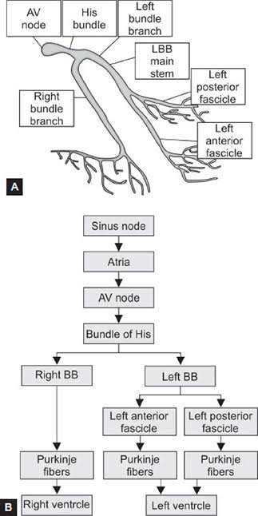
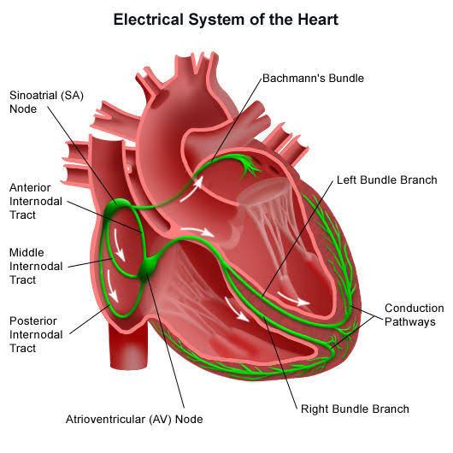

Slide 4
Bundle branch block
Condition in which there is a delay or blockage along the conducting pathway
These may be :
  Right bundle branch block ( RBBB )
  Left bundle branch block ( LBBB )
  Fascicular blocks

Slide 5
Ventricular depolarisation using normal pathway is complete within 120 ms
Depolarisation takes longer when these pathways are disrupted or changed in anyway, causing broad QRS complex
A broad QRS complex always indicate abnormal ventricular depolarisation
Normal QRS duration: 80 - 100 ms

Slide 6
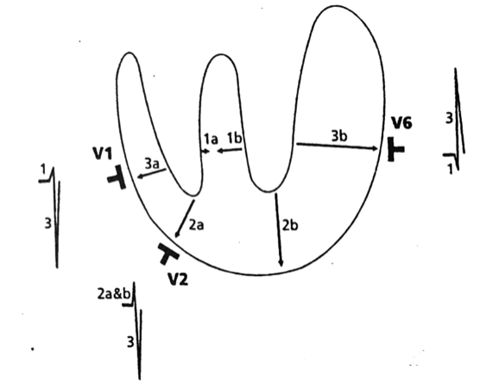
Genesis of normal QRS complex
Activation of ventricles begins in the lower 3rd of IVS from L–> R
It’s opposed by smaller activation force which arises in rt subendocardial region of IVS
The large L –> R force dominates – results in effective vector directed L–> R through the IVS

Slide 7
Genesis of normal QRS complex
Next , activation of free wall of both ventricles (subendocardial to subepicardial )
The larges R–> L force of left free wall dominates and counteracts the smaller L–> R of right free wall
This results in net vector directed from R -> L
Small initial vector first from L–> R followed by large vector from R -> L

Slide 8
LEFT BUNDLE BRANCH BLOCK
Left bundle branch block ( LBBB ) is the result of a delay or blockage of conduction within the left bundle branch
It can be
    Complete LBB ( QRS duration >120 ms )
    Incomplete LBB ( QRS duration: 100-120 ms )

Slide 9
COMPLETE LBBB
With complete LBBB, activation of the left side of the IVS and the left free wall is delayed and anomalous in character.
QRS duration is >120 ms

Slide 10
Complete LBBB
Mechanism of ventricular activation in complete LBBB follows :
1) Right septal activation
2) Delayed and anomalous left septal activation
3) Delayed and anomalous activation of the left free
ventricular wall

Slide 11
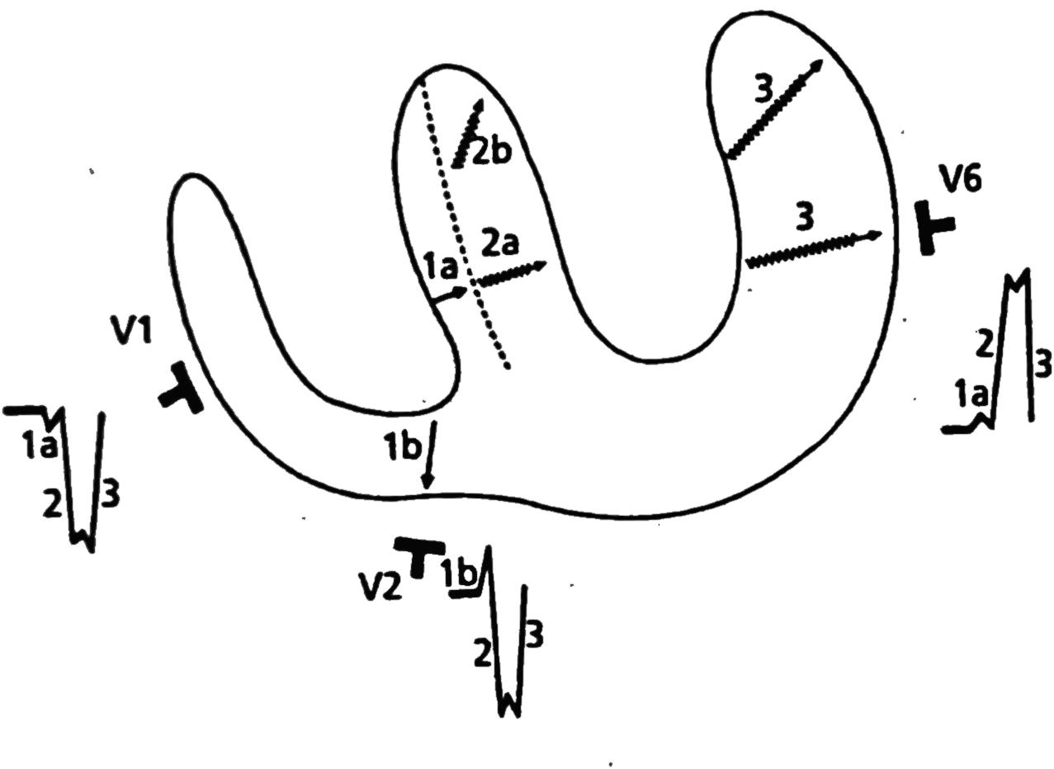
Right septal activation
This results in a small right to left vector (1a)
This vector is not opposed by a greater L–>R force of the left septal mass like normal intraventricular conduction
This unopposed vector will manifest as:
  i) a small initial +ve deflection in leads oriented to the left side of the IVS ( eg.V6)
ii) a small –ve deflection in leads oriented to the right side
of the IVS (eg. V1)

Slide 12
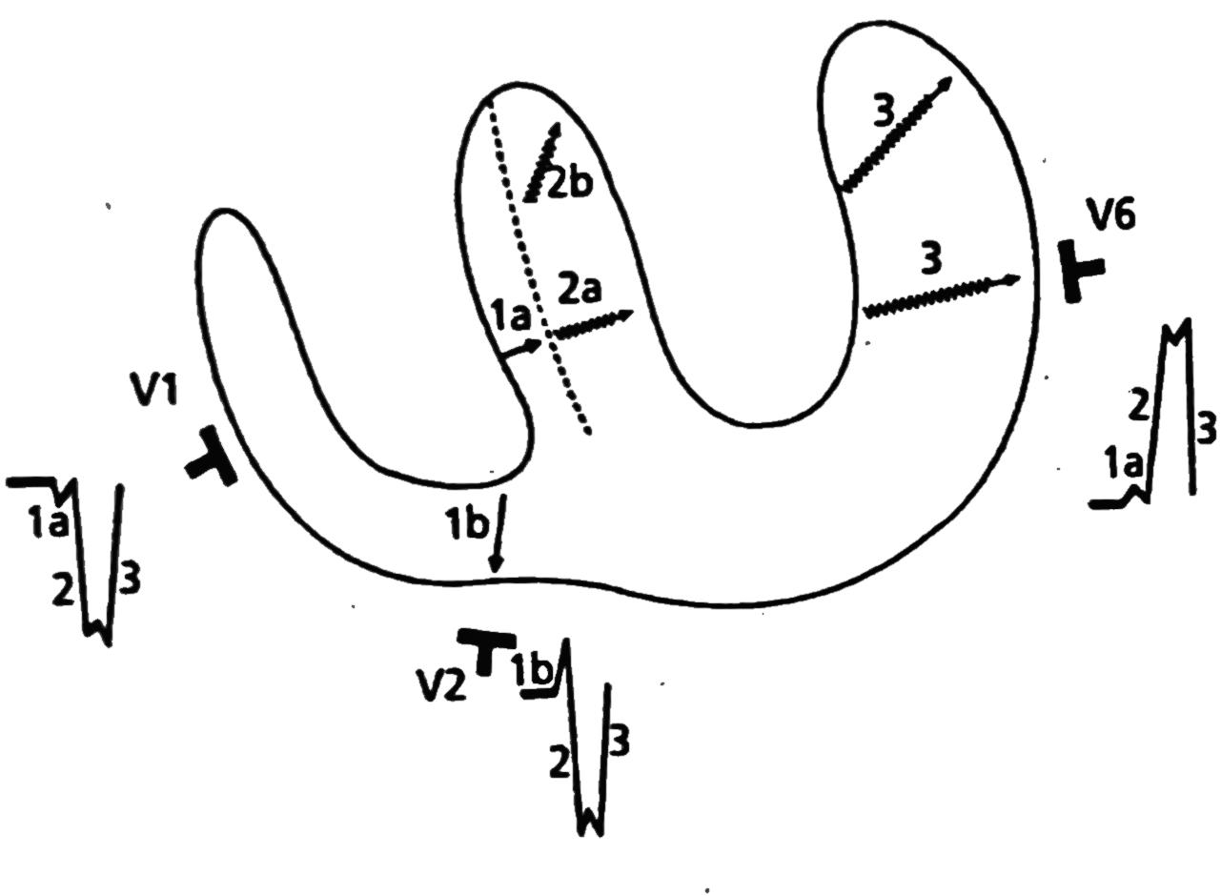
Delayed & anomalous left septal activation
Followed by the rt septal activation, the left side of the septum is activated in a delayed and anomalous manner
As a result vectors of large magnitude are produced that are directed to the left and posteriorly ( 2a and 2b)
This is reflected by
i) a tall R wave in leads oriented to the
left side of the septum
ii) a deep S wave in leads oriented to the
right side of the septum.

Slide 13
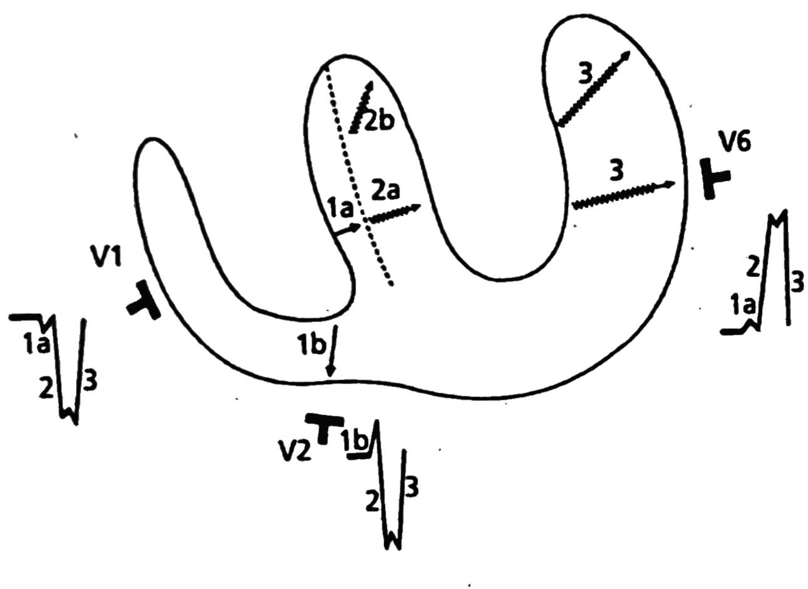
Delayed and anomalous activation of the lv free wall
Septal activation is followed by delayed and anomalous activation of the LV free wall
This results in a vector of large magnitude which is directed to left and posteriorly as well as somewhat superiorly ( vector 3)
This will be reflected by
i) a tall R’ wave deflection in left oriented leads
ii) a deep secondary S wave in right oriented
leads

Slide 14
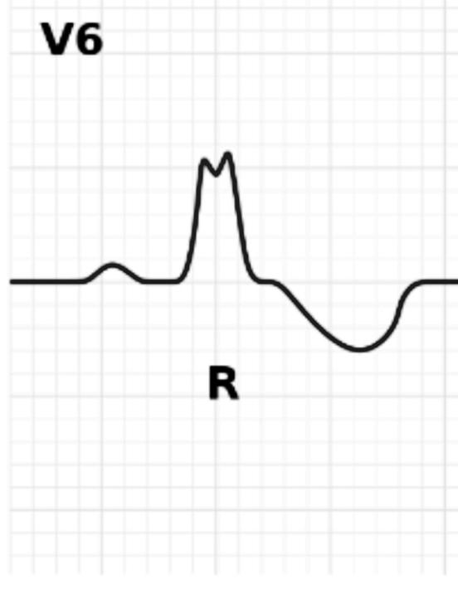
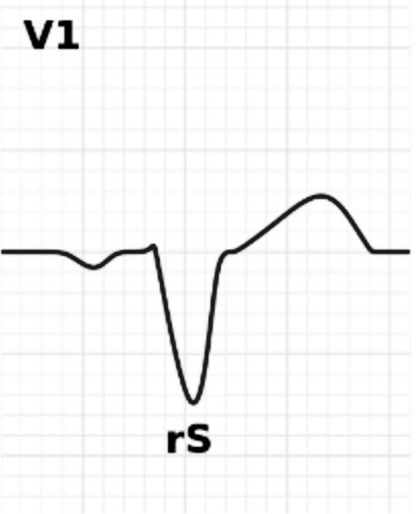
ECG manifestation of complete LBBB
QRS complex is prolonged to 120 ms or more, and may be as long as 200 ms
In Left oriented leads (I, V5 & V6 ),
• 3 +ve deflections ( first deflection is rarely seen)
• A tall notched R wave ( RR or M shaped complex )
• No initial Q wave or terminal S wave
• In Right oriented leads( V1& V2),
• Wide and notched QS complex or a rS complex
• a small initial r wave followed by a deep wide and
notched S wave ( r wave is more prominent in V2)

Slide 15
Secondary ST segment and T wave changes
ST segment and T wave are opposite in direction to the QRS deflection
In Left oriented leads,
• ST segment - depressed and minimally convex upwards
• T wave - inverted with a blunt nadir
In Right oriented leads,
• ST segment – Elevated, minimally concave upwards
• T wave - upright, asymmetrical with blunt apex

Slide 16
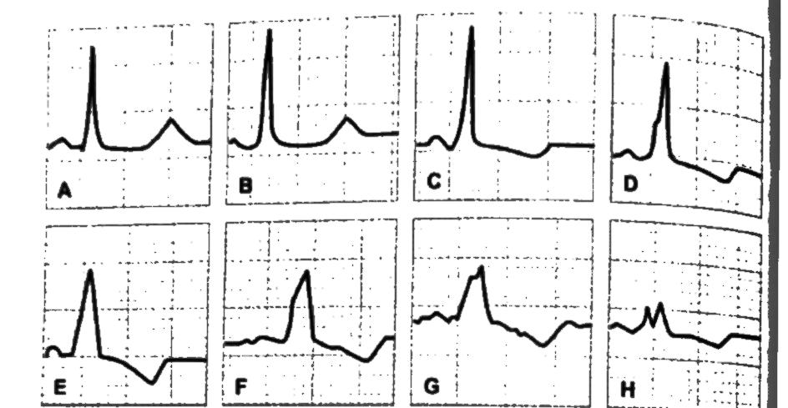
INCOMPLETE LEFT BUNDLE BRANCH BLOCK
Conduction through LBB is still possible but will be delayed.
Progressively increasing delay of conduction will result in a progressive sequence of ECG manifestations.

Slide 17
ECG manifestation of incomplete LBBB
The small initial q wave of the normal qR complex in left oriented leads disappears - result in a single tall R wave
The small initial r wave of the normal rS complex in V1 disappears - result in a QS complex
With further progression of incomplete LBB, a slur appears on the upstroke of the QRS complex
This slur becomes increasingly prominent and is accompanied by widening and eventual notching of the QRS complex until the fully developed manifestation of complete LBBB is attained.

Slide 18
Causes of LBBB
Ischemic heart disease
Cardiomyopathy
LVH
Hypertension
Fibrosis of the conduction system

Slide 19
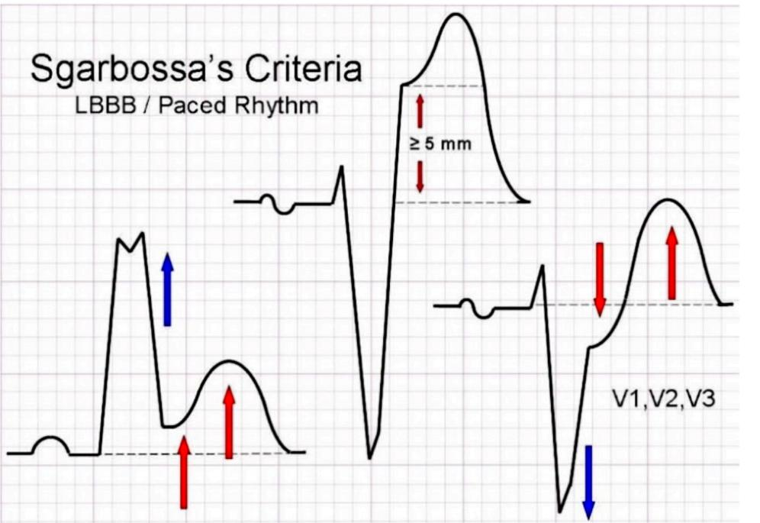
MI with LBBB
It is difficult to diagnose MI in patients with LBBB
SGARBOSSA CRITERIA :
Scoring system for identifying acute MI in presence of LBBB on ECG
ST elevation ≥ 1 mm concordant to +ve QRS complex (5 points)
ST depression ≥ 1 mm in V1- V3 (3 points)
ST elevation ≥ 5 mm discordant with- ve QRS complex (2 points)
=> A score of ≥ 3 points has a high specificity
for acute MI in LBBB

Slide 20
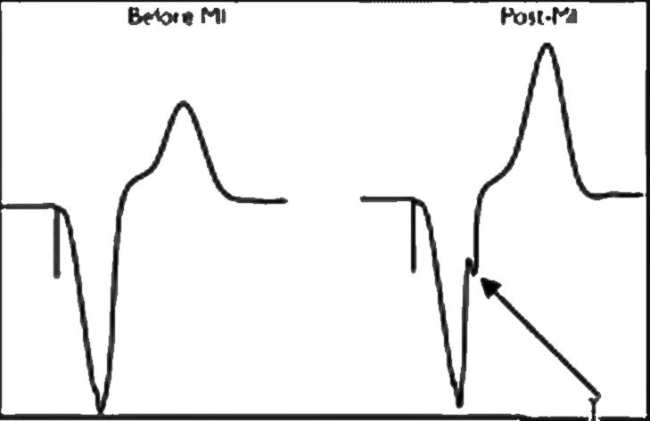
To identity previous MI in patients with pre existing LBBB, we use Cabrera sign and Chapman’s sign
CABRERA SIGN
Presence of a notch of 40ms in the ascending portion of the S wave in V3 or V4

Slide 21
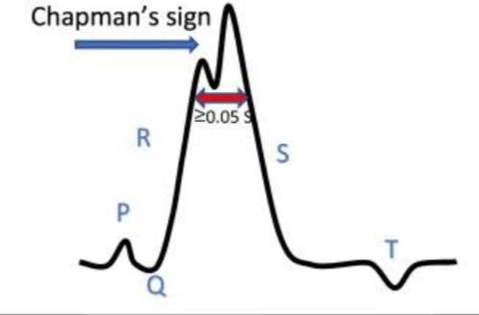
CHAPMAN’S SIGN
Notching in the upstroke of R wave in I, aVL or V6

Slide 22
MCQs

Slide 23
Pick the odd one out
a) Sgarbosa criteria
b) Cabrera sign
c) Sokolow lyon criteria
d) Chapman’s sign

Slide 24
Ans: c) Sokolow Lyon criteria

Slide 25
2) QRS duration of complete LBBB
a) 100 ms
b) >120 ms
c) >200 ms
d) <120 ms

Slide 26
Ans: B) >120ms

Slide 27
3.Chapman’s sign signifies:
a. Presence of notch 40ms in the ascending portion of the s
wave in V3 and V4
b. Presence of notch 40ms in the ascending portion of the s
wave in I, aVL , or V6
c. Presence of notching in the upstroke of R wave in I , aVL or V6
d. Presence of notching in the upstroke of R wave in V3 and V4

Slide 28
Ans: C

Slide 29
THANK YOU!

Slide 30
REFERENCE:
  Leo Schamroth : An introduction to Electrocardiography

