Slide 1
Statins in ASCVD
Dr FAZIL KT

Slide 2
Introduction
ASCVD: the leading cause of morbidity and mortality worldwide, including in India, with an earlier onset and higher burden in South Asians
Elevated LDL-C - causal factor in the development and progression of atherosclerosis.

Slide 3
Statins = the cornerstone of lipid-lowering therapy
Over last three decades, landmark RCTs -established the role of statins in both primary and secondary prevention of ASCVD

Slide 4
Despite newer lipid-lowering agents, statins remain first-line therapy, with high-intensity statins being essential for patients with established ASCVD.

Slide 5
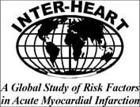
Attributable Risk Factors for a First Myocardial Infarction
INTERHEART Study(2004)
100
90
80
60
50
PAR (%)
40
36
33
18
20
20
14
12
10
7
0
Smoking
Fruits/
Veg
Exercise
Alcohol
Hyper-
tension
Diabetes
Abdominal
obesity
Psycho-
social
Lipids
All 9 risk
factors
Lifestyle factors
n=15,152 patients and 14,820 controls in 52 countries
Source: Yusuf S et al. Lancet. 2004;364:937-952
Notes:
In this study of 15,152 patients, lipids had the highest population attributable risk for a first myocardial infarction among 9 risk factors for cardiovascular disease.

Slide 6
Lipid structure and metabolism
Lipids constitute approximately 70% (by mass) of the dry weight of plasma.
Approximately half of circulating lipids are sterols, with the other major components being phospholipids and triglycerides, which circulate in lipoproteins.

Slide 7
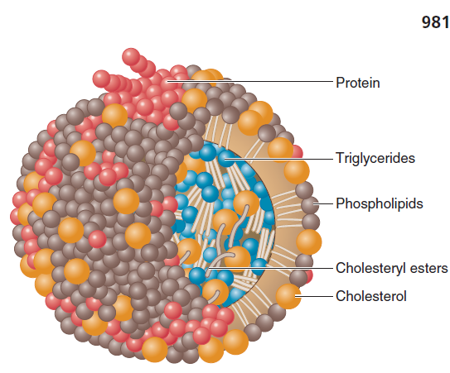
Lipoprotein structure

Slide 8
Lipoproteins – physiological functions
Absorption of
- dietary cholesterol
- long-chain fatty acids
- fat-soluble vitamins
Transport & exchange of
- triglycerides
- cholesterol
- fat-soluble vitamins

Slide 9
Lipoprotein | Density (g/ml) | Size (nm) | Major Lipids | Major Apoproteins
Chylomicrons | <0.930 | 75-1200 | Triglycerides | Apo B-48, Apo C, Apo E, Apo A-I, A-II, A-IV
Chylomicron Remnants | 0.930- 1.006 | 30-80 | Triglycerides Cholesterol | Apo B-48, Apo E
VLDL | 0.930- 1.006 | 30-80 | Triglycerides | Apo B-100, Apo E, Apo C
IDL | 1.006- 1.019 | 25-35 | Triglycerides Cholesterol | Apo B-100, Apo E, Apo C
LDL | 1.019- 1.063 | 18- 25 | Cholesterol | Apo B-100
HDL | 1.063- 1.210 | 5- 12 | Cholesterol Phospholipids | Apo A-I, Apo A-II, Apo C, Apo E
Lp (a) | 1.055- 1.085 | ~30 | Cholesterol | Apo B-100, Apo (a)

Slide 10
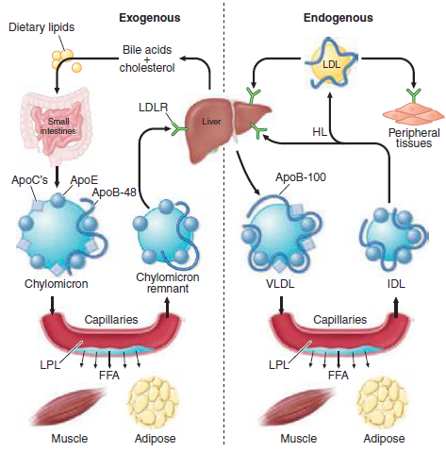
The normal Lipid Physiology

Slide 11
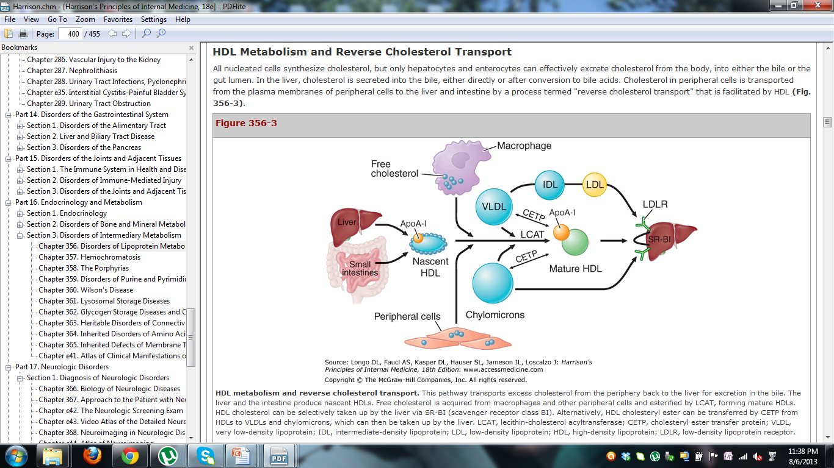
Reverse cholesterol transport by HDL

Slide 12
Role of Lipoproteins in Atherogenesis
HDL
High plasma
LDL
Endothelial
injury
(-)
LDL
+
VLDL
LDL infiltration
into intima
Adherence
of platelets
LCAT
APO-A1
Oxidative
modification
of LDL
Release
of PDGF
Liver
Other
growth
factors
+
Macrophages
Foam cells
Fatty streak
Cholesterol
excreted
Advanced
fibrocalcific
lesion
Notes:
12
Pro-atherogenic lipoprotein particles such as LDL-C infiltrate the intima of the arterial wall and undergo oxidative changes. Accumulation of these atherogenic particles attract macrophages that engulf cholesterol, causing formation of foam cells and subsequent fatty streaks. This process injures the endothelium of the arterial wall, promoting adherence of platelets, release of PDGF, and development of an advanced fibrocalcific lesion. Anti-atherogenic particles such as HDL-C and apo-A1 promote reverse cholesterol transport and cholesterol efflux from foam cells. They also help to prevent oxidation of LDL-C and other atherogenic particles.

Slide 13
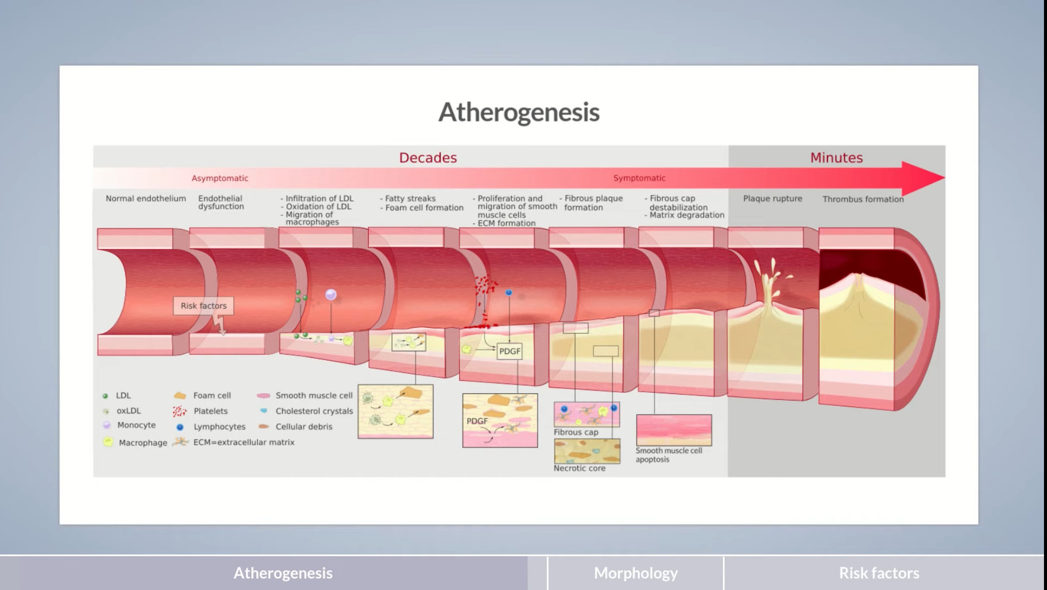

Slide 14
STATINS
COMPACTIN (mevastatin)-It was the first statin discovered from Penicillium citrinum.
but it is not widely used clinically today because other statins are safer and more effective.
A related fungal metabolite called LOVSTATIN (mevinolin) isolated from Aspergillus terreus.

Slide 15
Today, there are two classes of statins:
  Natural Statins:
  Lovastatin, Compactin, Pravastatin , Simvastatin
  Synthetic Statins: Atorvastatin,Fluvastatin,Rosuvastatin ,Pitavastatin

Slide 16
Mechanism of Action
Inhibition of the cholesterol biosynthetic pathway
Squalene
synthase
Dolichol
HMG-CoA Reductase
Acetyl
CoA
HMG-
CoA
Mevalonate
Farnesyl
pyrophosphate
Squalene
Cholesterol
Farnesyl-
transferase
E,E,E-Geranylgeranyl
pyrophosphate
Farnesylated
proteins
Geranylgeranylated
proteins
Ubiquinones
Notes:
16
Statins inhibit the HMG-CoA reductase enzyme, leading to reduced hepatic intracellular cholesterol production.

Slide 17
HMG-CoA Reductase Inhibitor:
Mechanism of Action
VLDL
Cholesterol synthesis
LDL receptor
(B–E receptor)
synthesis
VLDL_{R}
Apo B
LDL-R–mediated hepatic uptake of LDL and VLDL remnants
Apo E
Intracellular Cholesterol
Serum LDL-C
LDL
Apo B
Serum VLDL remnants
Serum IDL
Hepatocyte
Systemic Circulation
The reduction in hepatic cholesterol synthesis lowers intracellular cholesterol, which stimulates upregulation of the LDL receptor and increases uptake of non-HDL particles from the systemic circulation
Notes:
17
Statins decrease hepatic cholesterol synthesis, leading to an upregulation of LDL-C receptors on the surface of hepatocytes. This results in increased clearance of LDL-C particles from the serum.

Slide 18
PHARMACOKINETICS
Intestinal absorption (30%-80%)
Extensive first pass metabolism
T1/2 of parent compounds are 1-4hrs
Except atorvastatin and rosuvastatin → 20hrs

Slide 19
Hepatic CHOL synthesis is max between midnight and 2:00AM
All statins with t1/2 of 4 hrs or less should be taken in the evening
(EXCEPT ATORVASTATIN & ROSUVASTATIN )
70% of statin metabolites are excreted by the liver—feces

Slide 20
Pleiotropic Effects
Improvement of Endothelial Dysfunction
Normalized Vasomotion
Increased Bioavailability of Nitric Oxide
Antioxidant Effects
Anti-inflammatory Effects
Reduction of Serum CRP

Slide 21
Reduction of Adhesion Molecules
Plaque Stabilization
Stimulation of Endothelial Progenitor Cell Recruitment
Immunomodulation
Inhibition of Myocardial Hypertrophy

Slide 22
Classification of Statins
Natural vs synthetic
Hydrophilic (rosuvastatin, pravastatin) vs lipophilic (atorvastatin, simvastatin)
Potency: Rosuvastatin > Atorvastatin > Simvastatin > Pravastatin

Slide 23
Feature | Hydrophilic Statins | Lipophilic Statins
Solubility | Water-soluble | Fat-soluble
Tissue Penetration | Mainly liver → hepatoselective | Broad tissue distribution (muscle, liver, others)
Metabolism | Less CYP450-dependent (Pravastatin mostly non-CYP, Rosuvastatin CYP2C9 minor) | Mostly CYP3A4-dependent
Side Effects | Lower risk of muscle toxicity | Higher risk of myopathy/rhabdomyolysis
Drug Interactions | Fewer CYP-mediated interactions | More CYP-mediated interactions
Examples | Pravastatin, Rosuvastatin, Fluvastatin | Atorvastatin, Simvastatin, Lovastatin, Pitavastatin

Slide 24
First Generation | Second Generation | Third Generation
Compactin Lovastatin Pravastatin | Simvastatin Fluvastatin | Atorvastatin Rosuvastatin Pitavastatin

Slide 25
Major adverse effects
Myopathy (0.1-0.2%)
Rhabdomyolysis (0.01%)
Hepatotoxicity

Slide 26
Organ System | Adverse Effect | Key Features / Notes | Risk Factors / Prevention
Musculoskeletal | Myalgia | Muscle aches without CK elevation | Elderly, high dose, lipophilic statin, CYP3A4 inhibitors
 | Myopathy | Muscle symptoms with CK ↑ (>10× ULN) | Same as above
 | Rhabdomyolysis | Severe muscle breakdown, risk of renal failure | Very rare, monitor CK in symptomatic patients
Hepatic | Transaminase elevation | Mild ↑ALT/AST, usually <3× ULN | Baseline LFTs, monitor if symptomatic
 | Hepatitis / liver injury | Clinically significant | Rare
Metabolic | New-onset diabetes | Slight ↑ risk, mostly with high-dose therapy | Monitor fasting glucose in high-risk patients
 | Hyperglycemia | Mild ↑ fasting glucose | Rare
Neurological / Cognitive | Memory loss / confusion | Usually reversible on discontinuation | Very rare
 | Peripheral neuropathy | Case reports | Very rare
Gastrointestinal | Nausea, diarrhea, constipation | Mild, dose-dependent | Take with food, adjust dose if needed
 | Abdominal pain | Mild, transient | Rare
Dermatological | Rash, pruritus | Hypersensitivity reactions | Rare
 | Photosensitivity | Rare | Very rare

Slide 27
DRUG INTERACTIONS

Slide 28
CYP3A4-Mediated Interactions (Mostly Lipophilic Statins)
Affected Statins: Atorvastatin, Simvastatin, Lovastatin
Interacting Drug | Mechanism | Clinical Impact / Notes
Macrolide antibiotics (e.g., Clarithromycin, Erythromycin) | CYP3A4 inhibition | ↑ Statin levels → ↑ risk of myopathy/rhabdomyolysis
Azole antifungals (e.g., Ketoconazole, Itraconazole) | CYP3A4 inhibition | ↑ Statin toxicity
HIV protease inhibitors | CYP3A4 inhibition | ↑ Statin toxicity
Grapefruit juice | CYP3A4 inhibition | ↑ Statin levels, mainly Simvastatin & Atorvastatin
Amiodarone, Diltiazem, Verapamil | CYP3A4 inhibition | ↑ Myopathy risk

Slide 29
2. CYP2C9-Mediated Interactions (Some Hydrophilic Statins)
Affected Statins: Fluvastatin, Rosuvastatin (minor)
Interacting Drug | Mechanism | Notes
Warfarin | CYP2C9 inhibition | ↑ INR → ↑ bleeding risk; monitor INR closely
Amiodarone | CYP2C9 inhibition | ↑ Statin levels → mild ↑ myopathy risk

Slide 30
3. Drugs Increasing Myopathy Risk via Other Mechanisms
Interacting Drug | Mechanism / Notes
Fibrates (Gemfibrozil) | Inhibits statin glucuronidation → ↑ risk rhabdomyolysis
Niacin (high dose) | Additive myopathy risk
Colchicine | Additive myopathy risk, especially in elderly
Cyclosporine | Inhibits statin metabolism → ↑ toxicity

Slide 31
4. Drugs Affecting Statin Absorption
Interacting Drug | Mechanism | Notes
Bile acid sequestrants (Cholestyramine, Colestipol) | Reduce statin absorption | Take statin 1–2 h before or 4–6 h after sequestrants

Slide 32
Landmark Trials

Slide 33
Primary Prevention Trials
Trial | Statin Used | Population | Key Finding
WOSCOPS (1995) | Pravastatin | Middle-aged men with high LDL, no MI | ↓ First MI & CV death by ~31%
AFCAPS/TexCAPS (1998) | Lovastatin | Average cholesterol, no CAD | ↓ First acute coronary events by ~37%
ASCOT-LLA (2003) | Atorvastatin | Hypertensive patients, no CAD | ↓ CV events by 36%

Slide 34
Evidence: Primary Prevention
West of Scotland Coronary Prevention Study (WOSCOPS) (1995)
6,595 men with moderate hypercholesterolemia randomized to pravastatin (40 mg) or placebo for 5 years
Statins provide significant benefit in those with average cholesterol levels
31% RRR
9
7.5
6
5.3
Rate of MI or CHD death (%)
3
P<0.001
0
Placebo
Pravastatin
Source: Shepherd J et al. NEJM 1995;333:1301-1307
Notes:
34
The WOSCOPS trial was one of the first trials to examine the effect of statins on cardiovascular events in individuals with hypercholesterolemia. This trial specifically randomized men (45-65 years old) with moderate hypercholesterolemia (total cholesterol of 272 ± 23 mg/dL) and no history of myocardial infarction to pravastatin (40 mg) or placebo. Pravastatin resulted in a 31% relative risk reduction in the rate of coronary heart disease death or nonfatal myocardial infarction, with no effect on the risk of death from non-cardiovascular causes.

Slide 35
Air Force/Texas Coronary Atherosclerosis Prevention Study (AFCAPS/TEXCAPS) (1998)
6,605 patients with average LDL-C levels randomized to lovastatin (20-40 mg) or placebo for 5 years
A statin provides benefit in those with average LDL-C levels
37% RRR
6
5.5
4
3.5
Rate of MI, unstable angina, or SCD (%)
2
P<0.001
0
Placebo
Lovastatin
Source: Downs JR et al. JAMA 1998;279:1615–1622
Notes:
35
The AFCAPS/TEXCAPS trial randomized 6605 men and women with average levels of total cholesterol (221 mg/dl) and LDL-C (150 mg/dl) and below average levels of HDL-C (36mg/dl) to lovastatin (20-40 mg) or placebo, along with dietary modification. Over a 5 year follow-up, there was a significant 37% relative risk reduction in the rate of myocardial infarction, unstable angina, or sudden cardiac death in those receiving lovastatin.

Slide 36
Anglo-Scandinavian Cardiac Outcomes Trial—Lipid Lowering Arm (ASCOT-LLA) 2002
10,305 patients with HTN randomized to atorvastatin (10 mg) or placebo for 5 years
A statin provides significant benefit in moderate- to high-risk individuals by lowering LDL-C levels below current goals
4
Atorvastatin
Placebo
3
36% RRR
Cumulative incidence of MI and fatal CHD (%)
2
1
P=0.0005
0
0.0
0.5
1.0
1.5
2.0
2.5
3.0
3.5
Follow-up (yr)
*Post-treatment LDL-C level
Source: Sever PS et al. Lancet. 2003;361:1149-1158
Notes:
36
The ACSCOT-LLA trial (a substudy of the larger ASCOT trial) sought to assess the benefit of cholesterol reduction in hypertensive patients not deemed hypercholesterolemic (total non-fasting cholesterol <250mg/dl) by conventional means, but with at least three other cardiovascular risk factors. Patients were randomized to treatment with atorvastatin (10 mg) or placebo and the primary endpoint was non-fatal MI and fatal CHD by an intention to treat analysis. The study was stopped after 3.3 years due to a significant reduction in the primary endpoint in the atorvastatin arm compared to placebo (HR=0.64 [95% CI 0.50-0.83], p=0.0005). Importantly, while benefit was noted in the first year of treatment, there was no significant difference in death between the two arms.

Slide 37
Justification for the Use of Statins in Prevention: An Intervention Trial Evaluating Rosuvastatin (JUPITER) 2008
17,802 men (>50 years) and women (>60 years) with LDL-C <130 mg/dL and hs-CRP >2 mg/L randomized to rosuvastatin (20 mg) or placebo for up to 5 years*
A statin provides benefit in those with elevated hs-CRP levels
International (26 countries, but led by USA)
0.08
Rosuvastatin
Placebo
Cumulative incidence of CV
death, MI, stroke, hospitalization
for unstable angina, and
arterial revascularization
44% RRR
0.04
P<0.00001, NNT=25
0.00
0
1
2
3
4
Follow-up (years)
*The study was stopped prematurely after 1.9 years
Ridker PM et al. NEJM 2008;359:2195-2207
Notes:
The JUPITER trial sought to evaluate the effect of rosuvastatin (as compared to placebo) in a primary prevention population with a baseline LDL-C level <130 mg/dL that was screened to identify patients with a baseline hs-CRP level >2 mg/dL. Treatment with rosuvastatin was associated with an ~44% relative risk reduction in a composite CV end point. The number needed to treat (NNT) to reduce 1 event was 25 for the primary endpoint.

Slide 38
Management of Elevated Cholesterol in the Primary Prevention Group of Adult Japanese (MEGA) Trial 2006
7,832 men and postmenopausal women with total cholesterol levels of 220-270 mg/dL randomized to pravastatin (10-20 mg) or placebo for 5.3 years
A statin provides benefit in those with high cholesterol levels
33% RRR
6
5.0
4
Number of adverse CV events* per 1000 person years
3.3
2
P=0.01
0
Placebo
Pravastatin
Source: Nakamura H et al. Lancet 2006;368:1155-63
Notes:
The MEGA trial sought to evaluate the effect of low dose pravastatin as compared to placebo in a heterogeneous primary prevention population in Japan. Pravasatin was shown to have a significant reduction in a composite of adverse CV events.

Slide 39
Secondary Prevention Trials
Trial | Statin Used | Population | Key Finding
4S (Scandinavian Simvastatin Survival Study, 1994) | Simvastatin | Post-MI or angina with high LDL | ↓ All-cause mortality by 30%
CARE(Cholesterol and Recurrent Events) (1996) | Pravastatin | Post-MI, average cholesterol | ↓ Recurrent MI by 24%
LIPID(Long-term Intervention with Pravastatin in Ischemic Disease ) (1998) | Pravastatin | Prior MI or unstable angina | ↓ CHD death by 24%

Slide 40
Trial | Statin Used | Population | Key Finding
HPS (Heart Protection Study, 2002) | Simvastatin | High-risk (CAD, DM, PAD, stroke) | ↓ Major vascular events by 24%
PROVE-IT( Pravastatin or Atorvastatin Evaluation and Infection Therapy} TIMI-22 (2004) | Atorvastatin 80 mg vs Pravastatin 40 mg | Recent ACS | High-dose atorvastatin ↓ events more
TNT (Treating to New Targets) (2005) | Atorvastatin 80 mg vs 10 mg | Stable CHD | Intensive therapy ↓ major CV events by 22%

Slide 41
Trial | Statin Used | Population | Key Finding
IDEAL (2005) (Incremental Decrease in End Points Through Aggressive Lipid Lowering ) | Atorvastatin 80 mg vs Simvastatin 20–40 mg | Prior MI | Atorvastatin superior for recurrent events
IMPROVE-IT (IMProved Reduction of Outcomes: Vytorin Efficacy International Trial)(2015) | Simvastatin ± Ezetimibe | Recent ACS | Combo ↓ CV events more than statin alone

Slide 43
TREATMENT OF DYSLIPIDEMIA

Slide 44
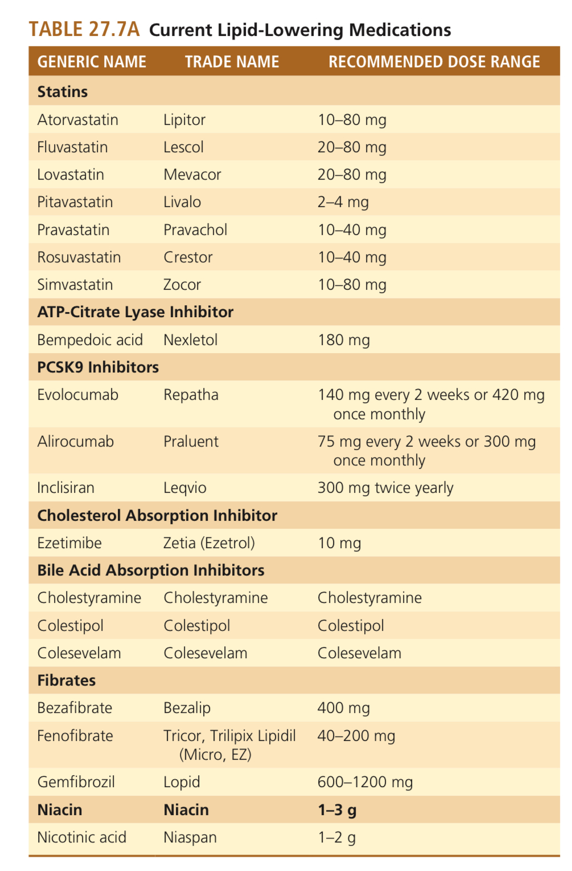

Slide 45
Treatment
1.Measure baseline lipids.
• Total cholesterol, LDL-C, HDL-C, non-HDL-C, triglycerides (TG).
• Consider Lp(a) if available, family history, genetic risk.
• Assess other risk factors: age, sex, smoking, diabetes, hypertension, CKD, etc.

Slide 46
2.Assess ASCVD risk.
• Use risk calculator appropriate for your population (e.g. SCORE2 ,SCORE2 OP)
Risk Factors used:
Age
Sex
Smoking
Systolic blood pressure
Non-HDL cholesterol (preferred over total cholesterol).
• Categorize risk: low, moderate, high, very high.

Slide 47
3.Decide on therapeutic target
• For very high risk (e.g. established ASCVD, recent ACS, high-risk comorbidity): target lower LDL-C
• For high / moderate risk: less aggressive but meaningful reductions

Slide 48
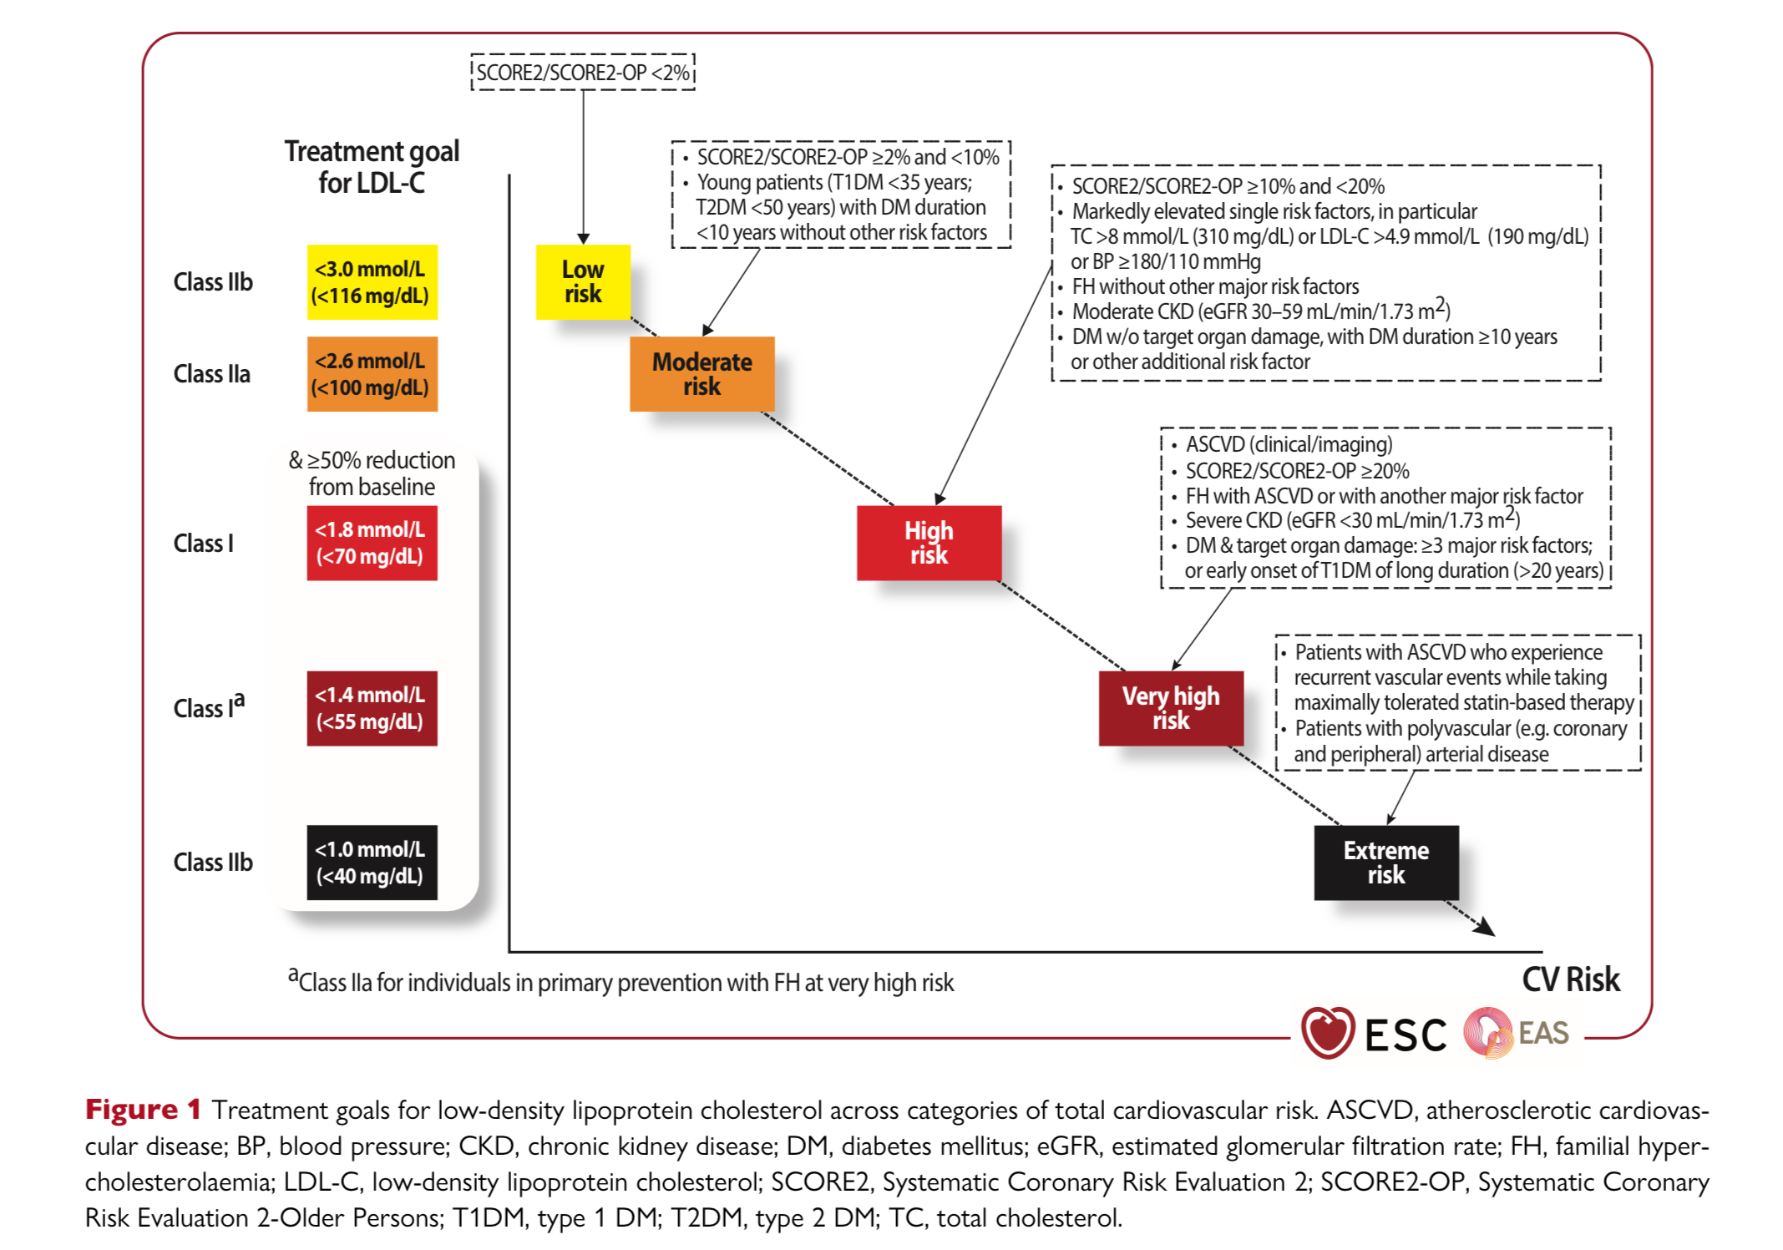

Slide 49
4.Lifestyle interventions + diet for all:
• Diet: reduce saturated fat, trans fats;
increase fibre, plant sterols etc.
• Physical activity, weight control, smoking cessation.
• Address other modifiable risk factors.

Slide 50
5.Decide if pharmacotherapy is indicated.
Consider:
LDL-C levels (e.g. ≥ 190 mg/dL or equivalent in mmol/L).
Diabetes in certain age (often >40 yrs).
High risk as per calculator.
If lifestyle alone insufficient

Slide 51
6.Pharmacotherapy
First-line therapy: Statins
  High-intensity statin for very high risk / very elevated LDL.
  Moderate intensity for others depending on risk.
  )

Slide 52
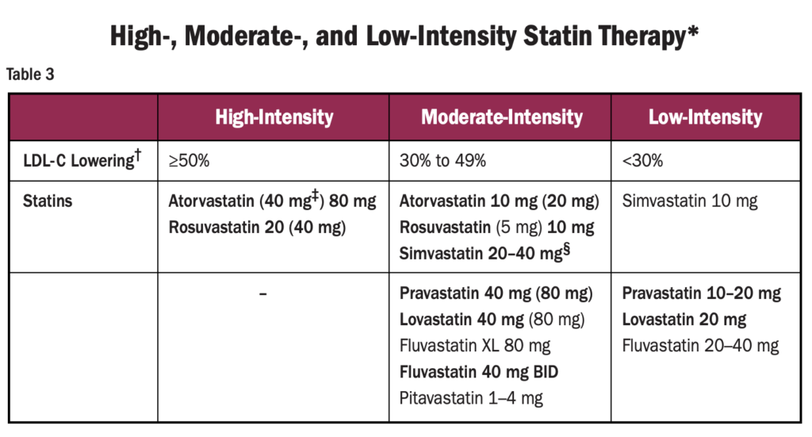
High: Atorvastatin 40–80 mg, Rosuvastatin 20–40 mg
Moderate: Atorvastatin 10–20 mg, Rosuvastatin 5–10 mg

Slide 53
If LDL-C target not met:
  Add ezetimibe.
  If still not achieved, consider PCSK9 inhibitors or newer agents especially in very high risk.

Slide 54
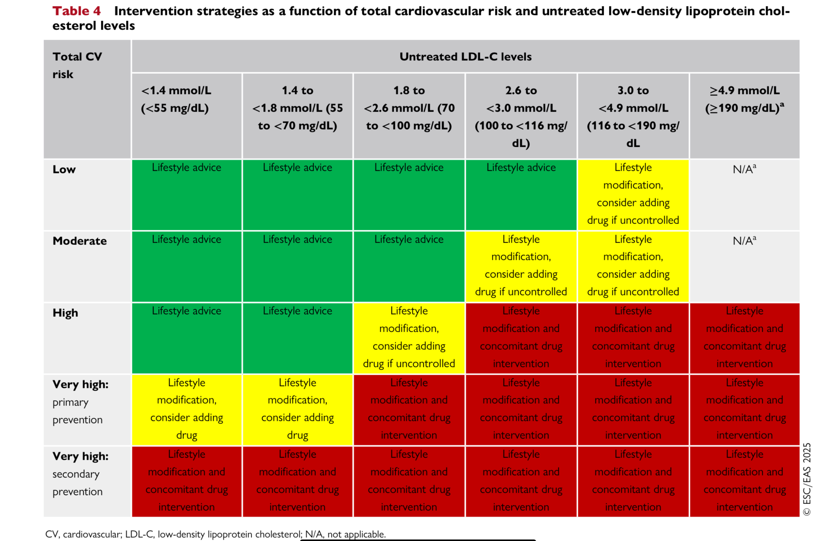

Slide 55
Special situations:
  Severe hypertriglyceridemia (e.g. TG >500 mg/dL or > 1000) → focus on preventing pancreatitis; may require fibrates, omega-3s
  Familial hypercholesterolemia: earlier, more aggressive therapy

Slide 56
CKD: Statins effective, dose adjustments (Atorvastatin is the drug of choice with severe renal impairment – no dose adjustment needed )
Diabetes: essential for CV protection
Elderly: assess risk-benefit
Pregnancy: contraindicated

Slide 57
Follow Up & Monitoring
Check lipids 4-12 weeks after starting or changing therapy. Adjust as needed
Monitor for side effects (liver enzymes, muscle symptoms etc.) and drug interactions.
Long-term maintenance: ensure adherence, lifestyle, review overall cardiovascular risk, update therapy if new evidence or events.

Slide 58
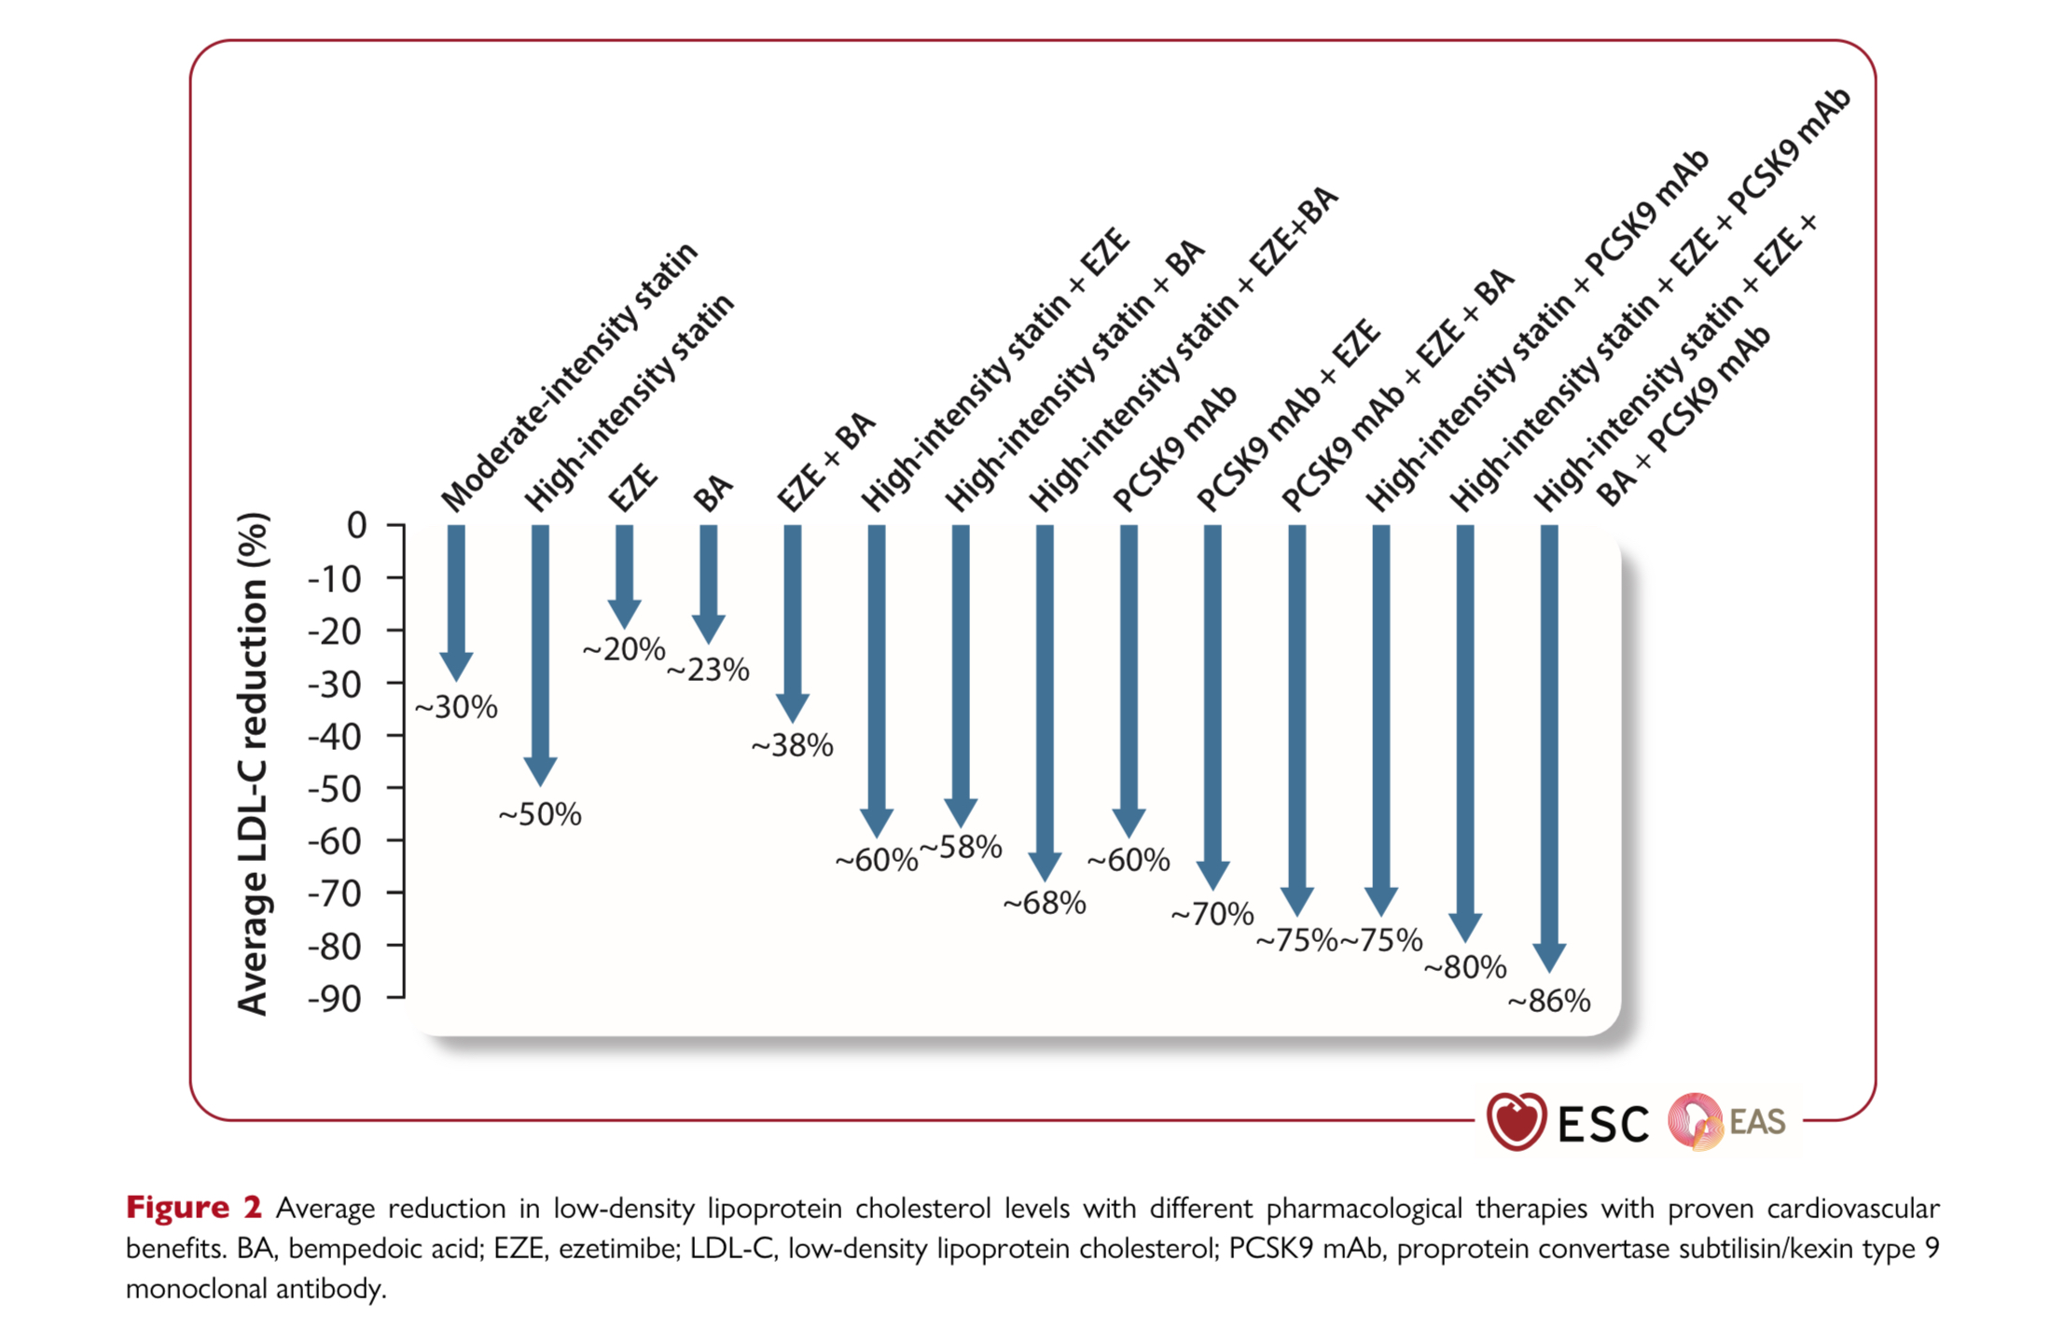

Slide 59
Summary
Statins = cornerstone of ASCVD prevention
High-intensity in established ASCVD
LDL-C targets
Combination therapy for residual risk

Slide 60
MCQ 1
A 52-year-old man with hypertension and smoking history has LDL-C 135 mg/dL. His 10-year ASCVD risk by SCORE2 is 12%. What is the most appropriate next step?
A. Lifestyle modification only
B. High-intensity statin
C. Moderate-intensity statin
D. Ezetimibe monotherapy

Slide 61
✅ Answer: B. HIGH-intensity statin
(High risk)

Slide 62
MCQ 2
In very high-risk ASCVD patients (e.g., recurrent MI + diabetes), what is the recommended LDL-C target according to recent ESC guidance?
A. <100 mg/dL
B. <70 mg/dL
C. <55 mg/dL
D. <40 mg/dL

Slide 63
✅ Answer: C. <55 mg/dL

Slide 64
MCQ3
Which statin is least dependent on CYP450 metabolism, making it safer in polypharmacy?
A. Simvastatin
B. Rosuvastatin
C. Atorvastatin
D. Lovastatin

Slide 65
✅ Answer: B. Rosuvastatin

Slide 66
MCQ4
Besides LDL-lowering, statins exert pleiotropic effects, which include:
A. Increased insulin resistance
B. Pro-inflammatory activity
C. Improved endothelial function and plaque stabilization
D. Increased platelet aggregation

Slide 67
✅ Answer: C. Improved endothelial function and plaque stabilization

Slide 68
THANK YOU

