Slide 1
TICAGRELOR TRIALS
Dr. Aiswarya Ravikrishnan

Slide 2
Ticagrelor
Ticagrelor is a non-thienopyridine from the cyclopentyltriazolopyrimidine (CPTP) class of P2Y12 inhibitors.
FDA approved in 2011.
Direct-acting drug with rapid onset (~2 hours); does not require metabolic activation.
30–40% of its antiplatelet effect is mediated by an active metabolite (AR-C124910XX) via CYP3A metabolism.
Inhibits P2Y12 reversibly via allosteric modulation.

Slide 3
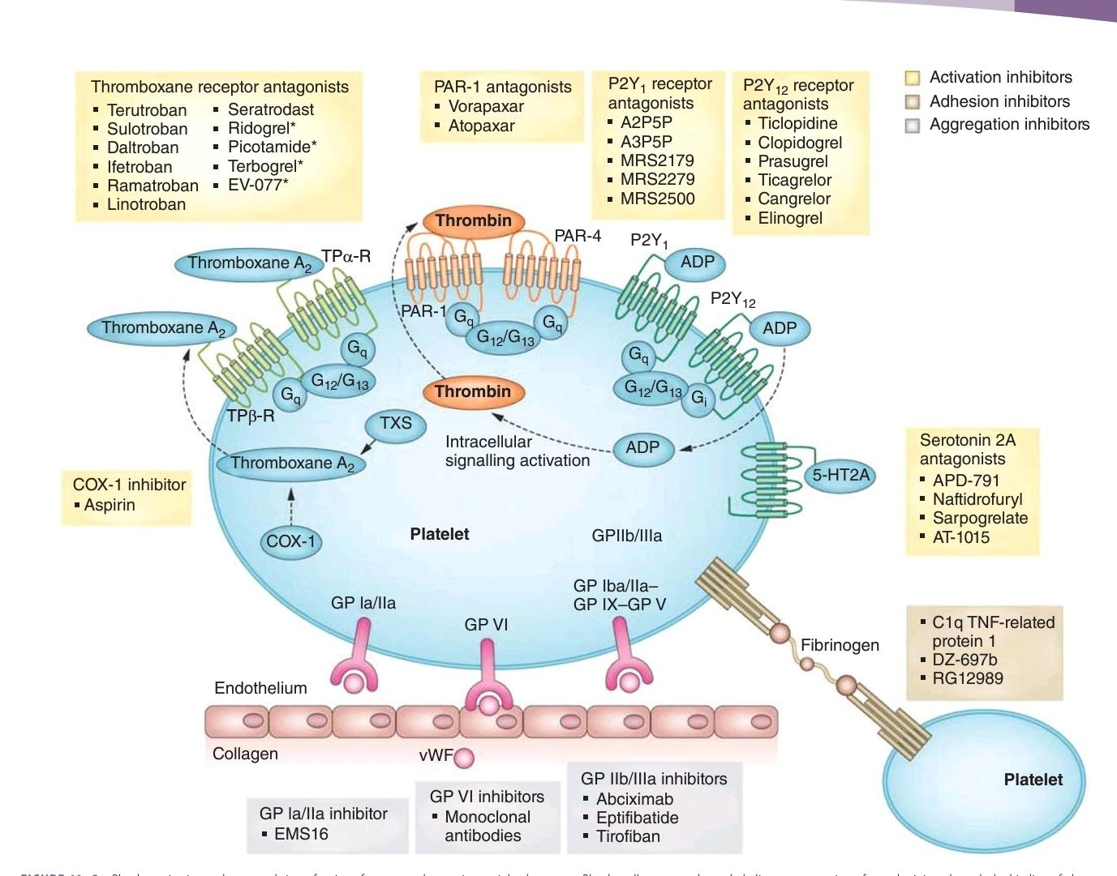

Slide 4
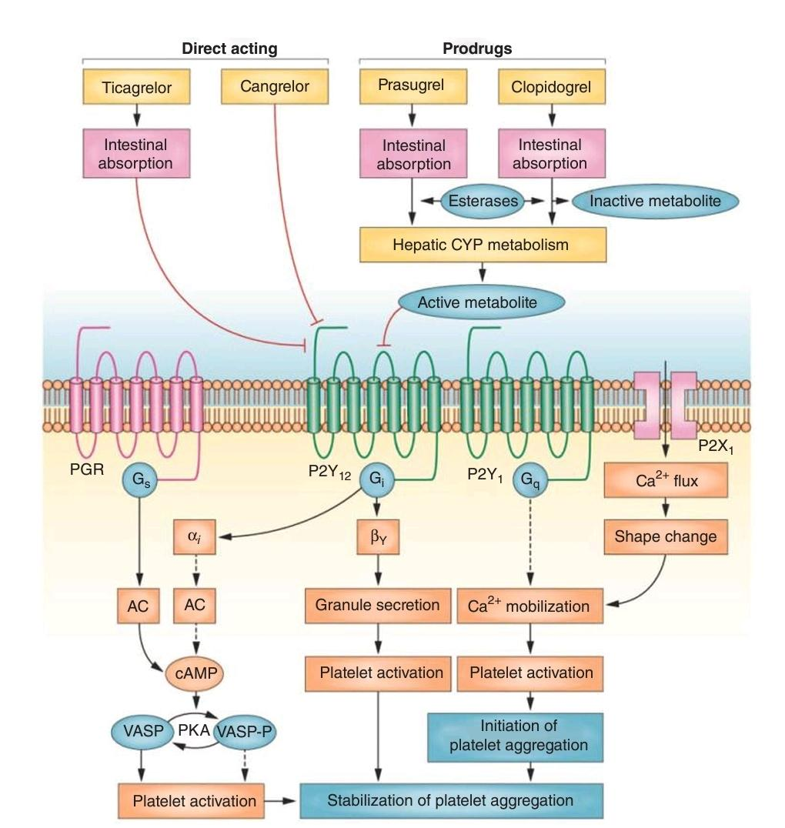

Slide 5
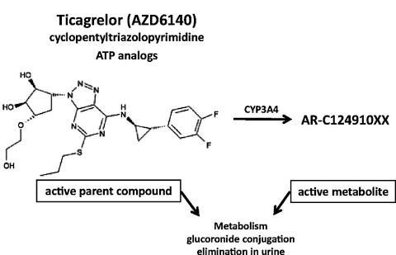

Slide 6
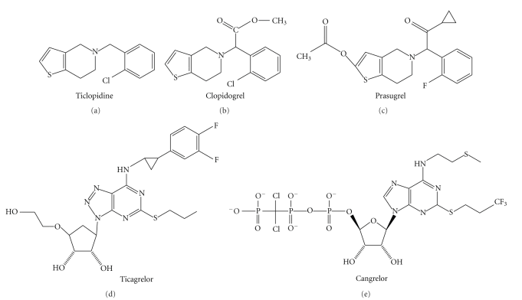

Slide 7
P2Y Receptors on Platelets:
Platelets express P2Y1 (Gq) and P2Y12 (Gi) receptors
ADP binding leads to:
P2Y1 activation: ↑ intracellular Ca²⁺ → initiates shape change and aggregation
P2Y12 activation: ↓ cAMP via adenylyl cyclase inhibition → sustains aggregation

Slide 8
Antiplatelet Effect:
All P2Y12 inhibitors prevent platelet activation by:
Inhibiting P2Y12 signaling
Increasing intraplatelet cAMP
Enhancing vasodilator-stimulated phosphoprotein (VASP) phosphorylation (VASP-P) → inhibits GP IIb/IIIa–mediated aggregation

Slide 9
Pharmacokinetics:
Rapid absorption
Half-life: 7–12 hours
Requires twice-daily dosing

Slide 10
Compared to clopidogrel, ticagrelor:
Provides stronger platelet inhibition
Achieves faster maximal platelet inhibition
Shows more consistent effects
Has faster offset due to reversible binding

Slide 11
Ticagrelor is rapidly taken up by red blood cells and metabolized.
It significantly inhibits cellular uptake of adenosine by blocking ENT-1 (equilibrative nucleoside transporter-1).
This leads to increased plasma adenosine levels.

Slide 12
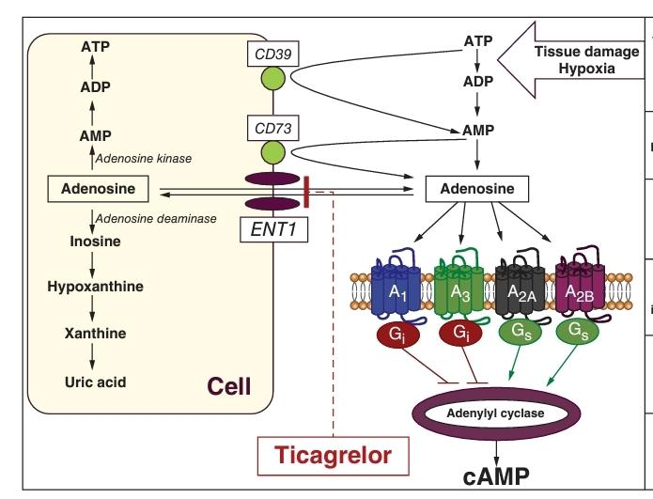

Slide 13
Adenosine effects:
Inhibits platelet aggregation via A2A G-coupled receptors.
Causes arterial vasodilation.
Reduces inflammatory response.
Has negative chronotropic and dromotropic effects.
Stimulates pulmonary vagal C fibers, contributing to dyspnea.
Plays a role in kidney glomerular filtration regulation.

Slide 14
Ticagrelor does not act directly on adenosine receptors, but enhances adenosine's effects.
These off-target effects may contribute to:
Reduced cardiovascular mortality.
Non-bleeding side effects such as:
Dyspnea.
Ventricular pauses.
Increased creatinine and uric acid levels (vs. clopidogrel).

Slide 15
Approved Use:
For treatment and prevention of secondary atherothrombotic events in ACS patients (both invasive and noninvasive strategies).
Can be started before coronary anatomy is known and in patients pretreated with clopidogrel.
Dosage:
Loading dose: 180 mg orally once.
Maintenance dose: 90 mg orally twice daily.

Slide 16
Not indicated for stable coronary artery disease (CAD).
Contraindications:
High risk of bleeding.
History of hemorrhagic stroke or intracranial bleeding.
Severe hepatic dysfunction.
Hypersensitivity to ticagrelor.
Sick sinus syndrome or high-degree AV block without a pacemaker.

Slide 17
Special Populations:
No dose adjustment needed for elderly or low-body-weight patients.
Pre-surgery:
A 5-day washout is recommended before surgery due to high platelet inhibition levels.

Slide 18
Drug Interactions:
Metabolized by CYP3A4/5 enzymes.
Avoid strong CYP3A inhibitors (e.g., ketoconazole, ritonavir) and inducers (e.g., rifampin, carbamazepine).
Avoid simvastatin or lovastatin doses > 40 mg.
Monitor digoxin levels when initiating or adjusting ticagrelor.

Slide 19
CYP2C19 polymorphisms and proton pump inhibitors do not affect ticagrelor efficacy.
Avoid high-dose aspirin; keep aspirin dose < 100 mg daily when used with ticagrelor.

Slide 20
Study of Platelet Inhibition and Patient Outcomes (PLATO)

Slide 21
The evidence for use of ticagrelor based on the PLATO trial:
Study Design:
PLATO trial (n = 18,624) compared ticagrelor + aspirin vs clopidogrel + aspirin in ACS patients.
Included patients with:
STEMI intended for primary PCI (38%).
UA/NSTEMI intended for invasive or medical management (62%).

Slide 22
Treatment Protocol:
Ticagrelor: 180 mg loading, then 90 mg twice daily.
Clopidogrel: 300 or 600 mg loading, then 75 mg daily.
Primary Outcome at 12 Months:
Composite of CV death, nonfatal MI, or stroke:
Ticagrelor: 9.8%.
Clopidogrel: 11.7%.
Relative risk reduction: 16% (P < .001).

Slide 23
Key Benefits of Ticagrelor:
22% lower all-cause mortality compared to clopidogrel (P < .001).
Benefits independent of:
Treatment approach (invasive or noninvasive).
Clinical presentation (STEMI or NSTE-ACS).
Revascularization strategy (PCI, CABG, or no revascularization).
Consistent benefit across subgroups:
STEMI, diabetes, and chronic kidney disease.

Slide 24
Onset of Benefit:
Effect apparent within 30 days, persisted up to 12 months.
Additional Findings:
Reduced recurrent ischemic events.
25% reduction in definite/probable stent thrombosis

Slide 25
Bleeding Risk:
No significant difference in major bleeding rates (study-defined).
Higher non-CABG-related major bleeding with ticagrelor.
Including more fatal intracranial bleeding.
No specific subgroups (e.g., elderly, prior TIA/stroke) had increased bleeding risk.

Slide 26
Adverse effects of ticagrelor based on the PLATO trial:
Increased Non–CABG-Related Bleeding with Ticagrelor:
Major or minor bleeding: 7.7% (ticagrelor) vs 6.2% (clopidogrel)
Major bleeding: 4.5% vs 3.8% (P = .03)
Intracranial Bleeding (ICH):
Overall ICH: 0.3% (ticagrelor) vs 0.2% (clopidogrel) (P = .06)
Fatal ICH: 0.1% vs 0.01% (P = .02)

Slide 27
No Significant Difference in:
CABG-related major bleeding: 7.4% (ticagrelor) vs 7.9% (clopidogrel)
Combined non–CABG + CABG-related major bleeding: 11.6% vs 11.2%
Life-threatening or fatal bleeding: 5.8% vs 5.8%
Overall ICH (restated): similar despite small numerical increase

Slide 28
Conclusion:
Ticagrelor is associated with more non–CABG-related and intracranial bleeding, particularly fatal ICH.
CABG-related and life-threatening bleeding risks are comparable to clopidogrel.

Slide 29
The geographic interaction and aspirin dose findings from the PLATO trial:
Predefined Subgroup Analysis:
Showed a borderline significant interaction by geographic region (P = .05).
Driven by a trend toward better efficacy of clopidogrel over ticagrelor in North America.
Key Factor Identified:
Higher use of high-dose aspirin (> 300 mg) in North American centers.

Slide 30
Ticagrelor's Efficacy:
Greatest benefit observed in patients using low-dose aspirin (< 100 mg).
Clinical Implication:
When combining ticagrelor with aspirin, only low-dose aspirin (< 100 mg daily) should be used.

Slide 31
PLATO Trial:
Dyspnea:
13.8% (ticagrelor) vs 7.8% (clopidogrel)
P < .001
Syncope:
1.1% vs 0.8%
P = .08 (not statistically significant)
Ventricular pauses ≥ 3 seconds (first week):
5.8% vs 3.6%
P = .01

Slide 32
Laboratory Abnormalities (at 1 month and 1 year):
Increased serum uric acid
Increased serum creatinine
P < .001 for both
Study Drug Discontinuation due to AEs:
7.4% (ticagrelor) vs 6.0% (clopidogrel)
P < .001
Geographic Subgroup Observation:
Borderline significant interaction by region (P = .05)
Reduced efficacy of ticagrelor vs clopidogrel in North America (possibly due to higher aspirin doses)

Slide 33
Dyspnea in Clinical Trials
Usually mild to moderate in intensity
Often resolved with continued treatment
Discontinuation due to dyspnea:
PLATO: 0.9% (ticagrelor-treated patients)
PEGASUS:
60 mg: 4.5%
90 mg: 6.5%

Slide 34
PLATO Substudy (Pulmonary Function Testing):
199 subjects underwent testing (with and without dyspnea)
No adverse effects of ticagrelor on pulmonary function after:
1 month
≥ 6 months of treatment

Slide 35
Prevention of Cardiovascular Events in Patients with Prior Heart Attack Using Ticagrelor Compared to Placebo on a Background of Aspirin–Thrombolysis In Myocardial Infarction 54

Slide 36
PEGASUS-TIMI 54 trial:
Study Objective:
To assess the efficacy and safety of prolonged ticagrelor use in post-MI patients for secondary prevention.
Patient Population:
Age > 50 years, history of MI 1–3 years prior.
Plus ≥1 additional risk factor:
Age ≥ 65 years
Diabetes mellitus (requiring meds)
Second spontaneous MI
Multivessel CAD
Chronic renal dysfunction

Slide 37
Intervention:
Ticagrelor 90 mg BID, 60 mg BID, or placebo, all with aspirin.
Primary Efficacy Endpoint (CV death, MI, or stroke) over 3 years:
90 mg: 7.85%
60 mg: 7.77%
Placebo: 9.04%
Significant risk reduction:
P = .004 (90 mg vs placebo)
P = .008 (60 mg vs placebo)

Slide 38
Bleeding Risk (Major bleeding):
90 mg: 2.60%
60 mg: 2.30%
Placebo: 1.06%
P < .001 for both ticagrelor doses vs placebo
No increase in fatal bleeding or intracranial hemorrhage (ICH)

Slide 39
Side Effects:
Dose-dependent dyspnea noted
Contributed to higher discontinuation rates
Clinical Implication:
Ticagrelor 60 mg BID is preferred for long-term secondary prevention in post-MI patients (>1 year)
Balances ischemic benefit with lower risk of major bleeding compared to 90 mg

Slide 40
The adverse effects from the PEGASUS trial:
Increased Bleeding with Ticagrelor + Aspirin vs Aspirin Alone:
TIMI major bleeding: 1.7% vs 0.8%
TIMI major + minor bleeding: 2.4% vs 1.0%
Both differences were statistically significant

Slide 41
No Difference in Severe Outcomes:
Fatal bleeding: 0.2% vs 0.2% (no difference)
Intracranial hemorrhage (ICH): 0.4% vs 0.3% (no significant difference)
Conclusion:
Ticagrelor increases the risk of non-fatal bleeding, but does not increase fatal bleeding or ICH compared to placebo.

Slide 42
Administration of Ticagrelor in the Cath Lab or in the Ambulance for New ST elevation myocardial infarction to open the Coronary artery

Slide 43
The ATLANTIC trial:
Study Objective:
To evaluate the effect of prehospital vs in-hospital ticagrelor administration in STEMI patients.
Patient Population:
1,862 patients undergoing emergency angiography for STEMI.

Slide 44
Intervention:
All received aspirin + ticagrelor 180 mg loading dose.
Randomized to:
Prehospital administration (in ambulance)
In-hospital administration (in cath lab)
Median time difference in dosing: only 31 minutes.

Slide 45
Primary Endpoints (both not significantly improved with prehospital administration):
Proportion of patients without ≥70% ST-segment resolution before PCI.
Proportion of patients without TIMI 3 flow in infarct-related artery at angiography.
Safety Findings:
Low and similar rates of major bleeding in both groups.

Slide 46
Exploratory Finding:
Significant reduction in definite acute stent thrombosis (≤ 24 hrs):
0% in prehospital group vs 0.8% in in-hospital group.
Due to low event rate, this result is considered exploratory.
Conclusion:
Prehospital ticagrelor is safe but did not improve primary surrogate outcomes.
Potential benefit in reducing acute stent thrombosis requires further investigation.

Slide 47
GLOBAL LEADERS TRIAL
Objective: Assess if 1-month DAPT followed by ticagrelor monotherapy is superior to standard 12-month DAPT
Design: Open-label, randomized, superiority trial
Population: 15,968 patients undergoing PCI (ACS or stable CAD)

Slide 48
Intervention:
Experimental: 1-month aspirin + ticagrelor, then ticagrelor monotherapy (23 months)
Control: Standard DAPT (aspirin + ticagrelor for ACS; aspirin + clopidogrel for stable CAD for 12 months), then aspirin alone

Slide 49
Key Results
Primary endpoint (All-cause death or Q-wave MI at 2 years):
No significant difference: 3.81% (experimental) vs 4.37% (standard); P = 0.073
Bleeding (BARC 3 or 5):
Numerically lower with ticagrelor monotherapy but not statistically significant
Subgroup findings: Possible benefits in ACS patients, but not conclusive

Slide 50
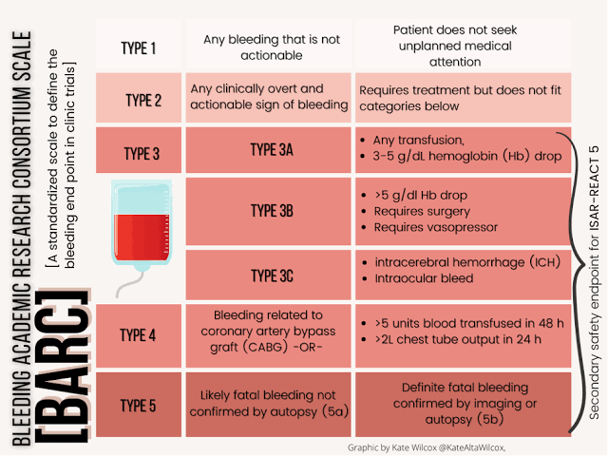

Slide 51
Clinical Implications
Did not meet primary endpoint, so not practice-changing alone
Showed safety of early aspirin withdrawal with continued ticagrelor
Supports the evolving strategy of tailored antiplatelet therapy post-PCI
Helped inform design of subsequent trials (e.g., TWILIGHT)

Slide 52
Ticagrelor with Aspirin or Alone in High-Risk Patients after Coronary Intervention

Slide 53
TWILIGHT Trial:
Assessed safety and efficacy of ticagrelor monotherapy after PCI
Population: High-risk patients undergoing PCI, initially on DAPT (aspirin + ticagrelor) for 3 months
Randomized (after 3 months):
Ticagrelor + placebo (monotherapy)
Ticagrelor + aspirin (continued DAPT)
Primary endpoint: BARC 2, 3, or 5 bleeding at 12 months
Key exclusion: Recent stent thrombosis or MI after index PCI

Slide 54
Key Findings
Bleeding significantly reduced in ticagrelor monotherapy:
4.0% vs 7.1% (HR 0.56; P < .001)
No increase in ischemic events:
Comparable rates of death, MI, or stroke between both groups
Benefit consistent across age, sex, diabetes, and renal function subgroups

Slide 55
Clinical Implications
Supports aspirin withdrawal after 3 months in high-risk PCI patients
Ticagrelor monotherapy:
Maintains ischemic protection
Reduces bleeding risk
May be especially valuable for patients with high bleeding risk
Helped shift guidelines toward shortened DAPT strategies

Slide 56
The Effect of Ticagrelor on Health Outcomes in diabEtes Mellitus Patients Intervention Study

Slide 57
THEMIS TRIAL
Objective: Evaluate benefit of ticagrelor + aspirin vs aspirin alone in diabetic patients with stable CAD and no prior MI or stroke
Population: 19,220 patients with type 2 diabetes and documented stable CAD
Design: Randomized, double-blind, placebo-controlled
Groups:
Ticagrelor (60 mg BID) + aspirin
Placebo + aspirin

Slide 58
Key Findings
Primary endpoint (CV death, MI, stroke):
Reduced with ticagrelor: 7.7% vs 8.5% (HR 0.90, P = .04)
Major bleeding increased:
TIMI major: 2.2% vs 1.0% (HR 2.32, P < .001)
No net clinical benefit in the overall population due to bleeding risk

Slide 59
Clinical Implications
No routine use of ticagrelor in all stable diabetic CAD patients
THEMIS-PCI substudy: Greater benefit in patients with prior PCI
Ticagrelor may be considered in selected high-risk diabetic patients with prior PCI and low bleeding risk
Reinforces importance of individualized risk–benefit assessment

Slide 60
ULTIMATE DAPT TRIAL

Slide 61
Objective: Evaluate if switching to ticagrelor monotherapy after 1 month of dual antiplatelet therapy (DAPT) is safer than continuing DAPT for 12 months in patients with acute coronary syndrome (ACS) post-percutaneous coronary intervention (PCI)
Design: Randomized, double-blind, placebo-controlled trial
Participants: 3,400 ACS patients from 58 centers across China, Pakistan, Italy, and the UK

Slide 62
Intervention: After 1 month of DAPT (aspirin + ticagrelor), patients were randomized to:
Continue DAPT (aspirin + ticagrelor)
Switch to ticagrelor monotherapy (ticagrelor + placebo)
Follow-up Duration: 12 months

Slide 63
Key Findings
Clinically Relevant Bleeding (BARC 2, 3, or 5):
Ticagrelor monotherapy: 2.1%
Continued DAPT: 4.6%
p < 0.0001
Major Adverse Cardiovascular and Cerebrovascular Events (MACCE):
Ticagrelor monotherapy: 3.6%
Continued DAPT: 3.7%
p for noninferiority < 0.0001

Slide 64
Net Adverse Clinical Events (NACE):
Ticagrelor monotherapy: 5.7%
Continued DAPT: 8.2%
P= 0.007

Slide 65
Clinical Implications
Ticagrelor monotherapy after 1 month of DAPT significantly reduces bleeding risk without increasing ischemic events in ACS patients post-PCI
Supports shortening DAPT duration to 1 month in selected patients
Findings may influence future guidelines to recommend early transition to monotherapy in appropriate patients

Slide 66
MCQs

Slide 67
Choose the False statement about Ticagrelor:
non-thienopyridine from the cyclopentyltriazolopyrimidine (CPTP) class of P2Y12 inhibitors.
FDA approved in 2011.
Indirect-acting drug with slow onset, requires metabolic activation.
30–40% of its antiplatelet effect is mediated by an active metabolite via CYP3A metabolism.
Inhibits P2Y12 reversibly via allosteric modulation.

Slide 68
Choose the False statement about Ticagrelor:
non-thienopyridine from the cyclopentyltriazolopyrimidine (CPTP) class of P2Y12 inhibitors.
FDA approved in 2011.
Indirect-acting drug with slow onset, requires metabolic activation.
30–40% of its antiplatelet effect is mediated by an active metabolite via CYP3A metabolism.
Inhibits P2Y12 reversibly via allosteric modulation.

Slide 69
Not an effect of adenosine
Inhibits platelet aggregation via A2A G-coupled receptors.
Causes arterial vasodilation.
Stimulates pulmonary vagal C fibers, contributing to dyspnea.
Has positive chronotropic and dromotropic effects.
Plays a role in kidney glomerular filtration regulation.

Slide 70
Not an effect of adenosine
Inhibits platelet aggregation via A2A G-coupled receptors.
Causes arterial vasodilation.
Stimulates pulmonary vagal C fibers, contributing to dyspnea.
Has positive chronotropic and dromotropic effects.
Plays a role in kidney glomerular filtration regulation.

Slide 71
Not a Ticagrelor trial
PLATO
PEGASUS TIMI 54
ATLANTIC
TWILIGHT
FAME

Slide 72
Not a Ticagrelor trial
PLATO
PEGASUS TIMI 54
ATLANTIC
TWILIGHT
FAME

Slide 73
Not an outcome of PLATO trial
Ticagrelor is associated with more non–CABG-related
CABG-related and life-threatening bleeding risks are comparable to clopidogrel.
Increased efficacy of ticagrelor vs clopidogrel in North America
Increased serum uric acid levels

Slide 74
Not an outcome of PLATO trial
Ticagrelor is associated with more non–CABG-related
CABG-related and life-threatening bleeding risks are comparable to clopidogrel.
Increased efficacy of ticagrelor vs clopidogrel in North America
Increased serum uric acid levels

Slide 75
References
Hurst’s The Heart: 14th edition
https://www.acc.org/Latest-in-Cardiology/Clinical-Trials/2014/04/02/11/53/PLATO
https://www.acc.org/Latest-in-Cardiology/Clinical-Trials/2015/03/11/19/41/PEGASUS-TIMI-54
https://www.acc.org/Latest-in-Cardiology/Clinical-Trials/2015/03/11/19/41/PEGASUS-TIMI-54
https://www.acc.org/Latest-in-Cardiology/Clinical-Trials/2018/08/25/23/10/GLOBAL-LEADERS
https://www.acc.org/Latest-in-Cardiology/Clinical-Trials/2014/09/01/07/23/ATLANTIC
https://www.acc.org/Latest-in-Cardiology/Articles/2024/04/02/17/02/sun-945am-dapt-acc-2024

Slide 76
ECG Discussion

Slide 77
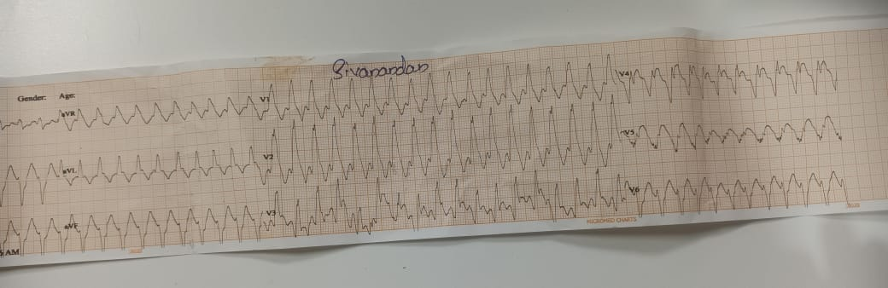
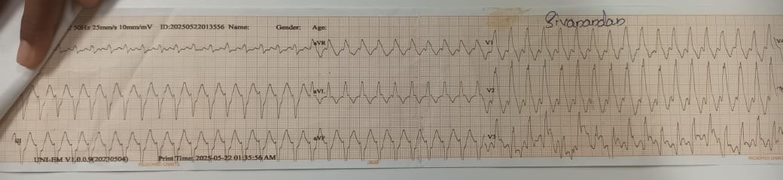

Slide 78
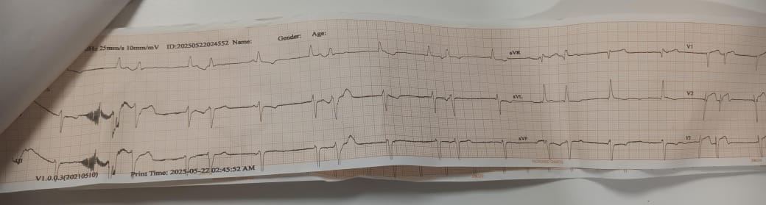
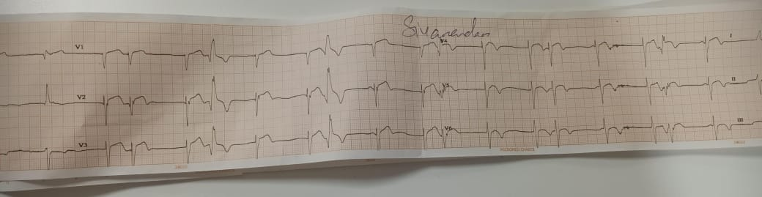

Slide 79
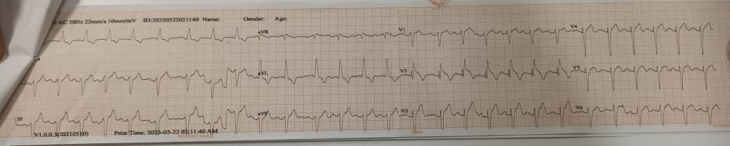

Slide 80
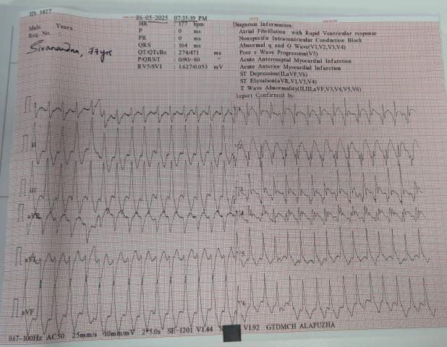

Slide 81
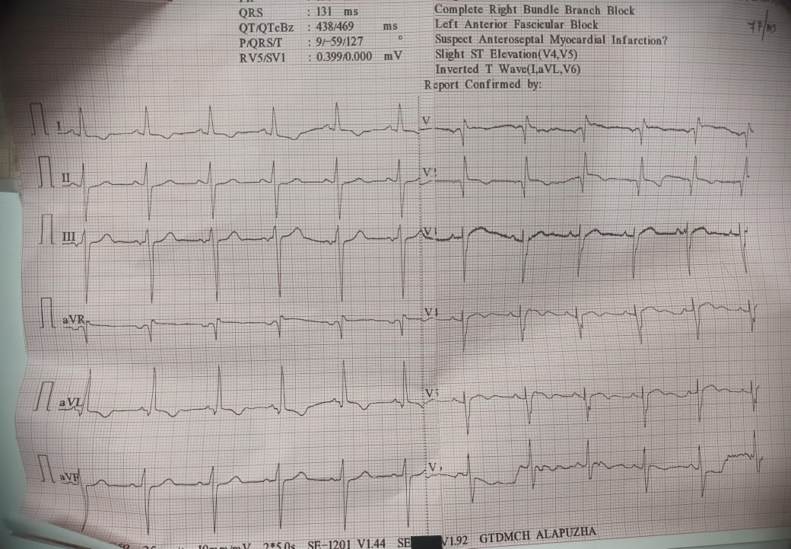

Slide 82


