Slide 1
Pericarditis
Dr sanjeev

Slide 2
Anatomy of the Pericardium
2 layers-
the visceral pericardium, a monolayer of mesothelial cells and collagen and elastin fibers adherent to the epicardial surface of the heart, and the fibrous parietal layer, which is normally about 2 mm thick and surrounds most of the heart.
The parietal pericardium is largely acellular and contains collagen and elastin fibers.
50 mLof serous fluid.
Posterior to the left atrium, the reflection occurs at the oblique sinus of the pericardium. The left atrium is largely extrapericardial.
The parietal pericardium has ligamentous attachments to the diaphragm, sternum, and other structures.

Slide 3
Functions of Pericardium
maintain the heart at a relatively constant position within the thorax,
it provides a barrier to infection.
The pericardium also secretes prostaglandins and related substances that may modulate neural traffic and coronary tone.
restraining effect on cardiac volume

Slide 4
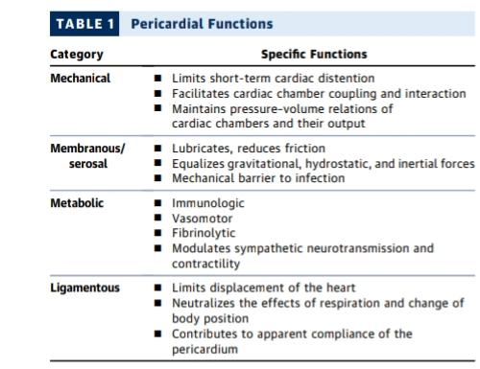

Slide 5
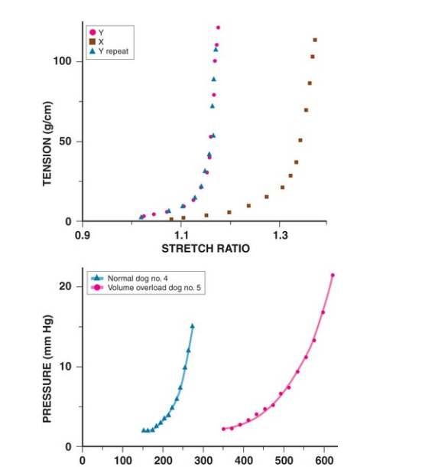
PRESSURE VOLUME RELATIONSHIP OF PERICARDIUM& STRETCH RATIO

Slide 6
The only noncardiovascular structures associated with pericardium are the phrenic nerves enveloped by the parital pericardium
The left atrium is largely extrapericardial.
The parietal pericardium has ligamentous attachments to the diaphragm, sternum, and other structures.
These attachments ensure that the heart occupies a fixed position within the thoracic cavity

Slide 7
Epidemiology and Etiologies
Pericarditis accounts for 0.1% of hospital admissions
5% of emergency department evaluations for chestpain.
commonly in men aged 16 to 65 years

Slide 8
Idiopathic and viral - high-income countries
whereas tuberculosis, often HIV associated, is the most common cause in low-income countries

Slide 9
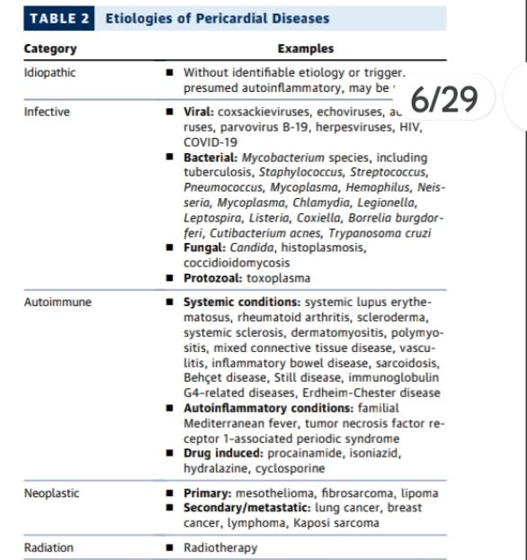

Slide 10
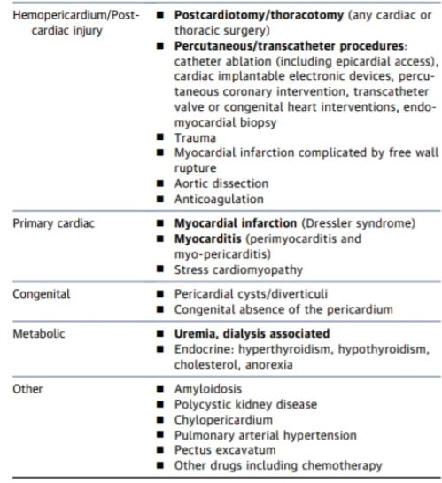

Slide 11
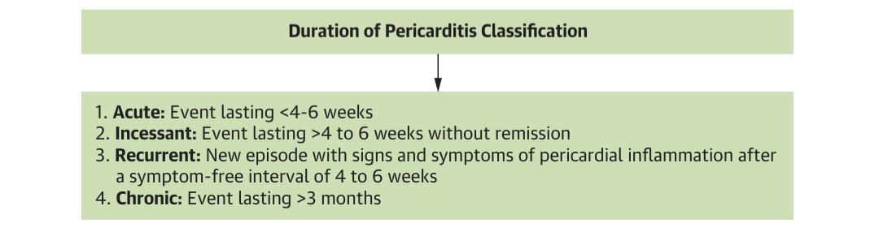

Slide 12
ACUTE PERICARDITIS
Acute pericarditis, defined as symptoms and/or signs resulting from pericardial inflamma-tion of no more than 1 to 2 weeks’ duration
idiopathic to denote acute pericarditis for which no specific cause
Most idiopathic cases are presumed to be viral in cause

Slide 13
Pathophysiology
Pericarditis is characterized by a severe inflammatory
response to injury of the mesothelial cells of the pericardium, triggered by
viral infections,
cardiac surgery or procedures,
immune derangements

Slide 14
activates the inflammasome
transcription and translation of proinflammatory genes
leading to the activation of caspase-1 and maturation of interleukin-1b
Dysregulated immunity is often implicated in recurrent and chronic cases,

Slide 15
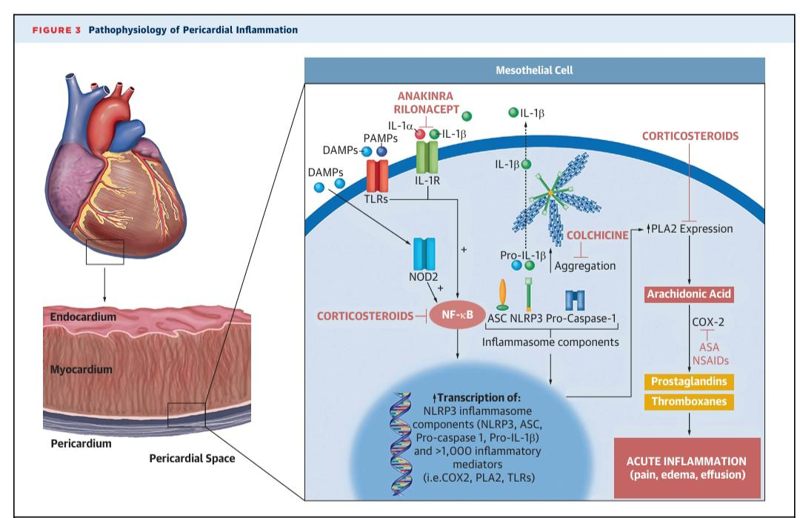

Slide 16
Pathophysiology
The pathophysiology of uncomplicated acute pericarditis is straight-forward; that is, the symptoms and signs result from inflammation of pericardiam
15% are associated with myocarditis.
Coexistent myocarditis is usually manifested by modest release of biomarkers such as troponin I
LV dysfunction is rare, and the long-term prognosis of pericarditis complicated by myocarditis appears to be good

Slide 17
History and Differential Diagnosis
Acute pericarditis is almost always manifested as chest pain
Radiation to the trapezius ridge
Associated symptoms can include dyspnea, cough, and occasionally hiccoughs
An antecedent history suggesting a viral illness is common
Pain- supine position
Relieved on leaning forward
Pleuritic chest pain

Slide 18
Physical Examination
low-grade fever and sinus tachycardia
friction rub caused by contact between the visceral and parietal pericardium
It consists of three components corresponding to ventricular systole, early diastolic filling, and atrial contraction and has been likened to the sound made when walking on crunchy snow
The rub is usually loudest at the lower left sternal border and best heard with the patient leaning forward

Slide 19
Laboratory Testing
The hemogram often reveals a modestly elevated white blood cell count with mild lymphocytosis
acute pericarditis have coexistent myocarditis based on elevations in injury biomarkers such as serum troponin I
Serum high-sensitivity C-reactive protein (hsCRP) is elevated in approximately three fourths of patients with acute pericarditis
Increased hsCRP is independently associated with recurrent symptoms.

Slide 20
hsCRP normalizes within 1 week and in almost all cases by 4 weeks after initial evaluation
chest radiography- normal or effusion

Slide 21
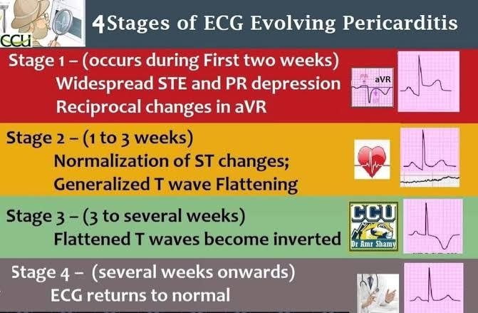

Slide 22
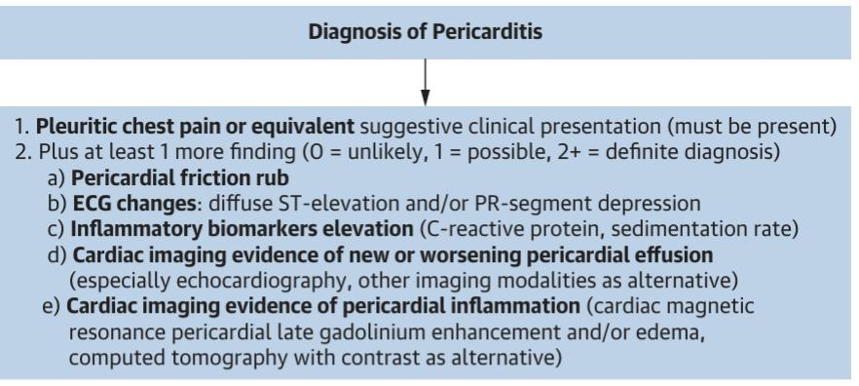

Slide 23
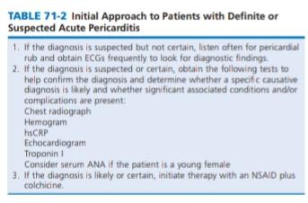

Slide 24
noninflammatory phenotype (low or near normal CRP,often associated with autoimmune conditions)-10% to 20%
inflammatory phenotype seenin 80% to 90% of patients.
These patients with an inflammatory phenotype and elevated CRP can present with
high fever, neutrophilic leukocytosis, and pericardial and/or pleural effusions

Slide 25
Risk factors for recurrence
Lack of response to NSAIDs,
early use of corticosteroids,
highCRP
severe pericardial LGE on CMR

Slide 26
Multimodality Imaging
Transthoracic echocardiography (TTE) remains the first-line imaging modality
presence of pericardial effusion (without or with tamponade)
pericardial thickening
features of constrictive physiology
myocardial involvement
inability of tissue characterization to identify and grade pericardial inflammation(adverse)

Slide 27
Cmr(Cardiac magnetic resonance)
CMR has become a valuable comprehensive second line imaging modality
when diagnostic uncertainties exist
acute complicated, incessant, recurrent, or chronic pericarditis
Increased pericardial signal on T2-short tau inversion recovery sequence indicating edema, pericardial thickening (>3mm)
pericardial late gadolinium enhancement-neovascularisation

Slide 28
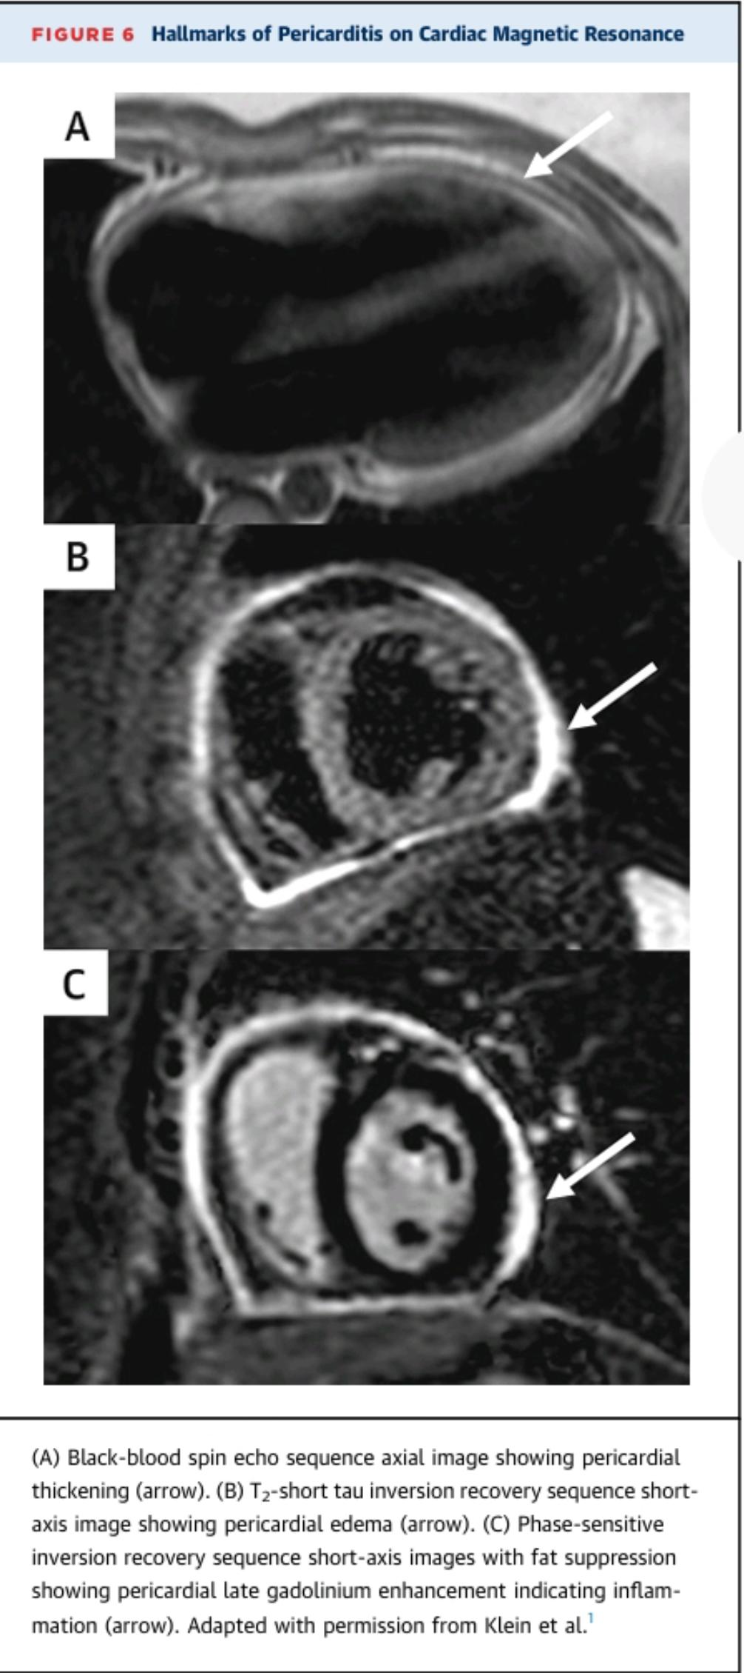

Slide 29
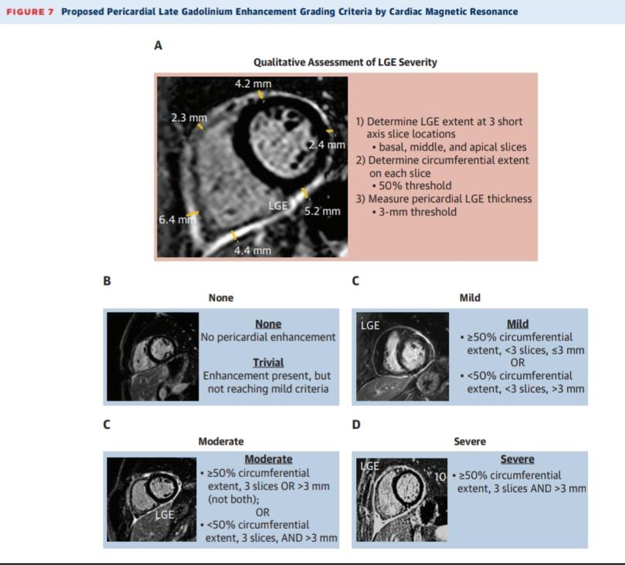

Slide 30
cardiac computed tomography
assessment of pericardial calcifications in constrictive pericarditis.
presence of pericardial effusion, thickening, and inflammation
delayed contrast sequence (although less accurate than CMR)
acute aortic syndromes, pulmonary embolism, and coronary artery disease(to diffrentiate)

Slide 31
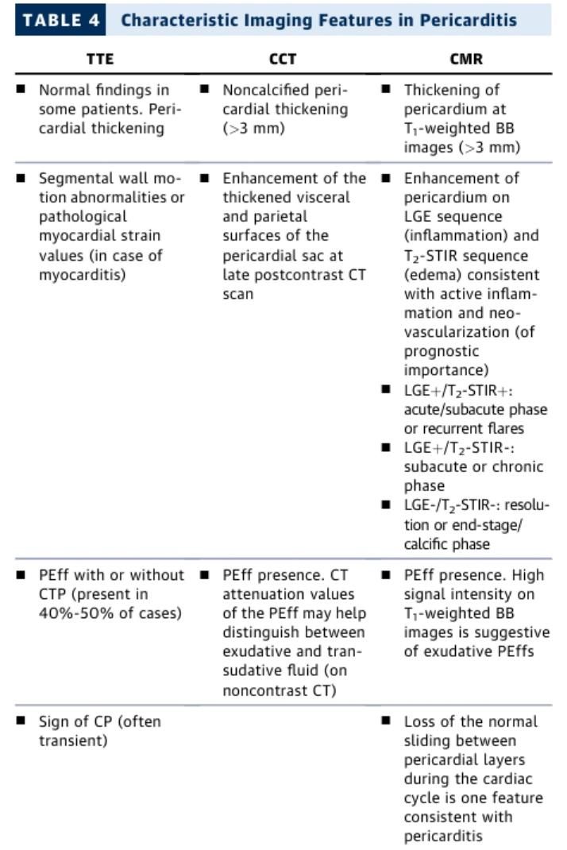

Slide 32
Management
dual anti-inflammatory therapy with colchicine (3 months following first flare,
6 months following first recurrence) and NSAIDs or
aspirin (starting at high dose and tapering after symptoms resolve and inflammatory markers normalize)
Exercise restriction for 1 month
Increased heart
rate can trigger pericardial inflammation by enhancing the frequency of friction of pericardial layers(<100)

Slide 33
autoimmune pericarditis, the focus on treating the underlying autoimmune condition
prophylaxis, such as colchicine, can be considered to prevent post–cardiac injury pericarditis
Nonresponders to the first-line dual therapy (experiencing recurrence or intolerance to treatment with first-line agents), corticosteroids were added to the treatment regimen

Slide 34
Anti–interleukin-1 (anti–IL-1)
patients with elevated CRP (>1 mg/dL or >10 mg/L) to achieving clinical remission, improve symptoms, reduce recurrences, and
normalize inflammatory markers while maintaining good safety profile.

Slide 35
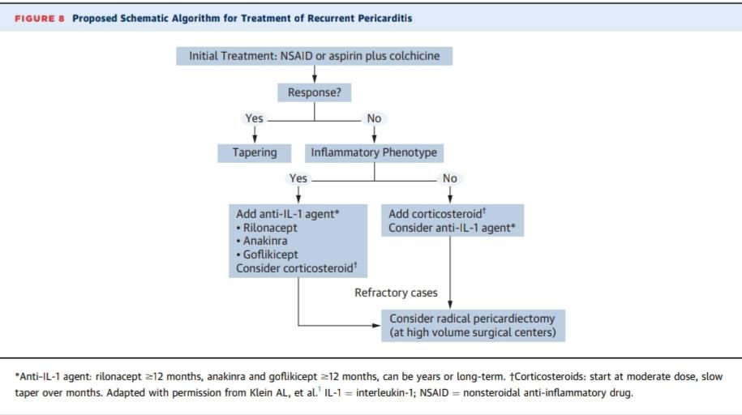

Slide 36
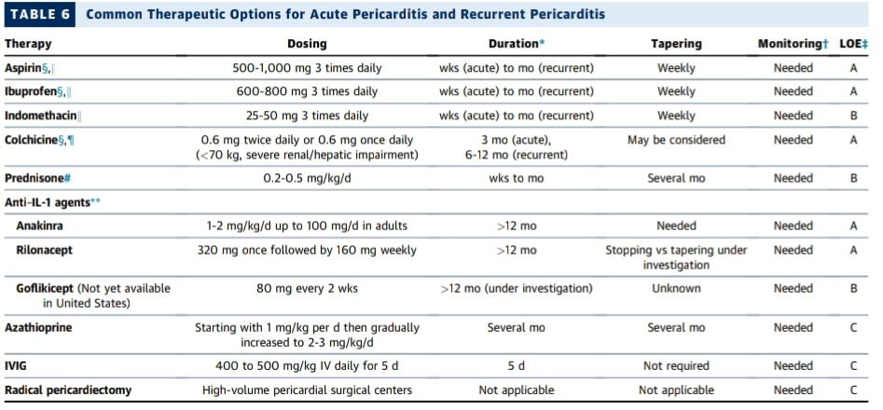

Slide 37
RHAPSODY(Rilonacept in Acute Pericarditis Study) trial
prolonged therapy beyond 18 months to achieve a betterand prolonged control of the disease
Azathioprine and intravenous immunoglobulins may also be considered for patients who fail corticosteroids and anti–IL-1 agents

Slide 38
Radical pericardiectomy
patients fail to respond to the pharmacotherapies
contraindications to conventional therapy, or desire pregnancy
corticosteroids and/or anti–IL-1 agents, may be continued until surgery to dampen inflammation
Continued for 3-6 months

Slide 39
Complications of Pericarditis
Pericardial Effusion
Cardiac Tamponade
Constrictive Pericarditis

Slide 40
Pericardial Effusion
Pericardial effusion is defined by the accumulation of >50 mL of fluid in the pericardial space
post viral infection
Malignancies
Tuberculosis

Slide 41
tte
TTE is the first-line imaging investigation
The size of a pericardial effusion is determined by measuring the greatest diameter perpendicular to the epicardium and parietal pericardium atnend-diastole or -systole adjacent to ventricles and atria, respectively,
Trivial (<1.0 cm and not visualized throughout cardiac cycle),
small (<1.0 cm),
moderate (1.0-1.9 cm),
large (2.0-2.5 cm),
very large (>2.5 cm)

Slide 42
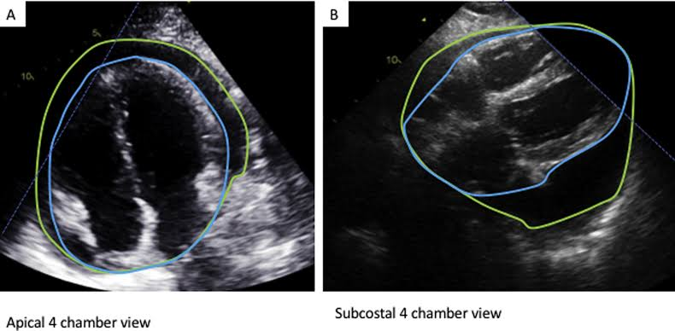

Slide 43
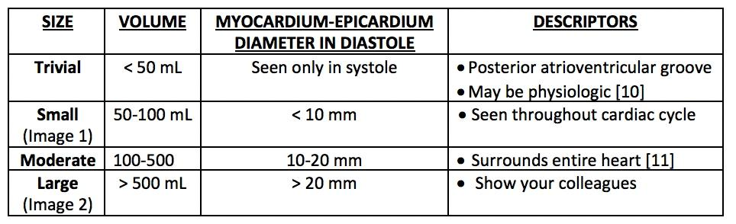

Slide 44
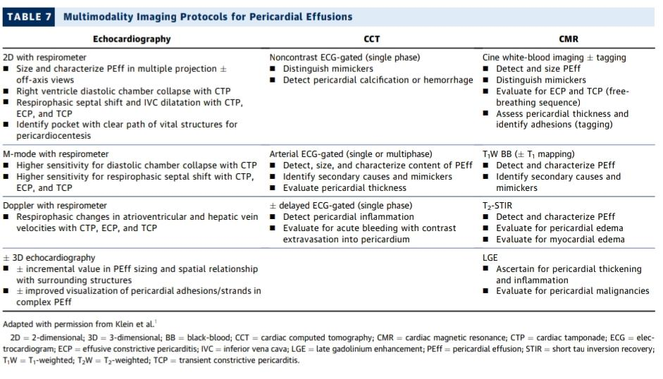

Slide 45
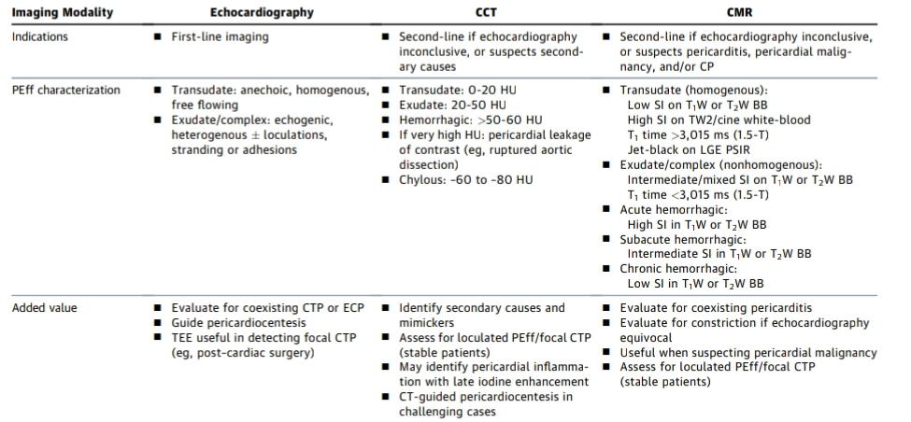

Slide 46
Cardiac Tamponade and Pericardiocentesis
When pericardial reserve volume is exhausted, additional pericardial fluid results n a marked increase in pericardial pressure with increased and equalized end-diastolic intracardiac pressures.
Cardiac output may be maintained initially by a compensatory sinus tachycardia
Pulsus paradoxus, and hypotension
Kussmauls sign

Slide 47
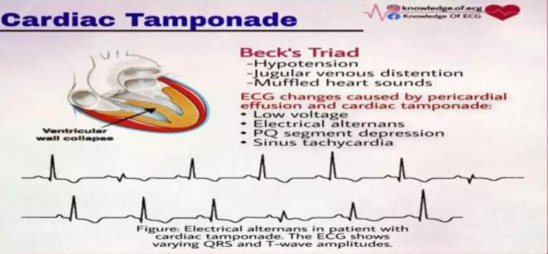

Slide 48
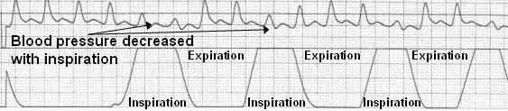

Slide 49
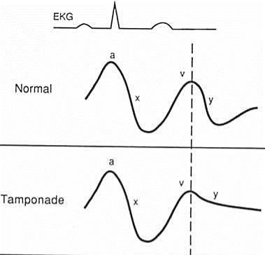
Jvp

Slide 50
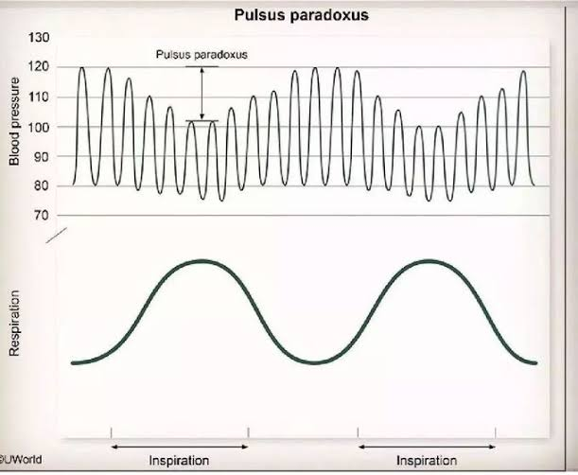

Slide 51
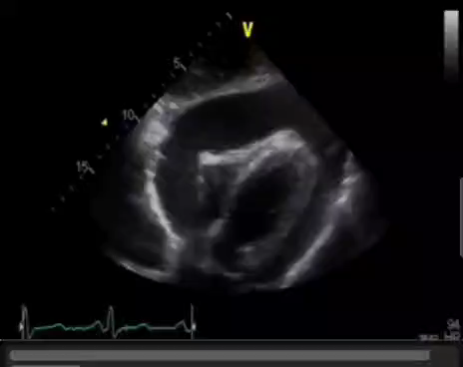

Slide 52
diastolic right ventricular collapse is the most specific finding
marked respiratory variation in ventricular inflow (trans-mitral >30% and trans-tricuspid >60%) are also features of cardiac tamponade

Slide 53
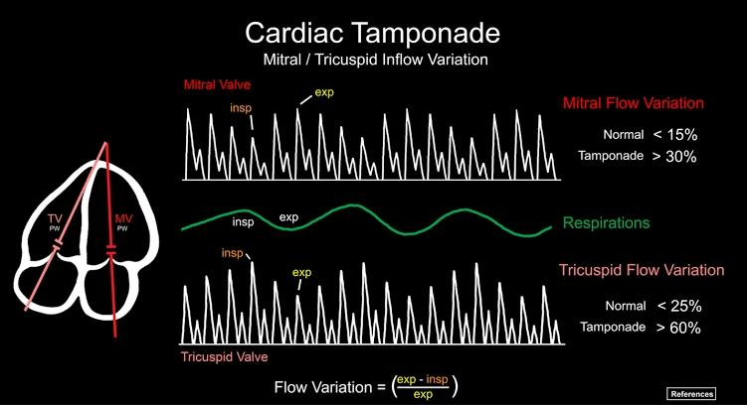

Slide 54
Pericardial effusions can be loculated or localized and result in regional tamponade( most commonly) encountered after cardiac surgery
Low-pressure tamponade typically occurs when blood volume decreases in the setting of a preexisting effusion
Aortic dissection
tamponade may occur without a paradoxical pulse because of aortic valve disruption and regurgitation.

Slide 55
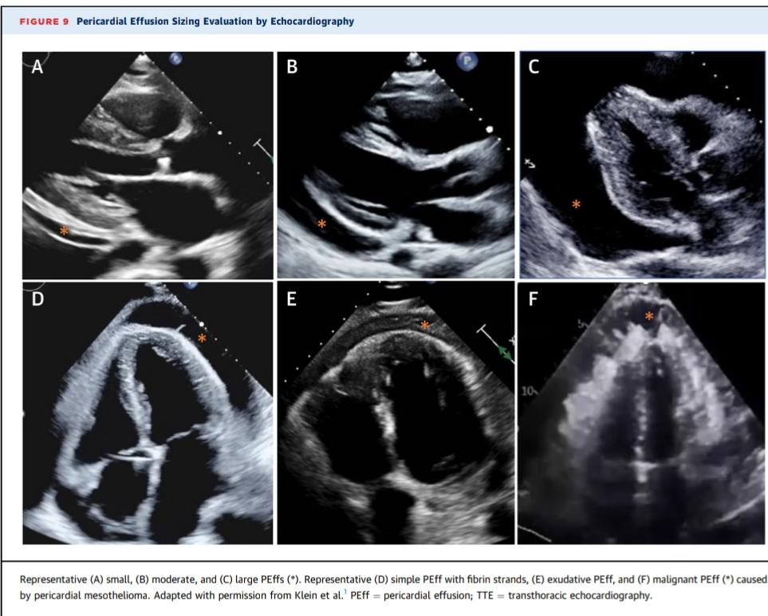

Slide 56
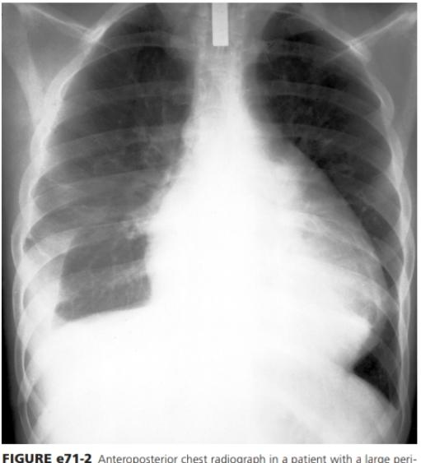
Cxray
larger effusions the
anteroposterior cardiac silhouette assumes a rounded, flask like
appearance

Slide 57
Managment
intravenous hydration with normal saline should be instituted
Positive inotropes can be used but are of limited efficacy

Slide 58
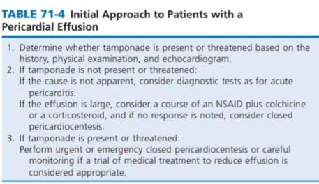

Slide 59
Pericardiocentesis
Pericardiocentesis is therapeutically performed in cases of impending or established cardiac tamponade
Anatomical approaches to pericardiocentesis include subxiphoid, apical, and parasternal
The most common approach to closed pericardiocentesis is subxiphoid

Slide 60
recommend leaving intrapericardial catheters in place for several days to allow continued drainage.
This minimizes recurrences
Closed pericardiocentesis

Slide 61
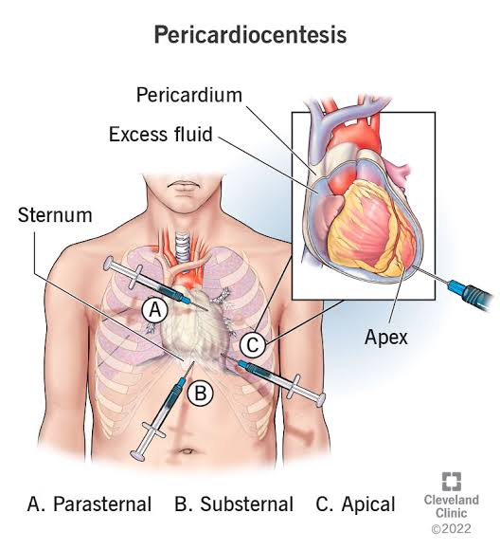

Slide 62
Open pericardiocentesis is preferred in bleeding from trauma and rupture of the LV free wall
Recurring effusions, especially those causing tamponade
Loculated effusions or effusions containing clots or fibrinous material are also of concern because the risk and difficulty associated with closed pericardiocentesis

Slide 63
Analysis of Pericardial Fluid
Lymphocytes are the predominant cell type.
white blood cell count and differential, hematocrit, and protein content
Chylous effusions can occur after traumatic or surgical injury to the thoracic duct or obstruction by a neoplastic process
detection of malignant cell
adenosine deaminase (ADA), interferon-gamma, and polymerase chain reaction (PCR) for TB

Slide 64
Diffrentials
Massive pneumothorax
Massive left sided pleural effussion

Slide 65
Mitral flow variation in cardiac tamponade??
A) 20
B) 30
C) 60
D) 10

Slide 66
Which among the following is not a component of becks triad
A) signs are low arterial blood pressure
B)distended neck veins,
C)muffled heart sounds.
D) distended ivc

Slide 67
Duation of Chronic pericarditis ?
A) 3 m
B) 3 weeks
C) 4 M
D) 6 M

Slide 68
Mechanism of action of colchicine?
A)caspase-1 inhibition
B) nlap-3 inhibition
C)inhibition of neutrophilic recruitment
D)all the above

Slide 69
thank you

