Slide 1
BULL’S EYE DIAGRAM
SANJANA K

Slide 2
INTRODUCTION
The bull’s eye diagram is a visual representation of left ventricular function.
Assess lv function, Wall motion and perfusion

Slide 3
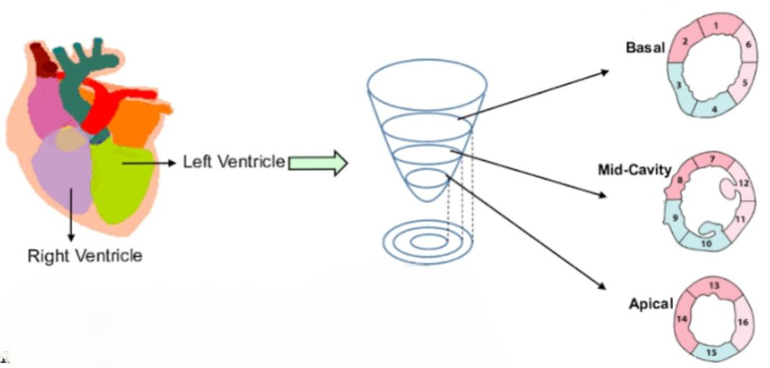
17- SEGMENT MODEL
The LV is divided into 17 segments .
It is further categorized into :
a) Basal
b) Mid
c) Apical

Slide 4
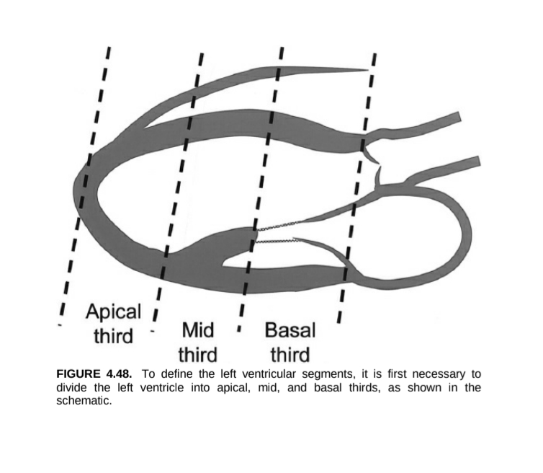
Basal- AV groove to tip of papillary muscle
Mid – Portion of LV with papillary muscle
Apical – Base of papillary muscle to apex.

Slide 5
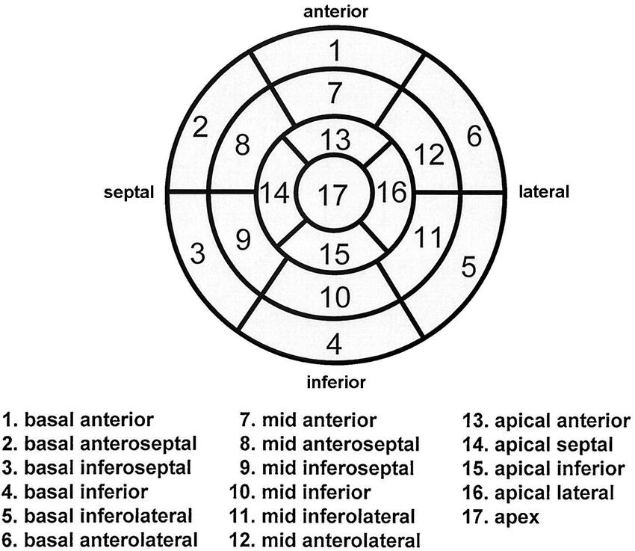

Slide 6
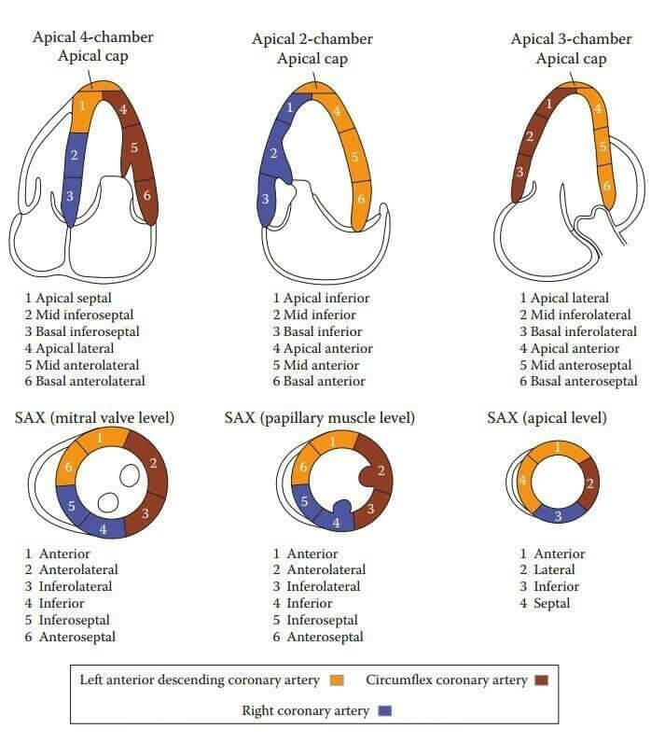

Slide 7
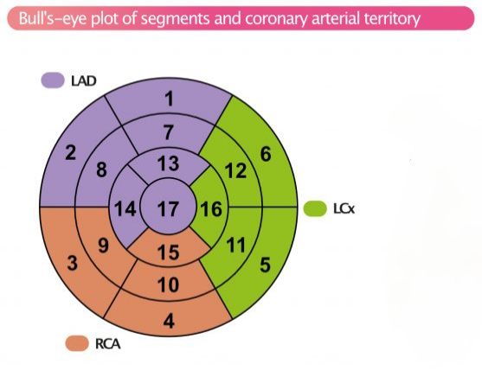
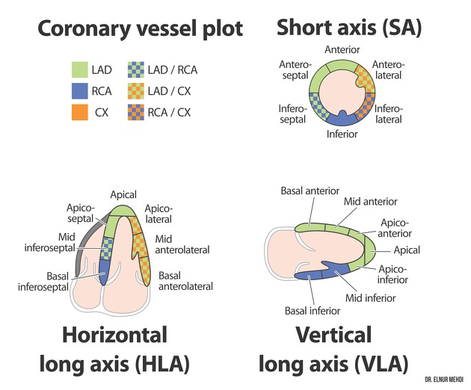
CORONARY ARTERY TERRITORIES
Each segment can be matched to coronary arteries: LAD, LCX, RCA.
Helps correlate wall motion with coronary perfusion.

Slide 8
REGIONAL WALL MOTION ANALYSIS
Bull’s eye diagram provide visual representation of wall motion
Each segments can be scored 1 to 5 based on contractility
1= Normal
2= Hypokinesis
3= Akinesis
4= Dyskinesis
5= Aneurysmal

Slide 9
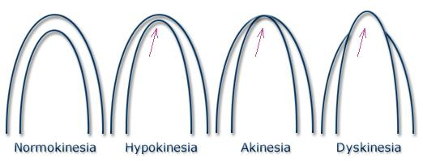
WMSI = Sum of wall motion scores
Number of segments visualized
→Normal WMSI is 1

Slide 10
MCQS

Slide 11
1) How many segments are represented in a Bull’s Eye Diagram of the LV ?
A) 20 segments B) 17 segments C) 12 segments D) 25 segments

Slide 12
B) 17 segments

Slide 13
2) Which coronary artery mainly supplies the lateral segments of the left ventricle in the bull’s eye model?
A) Right coronary artery (RCA) B)Left anterior descending artery (LAD) C) Left circumflex artery (LCx)
D) Posterior descending artery (PDA)

Slide 14
C) Left circumflex artery (LCx)

Slide 15
3) The central circle of the bull’s eye diagram corresponds to which part of the heart? A) Base B) Apex C)Mid-anterior wall D) Inferior wall

Slide 16
B) Apex

Slide 17
THANK YOU

