Slide 1
CORONARY BALLOON CATHETERS
Sana Muhammed P P

Slide 2
Introduction
Fine instruments
Manufactured with great care & engineering skill for the purpose of predilation of coronary artery lesion
It is a small tube which has a balloon mounted at the distal end

Slide 3
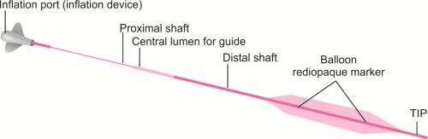
Parts of balloon catheter
Balloon
Shaft
Tip
Central lumen for GW
Inflation port

Slide 4
Uses
Plain Old Balloon Angioplasty ( POBA):
–Gain lesion access &open the stenosis
Predilation :
– Prepare the lesion for stent implantation
–Determine lesion length or diameter
–Determine lesion morphology
Post dilation :
–Optimise stent apposition to the vessel wall
–Ensure full stent expansion & apposition in the vessel
–Optimise minimum lumen diameter

Slide 5
Composition of a balloon
The first angioplasty balloon made by Gruentzig in 1976 was of polyvinyl chloride (PVC).
The next generation of balloon technology used cross-linked polyethylene (PE)
PE balloons are as compliant as PVC ,with a higher rated burst pressure.

Slide 6
Composition of balloon
Polyurethane makes balloon more resistant to damage.
It produces the most durable balloon for a given thickness.
Key requirements of Angioplasty balloons are
– strength –flexibility – low profile

Slide 7
Materials used now are polyethylene terephthalate (PET) or nylon
Advantages
▪︎ Tensile strength
▪︎ Max pressure rating
▪︎ low profile
▪︎ Ability to be moulded into ultrathin walls ( ranging from 5-50 microns)
▪︎ very precise shapes while still retaining tensile strength

Slide 8
Balloons may be coated for :
Lubrication
Trackability
Abrasion resistance
Deliver an anti restenotic / anti coagulatory drug

Slide 9
Balloon coating include :
Lubricious coating ( hydrophilic & hydrophobic)
Abrasion and puncture resistant coating
Tacky or high friction coatings
Conductive coatings
Anti thrombogenic coatings
Drug release coatings
Reflective and selective coatings

Slide 10
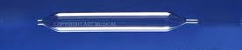
A standard dilatation balloon consists
  cylindrical body
  two conical tapers
  two necks (proximal and distal).

Slide 11
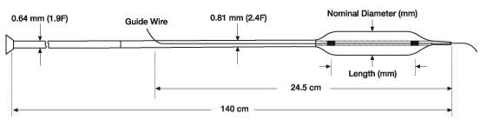
Terms used in context of Angioplasty Balloons
Balloon diameter: Nominal inflated balloon diameter measured at a specified pressure
Balloon length : Typically refers to the working length or the length of the straight body section.
Nominal pressure : Refers to the pressure at which when balloon is inflated it achieves the labelled balloon diameter . Usually 6-8 atm
Mean burst pressure ( MBP): Average pressure where 50% of balloons will burst.

Slide 12
Rated burst pressure ( RBP): Pressure below which 99.9% of the balloon will not burst upon single inflation.
Balloon profile: Max diameter of the balloon when mounted on a catheter in it’s deflated and wrapped condition.
Entry profile: Distal tip is usually tapered , allows the balloon to cross the lesion with minimum trauma.
Pushability: The ability to advance the balloon across the lesion
Trackability : Ease of tracking a balloon over the GW upto the target lesion
Working range : The inflation range between NP & RBP.

Slide 13
Balloon Compliance
    Change in balloon diameter / atmosphere of inflation pressure.
    It is an index of stretchability of balloon.
    More compliant balloons have the ability to mould according to the vessel shape.
    They can over dilate a vessel making it prone to complication like dissection, vessel rupture, abrupt closure and other ischemic complications.

Slide 14
Compliance % =diameter @high atm – diameter @ low atm
Diameter @ low atm. ×100%

Slide 15
Non compliant balloons (NC)
      Ultra high strength, thin walled balloons
      Fabricated from PET
      Nominal of 10 – 12 atm , RBP -18 to 28 atm
      Increase in diameter by < 10% over NP upon inflation to high pressure.

Slide 16
NC balloons
        RBP can be measured by increasing thickness of balloon , but also increase stiffness of balloon and balloon profile
        Stiffer , more durable
        Trackability and pushability
        Deflation and rewrapping

Slide 17
Non compliant balloon –when & why?
One of the major uses for a non-compliant balloon is
post dilation of a delivered sent.
20% of PCI procedures use a non-compliant balloon for:
- ‘Crack’ highly calcified lesions
- Post dilatation:
• Minimal longitudinal growth is key to avoid dilating outside the stented area
- Increasingly important in era of DES for reducing likelihood of:
• Mal-apposed stent struts
• Edge effect restenosis

Slide 18
• Features of a non-compliant balloon:
- Stiffer, more durable material = withstands/delivers higher pressure (great for “tough to crack” lesions)
- Less trackable through vasculature
- Minimal size expansion as pressure is increased: ideal for focused dilatation (4-6% growth rate)
- Typically offers poor re-wrap
- Nominal of 10-12 atm, RBP of 18-20 atm (ideal for post dilatation)

Slide 19
Eg of NC balloons
NC TREK Coronary Dilatation Catheter
NC Quantum Apex Catheter Scurve
Vector NC PTCA Balloon Catheter
NC Sprinter RX Catheter
OPN NC Balloon
NC Euphora Noncompliant Balloon Dilatation Catheter
Sapphire II NC Coronary Dilatation Catheter

Slide 20
Semi compliant (SC) balloons
        Used for preparation/ pre dilation of lesions before stent implantation .
        Made up of either Polyolefin co polymer (POC) or Polyethylene.
        Have NP of 6 – 8 atm & RBP of 12 – 18 atm.

Slide 21
SC balloons
    Tendency of ‘dog boning’ ( tendency to be oversized at edges with less dilatation at obstructive segment of lesion) .
    Increase in diameter by >20% upon inflation to higher pressure.
    Trackability and pushability
    Deflation and rewrapping

Slide 22
Semi compliant balloon-when & why?
Primary use for semi-compliant balloons is pre-dilatation of a stenotic portion of a coronary artery.
• 80% of PCI procedures use a semi-compliant balloon for:
- POBA
- Pre-dilatation:
• Accurately size lesion
• Allows better access to the lesion
- When unable to direct stent
- More difficult cases, such as ultra tight lesions on bifurcations

Slide 23
• Features of a semi-compliant balloon:
- Softer material = better trackability (great for difficult to reach/treat lesions)
- Expands in size as pressure is increased: provide sizing flexibility (8-10% growth rate)
- Offers good re-wrap (helpful when multiple inflations are required)
- Nominal of 6-8 atm, RBP of 12-14 atm
• Working range of 6-12 atms for smaller balloons
• Working range of 8-14 atms for workhorse balloons

Slide 24
Eg of SC balloon
Sprinter Legend
Apex
NC Quantum Apex
Maverick
Mustang
Ruby
Mini Trek
Sapphire II pro
Mozec Sc

Slide 25
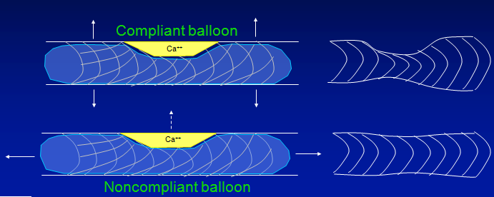
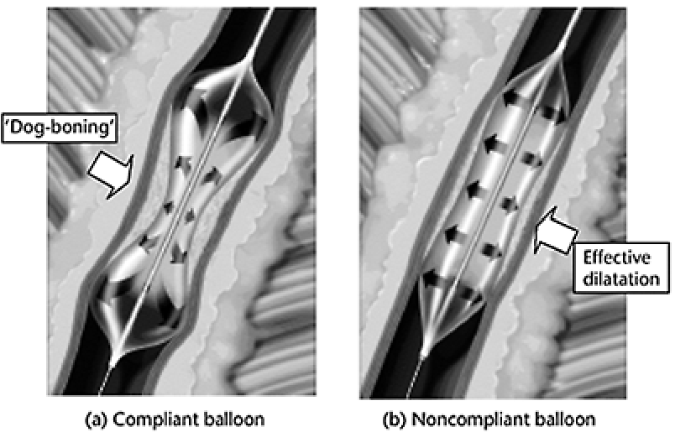
Compliance

Slide 26
SC Vs Nc balloon
Feature | SC balloon | NC balloon
Material | Soft material( eg : nylon) | Rigid materials (eg : PET )
Compliance | Moderate – expands more with increasing pressure | Low-maintains shape & diameter even under high pressure
Diameter control | Less precise- diameter increases with higher pressure | Very precise – minimal change in diameter despite high pressure
Inflation pressure range | 6-14 atm ( approx.) | 12-25+ atm
Shape during Inflation | Can be “dog-bone” | Cylindrical – uniform expansion
Risk of vessel injury | Lower due to soft material expansion | Higher if not used properly due to high pressure & rigidity
Best use cases | Pre dilation, lesion crossing, mild lesions | Post dilation, stent optimization, calcified or resistant lesions
Trackability | High- flexibility, easier to navigate tortuous anatomy | Lower – stiffer, may be harder to deliver in some vessels

Slide 27
Low pressure balloon
Low-pressure, elastomeric balloon are made of latex or silicone that is used primarily in fixation and occlusion.
Low pressure balloons are molded in a tubular shape which is then expanded several times its original size
Cannot be inflated to precise dimensions or retain well defined shapes and high pressures.

Slide 28
High- pressure balloons
Non-elastic balloon used to apply force.
High-pressure balloons are molded from noncompliant or semi-compliant materials that retain their designed size and shape under high pressure.
Thin-walled and exhibit high tensile strength –used to enlarge a narrow opening or passage within the body.

Slide 29
Types of balloons
Balloon catheters used in angioplasty are
Over-the-Wire (OTW)
Rapid Exchange design
Fixed Wire balloon systems.
Perfusion balloon
Cutting balloon
Scoring balloon
Drug eluting balloon

Slide 30

Over – the – wire (OTW)
▪︎ Classical balloon catheter – 2 lumens running through the
entire course of balloon catheter.
      - 1st lumen – passage for GW
      - 2nd lumen – connecting with an indeflator or balloon inflation/ deflation .
      ▪︎More useful : enhanced trackability is required
      ▪︎ Also in procedures requiring multiple GW exchange and balloon upsizing ( CTO ).

Slide 31
Over –wire- balloon
Disadvantage
More complex & time consuming
Longer GW required
Increased fluroscopy time
Higher cost
Patient discomfort
Requires 2 opertors( to hold the wire in place & to advance the balloon)
Advantage
Enhanced GW support
Flexibility with long lesions
Device compatability
Dual lumen design
Greater procedural control

Slide 32

Monorail/Rapid exchange (RX) balloon
        Current standard for PCI
        2 lumens but GW lumen does not extend along the entire course of the balloon.It starts from distal end but finishes before the proximal end of the balloon catheter

Slide 33
Monorail/Rapid exchange (RX) balloon
Advantage
Reduction in procedural & fluoroscopy
Allows rapid exchange of interventional devices over the same standard length GW
Lower doses of contrast media
Smaller device diameter
Disadvantage
Limited GW support
Difficulty in complex lesions
Less suitable for long lesions
Limited compatability

Slide 34
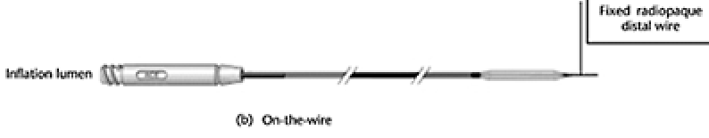
Fixed wire balloon system
Composed of an inelastic balloon wrapped around a smaller section of a GW
GW attached to the balloon can be rotated freely, but it cannot advance independently of the balloon.
The wrapped configuration is maintained by means of a temporary bond.
Inflation of the balloon, following proper positioning of the catheter breaks the bond, permitting the balloon to unwrap from the guidewire

Slide 35
Fixed wire balloon system
Advantage
Simplified procedure
Improved control
Faster setup
Reduced risk of wir displacement
Disadvantage
Limited Flexibility
Size limitations
Lack of wire exchangability
Single use

Slide 36
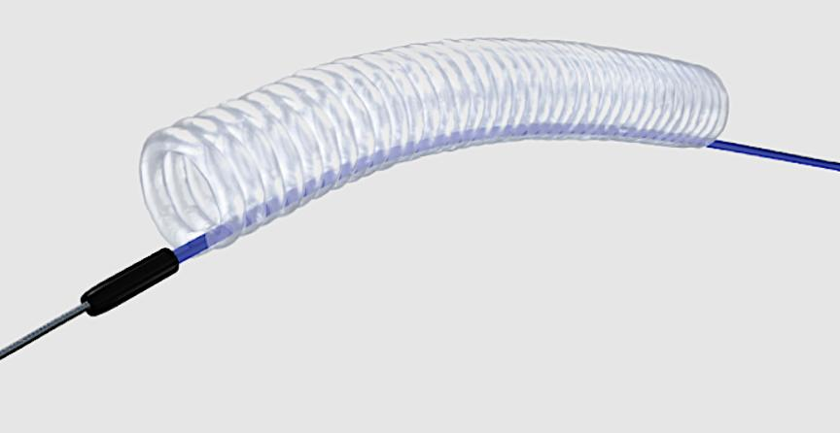
Perfusion balloon
      Have channels or a mesh structure that allows blood to flow through or around the balloon while it is inflated.
      Used in situations where prolonged balloon inflation is necessary especially in managing coronary perforations, where inflated balloons seals the perforations while central lumen provide perfusion to distal bed.
      Allows inflation upto 3 min in duration without producing deleterious changes in the ST segment

Slide 37
Perfusion balloon
Advantage
Reduced risk of ischemia
Improved patient outcome
Enhanced safety in complex lesions
Disadvantage
Complexity of the design requiring greater skill & experience from the operator
Cost
Limited availability

Slide 38
Cutting balloon
      Tiny, longitudinally arranged 3 or 4 atherotomes ( micro surgical blades) on the outer surface of a NC balloon.
      As the balloon is inflated it presses the microblades into the artery wall , creating controlled cuts that helps modify the plaque and make it easier to expand the artery.
      Useful in treating fibrotic ,calcified or ISR lesions.

Slide 39
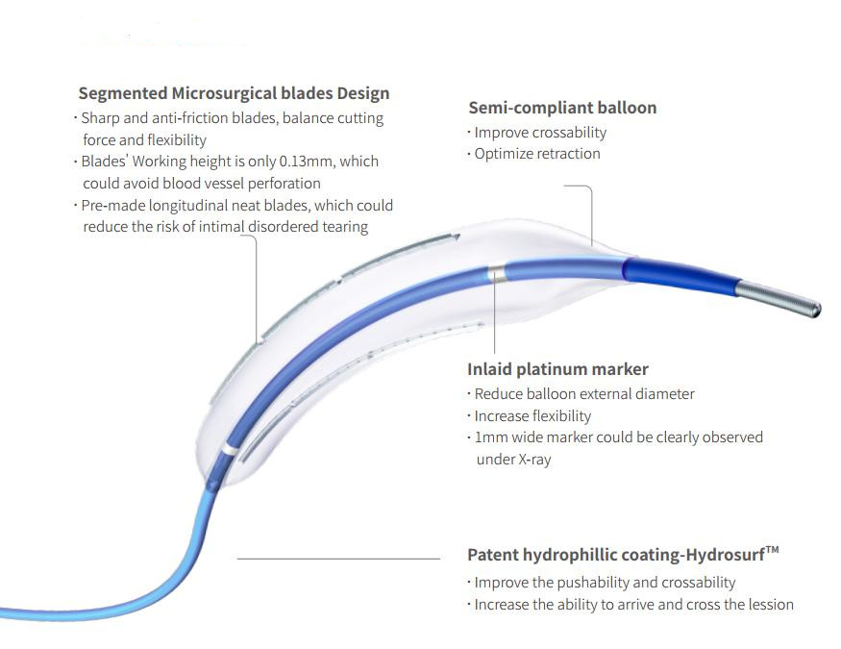
Cutting balloon
Balloon inflation is at lower inflation pressure (4-8 atm)
Reduced inflation pressure causes less injury to target vessel – decrease neoproliferative response – less in- stent restonsis

Slide 40
Cutting balloon
Advantage
Controlled plaque modification
Reduced need for high pressure
Improved stent expansion
Disadvantage
Complexity
Higher cost
Risk of arterial dissection

Slide 41
Scoring balloon catheter
      Have a series of metal wires or scoring elements attached to the surface of the balloon in a spiral or cage like pattern.
      As the balloon expands the scoring elements apply concentrated force to the plaque creating controlled micro incisions that help to fracture and compress the plaque more effectively.
      Useful in calcified , ISR or complex lesions.

Slide 42
Scoring balloon catheter
2 types :
  1. Angio Sculpt scoring balloon:
      Nitinol scoring element in a helical or spiral pattern around the balloon which provides scoring when the balloon is inflated.
      Advantages :
      •The spiral design allows for uniform scoring and reduces the risk of dissection.
      • Nitinol provide flexibility to navigate through tortuous anatomy.

Slide 43
Scoring balloon catheter
  2. Score Flex scoring balloon:
    Two parallel scoring wires are fixed to the balloon. When the balloon is inflated, these wires score the plaque.
Advantage:
    The parallel wire design provides a balanced distribution of pressure reducing the risk of vessel trauma.

Slide 44
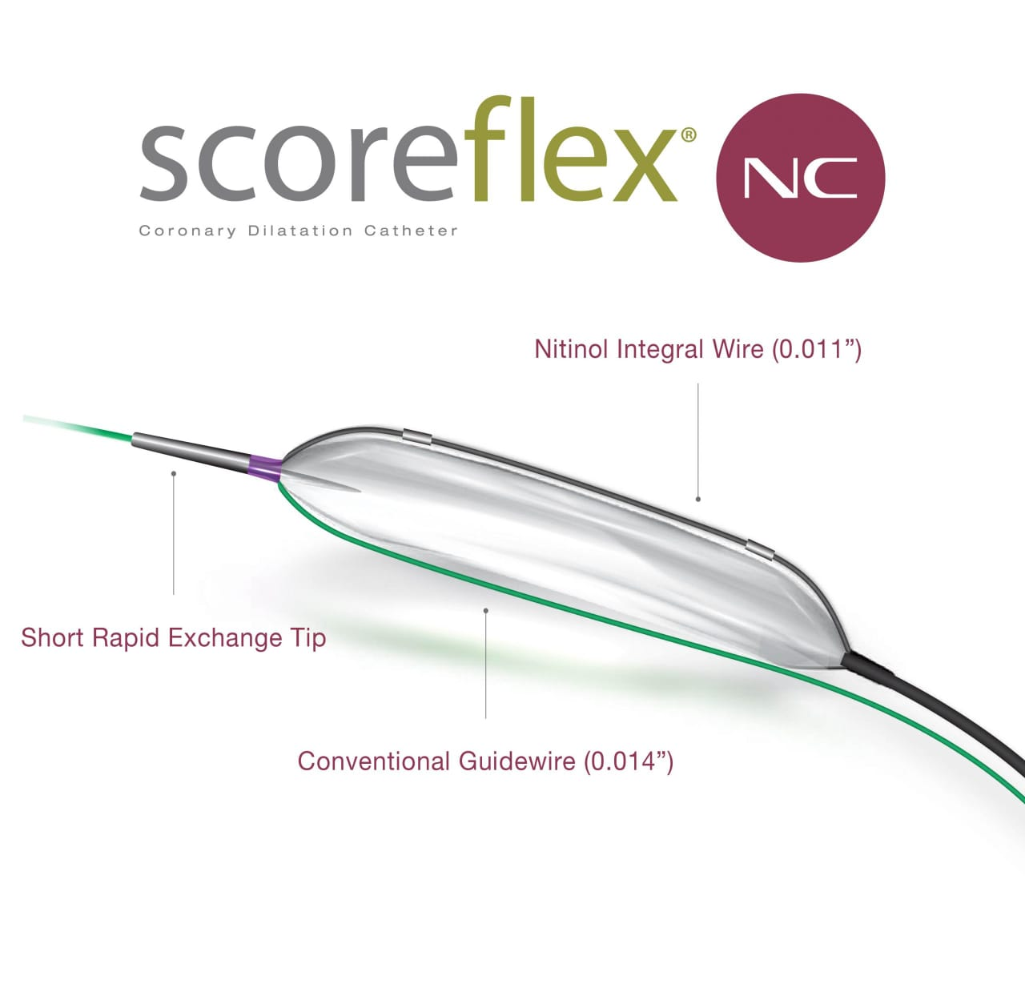
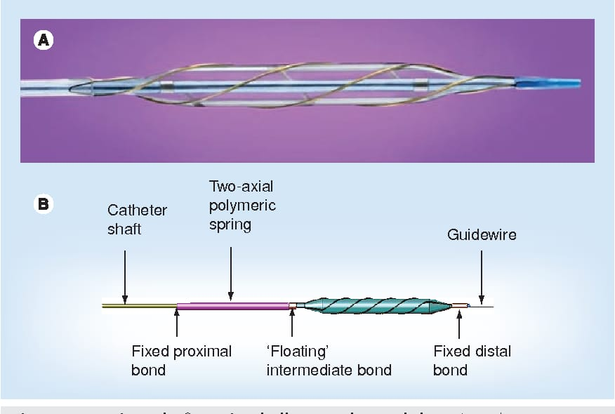
Angio sculpt balloon

Slide 45
Drug eluting balloon
      SC balloons covered with anti proliferative drugs that are rapidly released upon contact with vessel wall.
      Drugs used – Paclitaxel , Sirolimus , Polyethylene glycol ( PEG )
      Pre dilation with a smaller balloon before DEB treatment is required.
      Alternative to DES in the treatment of CAD.
  To treat patients where stent implantation is not desirable including small vessels, ISR, bifurcation side branch and possibly acute STEMI.

Slide 46
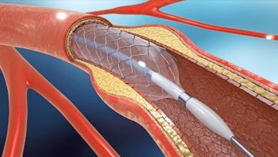
Drug eluting balloon
Most commony coated with 3μg /mm² paclitaxel, which rapidly crosses the cell membrane and binds to micro tubules ,inhibiting cell division,migration and proliferation of the cells.
Currently 4 DEBs are available:
      B Braun’s SeQuent™ Please
      Boston Scientific’s Ranger OTW ( Paclitaxel)
      Concept Medical’s Magic Touch ( Sirolimus)
      Eurocor’s DIOR™ paclitaxel- coated
60sec balloon inflation allowing a homogenous transfer of 8 – 18% of drug to the treated vessel wall ( size of balloon : artery is 1.1:1)

Slide 47
Complications
Balloon rupture
Dissection
Melon seeding
Perforations
Non deflation

Slide 48
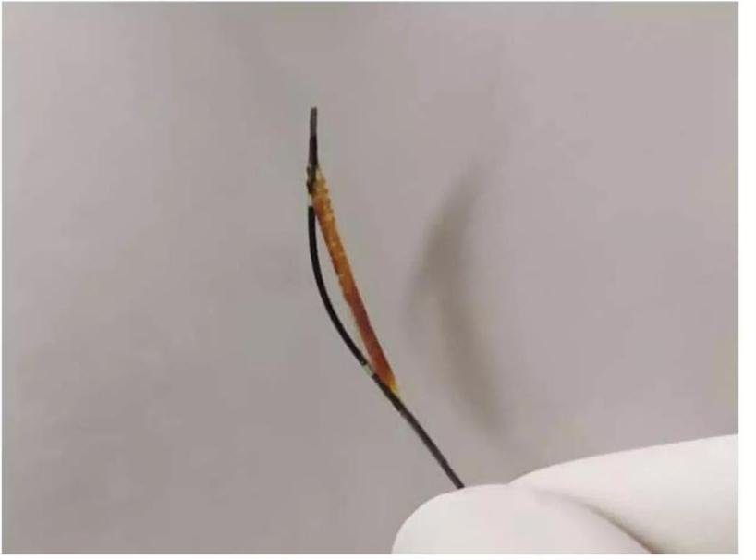
Balloon rupture
Tear or burst
There is a small but real risk of rupture of the balloon during high pressure inflation especially after PD
It can be avoided by careful PD avoiding pressure above RBP

Slide 49
Balloon rupture
•Circumferential Rupture: occurs due to over-dilatation of the balloon(beyond the recommended burst pressure.)
•Horizontal Rupture: occurs when there is structural defect in the balloon catheter due to defective manufacturing process. The balloon can rupture before RBP.
•Pinhole Rupture: Localized rupture which can occur in the balloon due to injury by a calcified spicule or an exposed stent strut. (can rupture even before RBP.)

Slide 50
Balloon rupture
Management of balloon rupture depends upon trauma inflicted on the vessel wall by the ruptured balloon.
Most of the complications due to balloon rupture can be managed conservatively.
Balloon rupture may sometimes require placement of covered stents or surgery.

Slide 51
Dissection
      Tear in the inner wall of artery.
      Occurs commonly after predilation ; Easily covered by the deployment of stents.
      If dissection occurs at the stent edge , the placement of another stent is required.

Slide 52
Melon Seeding
      Balloon slippage from target lesion to the prox or distal CA during balloon angioplasty ( ISR).
      This can be tackled by use of longer balloon, by slowly inflating the balloon or by using scoring or gripping balloons.

Slide 53
Perforations
      A tear or hole in the wall of an artery or blood vessel.
      Occurs usually after high pressure post dilation after stent deployment for calcific lesions.
      Avoidance of high balloon to artery ratio above 1.2:1 will reduce the chances of complications.

Slide 54
Non deflation
      Balloon fails to deflate after stent deployment and also after PD.
      This occurs because of probably contrast material getting trapped as crystals in the dilatation lumen of the balloon.

Slide 55
Other uses of balloons
      Length of stent assessment
      Support of wire for crossing
      Anchor balloon
      Tacking up a dissection flap
      Sealing perforations
      Exchange of wires
      Stent retrieval

Slide 56
Mcq
Which balloon system requires two operators and a long guidewire?
A) Monorail/Rapid Exchange
B) Perfusion Balloon
C) Over-the-Wire (OTW)
D) Fixed Wire

Slide 57
C) Over-the-Wire (OTW)

Slide 58
What does “Balloon Compliance” refer to?
A) The strength of the balloon
B) Change in balloon diameter per atmosphere of pressure
C) Maximum diameter at burst
D) Resistance to rupture

Slide 59
Answer : B) Change in balloon diameter per atmosphere of pressure

Slide 60
Which complication involves a tear in the inner artery wall during balloon inflation?
A) Melon Seeding
B) Dissection
C) Non deflation
D) Balloon rupture

Slide 61
Answer : B) Dissection

Slide 62
Which balloon type is designed to allow blood flow during prolonged inflation?
A) Fixed Wire Balloon
B) Perfusion Balloon
C) Scoring Balloon
D) Over-the-Wire Balloon

Slide 63
Answer: B) Perfusion Balloon

Slide 64
Which type of balloon is most prone to 'dog boning’?
A) Compliant
B) Semi-Compliant
C) Non-Compliant
D) Cutting

Slide 65
Answer: B) Semi-Compliant

Slide 66
Thank you!!

