Slide 1
VERICIGUAT
Dr. Mithun Anilkumar
DM cardiology Resident
TD medical college

Slide 2
Vericiguat
A novel oral soluble guanylate cyclase stimulator
Mechanism of action
-enhances the cyclic GMP pathway by directly stimulating soluble guanylate cyclase ( sGC) through a binding site independent of nitric oxide
- sensitizes sGC to endogenous NO by stabilizing NO binding to sGC

Slide 3
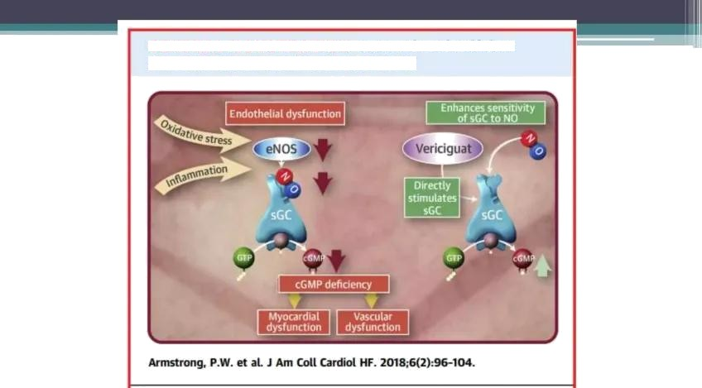

Slide 4
Vericiguat in heart failure
Cyclic GMP pathway
The sGC is an intracellular receptor for endogenous NO
NO is generated in endothelial cells (upon physiological stimuli such as laminar blood flow shear forces) and within endocardium.
NO diffuses to neighboring tissues such as vacular endothelium and cardiac muscle, and stimulates sGC to generate cGMP
sGC mediated cGMP is essential for normal cardiac and and vascular function

Slide 5
In heart failure endothelial dysfunction and ROS have been shown to reduce NO bioavailability, resulting in relative sGC deficiency and reduction in cGMP synthesis.

Slide 6
Reduced sGC can lead to
< Coronary microvascular dysfunction
< Cardiomyocyte stiffness
< Interstitial fibrosis
Which ultimately lead to myocardial dysfunction and progression of heart failure.

Slide 7
Based on these mechanism vericiguat improve HF by
Direct vasodilatory properties
Improving diastolic function
Improving endothelial function -vasomotor tone regulation
Improving cardiac reserve
It is used in once daily oral dose.

Slide 8
Pharmacokinetics
Absorption:
The bioavailability of vericiguat is 93% when taken with food.
Food increases AUC (area under the curve- total drug exposure across time) of vericiguat.
Distribution:
Vericiguat has high plasma protein binding (98%) and is primarily bound to albumin.
The average volume of distribution(Vd) is approximately 44 Liters.

Slide 9
Pharmacokinetics
Metabolism:
Vericiguat is metabolized primarily by glucuronidation via UGT1A9(uridine diphosphate-glucuronosyltransferase) and UGT1A1 to form an inactive metabolite.
The Cytochrome P450 system is responsible for <5% metabolism of vericiguat.

Slide 10
Pharmacokinetics
Excretion:
The half-life is 30 hours in patients with heart failure. Clearance is approximately 1.6 L/h.
Vericiguat is excreted primarily in urine as an inactive metabolite(53%).
Vericiguat is also excreted as an unchanged drug in feces(43%).

Slide 11
Administration
An increase in cardiac output and an increase in heart rate of 4 to 10 beats per minute
An increase in the cardiac index are observed in patients who received a single dose of 5 to 15 mg per oral (PO).
Systemic vascular resistance has decreased from the baseline reducing blood pressure.
The effect was inconsistent and not dose-dependent.

Slide 12
Administration
The immediate-release form of the vericiguat showed a mean half-life (t1/2) of about 18 to 22 hours.
There were no significant differences between single and multiple doses regarding bioavailability, the area under the curve (AUC), and Cmax (maximum concentration)..

Slide 13
Administration
According to phase III of the VICTORIA Heart Failure with Reduced Ejection Fraction study, the dose of vericiguat can be increased from 2.5 mg to 10 mg depending on patient response.
Phase II of the VITALITY Heart Failure with Preserved Ejection Fraction study reported that the dose could be titrated up to 15 mg

Slide 14
Use in Specific Patient Population
Patients with Hepatic Impairment:
No dosage adjustment of vericiguat is advised in patients with mild hepatic impairment(Child-Pugh A) or moderate hepatic impairment (Child-Pugh B).
Use of vericiguat should be avoided in severe hepatic impairment(Child-Pugh C) as there are no studies conducted in these patient populations.

Slide 15

Patients with Renal Impairment:
No dosage adjustment of vericiguat is suggested in patients with eGFR ≥15 mL/min/1.73m2.
The use of vericiguat has not been investigated in patients with eGFR <15 mL/min/1.73m2 or on dialysis.

Slide 16

Breastfeeding Considerations
Vericiguat has the potential cause for serious adverse reactions in breastfed infants. Hence, breastfeeding is not recommended during treatment with vericiguat.
Pregnancy Considerations
Due to concerns for embryo-fetal toxicity and substantial fetal harm to the fetus, vericiguat should not be administered to pregnant women or currently planning for pregnancy

Slide 17
Adverse Effects
The most common adverse drug reactions of vericiguat include hypotension, syncope, and anemia.
Headache and postural dizziness reportedly could be due to vasodilation mediated by vericiguat.
Diarrhea, nausea, and abdominal discomfort have been postulated due to smooth muscle relaxation.

Slide 18
Adverse Effects
Vericiguat might be beneficial in patients with severe heart failure and does not require decreasing or stopping the dose of vericiguat in patients with a mild increase in serum creatinine or potassium levels.

Slide 19
Drug-Drug Interactions
Administration of omeprazole with vericiguat reduced the absorption of vericiguat.
Magnesium hydroxide and aluminium hydroxide also decreased the absorption of vericiguat.
Drug-drug interaction study indicates that vericiguat is a suitable drug for managing patients with heart failure with multiple comorbidities requiring polypharmacy.

Slide 20
Contraindications
Vericiguat should be avoided in patients taking long-acting nitrates, soluble guanylate cyclase stimulators (e.g., riociguat), or phosphodiesterase type 5 (PDE-5) inhibitors concerning hypotension and syncope.
Clinicians should also avoid using the drug in patients with severe anemia because of concerns of a decrease in hemoglobin level with vericiguat

Slide 21
Monitoring
The clinical team should monitor blood pressure, heart rate, and hemoglobin are advised in patients treated with vericiguat.
Monitor BNP or NT-pro BNP levels to assess response to the therapy to vericiguat.
Monitor fluid intake and output, body weight, and clinical signs and symptoms of congestion and hypoperfusion in patients with heart failure.

Slide 22
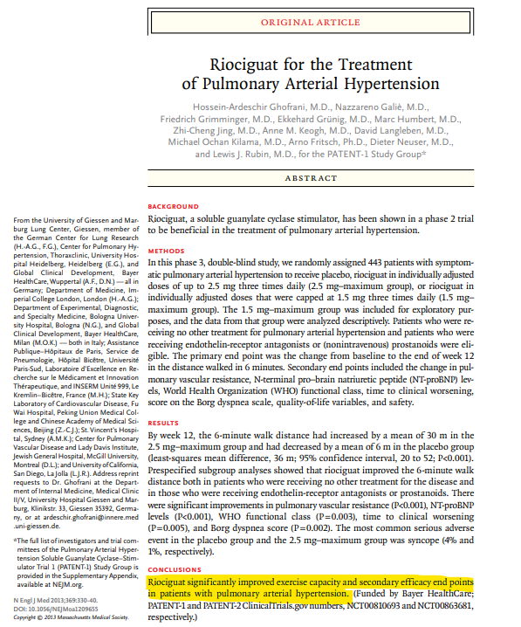

Slide 23
RIOCIGUAT
Approved in 2013, riociguat remains the first and only drug licensed for the treatment of both pulmonary arterial hypertension (PAH) and chronic thromboembolic pulmonary hypertension (CTEPH)

Slide 24
Pharmacology of Riociguat
Class: Soluble guanylate cyclase stimulator
Administration: Oral, with a typical titration regimen
Bioavailability: Approximately 94%, allowing effective oral dosing
Half-life: 7–12 hours in healthy individuals; prolonged in patients with hepatic or renal dysfunction
Metabolism: Primarily via cytochrome P450 (CYP1A1, CYP3A4) and glucuronidation
Excretion: Renal and biliary routes

Slide 25
RIOCIGUAT
The drug is usually initiated at a dose of 1 mg -three times daily, with titration by 0.5 mg increments every two weeks depending on blood pressure tolerance, up to a maximum of 2.5 mg three times daily.
The need for gradual titration is driven by its hypotensive potential.

Slide 26
Clinical Trial Evidence
The PATENT-1 (Pulmonary Arterial hyperTENsion sGC-Stimulator Trial 1)
Randomized controlled study evaluating riociguat in PAH patients.
Participants included those with idiopathic, familial, and connective tissue disease–related PAH, as well as those previously treated with endothelin receptor antagonists or prostanoids.
Key findings: Riociguat improved the 6-minute walk distance (6MWD) by a mean of 30–40 meters compared with placebo. It reduced pulmonary vascular resistance (PVR) by more than 30%.Improvements were also observed in NT-proBNP levels and WHO functional class.
Benefits were seen both in treatment-naïve patients and in those receiving combination therapy.
This trial established riociguat as an effective agent in PAH, leading to its regulatory approval.

Slide 27
Clinical Trial Evidence
The CHEST-1 trial (Chronic Thromboembolic Pulmonary Hypertension Soluble Guanylate Cyclase–Stimulator Trial 1)
The standard of care is pulmonary endarterectomy (PEA), but some patients are either inoperable or remain hypertensive after surgery.
The CHEST-1 trial demonstrated:
Significant improvement in 6MWD (39 meters with riociguat vs. 6 meters with placebo).Substantial reduction in PVR and NT-proBNP. Consistent improvements in functional capacity and hemodynamics.
CHEST-1 was the pivotal study that led to the first approval of a medical therapy for inoperable CTEPH.

Slide 28
Riociguat is currently approved for
Pulmonary arterial hypertension (PAH, WHO Group 1): In adults with functional class II–III symptoms, either as monotherapy or in combination with other drugs.
Chronic thromboembolic pulmonary hypertension (CTEPH, WHO Group 4): In patients who are inoperable or have persistent/recurrent PH after pulmonary endarterectomy.

Slide 29
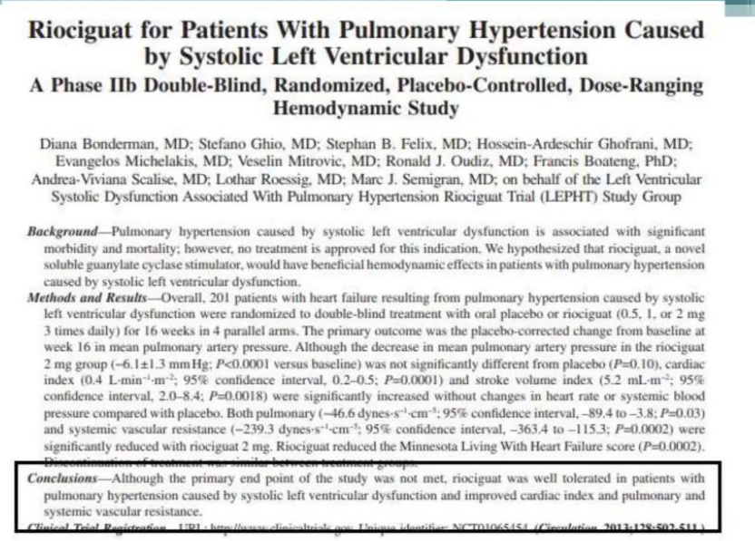

Slide 30
These hemodynamic improvements were independent of change in heart rate, BP, primary end point of pulmonary artery pressure.
This showed that sGC stimulator were beneficial in HF beyond simply improving the PAH.

Slide 31
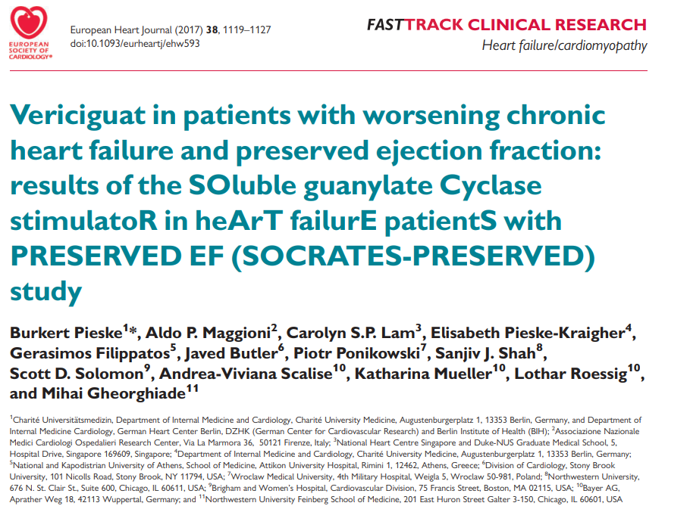

Slide 32
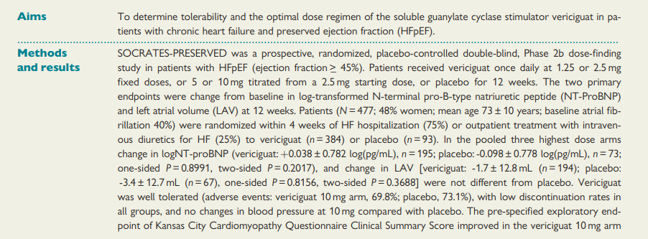
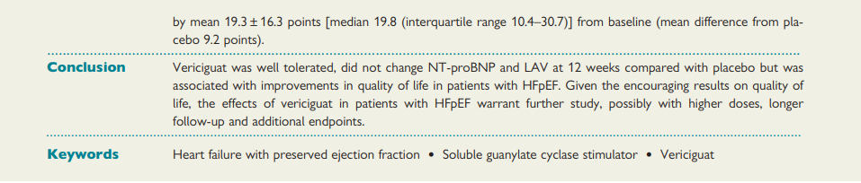

Slide 33
SOCRATES -REDUCED SOLUBLE
GUANYLATE CYCLASE STIMULATOR IN HEART FAILURE
In this study vericiguat was added to standard of care in patients with worsening chronic HF
requiring hospitalization or IV diuretic treatment
and increased BNP or NT-proBNP
Did not reach statistical significant changes in BNP and NT-pro BNP levels
BUT an exploratory analysis showed a clinically
significant reduction of NT-proBNP at the highest dose group (10mg).

Slide 34
SIGNIFICANCE:
The results of SOCRATES-REDUCED supported the progression to a larger Phase 3 trial, the VICTORIA trial, which ultimately demonstrated the clinical benefit of vericiguat in reducing cardiovascular death and heart failure hospitalizations.

Slide 35
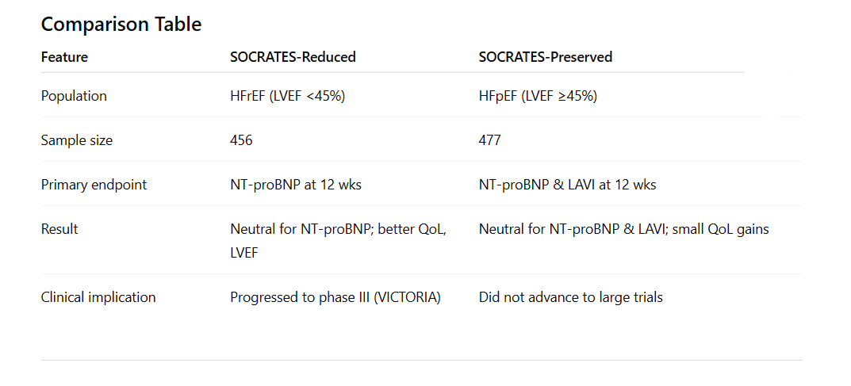

Slide 36
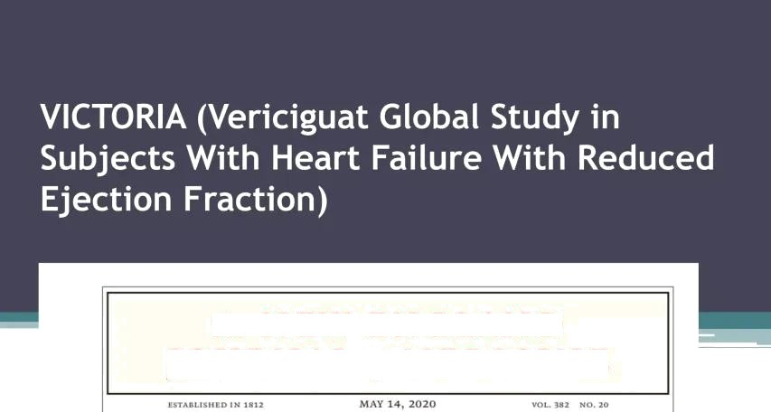
The N E W ENGLAND
JOURNAL of MEDICINE
Vericiguat in Patients with Heart Failure and Reduced Ejection Fraction

Slide 37
THE VICTORIA TRIAL
Was a large, randomized, double-blind, placebo-controlled phase III trial evaluating the efficacy and safety of vericiguat, in patients with heart failure with reduced ejection fraction (HFrEF).
The study enrolled 5,050 patients across 42 countries who had symptomatic HFrEF (LVEF <45%) and a recent worsening heart failure event (hospitalization or need for IV diuretics), placing them at very high risk. (sep 2016 to dec 2018)
Patients were randomized to receive either vericiguat (titrated up to 10 mg daily) or placebo, in addition to guideline-directed standard therapy.

Slide 38
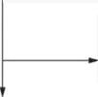

6857 Patients underwent screening
1807 Were excluded
1805 Did not meet eligibility criteria 2 H ad other reason
5050 Underwent randomization
2526 Were assigned to receive vericiguat 2519 Received vericiguat
7 Did not receive vericiguat
2524 Were assigned to receive placebo
2515 Received placebo
9 did not receive placebo

Slide 39
Follow-up
2526 Were assigned to receive vericiguat 25I9 received vericiguat
7 Did not receive vericguat
2524 Were assigned to receive placebo
2515 Received placebo
9 Did not receive placebo
6I0 discontinued tria1 regimen 177 Had adverse event
9 Were lost to Follow up
48 Did not adhere to
trial regimen
173 Had vericiguat discontin
ued by physician
8 Deviated from protocol 195 Decided to discontinue
trial regimen
565 Discontinued trial regimen
159 Had adverse event
I I Were lost to follow-up
49 Did not adhere to
trial regimen
154 Had placebo discontin ued by physician
2 Deviated from protocol
190 Decided to discontinue trial reg men
2526 Were included in the analysis
2524 Were included in the analysis

Slide 40
THE VICTORIA TRIAL
The primary endpoint was a composite of cardiovascular death or first heart failure hospitalization.
After a median follow-up of 10.8 months, the primary endpoint occurred in 35.5% of patients in the vericiguat group vs 38.5% in placebo, corresponding to a 10% relative risk reduction (hazard ratio 0.90; 95% CI 0.82–0.98; p = 0.02).
The benefit was primarily driven by fewer hospitalizations.

Slide 41
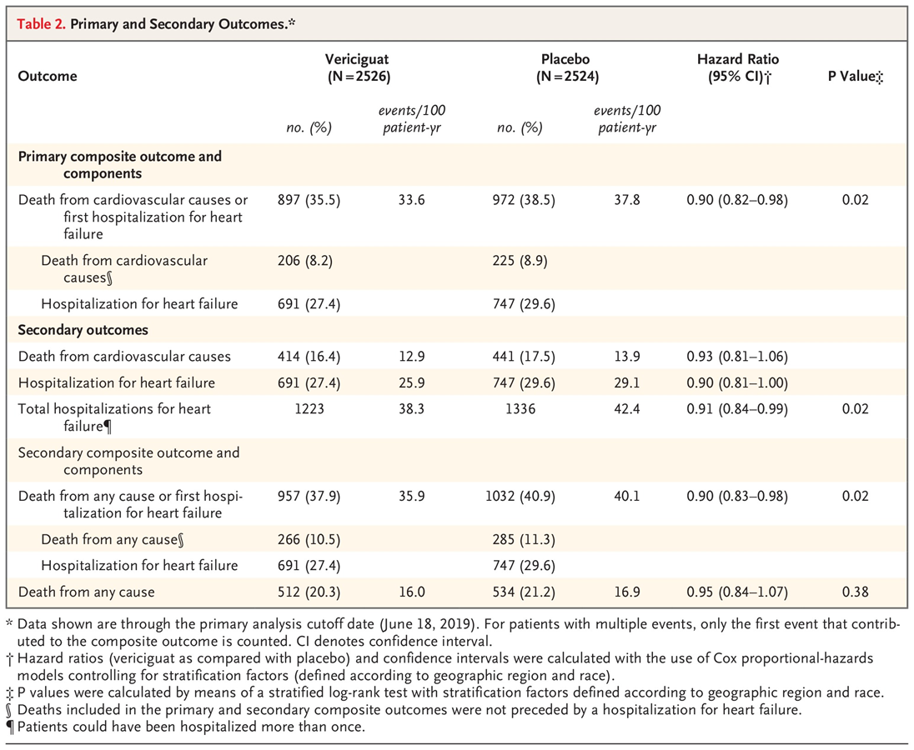
PRIMARY OUTCOME

Slide 42
SECONDARY OUTCOMES

Slide 43
THE VICTORIA TRIAL
Adverse events were similar between groups, though mild hypotension and anemia were more common with vericiguat.
Importantly, the drug was generally well tolerated, even in a high-risk, frail population.
Conclusion
VICTORIA trial demonstrated that vericiguat, added to standard therapy, provides a modest but significant reduction in cardiovascular death or hospitalization in patients with HFrEF following recent worsening, establishing it as a valuable therapeutic option for this vulnerable group.

Slide 44
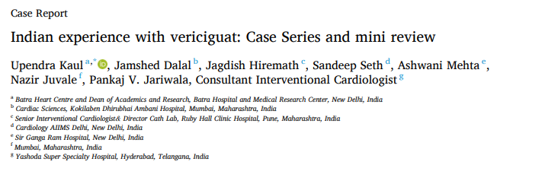
INDIAN SCENARIO

Slide 45
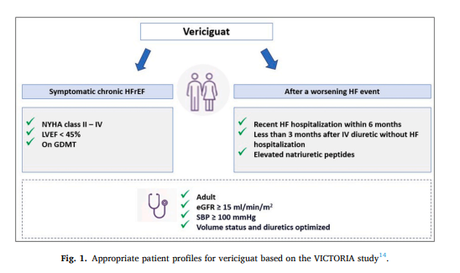
The recent 2023 Indian consensus on worsening heart failure gave the following expert recommendations:
Vericiguat is to be considered in patients who have had a worsening HF event despite treatment with optimal background HF therapy.

Slide 46
INDIAN SCENARIO
Vericiguat is to be considered in patients who have had worsening HF events and with tolerability issues where optimal background HF therapy ’can’t be optimized (such as hypotension, hyperkalemia, and low estimated glomerular filtration rate (eGFR)).
Vericiguat is to be considered either pre-discharge or soon after.
Vericiguat is to be considered for WHF patients with eGFR ≥15 ml/min.

Slide 47
CONCLUSION
Management of WHF patients should be on the front foot which includes early initiation of Vericiguat during OP visits for patients who present with worsening symptoms or tolerability issues to GDMT, at pre
discharge or at first follow up for hospitalized patients along with dose optimization of background HF drugs.

Slide 48
CONCLUSION
Quintuple therapy with vericiguat should be the cornerstone for management of patients with worsening heart failure or tolerability issues to GDMT irrespective of the location of care.
The four pillars of heart failure treatment need to be upgraded to quintuplet therapy once earliest signs of WHF have been detected.

Slide 49
VERICIGUAT IN INDIA
In September 2022, Bayer launched vericiguat in India under the brand name Verquvo™
In April 2024, Bayer partnered with Dr. Reddy’s Laboratories, granting non-exclusive rights to market vericiguat under a new brand name: Gantra®.

Slide 50
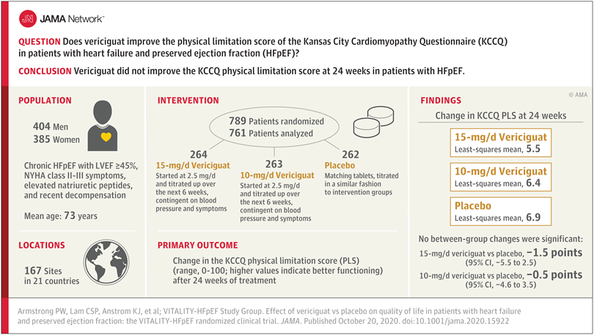
Effect of Vericiguat vs Placebo on Quality of Life in Patients With Heart Failure and Preserved Ejection Fraction
The VITALITY-HFpEF Randomized Clinical Trial

Slide 51
ONGOING TRIALS
VICTOR Trial (Phase III)—
Designed to evaluate vericiguat in ambulatory HFrEF patients without recent worsening events, unlike the earlier VICTORIA trial which focused on high-risk patients.
Design: Randomized, double-blind, placebo-controlled; ~6,105 participants; vericiguat titrated up to 10 mg daily vs placebo; primary endpoint: time to cardiovascular death or heart failure hospitalization
Timeline: Recruitment began November 2021; primary completion around November 2024; full study completed by February 2025

Slide 52
VICTOR Trial (Phase III)—
Results: Presented at ESC Congress 2025:No significant reduction in the primary composite endpoint (18.0% vs 19.1%, HR 0.93; p = 0.22).
However, cardiovascular death was numerically lower (9.6% vs 11.3%, HR 0.83), and there was a favorable safety profile.

Slide 53
Pooled Analysis: VICTORIA + VICTOR Analysis
Includes over 11,000 HFrEF patients from both trials spanning high- and lower-risk populations.
Findings: Significant reduction in the composite of cardiovascular death or HF hospitalization (HR 0.91; p = 0.009).Lower cardiovascular mortality (HR 0.89; p = 0.020), HF hospitalization (HR 0.92; p = 0.043), and all-cause mortality (HR 0.90; p = 0.025).Benefits especially pronounced in patients with NT-proBNP ≤ 6000 pg/mL

Slide 54
MCQ-1
A 62-year-old man with ischemic cardiomyopathy (LVEF 28%) is admitted with worsening dyspnea and edema. He was discharged 2 weeks ago after an HF hospitalization and is now on sacubitril/valsartan, carvedilol, spironolactone, and dapagliflozin. His BP is 108/70 mmHg, HR 76/min, creatinine 1.1 mg/dL.Which of the following would be the best next therapeutic addition?
Ivabradine
Vericiguat
Digoxin
Hydralazine + isosorbide dinitrate

Slide 55
Answer: B
Explanation: This patient has HFrEF with a recent worsening event despite GDMT → the ideal candidate profile for vericiguat

Slide 56
MCQ-2
Which drug should not be co-administered with vericiguat?
Loop diuretics
Sacubitril/valsartan
Long-acting nitrates
SGLT2 inhibitors
.

Slide 57
Answer: C
Explanation: Nitrates and PDE5 inhibitors (like sildenafil) interact with vericiguat via excessive cGMP stimulation, risking severe hypotension

Slide 58
THANK YOU

