Slide 1
CONTRAST INDUCED NEPHROPATHY
DR. MITHUN ANILKUMAR
SENIOR RESIDENT
CARDIOLOGY
TDMC

Slide 2
It is generally a reversible cause of AKI that occurs soon after the administration of radiocontrast media.
After intravascular CM injection, immediate renal toxicity may occur and in most cases it remains fortunately free of significant clinical consequences.

Slide 3
Varying terminology to describe CIN has been used, e.g.
  contrast-induced acute kidney injury [Cl- AKl]
  contrast nephropathy
  contrast-associated AKI
Mehran R. hlikolsky E. Contrast-induced nephropathy: definition, epidemiology, and patients at risk. Kidney Int Suppl 2006: S11-15

Slide 4
DEFINITION AND DIAGNOSTIC CRITERIA OF CIN
Most commonly, CI-AKI is defined as
  an absolute serum creatinine (sCr) increase of > or = 0.5 mg/dL (44 Mmol/L) or
  an > or =25% relative increase in sCr from baseline within 48 to 72 hours of CM exposure.
Kidney Disease Improving Global outcomes (KDIGO) working group criteria:
an increase in sCr > or = O.3 mg/dL (*26.5 Mmol/L) within 48 hours; or
an increase in sCr > or =1.5 times the baseline value within 7 days; or
a urine volume less than 0.5 mL/kg/h for 6 hours.

Slide 5
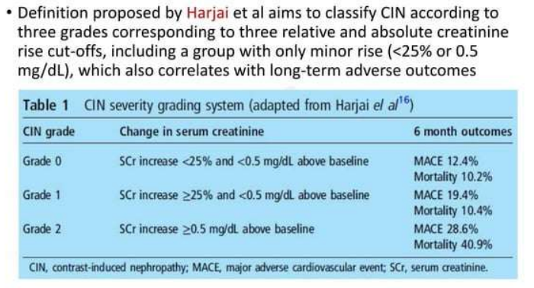

Slide 6
MECHANISMS UNDERLYING CIN
CI-AKI has three potential pathophysiologic mechanisms:
Direct toxicity of nephrons by iodinated contrast material
Micro showers of Atheroembolic to the kidneys, and
Intrarenal vasoconstriction induced by contrast material or atheroemboli.

Slide 7
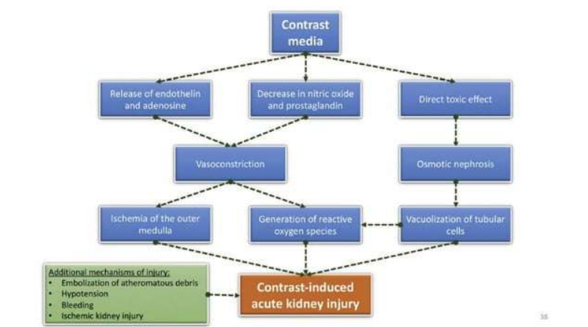

Slide 8
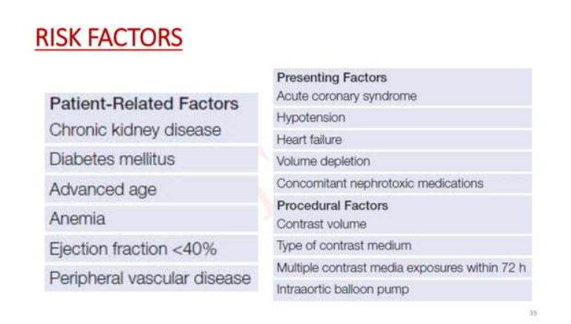

Slide 9
Procedure related risk factors
The total volume of contrast (>350 mL or >4 mL/kg) and previous contrast exposure within 72 h are directly related to the development of CIN.
Ratio of the volume of contrast media to creatinine clearance (V/CrCI) greater than 3.7: 1 correlates strongly with the risk pf developing CIN in patients with moderate CKD undergoing CA.
Periprocedural hemodynamic instability requiring the use of inotropic agents or intra-arterial balloon pump therapy is particularly high-risk feature.

Slide 10
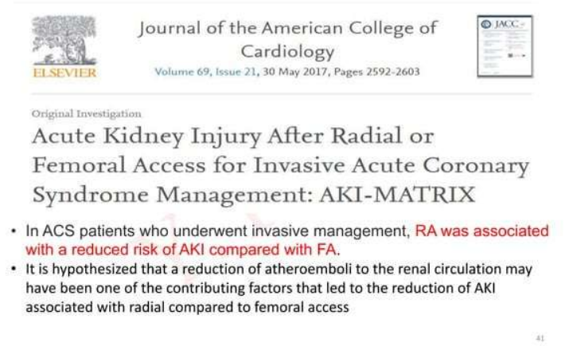

Slide 11
ASSESSMENT OF RISK

Slide 12
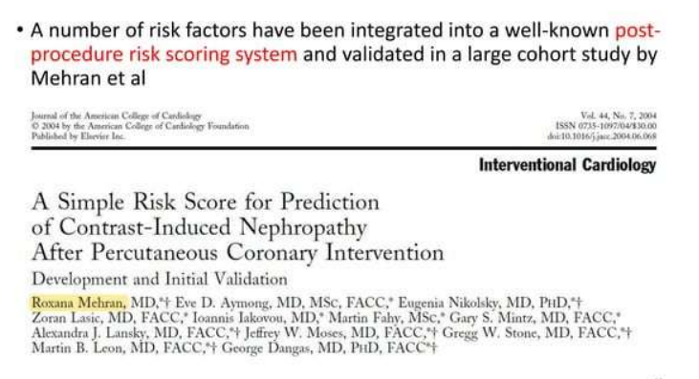

Slide 13
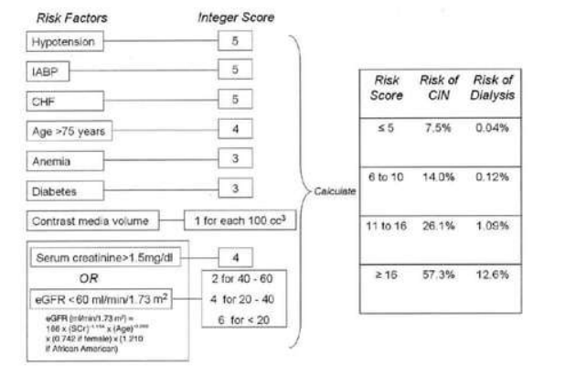

Slide 14
A limitation of this scoring systems is that calculation is only possible after contrast has been administered.
However, it is clinically desirable to be able to predict the risk of CIN before the patient is exposed to contrast allowing appropriate precautionary measures to be taken.
Such a pre-procedural CIN risk score has been proposed by Maioli et al, following validation in a prospective cohort study.

Slide 15
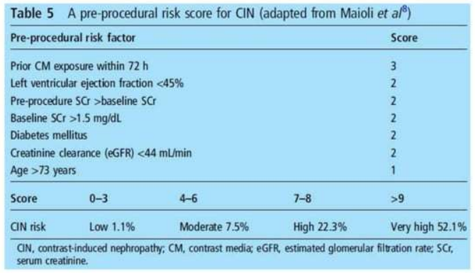

Slide 16
Biomarkers for Risk PrediCTion and Early Detection of Contrast-Induced Acute Kidney Injury

Slide 17
PROBLEMS WITH SCr
Relatively insensitive to the rapid GFR changes seen in AKI ,particularly in patients with normal baseline renal function.
SCr levels are influenced by age, sex, muscle mass , nutritional status, and hydration.
Elevations in SCr typically take 2-3 days to reach the current diagnostic threshold following an acute renal insult, thus reducing its usefulness as a marker of AKI.

Slide 18
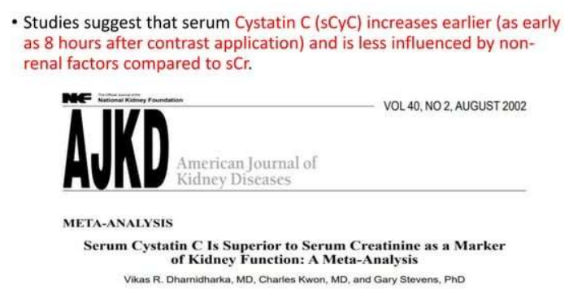

Slide 19
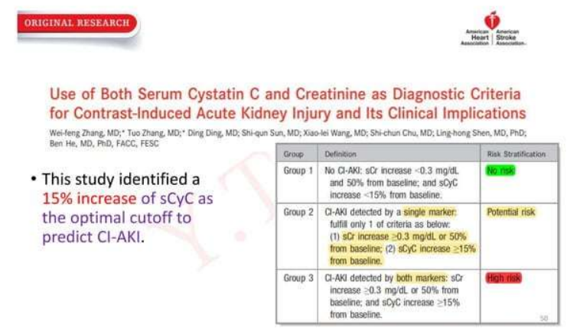

Slide 20
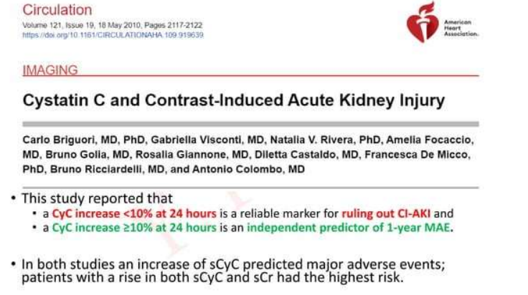

Slide 21
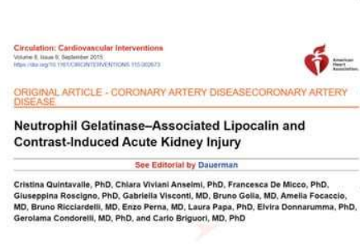
Neutrophil Gelatinase-Associated Lipocalin
NGAL is a reliable marker for the early detection of CI-AKI and prediction of 1-year major adverse events
Serum and urine NGAL levels rise within 2 and 4 hours ,respectively , after contrast administration.
Urine NGAL less than 2O ng/mL arid serum NGAL less than 179 ng/mL at 6 hours were identified as cutoffs to rule out CI- AKI.

Slide 22
Other biomarkers that have been investigated for the early detection and risk assessment of CI-AKI include:
serum liver fatty acid-binding protein (L-FABP),
serum kidney injury marker 1 (KIM-1), and
urine interleukin 18 (IL-18).

Slide 23
PROGNOSIS OF CONTRASTINDUCED ACUTE KIDNEY INJURY
CIN is often regarded in clinical practice as a transient event.
In up to 80 % of cases, SCr levels normalize after approximately 1—3 weeks.
However, CIN is of clinical importance as a number of clinical trials have revealed that it portends a multitude of short- term and long-term adverse events.

Slide 24
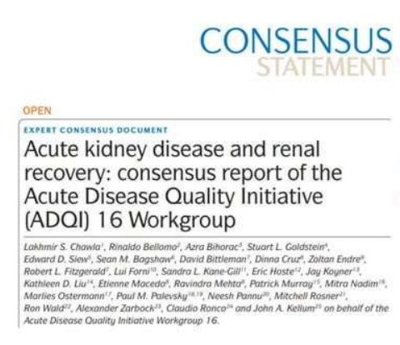
Resolution of an AKI episode within 48 hours is associated with better outcomes than longer durations of AKI
Patients with AKI episodes persisting beyond 7 days are more likely to develop CKD.

Slide 25
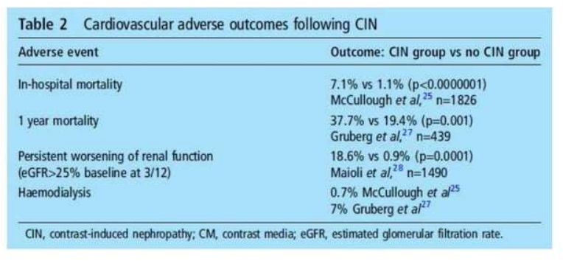

Slide 26
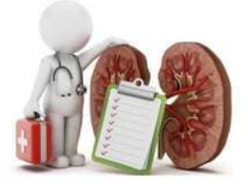
PREVENTION STRATEGIES TO MINIMIZE CONTRAST-INDUCED ACUTE KIDNEY INJURY

Slide 27
For all patients referred for procedures using contrast, a CIN risk assessment should be performed which includes
baseline measurement of SCr and
calculation of eGFR using a suitable formula, for example, Modification of Diet in Renal Disease or Chronic Kidney Disease Epidemiology.
If patients are identified as being at risk of CIN, particularly if eGFR is <40 mL/min, clinical indications for the contrast procedure should be reviewed and preventative measures instigated.

Slide 28
Minimising contrast volume
The maximal acceptable contrast dose (MACD) which is defined as
“5 mL x body weight (kg)/baseline serum creatinine {mg/dl ]
This value should not be exceeded.
A single invasive approach should idealIy be adopted, with CAG followed by ad hoc PCI to reduce the risk of atheroembolic complications while minimizing contrast volumes to <4 mL/kg or V/CrCl < 3.7.1
A slight reduction in contrast volume was documented with the use of an automated contrast injector system, although it did not impact the occurrence of CI-AKI.

Slide 29
The lower the eGFR, the less contrast material may cause CI-AKI
In general, it is desirable to limit the contrast medium to less than 30 mL for diagnostic procedure and less than 100 mL for an interventional procedure.
If staged procedures are planned and CI-AKI has occurred with the first procedure, it is advantageous to have more than 10 days between the first and second contrast exposures.

Slide 30
“Ultra-low contrast coronary angiography”
It uses meticulous contrast sparing techniques such as
Use small diameter catheters (i.e., 5-6 French) without side-holes
Limit the volume of contrast injected from the catheter to 1-2 cmm3 per Injection using a 3-cm3 syringe.
During PCI , prior to exchange of devices such as balloon catheters , remove contrast from the guide catheter by back bleeding contrast out of the “Y” connector

Slide 31
If available, display previous angiographic images alongside active fluoroscopy screen as a reference to use as guidance during guide wire, balloon , stent and ultrasound passage.
Absolutely no contrast ”puffing” during the procedure.
Use IVUS liberally for pre-assessment of the lesion, selection of therapeutic modalities and post-PCI result assessment.
These techniques can reduce contrast load during diagnostic and PCI procedures to under 10 to 20 cc.

Slide 32
Dedicated devices to reduce overall CV have been developed.
The DyeVert PLUS system is a device that is connected between the injection syringe and the manifold via a 4-way stopcock, allowing diversion of excess contrast during manual injection.
The fraction of CM that would not contribute to coronary opacification, but rather would reflux into the aortic root, is diverted into a reservoir chamber.
In initial trial, there were no differences in the rates of CI-AKI.

Slide 33
The next-generation DyeVert system was evaluated in a multicenter single-arm pilot study, in which up to 40% of CV was saved (p <0 0001)
Future research is needed to assess whether this reduction in CV translates into clinically meaningful benefit.

Slide 34
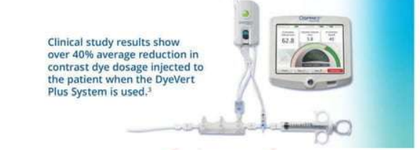

Slide 35
The type of CM plays an important role in the development of CI-AKI.
Low-osmolar CM (LOCM) compared to high-osmolar CM (HOCM) has decreased the risk of CI-AKI regardless of pre-existing CKD; therefore, LOCM is favored in current clinical practice.
A benefit of iso-osmolar CM (IOCM) over LOCM with regard to CI-AKI is uncertain due to mixed results of available studies on this topic.

Slide 36
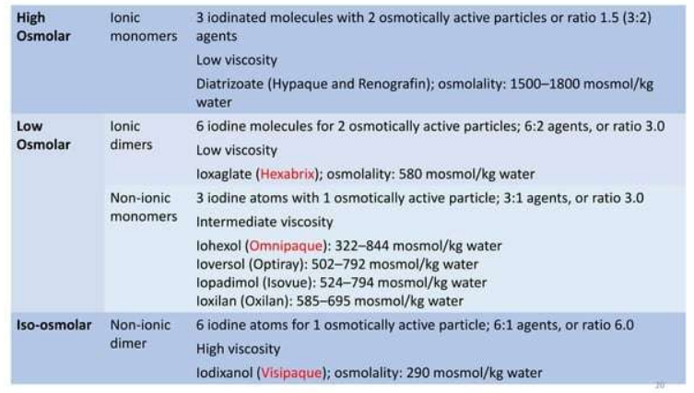

Slide 37
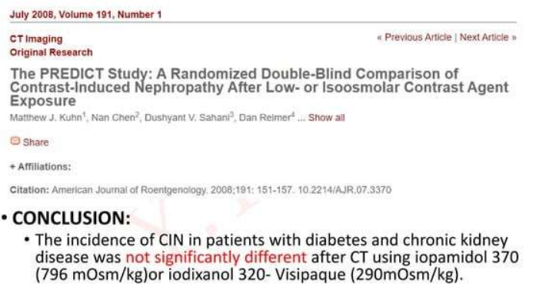

Slide 38
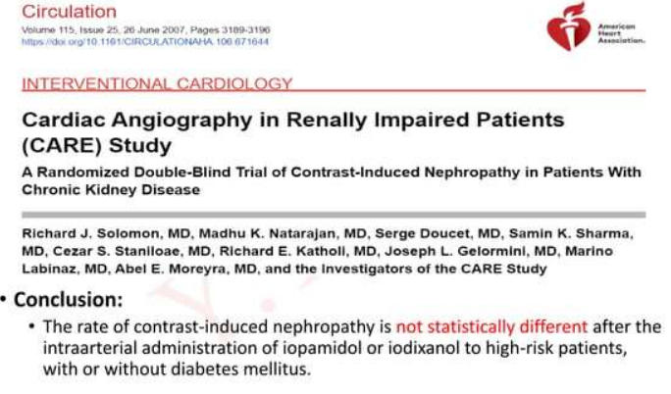

Slide 39
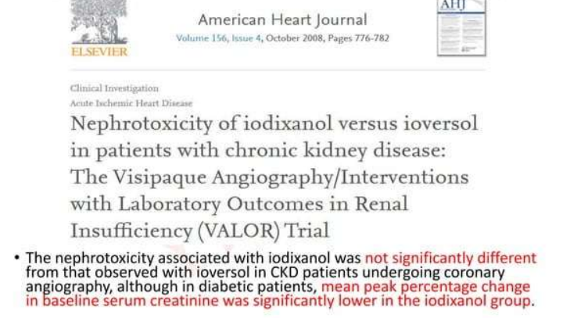

Slide 40
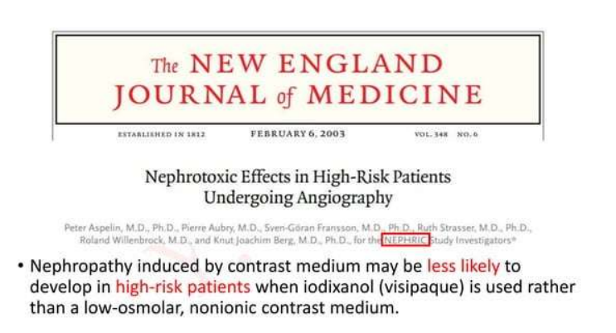

Slide 41
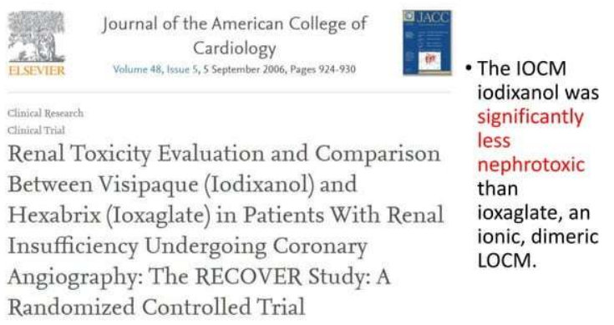

Slide 42
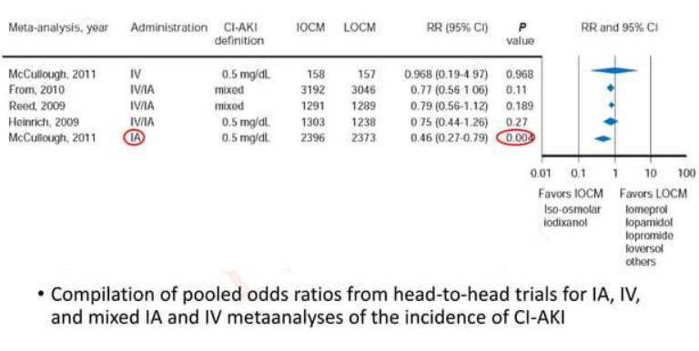

Slide 43
Patients should be advised to stop all non-essential nephrotoxic medications for 24h prior to and for 48 h following the contrast procedure pending SCr measurement.
It is also recommended that patients receiving intra-arterial contrast with an eGFR of <60mL/min/1.73 m2, or those receiving intravenous contrast with an eGFR of <45 ml/min/1.73 m2, discontinue metformin for 48 h prior to contrast exposure and restart once a 48 h SCr measurement excludes CIN.
This is to mitigate the risk of lactic acidosis due to reduced renal clearance of metformin that may occur following a potential ClN episode, rather than metformin nephrotoxicity per se.

Slide 44
PERIPROCEDURAL HYDRATION
The most effective prophylactic intervention prior to contrast exposure.
Supplementing Intravascular volume ensures renal blood flow is maintained and acts to dilute contrast in both blood plasma and tubular filtrate.
In lower risk ambulant patients, the oral route may be appropriate if adequate fluid intake is assured.
However, in moderate/higher risk or in hospitalized patients intravenous hydration with a crystalloid fluid is preferred over oral hydration as it guarantees delivery of appropriate fluid volumes and has been demonstrated as superior in clinical trials.

Slide 45
The choice of which crystalloid to use is, however, less clear.
When compared with isotonic (normal) saline (0.9%), intravenous sodium bicarbonate (1.26%) may have additional ROS scavenging, properties mediated through urine alkalinization and lacks chloride ions that are thought to exacerbate renal vasoconstriction.
In view of the current lack of evidence supporting the use of sodium bicarbonate 1.26% and with some studies offering conflicting evidence, the current ESC guidelines recommend pre-hydration with sodium chloride 0.9%.
For elective day case patients and for those with CCF in whom large volumes of intravenous fluid may provoke pulmonary oedema, it is also reasonable to use an alternative protocol delivering a shorter duration and volume of sodium chloride 0.9%.

Slide 46
In AMACING (A Maastricht Contrast-Induced Nephropathy Guideline) randomized trial, intravenous 0.9% sodium chloride was directly compared with no prophylaxis in 660 patients with an estimated GFR of 30—59mL/min/1.73m’ undergoing an elective procedure requiring iodinated contrast material.
Within 2 - 6 days after contrast exposure, no prophylaxis was non -inferior to intravenous hydration for the prevention of CIN’ and cost-saving.

Slide 47
However, the validity of this finding is diminished by substantial under enrollment, low rates of intraarterial procedures (48%) and interventional procedures (16%), and moderate chronic kidney disease in a majority of patients.
Given the known impact of low effective circulating volumes an the risk of CIN, there is still consensus that adequate hydration is needed to prevent CIN.

Slide 48
IVF Infusion Rate to Prevent CIN
IVF = 1 ml/kg/hr (max 100 ml/hr), 12 hours pre and upto 24 hours post procedure
CHF (NYHA > 2) or LVEF < or = 35% = 0.5 ml/kg/hr (Max 50 mi/hr)
Emergent procedure? (Suggested regimen)
Fluid bolus of 3mI/kg prior to procedure. Hydration during procedure and 12 hrs after if possible

Slide 49


Slide 50
The optimum rate and volume of intravenous fluid delivery a significant challenge:
underhydration increases CIN risk.
overhydration may precipitate acute pulmonary oedema in vulnerable patients with severe CKD and CCF.
Two hydration optimisation strategies have been trialled in CIN:
  LV end diastolic pressure (LVEDP) guided volume expansion and
  high urine output matched fluid replacement (RENALGUARD).

Slide 51
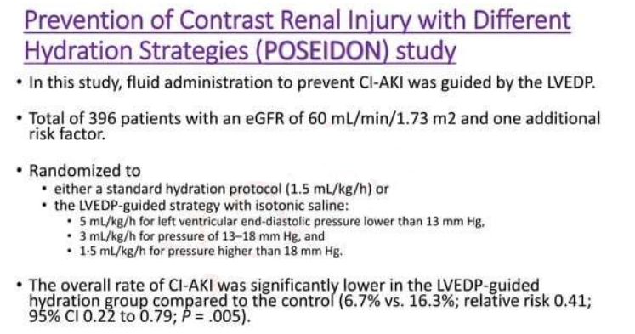

Slide 52
Renal Guard system
The concept of renal guard system is based on measuring urine putput by a foley catheter and simultaneously infusing an equivalent volume of isotonic saline
After a 250 mL bolus of saline at 90 minutes prior to contrast application, a continuous infusion of IV furosemide 0.25 to 0.5 mg/kg is started.
The system automatically adjusts the rate of the continuous IV saline infusion to maintain a urine output rate greater than 300mL/h throughout the procedure and for 4 hours thereafter.

Slide 53
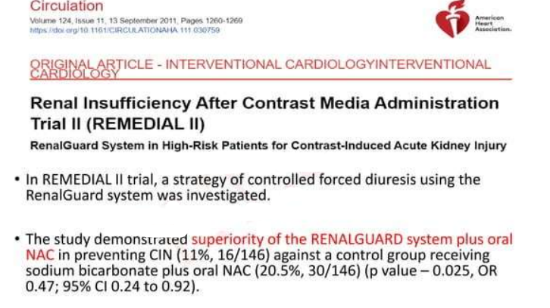

Slide 54
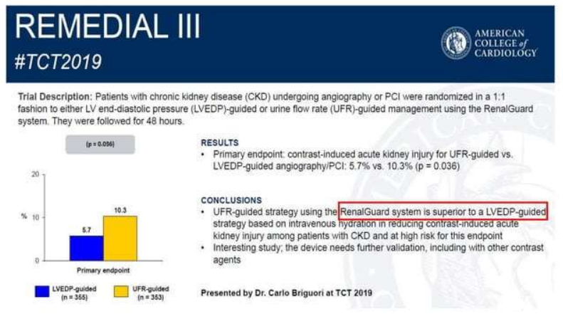

Slide 55
N-Acetyl Cysteine and Sodium Bicarbonate
N-acetyl cysteine (NAC) is assumed to limit Cl-AKl by acting as a scavenger of ROS and promoting vasodilatory effects in the renal medulla.
It has been widely investigated for the prevention of CI-AKI with mixed results.
Earlier trials with small sample sizes suggested a potential benefit of NAC, whereas larger studies failed to show a significant reduction in CI-AKI.

Slide 56
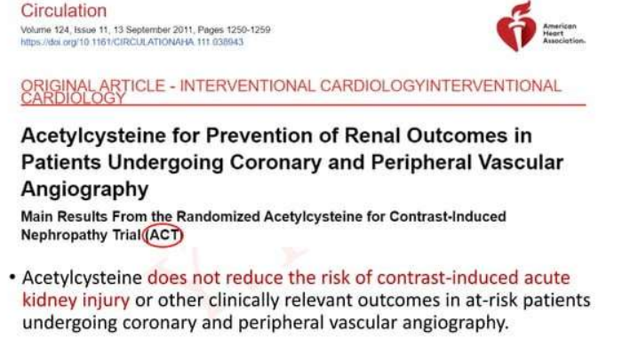

Slide 57
Similarly, isotonic sodium bicarbonate (NaHCO3) was hypothesized to prevent CI-AKI due to inhibition of free-radical formation by alkalinizing the renal tubular fluid.
Although smaller studies suggested a benefit of NaHCO3 administration for CI-AKI prevention, these findings were not confirmed in larger studies.

Slide 58
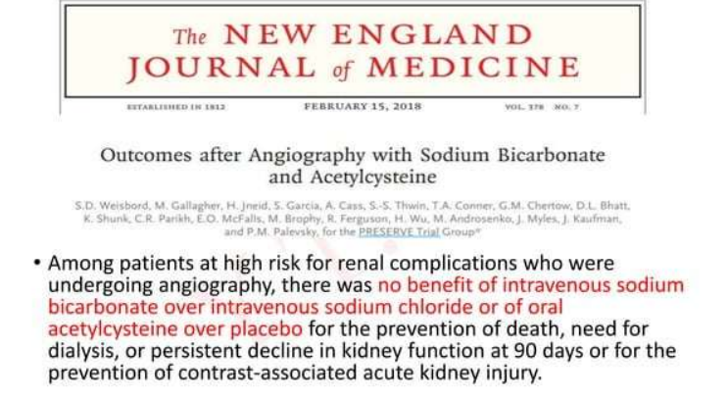

Slide 59
As such the ESC guidelines recommend that NAC is not to be used alone, although it may be used in addition to standard intravenous hydration regime .
KDIGO guidelines recommend using oral NAC together with IV isotonic crystalloids, in patients with increased risk of CI- AKI.
Routine use of NAC for CI-AKI prevention is class III in the ACC/AHA guidelines.

Slide 60
STATINS
More recently high-dose statin therapy (eg, rosuvastatin 40/20 mg, atorvastatin 80 mg or simvastatin 80 mg) has shown efficacy in preventing CIN in statin-naive patients
Initial PROMISS trial investigated short-term pretreatment with high- dose simvastatin in patients with baseline renal insufficiency undergoing coronary angiography and did not show a benefit of this strategy with regard to deterioration of renal function.

Slide 61
PRATO-ACS trial showed that high-dose rosuvastatin (40 mg loading and 20 mg/day maintenance) compared to no statin significantly reduced CI-AKI and 30-day rates of cardiovascular and renal events (death, dialysis, MI, stroke, Dr persistent renal damage) in statin-naive patients undergoing PCI.
TRACK-D study was the largest trial investigating the role of statins in CI-AKI prevention.
A significant reduction of CI-AKI was reported for the statin group compared to the control (2.3% vs. 3.9%; P -— .01).

Slide 62
IMPACT OF OXYGEN THERAPY FOR PREVENTION OF CIN

Slide 63
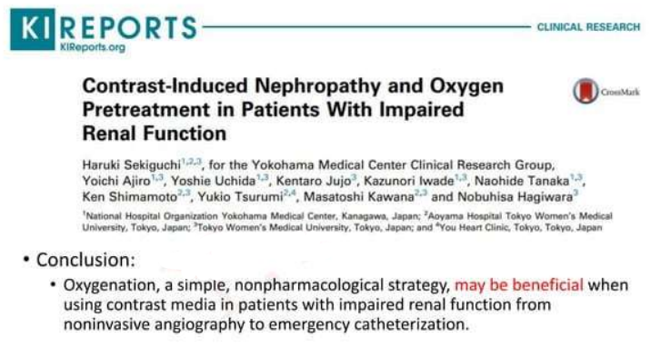

Slide 64
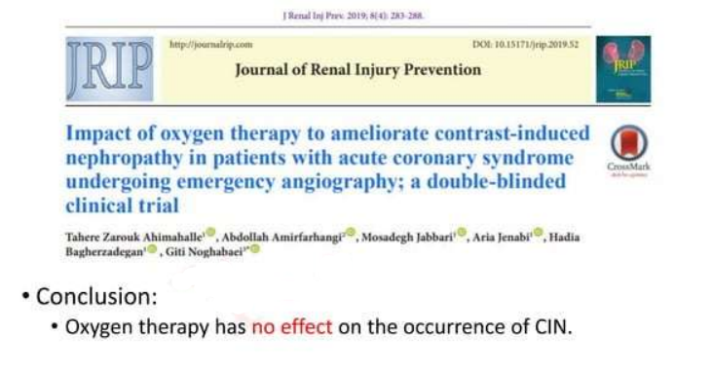

Slide 65
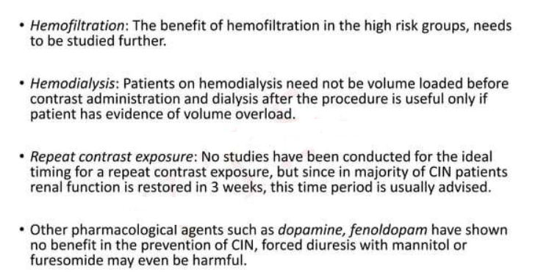

Slide 66
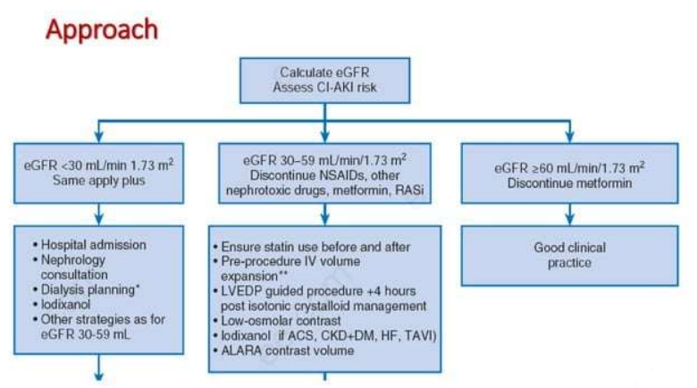

Slide 67
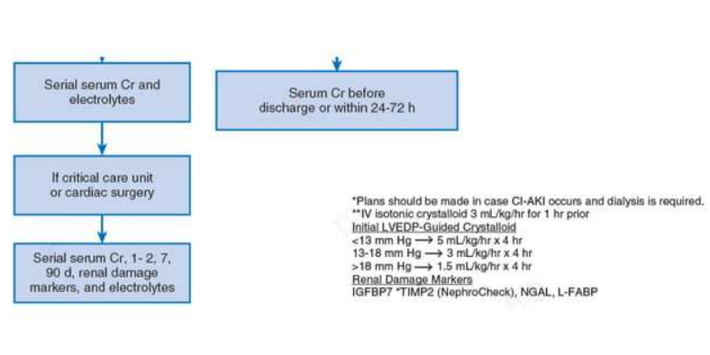

Slide 68
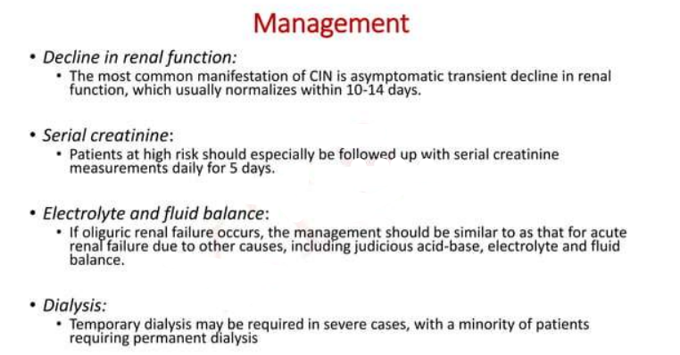

Slide 69
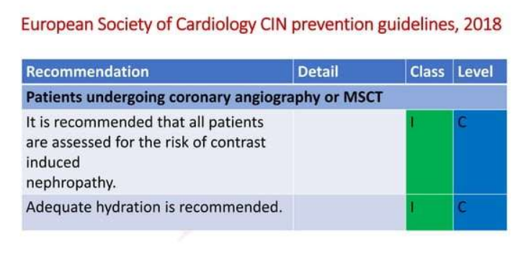

Slide 70
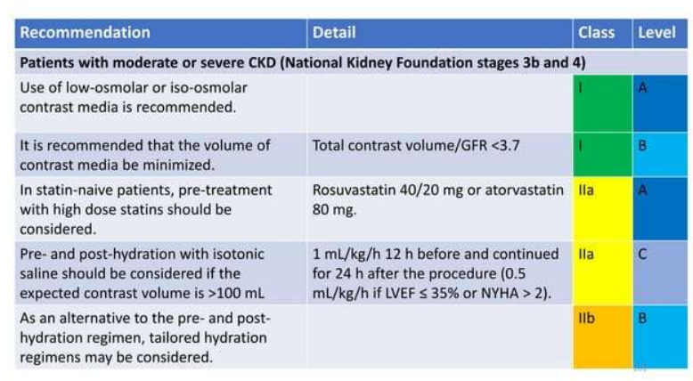

Slide 71
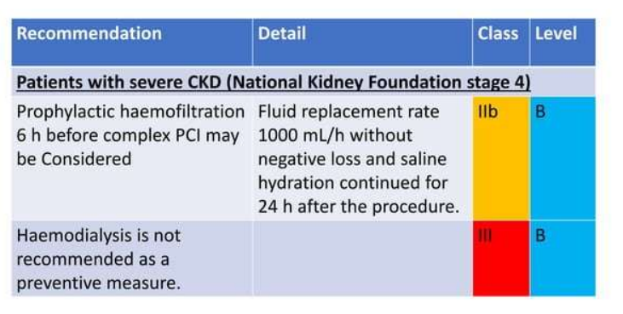

Slide 72
  Serum creatine usually peaks after contrast exposure in:
  6 hr
  24 hr
  48-72 hr
  7 days

Slide 73
48-72 hr

Slide 74
The strongest risk factor for CIN:
Age >70
Dm
Pre –existing renal impairment
High contratst volume

Slide 75
Pre existing renal impairment

Slide 76
Which is preffered in high risk patients with CKD?
Iohexol
Iodixanol
Urograffin
Diatrizoate

Slide 77
iodixanol

Slide 78


