Slide 1
DILATED CARDIOMYOPATHY
Dr. Aiswarya Ravikrishnan

Slide 2
Definition
Dilated cardiomyopathy (DCM) is a chronic heart muscle disease characterized by:
Dilatation and systolic impairment of the left or both ventricles,
Not explained by abnormal loading conditions (e.g., hypertension, valve disease) or coronary artery disease.
AHA definition: Ventricular chamber enlargement and systolic dysfunction with normal wall thickness.
Represents a primary myocardial disease (cardiomyopathy).

Slide 3
Etiology and Classification
>60% of DCMs are familial (genetic) with identifiable mutations.
Acquired (nongenetic) DCM = DCM phenocopies, caused by environmental or other non-genetic factors (e.g., toxins, infections, autoimmune).
Genetic DCM → inherited and often irreversible.
Nongenetic DCM → acquired and sometimes reversible.
Ischemic heart disease may mimic a DCM phenotype but is classified separately.

Slide 4
DCM is the final common pathway (end phenotype) of various myocardial injuries.
Mechanisms are better understood with:
Genetic and molecular assays,
Advanced imaging,
Novel biomarkers.
Intermediate/early DCM:
Borderline LV dilatation or dysfunction,
May present with arrhythmias or conduction disease.
Preclinical stage:
Seen in genetically affected but phenotypically normal relatives.

Slide 5
Epidemiology
Incidence: ~6 per 100,000 person-years.
Prevalence: ~36.5 per 100,000 person-years (~1 in 2,500).
Data largely from phenotype-based studies (pregenetic era).
With family screening, genetic testing, and early diagnosis, the prevalence is expected to rise.
When classified by specific etiology, most DCM subtypes are rare diseases (<1 in 2,000).
The overall burden of DCM — especially familial DCM (FDCM) — is dynamic and evolving, needing updated epidemiological studies.

Slide 6
Clinical Presentation
Typical manifestation: Systolic heart failure.
Common symptoms (nonspecific):
Fatigue
Dyspnea (breathlessness)
Palpitations
Signs of congestion or fluid retention (edema, ascites, raised JVP)
Symptoms occur in the presence of structural cardiac abnormalities consistent with DCM.

Slide 7
Diagnostic Criteria
Left Ventricular (LV) Systolic Dysfunction:
↓ LV ejection fraction (LVEF) on 2D echocardiography.
LV Dilatation:
LV end-diastolic volume/diameter > 2 SD (Z-score > +2) above normal,
Adjusted for body surface area, height, and age.

Slide 8
Coronary Artery Disease (CAD) Exclusion
Essential step to rule out ischemic etiology.
Investigations:
Coronary angiography → gold standard to exclude atherosclerosis.
CT coronary angiography → noninvasive alternative.
If ≥1 epicardial artery shows flow-limiting stenosis, DCM is secondary to CAD.
However, CAD and genetic DCM can coexist, requiring individualized assessment.
Functional testing (e.g., myocardial perfusion imaging) may help assess ischemia extent.

Slide 9
Cardiac Magnetic Resonance (CMR)
Now part of routine DCM evaluation.
Provides:
Confirmation of diagnosis,
Assessment of myocardial fibrosis (late gadolinium enhancement),
Identification of LV noncompaction (LVNC) or hypertrabeculation patterns.

Slide 10
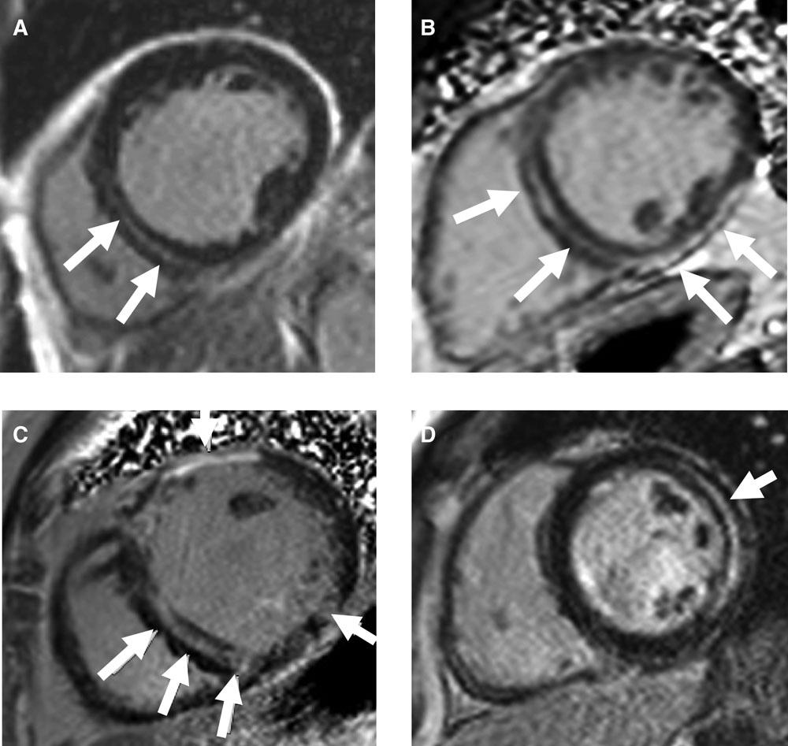

Slide 11
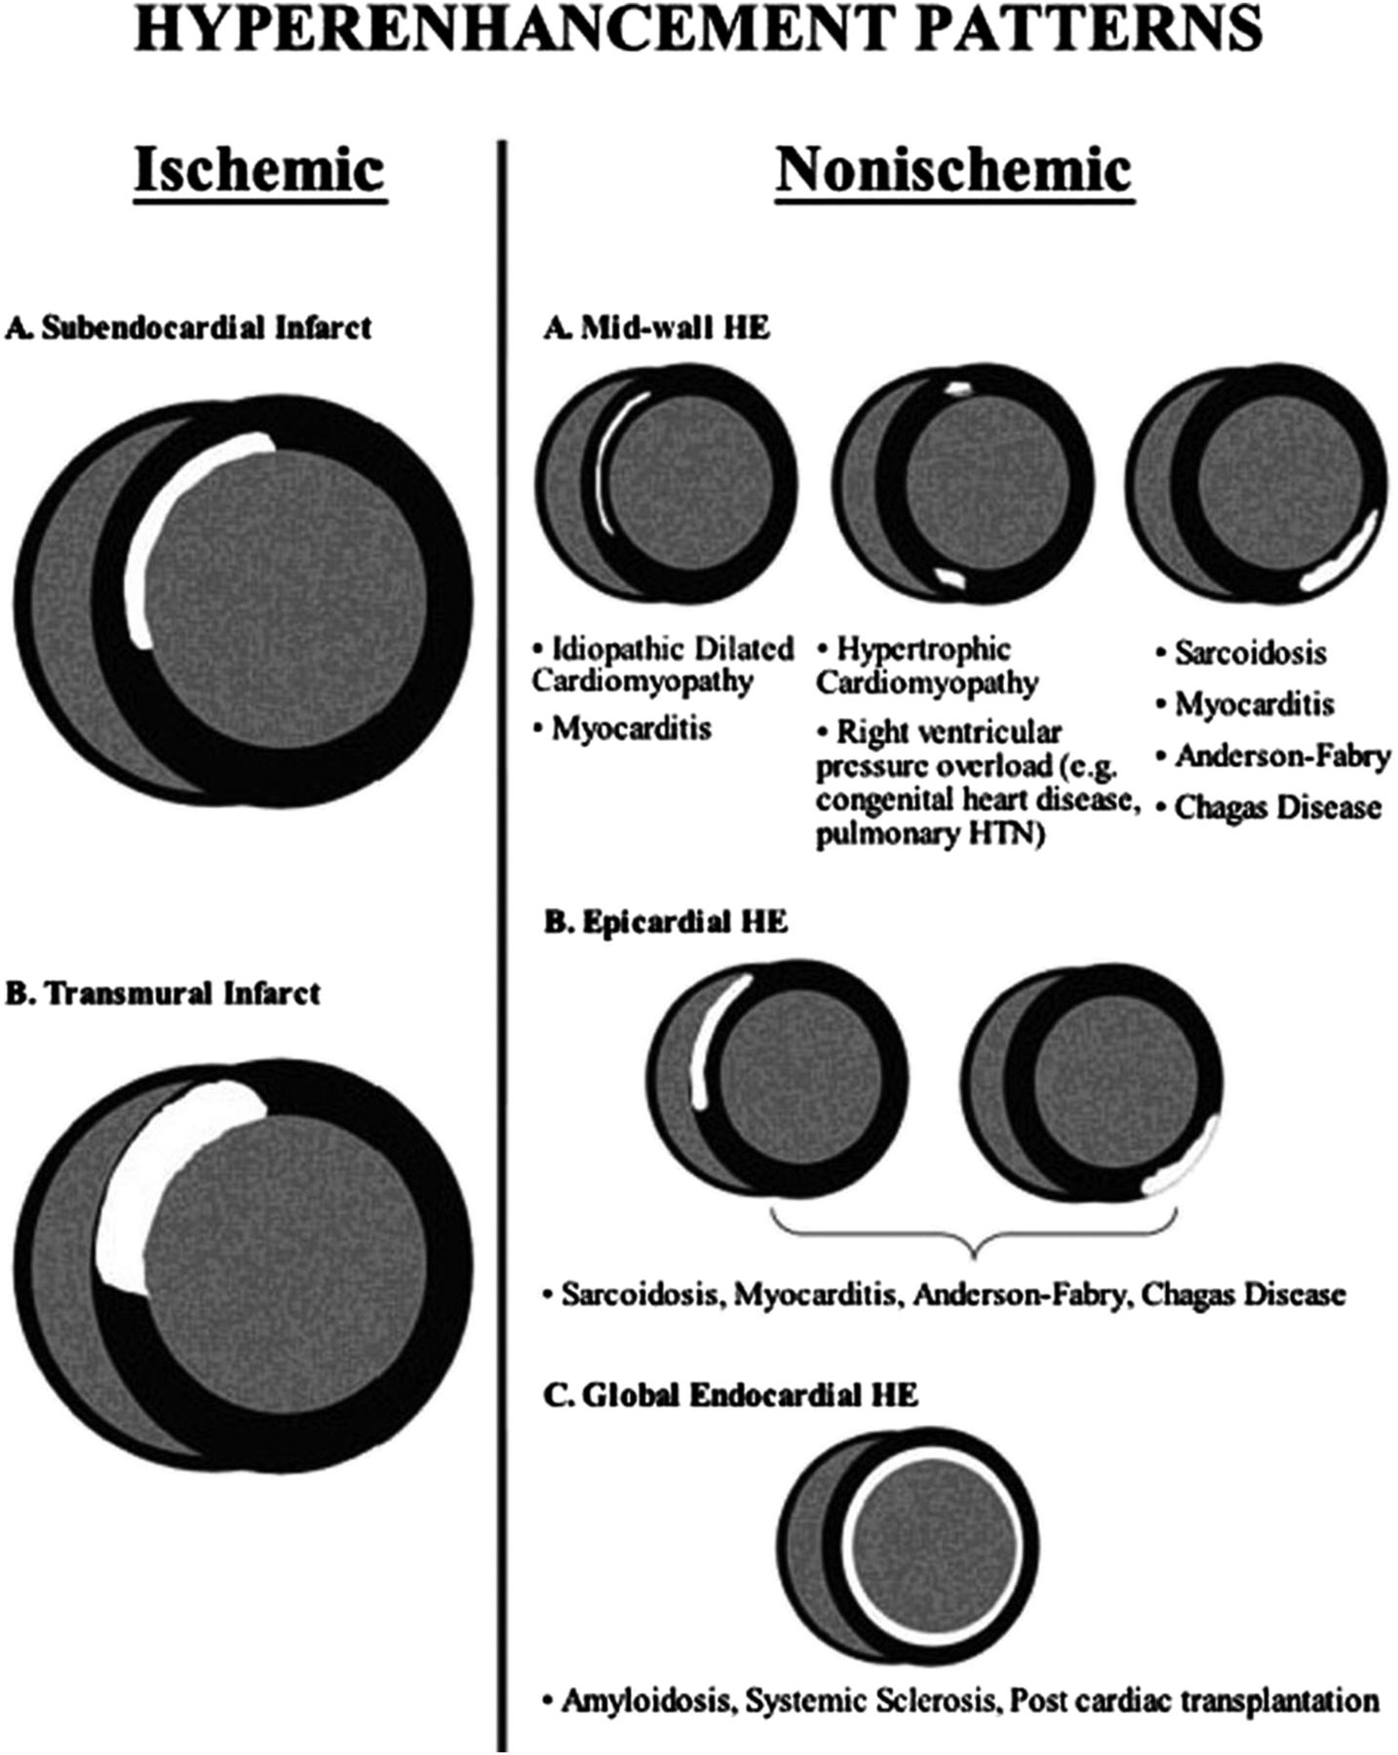

Slide 12
Echocardiographic Advances
3D echocardiography:
Improves visualization of valvular anatomy and ventricular remodeling,
Useful when 2D echo views are limited.
Contrast echocardiography:
Enhances endocardial border definition,
Improves accuracy of volume measurements,
Helps assess trabecular anatomy,
Used selectively (not routine).

Slide 13
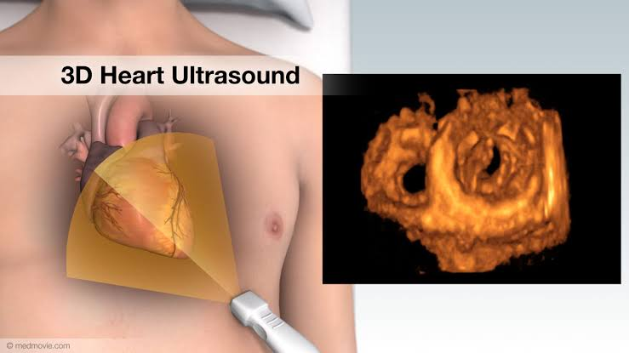

Slide 14
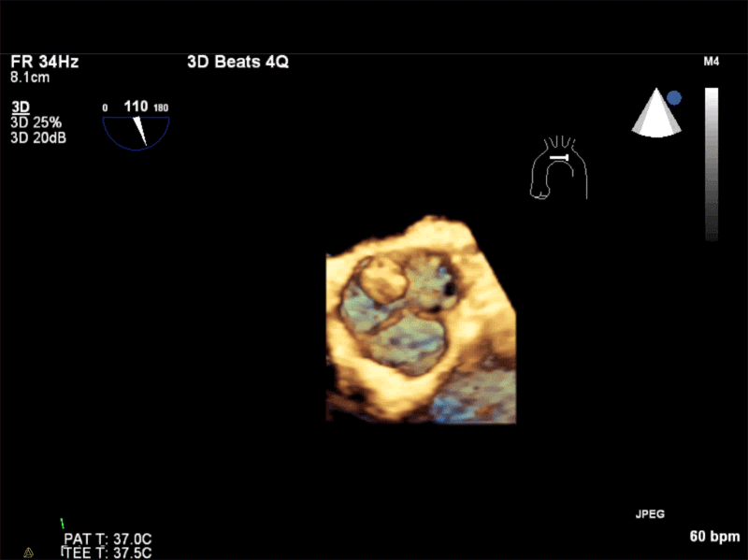

Slide 15
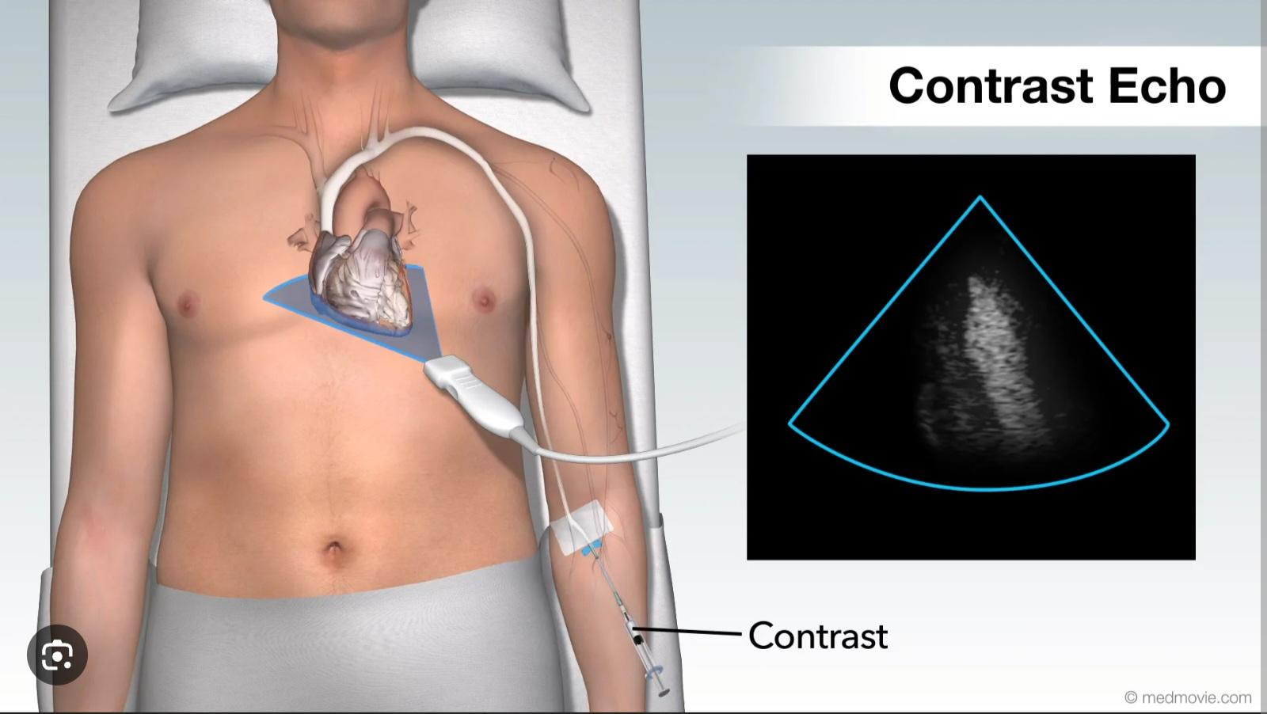

Slide 16
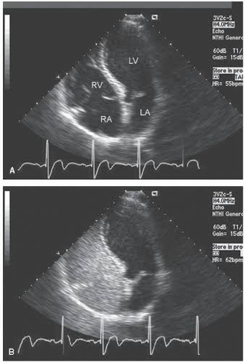

Slide 17
Emerging Imaging Techniques
Myocardial deformation imaging (strain analysis by echo).
Myocardial tagging (by CMR):
Useful for detecting subtle or early DCM phenotypes before overt dysfunction develops.

Slide 18
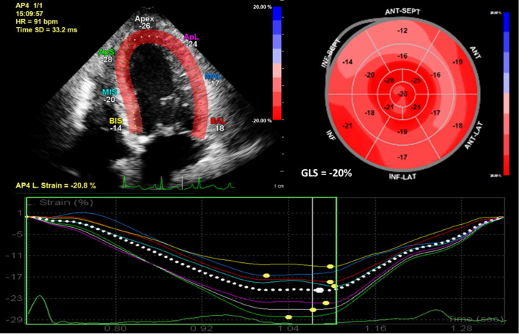
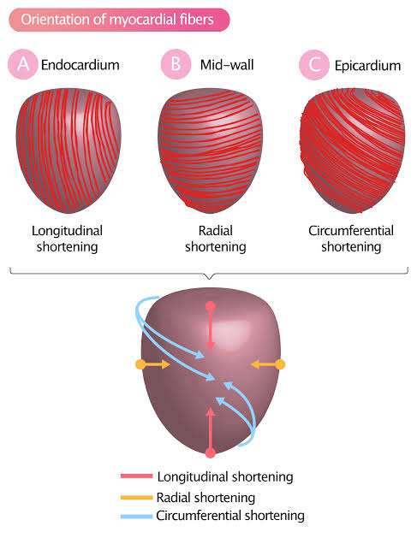

Slide 19
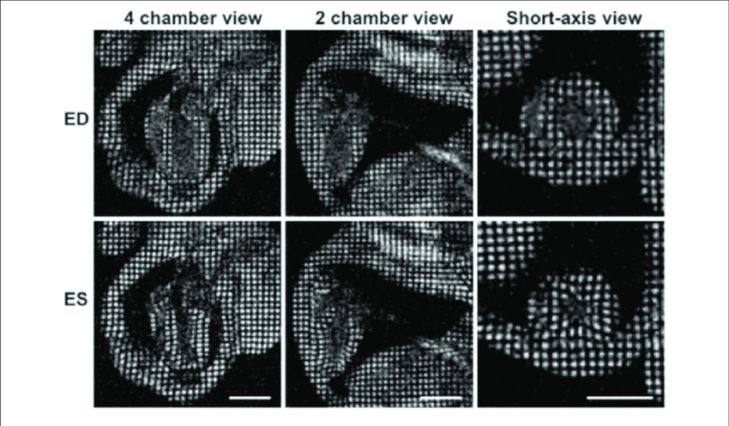

Slide 20
Diagnosis of Familial Dilated Cardiomyopathy (FDCM): The Role of Family Screening
>60% of Dilated Cardiomyopathy (DCM) cases are familial (genetic).
Familial DCM (FDCM) is diagnosed when ≥2 members of the same family are affected.
Family screening identifies symptomatic and asymptomatic carriers, enabling early diagnosis and intervention.

Slide 21
Three-Step Diagnostic Approach
.1. Deep Phenotyping in the Proband
Comprehensive evaluation of systemic features:
Anthropometry, integument (skin), hair, vision, musculoskeletal, auditory, and nervous systems.
Detects syndromic or extracardiac traits linked to genetic forms.
Provides essential data for genotype–phenotype correlation and family segregation studies.

Slide 22
.2. Genetic Counseling
Construction of a detailed pedigree.
Educate patients about the importance of family studies in suspected genetic disease.
Collect clinical history of living and deceased relatives to interpret familial disease patterns and fatal events.

Slide 23
.3. Family Screening
Conducted independent of genetic testing.
Involves:
Physical examination
Electrocardiography (ECG)
Transthoracic echocardiography (TTE)
Biochemical testing (e.g., CK, lactic acid)
Regular monitoring of relatives is recommended.
Results may refine the pedigree and clarify mode of inheritance (autosomal dominant, recessive, X-linked, etc.).

Slide 24
Findings in Relatives
Relatives of DCM patients may show:
Asymptomatic disease: Fulfilling diagnostic criteria but clinically silent.
Early/persistent LV remodeling or borderline LV dysfunction.
ECG abnormalities, such as:
Conduction disease
Short PR interval / Wolff–Parkinson–White pattern
Prolonged QT interval
T-wave inversion or early repolarization changes
Abnormal QRS voltages (high/low).
Biochemical markers: ↑ Creatine phosphokinase (CPK) or lactic acid.

Slide 25
Extracardiac manifestations:
Hearing loss
Diabetes mellitus
Cutaneous lesions
Skeletal deformities
Facial dysmorphism
Ocular defects

Slide 26
Clinical Importance of Family Screening
Enables detection of preclinical or early disease stages.
Provides insight into disease natural history and age-related penetrance.
Essential for accurate diagnosis of FDCM, risk stratification, and preventive management in at-risk relatives.
Helps distinguish genetic vs. sporadic forms of DCM.

Slide 27
MOGE(S) Nosology System in Dilated Cardiomyopathy (DCM)
Dilated Cardiomyopathy (DCM) can appear phenotypically similar despite being caused by different genetic defects.
The MOGE(S) nosology system provides a precise, standardized way to describe and classify cardiomyopathies by combining morphology, genetics, and clinical status.
Proposed by the World Heart Federation

Slide 28
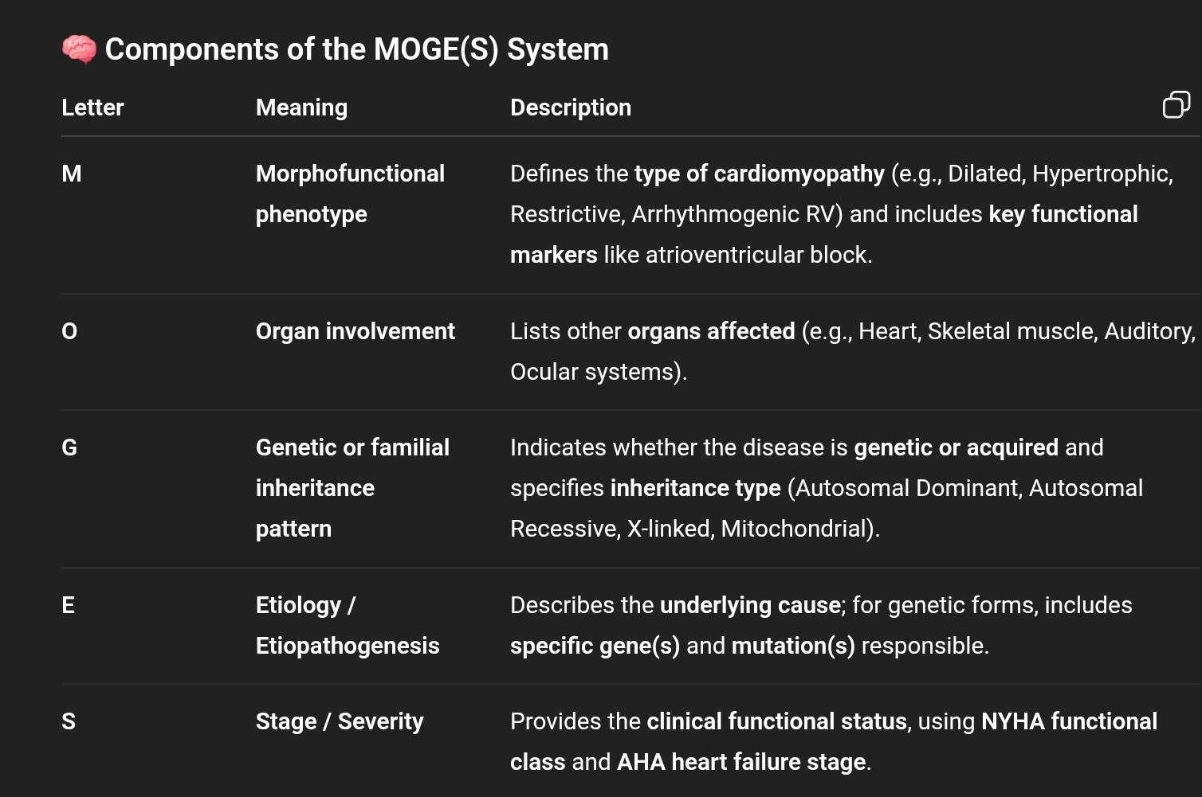
COMPONENTS OF MOGE(S) SYSTEM

Slide 29
Purpose and Significance
Ensures precise and personalized description of cardiomyopathy.
Helps differentiate phenotypically similar but genetically distinct DCMs.
Facilitates research, communication, and genetic counseling.
Enables tracking of disease progression and prognosis using standardized terminology.

Slide 30
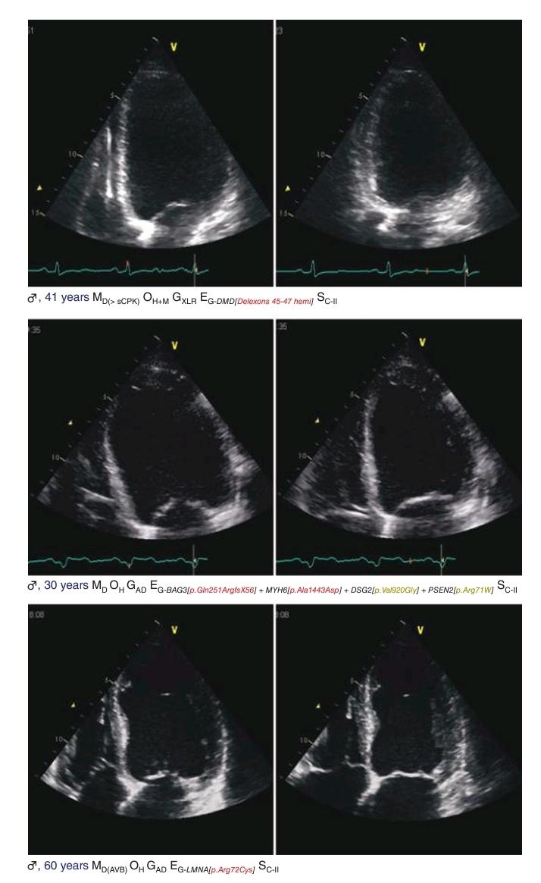

Slide 31
GENETIC DILATED CARDIOMYOPATHY
Inheritance and Phenotype Variability
>60% of DCMs are familial, confirming a strong genetic basis.
Follows Mendelian inheritance patterns or matrilineal (mitochondrial) transmission.
Most common inheritance pattern:
Autosomal Dominant (AD) — majority of familial DCM (FDCM).

Slide 32
Mitochondrial DNA Mutations and Systemic Involvement
Mitochondrial DNA mutations → may cause dilated or hypertrophic phenotypes; hypertrophy may evolve into DCM over time.
Associated extracardiac features can guide suspicion:
Skeletal myopathy
Sensorineural hearing loss
Ocular defects
Diabetes mellitus
Renal failure
Cognitive impairment / cryptogenic stroke
Cutaneous lesions or facial dysmorphism
Such multisystem involvement helps predict the underlying genetic subtype and pathway affected.

Slide 33
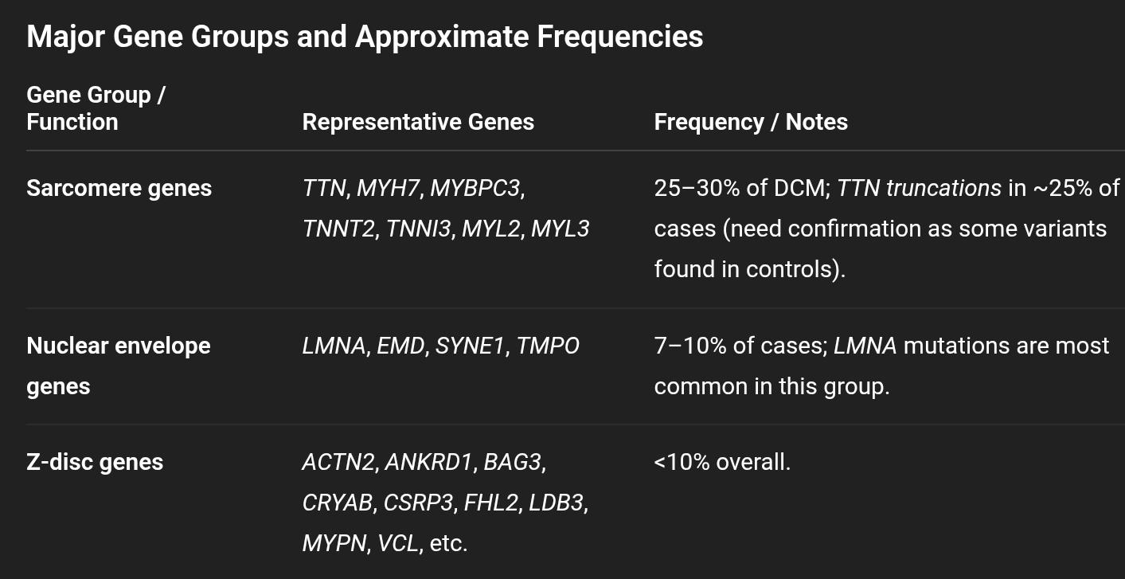
Genetic Heterogeneity
DCM is genetically heterogeneous — similar phenotypes can result from mutations in different genes.

Slide 34
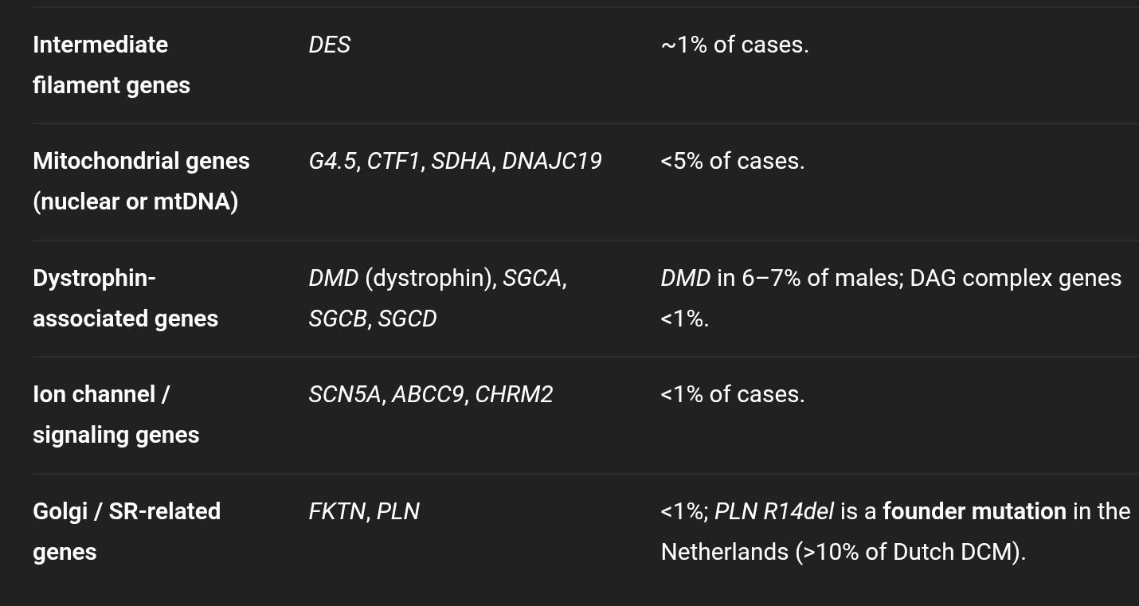

Slide 35
Mechanisms of Myocardial Damage
Multiple molecular mechanisms lead to a final common DCM phenotype, depending on:
The function of the affected gene,
Type of mutation (loss/gain of function, truncation, etc.),
Epistasis (gene–gene interaction), and
Epigenetic factors (modifiers of expression).

Slide 36
Proposed Mechanisms
Haploinsufficiency:
One functional allele insufficient for normal protein production.
Seen in LMNA (laminopathy) and DMD (dystrophinopathy).
Loss or gain of function:
Example: MYH7 mutations —
↑ Contractility → Hypertrophic cardiomyopathy (HCM)
↓ Contractility → Dilated cardiomyopathy (DCM)
Phenotypic overlap:
Some genes cause multiple phenotypes (DCM, HCM, RCM, or ARVC), depending on mutation site and effect.
LMNA and DMD → DCM ± arrhythmias (not HCM).

Slide 37
GENETIC TESTING IN DILATED CARDIOMYOPATHY (DCM)
Modern Testing Approach
Technique:
Next-Generation Sequencing (NGS) with multigene panels is now standard.
Tests both nuclear genes and mitochondrial DNA.
Advantages over Sanger sequencing:
Faster, cheaper, and higher throughput.
Detects variants in >100 candidate genes simultaneously.
Challenge:
Rapid identification of variants outpaces functional validation → many variants of uncertain significance (VUS).

Slide 38
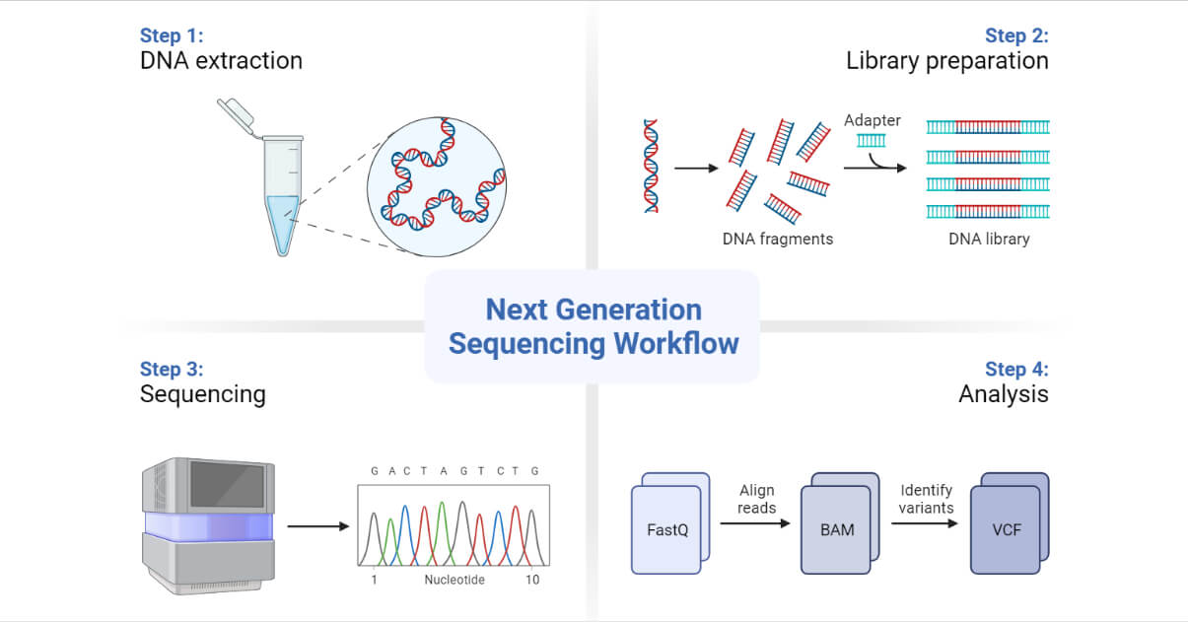

Slide 39
Diagnostic Value
Proven (definite) causal genes:
LMNA, DMD/DYS, and sarcomeric genes (TTN, MYH7, MYBPC3, etc.).
Provisional (unconfirmed) genes:
Genes described in only a few families or small series; need replication.
Genetic yield:
Pathogenic mutations found in ~60% of familial DCM (FDCM) cases.
Implies that 40% remain genetically unexplained → more genes yet to be discovered.
Ethnic / geographic variations:
Founder mutations influence prevalence.
Example: PLN p.(Arg14del) = >10% of Dutch FDCM but rare elsewhere.

Slide 40
Multiple Mutations and Interpretation
Large gene panels (e.g., TTN, DMD, OBSCN) increase chance of finding >1 mutation per person.
Despite multiple variants:
DCM usually remains a single-gene (Mendelian, autosomal dominant) disease.
One major / leading mutation drives disease; others may act as modifiers.
Misinterpretation risk:
Incorrectly labeling a benign variant as pathogenic can cause serious consequences, especially for family screening and prenatal decisions.

Slide 41
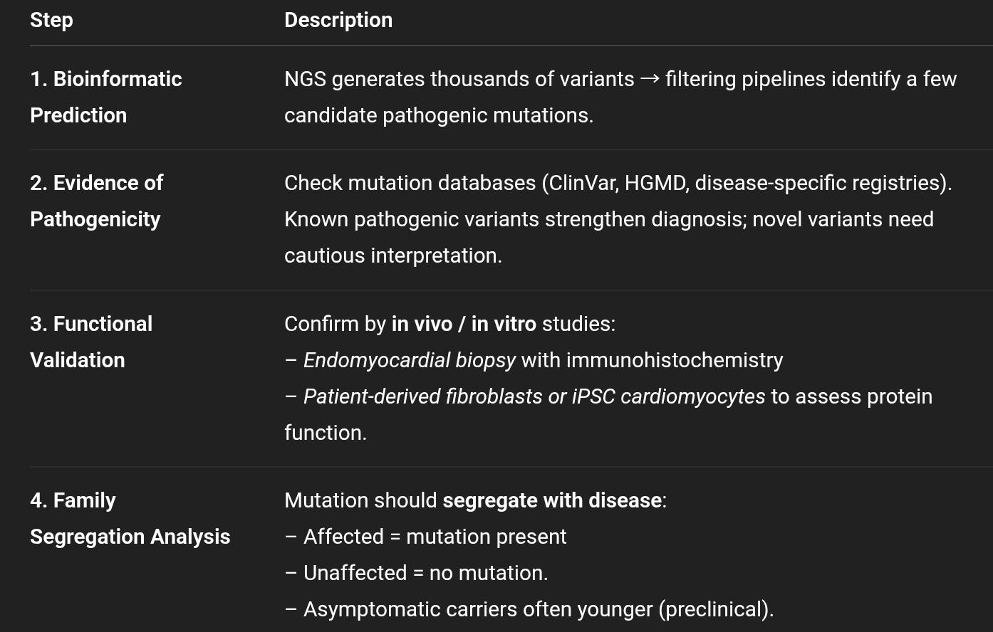
Multistep Process for Mutation Interpretation

Slide 42
Clinical Integration
Purpose of genetic testing:
Confirm diagnosis.
Guide family screening and counseling.
Inform prognosis (e.g., LMNA = high arrhythmia risk).
Enable reproductive decision-making (prenatal / preimplantation testing).
Interpretation requires expertise:
Collaboration between geneticists, cardiologists, and molecular pathologists.

Slide 43
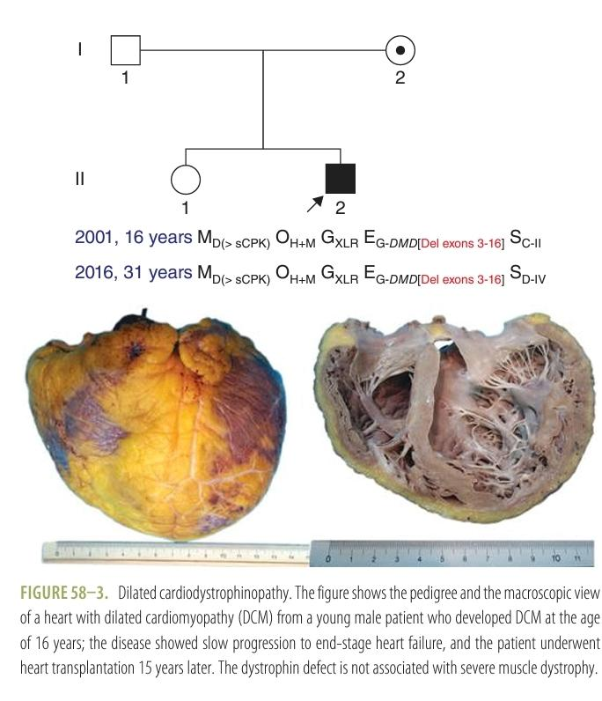

Slide 44
GENETIC DILATED CARDIOMYOPATHY — GROUPING BY DISEASE GENE
Although >100 genes are associated with DCM, only a few are well-validated and repeatedly confirmed.
Each subgroup often shows distinctive clinical patterns, inheritance, and risk of arrhythmia or systemic features — which can guide pretest clinical suspicion and targeted genetic testing.

Slide 45
DILATED CARDIOLAMINOPATHIES (DCM-LMNA)
Gene: LMNA (lamin A/C)
Inheritance: Autosomal Dominant
Prevalence: ~6–7% of all DCMs
Mechanism: Defect in nuclear envelope protein
Characteristic features:
DCM + conduction system disease (seen in up to 80%)
Conduction disease often precedes LV dilation/dysfunction
Arrhythmogenic phenotype: atrial + ventricular arrhythmias
High risk of sudden cardiac death (SCD) — can occur even with mildly impaired LV function

Slide 46
Guideline-based ICD indication
(Class IIa, Level B):
ICD recommended in LMNA mutation carriers with ≥1 of:
Nonsustained VT on Holter
LVEF <45%
Male sex
Nonmissense mutations (truncation, deletion, splice-site, insertion)

Slide 47
DILATED CARDIOEMERINOPATHIES (DCM-EMD)
Gene: EMD (Emerin)
Inheritance: X-linked recessive
Mechanism: Defect in nuclear envelope (emerin protein)
Clinical features:
Phenotype mimics LMNA disease → DCM + conduction block
But distinguished by:
X-linked inheritance pattern
Associated skeletal myopathy (Emery-Dreifuss muscular dystrophy)
Symptoms: palpitations, presyncope/syncope, heart failure
Complications: atrioventricular conduction block, atrial arrhythmias, ventricular arrhythmias, progressive heart failure

Slide 48
Management:
Pacemaker or ICD for conduction/arrhythmia
Heart failure therapy
Heart transplantation in end-stage disease

Slide 49
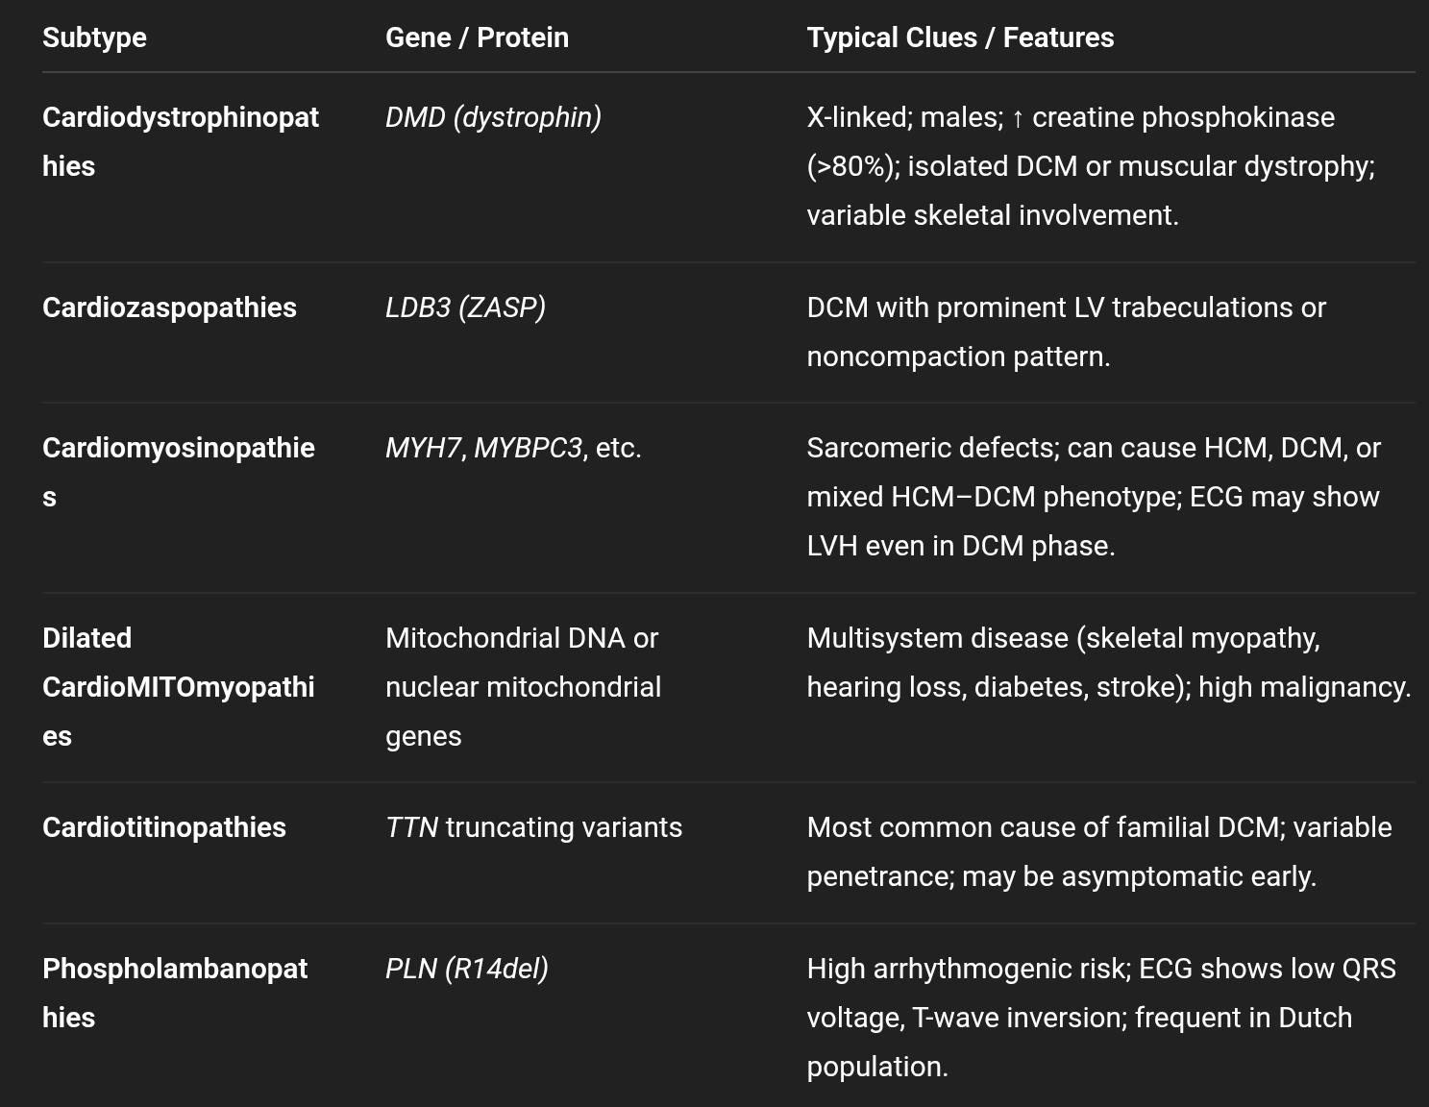
3. OTHER MAJOR GENE-BASED GROUPS (mentioned in overview)

Slide 50
4. Clinical Utility of Gene-Based Classification
Improves diagnostic accuracy (recognize genetic subtype early)
Guides prognosis and therapy:
e.g., ICD in LMNA and PLN mutations due to high arrhythmic risk
Aids family screening and counseling
Facilitates precision management (genotype-guided follow-up and therapy)

Slide 51
Dilated Cardiodystrophinopathies (DCM-DYS)
Gene: DMD (Dystrophin gene, MIM #300377)
Inheritance: X-linked recessive
Protein affected: Dystrophin (sarcolemmal membrane protein)
Genetic Basis
Caused by large DMD gene rearrangements — both in-frame and out-of-frame deletions (>80%)
Minority: nonsense, missense, or splice-site mutations
Leads to loss or marked reduction of dystrophin expression in cardiac myocytes
DMD mutations cause 3 related phenotypes:
Duchenne muscular dystrophy (DMD) – severe, early-onset
Becker muscular dystrophy (BMD) – milder, later-onset
X-linked DCM (DCM-DYS) – isolated or predominant cardiac involvement

Slide 52
Clinical Presentation
Typically affects males
May present as isolated DCM with no or minimal skeletal muscle weakness
In some, skeletal involvement appears late or after heart transplant
Fatigue, dyspnea, or heart failure are common presenting features
Arrhythmias uncommon (low arrhythmogenic risk)

Slide 53
Cardiac Pathology
Loss of dystrophin at cardiomyocyte sarcolemma → structural instability → myocyte necrosis and fibrosis
Endomyocardial biopsy: shows absent dystrophin staining in myocardium
Immunostaining: skeletal muscle may retain dystrophin (normal or reduced), myocardium lacks it
Left ventricular noncompaction (LVNC) seen in ~30% — prognostic marker

Slide 54
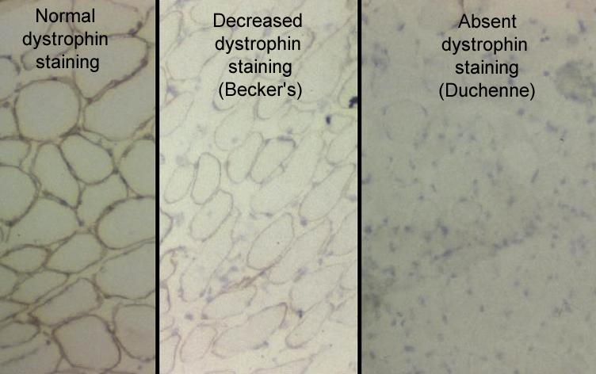

Slide 55
Diagnosis
Genetic testing: identifies DMD mutation (confirmatory)
Endomyocardial biopsy: loss of dystrophin protein expression confirms diagnosis
CK (creatine phosphokinase): often elevated (>80% of cases, but less marked than in Duchenne/Becker)
Consider DMD gene testing in males with unexplained DCM, especially with family history or high CK.

Slide 56
Prognosis and Arrhythmic Risk
Low risk of malignant ventricular arrhythmias
ICD use is per standard DCM guidelines; no ICD shocks observed in one study (median follow-up 14 months, n=34)
Heart failure is main driver of morbidity/mortality
LVNC may indicate worse prognosis

Slide 57
Management
Heart failure therapy as per guidelines (ACE inhibitors, β-blockers, etc.)
ICD: only if indicated for LV dysfunction/SCD prevention
Heart transplantation: feasible and performed in advanced stages
Ventricular assist devices (VADs) increasingly used in severe pediatric DMD/DCM cases
Genetic counseling for carrier females (risk of mild cardiac disease)

Slide 58
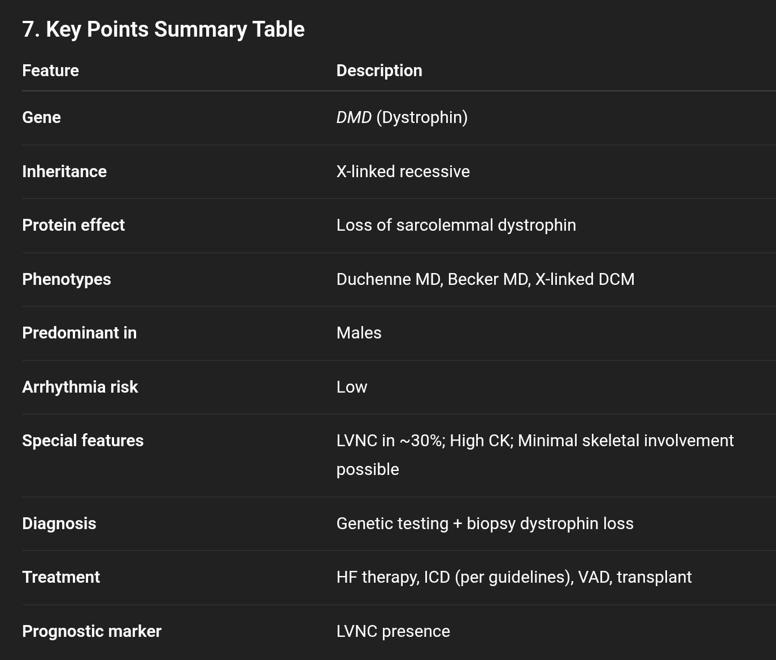

Slide 59
Dilated CardioZASPopathies (LDB3 mutations)
Gene: LDB3 (encodes Cypher/ZASP protein at the Z-disc)
Inheritance: Autosomal dominant (usually)
Main protein: Z-disc structural protein linking actin cytoskeleton to sarcomere
Phenotype:
Dilated LVNC cardiomyopathy (DCM + LV noncompaction)
Sometimes associated with HCM and Myofibrillar myopathy type 4
Characteristic feature → LV hypertrabeculation / LVNC
p.(D117N) variant common but may be benign (population polymorphism)

Slide 60
Clinical interpretation:
LDB3 may influence trabecular architecture more than contractile function
Disease causation not yet firmly established
Requires further investigation of LVNC as a diagnostic marker

Slide 61
Dilated CardioMyosinopathies (MYH7 mutations)
Gene: MYH7 (β-myosin heavy chain)
Inheritance: Autosomal dominant
Protein: Sarcomeric thick filament motor protein
Phenotype:
Usually associated with HCM, but some mutations cause DCM
DCM-linked mutations → loss-of-function → ↓ molecular force → chamber dilation
HCM-linked mutations → gain-of-function → hypercontractility

Slide 62
Mechanisms proposed:
Depressed myosin function → remodeling → DCM
Compound mutations (MYH7 + mitochondrial DNA) → HCM → DCM evolution
Multiple sarcomeric mutations → combined genetic effect → DCM phenotype
MYH7 mutations can cause either HCM or DCM depending on functional effect of the variant.

Slide 63
Dilated CardioMITOmyopathies
Genes: Mitochondrial DNA or nuclear genes encoding mitochondrial proteins
Inheritance:
Mitochondrial DNA mutations → maternal
Nuclear mutations → Mendelian (autosomal dominant or recessive)

Slide 64
Clinical features:
DCM or HCM → DCM progression
Often part of multisystem disease:
Hearing loss
Ptosis
Myopathy
Renal failure
Cryptogenic stroke
Diabetes
Optic neuritis / Retinitis pigmentosa

Slide 65
Examples:
ANT1 mutations → AR DCM
POLG1 mutations → AD DCM + progressive external ophthalmoplegia
Diagnosis:
mtDNA or nuclear gene sequencing (Sanger or NGS)
Heteroplasmy level determines severity
Risk: Drug intolerance (due to mitochondrial dysfunction)

Slide 66
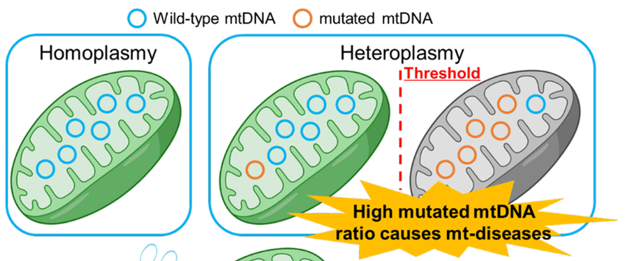

Slide 67
Dilated CardioTitinopathies (TTN mutations)
Gene: TTN (encodes Titin — largest human protein)
Inheritance: Autosomal dominant
Protein: Sarcomeric giant protein maintaining passive elasticity and stability
Phenotype:
Commonest genetic cause of DCM:
25% of familial DCM (FDCM)
18% of sporadic DCM
Penetrance: >95% after age 40
Clinical course: similar to non-TTN DCM

Slide 68
TTN truncating variants (TTNtv) found in 1 in 500 healthy individuals → interpret with caution
Also implicated in:
HCM
Limb-girdle muscular dystrophy type 2J
Early-onset fatal cardiomyopathy
Tibial muscular dystrophy
Antisense-mediated exon skipping is an emerging treatment strategy.

Slide 69
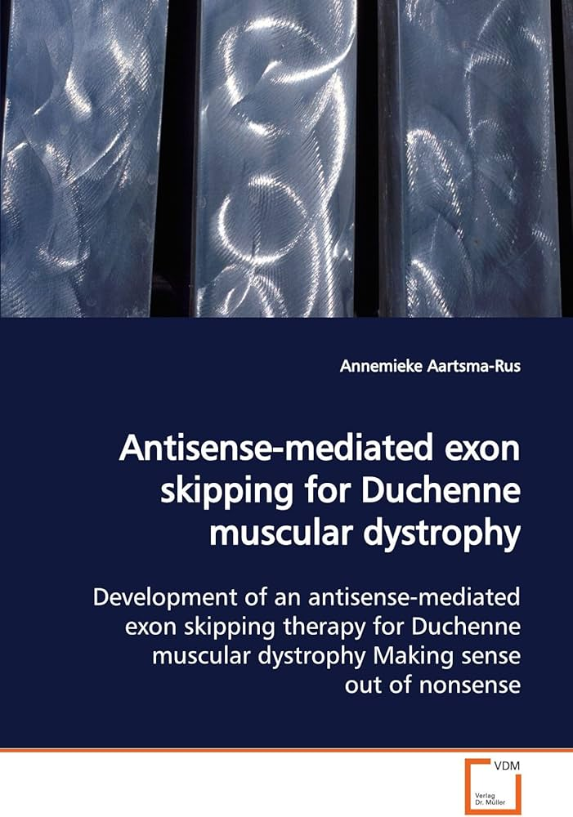
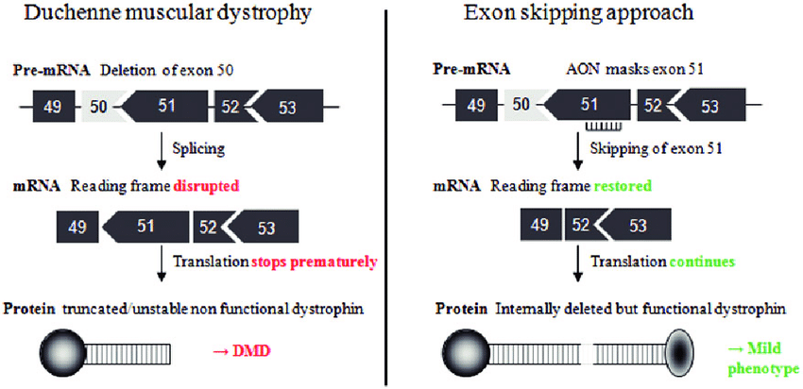
Uses Antisense Oligonucleotide

Slide 70
Dilated Phospholambanopathies (PLN mutations)
Gene: PLN (Phospholamban)
Inheritance: Autosomal dominant
Protein: Sarcoplasmic reticulum (SR) regulator of calcium handling
Mechanism:
PLN inhibits SERCA2a (SR Ca²⁺-ATPase) when unphosphorylated
Mutations → defective Ca²⁺ reuptake → impaired relaxation → DCM / arrhythmogenic cardiomyopathy

Slide 71
Common mutation: p.(Arg14del) — “Dutch founder mutation”
Found in 10–15% of Dutch DCM/ARVC cases
Causes high arrhythmic risk and SCD (often first presentation)
Characteristic ECG:
Low-voltage QRS
T-wave inversion in V4–V6
PLN mutations rare outside the Netherlands but equally malignant
Suspect in DCM + arrhythmia + low ECG voltage

Slide 72
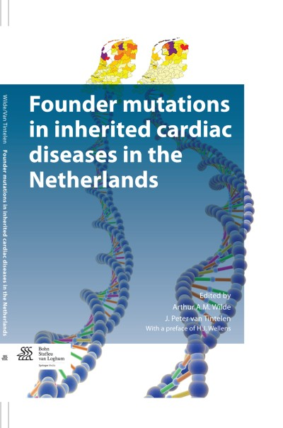

Slide 73
Non-Genetic (Acquired) Dilated Cardiomyopathy
Definition:
DCM with no identifiable pathogenic gene mutation, caused instead by acquired disease processes or toxic exposures that impair myocardial structure or function.
Unlike genetic DCM, non-genetic DCM can be reversible if the underlying trigger is identified and treated early.

Slide 74
.1. Autoimmune / Immune-Mediated DCM
Mechanism:
Autoantibodies or immune cell–mediated injury damages cardiomyocytes and causes LV dilation.
Associated systemic autoimmune diseases:
Systemic lupus erythematosus (SLE)
Systemic sclerosis
Rheumatoid arthritis
Sjögren syndrome
Polymyositis / Dermatomyositis
Eosinophilic granulomatosis with polyangiitis (formerly Churg–Strauss)

Slide 75
Clinical clue:
DCM coexisting with systemic autoimmune features (arthritis, rash, myositis, etc.)
Workup:
Autoimmune panel (ANA, anti-Ro/La, anti-dsDNA, ANCA, etc.)
CMR and biopsy (may show myocarditis or fibrosis)
Management:
Treat underlying autoimmune disorder (immunosuppressants, biologics) + standard heart failure therapy.

Slide 76
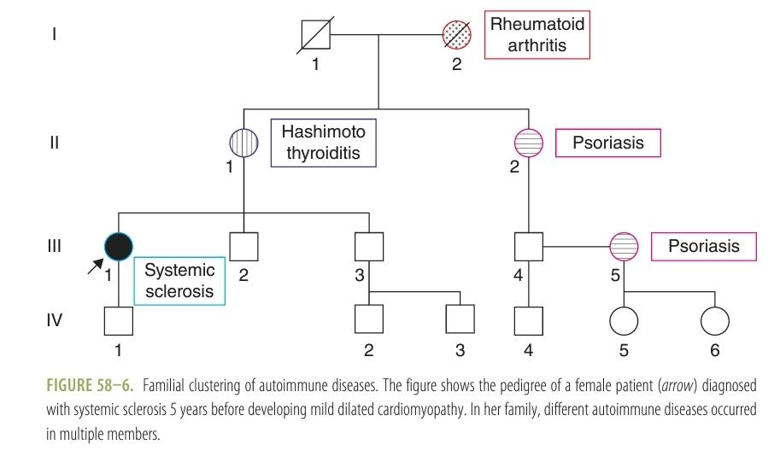

Slide 77
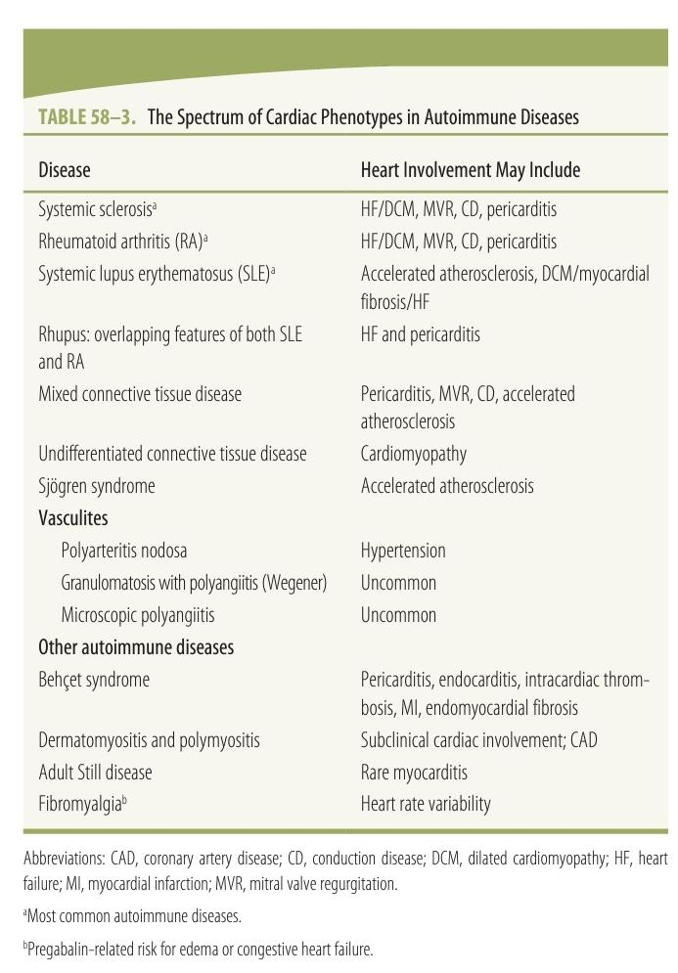

Slide 78
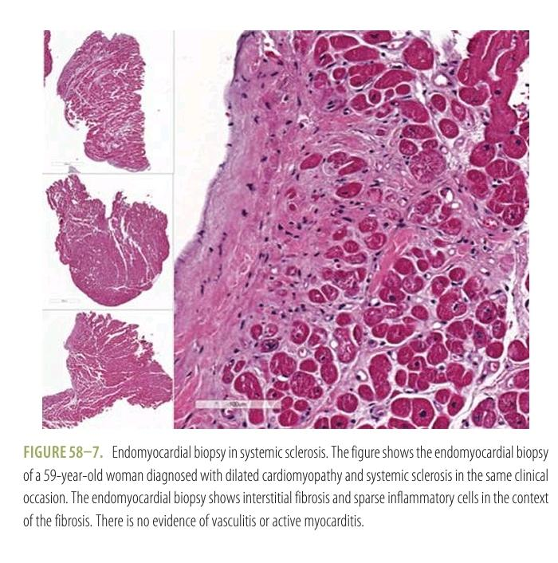

Slide 79
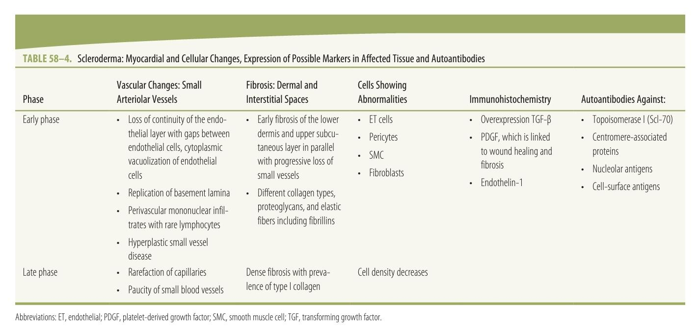

Slide 80
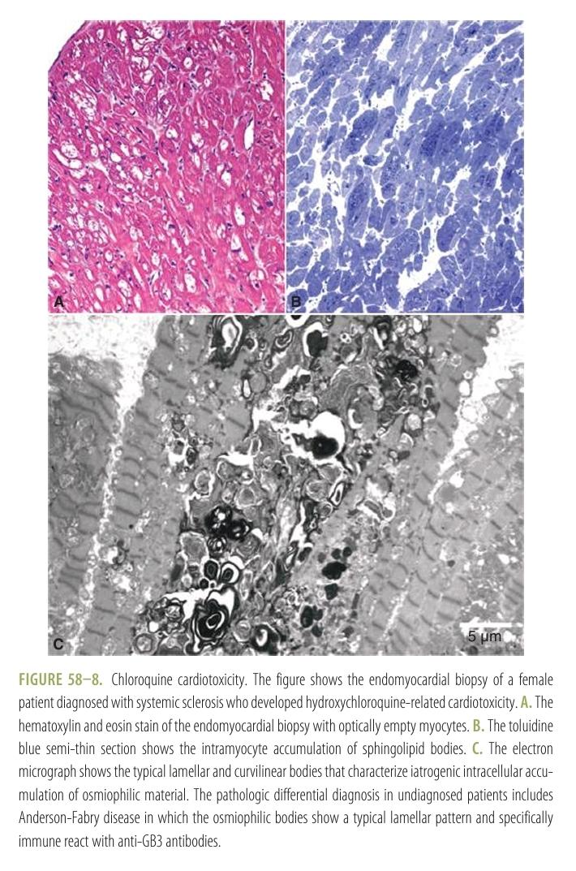

Slide 81
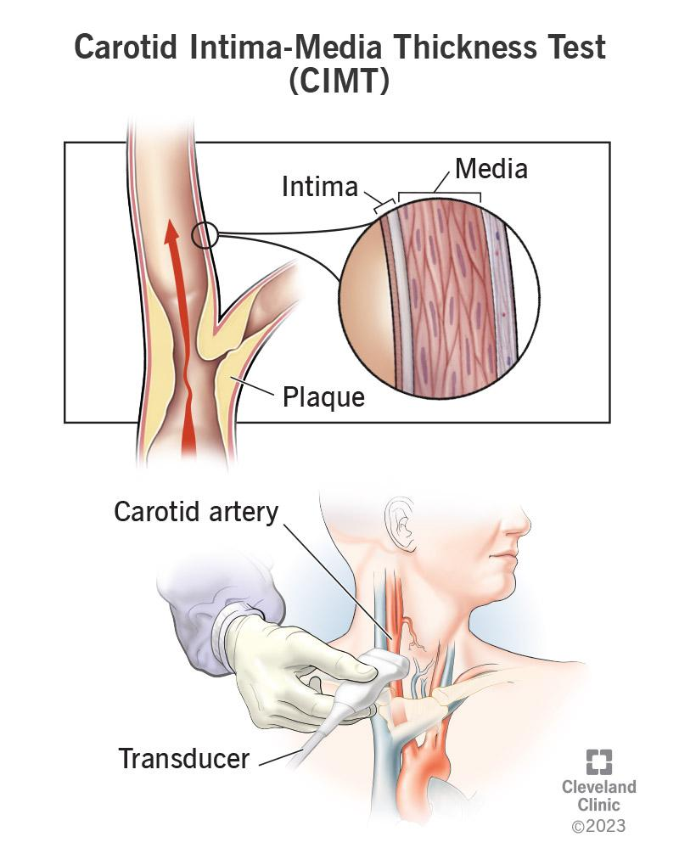

Slide 82
.2. Toxic DCM
Definition:
Myocardial injury and dilation due to toxic agents — either exogenous (drugs, alcohol, metals) or endogenous (metabolic derangements).
.a. Exogenous (Drug- or Toxin-Induced)
Mechanism: Direct myocyte toxicity, mitochondrial injury, oxidative stress.
Reversibility: Often partial or complete with withdrawal and medical therapy.

Slide 83
Common causes:
Alcohol → alcoholic cardiomyopathy
Anthracyclines (doxorubicin, daunorubicin) → dose-dependent myocyte necrosis
Trastuzumab, cyclophosphamide, ifosfamide
Cocaine, amphetamines
Chloroquine / Hydroxychloroquine (long-term)
Heavy metals (cobalt, lead)
Radiation-induced

Slide 84
.b. Endogenous
Thyrotoxicosis, pheochromocytoma, uremia, iron overload (hemochromatosis)
Tachycardia-induced cardiomyopathy (persistent tachyarrhythmia)
Proof of causality is essential → improvement after removal confirms diagnosis.

Slide 85
.3. Inflammatory Cardiomyopathies
Definition:
DCM phenotype with histologic or imaging evidence of myocardial inflammation.
Etiologies:
Viral myocarditis (Coxsackie, Parvovirus B19, etc.)
Autoimmune / immune activation post-infection
Giant cell or eosinophilic myocarditis

Slide 86
Diagnosis:
Cardiac MRI (edema, late gadolinium enhancement)
Endomyocardial biopsy (Dallas criteria, immunohistochemistry)
Course:
May evolve into chronic DCM due to fibrotic remodeling.

Slide 87
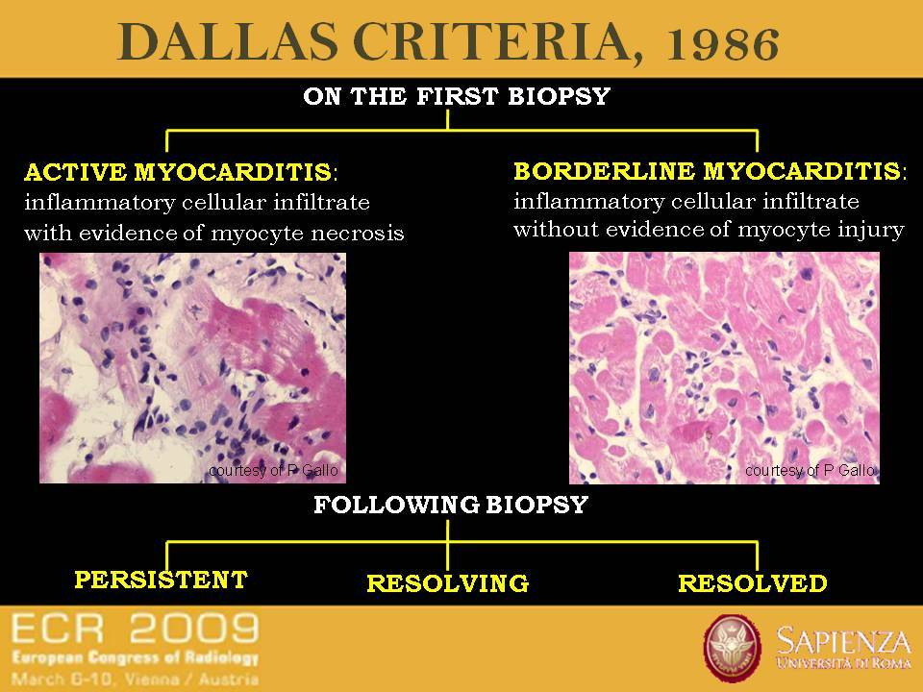

Slide 88
.4. Peripartum Cardiomyopathy (PPCM)
Timing:
Occurs during the last month of pregnancy or within 5 months postpartum.
Mechanism:
Likely multifactorial —
oxidative stress,
hormonal imbalance (prolactin fragments),
immune activation,
and sometimes genetic predisposition.

Slide 89
Features:
Systolic heart failure signs post-delivery
LV dilation and dysfunction
May recover spontaneously in 50–70%
Management:
Guideline-directed heart failure therapy
Avoid teratogenic drugs (ACEi/ARB during pregnancy)
Bromocriptine sometimes used (inhibits prolactin release)

Slide 90
.5. Overlap Between Genetic and Acquired DCM
Some diseases previously considered “acquired” (autoimmune or peripartum) may have genetic predispositions (e.g., LMNA or TTN variants).
Hence, family history and genetic counseling are now recommended in all DCM cases, even if the cause appears “non-genetic.”

Slide 91
Not a component of MOGE(S)
Morphofunctional phenotype
Organ involvement
Etiology
Efficacy of treatment
Genetic inheritance pattern

Slide 92
Not a component of MOGE(S)
Morphofunctional phenotype
Organ involvement
Etiology
Efficacy of treatment
Genetic inheritance pattern

Slide 93
Myocardial deformation imaging refers to
Myocardial biopsy
Strain ECHO
Cardiac CT
Cath study

Slide 94
Myocardial deformation imaging refers to
Myocardial biopsy
Strain ECHO
Cardiac CT
Cath study

Slide 95
Dalla’s criteria is used for
Rheumatic heart disease
Infective endocarditis
Myocarditis
Myocardial Infarction

Slide 96
Dalla’s criteria is used for
Rheumatic heart disease
Infective endocarditis
Myocarditis
Myocardial Infarction

Slide 97


Slide 98
AUTOIMMUNE / IMMUNE-MEDIATED DILATED CARDIOMYOPATHY
Autoimmune/immune-mediated DCM refers to myocardial involvement due to systemic autoimmune disease or, rarely, a primary autoimmune myocarditis without a defined systemic disease.
The cardiac manifestations are diverse, ranging from:
Pericarditis
Coronary vasculitis or ischemia
Conduction system disease
Arrhythmias
Myocardial fibrosis and dilation → DCM phenotype
Pulmonary hypertension (as a complication)

Slide 99
Cardiac involvement may:
Occur after a known diagnosis of autoimmune disease, or
Be the first presentation, leading to detection of an underlying autoimmune disorder.
Hence, systemic evaluation is essential.

Slide 100
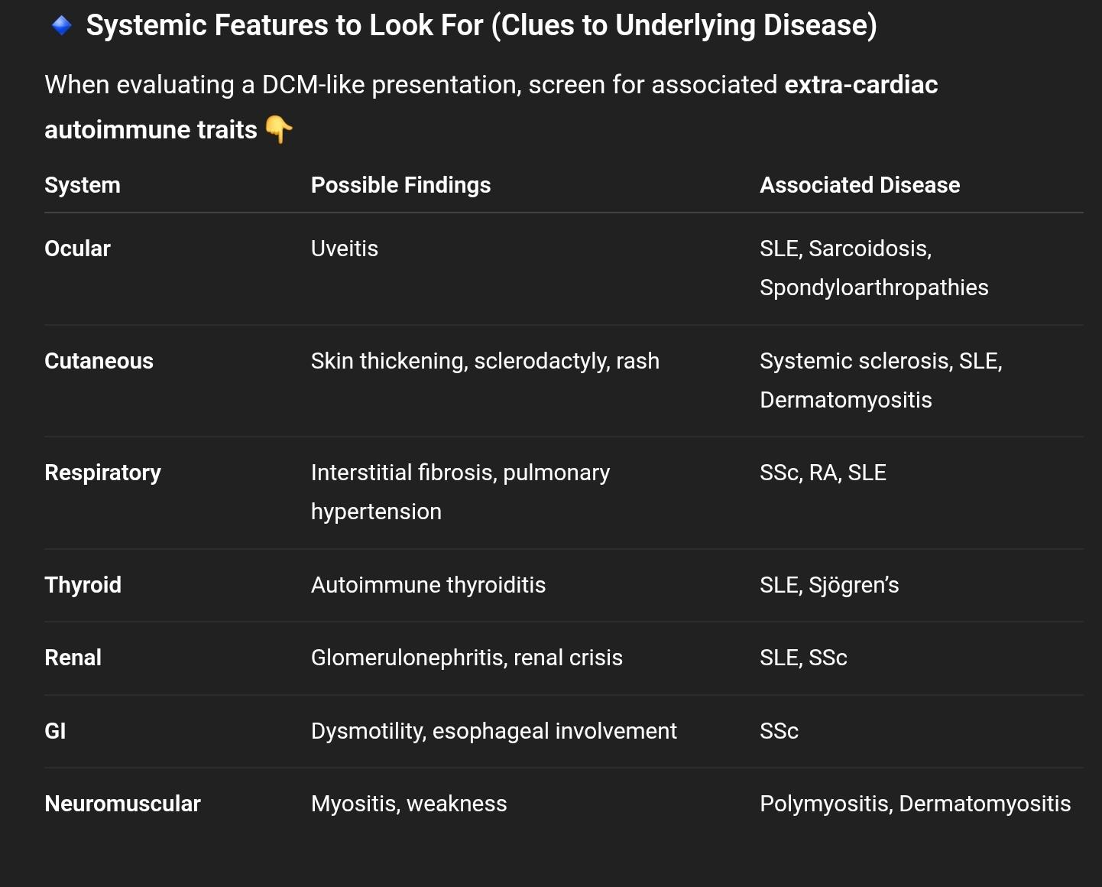

Slide 101
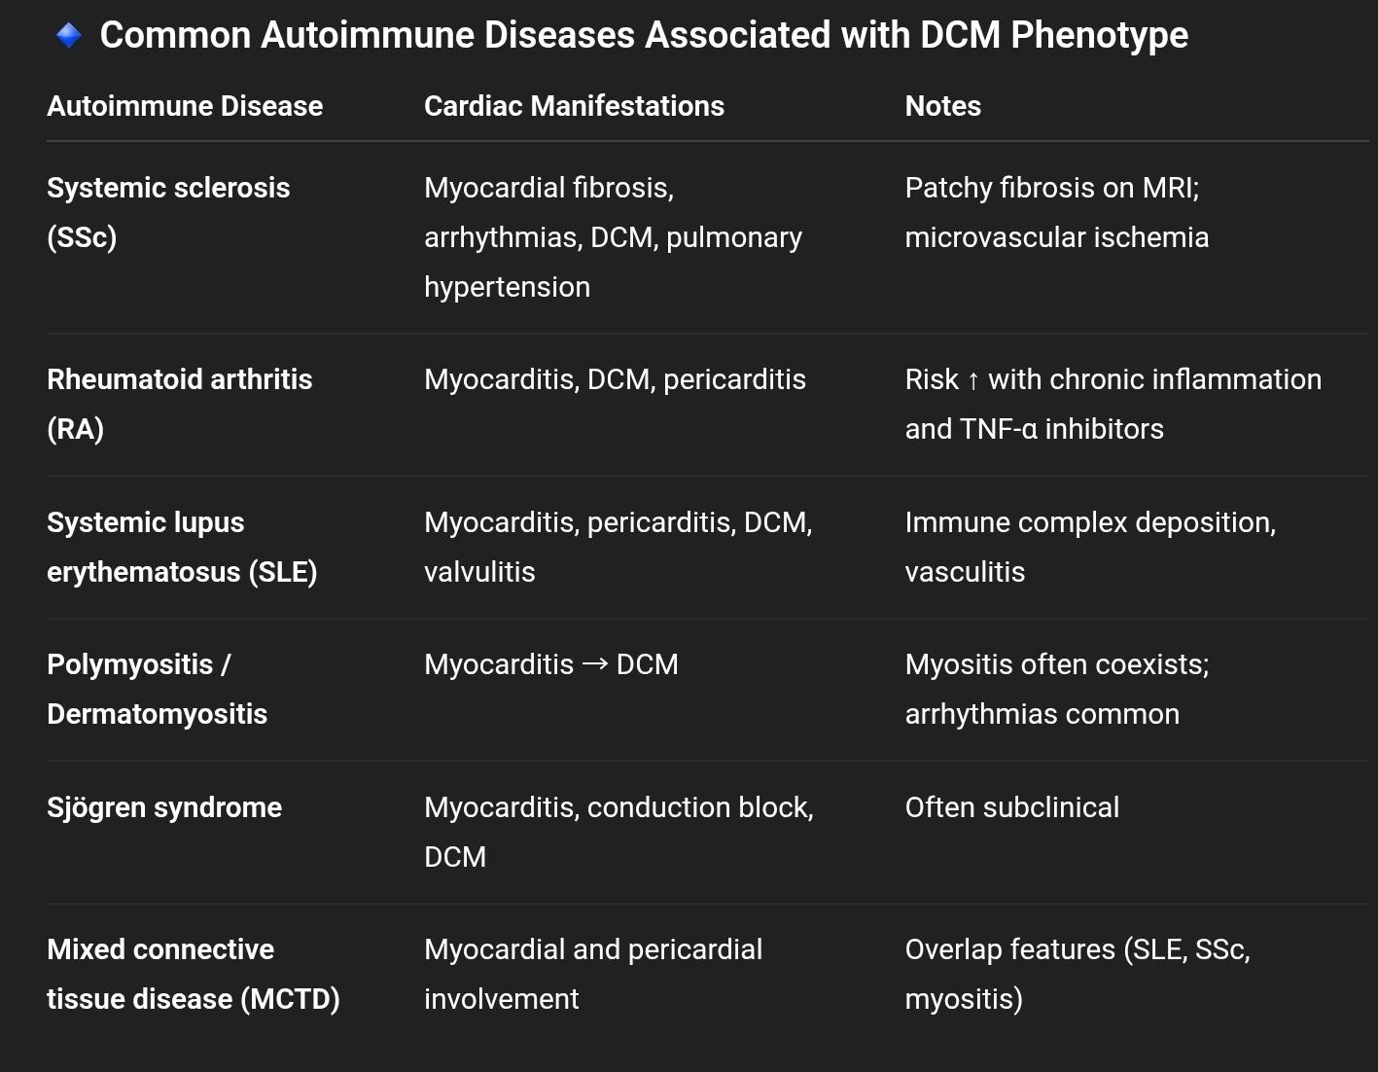

Slide 102
Pathophysiology
Mechanisms leading to DCM:
Chronic low-grade myocarditis → progressive fibrosis → systolic dysfunction
Microvascular ischemia (especially in systemic sclerosis)
Autoantibody-mediated myocyte injury
Cytokine-driven remodeling (IL-1, TNF-α)
Drug toxicity (iatrogenic cardiomyopathy)

Slide 103
Diagnosis
.1. Baseline Evaluation
History (autoimmune features, medications)
Physical exam (rashes, Raynaud’s, arthritis, etc.)
ECG (conduction defects, arrhythmias)
Echocardiogram (LV dilation, ↓EF)
.2. Advanced Testing
Autoimmune workup: ANA, anti-Ro/La, anti-Scl70, anti-dsDNA, ANCA, myositis-specific antibodies
Cardiac MRI: detects inflammation and fibrosis (late gadolinium enhancement)
Endomyocardial biopsy: in selected cases to identify immune infiltration or drug-induced toxicity

Slide 104
Management
Treat the underlying autoimmune disease
Corticosteroids, immunosuppressants (methotrexate, azathioprine, mycophenolate)
Biologics (e.g., rituximab) if refractory
Standard heart failure therapy
ACEi / ARB / ARNI
Beta-blockers
Diuretics
MRA
Withdrawal of offending drugs
Stop TNF-α inhibitors or hydroxychloroquine if implicated.
Monitor for arrhythmias or conduction block
Holter, ICD if high risk.

Slide 105
Familial & Genetic Considerations
Familial clustering of autoimmune diseases can occur (e.g., RA in one family member, SLE in another).
Autoinflammatory syndromes (genetic disorders of innate immunity) may mimic autoimmune DCM, so family data and genetic counseling are useful.

Slide 106
SYSTEMIC SCLEROSIS (SCLERODERMA) AND THE HEART
Systemic sclerosis (SSc) — also called scleroderma — is a multisystem autoimmune connective tissue disease characterized by:
Fibrosis of skin and internal organs
Vascular abnormalities (Raynaud phenomenon, microvascular damage)
Autoantibodies (anti-centromere, anti-Scl70, anti-RNA polymerase III)
Cardiac involvement in SSc can manifest as DCM, fibrosis, arrhythmia, or pericardial disease, and is a major determinant of morbidity and mortality.

Slide 107
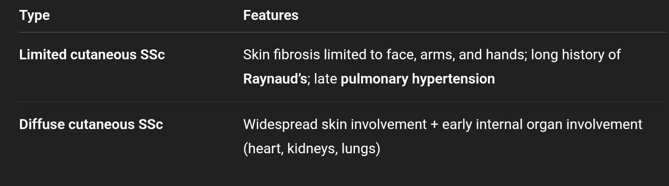
Classification

Slide 108
Epidemiology
Prevalence: 50–300 / 1 million
Incidence: 2.3–22.8 / 1 million/year
Sex ratio: Female : Male = 3:1 to 14:1
Ethnic variation in susceptibility
Overlap syndromes (e.g., with SLE or myositis) are common

Slide 109
Pathogenesis and Etiology
Most cases are sporadic and multifactorial; pathogenesis involves:
Microvascular injury → endothelial dysfunction → ischemia
Autoimmune activation → cytokine release → fibroblast activation
Excess collagen deposition → fibrosis of skin and internal organs
Contributing factors:
Environmental/occupational exposures (e.g., silica, solvents)
Genetic predisposition: HLA class II alleles, immune regulation genes
Maternal-fetal microchimerism hypothesis:
Fetal cells in maternal tissues may trigger a graft-vs-host–like immune reaction, explaining higher female prevalence.

Slide 110
Pathology of Cardiac Involvement
Early
Microvascular damage
Mononuclear inflammatory infiltrates
Late
Patchy myocardial fibrosis
Loss of interstitial cells and capillaries
Tissue atrophy
Difference from ischemic fibrosis:
Fibrosis is patchy and diffuse, not confined to coronary territories, and hemosiderin is absent (non-ischemic pattern).

Slide 111
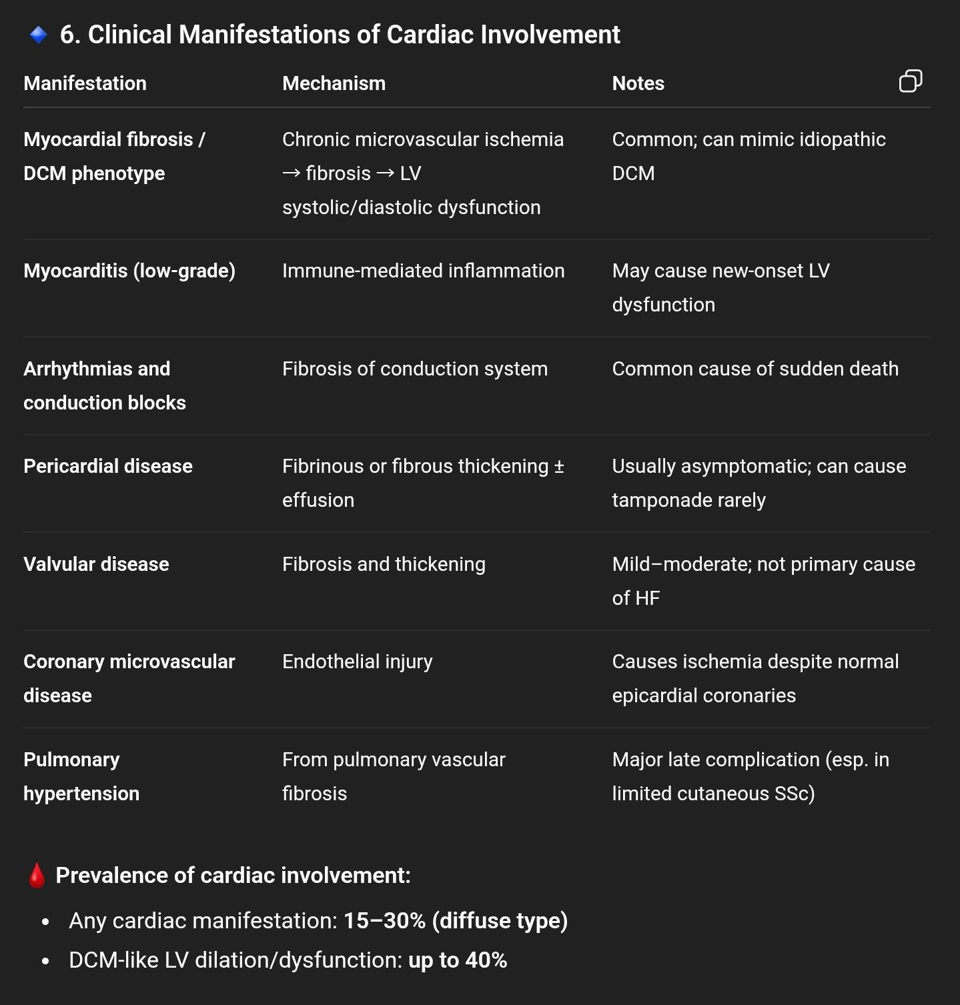

Slide 112
Pericardial Involvement
Commonly fibrous or fibrinous thickening, small effusions
Often clinically silent
Occasionally, small effusions may cause tamponade because of the stiff, fibrosed pericardium
Fluid characteristics: noninflammatory, no immune complexes or complement depletion

Slide 113
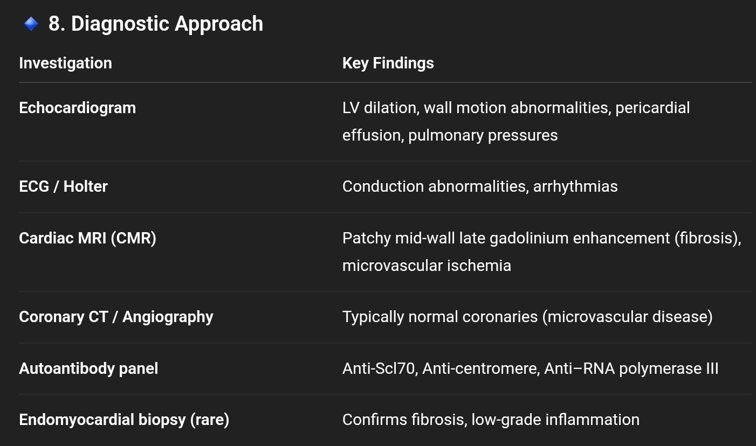

Slide 114
Management
Standard Heart Failure Therapy
ACE inhibitors / ARNI
Beta-blockers
Diuretics
MRA
Immunosuppressive Therapy (for myocarditis/active inflammation)
Corticosteroids (carefully used; risk of renal crisis)
Mycophenolate mofetil
Cyclophosphamide
Methotrexate

Slide 115
Biologic Agents / Targeted Therapy
Anti-TNF, Anti–IL-6, Anti–B-cell (rituximab)
CTLA4 (abatacept) — co-stimulation blockade
Useful in autoimmune overlap cases
Pulmonary Hypertension Management
Endothelin receptor antagonists, PDE5 inhibitors, prostacyclin analogues
Pericardial Tamponade
Drainage; avoid aggressive volume removal due to rigid pericardium

Slide 116
Prognosis
Depends on extent of myocardial fibrosis and pulmonary hypertension
Early detection via CMR and serologic screening improves outcomes
Cardiac involvement contributes significantly to mortality in diffuse SSc

Slide 117
RHEUMATOID ARTHRITIS AND THE HEART
RA is a chronic systemic autoimmune disease primarily affecting synovial joints, but cardiac involvement is common and a major cause of morbidity and mortality.
DCM and HF account for ~20% of RA-related deaths.
Autopsy studies: up to 60% show cardiac involvement.

Slide 118
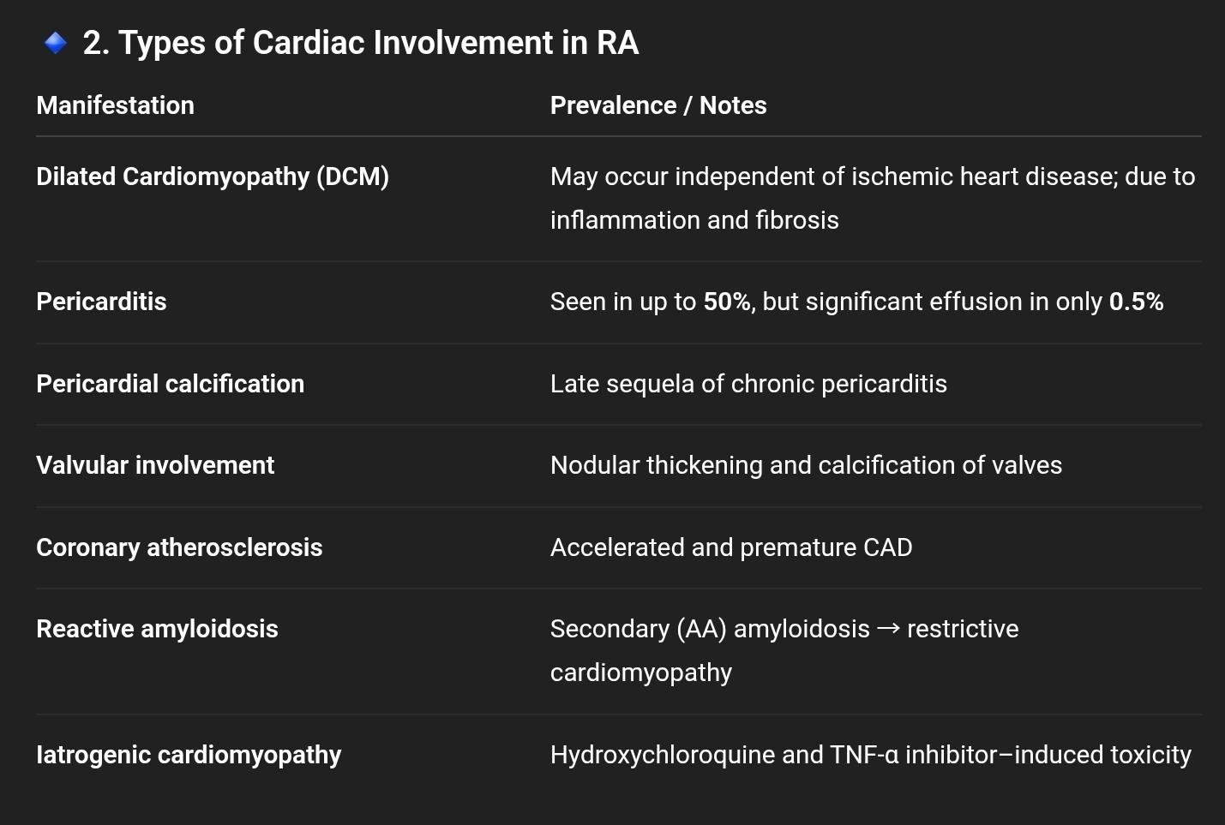

Slide 119
Dilated Cardiomyopathy and Heart Failure in RA
🔸 Epidemiology and Risk
HF incidence is significantly higher in RA patients than in matched controls, even after adjusting for CAD and traditional risk factors.
RA itself is an independent risk factor for HF.

Slide 120
Mechanisms
Chronic systemic inflammation → cytokine-mediated myocardial damage and fibrosis
Key cytokines: TNF-α, IL-1, IL-6
Autoimmune injury → myocarditis-like process
Diastolic dysfunction due to fibrosis and inflammation
Systolic dysfunction → progressive remodeling → DCM phenotype
Citrullinated myocardial proteins (autoantigenic targets) found in RA myocardium

Slide 121
Symptoms: fatigue, dyspnea, signs of HF
Both systolic and diastolic dysfunction on echo
LV volumes: may be normal or slightly reduced (CMR data)
Inflammatory markers (ESR, RF positivity) correlate with HF risk

Slide 122
Iatrogenic Myocardial Damage
.a. Hydroxychloroquine Toxicity
Mechanism: lysosomal dysfunction → accumulation of myelin figures and curvilinear bodies in cardiomyocytes
Pathology: restrictive or dilated cardiomyopathy
Diagnosis: endomyocardial biopsy
Reversible if detected early; drug discontinuation essential

Slide 123
.b. TNF-α Inhibitors (Etanercept, Infliximab, Adalimumab)
Conflicting data:
Early trials showed worsening HF → FDA warning
Later registry data: no increase or even reduced HF risk with good disease control
Guideline stance (ACR 2015):
Avoid TNF inhibitors in active HF (NYHA III–IV)
Use only if no alternative and HF is compensated

Slide 124
Reactive (AA) Amyloidosis
Occurs in long-standing, uncontrolled inflammation
21–30% of RA patients show amyloid deposition; 28% of those have cardiac involvement
Phenotype: restrictive cardiomyopathy (thickened walls, enlarged atria, low-voltage ECG)
Diagnosis: tissue biopsy (Congo red staining) ± evidence of systemic amyloidosis
Treatment: control of inflammation
Anti-TNF therapy may reduce amyloid deposition

Slide 125
Accelerated Atherosclerosis in RA
a. Epidemiology
Meta-analysis of >40,000 patients: 48% increased CV risk
RA patients experience premature CAD, often independent of lipid levels
b. Mechanisms
Chronic inflammation → endothelial dysfunction, plaque instability
Traditional risk factors: diabetes, dyslipidemia, obesity, hypertension, smoking
Disease-related factors: duration, activity, RF positivity, steroid use
Paradoxical low cholesterol during active inflammation (“lipid paradox”)

Slide 126
c. Effect of Therapy
TNF inhibitors: ↑ HDL and total cholesterol, neutral on LDL
Methotrexate + TNF-I combination: decreases overall CV risk
Statins: beneficial; discontinuation increases MI risk

Slide 127
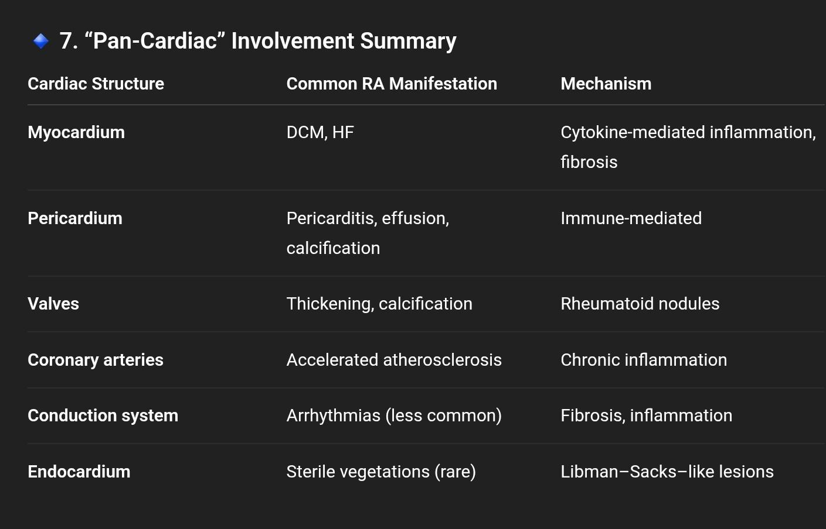

Slide 128
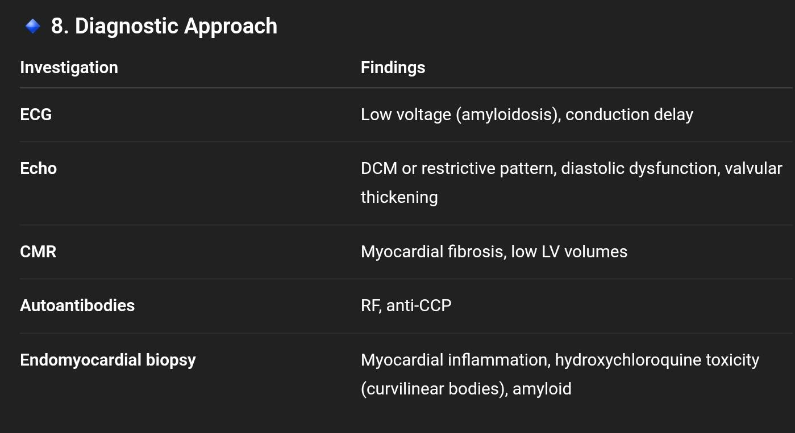

Slide 129
Management
Heart Failure Therapy
Standard guideline-directed therapy (ACEi/ARB/ARNI, beta-blockers, diuretics)
RA Disease Control
Methotrexate (mainstay)
Biologic DMARDs (anti-TNF, IL-6, CTLA4 blockers) cautiously used if no active HF
Drug-Induced Toxicity
Stop hydroxychloroquine if suspected
Amyloidosis
Control inflammation; consider anti-TNF for regression
Atherosclerosis Prevention
Aggressive control of CV risk factors + statins

Slide 130
Prognosis
Mortality risk ↑ due to HF, arrhythmia, or CAD
Good RA control = better cardiac outcomes
Combination methotrexate + TNF-I therapy reduces CV events

Slide 131
DILATED CARDIOMYOPATHY IN SYSTEMIC LUPUS ERYTHEMATOSUS (SLE)
SLE: chronic, multisystem autoimmune disease affecting young women (esp. of African ancestry).
Cardiac involvement is common and a major cause of morbidity and mortality.
DCM represents one of the most serious cardiac complications, often reflecting myocardial inflammation and fibrosis.
LV systolic dysfunction → poor outcome.
Pericarditis occurs in 10–30% of cases.

Slide 132
Epidemiology
Age of onset: 16–50 years
Incidence: 1–23 per 100,000 / year (varies by region)
Pediatric-onset SLE: 10–20% of total; tends to be more severe and causes earlier irreversible organ damage.

Slide 133
Pathogenesis of SLE
Multifactorial — interplay of:
Genetic predisposition (HLA-DRB115-DQB106, NCF2, PTPN22, CTLA4, FCGR2A/B, DNAS1)
Epigenetic changes (DNA hypomethylation → ↑ autoantibody production)
Hormonal influence (estrogens via ER-α/β modulate T, B, and dendritic cell responses)
Environmental factors (UV exposure, viral infections, drugs)
→ Result: loss of self-tolerance → autoantibody formation → immune complex deposition and complement activation → multiorgan inflammation (including myocardium).

Slide 134
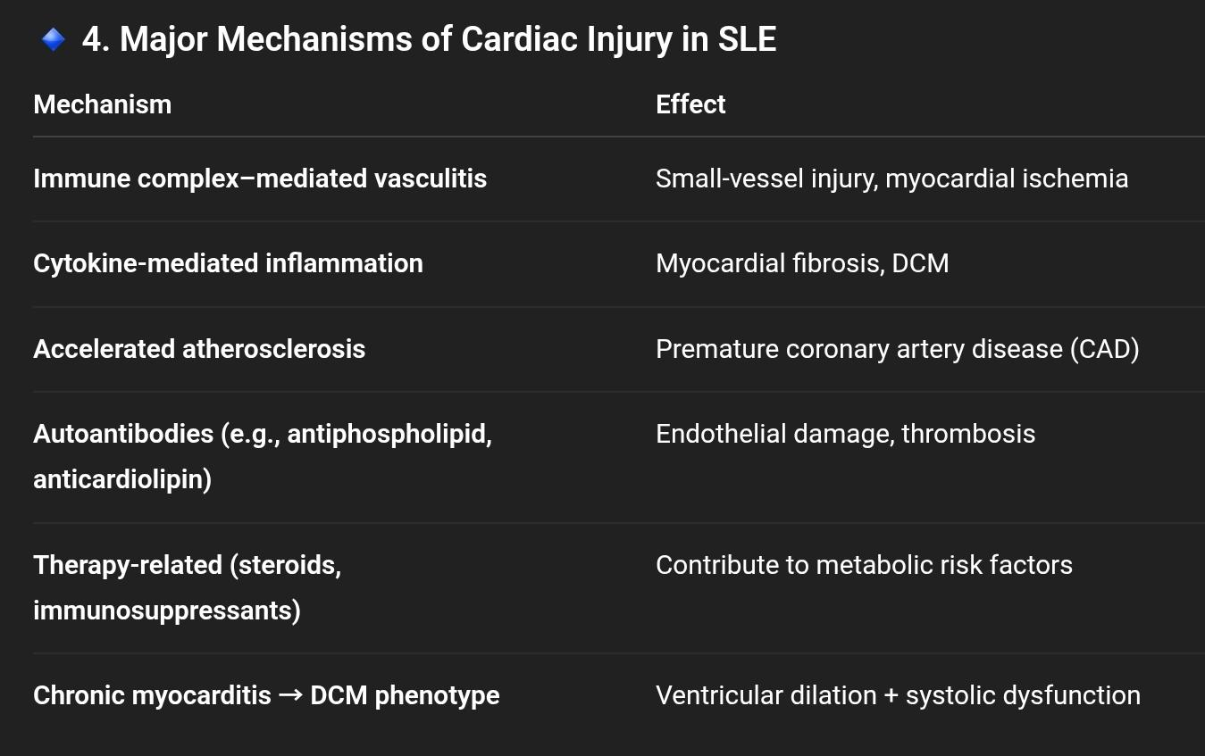

Slide 135
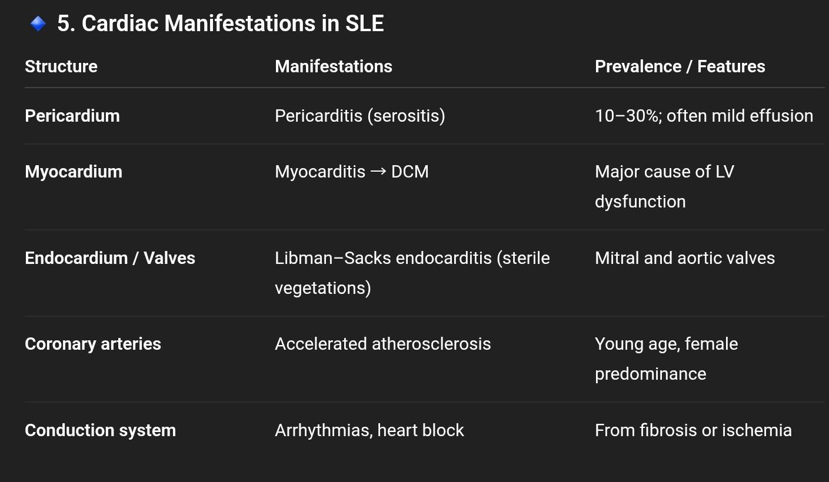

Slide 136
Myocardial Involvement and DCM in SLE
.a. Myocardial Fibrosis
Mid-wall fibrosis common (seen on CMR as late gadolinium enhancement).
Independent predictor of adverse cardiac events.
Extent >15% of LV mass → diastolic dysfunction + ↓ exercise capacity.
Fibrosis occurs independent of disease duration or severity.

Slide 137
.b. Dilated Cardiomyopathy
Mechanisms: chronic myocarditis, cytokine-mediated injury, microvascular ischemia, fibrosis.
LV systolic and diastolic dysfunction → HF.
Prognosis: similar to idiopathic DCM.
Inflammation and autoantibodies (anti-RNP, anti-SSA, antiphospholipid) implicated.

Slide 138
Accelerated Atherosclerosis in SLE
.a. Epidemiology
Not fully explained by traditional risk factors.
Systemic inflammation drives endothelial dysfunction.
~25% have CV events; ~4.5% experience MI.
.b. Mechanisms
Inflammation-induced endothelial injury
Autoantibody effects (esp. antiphospholipid)
Steroid therapy → dyslipidemia, hypertension, diabetes
Genetic + epigenetic modifiers

Slide 139
.c. Imaging & Biomarkers
Carotid IMT and plaque on ultrasound (even when IMT normal)
Coronary CMR contrast enhancement = early marker

Slide 140
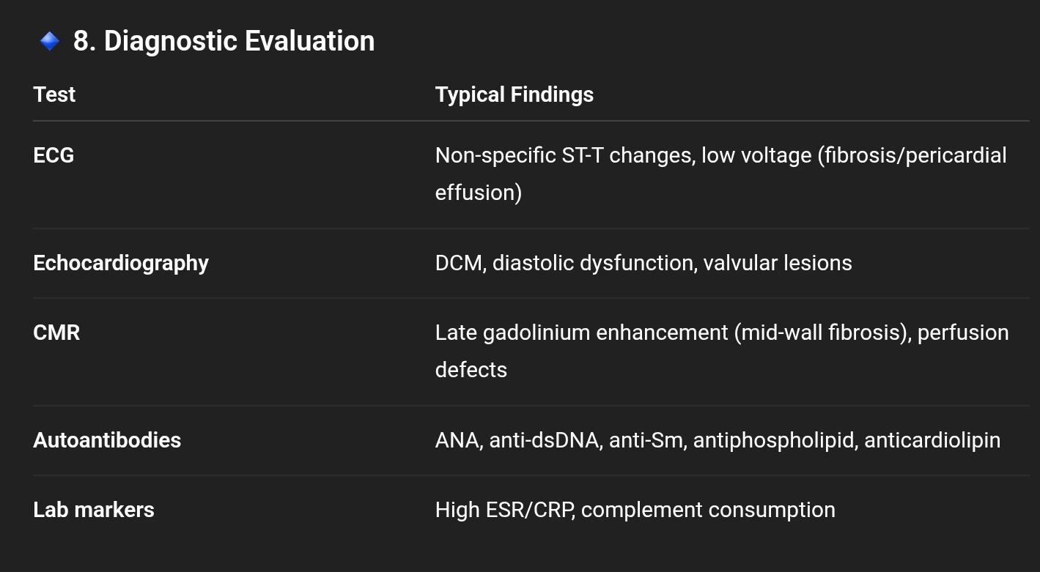

Slide 141
Management
a. General Principles
Control systemic disease activity → reduces cardiac inflammation.
Prevent and treat heart failure and atherosclerosis.

Slide 142
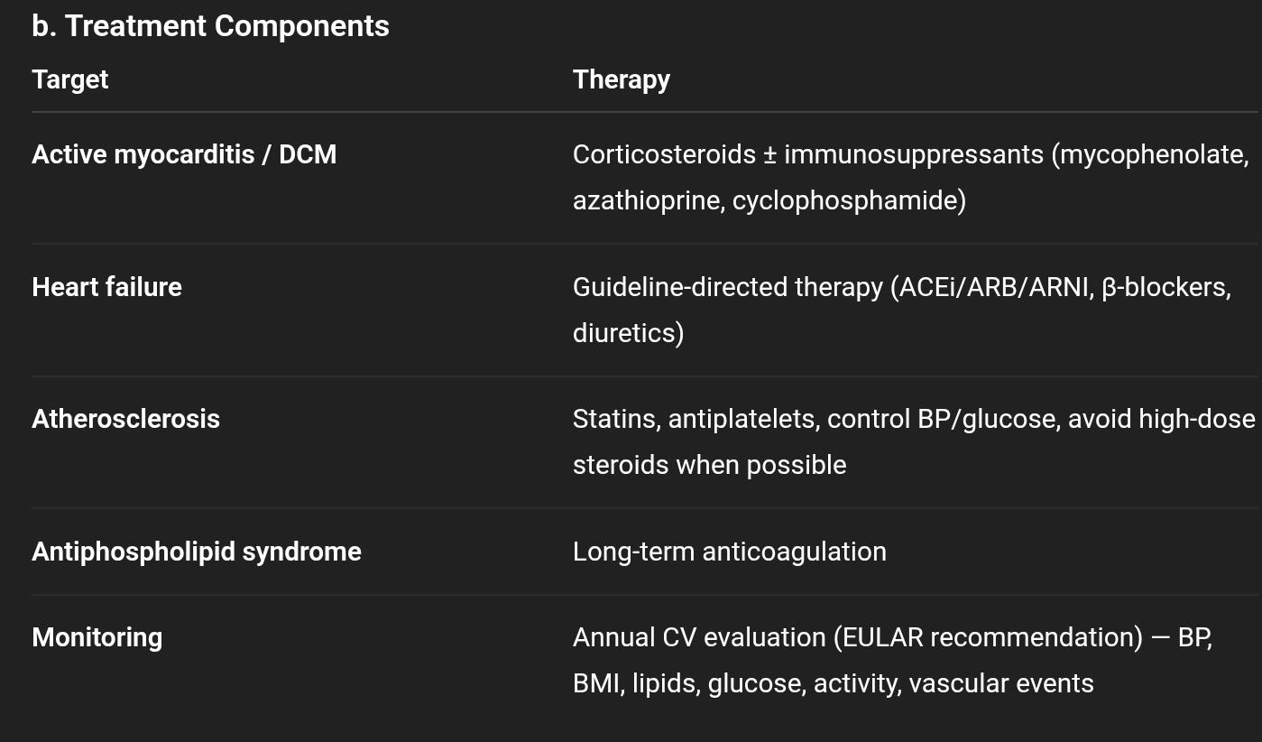

Slide 143
Prognosis
Cardiac involvement is a major determinant of mortality in SLE.
DCM carries similar outcomes to idiopathic DCM, but early detection and immunomodulation can improve outcomes.
CMR fibrosis burden and LV dysfunction predict prognosis.

Slide 144
