Slide 1
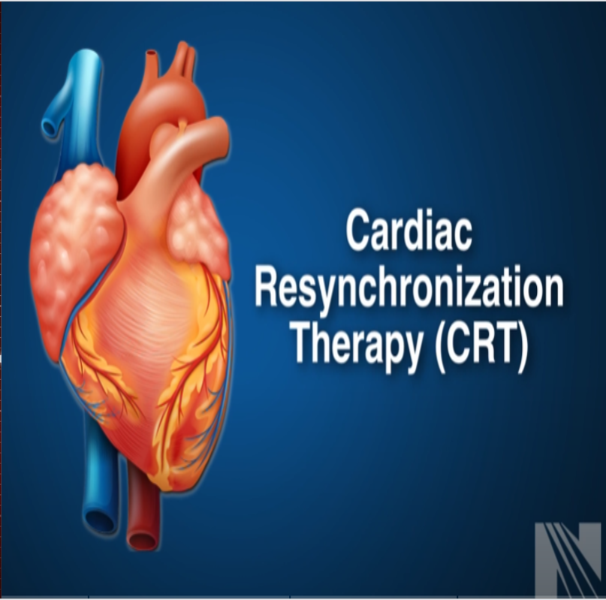
Sanjeev

Slide 2
Ventricular dyssynchrony: The target of CRT
Intra ventricular conduction abnormalities are common in chronic HF-→increased mortality and morbidity.

Slide 3
What is dyssynchrony
Dyssynchrony refers to impaired mechanical coordination due to impaired electrical activation of heart muscle.
Electrical dyssynchrony identified by prolonged QRS duration on ECG.
QRS prolongation typically due to conduction system disease, such as bundle branch block.

Slide 4
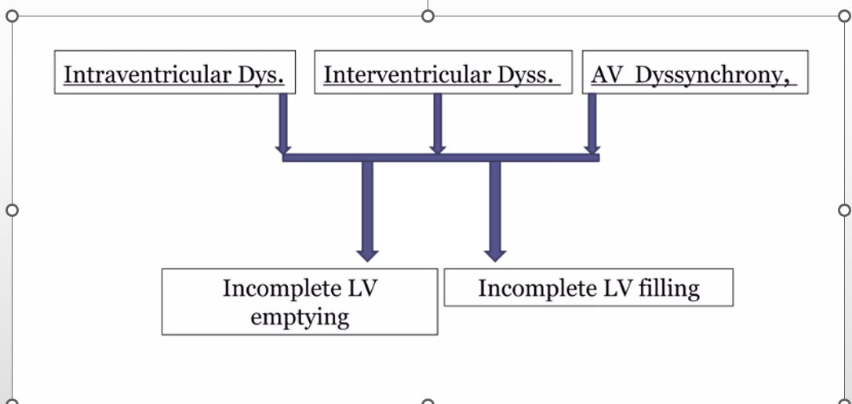

Slide 5
Types of dyssynchrony
AV Dyssynchrony
Interventricular Dyssynchrony
Intraventricular Dyssynchrony
Other Types
Mechanical Dyssynchrony
Electrical Dyssynchrony

Slide 6
Electrical Dyssynchrony
Conduction delay resulting in QRS duration more than 120 ms on surface ECG

Slide 7
Mechanical Dyssynchrony
The difference in the timing of mechanical contraction or relaxation between different segments of the left ventricle that results from electrical dyssynchrony has been termed mechanical dyssynchrony
Mechanical dyssynchrony may involve delay in mechanical activation of the left ventricle (LV) relative to the right ventricle (RV) (interventricular dyssynchrony) or of one LV region relative to another (intraventricular dyssynchrony).
can result in suboptimal ventricular filling, a reduction in left ventricular (LV) contractility, greater degree and prolonged duration of mitral regurgitation (MR), and paradoxical septal wall motion.

Slide 8
All patient with heart failure need optimal pharmacological therapy and lifestyle modifications.
But in a small subset, there is a definite role for devices.
Intraventricular dyssynchrony in the presence of severe left ventricular dysfunction is an important indication for cardiac resynchronization therapy.
Delay between the contractions of the septum and the lateral left ventricular wall causes reduced left ventricular stroke volume

Slide 9
CRT improves ventricular dyssynchrony with implantation of pacing leads to pace both the right and left ventricles.
Optimal placement of two leads, one on the right ventricular septum and a second in the coronary sinus at the site of latest LV activation allows for simultaneous or near simultaneous activation of both ventricles and improves inter- and intra-ventricular synchrony.
Early studies demonstrated a benefit of CRT in patients with HFrEF and ventricular dyssynchrony on hemodynamics, functional outcomes and quality of life (QoL) .

Slide 10
The important surrogate of ventricular dyssnchrony is an increased QRS duration.
In CRT, septum and lateral left ventricular wall contracts simultaneously producing improvement in the left ventricular stroke volume.
CRT improves the symptomatic status and survival of the heart failure patients with left ventricular dyssynchrony.
But still there is a 30% non-responder rate of patients who do not respond to CRT.

Slide 11
CRT produces a narrowing of the QRS complexes as the right ventricle and posterolateral left ventricle are paced in synchrony, to produce a better left ventricular output.
CRT system may include ICD protection(CRT-D), or provide only pacing therapy(CRT-P)

Slide 12
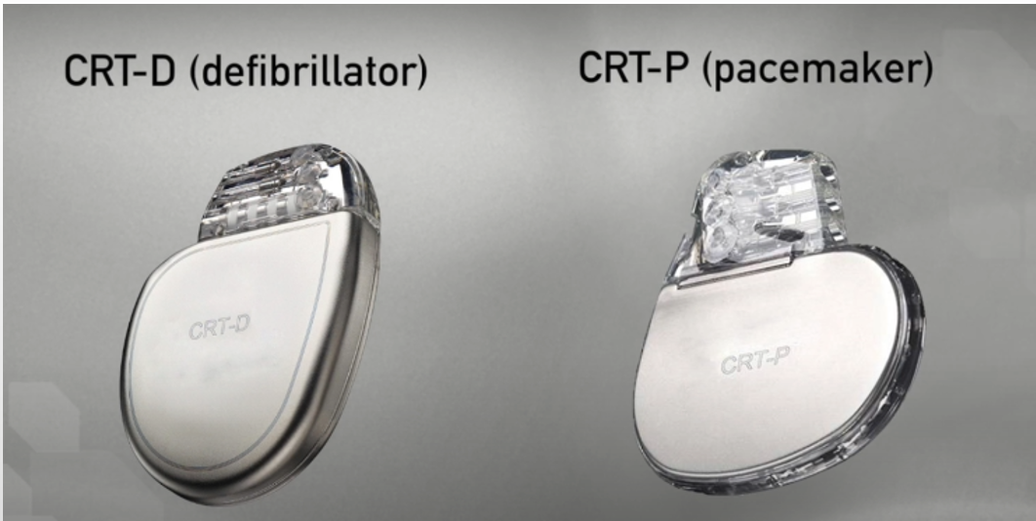

Slide 13
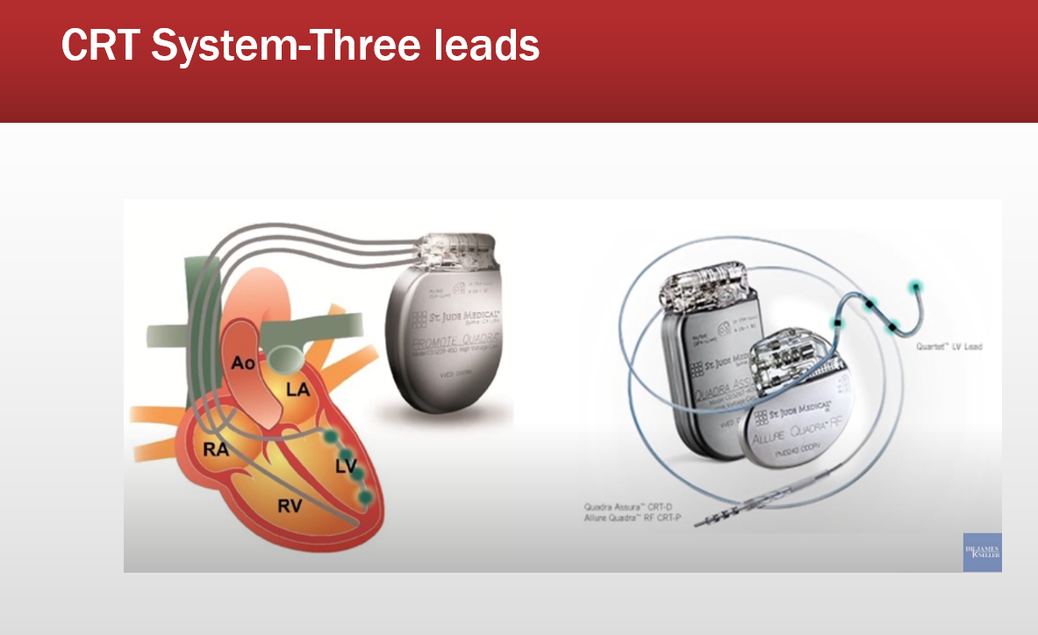

Slide 14
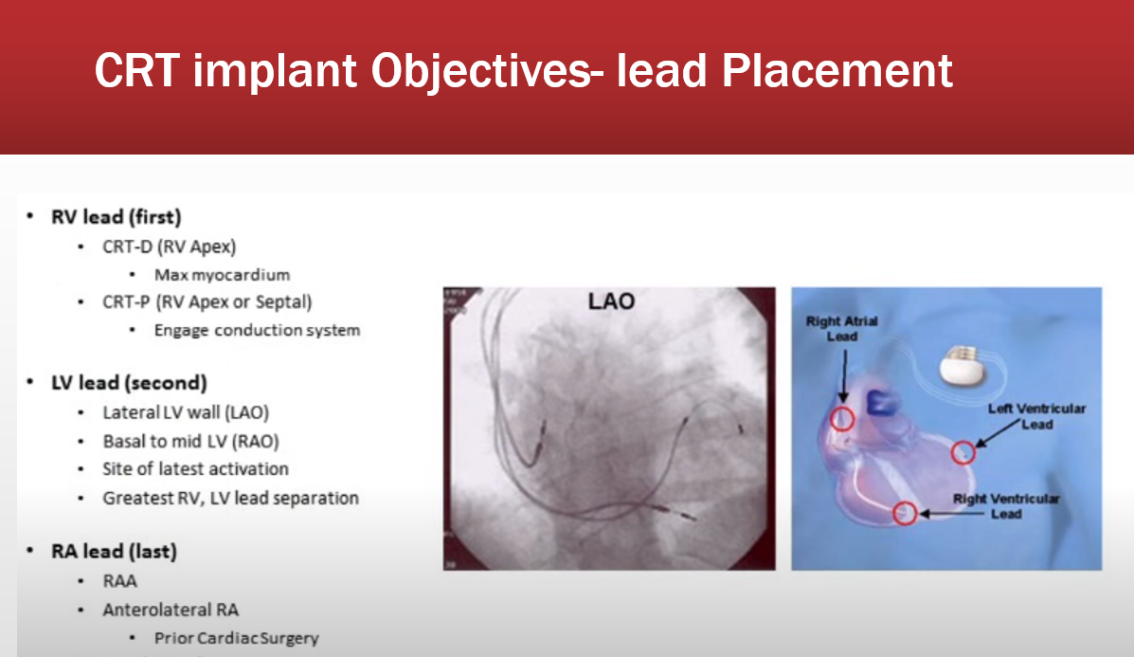

Slide 15
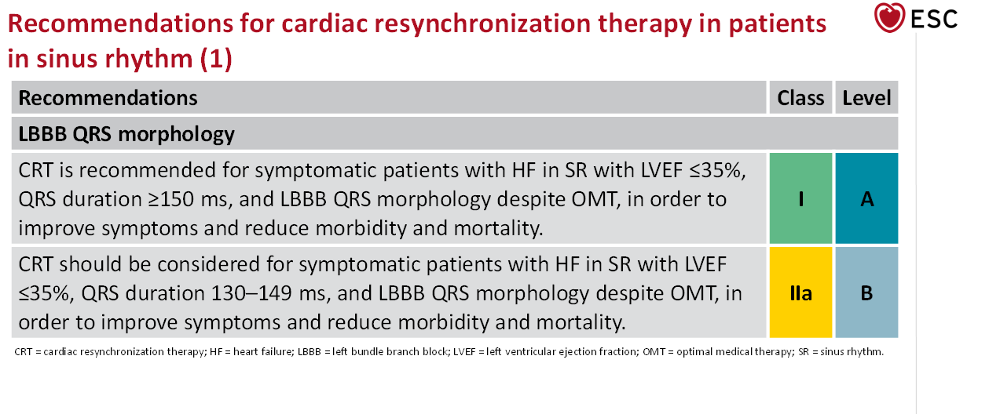
ESC Recommendations for CRT

Slide 16
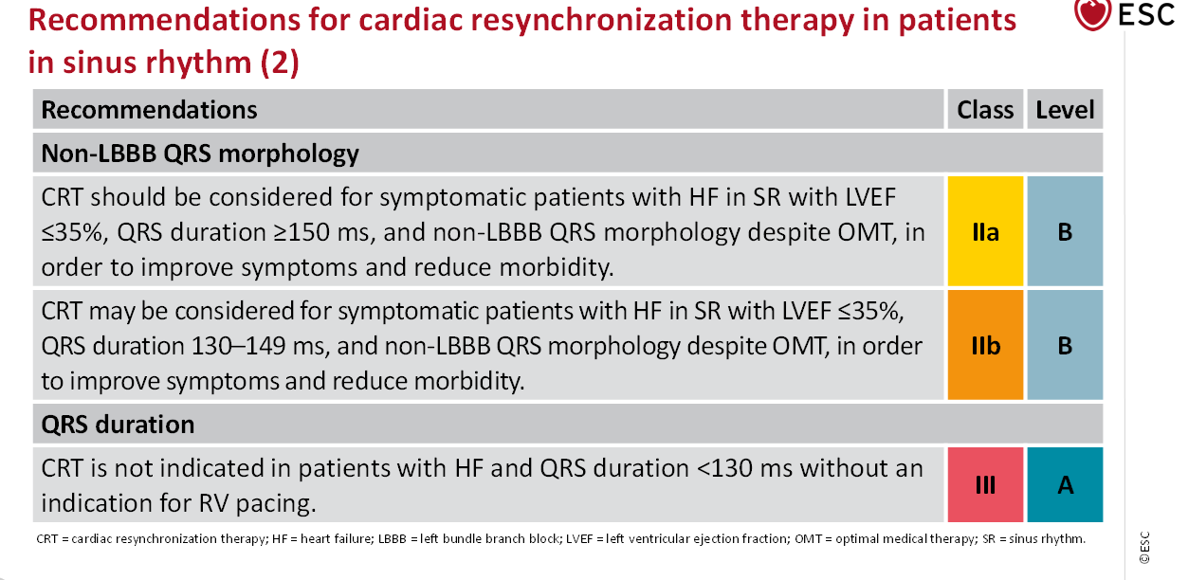

Slide 17
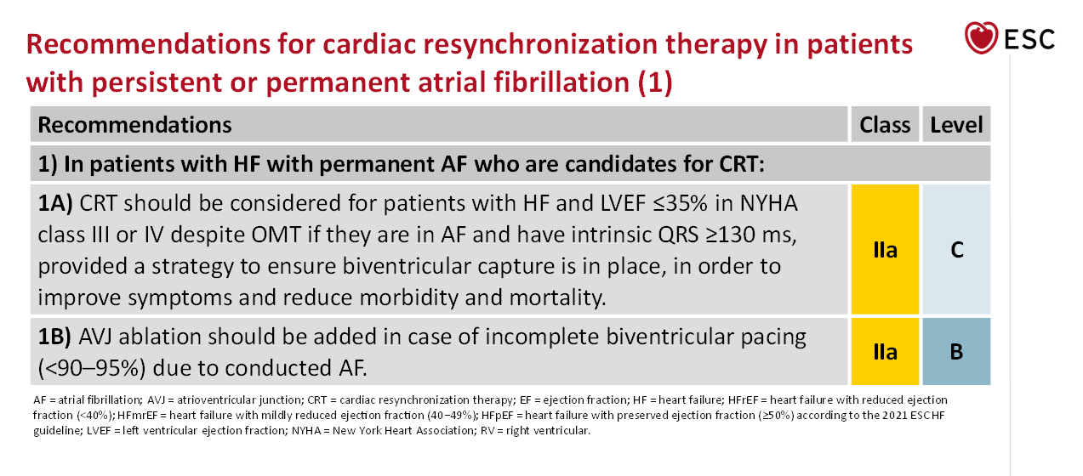

Slide 18
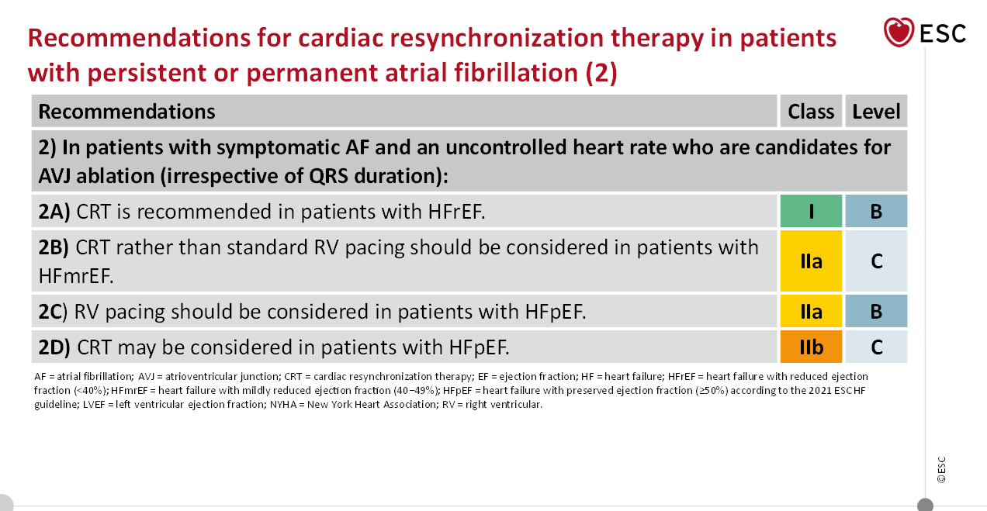

Slide 19
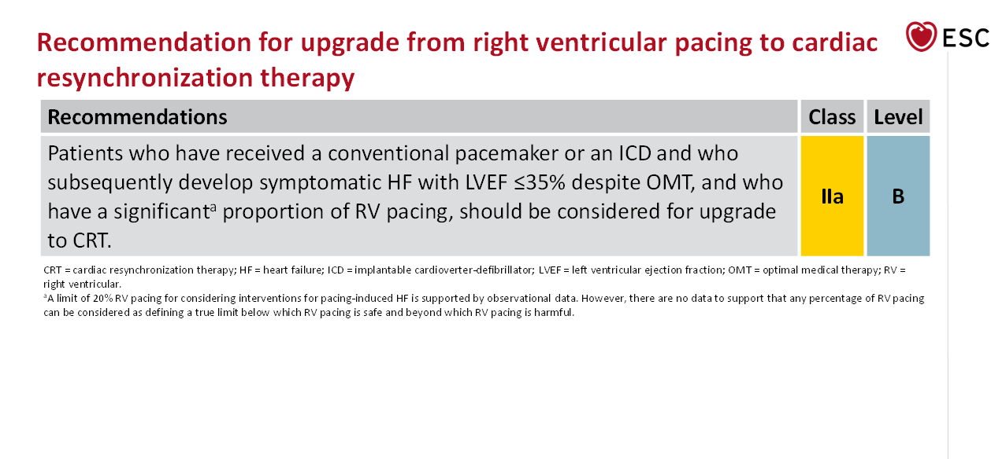

Slide 20
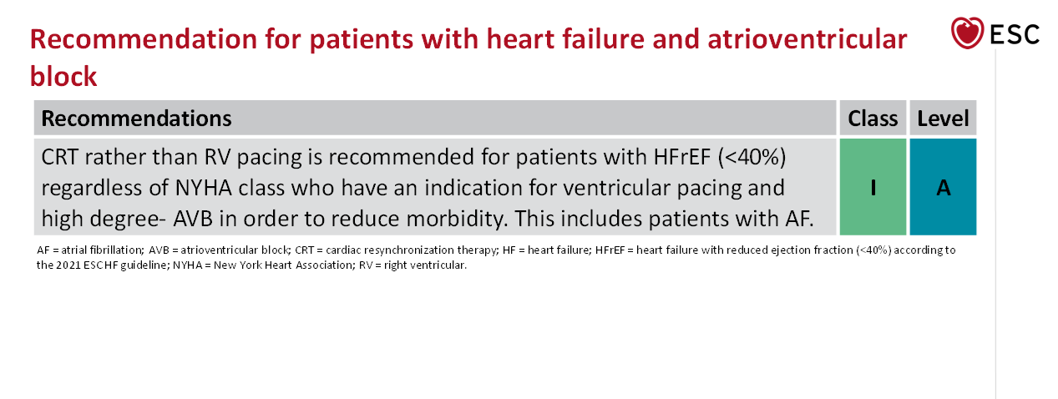

Slide 21
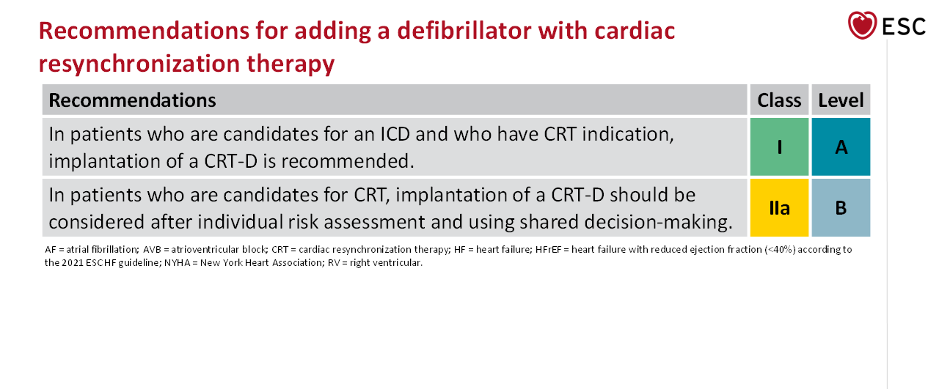

Slide 22
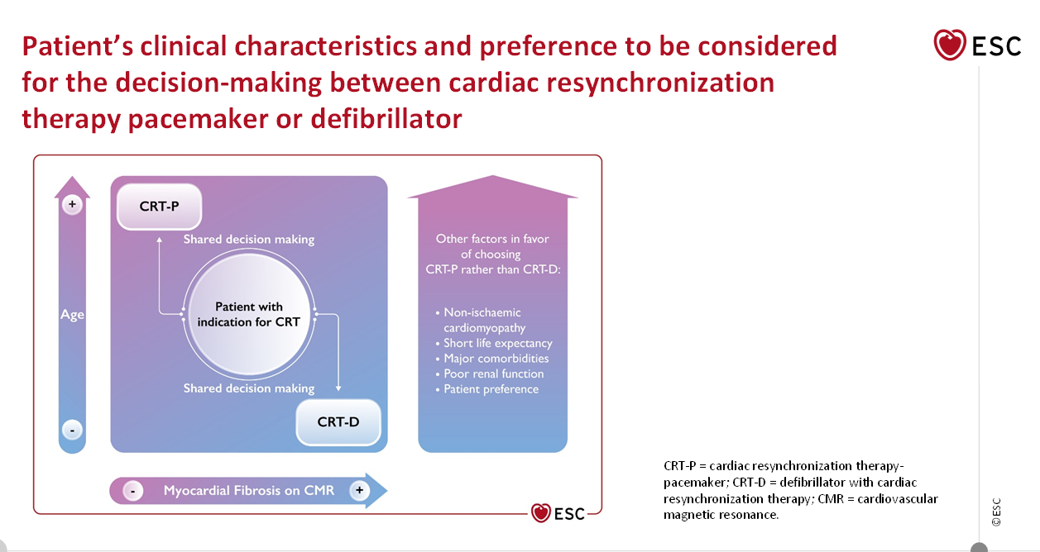

Slide 23
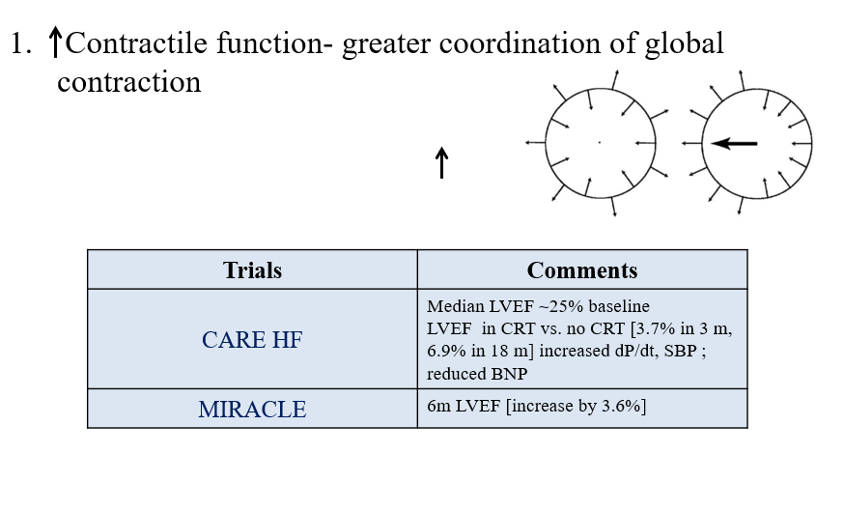
Mech of resynchronisation

Slide 24
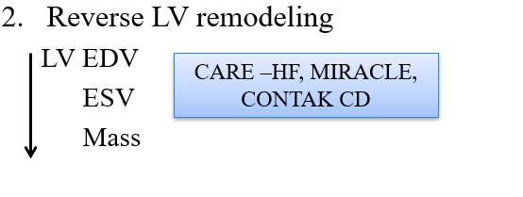

Slide 25
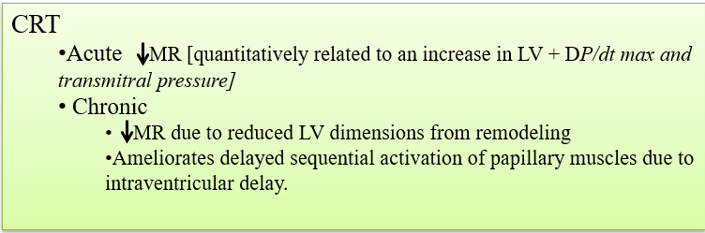
3.Reduction in Functional MR

Slide 26
Other mechanisms
Increase in cardiac index and reduced PCWP
Tolerate more aggressive medical therapies [ beta blockers]
Improved diastolic functions
Improvement in heart rate variability

Slide 27
IMPLANTATION
All implant procedures are performed usually in the EP laboratory.
Prophylactic antibiotic treatment is routinely administered.
The procedures are performed under local anesthesia, combined with deep sedation (using midazolam and propofol)
The pulse generator was implanted in the left pectoral pocket.

Slide 28
The leads for the CRT system are inserted through the cephalic and/or subclavian vein.
The sequence followed usually included the insertion and placement of the right ventricular (RV) lead first,then the LV lead, and the right atrial lead last.
The RV composite pace/sense-defibrillation lead is positioned at the RV apex or the RV septum or outflow tract.
The LV lead is an over-the-wire bipolar or quadripolar lead positioned in a CS tributary

Slide 29
After obtaining satisfactory intraoperative electrical measurements (pacing and sensing thresholds), each lead is secured in place by suturing to the muscle in the infraclavicular area.
Then, for the CRT-D patients, defibrillation threshold testing was performed with the induction of ventricular fibrillation (VF) using the ICD device by means of T-wave shocking.

Slide 30
LV lead implantation
Type of implantation
LV Epicardial Vein [Trans-venous]
LV Epicardial lead [Surgically planted]
LV Endocardial lead [ Trans-septal puncture]

Slide 31
CS Cannulation and LV lead implantation

Slide 32
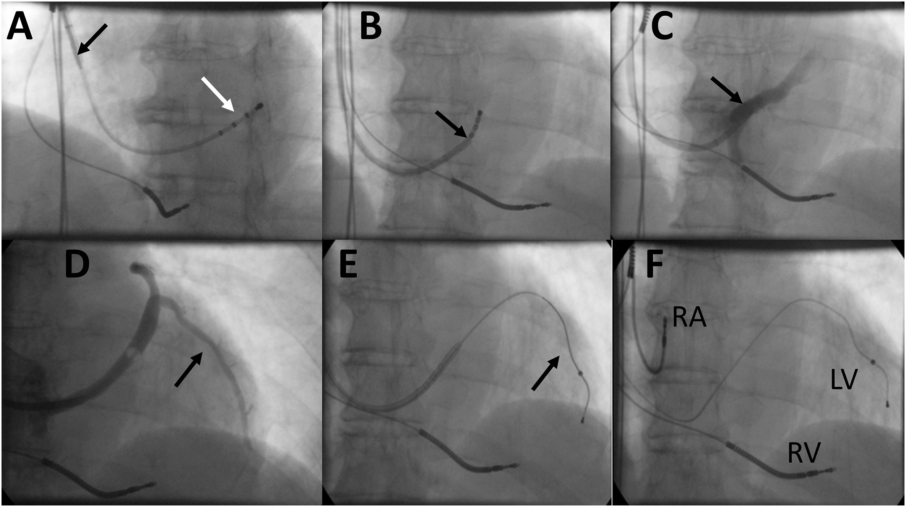

Slide 33
These images illustrate the typical step-wise approach to CRT followed in this series of patients.
A: After placement of the right ventricular lead (here a composite pace/sense-defibrillation lead), a steerable quadripolar electrophysiology catheter (white arrow) was inserted into the long sheath (black arrow) to facilitate coronary sinus (CS) cannulation.
B: Upon cannulation of the CS, the sheath is advanced over the catheter into the CS (arrow).
C: After withdrawal of the catheter, a small amount of contrast dye is injected into the CS to further confirm CS entry.
D: Then, a coronary venous angiogram is obtained with contrast injection with or without balloon venous occlusion to delineate the venous anatomy and select the target vein (arrow).
E: An over-the-wire left ventricular lead is steered in position (arrow) and tested.
F: Finally, the long sheath is removed and the atrial lead is positioned in the right atrial appendage, completing the process of positioning of all leads; alternatively, the atrial lead can be positioned before CS cannulation and placement of the left ventricular lead.

Slide 34
Limitations & Complications
1.Inability to cannulate C.S. and implant the LV pacing lead successfully
Coronary venous anatomy-Absent / inaccessible target vein
-Coronary venous tortuosity
2.High LV stimulation threshold → Scar burden
3.Phrenic nerve stimulation

Slide 35
In ability to advance in CS could be due to stenosis, valves, subs election, dissection and tortuosity.
Vieussen`s valve is an embryonic remnant, seen at the origin of the posterolateral ventricular vein.
If there is a prominent valve in the posterolateral vein, we can cannulate the middle cardiac vein and go into a lateral branch of this vein

Slide 36
CS stenosis can be ballon dilated, but branch vein stenosis is better left alone.
Search for other veins which could be used. This will also reduce the dye load in attempted dilation.
Dissections can occur due to dye injections and by sheath advancement.
In most of the dissection is distal, try using the lateral branch of the middle cardiac vein.
Pushing a catheter which is sub selected without recognizing it is one of the reasons for dissection.

Slide 37
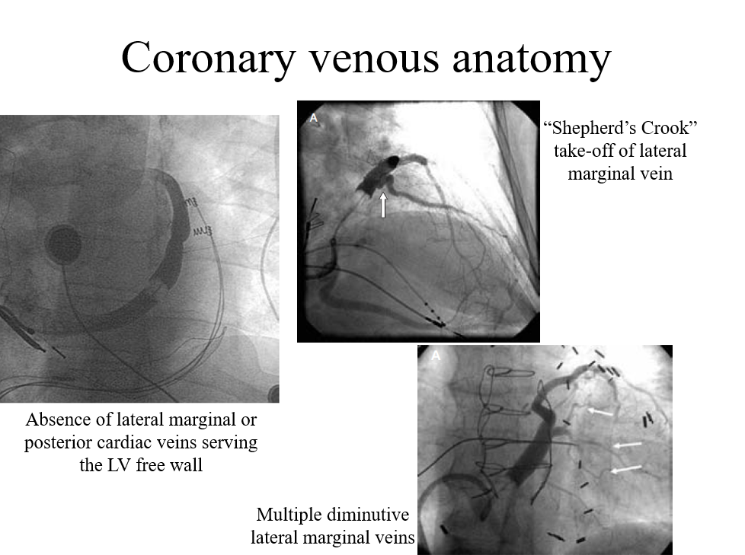

Slide 38
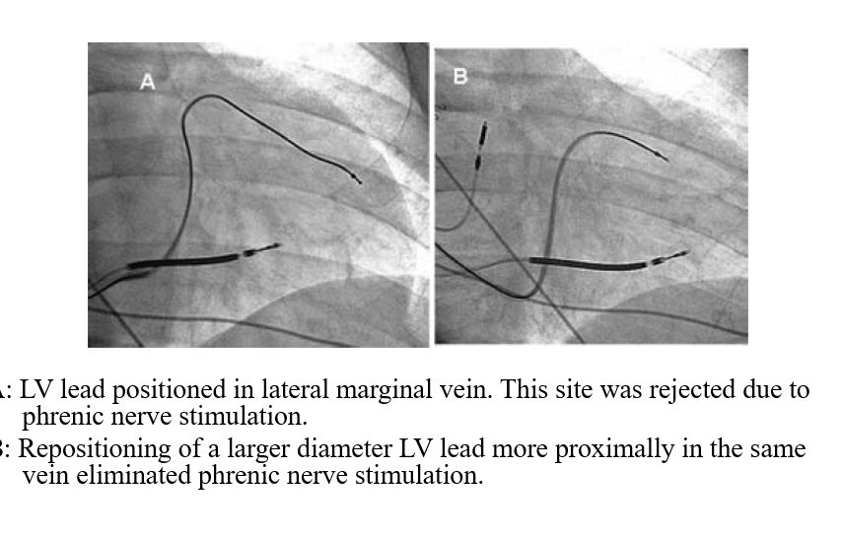
Phrenic Nerve stimulation

Slide 39
Complications
Lead related reintervention-dislodgement, malposition, subclavian crush syndrome
CIED-related infections, <12 months-Superficial infection, pocket infections, systemic infections
Pneumothorax
Hemothorax
Brachial plexus injury

Slide 40
Cardiac perforation
Coronary sinus dissection/perforation
Diaphragmatic stimulation
Hematoma, Seroma
Tricuspid regurgitation
Pacemaker syndrome

Slide 41
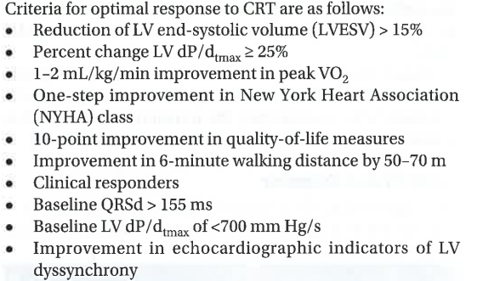
CRITERIA FOR OPTIMAL RESPONSE TO CRT

Slide 42
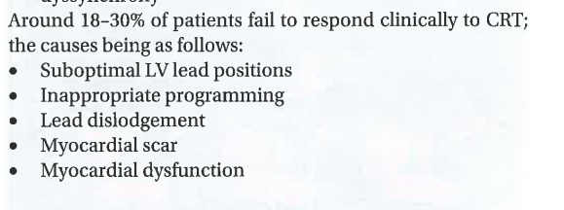

Slide 43
Lead Placement-
Optimal lead placement is critical for CRP response
In the absence of scarring optimal LV lead position is lateral or posterolateral
MDCT can be used for pre procedural mapping of cardiac veins

Slide 44
DEVICE OPTIMISATION
Device optimization post implantation include individualized programming of AV and VV delay to maximise the hemodynamic &clinical response to CRT.
Additional variables such as AV delay offset for As Vs Ap CRT and rate adaptive AV delay modulation makes this complicated.

Slide 45
There are multiple strategies for AV and VV optimization which make interpretation of data challenging.
Guidelines for CRT also do not provide recommendation for optimization of these parameters reflecting lack of consensus on the same.
Despite these limitations AV and VV optimisation may be useful in selected patients

Slide 46
MIRACLE TRIAL
Multicenter In Sync Randomized Clinical Evaluation (MIRACLE).
MIRACLE was the first prospective RCT designed to evaluate the benefits of CRT in patients with the inclusion criteria outlined
Patients assigned to CRT experienced an improvement in each of the primary endpoints at 6 months: 6MHWD, NYHA functional class, and QoL.
The trial also provided evidence of substantial LV reverse remodeling with CRT. The results of this trial led to FDA approval of the InSync system in 2001, the first approved CRT system in the United States.

Slide 47
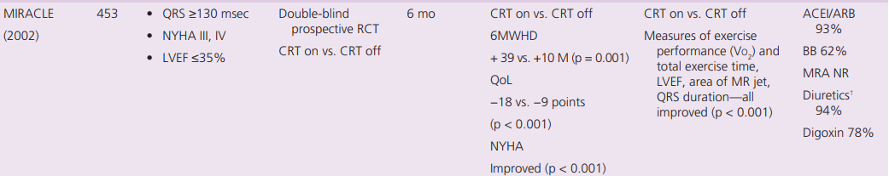

Slide 48
MIRACLE ICD TRIAL
Multicenter Insync–Implantable Cardioverter-Defibrillator Randomized Clinical Evaluation.
MIRACLE ICD was a prospective RCT designed to evaluate the benefits of an implantable cardiac defibrillator (ICD) + CRT vs. ICD alone.
The inclusion criteria and primary endpoints were the same as in MIRACLE with the additional requirement that subjects have an indication for a secondary prevention ICD or have a history of inducible sustained ventricular tachycardia.

Slide 49
With CRT, the improvements in QoL and (NYHA) classification were similar to those in MIRACLE but there was no difference in 6MHWD. However, Vo2 and total exercise time were improved.
The ventricular remodeling benefits seen with CRT in MIRACLE were not reproduced in MIRACLE ICD.
The combined CRT-ICD device used in this study was approved by the FDA in June 2002 for use in NYHA Class III and IV HFrEF patients with ventricular dyssynchrony and an ICD indication

Slide 50
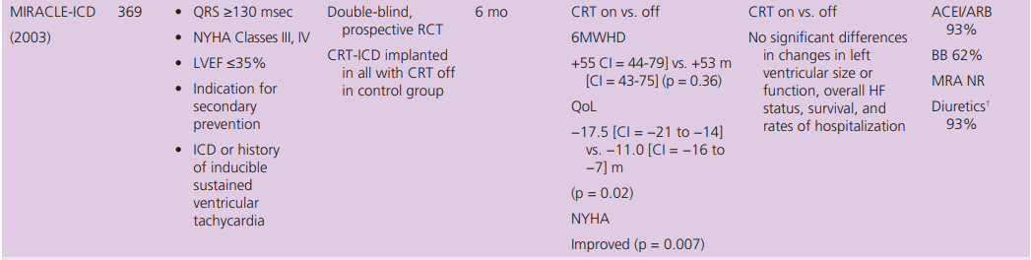

Slide 51
CONTAK- CD TRIAL
CONTAK CD. CONTAK CD was similar to MIRACLE ICD except NYHA Class II patients were enrolled.
Both the study design (crossover) and primary endpoint (Vo2 ) were changed during the study to a parallel design and a composite HF progression endpoint.
The 15% reduction in HF progression was not significant but Vo2 and 6MWHD were improved.
Significant reductions in ventricular dimensions and improvement in left ventricular ejection fraction (LVEF) similar to those seen in MIRACLE were demonstrated with CRT.

Slide 52
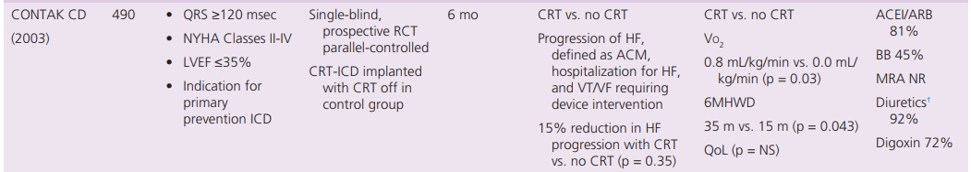

Slide 53
CARE –HF TRIAL (Cardiac Resynchronization in Heart Failure Trial)
.
The CARE-HF trial convincingly demonstrated the benefits of CRT+ medical therapy vs. medical therapy alone on morbidity and mortality in patients with NYHA Class III or IV HF and ventricular dyssynchrony
. CRT also led to a significant reduction in MR area by echocardiography and significant myocardial reverse remodeling and reduced N-terminal pro B-type natriuretic peptide (NT-proBNP) at 18 months.
These benefits were achieved irrespective of the use of beta blockers, mineralocorticoid receptor antagonists (MRAs), or digoxin.
In addition, the mean systolic blood pressure was 5.8 mm Hg (CI, 3.5 to 8.2, p = 0.001) higher in the CRT group than in the control group at 3 months; this difference was maintained at 18 months, confirming the blood pressure improvements in COMPANION

Slide 54
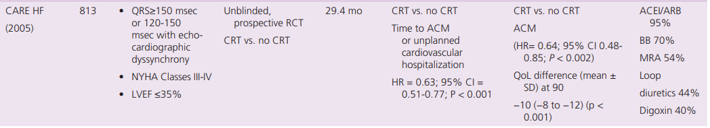

Slide 55
Randomized Controlled Trials of Cardiac Resynchronization Therapy in NYHA Class I and II Patients
These studies also provided preliminary data that informed the design of studies that allowed expanded indications to patients with an LVEF between 30% and 35% and NYHA Class I and II HFrEF patients.
The echo data from MIRACLE-ICD suggested a significant improvement in LV remodeling with CRT even in the small cohort of NYHA Class II patients enrolled similar to that seen in the more symptomatic patients in CARE-HF

Slide 56
NON RESPONDERS VS RESPONDERS
Factors reported to contribute to the nonresponder rate include suboptimal LV lead placement, suboptimal atrioventricular (AV) and ventricular-ventricular (VV) timing, ventricular scar, and HF disease progression.
A number of advances in CRT pacing are being developed to address the non responder rate, including biomarker-guided selection, optimal AV and VV timing, and the use of epicardial and endocardial LV pacing leads
.

Slide 57
Factors associated with a particularly beneficial response include LBBB, longer QRS duration, female sex, lack of prior myocardial infarction, and smaller left atrial volume

Slide 58
Super responders show a large benefit as normalization of ventricular function.
Nonprogressors- do not show a measurable benefit of CRT, but also do not have the predicted worsening HF over time as do nonresponders.
Negative responders are those who have clinical worsening of their disease after CRT implantation..

Slide 59
LIMITATIONS
Perhaps the most important of these is the benefit of CRT in patients with atrial fibrillation (AF). Patients with AF were excluded from most of the pivotal trials of CRT but the prevalence of AF is as high as 40% in some HFrEF studies.
Because of the lack of strong clinical trial data, the recommendations for CRT in patients with persistent AF with or without AV nodal ablation and RV pacing are weaker than those for similar patients with sinus rhythm

Slide 60
Another gap in knowledge for CRT is in patients with HF and preserved or mid-range ejection fraction in whom mechanical and electrical dyssynchrony may be present, but no large studies have yet addressed the benefits of CRT in these patients.

Slide 61
Factors associated with good response?
A) LBBB
B) Long qrs duration
C) Male sex
D) lack of mi

Slide 62
Investigation done for pre procedural maping of cardiac vein
A) MDCT
B) MRI
C) CECT

Slide 63
Which among the following not a complication of CRT?
A)PNEUMOTHORAX
B)SUBCLAVIAN CRUSH SYNDROME
C)BRACHIAL PLEXES INJURY
D)ARRYTHMIA

