Slide 1
MECHANICAL COMPLICATIONS OF ACUTE MI
DR FAZIL KT

Slide 2
Introduction
mechanical complications result from structural failure of infarcted myocardium
Caused by transmural myocardial necrosis following acute MI
Lead to acute hemodynamic collapse and high mortality
Represent true cardiology emergencies
Despite reperfusion era → still fatal if diagnosis is delayed

Slide 3
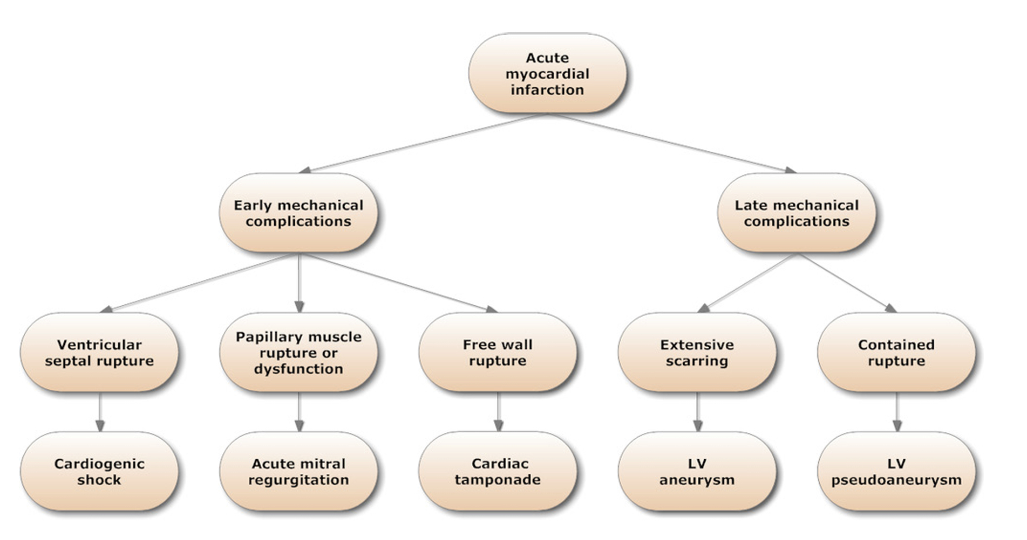

Slide 4
Papillary Muscle Rupture
Incidence - 0.1- 1%
Complete transection of an LV papillary muscle - sudden massive MR (incompatible with life )
Partial Rupture of a portion of a papillary muscle (tip or head) - more frequent
- Severe MR - not immediately fatal

Slide 5
IW or LW MI - Posteromedial PM (singular blood supply) -mc
AWMI - Anterolateral PM (dual blood supply)
Occurs with a relatively small infarction in approx half of cases
Rupture – RV papillary muscle is unusual -cause massive TR and RV failure

Slide 6
Time course -Bimodal peak
within 24 hr and 3–5 days; range: 1–14 days
Clinical manifestations –
abrupt onset of shortness of breath ,pulmonary edema
hypotension
Physical findings -soft murmur in some cases, no thrill, variable signs of RV overload, severe pulmonary edema, cardiogenic shock

Slide 7
Echo findings –
Hypercontractile LV
mobile mass in LV prolapsing into LA , prolapsing or flail leaflet
eccentric or board jet of severe MR ,
V shaped MR signal ( rather than typical rounded pattern) in spectral Doppler tracing

Slide 8
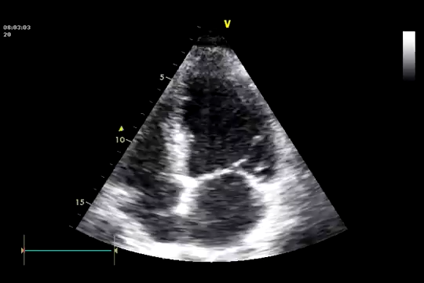

Slide 9
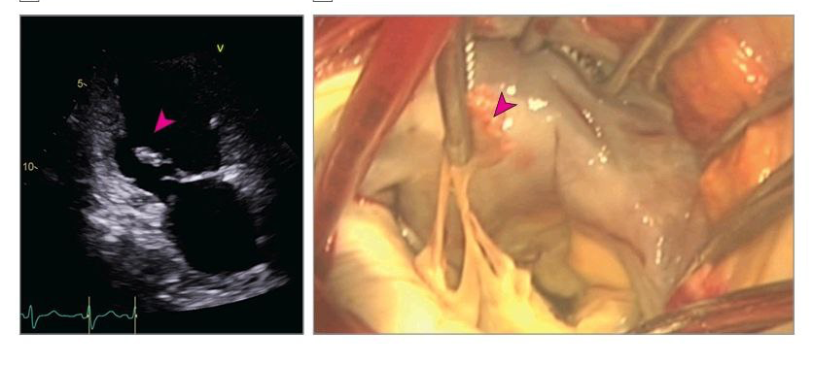

Slide 10
Management
Initial medical care and resuscitation -vasoactive drugs and respiratory support
In hemodynamically stable patients- IV nitroglycerin or nitroprusside — reduce LV afterload
The proportion of patients who required mechanical circulatory support before mitral valve surgery was in excess of 70%

Slide 11
SURGICAL REPAIR
MV replacement vs repair
Emergency mitral valve replacement ( generally chordal sparing ) is the treatment of choice
MV repair - typically for patients with partial PMR and stable hemodynamics, by surgeons with technical expertise in MV repair
mechanical valve- long-term symptom-free survival, particularly, in younger patients
BV - need for mechanical circulatory support or advanced heart failure therapies

Slide 12
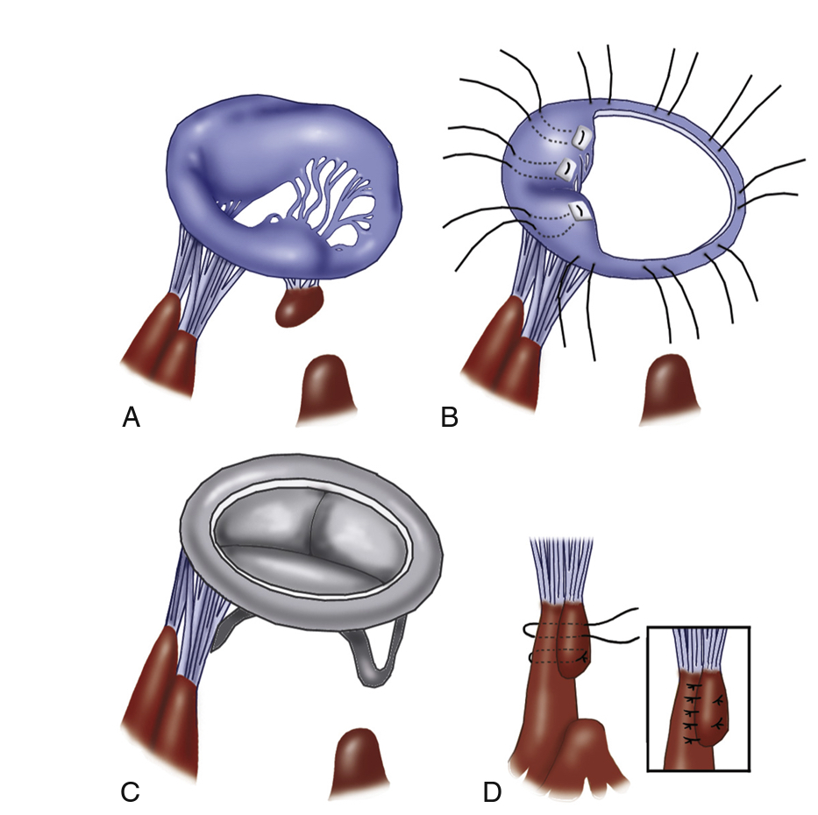

Slide 13
Transcatheter edge-to-edge MV repair
In selected patients with PMR complicated by cardiogenic shock and pump failure with high surgical risk

Slide 14
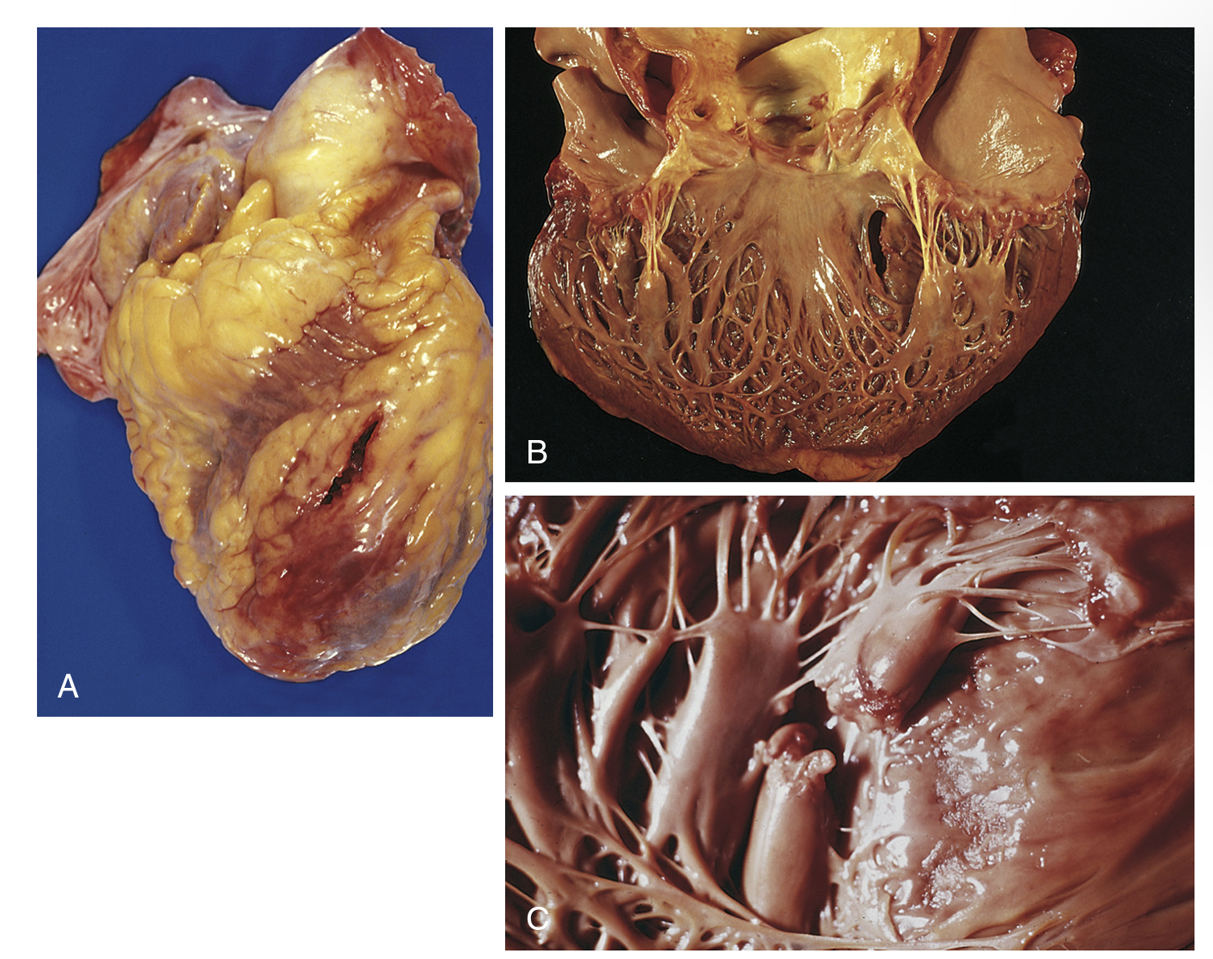
Ventricular septal rupture

Slide 15
Incidence – around 0.2 % in the current era of primary PCI
High mortality rate — 80% at 30 days in uncorrected defects, 40% at 30 days following repair
Anterior and apical VSR —> infarcts in the LAD territory
Posterior VSR —> caused by inferior (PDA) infarcts

Slide 16
Factors associated with increased risk
Female sex
older age
CKD
Factors associated with decreased risk
hypertension,
diabetes,
Chronic angina or history of MI

Slide 17
Time course -Bimodal peak
within 24 hr and 3–5 days; range: 1–14 days
Clinical manifestations –
Chest pain , dyspnoea , hypotension
Physical findings –
harsh pansystolic murmur at the left lower sternal border, thrill + ,
S3 , accentuated S2,
RV and LV failure,
cardiogenic shock

Slide 18
Echo findings – ventricular septal rupture with left to right shunt on color flow doppler, evidence of chamber enlargement with dysfunction.
Right heart catheterisation –step-up oxygen saturation from the RA to RV, large v waves - very high PCWP

Slide 19
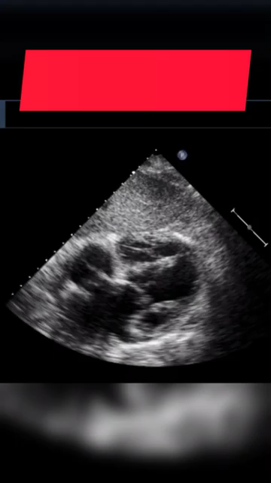

Slide 20
Management
Immediate afterload reduction- mainstay of treatment (to decrease the left-to-right shunt is essential): IABPs with pharmacotherapy are used in >80% of emergency and 65% of urgent repairs.
In the SHOCK Trial Registry, IABPs were used in up to 75% of postinfarct VSDs. Within 30 minutes of the initiation of IABP, the median systolic blood pressure was increased from 81 mm Hg to 102 mm Hg.

Slide 21
In patient with multiorgan failure - ECMO may be considered to allow for improvements in end-organ failure as a bridge to surgical candidacy.
In patients without clinical symptoms of end-organ failure, a delayed treatment may allow for connective tissue or scar formation around the defect, resulting in a better anchor for suture material and a lower potential for patch dehiscence

Slide 22
Surgical repair
Urgent postinfarct VSD surgical repair in patients with cardiogenic shock and respiratory failure ( associated with 40% mortality)
Delayed surgery –risks extension of the VSR and subsequent associated mortality.
Optimal timing of surgical treatment is IMPORTANT
During surgical repair of VSD, coronary bypasses are performed first, commonly with saphenous veins, to facilitate myocardial protection and minimize handling of the heart after VSD repair.

Slide 23
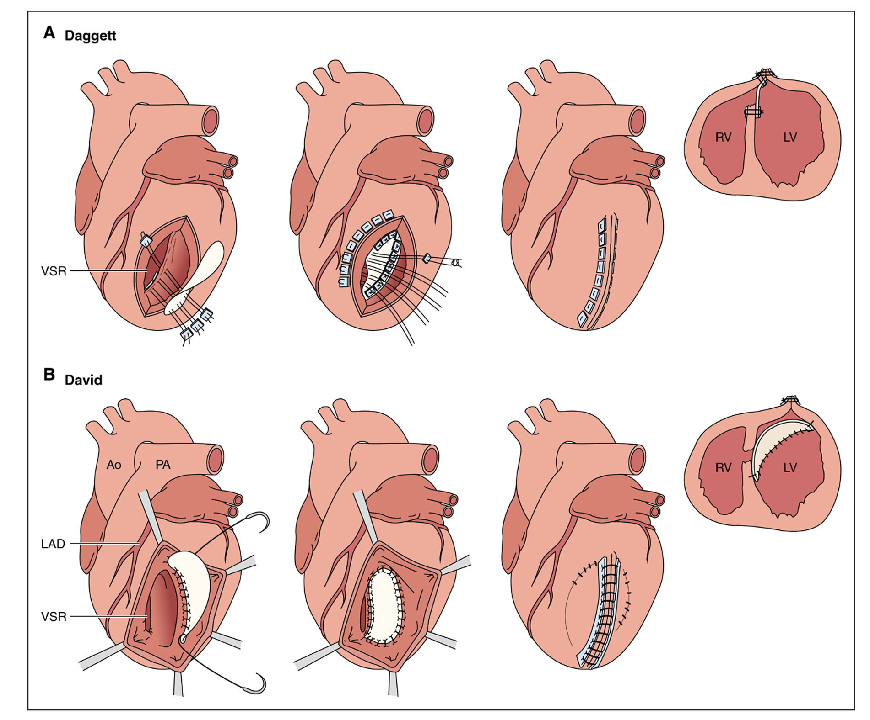
Surgical techniques –
primary repair (Dagett) – direct closure of VSR via RV – patch if defect is large (posterior/inferior VSR)
Infarct exclusion (David) – patch larger than the infarcted area is sewn over the defect and the infarcted myocardium, directly onto healthy myocardium (Anterior VSR) (via LV)
Double patch technique

Slide 24
preoperative prognostic factors associated with in-hospital mortality
poor ventricular function,
deteriorating cardiovascular status,
cardiogenic shock,
inferior AMI,
total occlusion of the infarct-related artery.

Slide 25
Transcatheter repair of VSR
In patients with high surgical risk —> percutaneous closure can be considered
The procedure is usually performed under GA with TEE guidance for device sizing
Most often, the VSD is crossed by using a hydrophilic wire from the left to the right ventricle into the pulmonary trunk. The wire is snared and exteriorized through the venous access (femoral or jugular)
Over this arteriovenous rail, a shuttle sheath is advanced into the interventricular septum and an occluder is deployed
If difficulties crossing the VSD are encountered, right to left wiring and exteriorization can be performed

Slide 26
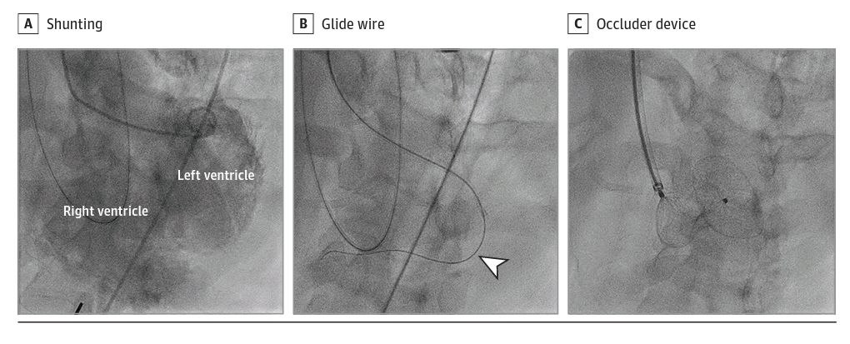

Slide 27
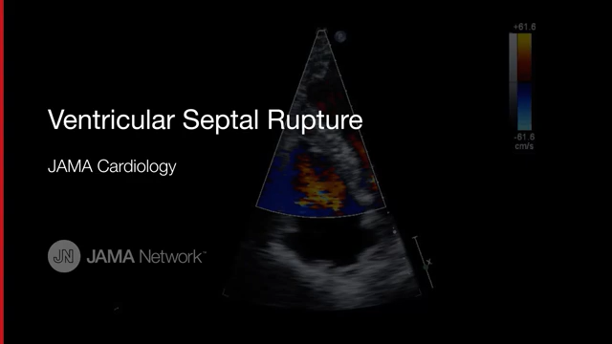

Slide 28
Complications
device embolization,
arrhythmia,
failure of complete occlusion of the VSD requiring surgical repair
In patients with severe refractory shock and biventricular failure, mechanical circulatory support or heart transplantation or total artificial heart may be considered.

Slide 29
Free wall rupture

Slide 30
Incidence – around 0.3-1 % .
Fribrinolysis does not reduce risk vs PCI –reduces risk
worst prognosis among the mechanical complications of AMI. In-hospital mortality is around 75 -90%
more common in the LV (specifically, the anterior or lateral wall) than in the right ventricle and seldom occurs in the atria

Slide 31
The tear is usually preceded by a large infarct with subsequent expansion, sometimes with a dissecting hematoma —occurs near the junction of the infarct and normal muscle
Time course -Bimodal peak
within 24 hr and 3–5 days; range: 1–14 days

Slide 32
Clinical presentation :
catastrophic - acute tear leading to tamponade and immediate death
Subacute -nausea, hypotension, and pericardial discomfort
Physical findings :
classically shows jugular venous distension (29%)
pulsus-paradoxus (47%)
frank electromechanical disassociation ( without preceding overt failure – specific for FWR)
muffled heart sounds in the setting of cardiovascular collapse
ECG may show new ST-segment elevation because contact with blood irritates the pericardium

Slide 33
Echo findings –
layered, high- acoustic echoes within the pericardium (blood clot);
direct visualization of tear;
signs of tamponade

Slide 34


Slide 35
Management
Immediate surgical referral is vital
Percutaneous relief with pericardiocentesis can be life-saving in tamponade and circulatory collapse
As sutures easily tear through in the extremely fragile, necrotic myocardial wall, attempts for direct closure should be avoided

Slide 36
The two most commonly applied techniques are
classical infarctectomy and patch reconstruction of the LV wall on cardiopulmonary bypass –primary patch repair
coverage of the affected region with an oversized pericardial patch reinforced by glue, with or without suture anchoring or collagen sponge patch

Slide 37
Mechanical circulatory support using ventricular assist devices may be considered to help wean patients from cardiopulmonary bypass after surgical closure of the LV free wall rupture and to provide LV decompression

Slide 38
Pseudoaneurysm
Pseudoaneurysms of the LV develop when cardiac rupture is contained by pericardial adhesions.
Incomplete rupture of the heart may occur when organizing thrombus and hematoma, together with pericardium, seal a rupture of the left ventricle and thus prevent the development of hemopericardium
With time, this area of organized thrombus and pericardium can become a pseudoaneurysm (false aneurysm) that maintains communication with the cavity of the left ventricle

Slide 39
walls of pseudoaneurysms are composed of organized hematoma and pericardium and lack any elements of the original myocardial wall.
can become quite large, even equaling the true ventricular cavity in size, and they communicate with the LV cavity through a narrow neck.
contain old and recent thrombi, the superficial portions of which can cause arterial emboli.
can drain off a portion of each ventricular stroke volume,

Slide 40
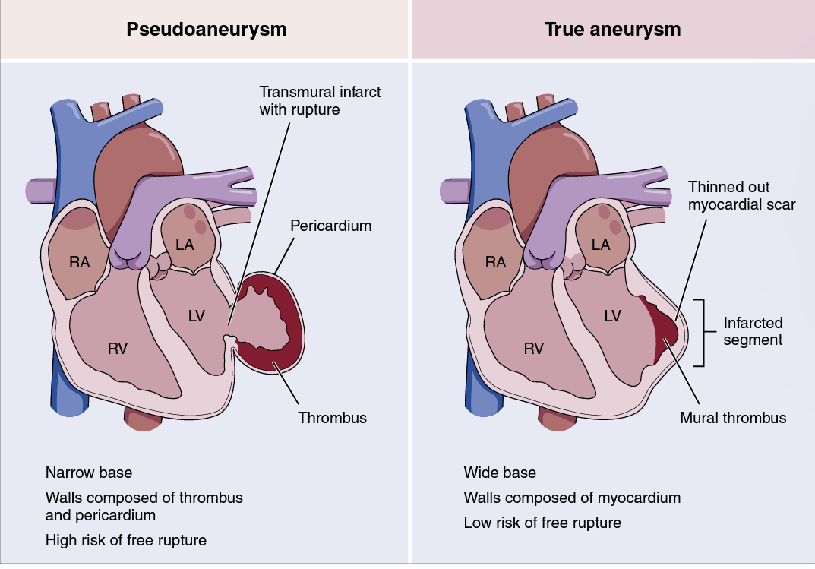
Diagnosis - echo, contrast- enhanced angiography, CMR, or CT
Differentiation between a true aneurysm and a pseudoaneurysm can sometimes be difficult with any imaging technique

Slide 41
Management of pseudoaneurysm
In patients with critically compromised hemodynamics,- surgical resection of the necrotic and ruptured myocardium with primary reconstruction
In subacute cases prompt elective surgery is indicated because the risk of rupture approaches 50% in untreated cases

Slide 42
True LV aneurysm - management
American College of Cardiology Foundation/AHA guidelines did not specify any level of recommendation for surgical repair, but the document suggested surgery for LV aneurysm in patients with refractory heart failure, ventricular arrhythmia not amenable to drugs or radiofrequency ablation, or recurrent thromboembolisms despite anticoagulation therapy.
Surgical techniques aiming at restoring the LV physiological geometry - plication, excision with linear repair, and ventricular reconstruction with endoventricular patches.

Slide 43
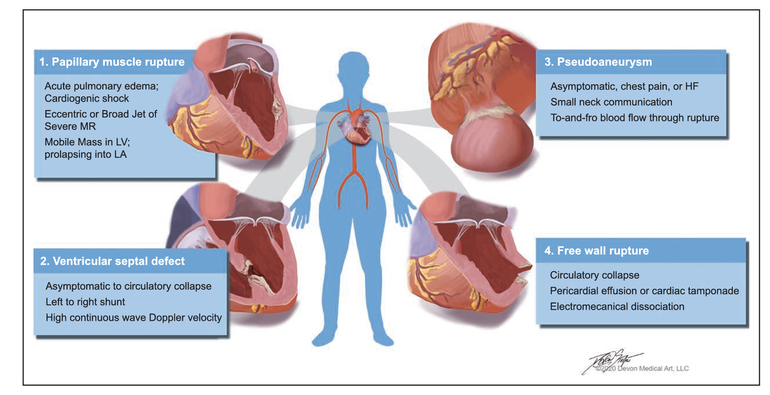

Slide 44
MCQ
Which of the following is TRUE regarding PMR ?
PMR is most frequent in ALMI
anterolateral papillary muscle is most affected
Harsh holosystolic murmur , with thrill
mitral valve repair is the treatment of choice

Slide 45
2. David AND Dagett procedure done for?
LV ANEURYSM
ISCHEMIC MR
VSR
FVR

Slide 46
4. Which of the following is false in LV pseudoaneurysm ?
maintains communication with the cavity of the left ventricle
Wall lack any elements of orginal myocardium
Maybe asymptomatic
Asymptomatic cases do not require surgery

Slide 47
Thank you

