Slide 1
Approach to Syncope
DR FAZIL KT

Slide 2
40% will experience syncope at least once in a lifetime
Major morbidity reported in 6%
(e g: fractures, motor vehicle accidents)
Minor injury in 29%
(e g: lacerations, bruises)

Slide 3
DEFINITION
Transient self limited loss of consciousness due to transient global cerebral hypoperfusion
rapid onset
short duration
spontaneous complete recovery
Can be associated with prodrome (presyncope) – dizziness ,weakness,fatigue ,

Slide 4















Classification and Etiology of Syncope
Neurally- Mediated
(Reflex)
Orthostatic
intolerance
Cardiac
syncope
Unknown causes
1
2
3
4
VVS
CSS
Drug-Induced
Vol. Depletion
Cardiac Arrhythmia
Situational
  Cough
  Post- Micturition
ANS Failure
  Primary
  Secondary
Structural
Cardio-pulmonary
9

Slide 5
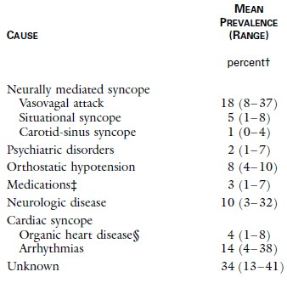

Slide 6
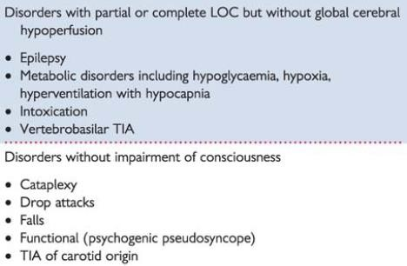

Slide 7
Pathophysiology
Failure of cerebral blood flow autoregulation –
leads global cerebral hypoperfusion
Mechanism
CO
PVR
Cerebral vascular resistance

Slide 8
Neural syncope
Sudden transient change in autonomic efferent activity
parasympathetic outflow , sympathetic outflow
- brady , vasodilation, vasoconstrictor tone –
cerebral blood flow

Slide 9
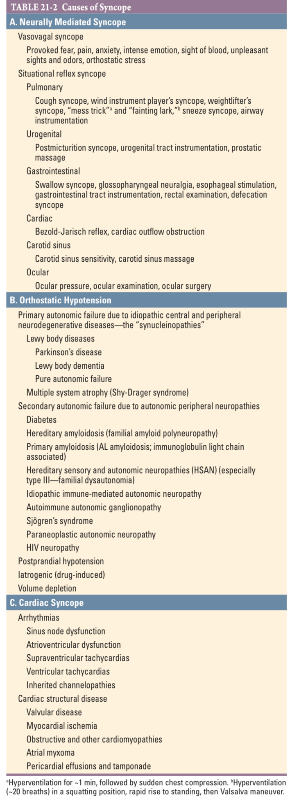

Slide 10
Mechanism of Reflex syncope (neurally mediated syncope)
Cardiovascular reflexes controlling the circulation become intermittently inappropriate
(In response to a trigger)
Resulting in vasodilatation and/ or bradycardia
Fall in arterial BP and global cerebral perfusion
  Triggers:
    orthostatic stress ( prolonged standing )
    hot shower
    emotional stress ( sight of blood)

Slide 11










Venous pooling→ reduced ventricular preload
↓ in COP and BP
sensed by arterial baroreceptors
↑catecholamine levels
Vigorously contracting vol-depleted ventricle
Mechanoreceptors or C fibers (atria, ventricles, pulmonary artery)
Afferent C fibers → dorsal vagal nucleus of the medulla
Paradoxical withdrawal of peripheral sympathetic tone Increase in vagal tone
Vasodilatation bradycardia
syncope or presyncope

Slide 12














Mixed type
Reflex syncope-3 types ( based on efferent pathway) sympathetic or parasympathetic
Vasodepressor type
Cardioinhibitory type
Vasodilatation
(↓BP)
hypotension
Bradycardia
(↓HR)
or Asystole
( predominate)
Vasodilatation
(↓BP)
+
Bradycardia (↓HR)

Slide 13
Orthostatic hypotension
  decrease in systolic BP ≥ 20 mmHg and in diastolic BP ≥10
mmHg within 3min of standing
Inabilty to maintain sufficient BP and adequate cerebral perfusion against gravity
Due to sympathetic autonomic failure

Slide 14
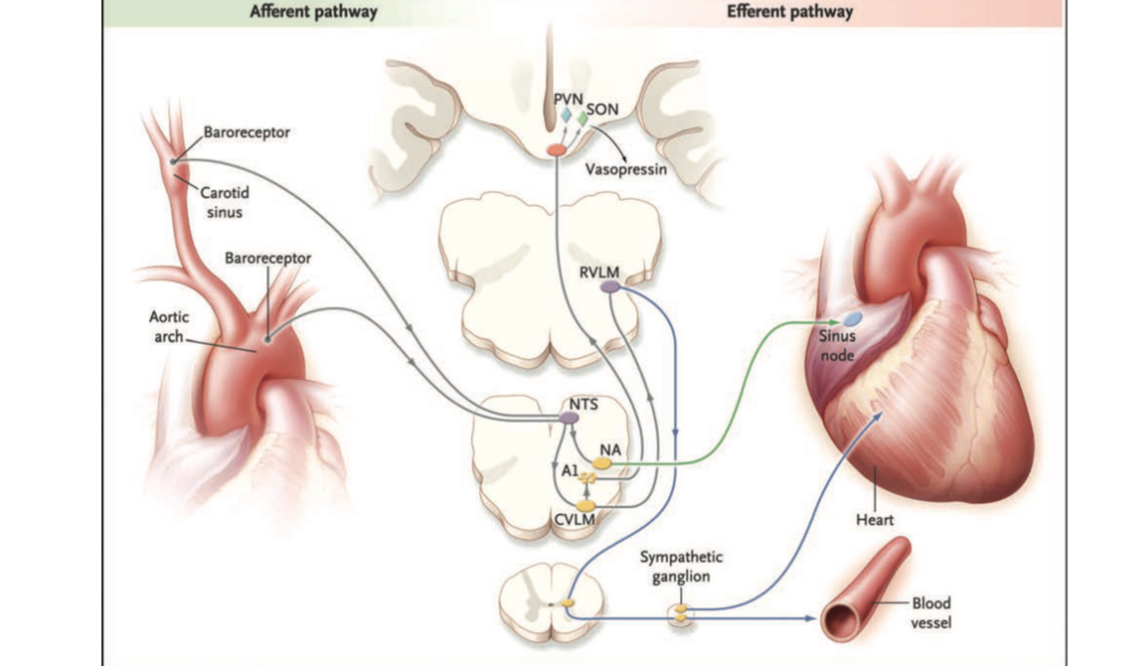
BAROREFLEX

Slide 15
Delayed OH
Initial OH
SYMPTOMS
Light headedness ,Dizziness ,neck pain
Supine HTN

Slide 16


Slide 17
Postural Orthostatic Tachycardia Syndrome (POTS)
Heart rate increases ≥30 bpm within 10 minutes of standing
(≥40 bpm in adolescents)
No significant drop in blood pressure
Symptoms lasting ≥6 months
No other explanation (like dehydration, anemia, thyroid disease)

Slide 18
1. Neuropathic POTS
2. Hyperadrenergic POTS
Higher standing norepinephrine levels.

Slide 19
3. Hypovolemic POTS
Low circulating blood volume.
Often linked to low renin/aldosterone levels.
4. Secondary POTS
Occurs due to another condition, such as:
Autoimmune disorders
Ehlers-Danlos syndrome
Diabetes
Post-viral syndromes (including after COVID-19

Slide 20
Cardiac syncope

Slide 21
History exam findings s/o cardiac syncope
1.Known heart ds
2. abN CVS Exam
3. family h/o sudden death
4. Male sex
5. Age > 35 yrs at time of syncope 6. 2 or fewer previous episodes 7. Palpitations 8.Chest pain or dyspnea

Slide 22
EGSYS Score
Palpitation preceding syncope | +4
Heart ds or abnormal ECG | +3
Syncope during effort | +3
Syncope while supine | +3
Precipitating factors | -1
A SCORE OF 3 OR MORE NEEDS A CARDIOLOGIST EVALUATION

Slide 23
San Francisco syncope rule
CHESS acronym
Patients with syncope are at 25% risk for serious outcomes if they present with one of these five clinical conditions:
1. Congestive heart failure (CHF),
2.Hematocrit <30%
ECG abnormalities
Shortness of breath
Systolic blood pressure <90 mm Hg

Slide 24
Evaluation of syncope
Diagnostic Assessment | Yield (%)
Initial Evaluation
History, Physical Exam, ECG | 38-40
Other Tests/Procedures
Head-Up Tilt | 27
External Cardiac Monitoring | 5-13
Insertable Loop Recorder (ILR) | 43-88
EP Study | <2-5

Slide 25
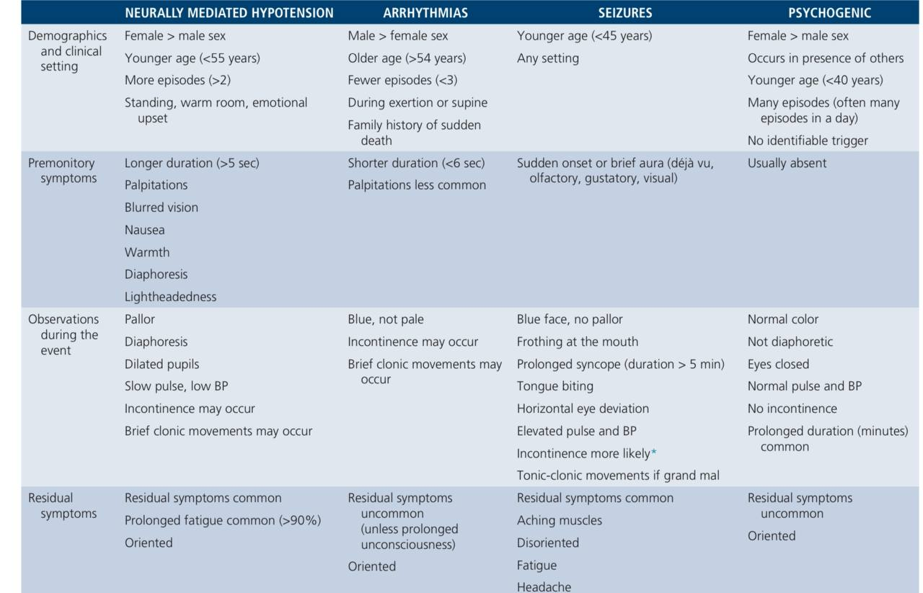

Slide 27
Ambulatory ECG
Method | Comments
Holter (24-48 hours) | Not Useful for infrequent events
Event Recorder | Useful for infrequent events Limited value in sudden LOC
Loop Recorder | Useful for infrequent events Implantable type more convenient (ILR)
Ambulatory ECG
  Holter monitoring
  Event recorder
    Intermittent vs. Loop
    Implantable Loop Recorder (ILR)

Slide 28
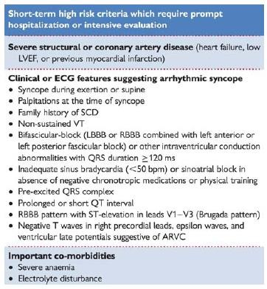

Slide 29
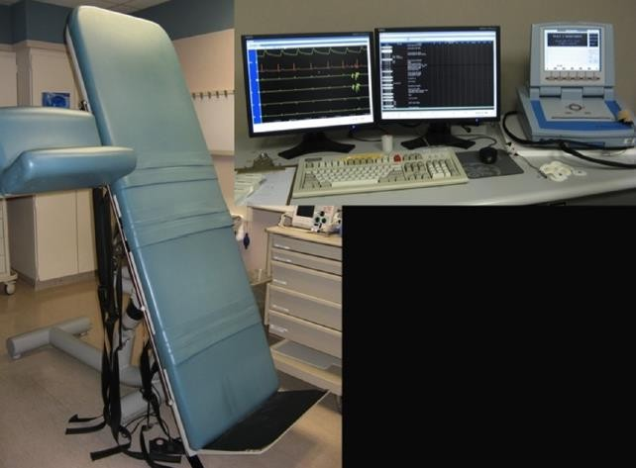
Head-up tilt test (HUTT)
Young patients without obvious or suspected heart disease with recurrent syncope of unexplained origin, in which the history is not typical enough for the diagnosis NMS

Slide 30
Patients should be fasting for 4 h prior to the test
Passive phase (20 min) + Sensitization phase (20 min)
Table tilted at an angle of 70 degrees, with footrest and rest for the upper limb
in which the BP will be measured.
- The Velcro straps allow securing the patient in case of loss of postural tone.
The necessary equipment:
  Device for non-invasive monitoring of BP (beat to beat)
  BP curve
ECG monitoring devices

Slide 31
The sensitivity of the test can be increased
by the use of longer tilt durations
steeper tilt angles
provocative agents such as isoproterenol or nitroglycerin

Slide 32
C/I
Severe LVOTO
Severe MS
Critical cerebral vascular stenosis
Critical proximal coronary stenosis

Slide 33
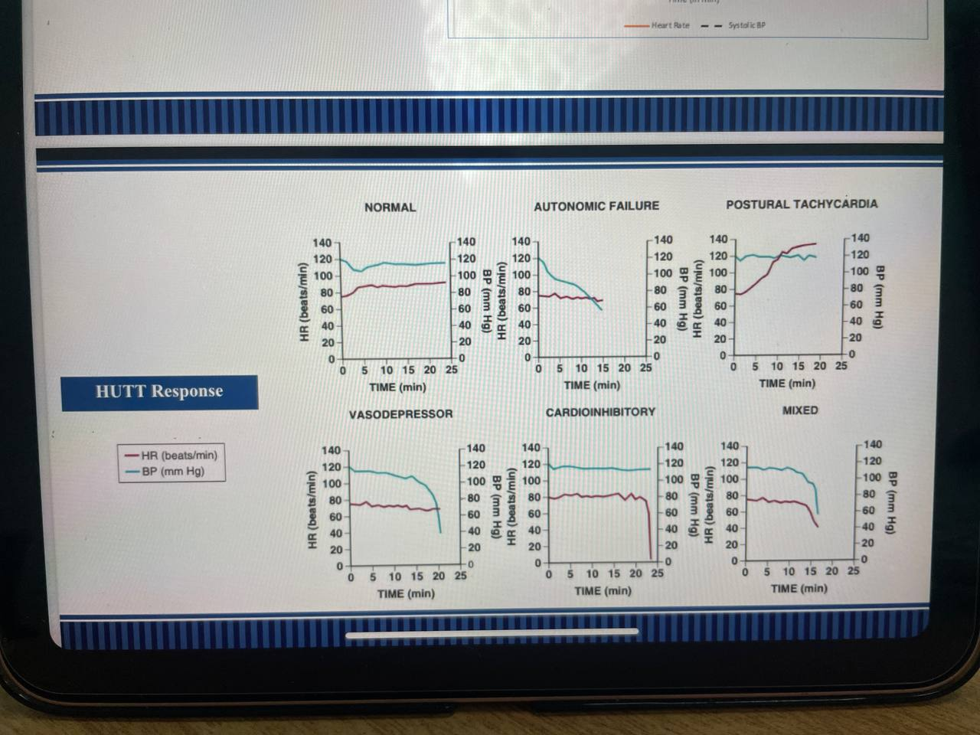

Slide 34
Carotid Sinus Massage (CSM)
Method
  Massage, 5-10 seconds
  Don’t occlude
  Supine and upright posture
(on tilt table)
Outcome
  >3 second asystole and/or> 50 mmHg fall in systolic BP with reproduction of symptoms = Carotid Sinus Syndrome
Absolute contraindications
  Carotid bruit,
  known significant carotid arterial disease
  previous CVA( last 3 months )
Complications
  Primarily neurological
  Less than 0.2%
  Usually transient
26:989.
Munro N, et al. J Am Geriatr Soc. 1994;42:1248-1251.

Slide 35
Management Strategies
Goals of treatment:
Prevention of symptom recurrence and associated injuries
improved quality of life
Initial treatment:
Education regarding avoidance of triggering events
(hot crowded environments, volume depletion, effects ofcough, tight collars)
Recognition of premonitory symptoms
Manoeuvres to abort the episode (e.g.supine posture, Physical Counterpressure manoeuvres (PCMs)
Careful avoidance of agents lowering BP: alpha-blockers, diuretics, alcohol

Slide 36
Isometric PCMs -induce a significant increase in BP
leg crossing
hand grip and arm tensing

Slide 37
Pharmacological treatment

Slide 38
MIDODRINE
Mechanism: Peripheral α1-agonist → increases vascular tone → prevents venous pooling
Evidence: RCTs show reduced recurrence in frequent vasovagal syncope
Best for: Young patients with hypotensive phenotype
Limitation: Supine hypertension, urinary retention

Slide 39
Fludrocortisone
Mechanism: Expands plasma volume
Evidence: POST-II trial showed modest benefit
Best for: Low blood pressure, hypovolemia tendency
Limitation: Hypertension, hypokalemia

Slide 40
Droxidopa
Increases norepinephrine levels
Useful in neurogenic orthostatic hypotension
Approved in several countries

Slide 41
SSRIs
Paroxetine (refractory emotional trigger syncope)
SSRIs are hypothesized to:
Stabilize central autonomic regulation
Reduce exaggerated reflex responses
Decrease recurrence in selected patients

Slide 42
VASOVAGAL SYNCOPE | ESC Recommendation | ACC/AHA/HRS Recommendation
Education & lifestyle | Class I | Class I
Midodrine | Class IIa (should be considered) | Class IIa (reasonable)
Fludrocortisone | Class IIb | Class IIb
Beta-blockers | Not recommended routinely | May be considered in patients ≥40 yrs (IIb)
SSRIs | Weak evidence (IIb) | May be considered in refractory cases (IIb)

Slide 43
Orthostatic Hypotension | ESC | ACC/AHA/HRS
Volume expansion (fluids, salt) | Class I | Class I
Compression stockings | Recommended | Recommended
Midodrine | Class IIa | Class IIa
Droxidopa | Recommended (where available) | Class IIa
Fludrocortisone | IIb | IIb

Slide 44
Cardiac pacing
frequent recurrent reflex syncope, >40 years, and documented spontaneous cardioinhibitory or mixed response during monitoring of recurrent syncope.
CSS
Dual-chamber pacing - age 40 or older with recurrent VVS and prolonged spontaneous pauses.

Slide 45
According to the European Society of Cardiology (ESC) Syncope Guidelines:
Class I indication → Syncope due to documented AV block or significant bradycardia
Class IIa indication → Recurrent reflex syncope with documented asystolic pauses (especially ≥40 years old)
Not recommended → Typical vasovagal syncope without documented cardioinhibitory response

Slide 46
Study | Year | Population | Design | Pacing Type | Main Outcome | Conclusion
VPS II (Second Vasovagal Pacemaker Study) | 2003 | Recurrent vasovagal syncope | Randomized, double-blind | Dual-chamber pacing vs sensing only | No significant reduction in recurrent syncope | Routine pacing not beneficial in typical vasovagal syncope
SYNPACE | 2004 | Severe recurrent vasovagal syncope | Randomized, placebo-controlled (pacemaker ON vs OFF) | Dual-chamber pacing | No significant difference in recurrence | Does not support routine pacing
ISSUE‑3 | 2012 | ≥40 yrs, recurrent syncope with documented asystole (loop recorder) | Randomized | Dual-chamber pacing vs sensing only | Significant reduction in recurrence | Pacing beneficial when asystole documented
BioSync CLS | 2020 | ≥40 yrs, severe reflex syncope with tilt-induced asystole | Randomized, double-blind | Closed-loop stimulation (CLS) vs inactive pacing | Marked reduction in syncope recurrence | Strong support for pacing in cardioinhibitory reflex syncope

Slide 47
THANK YOU

Slide 48
FALSE regarding orthostatic hypotension
  1)decrease in systolic BP ≥ 20 mmHg
  2) decrease in diastolic BP ≥20 mmHg
3) Inabilty to maintain sufficient BP and adequate cerebral perfusion against gravity

Slide 49
Contraindications for HUTT except? :
a) IHD
b) hypotension
c) left ventricular outflow tract obstruction
d) significant aortic stenosis

Slide 50
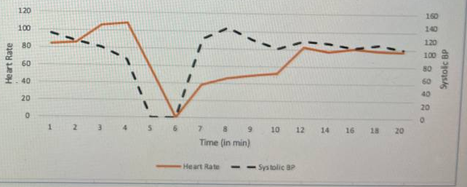
HUTT RESPONSE ?

Slide 51
Drugs proven to be useful in VVS except
A) Midodrine
B) Atenolol
C) Fludrocortisone
D) Paroxetine

