Slide 1

EXTRACORPOREAL MEMBRANE OXYGENATION
cardiopulmonary life-support
Sanjeev

Slide 2
DEFINITION
Extracorporeal life support (ECLS) is the application of extracorporeal technology to facilitate gas exchange or circulatory support, including extracorporeal membrane oxygenation (ECMO) and related techniques.
Extracorporeal cardiopulmonary resuscitation (ECPR) is the emergent application of ECLS to support patients who have sustained refractory or recurrent cardiac arrest.

Slide 3
ECLS HISTORY
Kolff and Berk in 1944 noted that blood became oxygenated as it passed through the cellophane chambers of their artificial kidney.
In 1953 by Gibbon who used artificial oxygenation and perfusion support for the first successful open heart operation.
in the late 1960s , ECMO technology was developed by a team led by Robert H. Bartlett, MD.
In 1965, Rashkind and colleagues were the first to use a bubble oxygenator as support in a neonate dying of respiratory failure.
In 1969, Dorson et al. reported the use of a membrane oxygenator for cardiopulmonary bypass in infants.
In 1970, Baffes et al. reported the successful use of extracorporeal membrane oxygenation as support in infants with congenital heart defects undergoing cardiac surgery.
ECMO was first used successfully in 1971 by a patient with severe lung dysfunction after a motorcycle accident.
In 1976, it was also used successfully for a baby who had severe lung injury from meconium aspiration, which led to increased use in the pediatric population.
In 2009, ECMO was used worldwide in the treatment of severe lung failure during the H1N1 influenza pandemic.

Slide 4
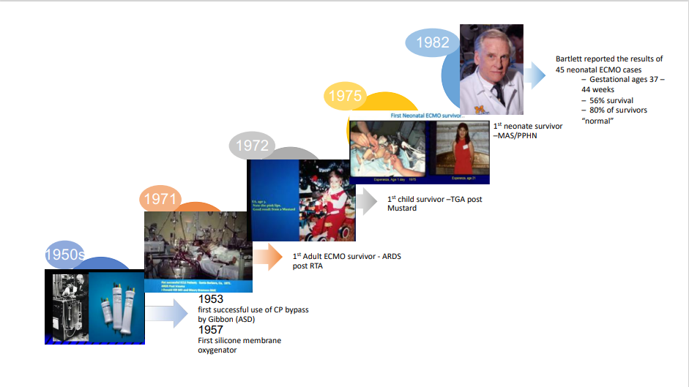
In 1953 by Gibbon who used artificial oxygenation and perfusion support for the first successful open heart operation.

Slide 5
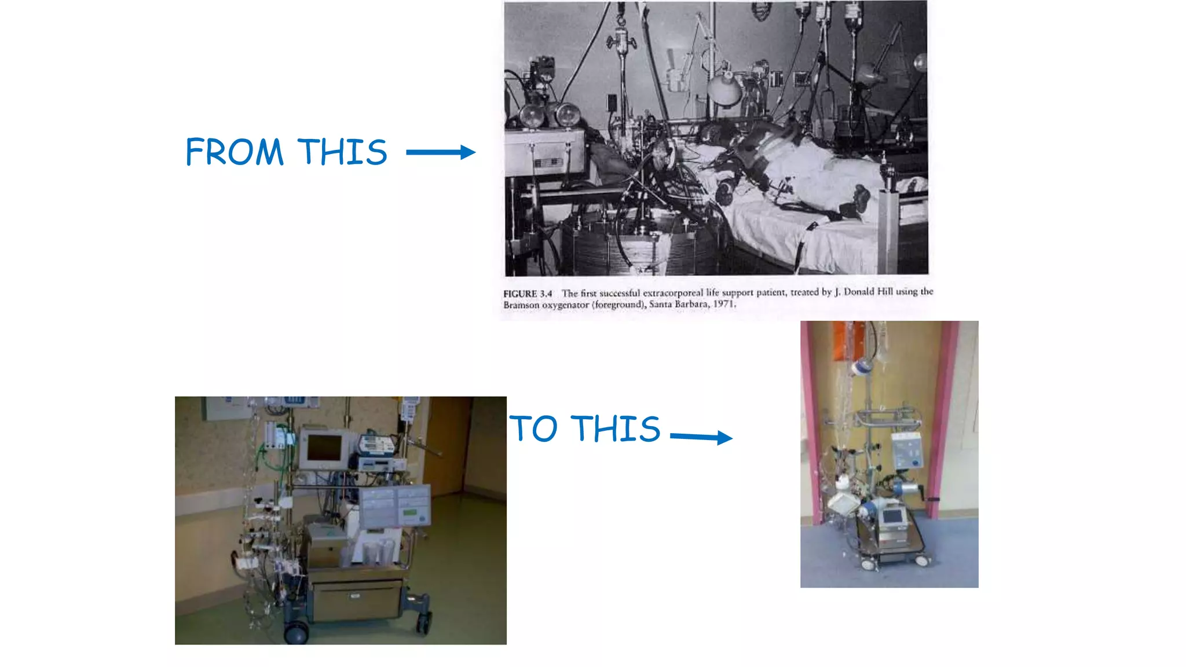
Long-term ECMO as support for severe respiratory failure was first successfully used in 1972 in an adult patient with post-traumatic respiratory failure

Slide 6
‘Extracorporeal Life Support Systems’ Nomenclature
ECLS: ExtraCorporeal Life Support
ECMO: Extracorporeal Membrane Oxygenation
Maquet Rotaflow™
ILA: Interventional Lung Assist
ILA Novalung™ by Xenios
ECCO2R: Extracorporeal Carbon Dioxide Removal
VAD: Ventricular Assist Device
Long term - LVAD: Berlin™, Heart Mate™
Short term - centrifugal cVAD: Maquet Rotaflow™ &
Levitronix Centrimag® & Pedimag™

Slide 7
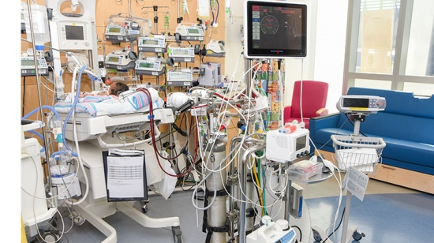
Extracorporeal life support (ECLS)
A set of extracorporeal modalities that can provide oxygenation, carbon dioxide (CO₂) removal, and/or circulatory support, excluding cardiopulmonary bypass for cardiothoracic or vascular surgery.

Slide 8
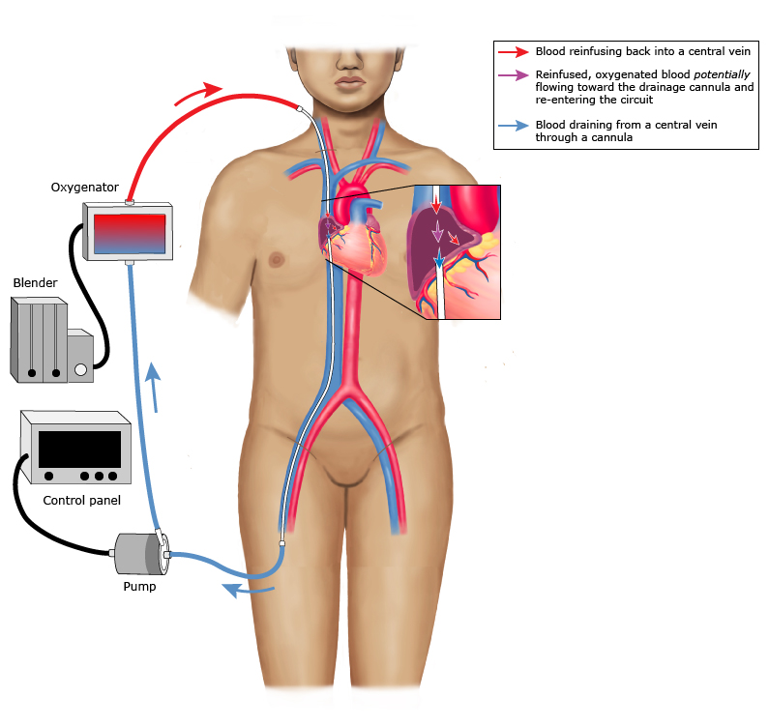
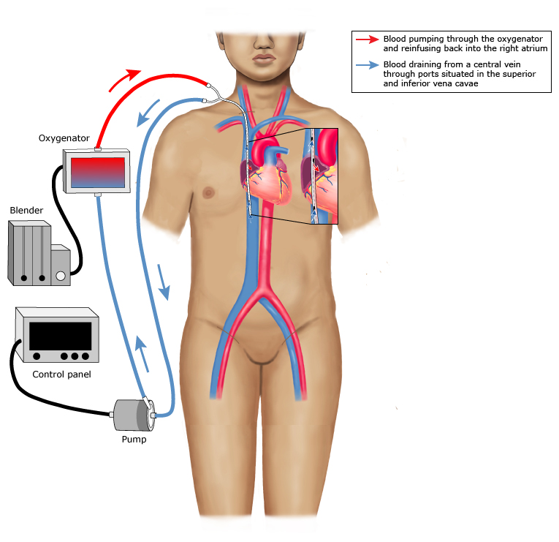
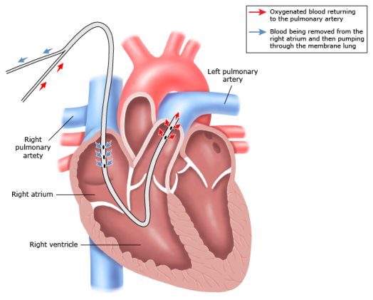
An advanced form of life support used mostly in patients with severe respiratory or cardiac failure when standard therapy fails.

Slide 9
ECMO is a Type of ECLS : 2 Main Physiologic Functions
Pulmonary Gas Exchange through an artificial ‘lung’ or Membrane
O2 delivery to meet metabolic needs
2. Removal of CO2
For Cardiac Support
Care of patient on ECMO involves exposure to anticoagulation and transfusion therapy.

Slide 10
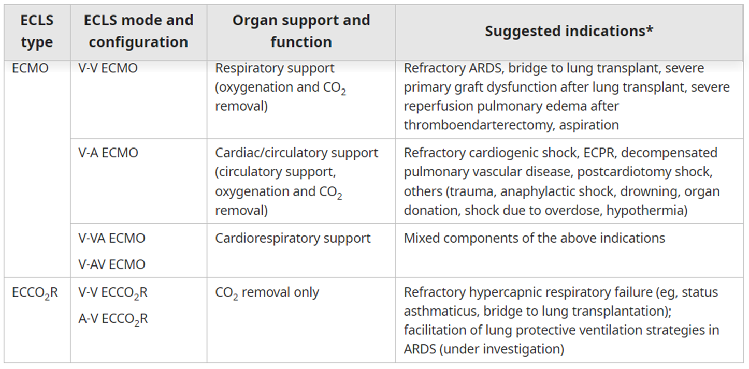
Different Types of ECMO
ECLS: extracorporeal life support; ECMO: extracorporeal membrane oxygenation; ECCO₂R: extracorporeal carbon dioxide removal.

Slide 11
Two most common forms of ECMO used in the intensive care unit:-
Venovenous ECMO (almost exclusively for respiratory failure).
venoarterial ECMO (for circulatory failure).
Extracorporeal carbon dioxide removal (ECCO2R):
Extracorporeal CO₂ removal (ECCO₂R) is another form of ECLS, used for the sole purpose of CO₂ removal.
It is not intended to impact the patient's oxygenation and typically provides only modest oxygenation at best.
It provides no cardiac support.
It is a common configuration used in patients with pure hypercapnic respiratory failure or patients with less severe forms of the acute respiratory distress syndrome who might benefit from increased lung-protective ventilatory strategies.

Slide 12
DIFFERENCES BETWEEN VENOARTERIAL AND VENOVENOUS EXTRACORPOREAL MEMBRANE OXYGENATION:
VA ECMO | VV ECMO
Provides cardiac support to assist systemic circulation | Does not provide cardiac support to assist systemic circulation
Requires arterial and venous cannulation | Requires only venous cannulation
Bypasses pulmonary circulation/decreases pulmonary artery pressures | Maintains pulmonary blood flow
Could be used in RV failure | Can’t be used
Lower perfusion rates are needed | Higher perfusion rates are needed
Higher PaO₂ is achieved | Lower PaO₂ is achieved
ECMO circuit connected in parallel to the heart and lungs | ECMO circuit connected in series to the heart and lungs

Slide 13
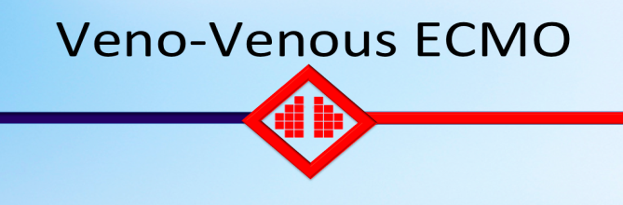
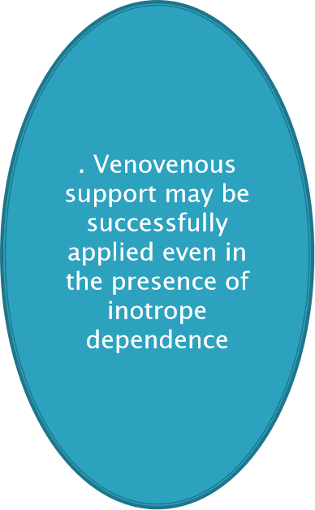
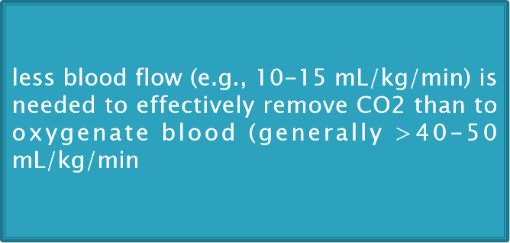
MODES OF ECMO
Used for respiratory failure refractory to mechanical ventilation.
To provide adequate gas exchange to support life and thereby facilitating a significant reduction in mechanical ventilation, reducing ventilator-associated lung injury and allowing the best chance of lung recovery. Minimize mechanical ventilation and lower the risk of ventilator-induced lung injury.

Slide 14
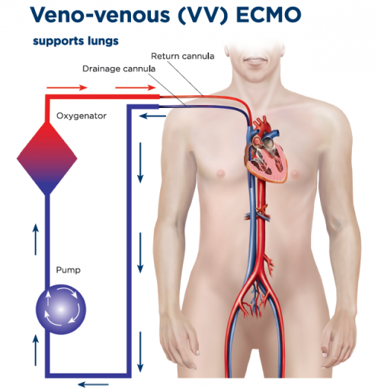
INDICATIONS:
Severe Pneumonia
Status Asthmatics
Pulmonary Vasculitus
ARDS from primary lung injury
Acute graft failure following lung transplantation
CONTRAINDICATIONS:
Age: > 70 years
Active malignancy
Severe brain injury
Previous Bone marrow transplant
Previous heart, lung, renal transplant (>30 days)
AIDS defining illness despite antiretroviral therapy
Cirrhosis
End-stage renal failure (dialysis)
Specific Exclusions for VV ECMO:
Chronic lung disease not eligible for transplant
Profound shock with multiorgan failure

Slide 15
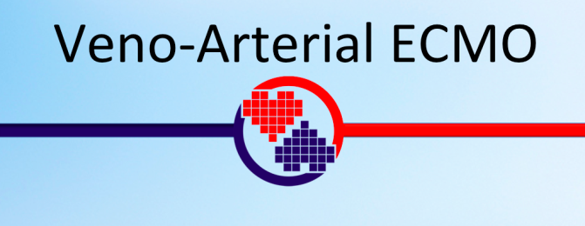
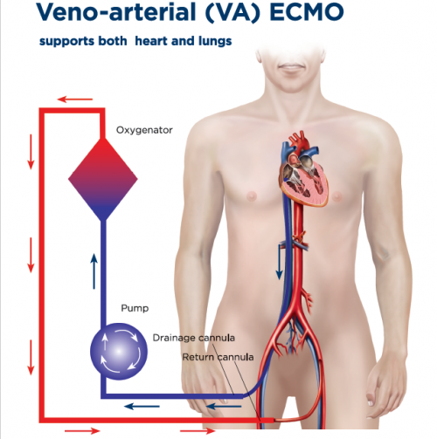
Provide both circulatory and gas exchange support.
Considered in patients with severe cardiac failure or combined cardiac and respiratory failure refractory to inotropes, intra-aortic balloon counterpulsation and mechanical ventilation.
Very similar to cardiopulmonary bypass use during cardiac surgery and can be considered as longer term cardiopulmonary bypass.
Used at low flows (2-3 L/min) as partial assistance to native cardiac output
or at higher flows (4-6 L/min) completely replacing native cardiac output

Slide 16
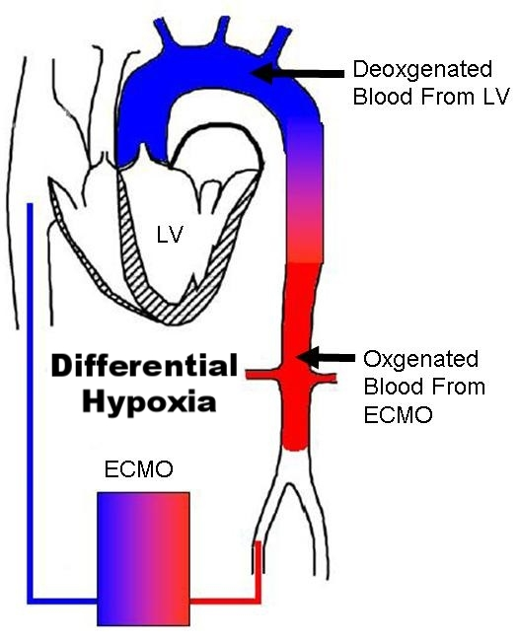
INDICATIONS
Profound unresponsive shock from:
Myocarditis
Myocardial infarction
Pulmonary embolism
Drug overdose
Cardiomyopathy
Primary graft failure post heart transplant
Bridge to heart transplantation or VAD
Post cardiotomy (outcome often poor
CONTRAINDICATIONS
Age: > 70 years
Active malignancy
Severe brain injury
Previous Bone marrow transplant
Previous heart, lung, renal transplant (>30 days)
AIDS defining illness despite antiretroviral therapy
Cirrhosis
End-stage renal failure (dialysis)
Specific Contraindications to V-A ECMO
Aortic dissection
Severe aortic regurgitation
Multiorgan failure

Slide 17
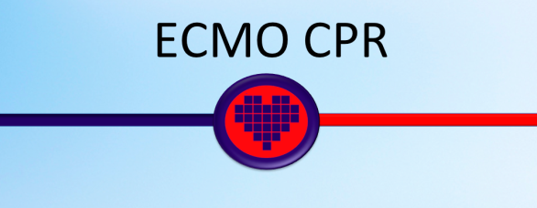
ECMO CPR is peripheral V-A ECMO deployed in patients undergoing advanced life support (ALS) for cardiac arrest.
It is indicated in select patients with refractory cardiac arrest when conventional ALS is unable to achieve return of spontaneous circulation (ROSC).
Clinical trial are currently underway. Initial case series suggest greater than 30% survival to hospital discharge.

Slide 18
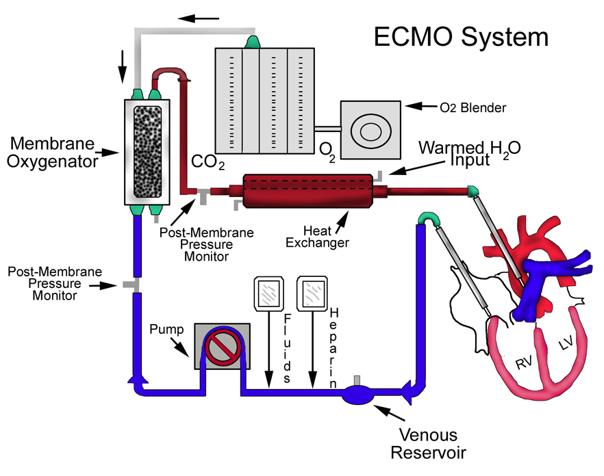
COMPONENTS

Slide 19
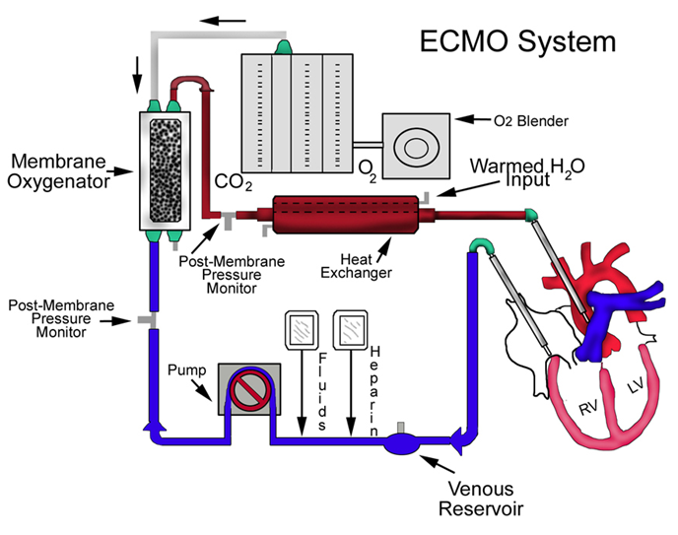
The ECMO system consists of four main components
Tubing and cannulas
Centrifugal pump
Oxygenator/ Membrane lung
Heat exchanger

Slide 20
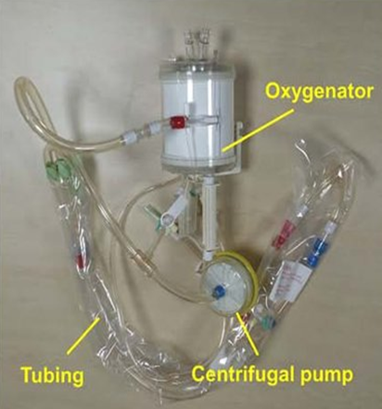
CIRCUIT / TUBING
Made from polyvinylchloride (PVC), mixed with a plasticizer.
The amount of plasticizer added determines the
flexibility of the tubing.
Currently, diethylhexyl phthalate (DEHP) is used as
a plasticizer to ensure ECMO circuits are flexible.
Tubing length and diameter contribute to blood flow.
Achieving the desired flow is determined by the vascular access site, the diameter of drainage tubing, the diameter of the access (drainage) cannula, resistance and certain pump properties.
Typically the tubing in our adult ECMO circuits has an external diameter of 3/8th of an inch. Blood flow through one meter of this size tubing, with a pressure gradient of 100 mmHg is typically around 5 L/min.

Slide 21
CANNULAE
Cannulae are plastic tubes that are inserted into the vascular system for drainage or re-infusion of blood.
ACCESS (DRAINAGE) CANNULA drains blood from the venous system into the ECMO circuit in both VV or VA ECMO.
RETURN (RE-INFUSION) CANNULA delivers blood back to the patient from the ECMO circuit. Only single stage cannulae that expel blood from the cannula tip are used for this purpose.
DISTAL PERFUSION CANNULA delivers blood antegrade into the superficial femoral artery distal to the ECMO return cannula to maintain perfusion to the leg in a femoral cannulation.
In case of complications or by preference of the ECMO centre perfusion to the perfusion cannula can also be inserted into a distal artery (e.g. dorsalis pedis) and blood is supplied to the leg retrograde.

Slide 22
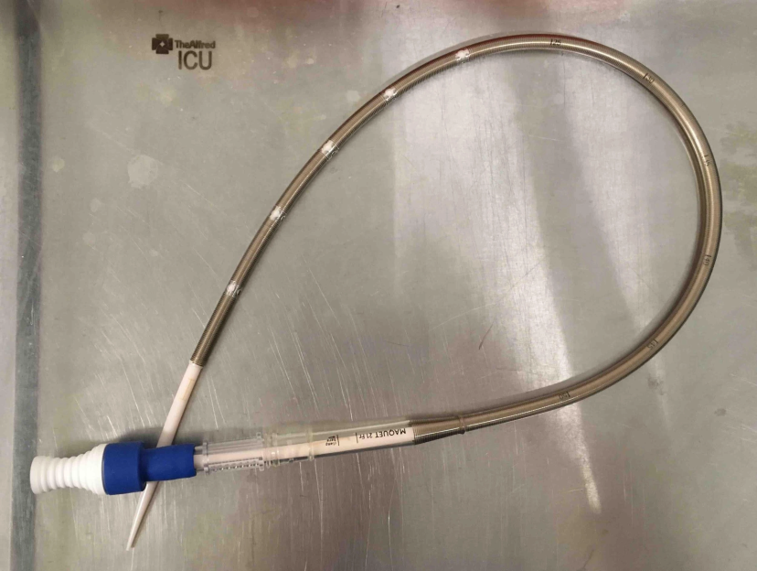
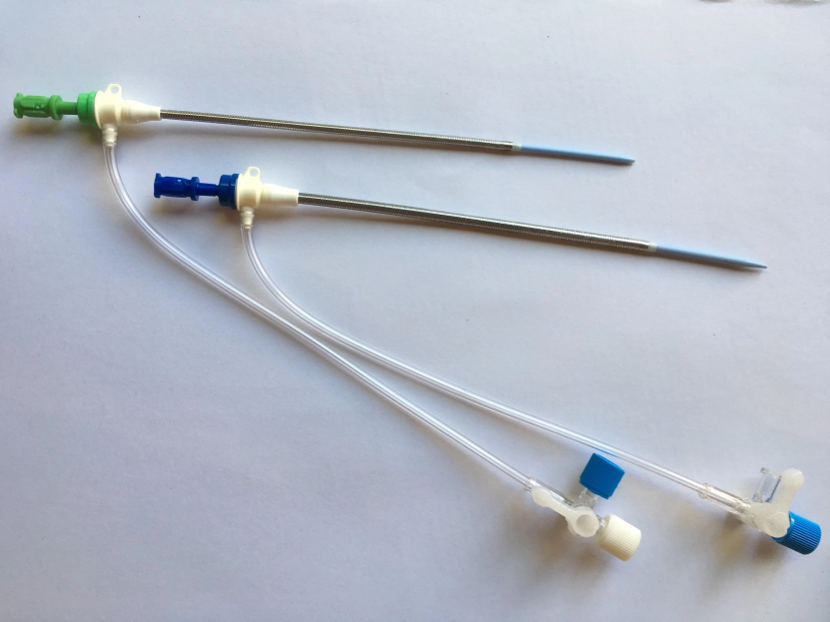
MULTI-STAGE CANNULAE:
These are able to drain blood through side holes over a long (20-25cm) region of the distal cannula including to the tip.
Theoretically, they allow greater flow for lower suction pressure. In practice, most blood enters the cannula via the most proximal side ports.
This has major implications for siting the cannula (VV ECMO Configurations). They are also referred to as venous cannulae
Multi-stage cannula
Distal Perfusion Cannula – reinforced distal perfusion cannulae size 6 and 8 Fr

Slide 23
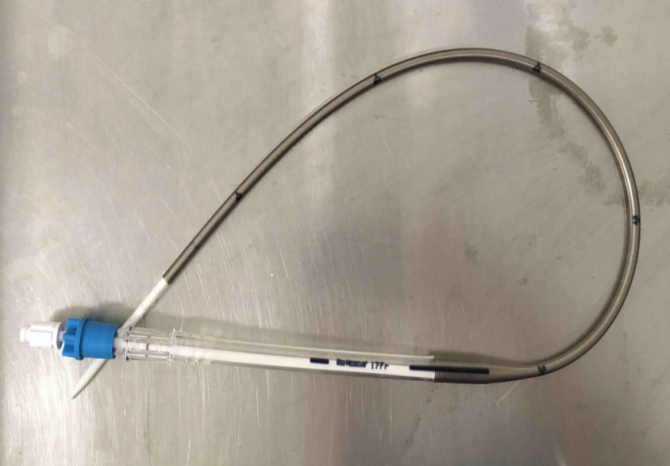
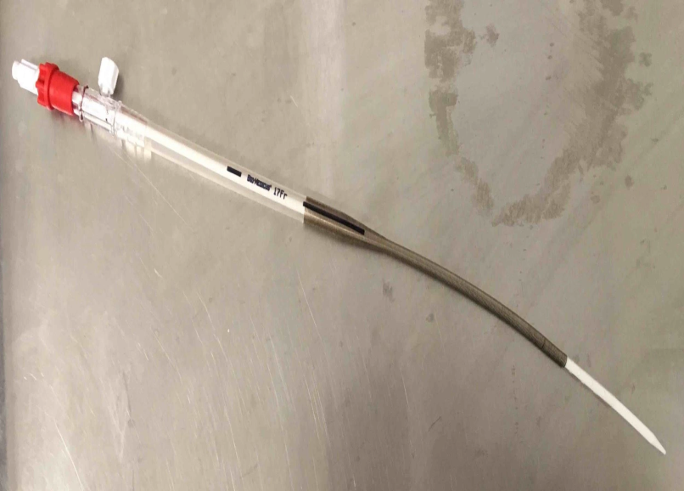
SPECIFICATION OF CANNULAE:
SINGLE-STAGE CANNULAE:
These have a short perforated region near the tip to return or access blood.
Depending on their length they are often referred to as venous (longer length e.g. 50-60 cm – see figure 1) and arterial (short e.g. 15-20 cm – see figure 2) with a side port for the connection of a distal perfusion cannula.
Single-stage venous cannula
Single-stage arterial cannula

Slide 24
CANNULATION APPROACH

Slide 25
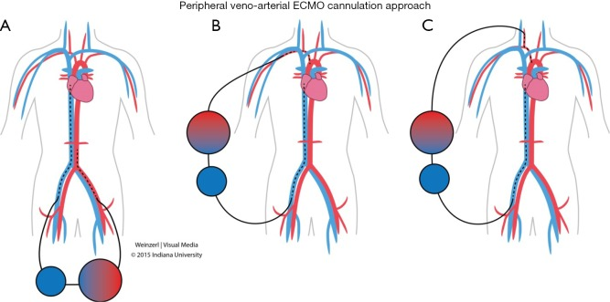
PERIPHERAL VENO-ARTERIAL ECMO CANNULATION APPROACH

Slide 26
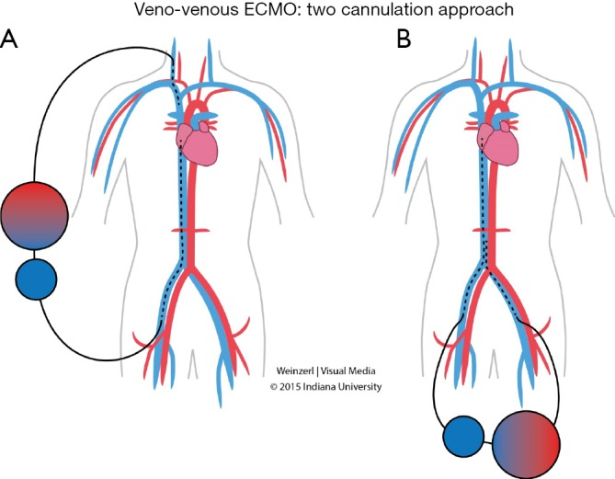
VENO-VENOUS ECMO: TWO CANNULATION APPROACH

Slide 27
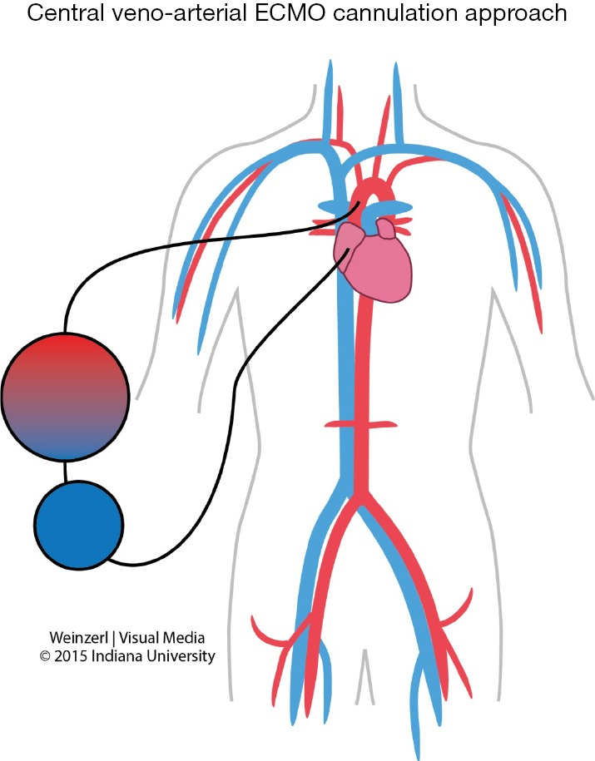
CENTRAL VENO-ARTERIAL ECMO CANNULATION APPROACH

Slide 28
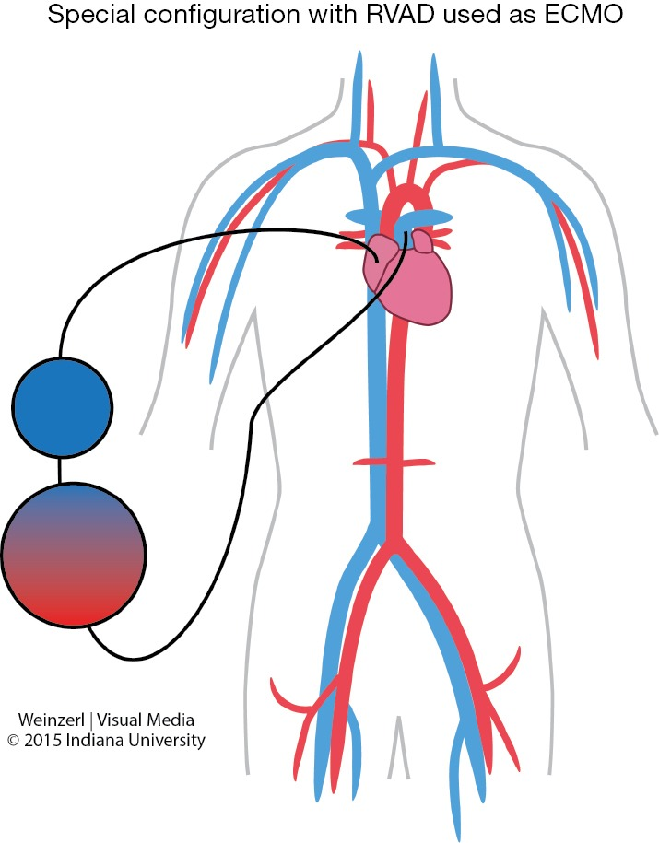
SPECIAL CONFIGURATION WITH RVAD USED AS ECMO

Slide 29
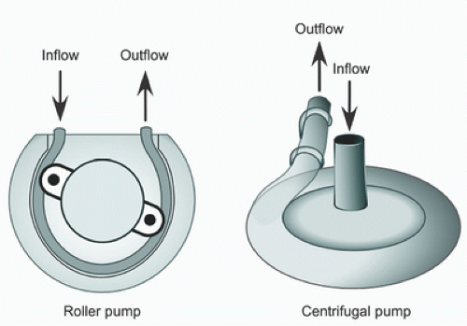
CENTRIFUGAL PUMP
ECMO blood pump controls the blood flow for the patient.
OCCLUSIVE PUMPS are positive displacement pumps and include roller pumps. These pumps will displace a volume of fluid depending on the speed of the pump, and are insensitive to afterload.
NON OCCLUSIVE PUMPS / ROTARY PUMPS can be centrifugal, diagonal or axial. These pumps are all preload dependent and afterload sensitive. Importantly, these pumps are limited in the amount of pressure they can generate.

Slide 30
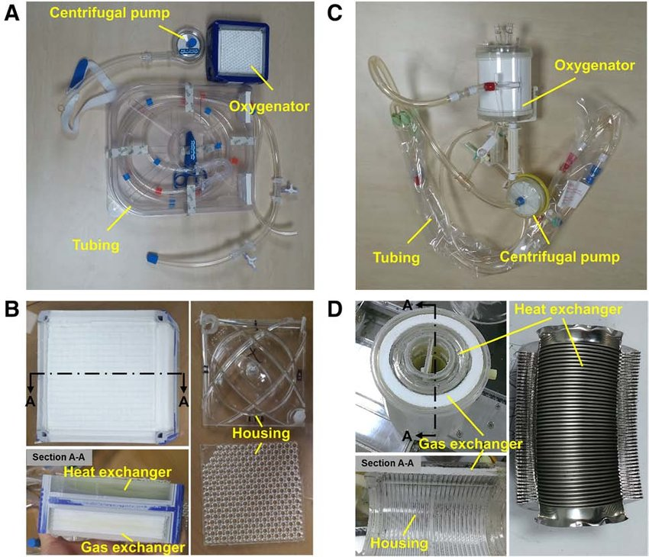
OXYGENATOR
The Maquet Quadrox ID is the current gas exchange device.
Made from plasma resistant hydrophobic PMP (poly-methyl pentene) hollow fibers and contain an integrated heat exchanger.
Designed in order to reduce the formation of micro bubbles and protect against bacterial contamination.

Slide 31
INDICATIONS OF ECMO FOR
CARDIAC SUPPORT

Slide 32
Typical cardiac indications include refractory low cardiac output (cardiac index less 2 L⁄min⁄m2) and hypotension (systolic blood pressure <90 mmHg) despite adequate intravascular volume, high dose inotropic agents and an intra-aortic balloon pump.
ECMO Indications for cardiac support (VA ECMO only):
Cardiogenic shock Severe cardiac failure due to almost any cause:
Acute coronary syndrome
Cardiac arrhythmic storm refractory to other measures
Sepsis with profound cardiac depression
Drug overdose/toxicity with profound cardiac depression
Myocarditis
Pulmonary embolism
Isolated cardiac trauma
Acute anaphylaxis
Post cardiotomy: Inability to wean from cardiopulmonary bypass after cardiac surgery.

Slide 33
Post heart transplant: primary graft failure after heart or heart-lung transplantation.
Chronic cardiomyopathy:
Periprocedural support for high-risk percutaneous cardiac interventions
Bridge to transplant
as a bridge to longer term VAD support
as a bridge to decision

Slide 34
Indications of ECMO
for
respiratory support

Slide 35
Both VV ECMO and VA ECMO can be used as a rescue therapy in acute respiratory failure to buy time and maintaining life awaiting improvement of the underlying disease.
ECMO indications for respiratory support:
Acute respiratory distress syndrome:
Extracorporeal assistance to provide lung rest:
Severe bacterial or viral pneumonia
Aspiration syndromes
Alveolar proteinosis
Airway obstruction
Pulmonary contusion
Smoke inhalation

Slide 36
Lung transplant:
Lung hyperinflation:
Pulmonary haemorrhage or massive haemoptysis
Congenital diaphragmatic hernia, meconium aspiration
Primary graft failure after lung transplantation
Bridge to lung transplant
Intraoperative ECMO
status asthmatics

Slide 37
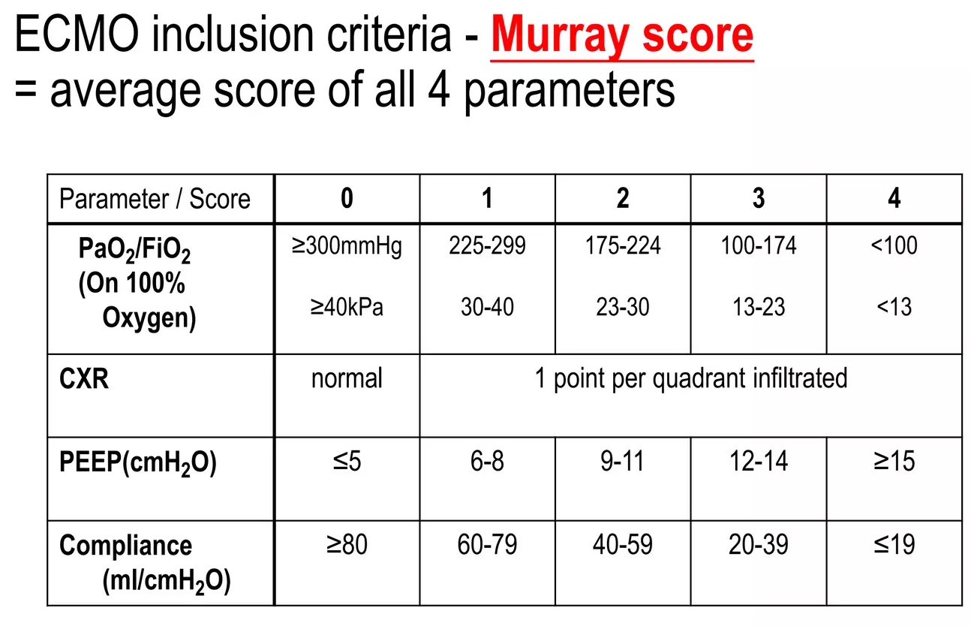
THE MURRAY SCORE IS USED TO GRADE THE SEVERITY OF LUNG INJURY IN ACUTE RESPIRATORY DISTRESS SYNDROME (ARDS):

Slide 38
THE MURRAY SCORE IS BASED ON FOUR CRITERIA:-
Hypoxemia
Respiratory compliance
Chest radiographic findings
Positive end-expiratory pressure.
A score greater than 2.5 will indicate ARDS, a score between 1-2.5 indicates mild to moderate lung injury, and a score of zero rules out lung injury.

Slide 39
CONTRAINDICATIONS TO ECMO

Slide 40
ABSOLUTE: Among these futile treatment without exit strategy in case of
Unrecoverable heart and not a candidate for transplant or destination therapy of VAD support
Disseminated malignancy
Known severe brain injury
Unwitnessed cardiac arrest
Prolonged CPR without adequate tissue perfusion
Unrepaired aortic dissection
Severe aortic regurgitation
Severe chronic organ dysfunction (emphysema, cirrhosis, renal failure)
Compliance (financial, cognitive, psychiatric, or social limitations in patient without social support)
Peripheral vascular disease is contraindicated in peripheral VA ECMO
VV ECMO is contraindicated in cardiogenic failure and in Severe chronic pulmonary hypertension (mean pulmonary artery pressure >50 mmHg)
RELATIVE: contraindication for anticoagulation, advanced age, obesity

Slide 41

ECMO RELATED

Slide 42
The most frequent complication during ECMO is HEMORRHAGE, ranging between 10-30%.
Bleeding is increased because of systemic heparinization, platelet dysfunction, and clotting factor hemodilution.
Pulmonary hemorrhage is seen commonly in patients on ECMO. Management includes bleeding control as above, using steroids, and frequent bronchoscopy to clear the airway over time.
Intracerebral hemorrhage or infarction occurs in approximately 10-15% of ARDS patients on ECMO.
Systemic thromboembolism due to thrombus formation within the extracorporeal circuit.
Heparin-induced thrombocytopenia (HIT) can occur in patients receiving ECMO.
Neurological complications are highly variable ranging between 4-37%.

Slide 43
MEDICAL COMPLICATIONS
Hypertension is a dangerous complication because of the risk of hemorrhage and stroke.
Arrhythmias may occur as a result of hypoxia and electrolyte imbalance or an underlining cardiac pathology.
Oliguria is a commonly observed renal complication during the early part of ECMO.
Direct hyperbilirubinemia and biliary calculi may occur secondary to prolonged fasting and total parenteral nutrition (TPN), hemolysis, and diuretics.
Mechanical complications: clots in the circuit are the most common mechanical complication (19%).

Slide 44
VA ECMO-specific complications
CANNULATION RELATED COMPLICATIONS: vessel perforation with hemorrhage, arterial dissection, distal ischemia, and incorrect location (e.g., venous cannula within the artery) or development of pseudoaneurysm at the site of insertion.
Cardiac thrombosis.
Coronary or cerebral hypoxia.

Slide 45
WEANING OF VV ECMO:-
Improvement in clinical assessment, lung compliance, radiographic appearance.
Ventilator setting to moderate levels of support.
(e.g. PIP ≤ 30 cm H2O, FIO2 ≤50%, PEEP ≤ 10 cm H2O, and rate <20 to 30)
Fresh gas flow to the oxygenator is turned off.
If gas exchange is acceptable after 1-4 hours, the patient can be decannulated.

Slide 46
WEANING OF VA ECMO:-
Improvement in pulsatility, increase in pulse pressure
Echocardiography- noninvasive assessment of ventricular contractility
Patient is fully ventilated
Extracorporeal flow is gradually reduced at discrete intervals over a period of 4-8 hours.
Serial assessment of perfusion, myocardial function, and blood gases until a terminal flow of 25% of full support is achieved.
Blood gas analysis and measurement of lactate, mixed venous O2 saturation, and cardiac function by echocardiography ensure that native cardiac function is adequate.
When the patient can tolerate low extracorporeal flow and maintain good perfusion, the ECLS circuit is discontinued and the cannulas are removed
Predictors of nonsurvival include persistent elevation of lactate, prolonged duration of support, progressive multiple organ dysfunction, and nosocomial pneumonia.

Slide 47
WITHDRAWAL OF ECMO
Terminate support in apparently refractory cases if lung function had not returned after a period of time (2-3 weeks) under the assumption that organ damage was irreversible by this time.

Slide 48
Which ECMO configuration provides both cardiac and respiratory support?
Veno-venous (VV) ECMO.
B) Veno-arterial (VA) ECMO.
C) Arterio-venous (AV) ECMO.
D) VV-AV ECMO.

Slide 49
Where is the arterial cannula placed in peripheral VA-ECMO?
Jugular vein.
B) Subclavian vein.
C) Femoral artery.
D) Pulmonary artery.

Slide 50
What is a common complication of peripheral VA-ECMO?
Hypertension.
B) Limb ischemia.
C) Increased left ventricular stroke volume.
D) Pulmonary edema.

Slide 51
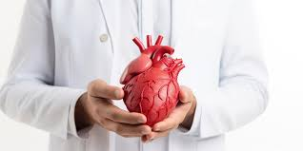
THANK YOU

