Slide 1
EMBRYOLOGYOF INTERATRIAL SEPTUM
Dr. mithun anilkumar
SENIOR RESIDENT
DEPartment of CARDIOLOGY
tdmc

Slide 2
Heart embryology
Right and left Endocardial heart tubes
Both fuse together
The single tube- series of dilatations
Bulbus cordis
Primitive Ventricle
Primitive atrium
Sinus venosus

Slide 3
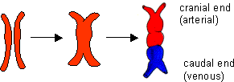

Slide 4
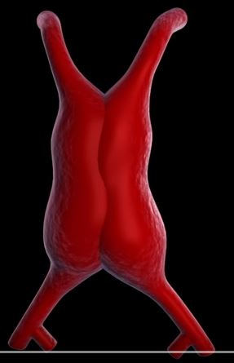

Slide 5
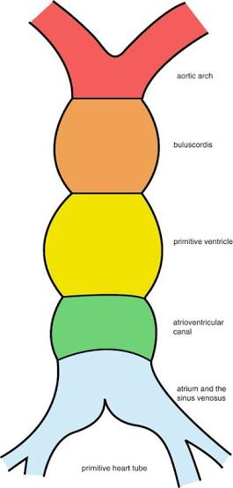

Slide 6
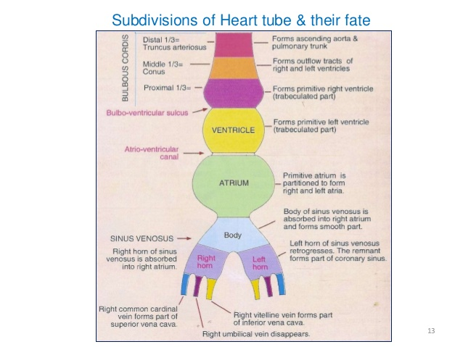

Slide 7
Sinus venosus and its absorption into the right ventricle
This is the caudal most part of the primitive heart tube.
It represents a body with two prolongations that are referred to as its right and left horns
Vitelline vein
Umbilical vein
Common cardinal vein / duct of cuvier
Initially both horns are of equal size

Slide 8
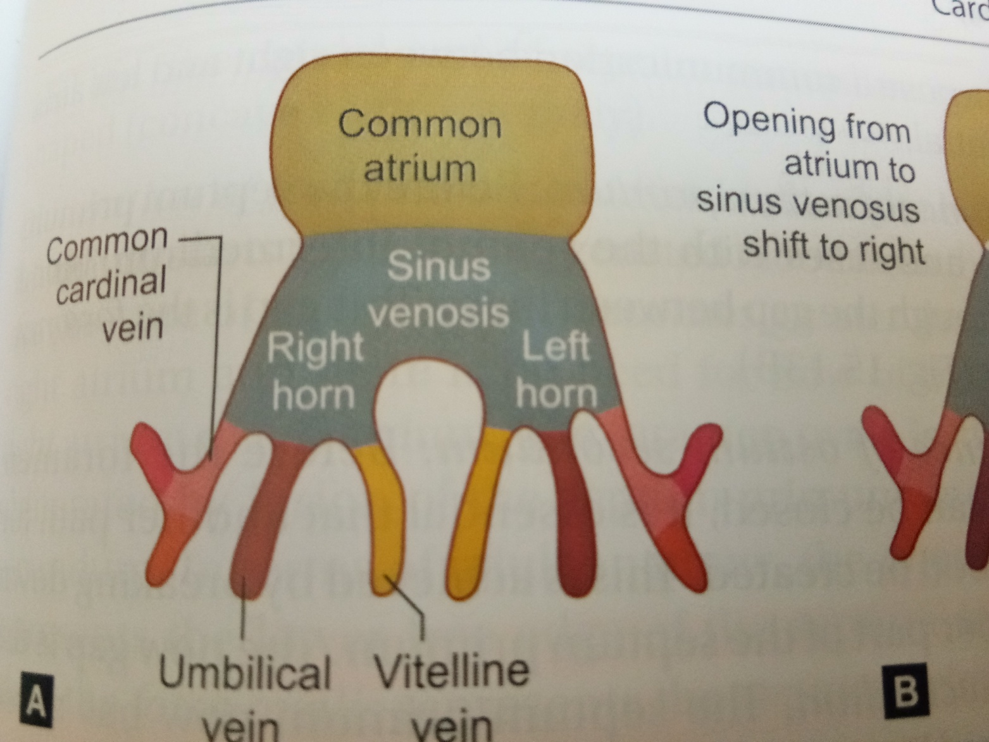

Slide 9
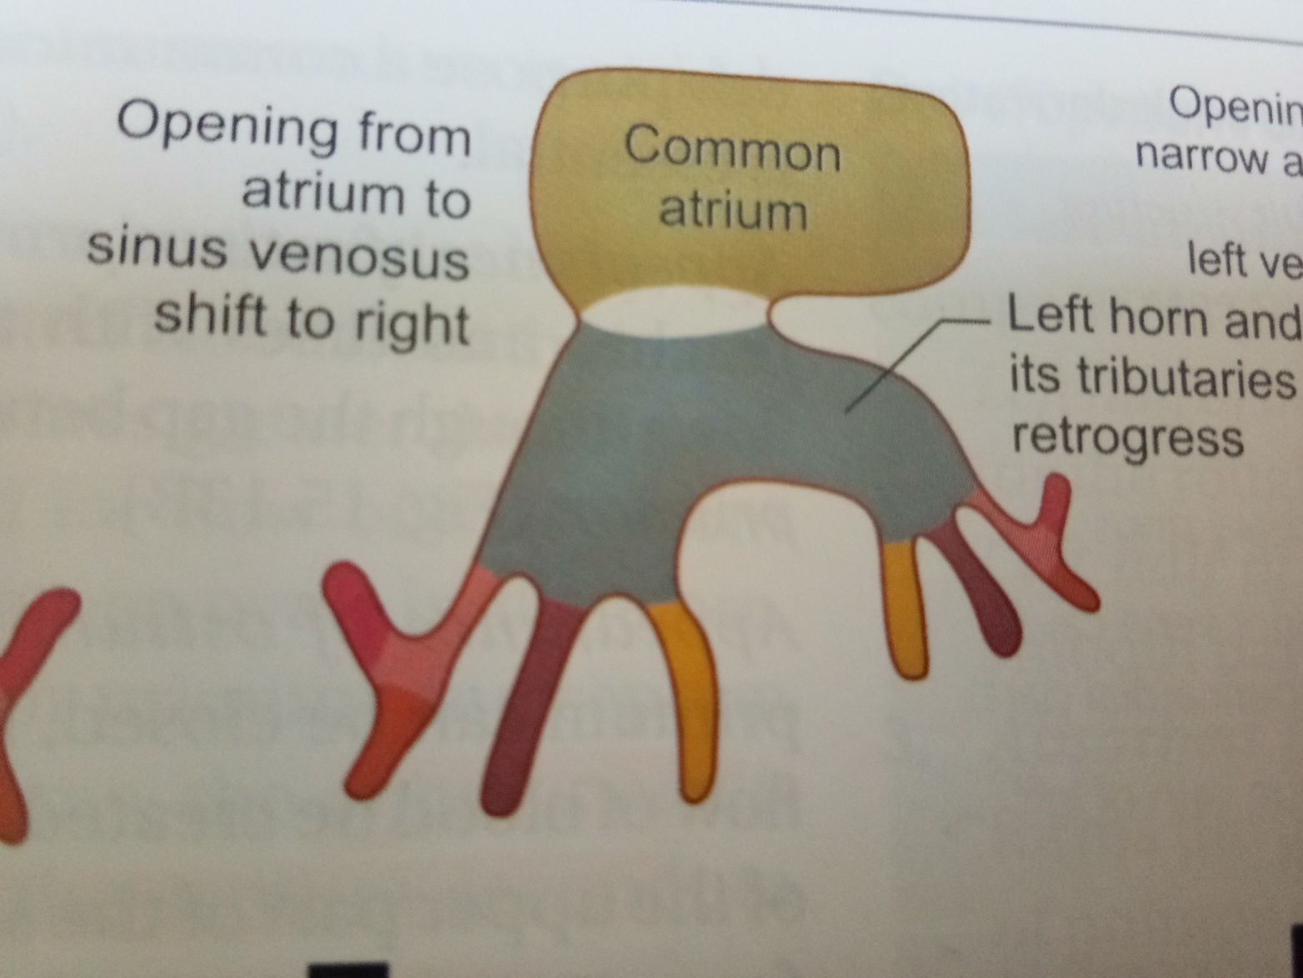

Slide 10
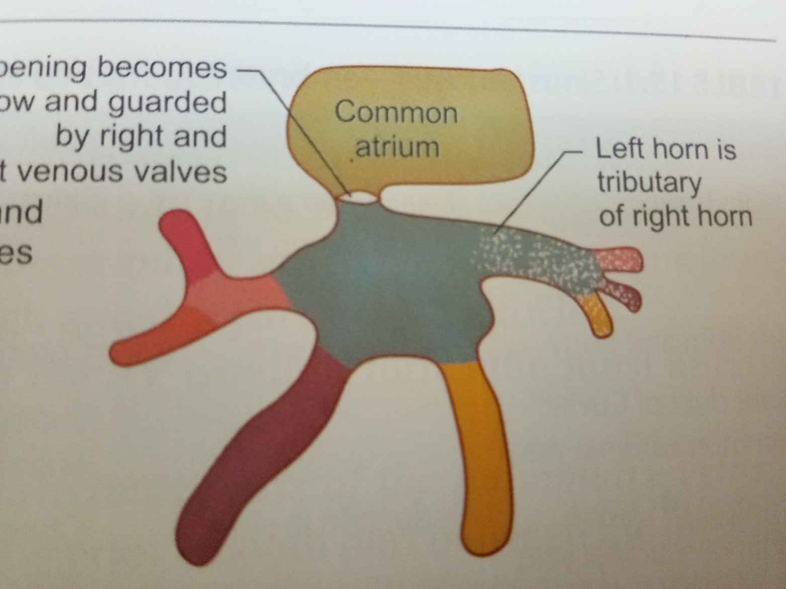

Slide 11
REGRESSION OF LEFT HORN AND ITS TRIBUTARIES
The right groove remains shallow but the left one becomes very deep
It results in that left part becomes completely separated from the atrial chamber.
The left horn becomes reduced in size and appears like a tributary of the right horn of sinus venosus.
The left horn becomes part of coronary sinus

Slide 12
SINOATRIAL ORIFICE
Initially sinoatrial orifice- transverse, larger and median in position
Later the opening becomes narrow and shifts to the right and onto the dorsal aspect of the atrium
It changes its orientation from transverse to oval and finally to vertical with a narrow slit

Slide 13
FATE OF TRIBUTARIES OF SINUS VENOSUS
Embryonic part | Adult part
Left horn and body | Coronary sinus
Right common cardinal vein | SVC
Right vitelline vein | IVC

Slide 14
ATRIAL SEPTATION
The primary atrial septum (septum primum) forms by active growth of a myocardial septum
Initially the primordium of this septum can be seen as a ridge in the medial roof of the common atrium.
The leading edge of the ridge is covered with a mesenchymal cap termed the SPINA VESTIBULI, which is contiguous superiorly with the superior AV cushion and inferiorly with the inferior AV cushion

Slide 15
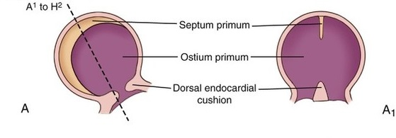

Slide 16
As the primary septum descends from the roof of the atrium toward the AV canal, thereby decreasing the size of the primary interatrial foramen (ostium primum), the mesenchymal leading edge continues to fuse with the AV cushions, which themselves are also in the process of fusing.
These events result in closure of the primary interatrial formanen (ostium primum) and the formation of the central fibrous body

Slide 17
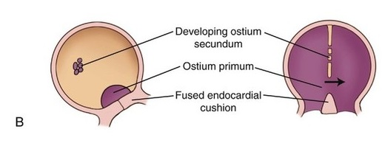

Slide 18
Concomitantly, perforations appear in the superior aspect of the primary atrial septum.
These perforations coalesce, resulting in the secondary atrial foramen (or ostium secondum).
Next the secondary atrial septum develops as an infolding of the atrial roof located between the primary septum and the left venous valve.
The foramen ovale is the opening bordered by the free edge of the septum secondum
After fusion of the septum primum with the septum secondum, the foramen ovale becomes the fossa ovalis.

Slide 19
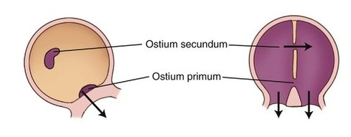

Slide 20
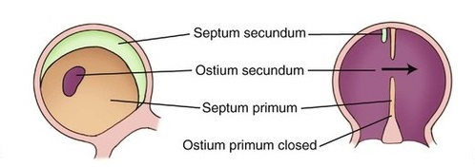

Slide 21
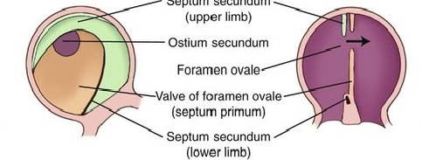

Slide 22
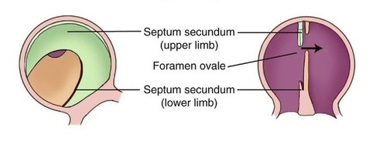

Slide 23
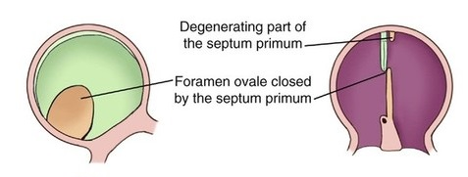

Slide 24
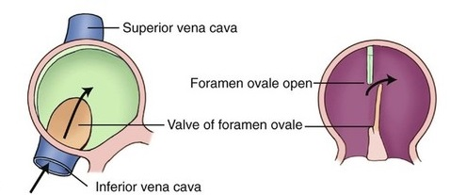

Slide 25
Once the two septa overlap blood has to flow through the interval between the septa. This gap is the foramen ovale
It is an oblique valvular passage that allows blood to flow from right to left but not left to right.
This is patent throughout fetal life

Slide 26
OBLITERATION OF THE FORAMEN OVALE
After birth of the baby, the left atrium starts receiving oxygenated blood from the lungs, the pressure of this chamber becomes greater than that of right atrium and there is no need for flow of blood from right atrium to left atrium.
The foramen ovale is, therefore, obliterated by fusion of the septum primum and septum secondum.
Annulus ovalis represents the lower free edge of the septum secondum while the fossa ovalis represents the septum primum

Slide 27
Multiple genetic factors including Tbx5, Nkx-2.5, Evc and Prk-AR1, have been identified in patients with abnormal atrial morphogenesis and septation

Slide 28
The fossa ovalis oocupies about 28% of the septal area, irrespective of the age, and is bordered by a limbus and guarded by a valve.
After birth the patent foramen ovale closes via fusion of its valve with the limbus of fossa ovalis as left atrial pressure exceeds right atrial pressure.
The incidence of persistent patency of foramen ovale declines from about 1/3 during the first three decades of life to about ¼ during fourth to eighth decades
Redundancy of the valve of the foramen is responsible for an atrial septal aneurysm

Slide 29
ASD
6-10% of all cardiac anomalies
M:F = 1:2 [ sinus venosus defects 1:1]
1 in 1500 live births
Most common congenital abnormality in adult > 40yrs [30-40%]

Slide 30
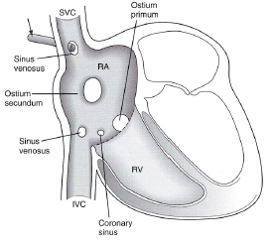
EMBRYOLOGY & TYPES OF ASD
Types of ASD
  Secundum ASD
  Primum ASD
  Sinus venosus ASD
  Coronary Sinus type
  PAPVC

Slide 31
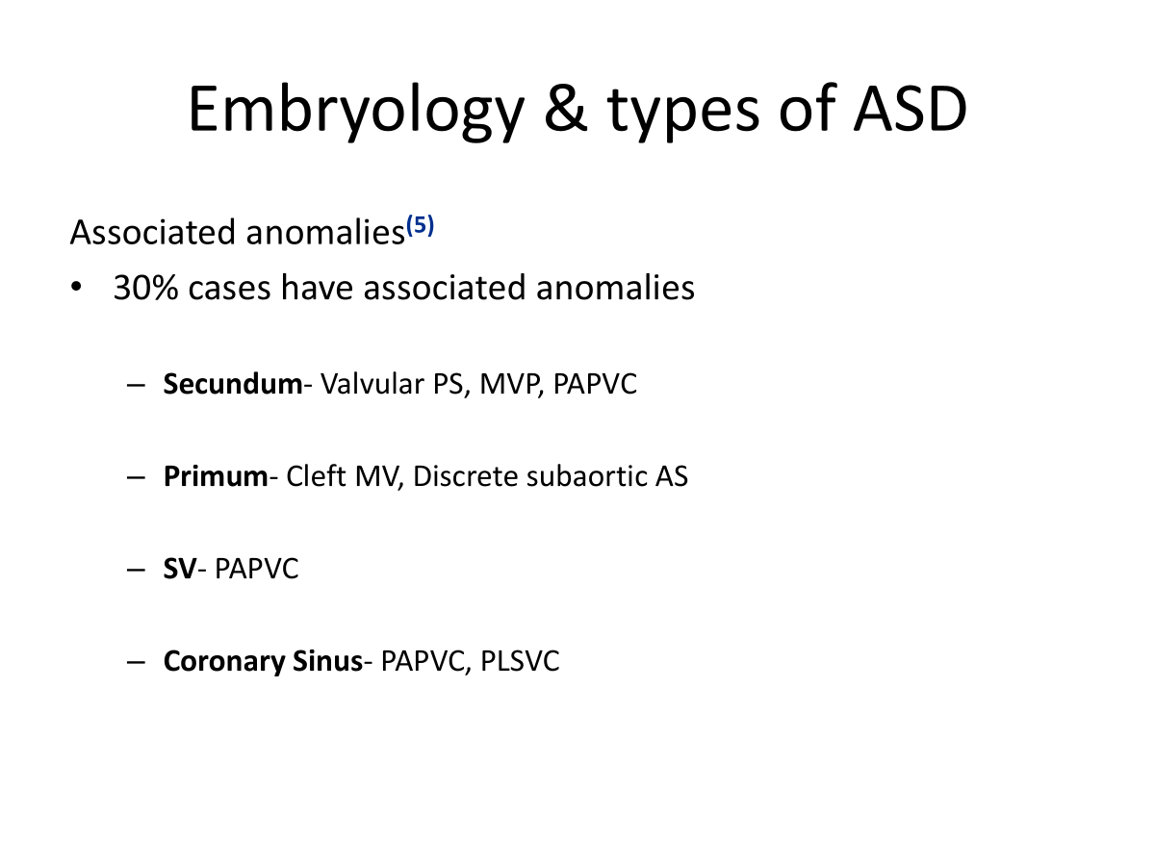

Slide 32
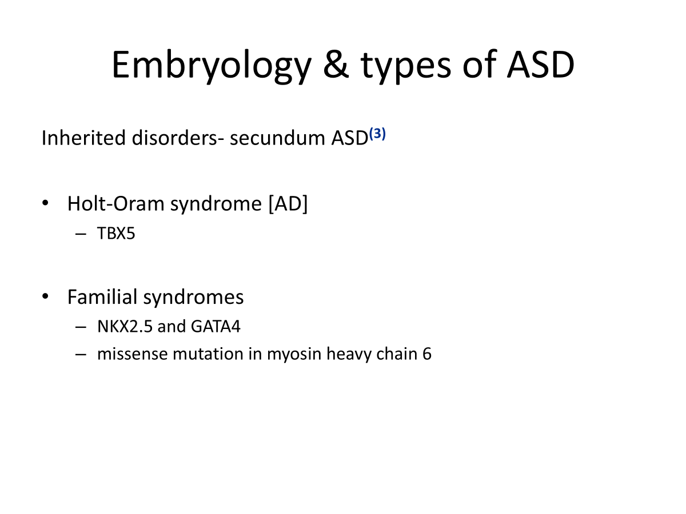

Slide 33
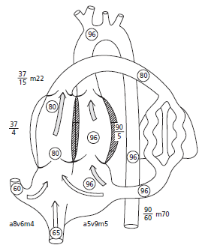
Physiology, natural history
Effects of L to R shunt⁽²⁾
RA/RV dilation, volume overload RV, RVF
Atrial arrhythmias
Increased PBF
+/- PAH

Slide 34
Clinical Findings
G/E- thin, upper limb abnormalities
JVP- mean normal, a=v
Pulse & BP- no change in pulse volume and BP during valsalva, square wave response
Prominent RV pulsations, 2nd space pulsations
Auscultation
  Loud T1
  Wide fixed split S2
  Pulmonary ESM
  Tricuspid MDM
Features of PAH in some cases

Slide 35
Special situations
Lutembacher- RHD MS/MR + secundum ASD
PAPVC & Scimitar syndrome
Raghib’s syndrome- coronary sinus ASD + PLSVC

Slide 36
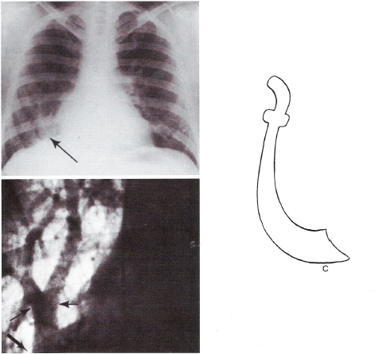
PAPVC & Scimitar syndrome⁽¹⁾

Slide 37
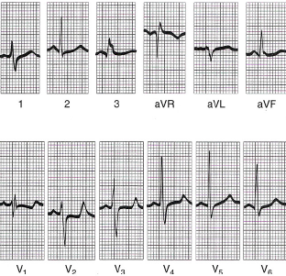
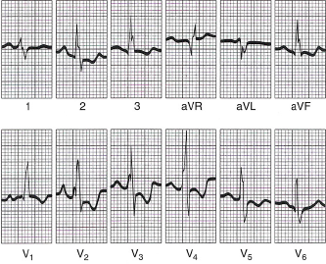
Investigations- salient features
ECG
SN dysfunctions
  AF, AFL, SVT
  Absence of sinus arrhythmia
AV conduction
  Increased PR interval
  CHB
rsR’ or rSr’ pattern in V1
Crochetage [notched R II,III,aVF]

Slide 38
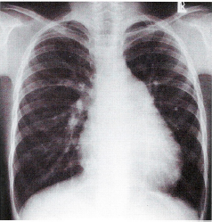
Investigations- salient features
RAE
RV Apex
Prom MPA
Increased PBF

Slide 39
Investigations- salient features
Echo
  Most important Ix for confirmation of diagnosis, location and type of ASD, severity, need for intervention & planning further Mx/ Follow up
  RA, RV Volume overload
  Associated abnormalities
  Abnormal venous connections
  Suitability for device closure, rims

Slide 40
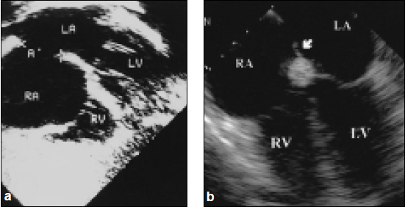
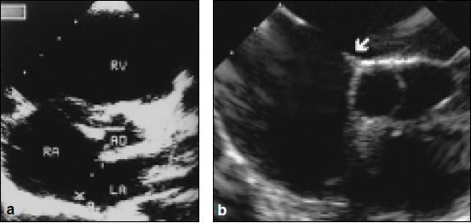
Investigations- salient features
AV rim & Postero-superior (atrial) rim
[Suboastal coronal & TEE 4C]
Aortic rim
[TTE PSX & TEE BSX]

Slide 41
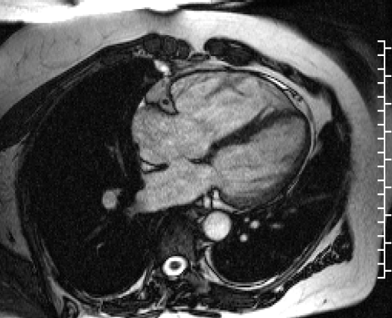
Investigations- salient features
MRI

Slide 42
Investigations- salient features
CATH
Main indication is assessment of PVR in doubtful cases & anomalous venous connections not visible on echo
Oximetry
  SVC step up 10% or 5% in 2 serial samples [AVSD, RSOV/LV to RA, VSD + TR, PAPVC, Systemic AVF]
  SVC sat >75-80% [RPV to SVC, LPV to L inominate vein]
  CS sat > 45% PLSVC or anomalous PV connections to CS
Pressures
  RA, LA mean normal, RA a=v
  RVSP 35-40 mm Hg in infants & 25-30 mm Hg in Adults, diff of 15-30 mm b/w RVSP & PAP noted

Slide 43
Management
In whom, When & How should you close the defect ?
  RV volume overload [+/- symptoms]
  Paradoxical embolism
Surgical vs Device closure

Slide 44
Management⁽⁵⁾ ⁽⁶⁾
<5 mm, no volume overload [unless paradoxical embolism] followed up
Secundum ASD>5 mm, <38 mm size with a rim of 5 mm all around except towards aorta Device closure [Larger ASD, associated tricuspid repair, sinus venosus, coronary sinus, or primum ASD for Sx]
PAP <5 WU, if>5 WU then PVR<2/3 SVR, PAP<2/3 SYS Pressure [baseline or when challenged with vasodilators with net Qp: Qs>1.5] ⁽⁶⁾

Slide 45
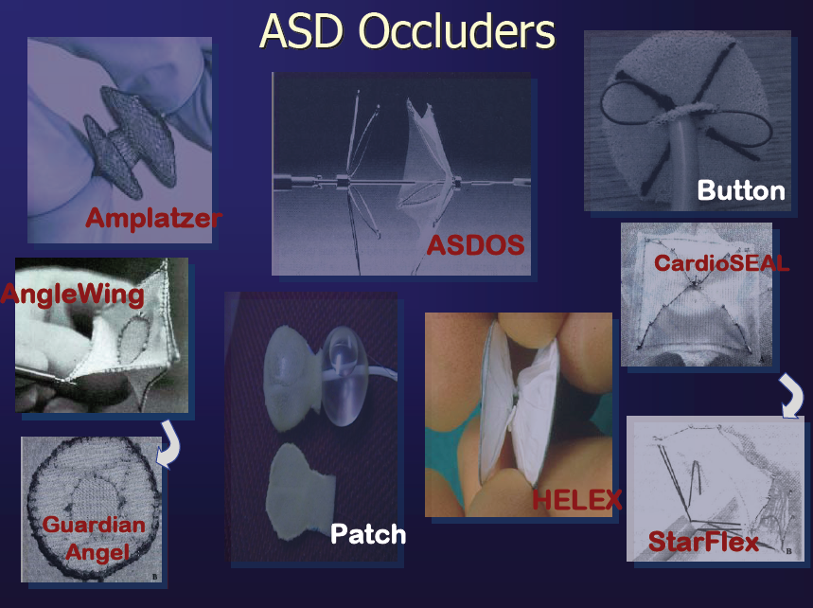
Devices

Slide 46
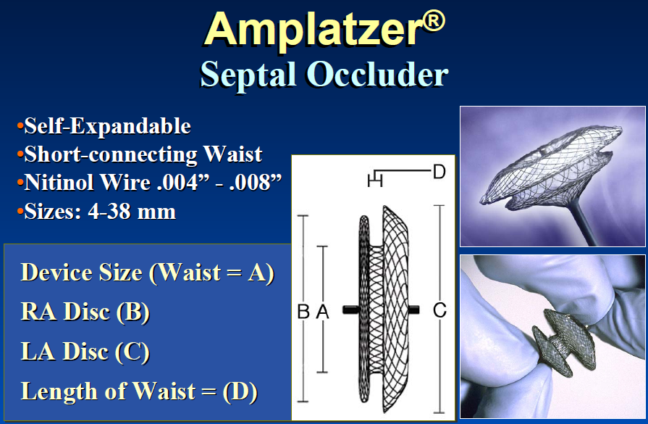
Devices

Slide 47
Occluder diameter 2-4mm size larger than the maximum strechable defect size

Slide 48
COMPLICATIONS
Procedural success rate 95%-98%
Very rare complication (<0.5%)
Entrapment in RA structures & PV, impingement of aorta
Inability to release, withdraw
Twisting of device
Dislodgment & embolization
Thrombosis Very rare [0.05-0.2%]
  Related to
  Poor implant apposition
  Poor device endothelialization
  Underlying prothrombotic

Slide 49
FOLLOW UP
Issues
  Atrial arrhythmias- OAC, RF ablation
  RV & LV dysfunction [Pre intervention- balloon occlusion and reassessment of hemodynamics in poor LV function]
  PAH
  Coexistant valvular or other cardiac lesions
IE prophylaxis upto 6m after procedure
Aspirin atleast 100mg daily upto 6 m
Echo f/up at 24 hrs, 1 m, 6m, 1 yr & then at regular intervals

Slide 50
Left horn of the sinus venosus becomes?
SVC
IVC
Coronary sinus
Left atrium

Slide 51
Coronary sinus

Slide 52
Which is the first structure to develop?
Ostium secundum
Septum secundum
Fossa ovalis
Septum primum

Slide 53
Septum primum

Slide 54
Most common type of ASD…
Ostium primum
Ostium secondum
Sinus venosus
Coronary sinus type

Slide 55
Ostium secondum

Slide 56
All of the following are indications for device closure except
< 5 mm asd defect
Secundum ASD 24 mm size with a rim of 5 mm all around
Ostium primum defect
Asd secundum of 36 mm with a rim of 5 mm all around except aortic rim

Slide 57
Ostium primum defect

Slide 58
Duration of IE prophylaxis post asd closure?
1 month
2 months
6 months
3 months

Slide 59
6 months

Slide 60
Thank you

