Slide 1
EVOLUTION OF ATHEROMA
DR RESHMA TANIA NOUSHAD
DM CARDIOLOGY RESIDENT

Slide 2
INTRODUCTION
Atherosclerosis - The most significant arterial disease
Impact - Leading cause of death and disability
Related Conditions: Ischemic heart disease (IHD) and CVA together cause nearly one-third of all deaths.
Cause: Atherosclerosis is an inflammatory response in the vessel wall due to chronic injury from factors like:
Hyperlipidemia
Hypertension
Smoking
Diabetes mellitus

Slide 3
Can affect both large and medium-sized arteries diffusely
Even in early life, asymptomatic individuals may have intimal lesions in their coronary or carotid arteries
Causes focal stenoses in certain areas of vessels more than others
long "incubation" period compared to most human diseases.
Despite its slow progression, complications like myocardial infarction (MI), unstable angina, and stroke can occur suddenly.
Shows both chronic and acute manifestations, displaying variability over time.
Can cause narrowing (stenosis) in some blood vessels and dilation (ectasia) in others.

Slide 4
Affected Vessels
Affected Arteries: Medium to large arteries
  aorta, carotid, coronary, iliofemoral, and cerebral arteries
Unaffected Vessels: Some medium-sized arteries
  internal mammary artery and veins are usually spared
In the absence of pulmonary hypertension the pulmonary arteries are also spared

Slide 5
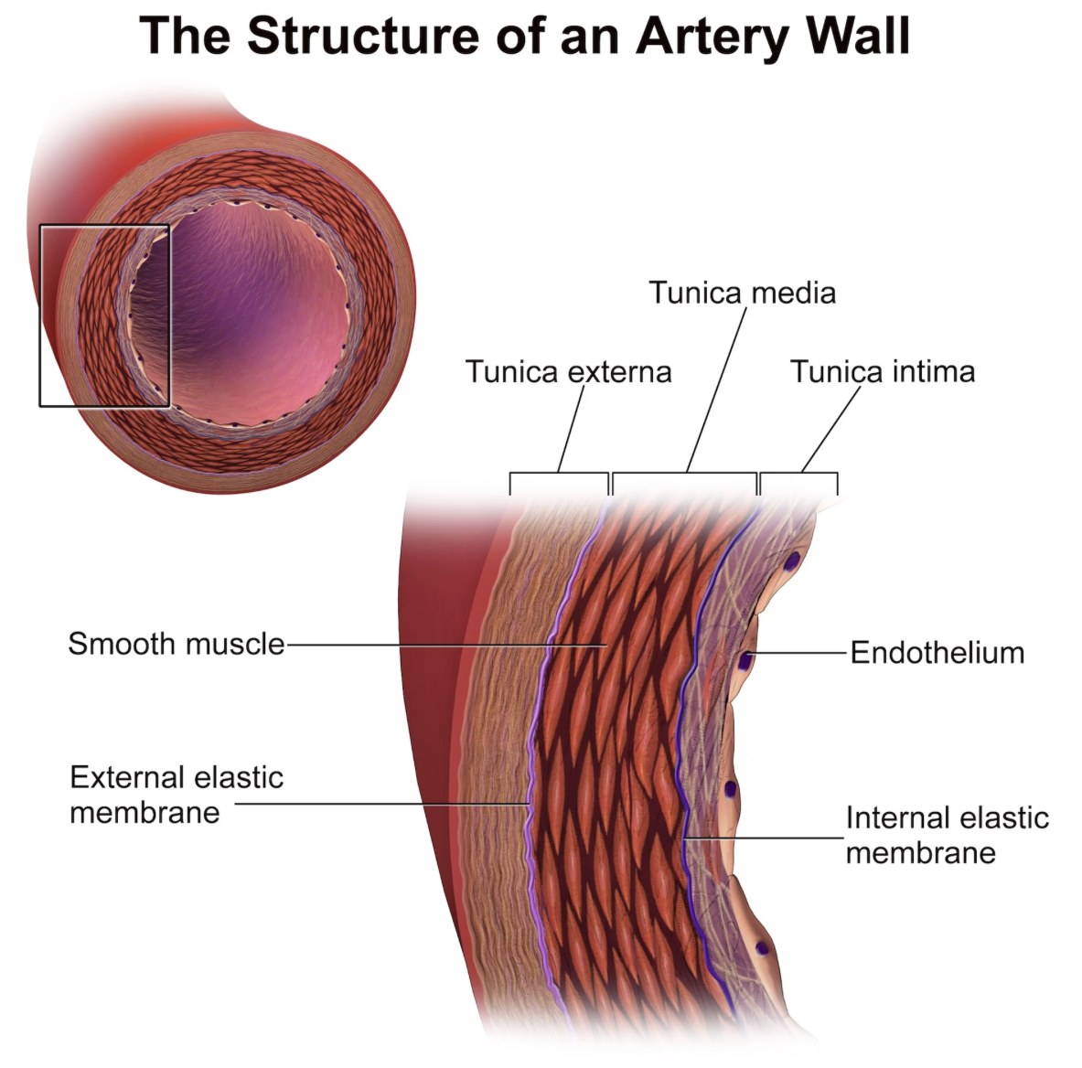
Structure Of Normal Artery
Cell Types Composing The Normal Artery :
Endothelial Cells (ECs)
Smooth Muscle Cells (SMCs)

Slide 6
Endothelial Cells (ECs) :
Essential surface in contact with blood
They are among the few natural or synthetic surfaces that can keep blood in a liquid state during extended contact.
Ability is partly due to the expression of heparan sulfate, which acts as a cofactor for antithrombin III.
ECs also contain thrombomodulin, which binds to thrombin and promotes antithrombotic effects by activating proteins S and C.
They possess strong fibrinolytic capabilities, producing both tissue and urokinase-type plasminogen activators.

Slide 7
Smooth Muscle Cells (SMCs) :
Second major cell type in the normal arterial wall
Contract and relax, controlling blood flow through various arterial beds, particularly at muscular arterioles
Produce most of the complex arterial extracellular matrix (ECM) - crucial for homeostasis and the development and complications of atherosclerotic lesions.
Ability to migrate and proliferate, contributing to the formation of intimal hyperplastic lesions, such as atherosclerosis, restenosis, in-stent stenosis after PCI, and anastomotic hyperplasia in vein grafts
The death of SMCs can lead to the destabilization of atheromatous plaques or contribute to ectatic remodeling

Slide 8
Tunica Intima:
Normal arteries have a well-developed trilaminar structure
Innermost layer of the artery is thin at birth.
Although a simple monolayer of endothelial cells (ECs), this layer is actually more complex and heterogeneous.
The endothelial monolayer sits on a basement membrane that includes nonfibrillar collagen (e.g., type IV), laminin, fibronectin, and other extracellular matrix (ECM) molecules.
As aging occurs, a more complex intima develops, incorporating arterial smooth muscle cells (SMCs) and fibrillar interstitial collagens (types I and III).

Slide 9
Smooth muscle cells (SMCs) produce the extracellular matrix (ECM) components of the arterial intima.
Certain areas of the arterial tree naturally develop a thicker intima compared to other regions, even without atherosclerosis.
Proximal left anterior descending (LAD) artery often has a more developed intimal cushion of SMCs than typical arteries.
The process of diffuse intimal thickening does not always involve lipid accumulation and can occur in individuals without significant atheroma.
The internal elastic membrane forms the outer boundary of the tunica intima and separates it from the underlying tunica media.

Slide 10
Tunica Media :
In elastic arteries - well-developed concentric layers of smooth muscle cells (SMCs) interspersed with elastin-rich extracellular matrix (ECM).
Well-suited to storing the kinetic energy from left ventricular (LV) systole in the walls of the great arteries.
The lamellar structure maintains structural integrity of large arterial trunks.
In muscular arteries - organization is less uniform.
SMCs in these smaller arteries are typically embedded in the surrounding matrix in a more continuous rather than lamellar pattern.

Slide 11
Smooth muscle cells (SMCs) in normal arteries rarely proliferate.
In a healthy artery, there is a state of ECM homeostasis.
ECM neither accumulates nor atrophies because the rates of matrix synthesis and dissolution are typically balanced.
The tunica media is bounded abluminally by the external elastic lamina, which separates it from the adventitial layer.

Slide 12
Tunica Adventitia:
Contains collagen fibrils arranged more loosely compared to the intima.
Outermost layer of the arterial wall houses the vasa vasorum and nerve endings.
Cellular population in the adventitia is less dense.
Contains fibroblasts and mast cells.
Emerging evidence indicates that mast cells may play a role in the formation of atheroma and aneurysms in animal models.

Slide 13
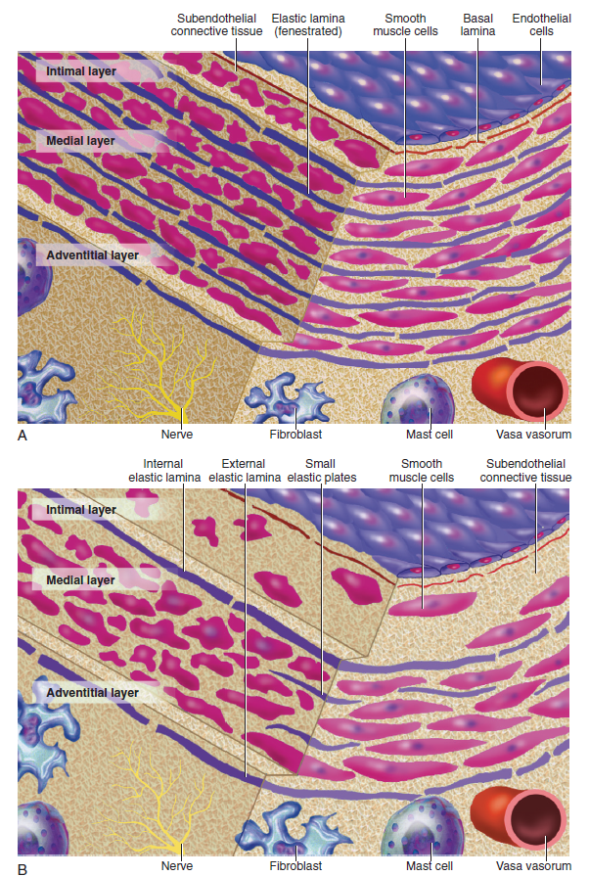

Slide 14
Initiation Of Atherosclerosis
Extracellular Lipid Accumulation :
Small lipoprotein particles accumulate in the intima of arteries.
These particles bind to proteoglycans in the arterial intima and often form aggregates.
Lipoproteins bound to proteoglycans are more susceptible to oxidative and other chemical modifications.
Contributors to oxidative stress in early atheroma include:
NADH/NADPH oxidases expressed by vascular cells
Lipoxygenases expressed by infiltrating leukocytes
Myeloperoxidase

Slide 15
Leukocyte Recruitment :
Hallmark of atherogenesis - increased recruitment of leukocytes to the arterial wall
Endothelial cells (ECs) resist adhesive interactions with leukocytes
In inflamed tissues, leukocyte recruitment and trafficking mainly occur in postcapillary venules rather than arteries.
In early atherosclerotic lesions, monocytes and T lymphocytes tend to accumulate.

Slide 16
Intracellular Lipid Accumulation – Foam Cell Formation :
Once recruited to the arterial intima, monocytes absorb lipids & transform to foam cells or lipid-laden macrophages.
While most cells express the classic LDL receptor, this receptor does not mediate foam cell accumulation.
Patients with familial hypercholesterolemia, who lack functional LDL receptors, still develop tendinous xanthomas filled with foamy macrophages.
Scavenger receptors are thought to mediate the excessive lipid uptake characteristic of foam cell formation.
These receptors bind modified rather than native lipoproteins and facilitate their internalization.

Slide 17
CD36 and macrosialin are other receptors involved in foam cell formation, with a preference for binding oxidized forms of LDL.
Once macrophages transform into foam cells, they can undergo replication.
M-CSF (macrophage colony-stimulating factor) is likely one of the factors that trigger macrophage cell division.
Other potential mitogens or co-mitogens for macrophages include IL-3 and GM-CSF (granulocyte-macrophage colony-stimulating factor).

Slide 18
SMC Migration and Proliferation :
Some smooth muscle cells (SMCs) likely enter the arterial intima early in life, while others accumulate in advancing atheroma either by recruitment from the underlying media or from blood-borne precursors.
Chemo-attractants for SMCs likely include molecules like platelet-derived growth factor (PDGF).
SMCs in the atherosclerotic intima can also proliferate through cell division.
The estimated rate of SMC division in atherosclerotic lesions is less than 1%.
Despite the slow replication rate, significant SMC accumulation can occur over decades, contributing to lesion evolution.

Slide 19
Smooth muscle cells (SMCs) in the normal arterial tunica media differ significantly from those in the intima of an evolving atheroma.
SMCs in the atherosclerotic intima display a less mature phenotype compared to the quiescent SMCs in the normal arterial medial layer.
These intimal SMCs have higher levels of the embryonic isoform of smooth muscle myosin.
Morphologically, intimal SMCs in atheroma are distinct:
They contain more rough endoplasmic reticulum.
They have fewer contractile fibers compared to normal medial SMCs.

Slide 20
Arterial ECM :
The extracellular matrix (ECM) constitutes a significant portion of the volume in advanced atherosclerotic plaques.
Major ECM macromolecules in atheromas include:
Interstitial collagens (types I and III)
Proteoglycans such as versican, biglycan, aggrecan, and decorin
Elastin fibers may also accumulate in atherosclerotic plaques.
Arterial smooth muscle cells (SMCs) are responsible for producing these matrix molecules.

Slide 21
Stimuli for excessive collagen production by SMCs include:
PDGF (Platelet-Derived Growth Factor)
TGF-β (Transforming Growth Factor-beta)
ECM secretion is regulated by a balance between formation and breakdown.
Breakdown of ECM molecules is partially mediated by matrix metalloproteinases (MMPs), which are catabolic enzymes.
The dissolution of ECM macromolecules facilitates the migration of SMCs, allowing them to traverse the elastin-rich internal elastic lamina.

Slide 22
ECM breakdown is crucial for arterial remodeling that occurs with lesion growth.
In the early stages of an atheromatous lesion, plaques typically grow outwardly, in an abluminal direction.
This outward growth leads to an increase in the overall caliber of the artery.
This process is known as positive remodeling or compensatory enlargement, which involves turnover of ECM molecules to support the artery’s circumferential growth.
Luminal stenosis usually occurs only after the plaque burden exceeds approximately 40% of the artery's cross-sectional area.

Slide 23
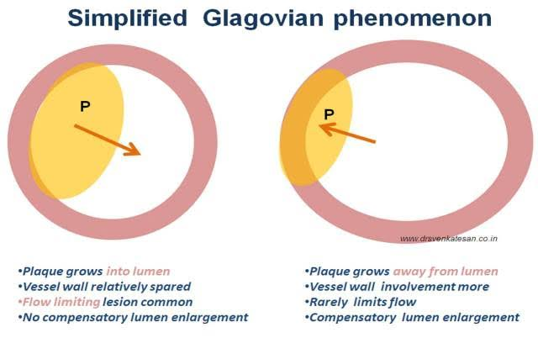

Slide 24
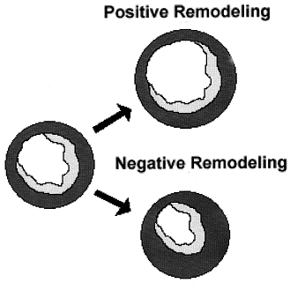

Slide 25
Angiogenesis in Plaques :
As atherosclerotic plaques grow, they develop their own microcirculation.
This microvascular network likely forms in response to angiogenic peptides overexpressed in atheromas, such as:
Vascular Endothelial Growth Factor (VEGF)
Various forms of Fibroblast Growth Factors
Placental Growth Factor (PlGF)
Oncostatin M
These microvessels within plaques have significant functional roles:
They provide a relatively large surface area for the trafficking of leukocytes.

Slide 26
Complications Of Atherosclerosis
Arterial Stenosis and their Consequences :
Once plaque burden surpasses the artery's ability to remodel outward, it begins to encroach on the arterial lumen.
Lesions that cause stenosis greater than 60% can limit blood flow under increased demand, potentially leading to chronic stable angina or intermittent claudication.

Slide 27
Thrombosis and Atheroma Complication :
critical mechanism for transition from chronic to acute atherosclerosis.
A physical disruption of the atherosclerotic plaque commonly causes acute thrombosis.
Plaque Rupture and Thrombosis :
Accounts for 2/3 cases of acute MI.
Reflects an imbalance between forces that impinge on plaque’s cap and mechanical strength of fibrous cap.

Slide 28
Superficial Erosion of Plaques :
Superficial erosion of plaques accounts for up to 25% of acute myocardial infarctions (MIs).
The pathobiology of superficial erosion is less understood compared to other mechanisms.
This type of plaque disruption is more likely to cause fatal acute MI in women and individuals with hypertriglyceridemia and diabetes mellitus (DM).
Apoptosis of endothelial cells (ECs) may contribute to their desquamation in areas of superficial erosion.

Slide 29
Stage I:
Monocytes adhere to the intact endothelial surface.
Monocytes then move into the intima.
Key Processes: Endothelial dysfunction, influx of lipid-laden macrophages and T lymphocytes, inflammation, smooth muscle proliferation, and deposition of collagen and elastic tissue.
Earliest Visible Lesions (Fatty Streaks):
Plasma lipid is absorbed by intramural macrophages.
Lipids accumulate in intimal foam cells under an intact endothelial surface.
Known as Stage II lesions by the AHA Committee on plaque nomenclature.

Slide 30
Stage III Lesions:
Similar to Stage II lesions but larger.
Contain more extracellular lipid and inflammatory cells.
Overall: Stages I, II, and III collectively form what is known as the "fatty streak.”

Slide 31
Atherosclerotic Plaques:
As lesions grow, they become larger and are termed "atherosclerotic plaques."
Plaque Composition:
A collagen cap.
A core with variable amounts of lipid.
Calcium deposits.
Vascularization from the vasa vasorum.

Slide 32
Disease Progression:
Leads to luminal narrowing and changes in plaques.
Plaque changes include:
Surface ulceration
Intraplaque hemorrhage
Rupture
Thrombosis
Clinical Complications:
Coronary Arteries:
Results in ischaemic heart disease (IHD).
Manifestations: Angina pectoris, myocardial infarction, sudden cardiac death.

Slide 33
Cerebral Circulation:
Causes transient ischaemic attacks (TIAs) or cerebral infarcts (strokes).
Aorta:
Leads to aneurysm and potential rupture, especially in the abdominal aorta.
Narrowing of the iliofemoral vessels can cause gangrene in the lower extremities.

Slide 34
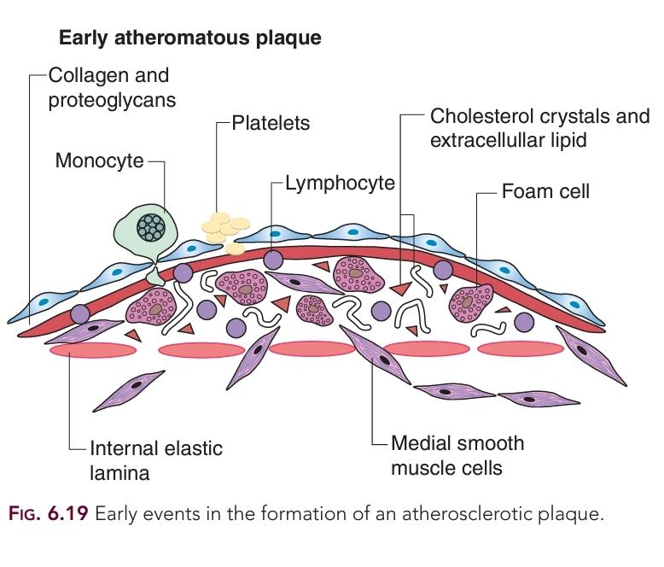

Slide 35
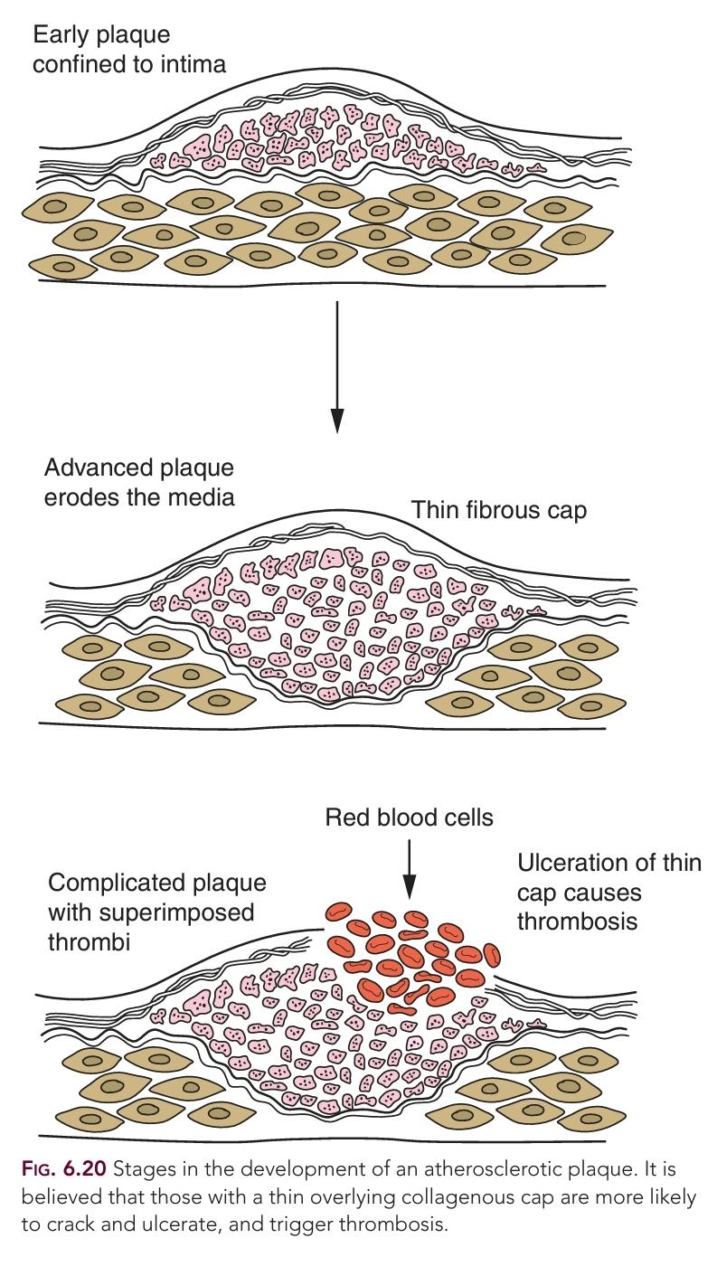

Slide 36
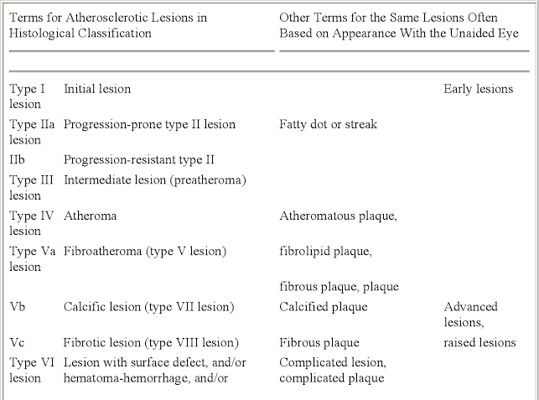

Slide 37
Calcification in Atherosclerotic Plaques:
Common and increases with the extent of plaque formation and age.
Two Distinct Patterns:
Nodular Calcification: Calcium forms nodular masses within the lipid core.
Plate Calcification: Plates of calcification develop in the connective tissue, deep in the intima, near the medial/intimal junction.
Regulated Process:
Plaque calcification is now understood to be a regulated process, not just passive precipitation of calcium phosphate crystals.
The extent of calcification roughly correlates with the amount of atherosclerosis but not with arterial narrowing.

Slide 38
Calcification and Thrombosis:
Calcification generally has no direct causal link to thrombosis, with one exception:
In individuals over 75 years old, diffuse intimal atherosclerosis and calcification can be associated with diffuse ectasia (dilatation) of the coronary arteries.
Shear stress can cause intimal tears at the margins of calcium plates, leading to thrombosis.
Screening for Calcification:
New non-invasive methods such as electron beam tomography and computed tomography angiography (CTA) are used to screen for calcification, indicating the atherosclerotic load within coronary arteries.

Slide 39
Special Cases Of Arteriosclerosis
Restenosis after Arterial Intervention:
Restenosis and In-stent Restenosis (ISR) after PCI are special forms of arterial hyperplastic disease.
Intravascular ultrasound (IVUS) studies indicate that a significant portion of luminal narrowing after balloon angioplasty is due to negative remodeling, or constriction from the adventitial side.
These findings have led to renewed interest in the role of adventitial inflammation and the subsequent scar formation and wound contraction as mechanisms of arterial constriction after balloon angioplasty.

Slide 40
In-stent restenosis (ISR), unlike general restenosis, primarily results from intimal thickening.
Histologic studies show that ISR lesions consist largely of myxomatous tissue, characterized by sparse stellate SMCs within a loose, highly hydrated ECM.
Drug-eluting stents (DES) have significantly reduced ISR rates but carry an increased risk of late stent thrombosis.

Slide 41
Aneurysmal Disease:
Can lead to aneurysmal disease, especially in the infrarenal abdominal aorta.
lack of vasa vasorum results in inadequate blood supply to the tunica media,
Lumbar lordosis may disrupt blood flow dynamics in the distal aorta, creating flow disturbances that contribute to aneurysm development.

Slide 42
Aneurysmal disease involves transmural destruction of arterial architecture.
Medial SMCs are significantly reduced in advanced aortic aneurysms compared to typical stenotic lesions.
Destruction of elastic laminae indicates extensive degradation of elastin, collagen, and other ECM constituents.
Aortic aneurysms also exhibit considerable inflammation, particularly in the adventitia.

Slide 43
THANK YOU

Slide 44
MCQ 1
Foam cell formation in atherosclerosis is primarily mediated through:
A. Native LDL receptor uptake
B. HDL receptor activation
C. Scavenger receptors binding modified LDL
D. Insulin receptor signaling

Slide 45
MCQ-2
Luminal stenosis usually becomes apparent only after plaque burden exceeds approximately:
A. 10% of cross-sectional area
B. 25% of cross-sectional area
C. 40% of cross-sectional area
D. 60% of cross-sectional area

Slide 46
MCQ -3
Histologically, in-stent restenosis primarily consists of:
A. Lipid-rich necrotic core
B. Myxomatous tissue with sparse stellate SMCs
C. Dense calcified plaque
D. Thrombotic occlusion

