Slide 1
ASD CLOSURE

Slide 2
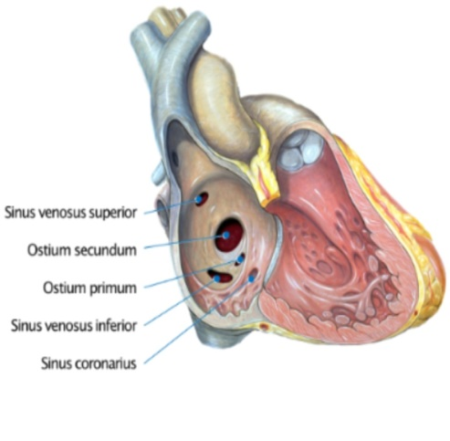
INTRODUCTION
Atrial septal defects (ASD) result from deficient development of the inter atrial septum.
ASDs are classified according to their location
TYPE OF ASD | LOCATION
Ostium secundum | Near foramen ovale (mid IAS)
Ostuim primum | Base of IAS
Sinus venosus | Near the entry of SVC/IVC
Coronary sinus | Absence of common wall that seperates LA from coronary sinus

Slide 3
INVESTIGATIONS
2D ECHO
Dilated RA & RV
Paradoxical septal motion of IVS ( due to RV volume overload)
Colour flow imaging can confirm the presence of ASD jet across IAS
Associated TR jet can be seen

Slide 4
INVESTIGATIONS
ECG findings
Right axis deviation
Complete or incomplete RBBB
RVH
Right atrial enlargement
Crochetage sign : notch at the apex of R wave in inferior leads
CXR
Cardiomegaly
Prominent PA

Slide 5
ASD CLOSURE
Transcatheter closure is applicable only for secundum ASDs
Ostium primum,sinus venosus and coronary sinus defects require surgical closure as they lack sufficient surrounding septal rims
Surgical closure of OS-ASD is reasonable in the setting of => unfavourable anatomy for percutaneous closure => after failed trans catheter closure or => when concomitant surgical repair of associated
defects is required.

Slide 6
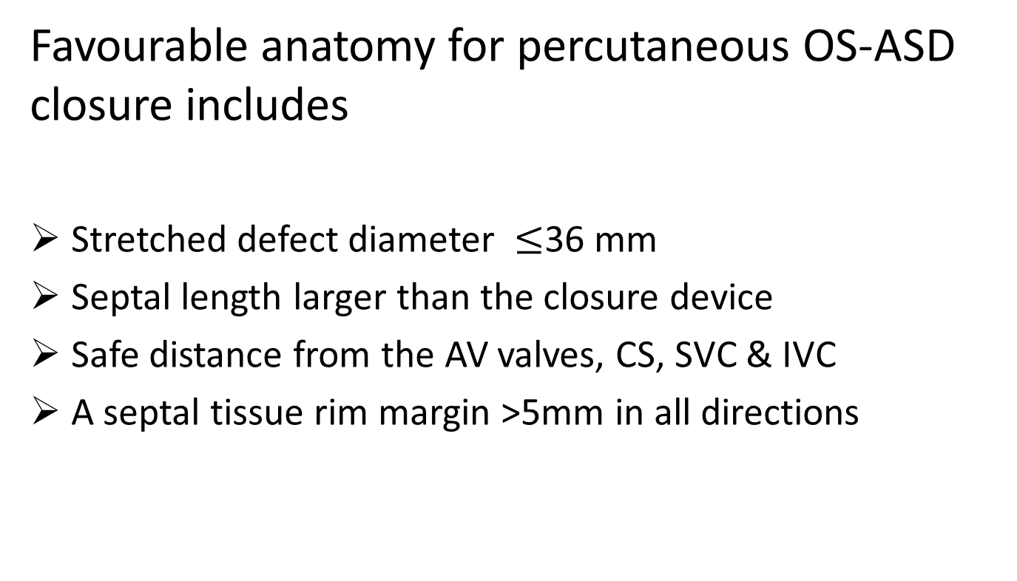
Favourable anatomy for percutaneous OS-ASD closure includes
Stretched defect diameter $≤$36 mm
Septal length larger than the closure device
Safe distance from the AV valves, CS, SVC & IVC
A septal tissue rim margin >5mm in all directions

Slide 7
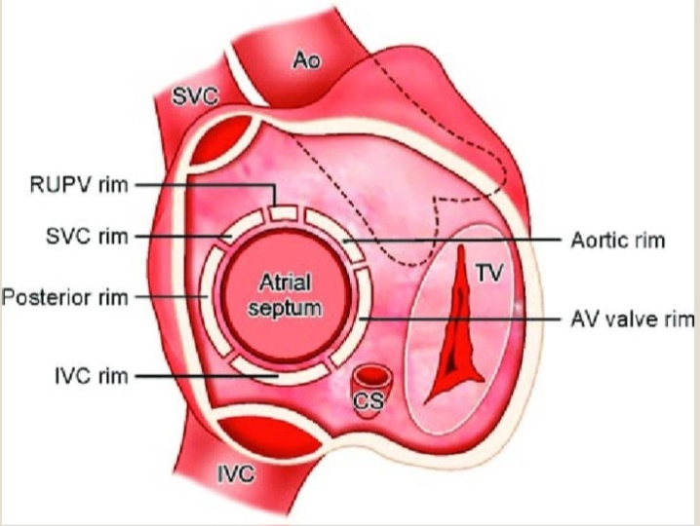
DEFENITION OF RIMS
Aortic rim : superoanterior / antero superior
AV valve rim : inferoanterior / antero inferior
SVC rim : superoposterior/ postero superior
IVC rim : inferoposterior / postero inferior
Posterior rim : posterior free wall of atria

Slide 8
HAEMODYNAMICS
As LA pressure is higher than RA pressure, blood flows from L to R (L to R shunt)
Volume overload on RA & RV
Increased pulmonary blood flow
RA,RV & PA dilation over time
Chronic increased blood flow to pulm circulation may lead to pulm vascular remodelling and pulm.htn
Due to L -> R shunt ,right sided O2 saturation increases
PVR <5 wood units
Further increase in PVR (>10 wood unit) due to unrepaired defects result in shunt reversal ( R to L / Bidirectional ) leading to Eisenmenger syndrome

Slide 9
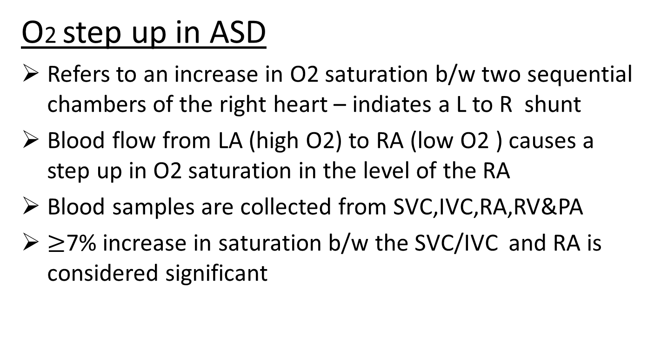
HEMODYNAMICS
O2 step up in ASD
Refers to an increase in O2 saturation b/w two sequential chambers of the right heart – indiates a L to R shunt
Blood flow from LA (high O2) to RA (low O2 ) causes a step up in O2 saturation in the level of the RA
Blood samples are collected from SVC,IVC,RA,RV&PA
$≥$7% increase in saturation b/w the SVC/IVC and RA is considered significant

Slide 10
Shunt quantification in ASD
Oximetry run – most commonly used method of shunt calculation
Samples are obtained from various sites ( SVC, IVC, RA, RV, PA,Ao,LA,LV etc.)
Qp/Qs calculation estimates shunt direction and magnitude
It represents pulmonary to systemic flow ratio
Qp = pulmonary blood flow
Qs = systemic blood flow

Slide 11
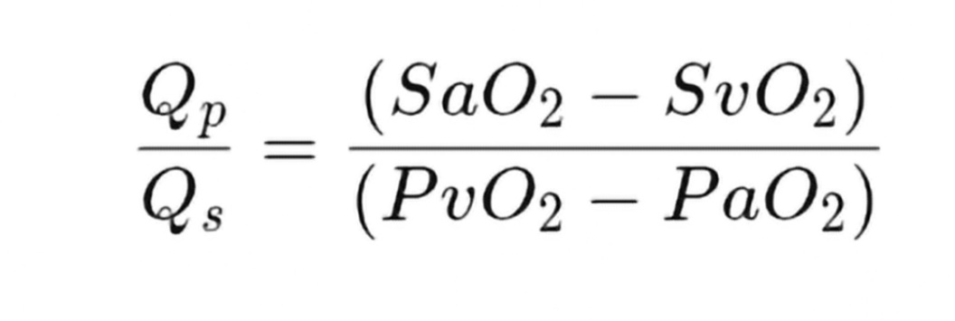
Shunt quantification in ASD
By Fick’s principle,
Qp = O2 consumption
pul.veous O2 – pul.artery O2
Qs = O2 consumption
syst arterial O2 – mixed venous O2

Slide 12
Shunt quantification in ASD
If Qp/Qs is >1:1 - L -> R shunt
<1:1 - R-> L shunt
>1.5:1 - significant L -> R shunt
Qp/Qs = 1.5 – 1.9 : device closure

Slide 13
INDICATIONS
OS ASD >5 mm (but <36 mm )
RV volume overload
Clinically significant shunt (Qp/Qs > 1.5)
Enough rim (4 mm)
PVR <5 wood units

Slide 14
CONTRAINDICATIONS
Patients with associated cardiac anomalies requiring cardiac surgery
Eisenmenger syndrome with severe PAH
Patients with current systemic/ local infection or sepsis
Intracardiac thrombus
Unsuitable defect anatomy including deficient rims (except anterior rim)
Pts with bleeding disorders or with contraindicated antiplatelet therapy
Patients allergic to nickel

Slide 15
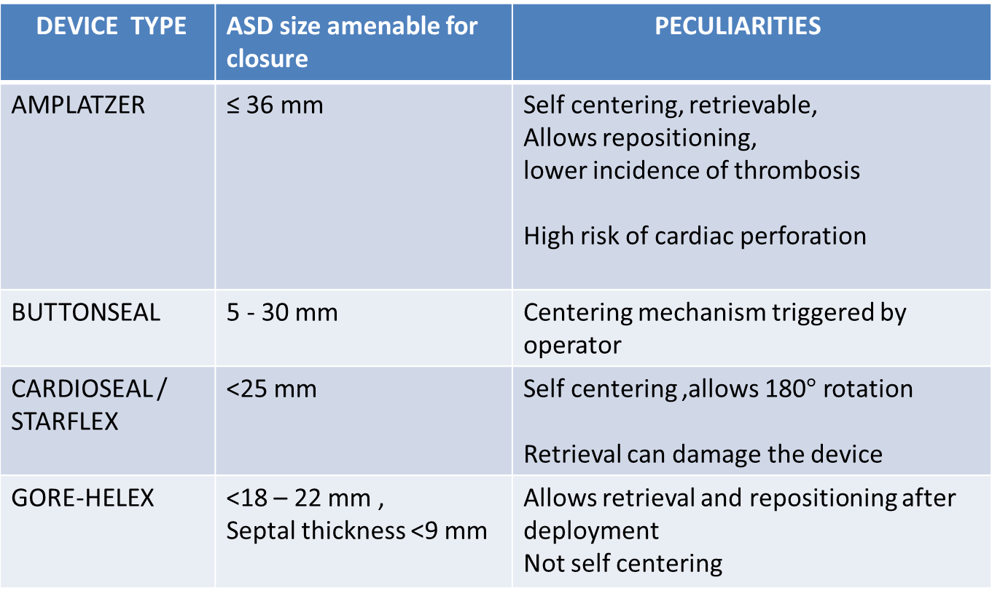
ASD DEVICES
DEVICE TYPE | ASD size amenable for closure | PECULIARITIES
AMPLATZER | ≤ 36 mm | Self centering, retrievable, Allows repositioning, lower incidence of thrombosis High risk of cardiac perforation
BUTTONSEAL | 5 - 30 mm | Centering mechanism triggered by operator
CARDIOSEAL / STARFLEX | <25 mm | Self centering ,allows 180$°$ rotation Retrieval can damage the device
GORE-HELEX | <18 – 22 mm , Septal thickness <9 mm | Allows retrieval and repositioning after deployment Not self centering

Slide 16
AMPLATZER SEPTAL OCCLUDER
Double disc occluder – comprised of Nitinol mesh and polyester material
3-4 mm connecting waist between the discs corresponding to the thickness of the atrial septum
Devise size is determined by the diameter of the waist (4-40 mm available)
LA disc is larger than RA disc due to L to R shunting
Size of the waist(mm) | LA disc (mm) | RA disc (mm)
4 – 10 | 12 | 8
11 – 34 | 14 | 10
>34 | 16 | 10

Slide 17
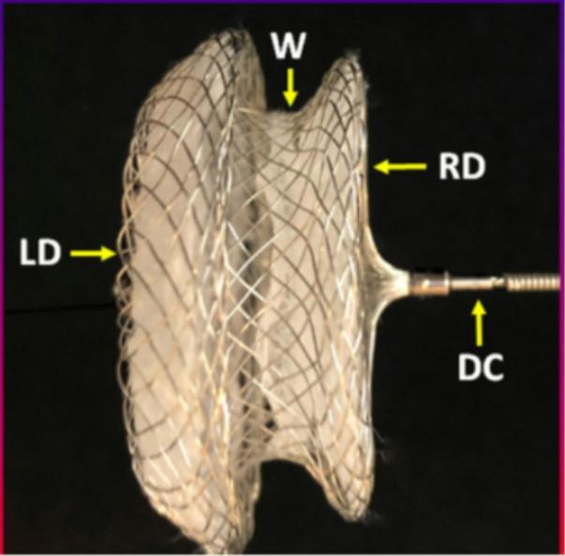
AMPLATZER SEPTAL OCCLUDER

Slide 18
Hardwares used
7 F Femoral sheath
6 or 7 F MP catheter
035 J tip terumo
Amplatzer super stiff guide wire
Amplatzer sizing balloon
Amplatzer delivery system

Slide 19
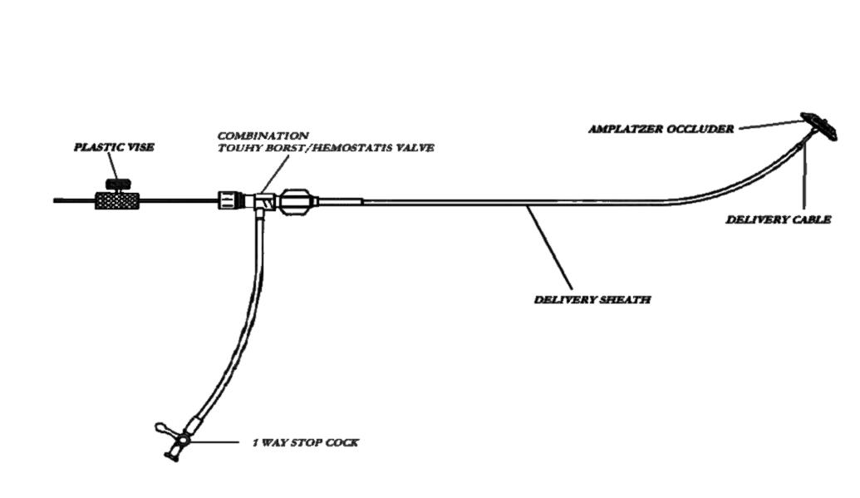
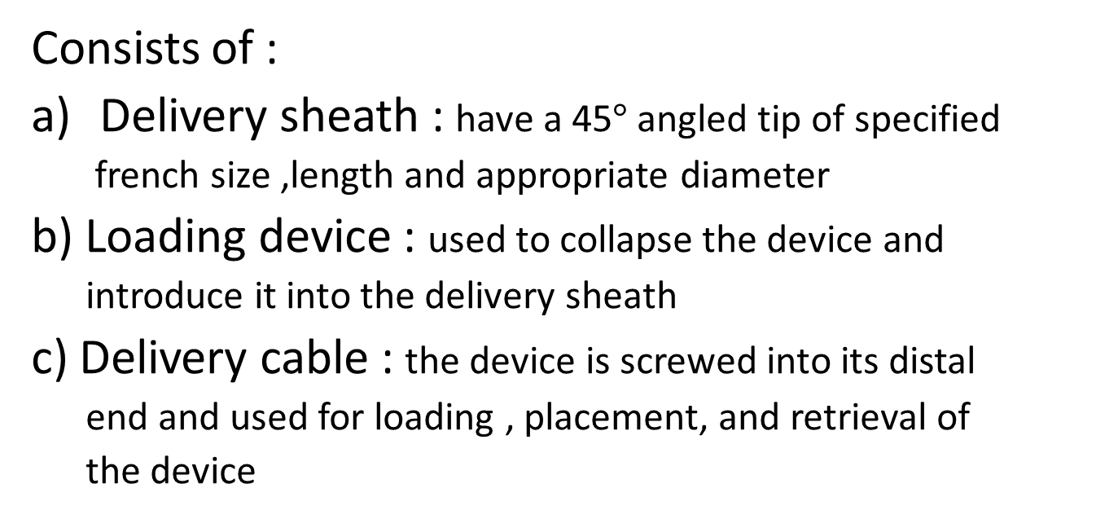
1. Amplatzer delivery system
Consists of :
Delivery sheath : have a 45$°$angled tip of specified
french size ,length and appropriate diameter
b) Loading device : used to collapse the device and
introduce it into the delivery sheath
c) Delivery cable : the device is screwed into its distal
end and used for loading , placement, and retrieval of
the device

Slide 20
cont….
d) Plastic pin vise : facilitates unscrewing of delivery cable during device deployment
Size of sheath | Size of delivery system
6F | <10 mm
7F | 10 – 15 mm
8F | 16 – 19 mm
9F | 20 – 26 mm
10F | 28 – 34 mm
12F | 36 mm , 38 mm
14F | 40 mm

Slide 21
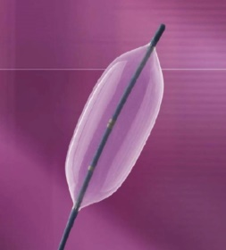
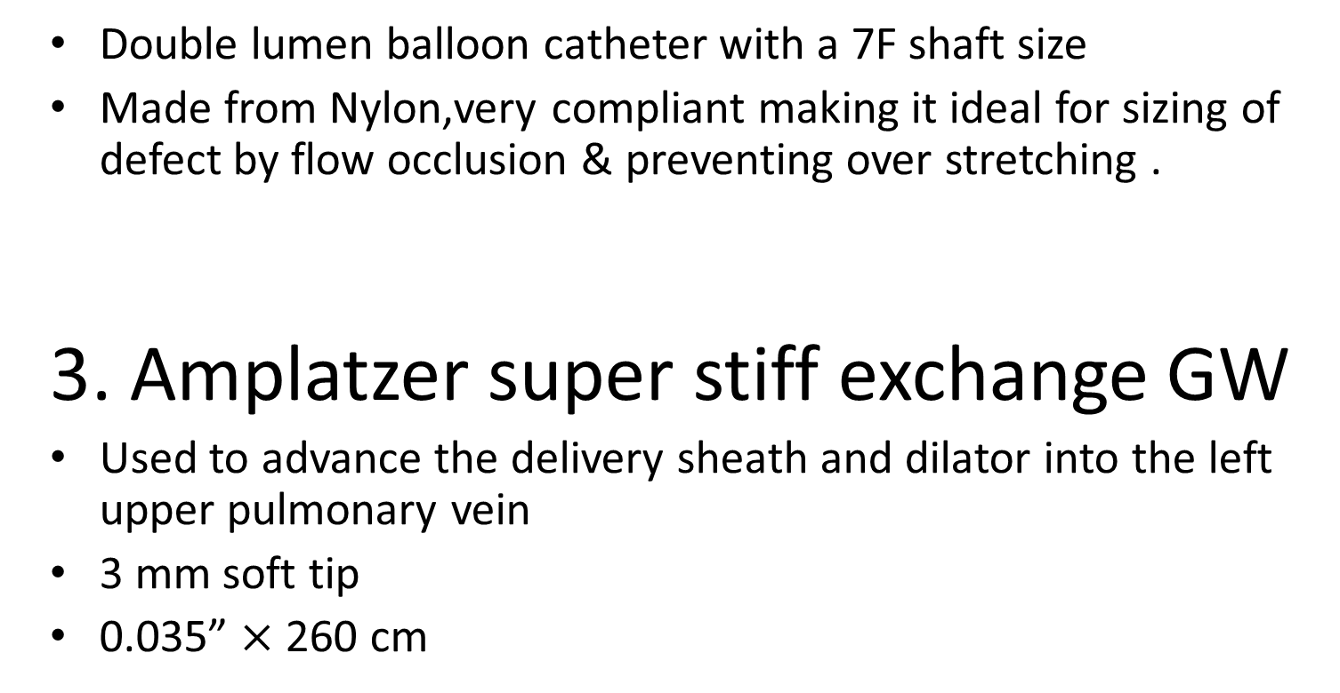
2. Amplatzer sizing balloon
Double lumen balloon catheter with a 7F shaft size
Made from Nylon,very compliant making it ideal for sizing of defect by flow occlusion & preventing over stretching .
3. Amplatzer super stiff exchange GW
Used to advance the delivery sheath and dilator into the left upper pulmonary vein
3 mm soft tip
0.035” $×$ 260 cm

Slide 22
PROCEDURE
Performed under TEE /intracardiac echocardiography/ TTE
Patient heparinised (ACT – 200 to 250 sec prior to device insertion)
RFV – 7 F femoral sheath – MP catheter is passed to SVC
The catheter is then withdrawn slowly aiming the tip toward the patient’s left shoulder until it jumps into the defect
A GW (035 J tip terumo) is advanced through the septum to the LUPV
The wire is exchanged with a more supportive amplatzer super stiff wire
Insert amplatzer sizing balloon over the exchange wire into LA and determine the stretched diameter of the defect

Slide 23
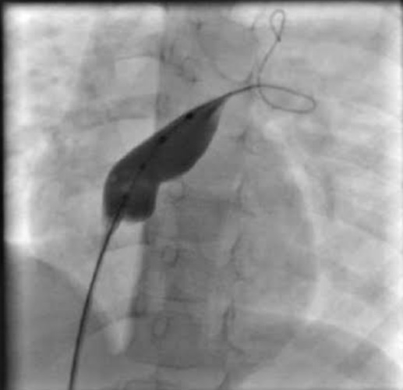
Sizing the defect
2 methods :
a) Pull-back techniqe
Inflated in the LA to a diameter 5 mm greater than the imaged diameter using a 30% contrast saline mixture
Then opposed into atrial septum to eliminate shunt by color doppler
Steady pull is maintained during gradual balloon deflation until it advances into the defect creating a waist
The contrast volume is recorded
Balloon is deflated and removed from the body
Reinflate the balloon using the recorded contrast volume and measured against a sizing plate
b) Static technique (amplatzer sizing balloon)
Under fluoroscopic or echocardiographic guidance balloon is placed across the defect
Inflate the diluted contrast medium until L – R shunt ceases
Measurement can then be made similar to pull back technique

Slide 24
Device selection :
If the defect has adequate rim (>5 mm), select device 0 - 2 mm larger than the stretched diameter of the balloon
If the superior/anterior rim is deficient (5 – 7 mm),select a device 4mm larger than the balloon stertched diameter
Exchange 7F sheath with 60 – 75 cm long compatible sheath
Prepare the device by soaking it in heparinised saline ,inspect the device for any defects
Press the delivery cable through the loader & screw the device at the tip of the delivery cable
Pull the device into the loader
Insert the dilator into the delivery sheath ,secure the sheath with lockery mechanism

Slide 25
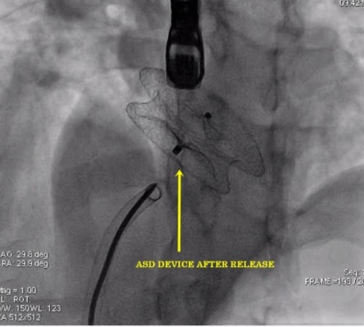
Cont…
Once the sheath has reached the IVC remove the dilator
Advance the sheath over GW into LUPV.
Test injection or by echo to verify the position
Remove exchange wire
Attach loading device to the delivery sheath . Advance the device into the sheath by pushing the delivery cable
Deploy LA disc – part of the connecting waist – pull the device gently against the atrial septum
Pull the sheath back and deploy the RA disc
Angiogram profile of IAS
To and fro motion of delivery cable assures secure position across ASD
Confirm correct position
Release the device

Slide 26
Multiple ASD and multifenestrated Defects
When defects are within 7 mm of each other, a single device is usually used
The device waist crosses the largest defect and the large componenets occlude the remaining defects
When defects are distanced, multiple devices are necessary
The smaller device is released first ,then the larger defect aiming to overlap devices
Fossa ovalis fenestrations may require non self cenetering devices like HSO or Amplatz cribriform devices

Slide 27
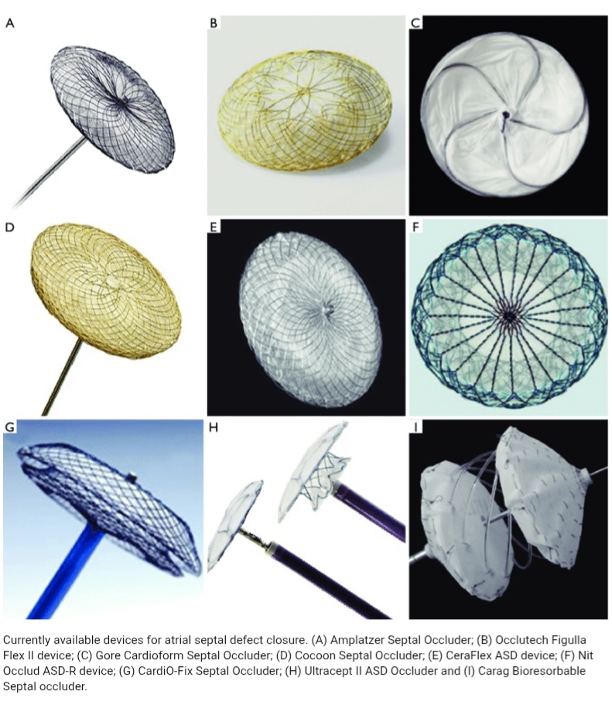
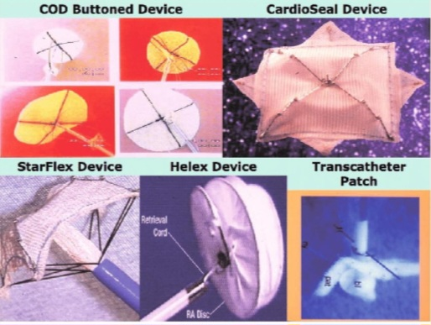
Other ASD closure devices

Slide 28
COMPLICATIONS
Device malposition, migration or embolization which may require surgical removal
Device associated thrombus
Heart blocks
Arrhythmias
Allergies
Bleeding
Stroke and other thromboembolic events
Infection
Air embolization
Residual shunts
Cardiac tamponade

Slide 29
MCQs
Which among the following is not a contraindication for ASD device closure
a) patient with sepsis
b) Patient with bleeding disorders
c) RV volume overload
d) Intracatdiac thrombus

Slide 30
Ans c) RV volume overload

Slide 31
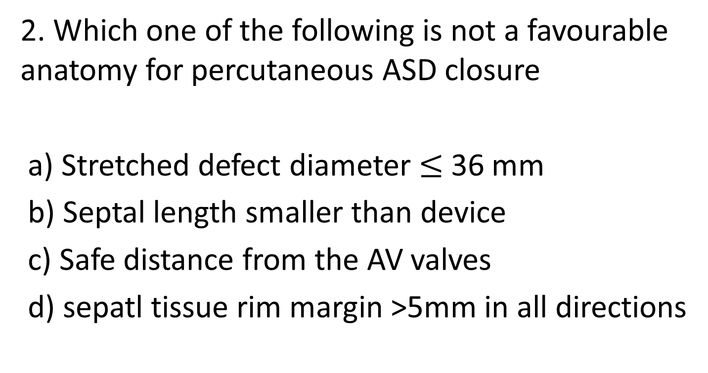
2. Which one of the following is not a favourable anatomy for percutaneous ASD closure
a) Stretched defect diameter $≤$ 36 mm
b) Septal length smaller than device
c) Safe distance from the AV valves
d) sepatl tissue rim margin >5mm in all directions

Slide 32
Ans b) Septal length smaller than the device

Slide 33
3. Which among the following device is used to close fenestrated Fossa ovalis
a) Amplatz cribriform device
b) cardioseal
c) Starflex
d) cocoon sepatal occluder

Slide 34
Ans a) Amplatz cribriform occluder

