Slide 1
BUNDLE BRANCH BLOCKS AND
HEMI-BLOCKS
DR.MITHUN ANILKUMAR
SENIOR RESIDENT
DM CARDIOLOGY
TDMC

Slide 2
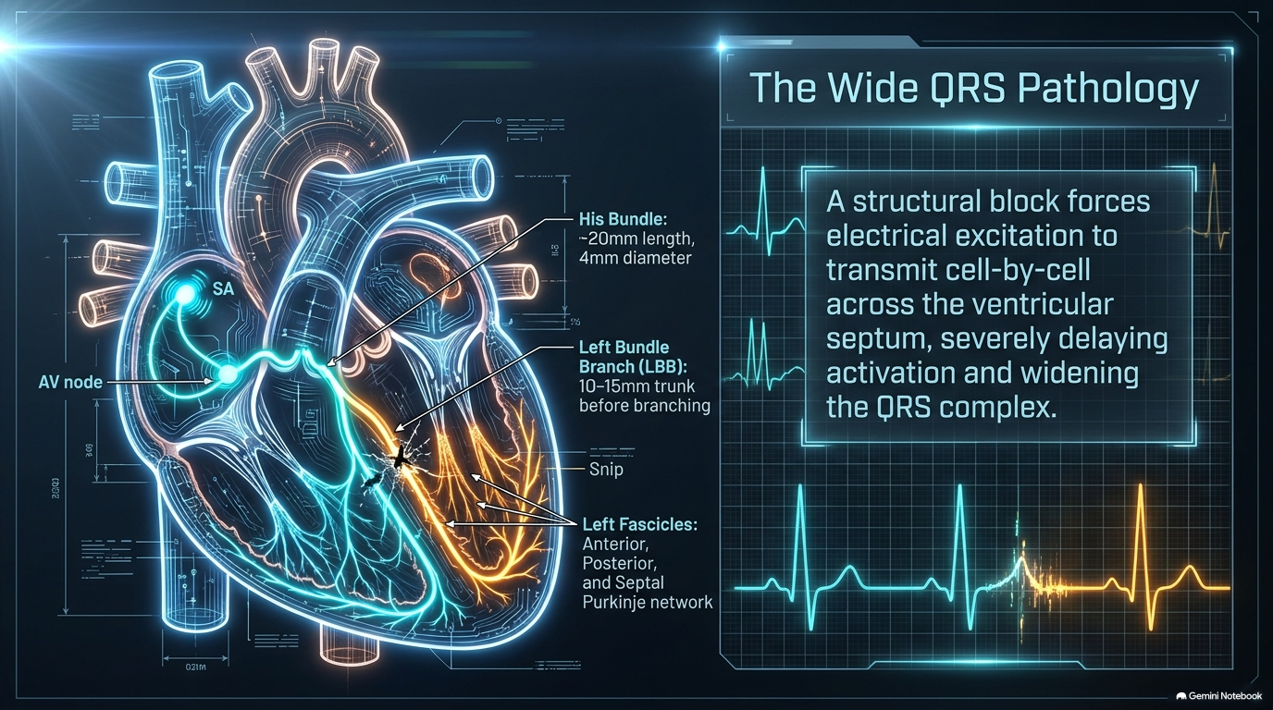

Slide 3
LEFT BUNDLE BRANCH BLOCK

Slide 4
ECG Diagnostic criteria
QRS duration ≥ 120ms
Dominant S wave in V1
Broad monophasic R wave in lateral leads (I, aVL, V5-6)
Absence of Q waves in lateral leads
Prolonged R wave peak time > 60ms in leads V5-6

Slide 5
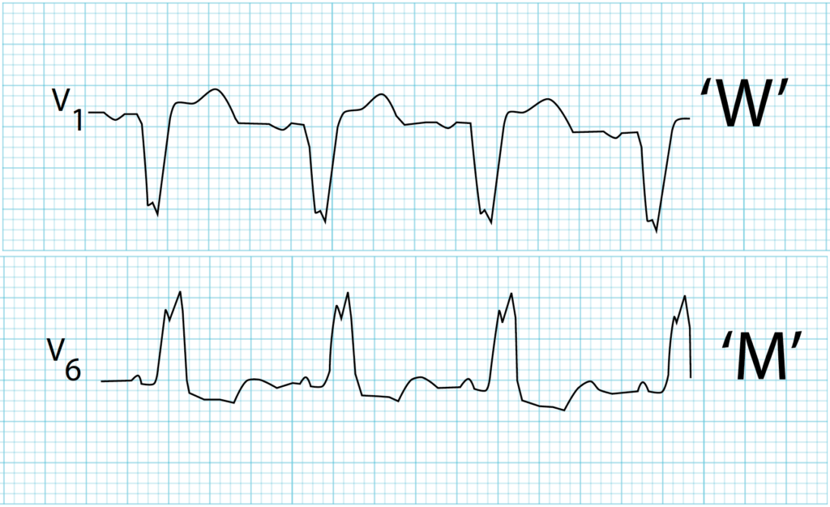

Slide 6
Electrophysiology
In normal cardiac conduction, impulses travel equally down the left and right bundles, with the septum activated from left to right and the formation of small Q waves in lateral leads
In LBBB, conduction delay means that impulses travel first via the right bundle branch to the RV, and then to the LV via the septum
Septal activation is thus reversed eliminating lateral Q waves
The overall depolarisation vector from the right to left ventricle produces tall R waves in lateral leads (I, V5-6) and deep S waves in the right precordial leads (V1-3). The delay between activation of the RV and LV produces the characteristic “M-shaped” R wave seen in lateral leads
Delayed overall conduction time to the LV extends the QRS duration to ≥ 120 ms

Slide 7
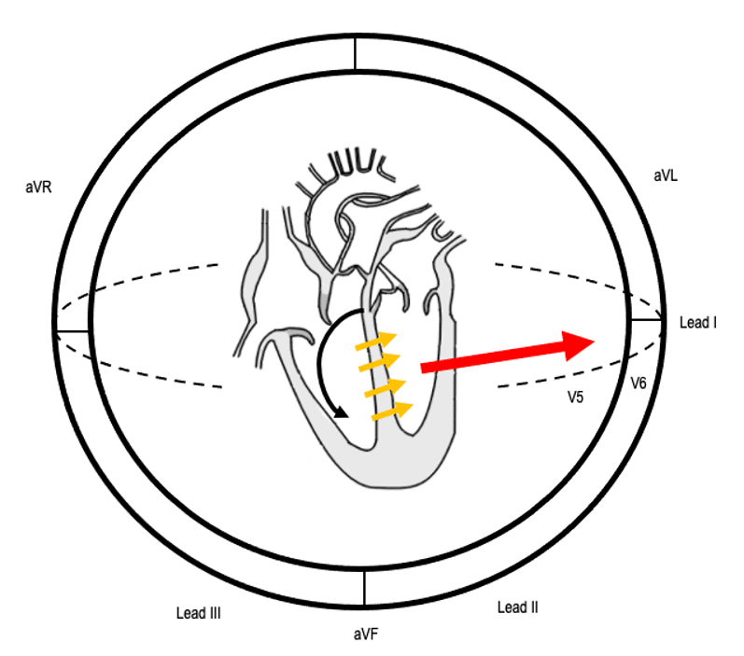
Electrophysiology
Sequence of conduction in LBBB:
1) Conduction delay means impulses travel first via the right bundle branch (black arrow)
2) Septum is activated from right-to-left (yellow arrows)
3) Overall depolarisation vector is directed towards lateral leads (red arrow)

Slide 8
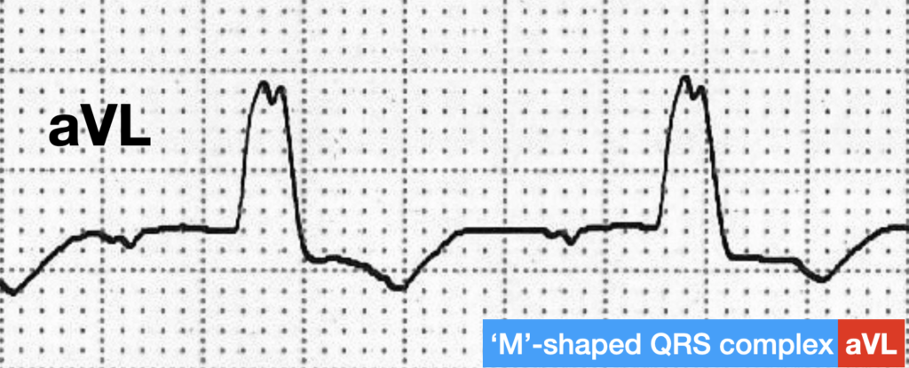
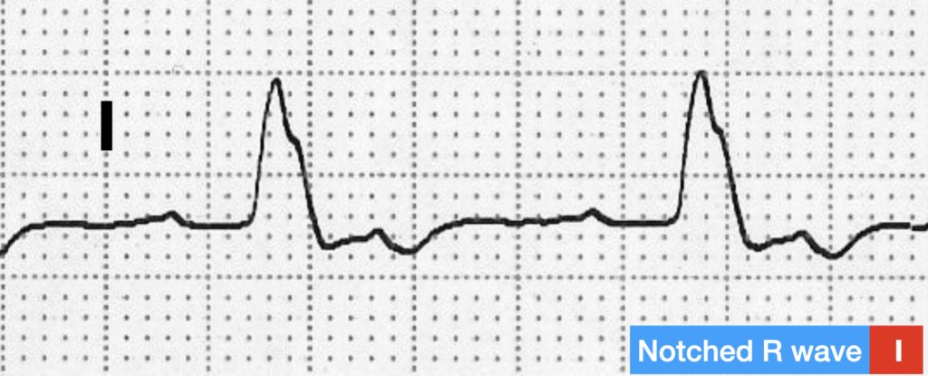
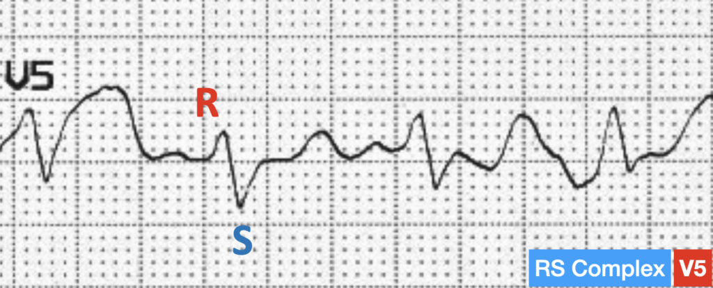
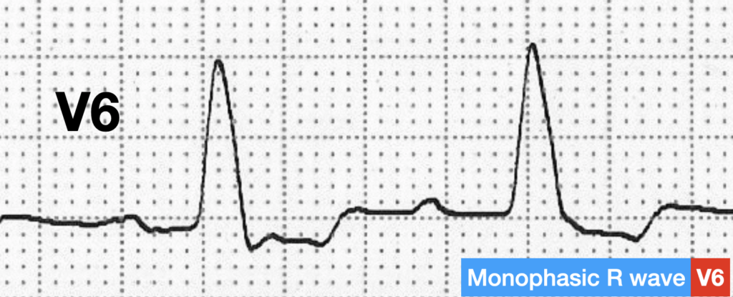
ECG QRS Morphology
QRS MORPHOLOGY IN THE LATERAL LEADS
The R wave in the lateral leads may be either “M-shaped”, notched, monophasic, or an RS complex

Slide 9
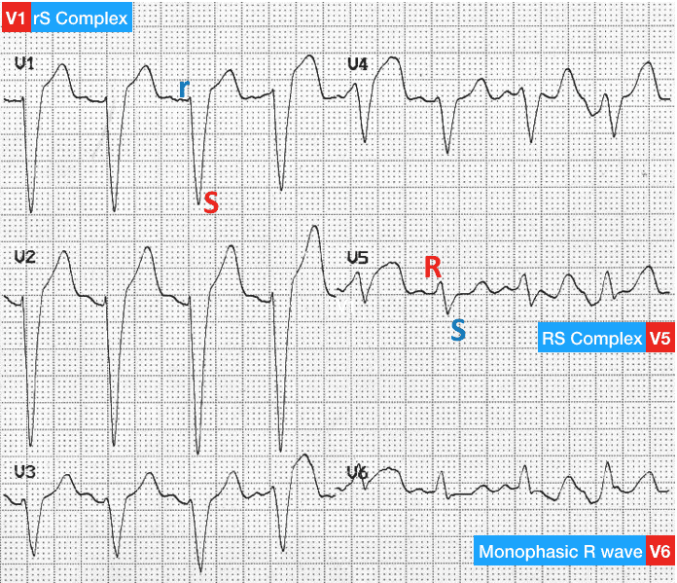
ECG QRS Morphology
QRS MORPHOLOGY IN V1
The QRS complex in V1 may be either:
rS complex (small R wave, deep S wave)
QS complex (deep Q/S wave with no preceding R wave)

Slide 10
What about the ST elevation?
Appropriate discordance refers to the fact that abnormal depolarisation should be followed by abnormal repolarisation, which appears discordant to the preceding QRS complex
Lateral leads with tall, broad R waves will often have associated ST-segment depression and T-wave inversion, and those with deep S waves can have an allowable amount of ST elevation that does not indicate ischaemia (generally viewed as < 25% of the size of the preceding S wave)
Any concordant ST segment change is concerning for ischaemia.

Slide 11
Causes of Left Bundle Branch Block
It is unusual for LBBB to exist in the absence of organic disease. Causes are varied and include:
Aortic stenosis
Ischaemic heart disease
Hypertension
Dilated cardiomyopathy
Anterior MI
Lenègre-Lev disease: primary degenerative disease (fibrosis) of the conducting system
Hyperkalaemia
Digoxin toxicity
New LBBB in the context of chest pain was once considered a “STEMI-equivalent” and part of the criteria for thrombolysis. However, more up-to-date data suggests that chest pain patients with new LBBB have little increased risk of acute myocardial infarction at the time of presentation.

Slide 12
SGARBOSSA CRITERIA
In patients with left bundle branch block (LBBB) or ventricular paced rhythm, infarct diagnosis based on the ECG can be difficult
Abnormal depolarisation should be followed by abnormal repolarisation, manifesting as ST-segment and T-wave deviations that do not necessarily indicate acute ischaemia (“appropriate discordance”)
In 1996, Elena B Sgarbossa first described criteria to assist clinicians to diagnose infarction in the setting of LBBB

Slide 13
Original Sgarbossa Criteria
The original three criteria used to diagnose infarction in patients with LBBB are:
Concordant ST elevation > 1mm in leads with a positive QRS complex (score 5)
Concordant ST depression > 1 mm in V1-V3 (score 3)
Excessively discordant ST elevation > 5 mm in leads with a -ve QRS complex (score 2)
These criteria are specific, but not sensitive (36%) for myocardial infarction.
A total score of ≥ 3 is reported to have a specificity of 90% for diagnosing myocardial infarction.
During right ventricular pacing the ECG also shows left bundle brach block and the above rules also apply for the diagnosis of myocardial infarction during pacing, however they are less specific.

Slide 14
Smith-Modified Sgarbossa Criteria
The most important change is the modification of the rule for excessive discordance.
The use of a 5 mm cutoff for excessive discordance was arbitrary and non-specific — for example, patients with LBBB and large voltages will commonly have ST deviations > 5 mm in the absence of ischaemia. The modified rule is positive for “STEMI” if there is discordant ST elevation with amplitude > 25% of the depth of the preceding S-wave.
Smith-Modified Sgarbossa Criteria:
Concordant ST elevation ≥ 1 mm in ≥ 1 lead
Concordant ST depression ≥ 1 mm in ≥ 1 lead of V1-V3
Proportionally excessive discordant STE in ≥ 1 lead anywhere with ≥ 1 mm STE, as defined by ≥ 25% of the depth of the preceding S-wave

Slide 15
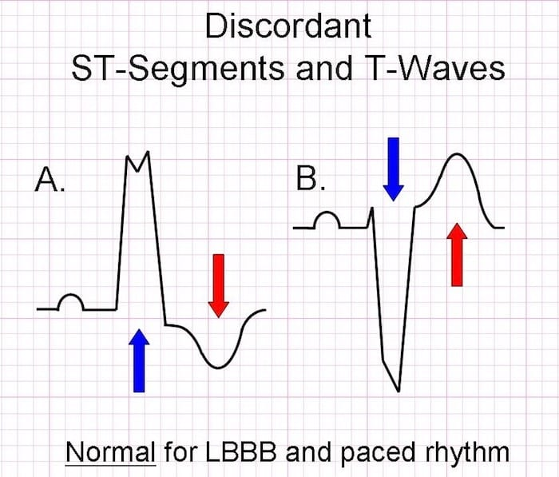
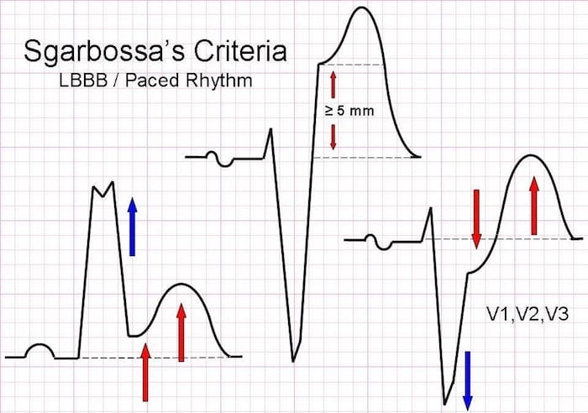

Slide 16
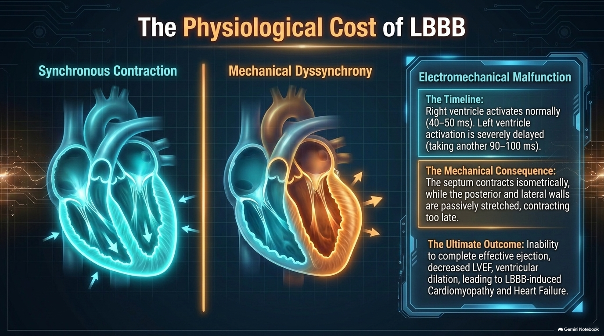

Slide 17
RIGHT BUNDLE BRANCH BLOCK

Slide 18
Definition
RBBB is a delay or block of conduction within the right bundle branch.
Complete RBBB: QRS duration ≥120 ms.
Incomplete RBBB: QRS duration 100–119 ms.

Slide 19
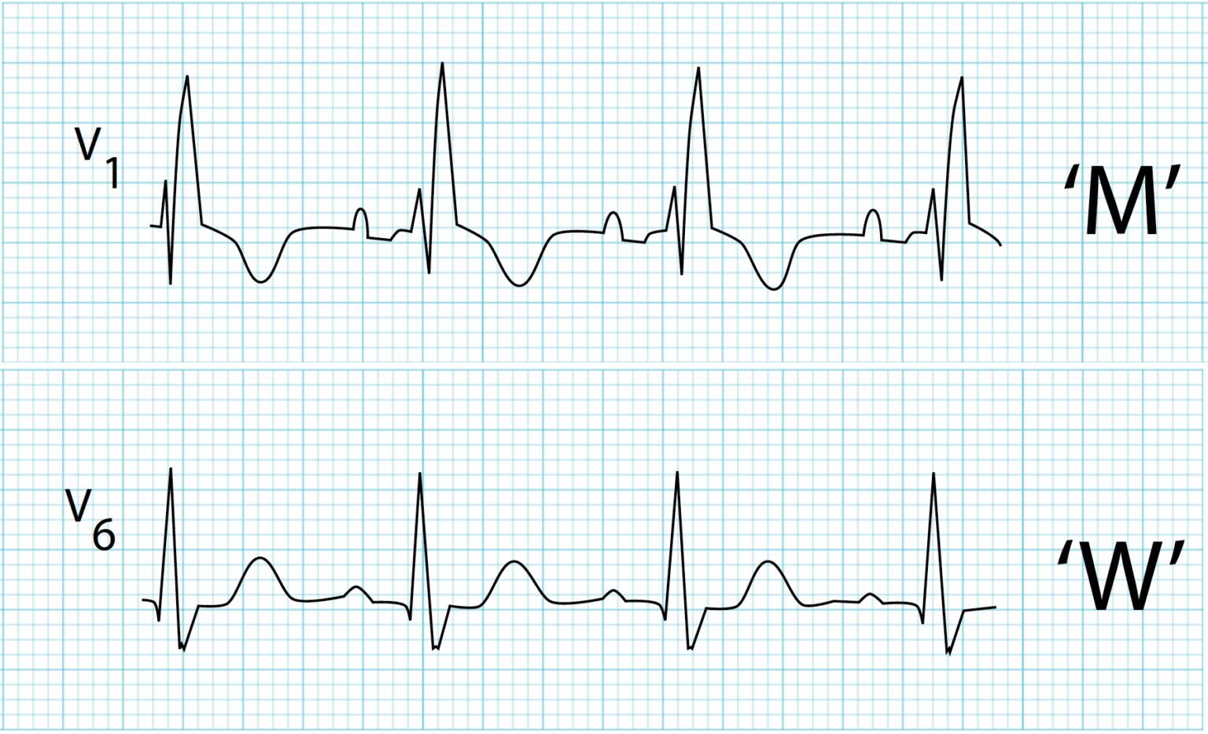
ECG Criteria for Complete RBBB
QRS duration ≥120 ms.
rsR′ pattern in lead V1, with a prominent terminal R′ wave.
Slurred S wave in leads I and V6.

Slide 20
Typical ECG Manifestations
Lead V1: Tall, broad, frequently notched R′ deflection.
Leads I, V5 and V6: Prominent, delayed and widened S wave.
QRS complex: Duration is ≥120 ms.
Terminal S wave: Delayed in leads I, II, aVL, aVF and V4–V6.
Secondary ST-T changes: ST-T changes are generally opposite in direction to the terminal QRS deflection.
V1 and aVR: ST depression with T-wave inversion may be present.
Left-oriented leads: ST elevation may occur with an upright T wave.

Slide 21
Electrophysiology
In normal cardiac conduction, impulses travel equally down the left and right bundles, with the septum activated from left to right and the formation of small Q waves in lateral leads
In RBBB, the left ventricle is activated normally, thus the early part of the QRS complex correlating to septal depolarisation is unchanged
There is delayed activation of the right ventricle as depolarisation originates from the left ventricle across the septum. This produces a secondary R wave (R’) in the precordial leads, and a wide, slurred S wave in lateral leads
Normal activation of the left ventricle means that cardiac axis remains normal in isolated RBBB

Slide 22
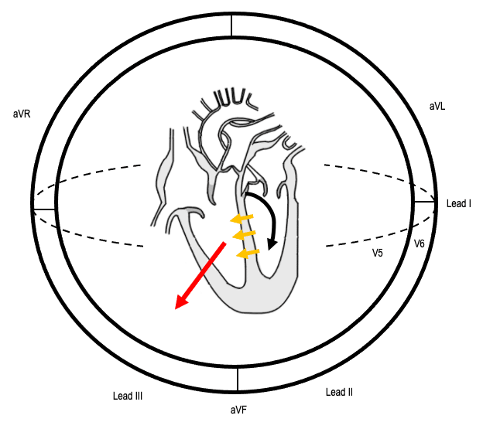
Electrophysiology
Sequence of conduction in RBBB:
1) Left ventricular activation via the left bundle (black arrow) occurs normally
2) Septal depolarisation (yellow arrows) is thus unaffected, producing a normal early QRS complex
3) Activation of the RV originates across the septum. The resultant depolarisation vector (red arrow) produces delayed R waves in leads V1-3, and S waves in lateral leads

Slide 23
Significance of RBBB
RBBB may occur even in the absence of clinically apparent heart disease.
It has been reported in approximately 0.8–2.9% of healthy individuals.
However, RBBB may also occur with cardiovascular and pulmonary diseases.
Associated conditions include:
  Atrial septal defect
  Pulmonary embolism
  Pulmonary hypertension
  Other structural heart diseases
Therefore, the significance of RBBB depends on the clinical setting and associated cardiac disease.
RBBB in a patient with an underlying cardiovascular disease may indicate a more significant substrate and worse prognosis.

Slide 24
Causes of Right Bundle Branch Block
Right ventricular hypertrophy / cor pulmonale
Pulmonary embolus
Ischaemic heart disease
Rheumatic heart disease
Congenital heart disease (e.g. atrial septal defect)
Myocarditis
Cardiomyopathy
Lenègre-Lev disease: primary degenerative disease (fibrosis) of the conducting system
There is increasing literature suggesting that in the context of chest pain, a new RBBB is highly concerning for OMI and a potential indication for immediate reperfusion therapy. The right bundle branch is supplied by LAD perforators in most patient populations and thus occlusion of this branch may manifest as a new RBBB +/- LAFB.

Slide 25
Significance of Anatomical Length of the Right Bundle Branch
The normal right bundle branch is approximately 40 mm long.
The conduction velocity in the right bundle is approximately 2 m/s.
Therefore, conduction through the right bundle normally takes about 20 ms.
If conduction velocity decreases by only 4 cm/s, conduction time increases by approximately 5 ms.
Further slowing of conduction can progressively increase the QRS duration.
A conduction velocity of approximately 20–30 cm/s can produce a QRS duration of 90–110 ms.
With further slowing, the QRS duration may increase to ≥120 ms, resulting in complete RBBB.
Therefore, even a small reduction in conduction velocity can produce a significant increase in QRS duration.

Slide 26
ST Segment and T-Wave Changes in RBBB
Uncomplicated RBBB
The ST segment and T wave show secondary repolarization changes.
These changes are generally opposite in direction to the terminal QRS deflection.
In right-sided leads such as V1, the terminal QRS is positive because of the R′ wave.
Therefore:
  ST segment → depressed
  T wave → inverted
In left-sided leads such as V6, the terminal QRS is predominantly negative because of the wide S wave.
Therefore:
  ST segment → elevated
  T wave → upright
These are secondary changes due to abnormal ventricular depolarization, rather than primary myocardial ischemia.

Slide 27
Incomplete RBBB
Incomplete RBBB may occur without obvious structural heart disease.
The ECG may initially show only subtle changes.
The earliest manifestation may be diminution of the S wave in V2.
With increasing delay in right bundle conduction:
  The terminal R wave becomes more prominent.
  The terminal R wave becomes slurred or notched.
  The ECG progressively approaches the pattern of complete RBBB.
The diagnosis of incomplete RBBB should therefore be interpreted according to the clinical context and underlying pathology.

Slide 28
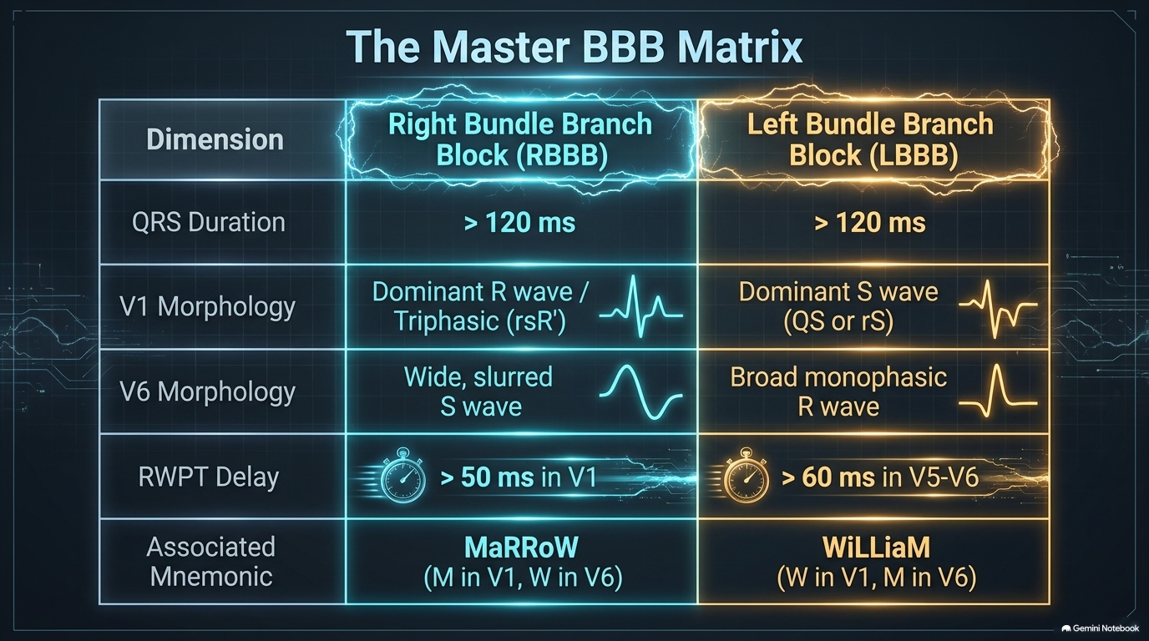

Slide 29
Fascicular blocks

Slide 30
Fascicular Block
Fascicular block is a delay or interruption of conduction within one of the major divisions/fascicles of the left bundle branch.
The major fascicles are:
  Left anterior fascicle
  Left posterior fascicle
  Left septal fascicle — described as an additional fascicle in some models.

Slide 31
FASCICLE ANATOMY
The left bundle branch divides into two major divisions:
1. Anterosuperior division
Runs anteriorly and superiorly.
Activates the anterolateral LV wall.
2. Posteroinferior division
Runs inferiorly and posteriorly.
Activates the diaphragmatic/inferior LV wall.
Important anatomical point
The peripheral fibers of the two divisions anastomose, forming a network with rapid conduction properties.

Slide 32
The anterosuperior fascicle is more susceptible to interruption than the posteroinferior fascicle.
Reasons
Anterosuperior fascicle
  Relatively long and thin.
Posteroinferior fascicle
  Relatively short and thick.
Blood supply
  Posteroinferior division has a dual blood supply.
  Anterosuperior division has a single blood supply, mainly from the septal branches of the LAD.
The anterosuperior division is located close to the aortic valve and may therefore be involved in disease affecting the aortic valve.
Clinical implication
LAFB is much more common than LPFB.

Slide 33
Left anterior fascicular block

Slide 34
Left Anterior Fascicular Block (LAFB)
LAFB occurs when conduction is delayed or interrupted in the anterosuperior division of the left bundle branch
Activation is preferentially transmitted through the posteroinferior fascicle.
The initial ventricular activation therefore proceeds inferiorly and to the right.
Subsequently, activation spreads toward the left and superior regions.
The overall QRS vector shifts superiorly and leftward.
Result
LAFB → superior + leftward QRS axis → Left Axis Deviation.

Slide 35
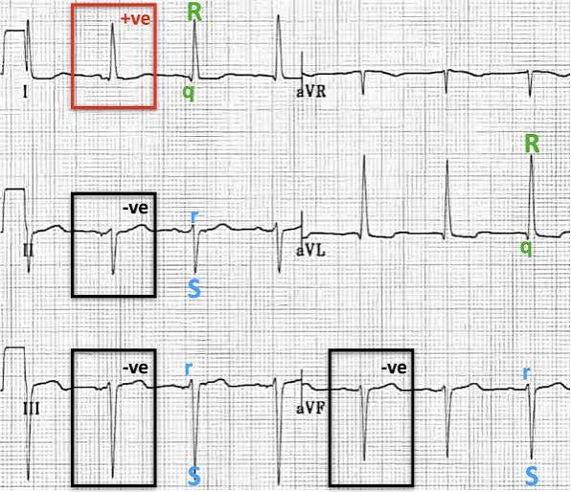

Slide 36
Mechanism of LAFB
Normal conduction-> Activation spreads through both major divisions of the left bundle.
In LAFB→The anterior fascicle is blocked.
→ Activation proceeds mainly through the posteroinferior fascicle
→ Initial activation is directed inferiorly and to the right
→ Later activation spreads toward the left and superior LV
→ Net QRS axis shifts leftward and superiorly.
LAFB does not primarily widen the QRS; it changes the direction of ventricular activation.

Slide 37
ECG Characteristics of LAFB
Left axis deviation
  Usually QRS axis −30° or more negative.
  In more advanced LAFB, the axis may be −45° to −60° or beyond.
Prominent initial inferiorly/rightward vector
  Produces q waves in leads I and aVL.
  Produces r waves in II, III and aVF.
Delayed intrinsicoid deflection
  Particularly in lead aVL.
Slight slurring or irregularity of QRS limbs.
QRS duration is normal or only minimally prolonged.

Slide 38
LAFB: The Classic ECG Pattern
I and aVL → qR
II, III, aVF → rS
Therefore:
qR in I/aVL + rS in inferior leads + LAD = LAFB

Slide 39
LAFB PRODUCE qR IN I AND AVL
Because the initial 20 ms vector is directed inferiorly and to the right.
In I and aVL:
The initial vector moves away from these leads.
→ Initial negative deflection
→ q wave
Then the major QRS forces move toward the left lateral leads.
→ Large positive deflection
→ R wave
Therefore:
I/aVL = qR pattern

Slide 40
LAFB PRODUCE rS IN INFERIOR LEADS?
The initial activation vector is directed inferiorly and to the right.
Therefore, it moves toward the inferior leads.
→ Initial positive deflection
→ r wave
The dominant later forces move superiorly.
→ Terminal negative deflection
→ S wave
Therefore:
II, III, aVF = rS pattern

Slide 41
LAFB: QRS Axis
Normal QRS axis→ Usually approximately −30° to +90°.
LAFB→ The axis shifts superiorly and leftward.
Mild LAFB → approximately −30°
More advanced LAFB → may reach −45° to −60° or more

Slide 42
Important Differential: Left Axis Deviation ≠ LAFB
Causes include:
LAFB
Inferior wall myocardial infarction
Some forms of Wolff–Parkinson–White syndrome
Pacing from the ventricular apex
Ectopic ventricular rhythm from the LV apex
Chronic obstructive airway disease (rare)
Congenital heart disease (endocardial cushion defects,TA,Hypoplastic right ventricle,single ventricle,corrected TGA)
Key point
LAD is not synonymous with LAFB.
The morphology and clinical context must support the diagnosis.

Slide 43
LAFB and LV Hypertrophy
Important diagnostic pitfall
LAFB causes spatial reorientation of QRS forces and can increase QRS amplitudes in the frontal plane.
Therefore:
Diagnosis of LVH using limb-lead voltage criteria becomes more difficult.
The R wave in V6 may be reduced.
LAFB can mask LVH in the chest leads.
This may result in underdiagnosis of LVH.
Clinical message→LAFB can alter QRS voltage enough to interfere with conventional LVH criteria.

Slide 44
Clinical Significance of LAFB
LAFB may occur with:
Ischemic heart disease
Chronic hypertension
Cardiomyopathy
Aortic valve disease
Degenerative conduction system disease

Slide 45
Important concept
Isolated LAFB is not necessarily associated with structural heart disease.
However, in an older patient or a patient with other conduction abnormalities, it may reflect underlying conduction-system fibrosis or structural heart disease.

Slide 46
LEFT POSTERIOR FASCICULAR BOCK

Slide 47
DEFINITION
Conduction delay/block in the posteroinferior division of the left bundle branch
Very rare fascicular block
Activation occurs predominantly through the left anterior fascicle
Produces right axis deviation (RAD)

Slide 48
Why Does LPFB Cause RAD?
Posterior fascicle is blocked
Impulse travels predominantly through the left anterior fascicle
Initial ventricular activation is directed:
  Superiorly
  Leftward
  Toward approximately −50°
Subsequent ventricular activation is directed predominantly:
  Inferiorly
  Rightward
Therefore → Right axis deviation

Slide 49
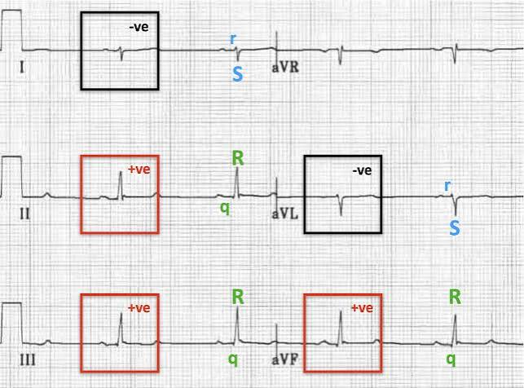

Slide 50
PFB produces:
Right axis deviation of mean frontal-plane QRS axis
Superior and leftward deviation of the initial QRS vector
Secondary repolarization/T-wave changes

Slide 51
Initial QRS Vector in LPFB
Initial QRS vector is directed:
  Superiorly
  To the left
  Approximately −50°
Produces:
  Small q waves in II, III and aVF
  Small initial r wave in lead I
Subsequent dominant forces are directed inferiorly/rightward
Produces tall R waves in inferior leads

Slide 52
Effects on Individual Leads
Lead I & aVL→Predominantly negative QRS →rS complexes
Leads II, III & aVF→Predominantly positive QRS →qR complexes
R wave usually tallest in lead III

Slide 53
Effects on T Wave
LPFB produces secondary repolarization changes
T-wave vector tends to deviate away from the main QRS vector
Maximum T-wave vector is approximately −30°
ECG:
Low-to-inverted T waves in:
  II
  III
  aVF
Upright T wave in lead I

Slide 54
QRS DURATION AND AXIS
QRS duration normal or minimally increased
Right axis deviation
rS complexes in leads I and aVL
qR complexes in leads II, III and aVF
Important
RAD alone is not sufficient for diagnosis
Other causes of RAD must be excluded

Slide 55
Why Is LPFB Rare?
Left posterior fascicle is:
  Short
  Thick
  Relatively well vascularized
Has a dual blood supply
Therefore, it is relatively resistant to ischemic injury
Hence:LAFB is common → LPFB is rare

Slide 56
Clinical Significance of LPFB
Isolated LPFB is very uncommon
Should prompt consideration of underlying cardiac disease
Possible associations:
  Ischemic heart disease
  Myocardial infarction
  Cardiomyopathy
  Conduction-system fibrosis/degeneration

Slide 57
LPFB + RBBB
BIFASCICULAR BLOCK
RBBB → right bundle affected
LPFB → left posterior fascicle affected
Remaining major pathway:
  Left anterior fascicle
Clinical importance:
Indicates more extensive conduction-system disease
May progress to advanced AV block/complete heart block
Particularly important in patients with structural heart disease

Slide 58
LEFT SEPTAL FASCICULAR BLOCK

Slide 59
DEFINITION
Delay/block in conduction through the left septal fascicle
Affects early septal activation
Septal activation normally contributes to the initial 35–40 ms of QRS
Overall QRS duration may remain normal or minimally increased

Slide 60
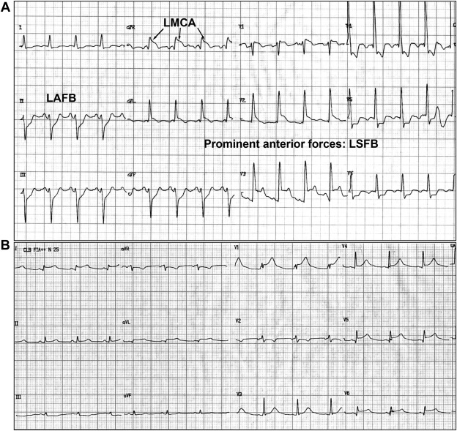

Slide 61
ECG Effects of LSFB
Loss of normal septal q waves
Prominent anterior forces
Prominent R waves in V1–V3
Attenuated S waves in right precordial leads
QRS axis usually normal
QRS duration usually normal/minimally increased

Slide 62
Criteria for LSFB
Causes/Associations of LSFB
May be associated with:
Coronary artery disease
Cardiomyopathy
Diabetes mellitus
Chagas disease
QRS duration normal or minimally increased
Normal QRS axis
Prominent R waves in V1–V3
Loss of septal q waves
Initial q waves in V1 and V2
Important→Diagnosis of exclusion
Other causes of prominent R waves in V1–V3 must be excluded

Slide 63
mcq
A patient has an ECG showing QRS duration of 92 ms, QRS axis of −55°, qR complexes in leads I and aVL, and rS complexes in II, III and aVF. Which conduction abnormality is most likely?
A. Left posterior fascicular block
B. Left anterior fascicular block
C. Right bundle branch block
D. Left septal fascicular block
Answer: B. Left anterior fascicular block

Slide 64
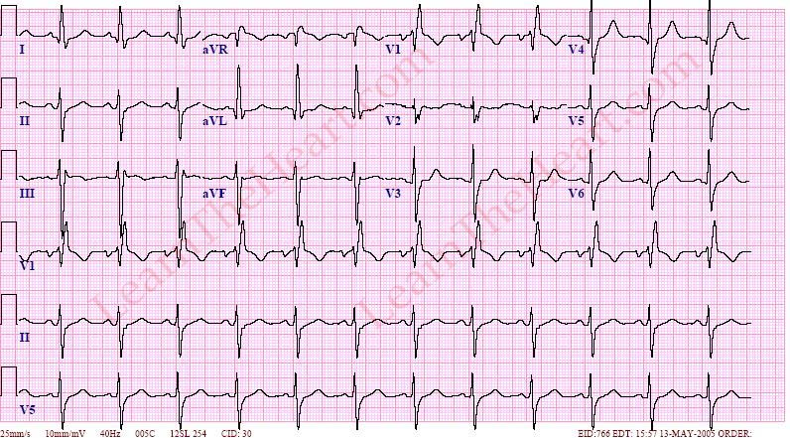
MCQ
A 72-year-old man with previous anterior MI has an ECG showing:
QRS duration 132 ms
rsR′ in V1
Broad S wave in V6
QRS axis −55°
rS complexes in II, III and aVF
qR complexes in I and aVL
What is the diagnosis?
RBBB alone
LBBB
RBBB + LPFB
RBBB + LAFB
LAFB alone
ANS→RBBB + LAFB

Slide 65
MCQ
A 58-year-old patient has isolated RAD with suspected LPFB. Which anatomical feature makes isolated LPFB relatively uncommon?
A. Posterior fascicle is long and thin
B. Posterior fascicle has a single blood supply
C. Posterior fascicle is short, thick and has dual blood supply
D. Posterior fascicle is supplied only by the LAD
E. Posterior fascicle has no anastomoses
Answer: C. Posterior fascicle is short, thick and has dual blood supply

Slide 66
MCQ
A 55-year-old man has an ECG showing prominent R waves in V1–V3. There is no obvious RVH. QRS duration is 90 ms.
Which of the following is least likely to be a cause?
A. Posterior myocardial infarction
B. RBBB
C. Left septal fascicular block
D. Wolff-Parkinson-White syndrome
E. Anterior myocardial infarction
Answer: E. Anterior myocardial infarction

Slide 67
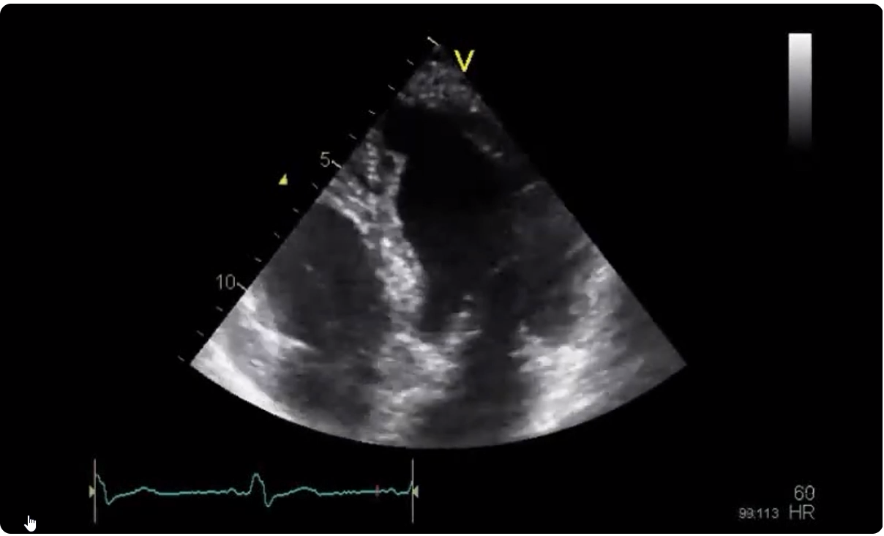
MCQ
A patient with complete LBBB undergoes echocardiography. Which ECG conduction abnormality explains the FINDING?
A. Early left-to-right septal activation
B. Delayed right-to-left septal activation
C. Simultaneous activation of both ventricles
D. Isolated delayed RV activation
E. Accelerated LV activation
Answer: B. Delayed right-to-left septal activation

Slide 68
MCQ
A 78-year-old man presents with recurrent unexplained syncope. ECG shows:
Complete RBBB
LAFB
PR 220 ms
What is the major clinical concern?
A. Acute pericarditis
B. Progression to high-grade AV block
C. Development of atrial fibrillation
D. Development of WPW
E. Acute myocarditis in all cases
Answer: B. Progression to high-grade AV block

Slide 69
TRIFASCICULAR BLOCK
RBBB+LAFB+1ST DEGREE HB
RBBB+LPFB+1ST DEGREE HB
RBBB+ALTERNATING LAFB/LPFB
LBBB + 1ST DEGREE HB
ALTERNATING LBBB AND RBBB

Slide 70
THANK YOU

