Slide 1

The CARE Trial: Pravastatin in Post-MI Patients with Average Cholesterol
Cholesterol and Recurrent Events (CARE) Trial — New England Journal of Medicine, October 3, 1996, Volume 335, Number 14
Sacks FM, Pfeffer MA, Moye LA, et al. | Brigham and Women's Hospital / Harvard Medical School

Slide 2
CHAPTER 1
Background & Rationale
Why the most common post-MI patient was being undertreated — and what CARE set out to prove.

Slide 3
The Clinical Problem: Coronary Disease in Average-Cholesterol Patients
The Gap in Evidence
The Clinical Reality
Prior to CARE, all major cholesterol-lowering trials focused exclusively on patients with elevated LDL cholesterol. This approach was logical — the relation between blood cholesterol and coronary events is stronger at elevated rather than average levels, and event rates are higher.
However, this left the majority of post-MI patients without evidence-based lipid-lowering guidance.
The large majority of patients with coronary artery disease have cholesterol levels that are — like those of the general population — in the average, not elevated, range.
The Unanswered Question
Could cholesterol-lowering therapy prevent recurrent coronary events in post-MI patients who are not hypercholesterolemic?

Slide 4
CHAPTER 2
Study Design & Methods

Slide 5
Trial Design Overview
Core Design
Randomized, double-blind, placebo-controlled trial — pravastatin 40 mg once daily vs matching placebo. Duration: 5 years (median follow-up 5.0 years; range 4.0–6.2 years).
Randomization & Follow-up
Stratified by clinical center; assignment via telephone call to data center. Post-randomization: quarterly clinic visits; lipid levels measured at baseline, 6 and 12 weeks, quarterly in year 1, then semiannually.

Slide 6
Patient Eligibility Criteria
Demographics & MI Requirements
Lipid Inclusion Criteria
Population: Men and postmenopausal women with documented acute MI
Age: 21–75 years
MI timing: Acute MI 3–20 months before randomization
MI confirmation: Typical symptoms + elevated serum creatine kinase
Plasma total cholesterol: <240 mg/dL
LDL cholesterol: 115–174 mg/dL
Fasting triglycerides: <350 mg/dL
Fasting glucose: ≤220 mg/dL
Lipid Measurement Protocol
Cardiac Criteria
Lipid values were averaged from 2–3 clinic visits occurring ≥8 weeks post-MI hospitalization,— ensuring stable, representative baseline values.
Left ventricular ejection fraction ≥25%
No symptomatic congestive heart failure
Key Exclusions
Symptomatic CHF
LVEF <25%
Triglycerides ≥350 mg/dL

Slide 7
Baseline Patient Characteristics
A total of 4,159 patients were enrolled — 2,078 placebo; 2,081 pravastatin. The characteristics of both groups before randomization were similar, confirming successful randomization.

Slide 8
Primary & Secondary Endpoints Defined
Primary Endpoint
Secondary Endpoints
Fatal coronary heart disease (CHD) OR confirmed nonfatal myocardial infarction.
Components of fatal CHD: Fatal MI (definite or probable), sudden death, death during coronary intervention, other coronary death. Nonfatal MI required core laboratory confirmation via serum creatine kinase.
Coronary artery bypass grafting (CABG)
Percutaneous transluminal coronary angioplasty (PTCA)
Stroke
Unstable angina
All-cause mortality
Cancer incidence
Subgroup Composite
"Major coronary events" = fatal CHD + nonfatal MI + CABG + PTCA.

Slide 9
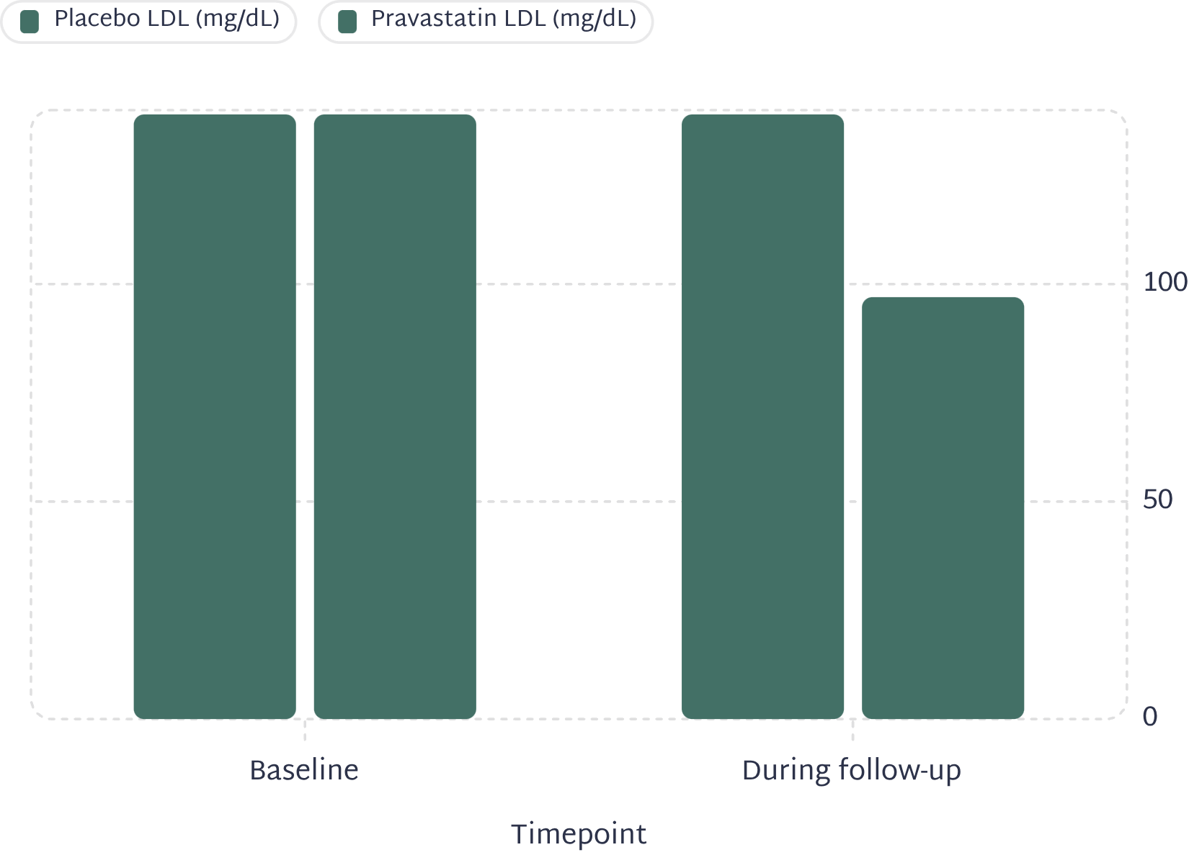
Lipid Changes During Treatment
Pravastatin produced robust, sustained lipid lowering maintained throughout the 5-year follow-up — no evidence of tachyphylaxis or waning effect over time.
Key Lipid Changes vs. Placebo
LDL cholesterol: ↓32% (139 → 97–98 mg/dL); 28% lower than placebo during follow-up
Total cholesterol: ↓20% vs. placebo (P<0.001)
HDL cholesterol: ↑5% vs. placebo (P<0.001)
Triglycerides: ↓14% vs. placebo (P<0.001)

Slide 10
CHAPTER 3
Results

Slide 11
Table 2: All Cardiovascular Events by Study Group
Pravastatin significantly reduced all major coronary endpoints. Unstable angina and fatal CHD alone did not reach individual statistical significance.
Event | Placebo N (%) | Pravastatin N (%) | Risk Reduction (95% CI) | P value
Fatal CHD or Nonfatal MI (Primary) | 274 (13.2%) | 212 (10.2%) | 24% (9–36%) | 0.003
Death from CHD | 119 (5.7%) | 96 (4.6%) | 20% (−5 to 39%) | 0.10
Nonfatal MI | 173 (8.3%) | 135 (6.5%) | 23% (4–39%) | 0.02
Fatal MI | 38 (1.8%) | 24 (1.2%) | 37% (−5 to 62%) | 0.07
Fatal MI or confirmed nonfatal MI | 207 (10.0%) | 157 (7.5%) | 25% (8–39%) | 0.006
Clinical nonfatal MI | 231 (11.1%) | 182 (8.7%) | 23% (6–36%) | 0.01
CABG | 207 (10.0%) | 156 (7.5%) | 26% (8–40%) | 0.005
PTCA | 219 (10.5%) | 172 (8.3%) | 23% (6–37%) | 0.01
CABG or PTCA | 391 (18.8%) | 294 (14.1%) | 27% (15–37%) | <0.001
Unstable angina | 359 (17.3%) | 317 (15.2%) | 13% (−1 to 25%) | 0.07
Stroke | 78 (3.8%) | 54 (2.6%) | 31% (3–52%) | 0.03

Slide 12
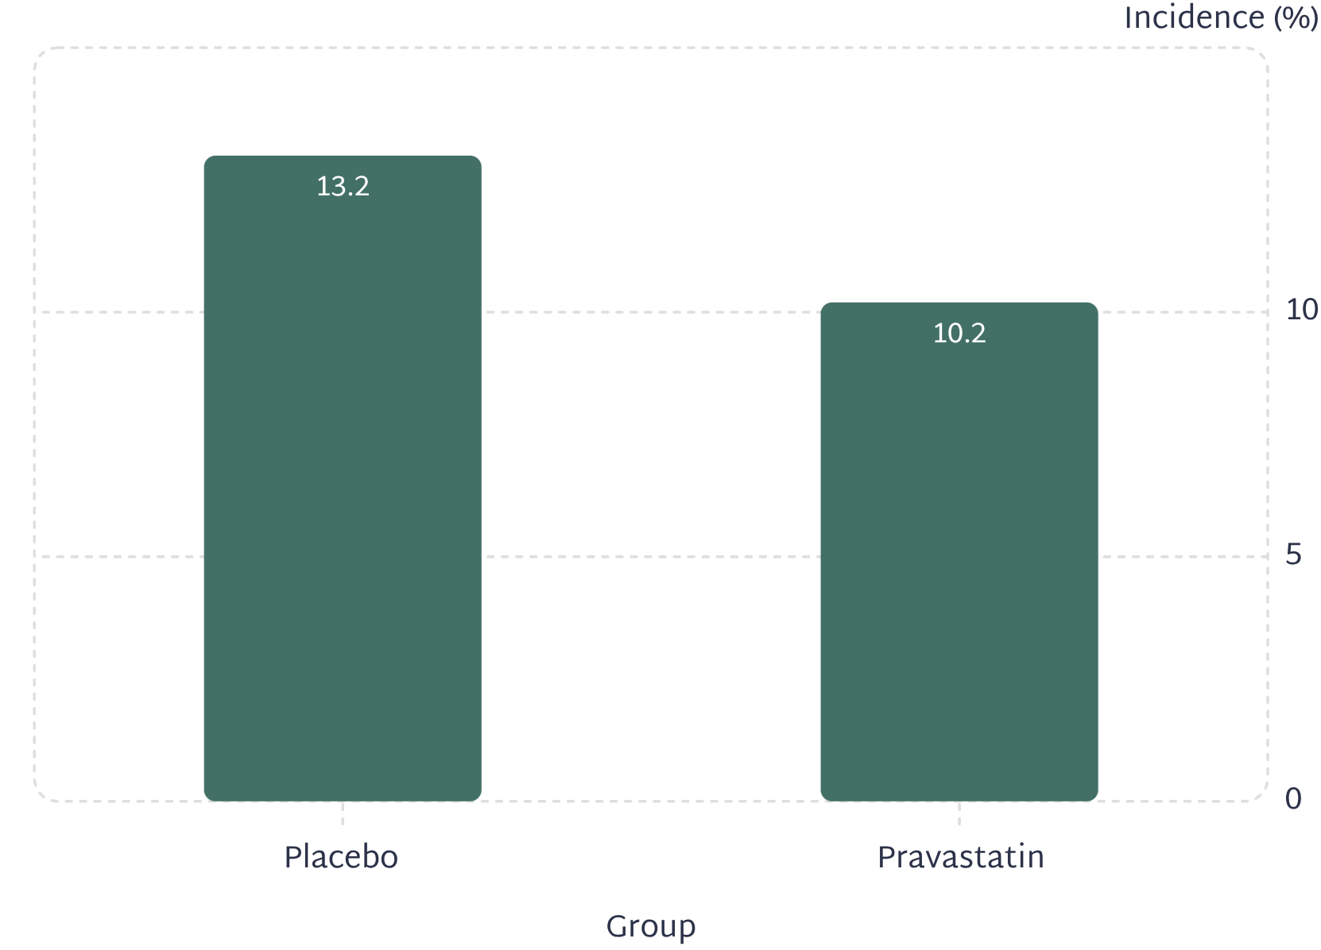
Primary Endpoint: 24% Reduction in Fatal CHD or Nonfatal MI
Primary Outcome at a Glance
Pravastatin group: 212 patients (10.2%) experienced the primary endpoint.
Placebo group: 274 patients (13.2%) experienced the primary endpoint.
Absolute risk reduction: 3.0 percentage points
Relative risk reduction: 24% (95% CI: 9–36%; P=0.003)
Nonfatal MI Alone
Fatal MI Alone
Fatal CHD Alone
Total MI (Fatal + Confirmed Nonfatal)
135 (6.5%) vs. 173 (8.3%) — 23% RRR (P=0.02)
24 (1.2%) vs. 38 (1.8%) — 37% RRR (P=0.07, NS)
96 (4.6%) vs. 119 (5.7%) — 20% RRR (P=0.10, NS)
157 (7.5%) vs. 207 (10.0%) — 25% RRR (P=0.006)

Slide 13
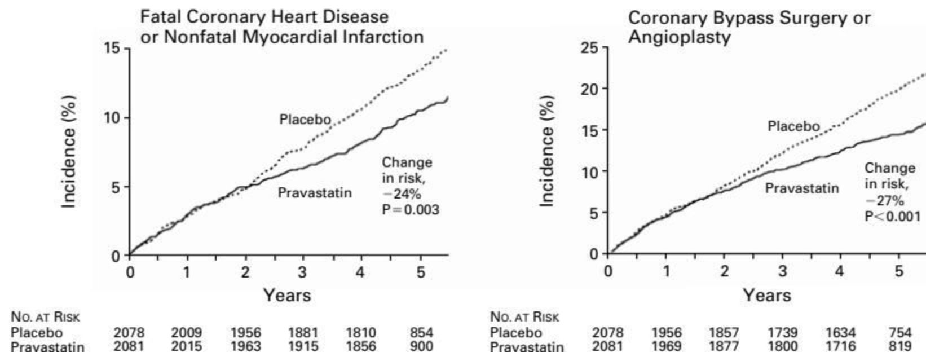

Figure 1: Kaplan-Meier Curves — Coronary Event Incidence Over 5 Years
Left Panel — Primary Endpoint (Fatal CHD or Nonfatal MI)
Right Panel — CABG or Angioplasty
Pravastatin (solid line) consistently below placebo (dotted line) from year 1 onward. 24% risk reduction, P=0.003.
Pravastatin group diverges from placebo progressively over 5 years. 27% risk reduction, P<0.001.
Curve separation begins within the first year and widens progressively — indicating early onset and sustained duration of benefit from pravastatin therapy.

Slide 14
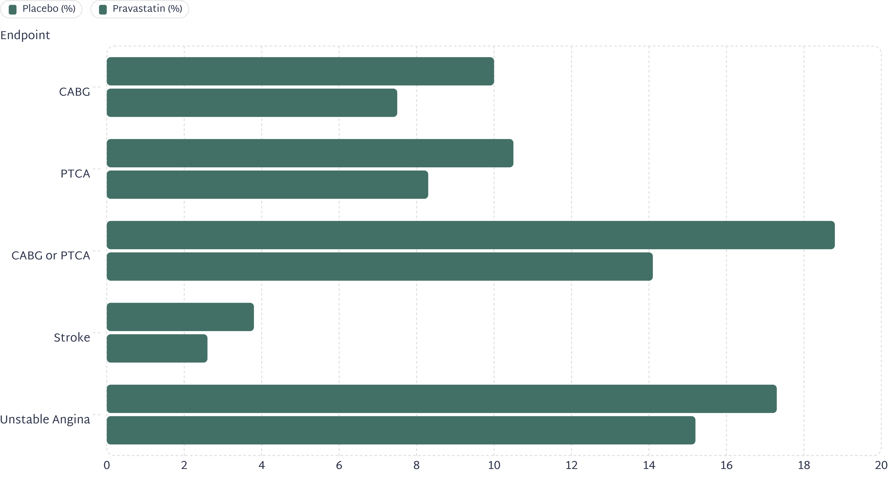
Secondary Endpoints: Revascularization & Stroke
CABG: ↓26%
PTCA: ↓23%
CABG+PTCA: ↓27%
Stroke: ↓31%
156 (7.5%) vs. 207 (10.0%) — 95% CI: 8–40%; P=0.005
172 (8.3%) vs. 219 (10.5%) — 95% CI: 6–37%; P=0.01
294 (14.1%) vs. 391 (18.8%) — 95% CI: 15–37%; P<0.001
54 (2.6%) vs. 78 (3.8%) — 95% CI: 3–52%; P=0.03

Slide 15
All-Cause Mortality & Non-Cardiovascular Deaths
All-Cause Mortality
Breakdown of Non-Coronary Deaths
180 deaths in pravastatin group vs. 196 deaths in placebo group.
9% RRR (95% CI: −12 to 26%; P=0.37) — not statistically significant.
Cause | Pravastatin | Placebo
Non-coronary CV deaths | 16 | 11
Cancer deaths | 49 | 45
Violent deaths | 8 | 4
Other causes | 11 | 15
No significant differences in any non-cardiovascular cause of death between groups.

Slide 16
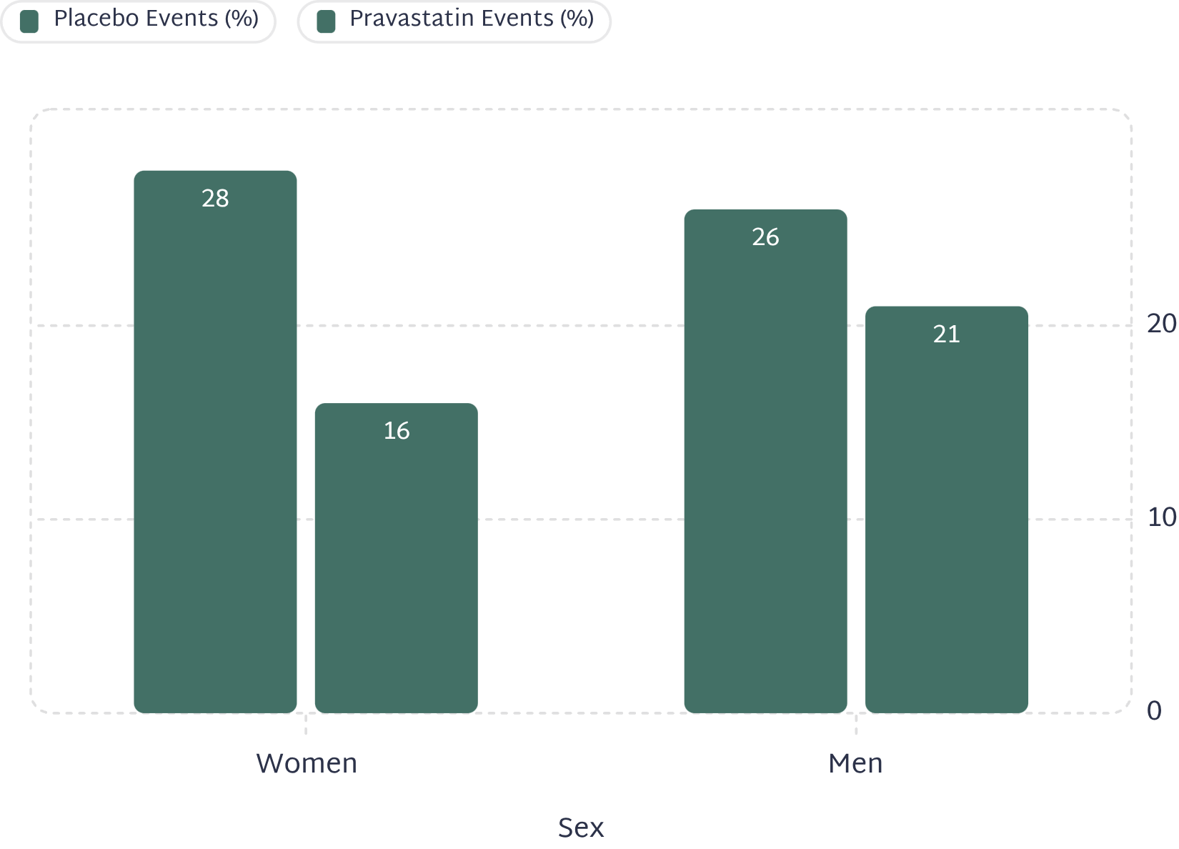
Effect by Sex: Women Benefit More Than Men
Sex-Specific Risk Reductions
Women (n=576): 46% RRR in major coronary events (80 vs. 46 events; P=0.001)
Men (n=3,583): 20% RRR in major coronary events (469 vs. 384 events; P=0.001)

Slide 17
Effect by Age: Older Patients Benefit More
Age <60 Years (n=2,030)
Age ≥60 Years (n=2,129)
20% RRR in major coronary events
258 placebo vs. 217 pravastatin events (P=0.02)
27% RRR in major coronary events
291 placebo vs. 213 pravastatin events (P<0.001)

Slide 18


Effect by Comorbidities: Diabetes, Hypertension, Smoking
Hypertension Present (n=1,774)
Diabetes Present (n=586)
Current Smokers (n=671)
23% RRR — 263 placebo vs. 200 pravastatin events (P=0.005)
Hypertension absent (n=2,385): 24% RRR — 286 vs. 230 events (P=0.002)
25% RRR — 112 placebo vs. 81 pravastatin events (P=0.05)
Diabetes absent (n=3,573): 23% RRR — 437 vs. 349 events (P<0.001)
33% RRR — 111 placebo vs. 81 pravastatin events (P=0.006)
Non-current smokers (n=3,488): 22% RRR — 437 vs. 349 events (P<0.001)
Benefit was consistent across all comorbidity subgroups — all interaction P-values >0.10. Pravastatin was effective regardless of the presence of traditional cardiovascular risk factors.

Slide 19
Effect by Cardiac Function: LVEF & Prior Revascularization
Left Ventricular Function
Prior Revascularization
LVEF ≤40% (n=706): 28% RRR (112 vs. 84 events; P=0.02) — benefit preserved even with impaired LV function
LVEF >40% (n=3,453): 23% RRR (436 vs. 346 events; P<0.001)
Prior CABG : 22% RRR (116 vs. 88 events; P=0.08, NS)
No prior CABG: 25% RRR (433 vs. 342 events; P<0.001)
Prior PTCA : 25% RRR (188 vs. 153 events; P=0.009)
No prior PTCA : 23% RRR (361 vs. 277 events; P<0.001)
Patients with impaired LVEF had previously been considered uncertain candidates for lipid-lowering therapy — CARE demonstrated clear benefit in this subgroup.

Slide 20
Effect by MI Type & Lipid Levels
By MI Type
By LDL at Median Split
Q-wave MI (n=2,556): 27% RRR (334 vs. 251 events; P<0.001)
Non-Q-wave MI (n=1,600): 19% RRR (215 vs. 179 events; P=0.04)
LDL ≤137 mg/dL: 23% RRR (269 vs. 210 events; P=0.004)
LDL >137 mg/dL: 24% RRR (280 vs. 220 events; P=0.002)
By Triglyceride Level
By Total Cholesterol
Triglycerides <144 mg/dL: 32% RRR (281 vs. 195 events; P<0.001)
Triglycerides ≥144 mg/dL: 15% RRR (268 vs. 235 events; P=0.07, NS)
Total cholesterol ≤209 mg/dL: 19% RRR (260 vs. 211 events; P=0.02)
Total cholesterol >209 mg/dL: 27% RRR (289 vs. 219 events; P<0.001)

Slide 21
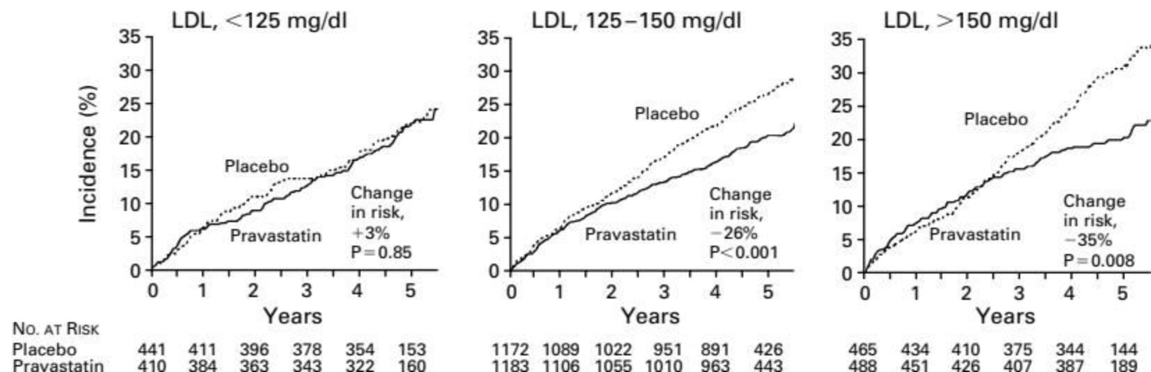
Figure 2: LDL Threshold Effect — Coronary Events by Baseline LDL Subgroup
LDL >150 mg/dL (n=953)
LDL 125–150 mg/dL (n=2,355)
LDL <125 mg/dL (n=851)
35% RRR in major coronary events (145 vs. 102 events; P=0.008)
26% RRR in major coronary events (311 vs. 239 events; P<0.001)
−3% (no benefit; 93 vs. 89 events; P=0.85)
Interaction P=0.03 (statistically significant). Clinical implication: LDL ~125 mg/dL may represent an approximate lower boundary below which cholesterol-lowering therapy provides no additional coronary benefit — a hypothesis later challenged by PROVE-IT and TNT.

Slide 22
Clinical Impact & Discussion

Slide 23
Stroke Reduction: An Important Secondary Finding
CARE Stroke Result
Mechanistic Evidence
Stroke was a pre-specified secondary endpoint —
31% reduction in stroke with pravastatin (54 vs. 78 events; P=0.03)
. CARE provided the first prospective evidence in average-cholesterol patients.
Carotid ultrasound studies showed pravastatin and lovastatin slowed progression of carotid atherosclerosis — consistent with the clinical stroke reduction observed. CARE supports the hypothesis that elevated LDL is a treatable cause of cerebrovascular atherosclerosis, even at average levels.

Slide 24
The LDL Threshold: Clinical Implications
The CARE Finding
Clinical Implication (1996)
Patients with LDL <125 mg/dL showed no benefit (and a non-significant 3% increase in events) — suggesting a floor effect. The reduction in coronary events with pravastatin was strongly influenced by baseline LDL: 35% RRR (LDL >150), 26% RRR (LDL 125–150), −3% (LDL <125). Interaction P=0.03.
Pravastatin should be prioritized in post-MI patients with LDL ≥125 mg/dL. Benefit is greatest with LDL >150 mg/dL.
Later Revision
This threshold concept was subsequently challenged by PROVE-IT (2004) and TNT (2005), which demonstrated benefit of intensive LDL lowering to <70 mg/dL — suggesting the threshold may be considerably lower than CARE indicated.

Slide 25
CHAPTER 7
Limitations & Legacy
What CARE could not prove, where it fell short — and how it shaped the next two decades of cardiovascular medicine.

Slide 26


Study Limitations
No Mortality Benefit Demonstrated
Subgroup Power Limitations
All-cause mortality reduction was 9% (P=0.37). The trial was not powered to detect a mortality difference .
The trial was not adequately powered to assess the primary endpoint within individual subgroups. Consequently, the broader "major coronary events" composite was used for subgroup analyses, reducing specificity and complicating direct comparisons.
LDL Threshold Not Definitive
Demographics & Single-Agent Design
The finding of no benefit below LDL 125 mg/dL was based on a subgroup analysis and was explicitly described as requiring confirmation.
86% male, 92–93% white — limited generalizability to women and non-white populations. Results are specific to pravastatin 40 mg .

Slide 27
The CARE Trial's Legacy in Cardiovascular Medicine
Landmark Impact
Trials Built on CARE
CARE extended the indication for statin therapy from hypercholesterolemic patients to the much larger population of post-MI patients with average cholesterol levels — the majority of survivors of myocardial infarction.
This gave "new importance to cholesterol-lowering therapy by demonstrating a significant reduction in the incidence of coronary events in patients with cholesterol levels of less than 240 mg per deciliter."
01
LIPID (1998)
Pravastatin in broader cholesterol range post-MI/unstable angina — confirmed CARE findings and extended them
02
Guideline Impact
PROVE-IT (2004)
Directly contributed to ACC/AHA recommendations for universal statin therapy in post-MI patients regardless of baseline LDL.
Helped establish the concept that absolute cardiovascular risk, not just cholesterol level, should guide treatment decisions.
Intensive (atorvastatin 80 mg) vs. moderate (pravastatin 40 mg) — showed benefit of lower LDL targets, challenging CARE's threshold
03
TNT (2005)
Atorvastatin 80 mg vs. 10 mg — established "lower is better" for LDL in stable CAD

Slide 28
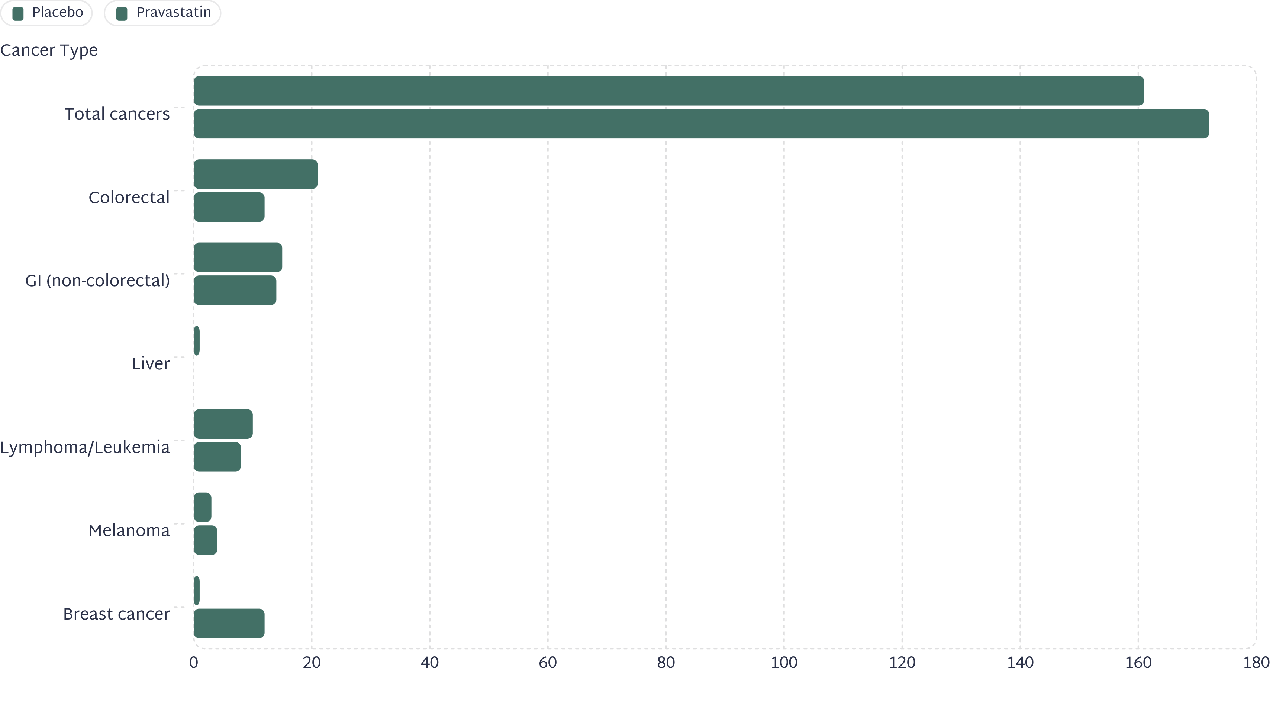
Cancer Incidence by Site: Pravastatin vs. Placebo
No significant increase in overall cancer incidence with pravastatin — allaying concerns raised by animal carcinogenicity studies. Breast cancer signal (12 vs. 1; P=0.002) was the only statistically significant site-specific difference, and was not replicated in the LIPID trial. Colorectal cancer was numerically lower in the pravastatin group (12 vs. 21) — consistent with later data suggesting a possible protective effect.

Slide 29
1
Average cholesterol ≠ safe cholesterol in post-MI patients
CARE proved that LDL 115–174 mg/dL still confers significant recurrent event risk that is modifiable with pravastatin. "Average" values remain pathologically elevated in the context of established CAD.
2
Pravastatin 40 mg → 24% RRR; NNT ≈ 33
Absolute risk reduction of 3 percentage points over 5 years. Approximately 33 patients need to be treated to prevent one primary event — a clinically meaningful number given the safety profile.
3
Women benefit more than men (46% vs. 20% RRR)
Pravastatin is effective and should not be withheld from post-MI women. The sex-by-treatment interaction was statistically significant (P=0.05).
4
LDL threshold ~125 mg/dL; stroke also reduced by 31%
Below LDL 125 mg/dL, no significant benefit was observed in CARE (though later trials challenged this). Additionally: statins have cerebrovascular benefits that extend beyond coronary protection — a prospectively confirmed finding in CARE.
5
CARE + 4S + WOSCOPS = statin foundation
Together these three trials established statins as the cornerstone of cardiovascular secondary and primary prevention — a paradigm that persists and has been refined but never overturned.

Slide 30
THANK YOU

