Slide 1
Cardiovascular Embryology Part 1
Dr Jerin K John

Slide 2
Steps in the Embryology of the Cardiovascular System
EARLY DEVELOPMENT OF EMBRYO
ESTABLISHMENT OF THE CARDIOGENIC FIELD
FORMATION AND POSITION OF THE HEART TUBE
FORMATION OF THE CARDIAC LOOP
DEVELOPMENT OF THE SINUS VENOSUS
FORMATION OF THE CARDIAC SEPTAE
FORMATION OF THE CONDUCTING SYSTEM OF THE HEART
VASCULAR DEVELOPMENT

Slide 3
Chronology of events
Day 0 – fertilization and initiation of embryogenesis
Week 1 – blastocyst formation and implantation
Week 2 – formation of bilaminar germ disc (epiblast and hypoblast)
Week3 – formation of trilaminar germ disc (gastrulation)
Mid week 3 – heart begins to form
Week 4 – cardiac looping begins
Mid week 4 – development of sinus venosus
Week 4-5 – development of cardiac septae, development of aortic arches, development of arterial and venous system begins.

Slide 4
1st week of development
Day 0 – fertilization
Day 1 – zygote formation
Day 2 – 2 cell stage (30 hrs)
Day 2 – 4 cell stage (40 hrs)
Day 3 – 16 cell stage
Day 4 – morula (32 cell stage)
Day 5 – blastocyst (inner cell mass-embryoblast and outer cell mass-trophoblast)
Day 6 – implantation

Slide 5
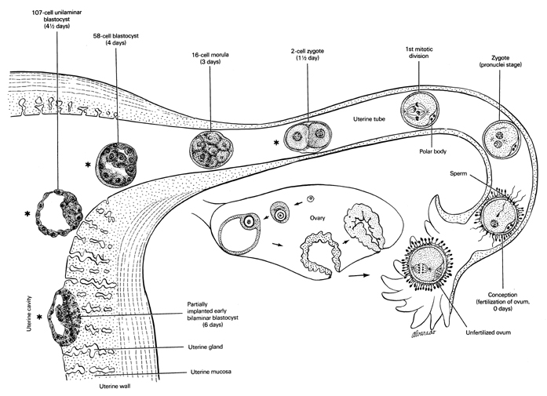

Slide 6
2nd week of development
Week of TWOs:
The trophoblast differentiates into 2 layers,
  cytotrophoblast
  Syncytiotrophoblast
The embryoblast forms 2 layers,
  epiblast
  hypoblast.
The extraembryonic mesoderm splits into 2 layers,
  Somatopleural
  splanchnopleural
2 cavities,
  amniotic cavity
  yolk sac cavity
Beginning of uteroplacental circulation

Slide 7
3rd week of development
Formation of trilaminar germ disc (Gastrulation)
  Ectoderm
  Mesoderm
  Endoderm
Appearance of primitive streak
Formation of notochord
Formation of oropharyngeal and cloacal menbrane
Establishment of body axes
Further development of trophoblast – appearance of tertiary chorionic villi

Slide 8
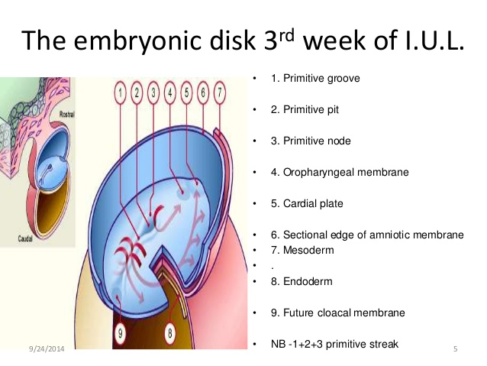

Slide 9
ESTABLISHMENT OF THE CARDIOGENIC FIELD

Slide 10
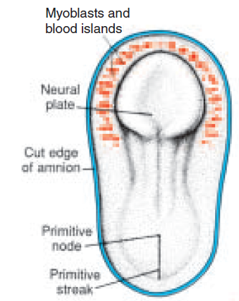
Dorsal view of a late presomite embryo (approx. 18 days) after removal of the amnion.
Human heart starts to develop in middle of 3rd week of embryonic life.
Till then, its needs are met by simple diffusion.
Cardiac progenitor cells lie in the epiblast, immediately adjacent to cranial end of primitive streak.
From there, they migrate through the streak into splanchnic layer of lateral plate mesoderm.
To form horseshoe shaped cluster of cells – primary heart field (PHF)

Slide 11
Transverse section showing position of the blood islands in splanchnic mesodermal layer.
Cells in PHF are induced by the underlying pharyngeal endoderm to form cardiac myoblasts.
With time, the islands unite and form a horseshoe-shaped endothelial-lined tube surrounded by myoblasts.
This region is known as the cardiogenic field.
PHF is specified on both sides from lateral to medial to become atria, LV and most of RV.

Slide 12
Cephalocaudal section showing the position of the pericardial cavity and cardiogenic field.
Intraembryonic cavity over cardiogenic field later develops into the pericardial cavity
In addition to the cardiogenic region, other blood islands appear bilaterally, parallel and close to the midline of the embryonic shield.
These islands form a pair of longitudinal vessels, the dorsal aortae.

Slide 13
Cardiac Precursor Cells
Derived from 4 sources :
Primary heart field (PHF)
Secondary heart field (SHF)
Cardiac neural crest cells (CNC)
Proepicardium

Slide 14
Secondary Heart Field
Appears slightly late around days 20-21.
Resides in splanchnic mesoderm, ventral to posterior pharynx.
SHF forms part of RV and outflow tract (conus cordis and truncus arteriosus) .

Slide 15
Cardiac Neural Crest Cells
Neural crest cells, originate in the edges of the neural folds in the hindbrain region.
Migrate through pharyngeal arches 3, 4, and 6 to the outflow region of the heart and contribute to endocardial cushion formation in both the conus cordis and truncus arteriosus.
They also contribute to the formation of semilunar valves.
Also contribute smooth muscle cells along the proximal segments of coronary arteries.
Since neural crest cells also contribute to craniofacial development, it is not uncommon to see facial and cardiac abnormalities in the same individual.

Slide 16
Proepicardium
Mesothelial cells on the surface of the septum transversum form the proepicardium near the sinus venosus and migrate over the heart to form most of the epicardium.
Responsible for formation of coronary arteries, including their endothelial lining and smooth muscle.

Slide 17
FORMATION AND POSITION OF THE HEART TUBE
Two processes responsible for positioning of the heart :
Folding of the embryo in a cephalocaudal direction
Folding of the embryo in a lateral direction

Slide 18
Cephalocaudal Folding
Initially, cardiogenic area is anterior to the oropharyngeal membrane and the neural plate.
Rapid cephalad growth of CNS extends it over the central cardiogenic area.
Because of cephalic folding of the embryo, the oropharyngeal membrane is pulled forward.
The heart and pericardial cavity move first to the cervical region and finally to the thorax
Figures showing effects of the rapid growth of the brain on positioning of the heart.
A. 18 days. B. 20 days. C. 21 days. D. 22 days

Slide 19
Lateral folding of the embryo
Due to lateral folding, the pair of endothelial tubes merge except at their caudalmost ends.
Simultaneously, the crescent part of the horseshoe-shaped area expands to form the future outflow tract and ventricular regions.
Thus, the heart becomes a continuous expanded tube consisting of an inner endothelial lining and an outer myocardial layer.
It receives venous drainage at its caudal pole and begins to pump blood out of the first aortic arch into the dorsal aorta at its cranial pole.

Slide 20
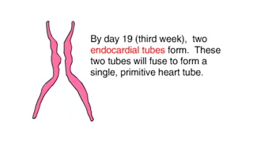
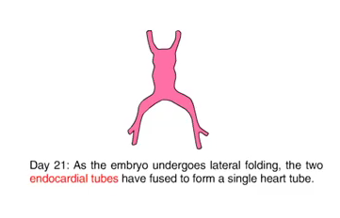
Lateral folding of the embryo
Notes:
the caudal regions of the paired cardiac primordia merge except at their
caudalmost ends. Simultaneously, the crescent part of the horseshoe-shaped
area expands to form the future outflow tract and ventricular regions. Thus, the
heart becomes a continuous expanded tube consisting of an inner endothelial
lining and an outer myocardial layer. It receives venous drainage at its caudal
pole and begins to pump blood out of the first aortic arch into the dorsal aorta
at its cranial pole

Slide 21
Development of layers of myocardium
During these events, the myocardium thickens and secretes a thick layer of extracellular matrix, rich in hyaluronic acid, that separates it from the endothelium called cardiac jelly.
In addition, mesothelial cells on the surface of the septum transversum form the proepicardium near the sinus venous and migrate over the heart to form most of the epicardium.
The remainder of the epicardium is derived from mesothelial cells originating in the outflow tract region.

Slide 22
Thus, the heart tube consists of three layers:
  Endocardium – forming the internal lining of the tube;
  Myocardium – forming the muscular wall;
  Epicardium or visceral pericardium – covering the outside of the tube.
This epicardium is responsible for formation of the coronary arteries, including their endothelial lining and smooth muscle.

Slide 23
Development of Pericardium
The developing heart tube bulges more and more into the pericardial cavity.
Initially, the tube remains attached to the dorsal side of pericardial cavity by the dorsal mesocardium.
No ventral mesocardium is ever formed.
With further development, the dorsal mesocardium disappears, creating the transverse pericardial sinus, which connects both sides of pericardial cavity.
The heart is now suspended in the cavity by blood vessels at its cranial and caudal poles

Slide 24
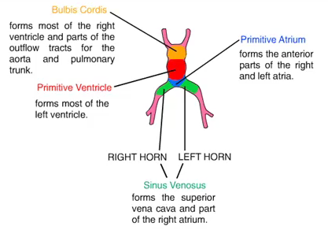
Formation of the Cardiac Loop
The heart tube starts to bend on day 23.
The cephalic portion of the tube bends ventrally, caudally, and to the right .
The atrial (caudal) portion shifts dorsocranially and to the left.
This bending creates the cardiac loop which is complete by day 28

Slide 25
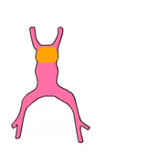
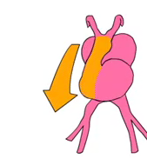

Bulbus Cordis

Slide 26
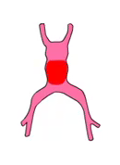
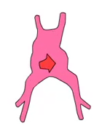
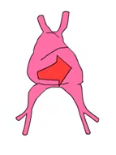
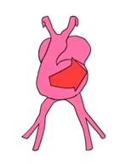
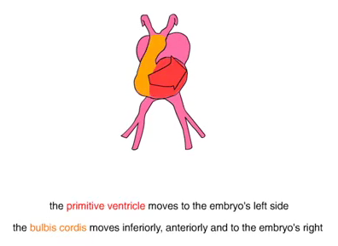
Primitive Ventricle

Slide 27
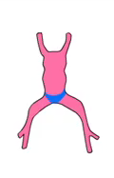
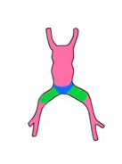
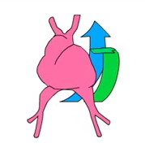
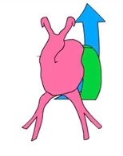
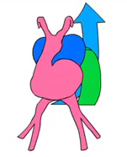
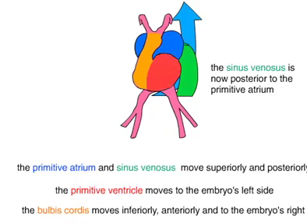
The Primitive Atrium and Sinus Venosus

Slide 28
The bulbus cordis develops 3 divisions :
  Proximal part – forms the trabeculated part of RV.
  Midportion (conus cordis) – forms the outflow tracts of both ventricles.
  Distal part (truncus arteriosus) – forms the roots and proximal portion of the aorta and pulmonary artery.
The junction between the primitive ventricle and the bulbus cordis (bulboventricular sulcus) remains narrow. It is called the primary interventricular foramen .

Slide 29
The smooth walled heart tube begins to form primitive trabeculae proximal and distal to the primary interventricular foramen.
The bulbus temporarily remains smooth walled.
The primitive ventricle, which is now trabeculated, is called the primitive LV.
Likewise, the trabeculated proximal third of the bulbus cordis may be called the primitive RV.

Slide 30
The atrial portion, initially a paired structure outside the pericardial cavity, forms a common atrium and is incorporated into the pericardial cavity.
The AV junction remains narrow and forms the AV canal, which connects the common atrium and the early embryonic ventricle
The conotruncal portion, initially on the right side, shifts gradually to a more medial position due to formation of 2 transverse dilations of the atrium, bulging on each side of the bulbus cordis .

Slide 31
Development of the Sinus Venosus
In mid 4th week, the sinus venosus receives venous blood from the right and left sinus horns.
Each horn receives blood from 3 important veins:
  vitelline or omphalomesenteric vein,
  umbilical vein,
  common cardinal vein.
Entrance of the sinus shifts to the right primarily caused by left-to-right shunts of blood occuring in the venous system.
The right horn, now the only communication between the original SV and the atrium, is incorporated into the RA.
Notes:
In the middle of the fourth week, the sinus venosus receives venous blood
from the right and left sinus horns (Fig. 11.10A). Each horn receives blood
from three important veins: (a) the vitelline or omphalomesenteric vein,
(b) the umbilical vein, and (c) the common cardinal vein. At first communication
between the sinus and the atrium is wide. Soon, however, the entrance
of the sinus shifts to the right (Fig. 11.10B). This shift is caused primarily by
left-to-right shunts of blood, which occur in the venous system during the fourth
and fifth weeks of development.
With obliteration of the right umbilical vein and the left vitelline vein during
the fifth week, the left sinus horn rapidly loses its importance (Fig. 11.10B).
When the left common cardinal vein is obliterated at 10 weeks, all that remains
of the left sinus horn is the oblique vein of the left atrium and the coronary
sinus (Fig. 11.11).

Slide 32
Development of Venous Valves
The sinuatrial orifice, is flanked on each side by a valvular fold, the right and left venous valves.
Dorsocranially, the valves fuse, forming a ridge known as the septum spurium.
The left venous valve and the septum spurium fuse with the developing atrial septum.
The superior portion of the right venous valve disappears entirely.
The inferior portion develops into two parts:
  (1) valve of the inferior vena cava
  (2) valve of the coronary sinus.
The crista terminalis forms the dividing line between the original trabeculated part of the RA and the smooth-walled part,from the right sinus horn
Notes:
As a result of left-to-right shunts of blood, the right sinus horn and veins
enlarge greatly. The right horn, which now forms the only communication
between the original sinus venosus and the atrium, is incorporated into the
right atrium to form the smooth-walled part of the right atrium (Fig. 11.12).
Its entrance, the sinuatrial orifice, is flanked on each side by a valvular fold,
the right and left venous valves (Fig. 11.12A). Dorsocranially the valves fuse,
forming a ridge known as the septum spurium (Fig. 11.12A). Initially the valves
are large, but when the right sinus horn is incorporated into the wall of the
atrium, the left venous valve and the septum spurium fuse with the developing
atrial septum (Fig. 11.12C ). The superior portion of the right venous valve
disappears entirely. The inferior portion develops into two parts: (a) the valve ofthe inferior vena cava, and (b) the valve of the coronary sinus (Fig. 11.12C ).
The crista terminalis forms the dividing line between the original trabeculated
part of the right atrium and the smooth-walled part (sinus venarum), which
originates from the right sinus horn (Fig. 11.12C ).

Slide 33
Development of the Sinus Venosus
When the left common cardinal vein is obliterated at 10 weeks, all that remains of the left sinus horn is the oblique vein of the LA and coronary sinus

Slide 34
Formation of the Cardiac Septae
The major septae are formed between the 27 and 37th days of development
It is a simultanuous process in the following areas
  Septum formation in the common atrium
  Septum formation in the atrioventricular canal
  Septum formation in the truncus arteriosus and conus cordis
  Septum formation in the ventricles

Slide 35
Septum formation in the Common Atria
At the end of the 4th week, a sickle-shaped crest grows from the roof of the
common atrium into the lumen. This crest is the first portion of the septum
primum
A. 30 days .
B. Same stage as A, viewed from the right.

Slide 36
Septum formation of the Common Atria
When the lumen of the right atrium expands as a result of incorporation of
the sinus horn, a new crescent-shaped fold appears. This new fold, the septum secundum never forms a complete partition in the atrial cavity
C. 33 days.
D. Same stage as C, viewed from the right

Slide 37
Septum formation of the common atria
When the upper part of the septum primum gradually disappears, the
remaining part becomes the valve of the oval foramen.
E. 37 days; F. Newborn.
G. The atrial septum from the right; same stage as F.

Slide 38
Further differentiation of the Atria
Primitive RA enlarges by incorporation of the right sinus horn.
From Primitive LA, a single embryonic pulmonary vein develops as an outgrowth of the posterior left atrial wall, just to the left of the septum primum.
This vein gains connection with veins of the developing lung buds.
During further development, the 4 Pulmonary Veins are incorporated, forming the large smooth walled part of the adult LA.

Slide 39
Further differentiation of the Atria
Both the wall of the right sinus horn (blue) and the pulmonary veins (red) are incorporated into the heart to form the smooth-walled parts of the atria.

Slide 40
Septum formation of the Atrioventricular Canal
At the end of the 4th week, two mesenchymal cushions, the atrioventricular endocardial cushions, appear at the superior and inferior borders of the atrioventricular canal, two additional lateral cushions appear at the left and right borders.
At the end of the 5th week there is complete fusion of the superior and inferior cushions with complete division of the canal into left and right orifices.

Slide 41
Atrioventricular Valves
After the endocardial cushions fuse, each AV orifice is surrounded by local proliferations of mesenchymal tissue.
Bloodstream hollows and thins out tissue on the ventricular surface of these proliferations, forming valves that remain attached to the ventricular wall by muscular cords.
Finally, muscular tissue in the cords degenerates and is replaced by dense connective tissue.

Slide 42
THANK YOU

Slide 43
Which of the following structures is primarily derived from the Secondary Heart Field (SHF)?
A. Left atrium
B. Left ventricle
C. Outflow tract (conus cordis and truncus arteriosus) and part of the right ventricle
D. Coronary sinus

Slide 44
Answer: C. Outflow tract (conus cordis and truncus arteriosus) and part of the right ventricle

Slide 45
The cardiac loop is normally completed by which embryonic day?
A. Day 21
B. Day 23
C. Day 28
D. Day 35

Slide 46
Answer: C. Day 28

Slide 47
During embryonic development, the left sinus horn ultimately forms which of the following structures?
A. Smooth-walled part of the right atrium
B. Crista terminalis
C. Coronary sinus and oblique vein of the left atrium
D. Inferior vena cava

Slide 48
Answer: C. Coronary sinus and oblique vein of the left atrium

