Slide 1
ECG Basics
DR RESHMA TANIA NOUSHAD

Slide 2
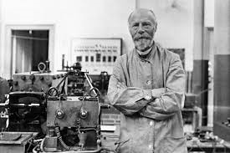
Willem Einthoven
Father of Electrocardiography.
Introduced P-QRS-T wave nomenclature.
Described Einthoven Triangle
Established Standard bipolar limb leads(I,II,III).

Slide 3
Electrocardiogram
An ECG is the recording (gram) of the electrical activity (electro) generated by the cells of the heart (cardio) that reaches the body surface.
Electrical activity → cardiac contraction

Slide 4
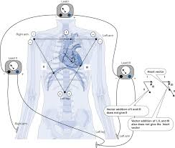
The electrocardiograph is a sophisticated galvanometer – detects and records changes in electromagnetic potential
Has a positive pole and a negative pole
When an electrical current passes through a wire placed in magnetic field it experiences a force, this causes the wire or attached needle to move.
The amount of movement is proportional to the current flowing through it.

Slide 5
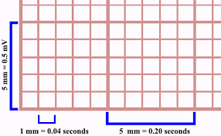
Electrocardiographic paper
Divided into small and large squares
1 small square = 1mm
1 large square = 5 mm
Paper speed – 25 mm/s
5 large squares – 1 s
1 large square – 0.20 s
1 small square – 0.04 s
Voltage → vertical axis
Time → horizontal axis

Slide 6
The electrical field of the heart
The heart is situated in the center of the electrical field which it generates
The intensity of this electrical field diminishes algebraically with the distance from its center
Distances >15 cm decrement in intensity of electrical field is hardly noticeable

Slide 7
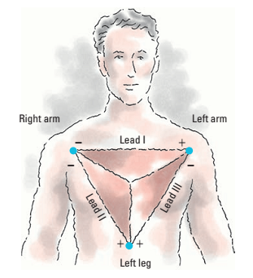
The conventional ECG leads
1. Frontal plane leads : standard leads I, II and III and leads AVR, AVL and AVF
2. Horizontal plane leads : precordial leads V1 to V6
Standard limb leads:
I, II and III
The electrode placement is referred to as Einthoven’s triangle

Slide 8
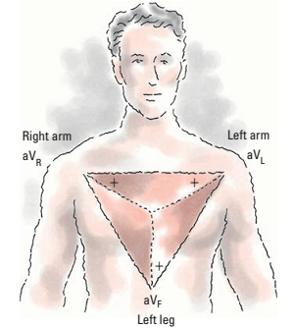
Unipolar limb leads
Augmented limb leads are unipolar leads and include aV_{R}, aV_{L} and aV_{F.}
The letter ‘a’ stands for ‘augmented’ and letters R, L, and F stand for positive electrode position of the lead.
They measure electrical activity between one limb and a single electrode.
While aV_{R} provides no specific view, aV_{L} and aV_{F} show electrical activity from lateral and inferior wall of the heart, respectively.
aV_{R} produces negative deflection and aV_{L} and aV_{F} produce positive deflections.

Slide 9
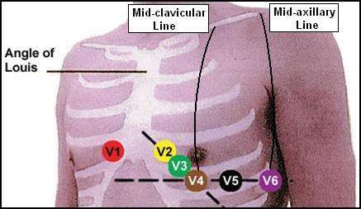
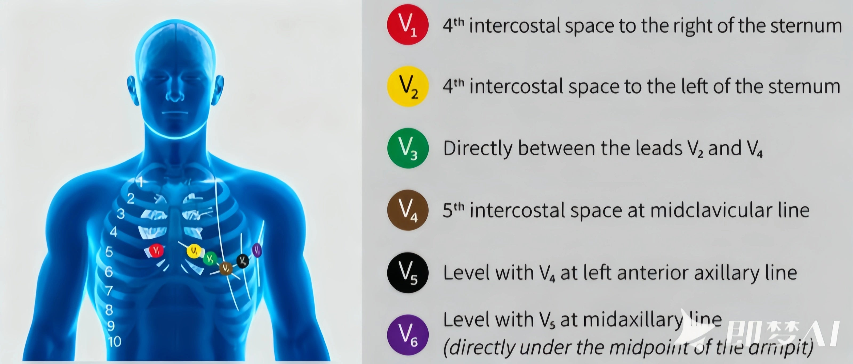
Horizontal plane leads

Slide 10
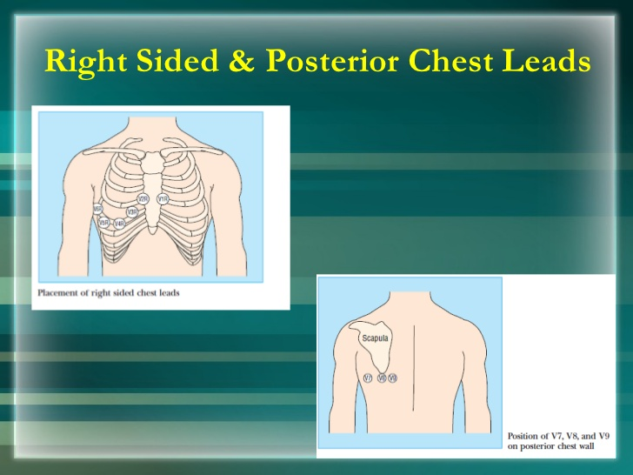
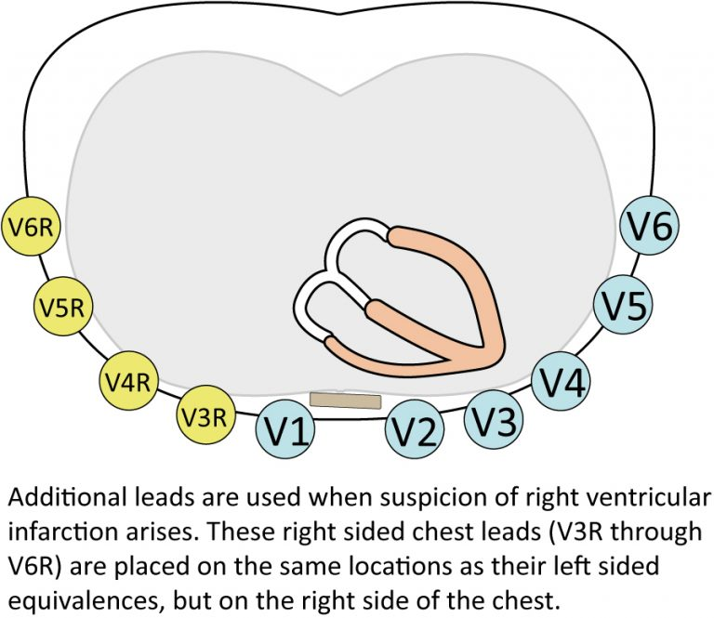
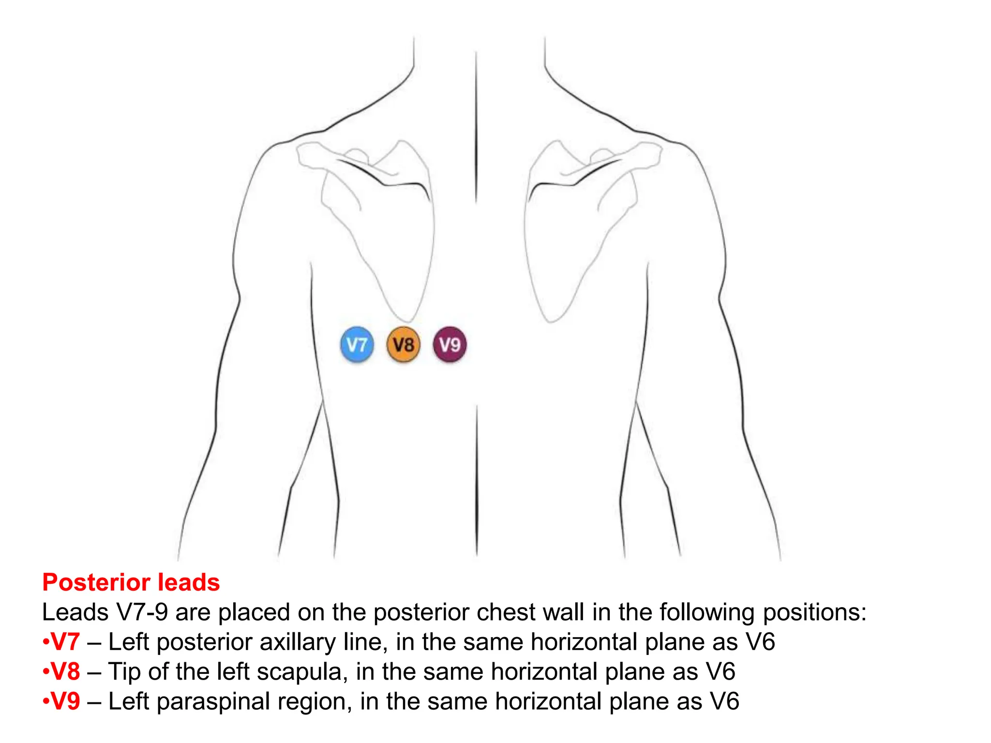

Slide 11
Standard sites unavailable
Because of patient pathology – amputation, burns or bandages
The electrodes should be positioned as closely as possible to the standard sites

Slide 12
Specific cardiac abnormalities
In the presence of tachycardia alternative lead placement may produce a lead that reveals atrial activity
A. moving positive V1 electrode one ICS above its standard site
B. using this site for the positive V1 electrode and the xiphoid process of the sternum for the negative V1 electrode
In dextrocardia the right and left arm electrodes should be reversed and the precordial leads should be recorded from rightward oriented positive electrodes
RV hypertrophy and infarction best detected by in V3R or V4R

Slide 13
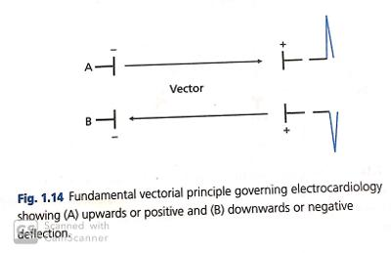
The basic action of electrocardiograph
Sequential depolarization of cardiac muscle tissue causes a depolarization front which results in an electrical current
Electrocardiographic current forms an electromagnetic force or vector which can be detected and recorded by the electrocardiograph

Slide 14
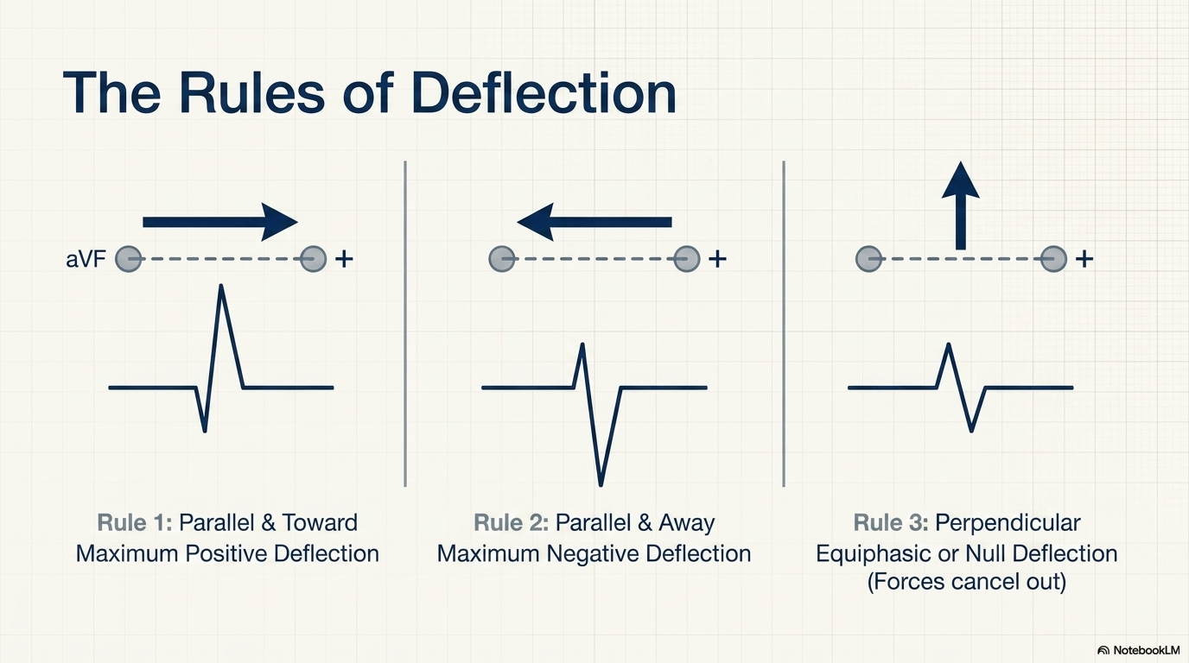

Slide 15
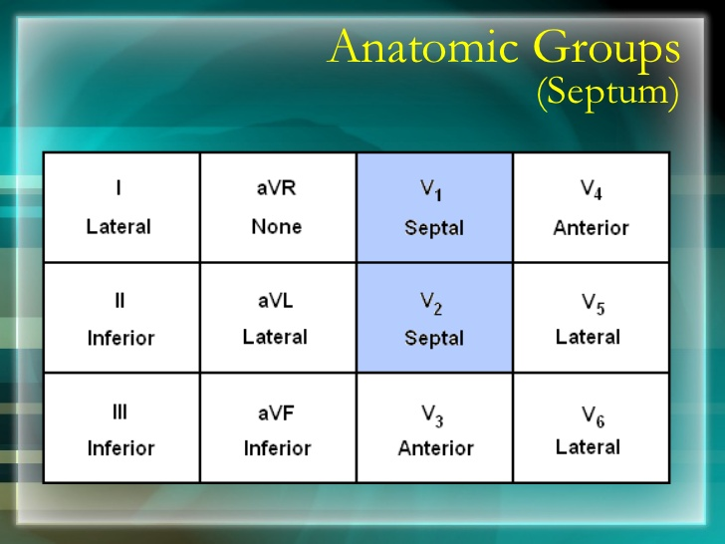

Slide 16
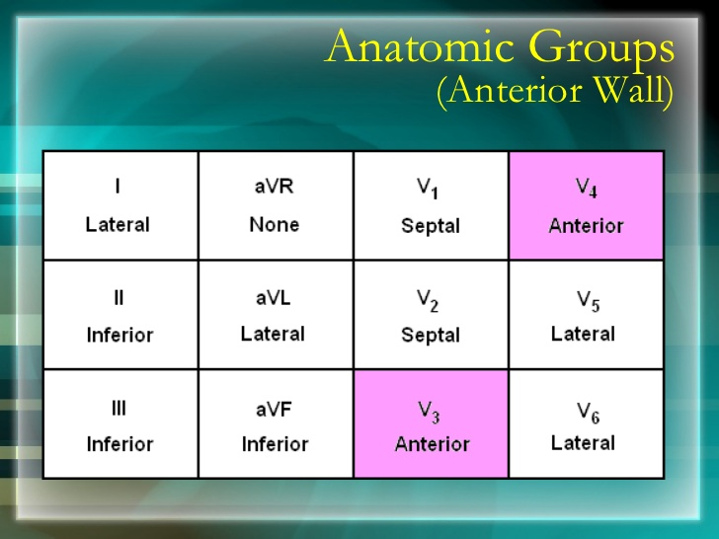

Slide 17
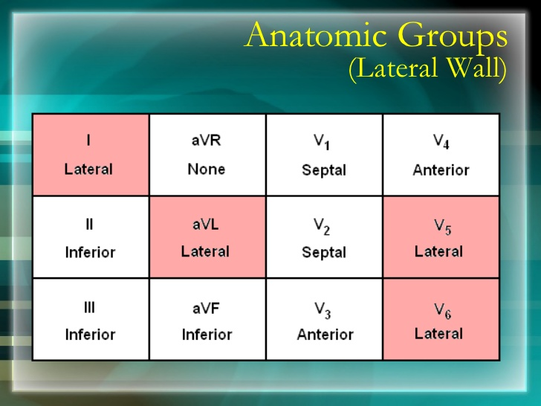

Slide 18
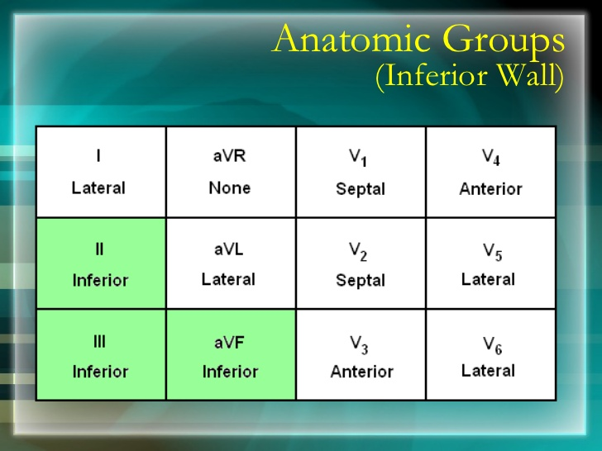

Slide 19
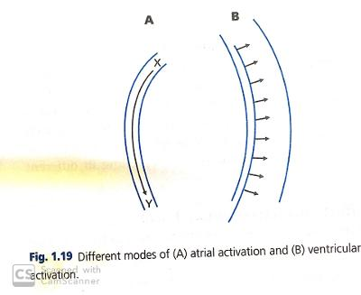
Modes of atrial and ventricular activation
Atrial chamber – thin walled and not equipped with specialized conduction system of the ventricles
Activation occurs longitudinally and by contiguity.
Activation of ventricles – effected through the specialized and highly efficient conduction system
The muscle is activated from endocardial to epicardial surface
Excitation occurs transversely and the whole chamber
activated near synchronously

Slide 20
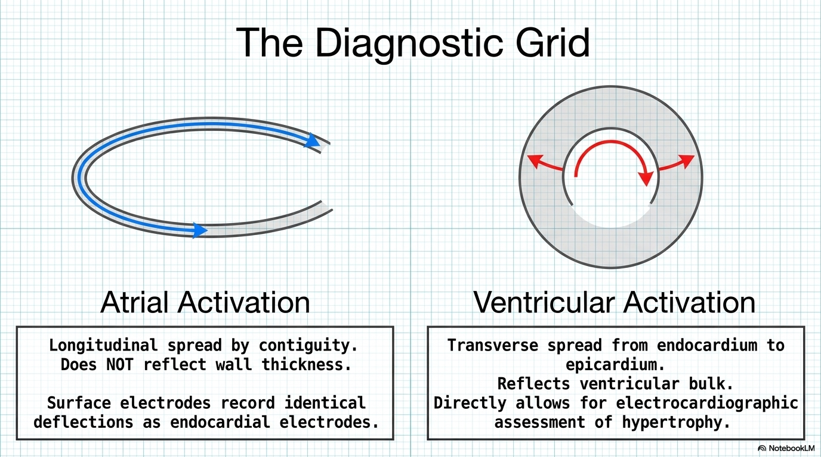

Slide 21
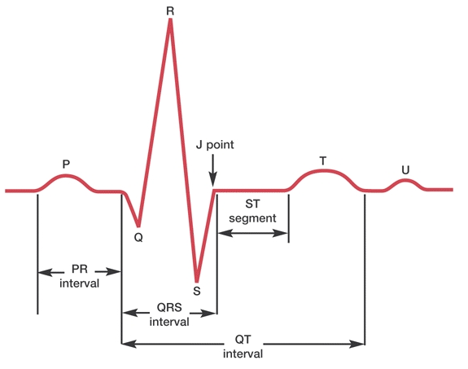
Waveforms

Slide 22
Deflection | What it represents
P wave | Atrial depolarisation
PR interval | Time delay between atrial depolarisation and ventricular activation
QRS complex | Ventricular depolarisation
ST segment (isoelectric) | Electrical plateau of ventricular activation
T wave | Ventricular repolarisation
QT interval | Total time for ventricular depolarisation and repolarisation
U wave | Possibly septal or late ventricular repolarisation

Slide 23
Interpretation of the Normal ECG
1. rate and regularity
2. P wave morphology
3. PR interval
4. QRS complex morphology
5. ST- segment morphology
6. T wave morphology
7. U wave morphology
8. QTc interval
9. Rhythm

Slide 24
RATE AND REGULARITY
Rule of 300
Identify the QRS complex
Count the number of large boxes between one QRS wave and the next one
Divide 300 by this number
The resultant number is the heart rate
No. of large squares between QRS complexes | Heart rate (bpm)
1 | 300
2 | 150
3 | 100

Slide 25

Number of large boxes between one QRS wave and the next one is 6
300/6=50 beats per minute

Slide 26
10 second rule
This is particularly useful when the rhythm is irregular
Obtain a 6-second strip
Count the number of P waves in the strip
Multiply the number by 10 to get the number of atrial beats per minute
Repeat the same for ventricular rate by counting the number of R waves and multiplying by 10

Slide 27
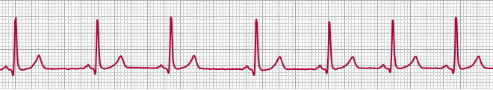
10 second rule example
Number of R waves in the 6-second strip: 7
Ventricular heart rate—7×10=70 beats per minute

Slide 28

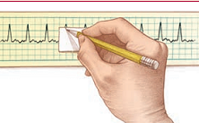
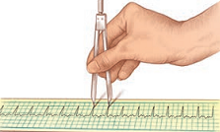
Rhythm
Atrial rhythms are evaluated by measuring intervals between consecutive P waves
Ventricular rhythms are evaluated by measuring intervals between consecutive R waves
In the absence of R waves, use the Q wave
Paper-and-pencil method or the caliper method can be used for measuring the rhythms.
Paper-and-pencil method
Caliper method

Slide 29
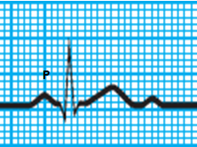
P wave morphology
Represents atrial depolarization (conduction of electrical impulse through the atria)
Location: Precedes the QRS complex
Amplitude: no more than 0.2 mV in frontal plane and no more than 0.1 mv in transverse plane
Duration: <0.12 seconds
Configuration: Usually rounded
and upright
Deflection: entirely positive or negative in all leads except V1 and V2

Slide 30
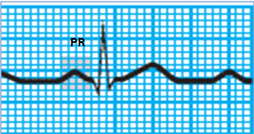
PR interval
The PR interval represents atrial impulse from the atria through AV node which is controlled by the balance between sympathetic and parasympathetic divisions
Location: From the beginning of the P wave to the beginning of the QRS complex
Duration: in childhood 0.10 to 0.12 second
in adolescence 0.12 to 0.16 second
in adulthood 0.12−0.20 seconds

Slide 31

Morphology of the QRS complex
General contour : QRS complex higher frequency signals causing its contour to be peaked rather than rounded

Slide 32
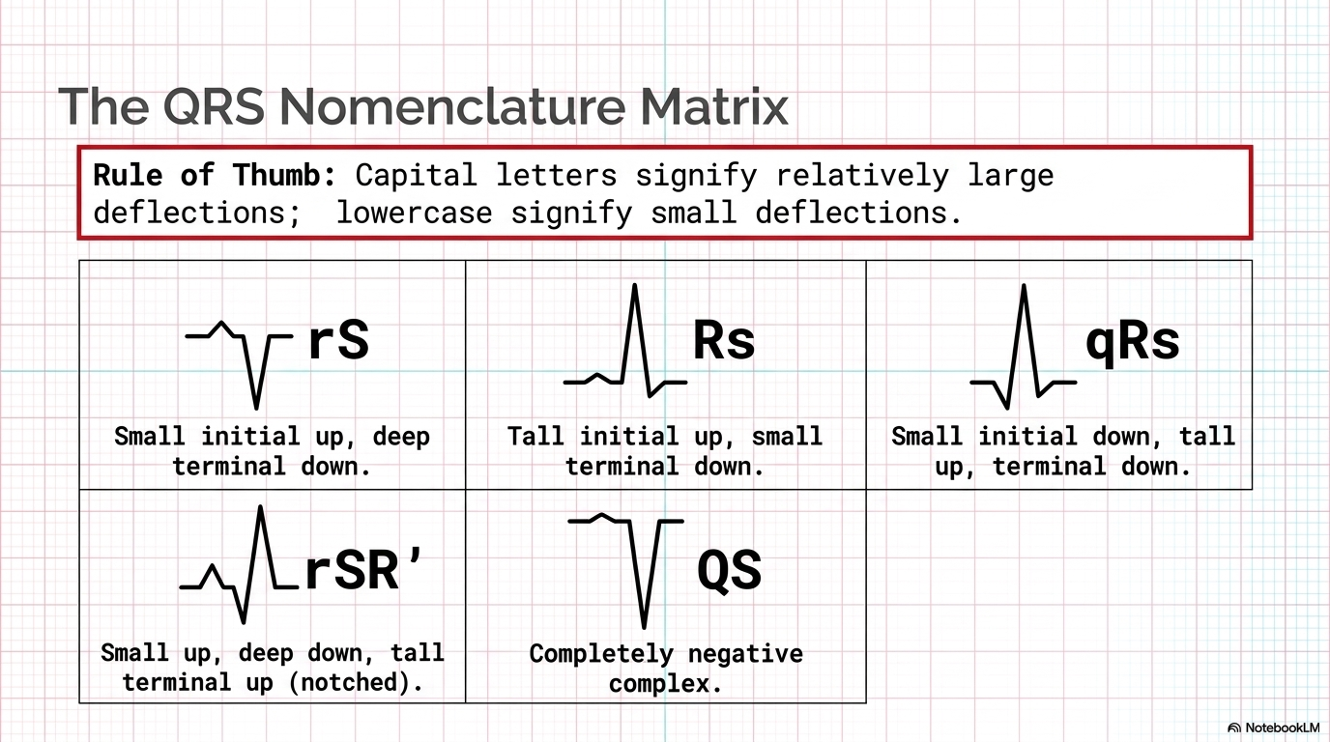
Nomenclature

Slide 33
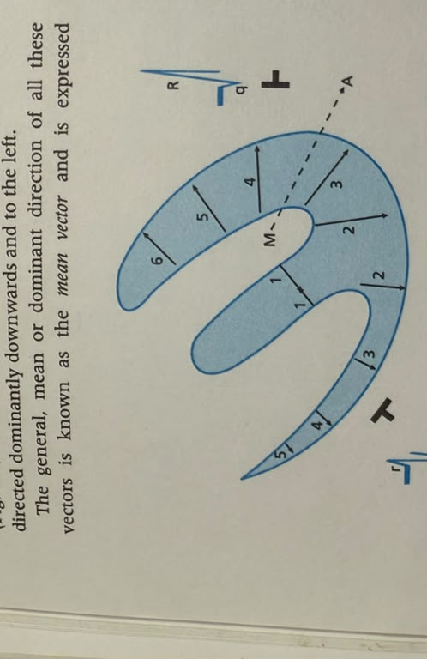
ACTIVATION OF VENTRICLES
1st – Interventricular septum activation from left to right
2nd – Free wall of ventricle
Progressive synchronous activation from endocardial to epicardial sequentially from the apex to the base of the heart.(VECTOR 3,4,5)
The majority of the large electrical forces occur in the apical region of the left ventricle and adjacent free wall(Vector 2, 3 and 4 of LV)
Vector : Downward and to left.

Slide 34
Q waves- normal duration limits
LIMB LEADS |  | PRECORDIAL LEADS
LEAD | UPPER LIMIT | LEAD | UPPER LIMIT
I | <0.O3 | V1 | ANY Q
II | <0.03 | V2 | ANY Q
III | NONE | V3 | ANY Q
aVR | NONE | V4 | <0.02
aVL | <0.03 | V5 | <0.03
aVF | <0.03 | V6 | <0.03
The absence of small Q waves in leads V5 and V6 should be considered abnormal
Q wave of any size is normal in leads III and aVR because of their right ward orientations

Slide 35
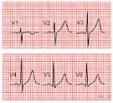
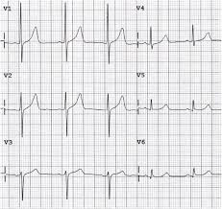
R waves
R wave normally increases in amplitude and duration from lead V1 to lead V4 or V5
Loss of normal R wave progression from lead V1 to lead V4 indicates loss of left ventricular myocardium

Slide 36
S waves
It is large in V1, larger in V2 and progressively smaller from V3 through V6
QRS interval
Normally ranges from 0.07 to 0.11 second
Slightly longer in males than in females

Slide 37
The electrical axis
The major electrical forces occurs in the apical region of the LV and the adjacent free wall and are directed dominantly downwards and to the left
The mean or dominant direction of all these vectors is known as the mean vector and expressed electrocardiologically as the mean QRS axis.

Slide 38
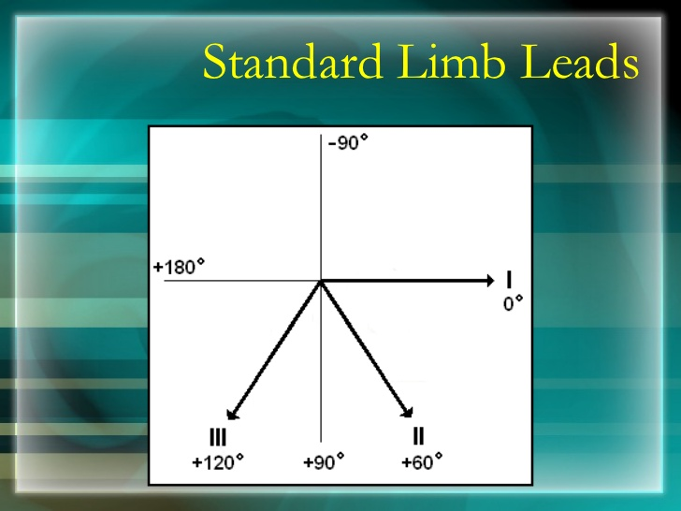

Slide 39
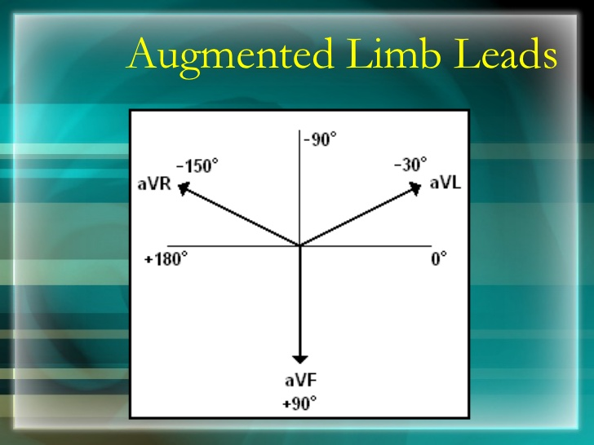

Slide 40
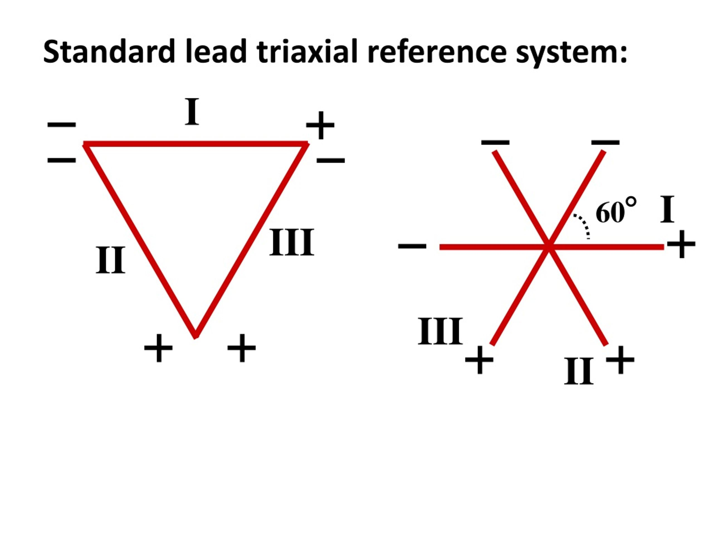
FRONTAL PLANE HEXAXIAL SYSTEM
Combination of two triaxial reference system
1.Three standard leads
2.Three unipolar extremity leads.
THREE STANDARD LEADS
EINTHOVEN EQUILATERAL TRIANGLE
Each angle of triangle :60 degree.
The lead axes of the triangle may be transposed so that they bisect each other while maintaining their orientation.
The leads form triaxial reference system with each lead axis separated by 60 degree

Slide 41
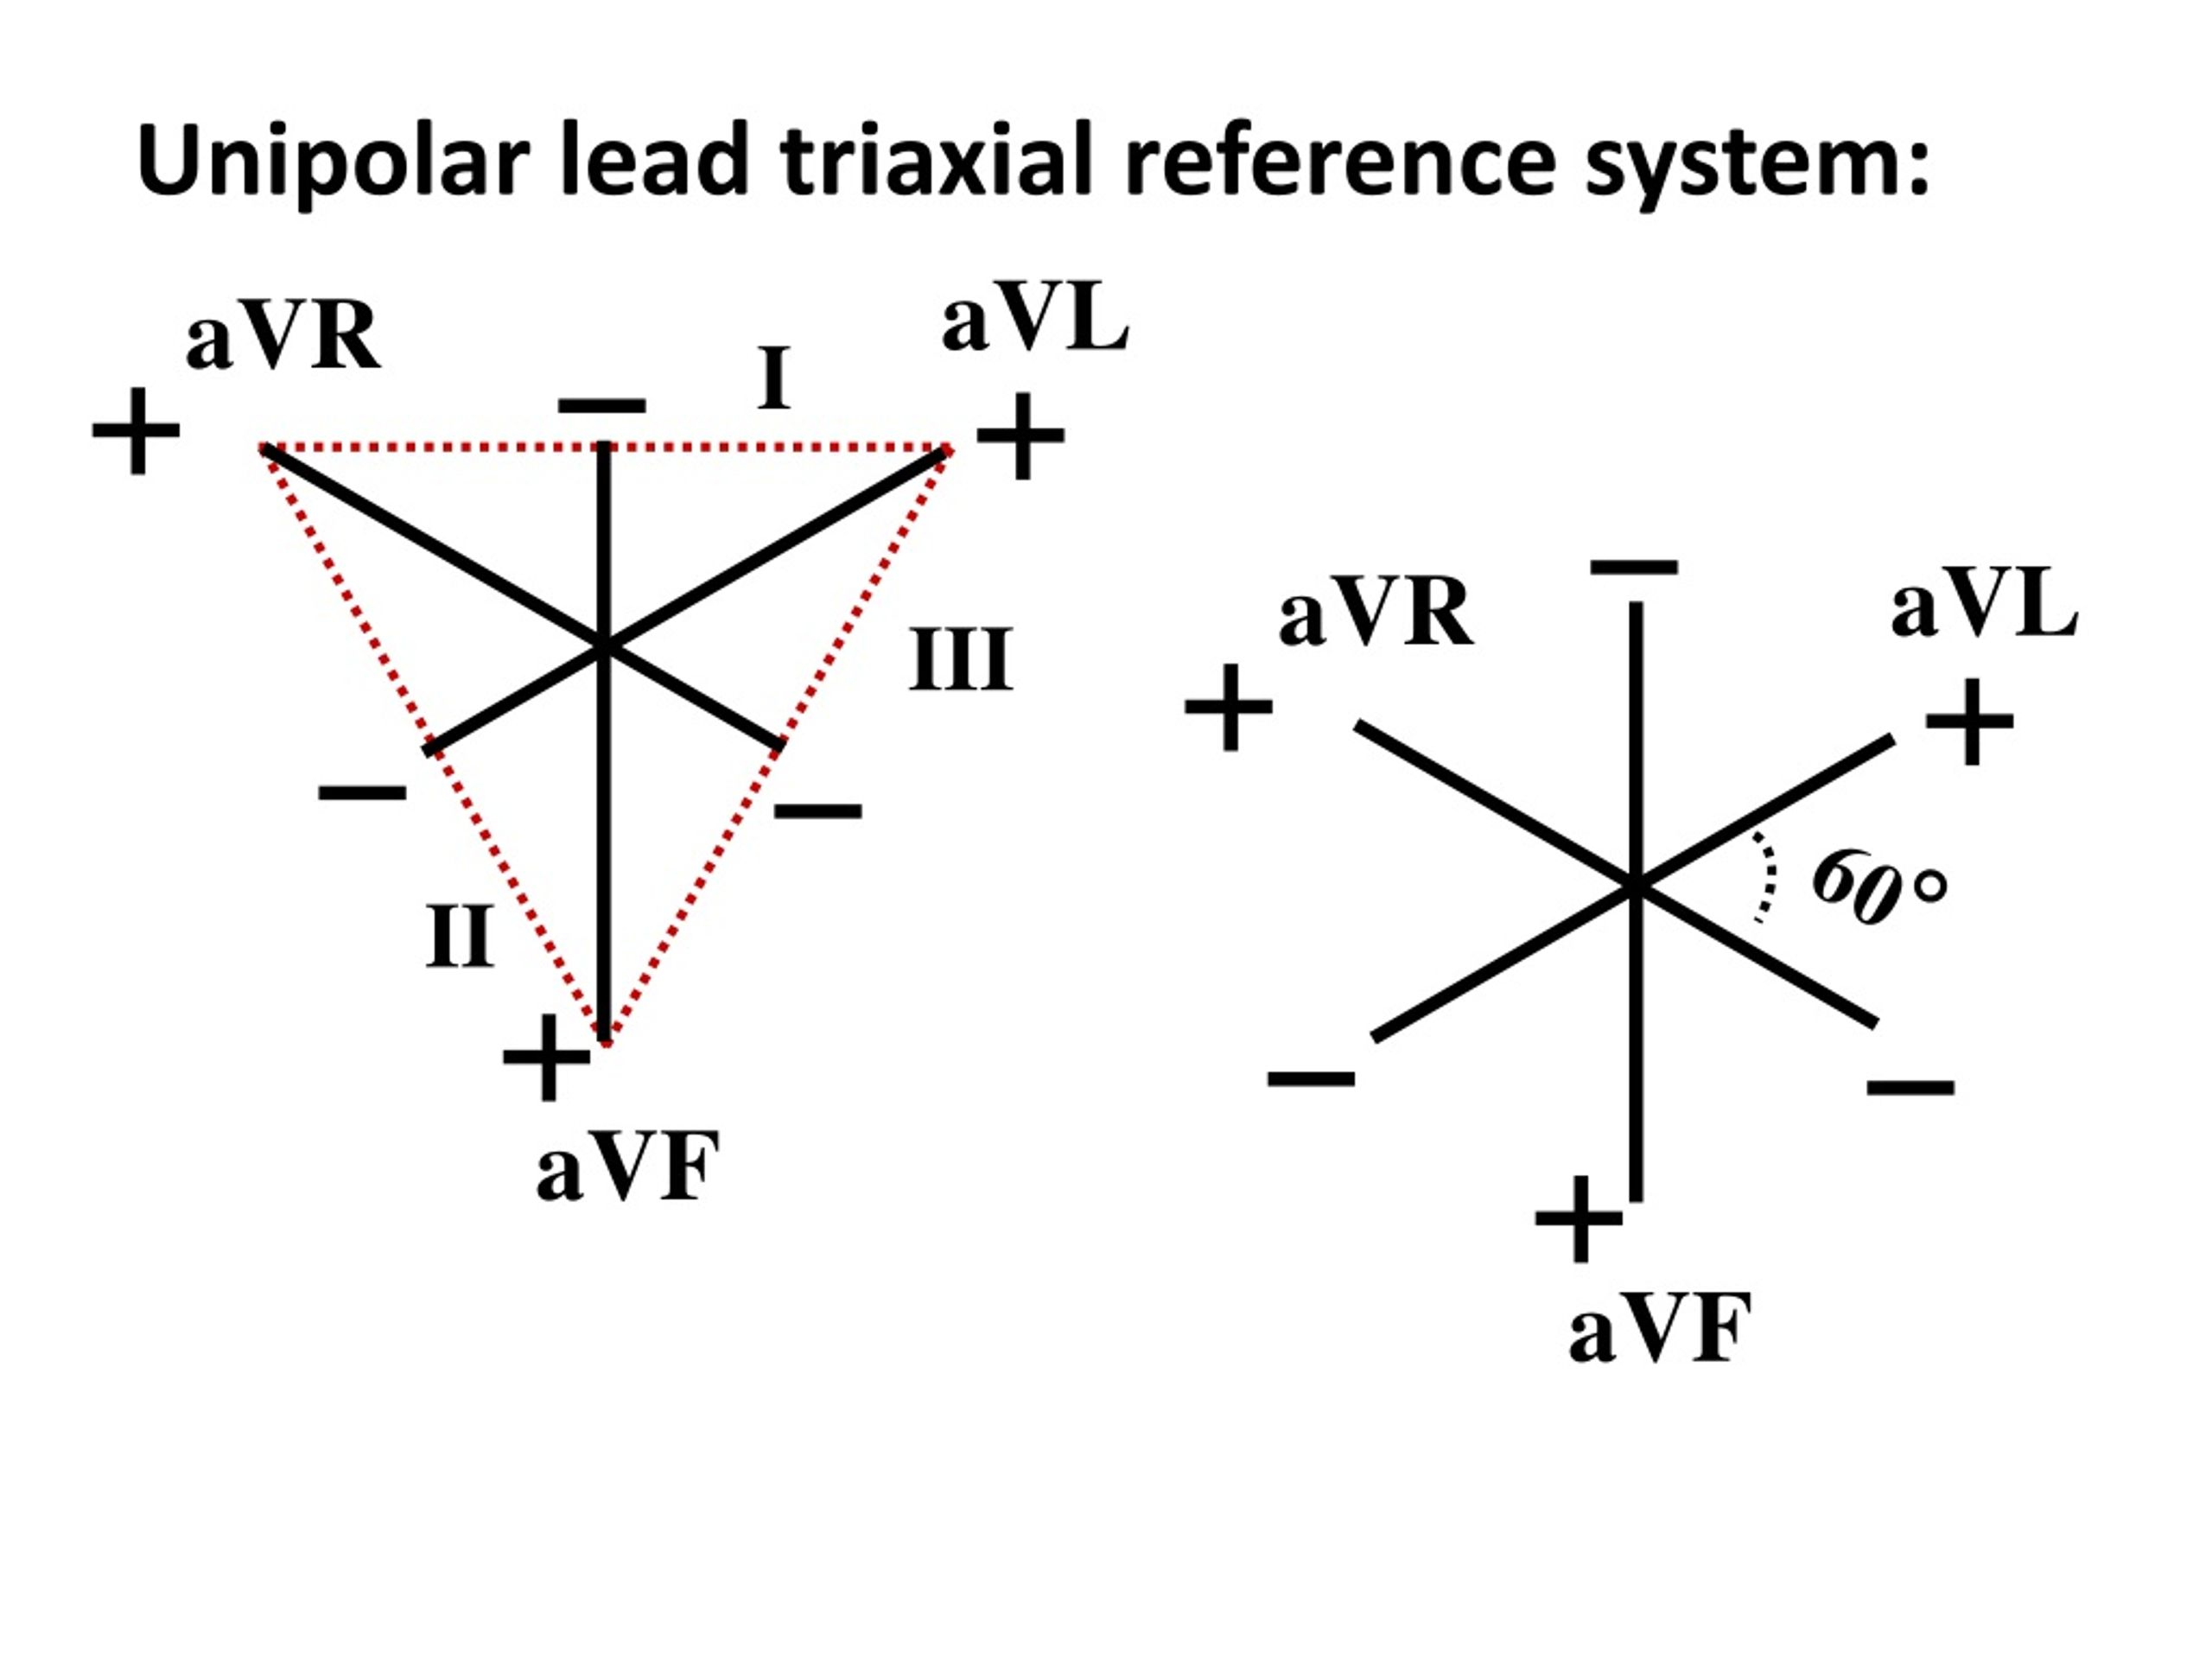
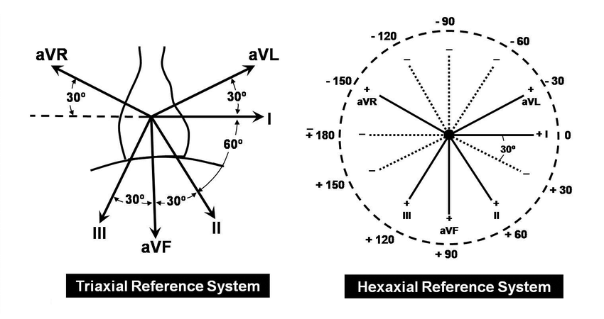
Unipolar extremity lead axes bisect the angles of the equilateral triangle formed by the standard leads.
Each electrode of these unipolar lead is a positive electrode.
These leads may be transposed so that they bisect each other while maintaining the orientation, with each lead axis separated by 60 degree.

Slide 42
Naming the degrees of hexaxial reference system
By convention the upper hemisphere are labelled negative whereas in lower half are labelled positive degrees
The one exception is lead AVR positive pole located at -150

Slide 43
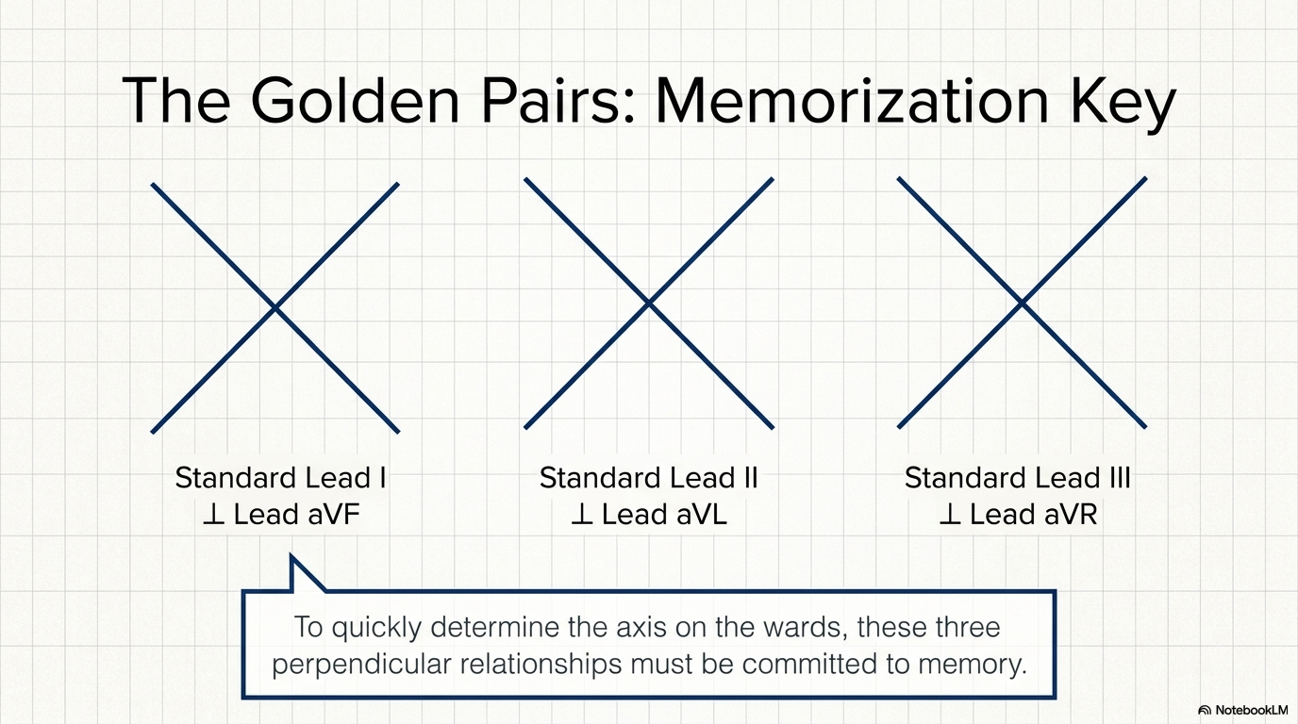

Slide 44
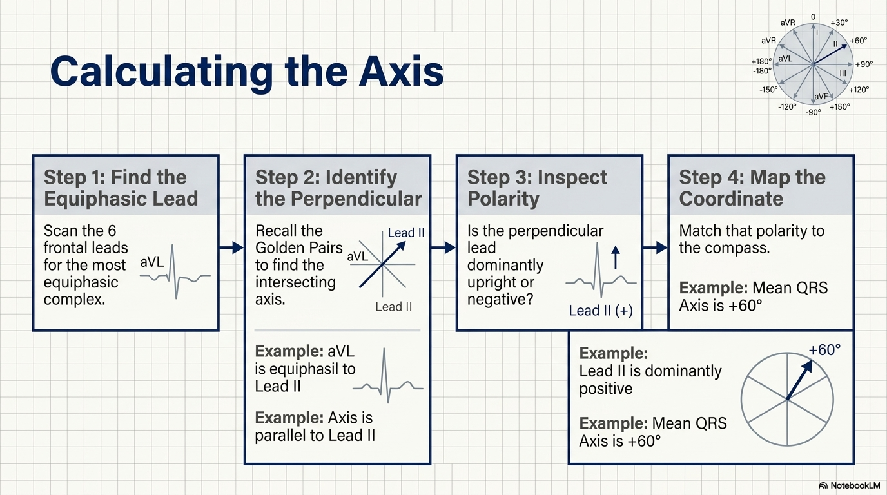

Slide 45
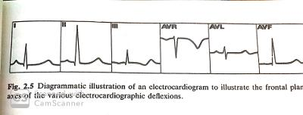
Derivation of the frontal plane axes
1. examine the six frontal plane leads
2. determine the most equiphasic QRS deflection
3. identify the lead perpendicular to the transitional lead
4. consider the predominant direction of the QRS complex in the lead identified in step 3

Slide 46
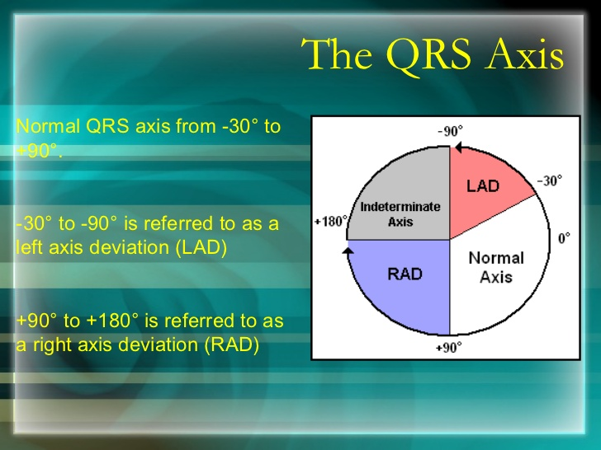

Slide 47
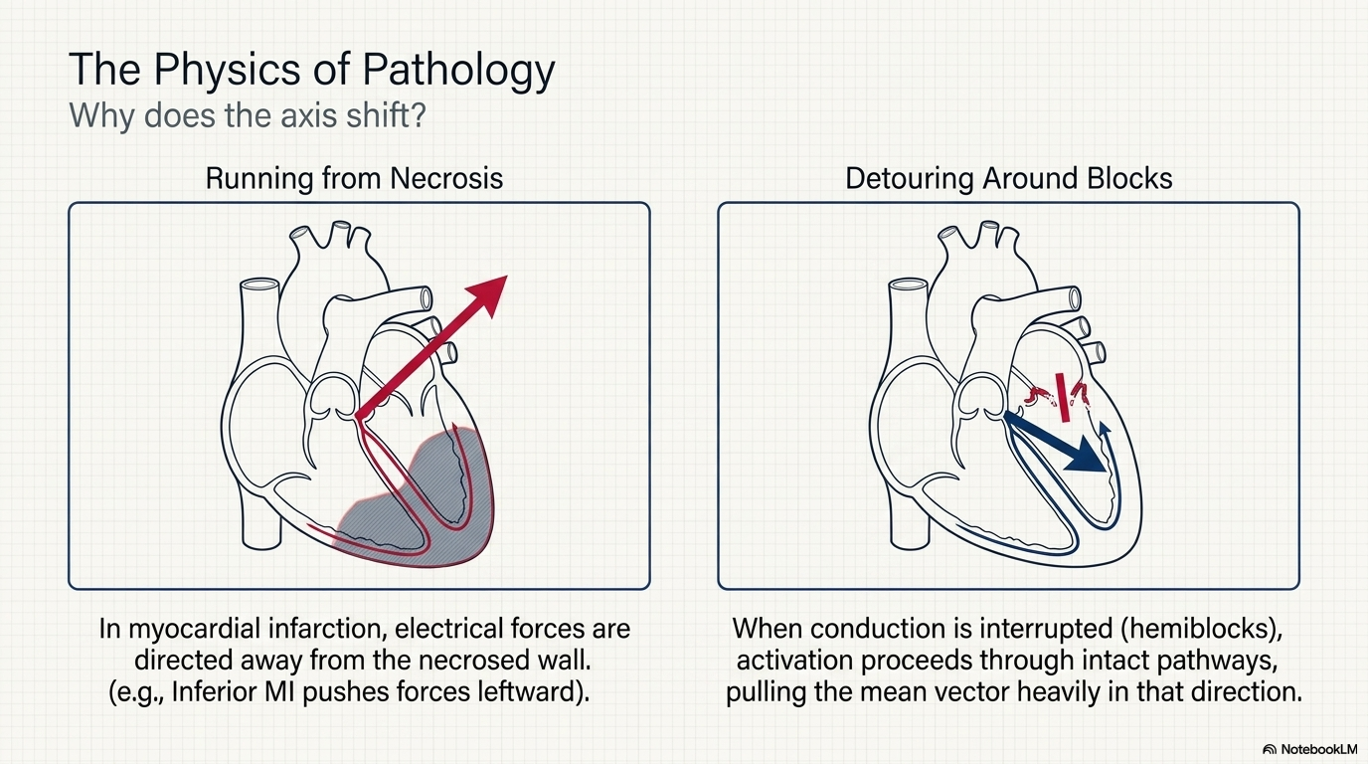

Slide 48
Left axis deviation
Normal variation
Inferior wall myocardial infarction (Ml)
Left anterior hemiblock
Mechanical shifts (ascites, pregnancy, tumors)
Left bundle branch block
Left ventricular hypertrophy
Aging

Slide 49
Right axis deviation
Normal variation
Lateral wall Ml
Left posterior hemiblock
Right bundle branch block
Emphysema
Right ventricular hypertrophy

Slide 50
Morphology of ST segment
ST segment represents the period during which the ventricular myocardium proceeds through the preliminary two phases of repolarisation: phases 1 and 2, following its depolarization in phase 0

Slide 51
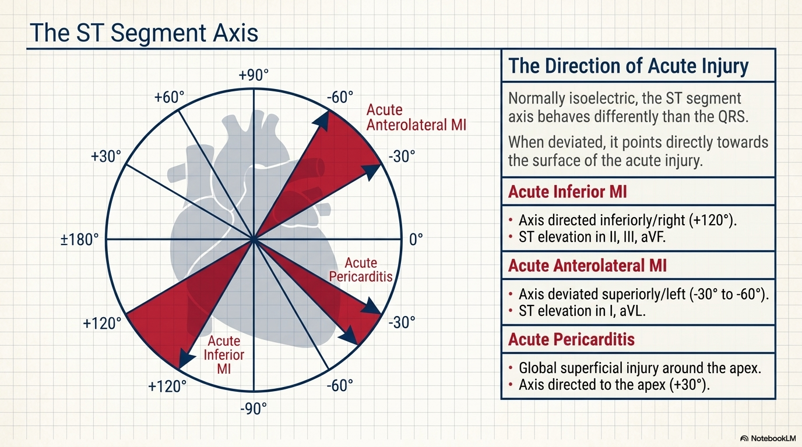

Slide 52
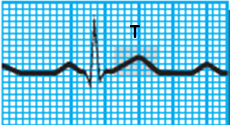
T wave
T wave represents ventricular recovery or repolarization
Location: Follows the S wave
Amplitude: do not exceed 0.5 mV in any limb lead or 1.5 mV in any precordial lead
Configuration: Round and smooth
Deflection: Upright in leads I, II and V₃to V₆; inverted in lead aV_{R}; variable in other leads

Slide 53
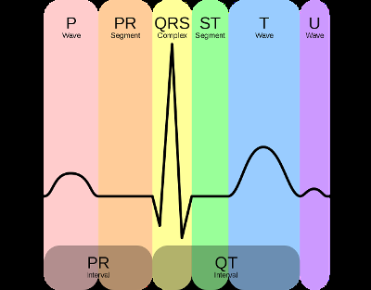
U wave
The U wave may not appear in all rhythm strips.
If present, it represents the recovery period of the Purkinje or ventricular conduction fibers
Configuration: Typically upright and rounded
Prominent U wave indicates
hypercalcemia, hypokalemia or
digoxin toxicity

Slide 54

QT interval
QT interval determines ventricular depolarization and repolarization
Location: Extends from the beginning of the QRS complex to the end of the T wave
Duration: 0.36−0.44 seconds; varies according to age, sex, and heart rate
When the rhythm is regular, duration of QT interval should not be greater than half the distance between consecutive R waves.
Length varies according to the heart rate. Faster the heart rate, shorter is the QT interval.

Slide 55
QTc interval
QT interval varies inversely with the cardiac rate
To ensure recovery from one cardiac cycle before the next cycle begins the duration of recovery must decrease as the rate of activation increases
Bazett formula: QTc = QT/ sq root of RR
Upper limit of Qtc interval is approximately 460ms

Slide 56
Abnormality in duration of QT interval indicates myocardial problems
Prolonged QT: Increases the risk of a life-threatening arrhythmia known as torsades de pointes
Certain medications also increase the QT interval such as amiodarone, amitriptyline, chlorpromazine
Prolonged QT may also indicate congenital conduction system defect present in certain families
Short QT interval: Digoxin toxicity or hypercalcemia

Slide 57
THANK YOU

Slide 58
A normal cardiac electrical axis lies approximately between:
A. −90° to 0°
B. −30° to +90°
C. 0° to +180°
D. +90° to +180°

Slide 59
Which ECG lead is electrically neutral and therefore does not contribute to the calculation of Einthoven’s triangle?
A. Lead I
B. Lead II
C. Lead III
D. aVF

Slide 60
Which of the following statements regarding the U wave is TRUE?
A. The U wave normally precedes the T wave.
B. Prominent U waves are classically associated with hyperkalemia.
C. U waves are best appreciated in leads V2–V4 and become prominent in hypokalemia.
D. The U wave represents atrial repolarization.

