Slide 1
ECG ABNORMALITIES IN CHAMBER ENLARGEMENT
Dr FAZIL KT

Slide 2
Outline
• Left Ventricular Hypertrophy (LVH)
• Right Ventricular Hypertrophy (RVH)
• Biventricular Hypertrophy (BVH)
• Atrial enlargement
Cardiology Residency Training • ECG Changes in Chamber Enlargement

Slide 3
Left Ventricular Hypertrophy

Slide 4
Ventricular Depolarization & Normal QRS Vectors
Dominance of Left Ventricular Forces
• Anatomical Baseline: The mass of the normal adult left ventricle is approximately 3 times that of the right ventricle.
• Resultant Vector: dominated by the left ventricle, pulling the mean QRS vector posteriorly, inferiorly, and to the left.
• Septal Activation: Depolarization begins in the middle of the left side of the interventricular septum, traveling from left to right, creating initial small r waves in V1 and small q waves in V6.

Slide 5
The Chest Lead Transition
• Right Chest Leads (V1-V2): Look at the ventricular septum and right ventricle. Normally display rS complexes, where the deep S wave represents the dominant, receding left ventricular forces.
• Transition Zone (V3-V4): The chest lead area where QRS electrical forces switch from negative (rS) to positive (qR or Rs), displaying equal R and S waves.
• Left Chest Leads (V5-V6): Directly face the left ventricular free wall. Normally display qR or qRs complexes with a tall, positive R wave representing direct left ventricular depolarization.

Slide 6
The Overload Concept: Systolic vs. Diastolic
Systolic (Pressure) Overload Profile
• Mechanical Trigger: Faced with high resistance to ventricular ejection during systole (e.g., severe systemic hypertension, aortic stenosis, coarctation of aorta).
• Remodeling: Stimulates concentric hypertrophy—the parallel replication of sarcomeres in myofibrils, thickening the ventricular wall with minimal chamber dilation.

Slide 7
Ischemic Risk: Concentric hypertrophy leads to a mismatch between coronary perfusion capacity and muscle mass, causing subendocardial ischemia, even without coronary artery disease.
Conduction Slowing: Subendocardial and interstitial fibrosis in long-standing pressure overload, creating barriers that delay electrical depolarization
Repolarization Reversed: Depolarization travels from endocardium to epicardium. In severe concentric hypertrophy, repolarization is delayed in the subendocardium, reversing the normal repolarization direction (T wave opposes QRS).

Slide 8
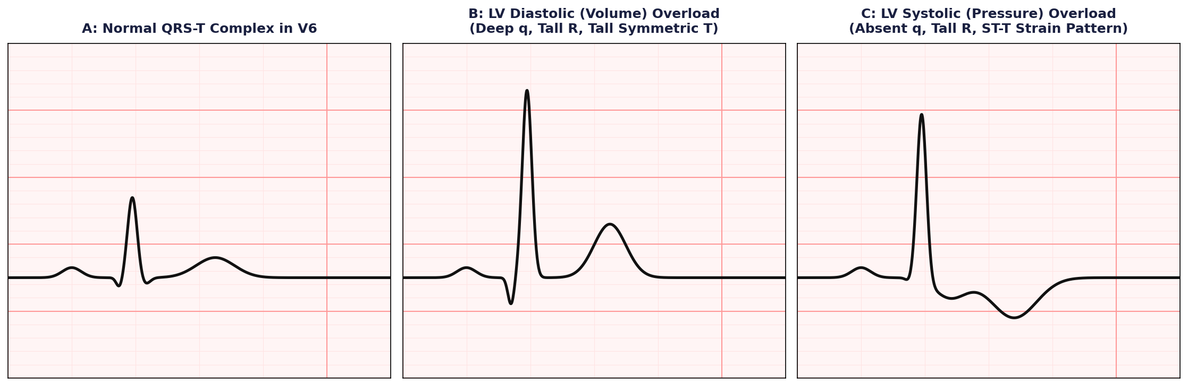
ECG Profile in LV Systolic Overload
Systolic ECG Findings
• QRS Voltage: Markedly elevated R wave amplitude in V5 and V6, and very deep S waves in leads V1 and V2.
• Septal q Wave Attenuation: In systolic overload, the initial small q wave in left-oriented leads (V5, V6, I, aVL) disappears or becomes highly attenuated.
• Classic ST-T Strain: Downward-sloping ST-segment depression with an upward convexity, transitioning into asymmetrical, deeply inverted T waves in left-oriented leads.
• Precordial U Waves: Inversion of U waves in left precordial leads (V4-V6), which serves as a highly sensitive and specific sign of left ventricular strain.

Slide 9
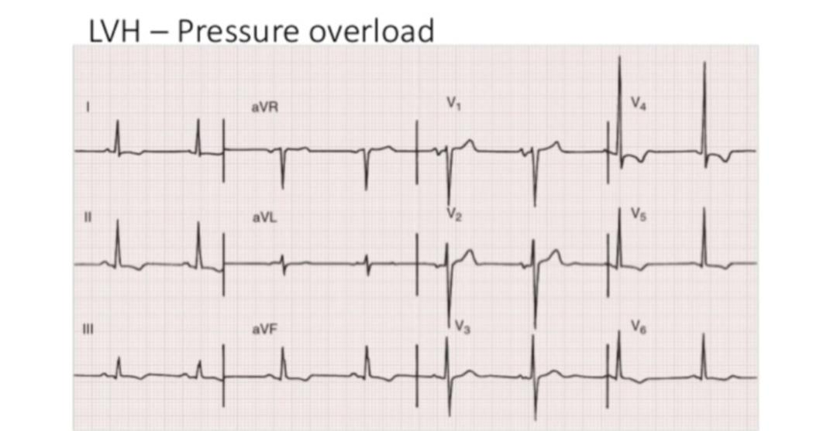

Slide 10
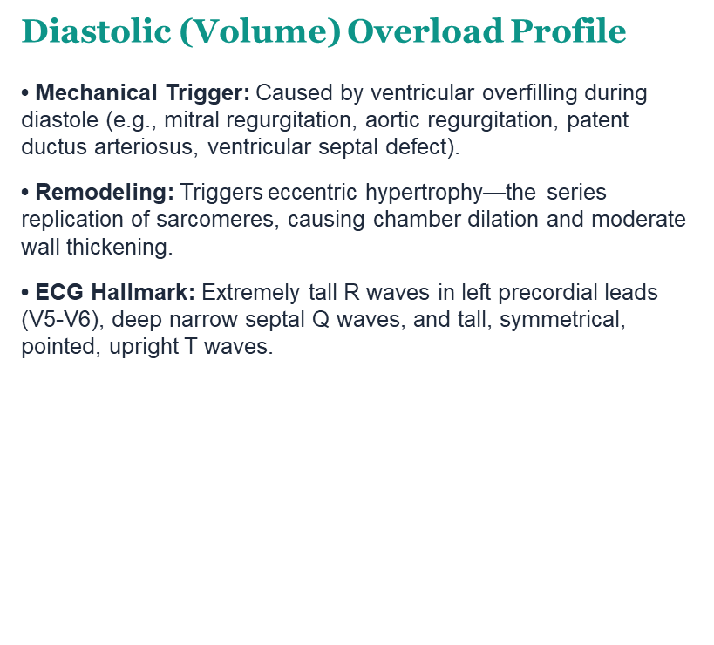

Slide 11
ECG Profile in LV Diastolic Overload
• Massive QRS Voltage: Because the dilated, hypertrophied ventricle sits closer to the chest wall, its voltage is exceptionally high—frequently exceeding 4-5 mV.
• T Waves Symmetrical: Unlike systolic overload where repolarization is reversed, diastolic overload preserves normal repolarization sequence, producing upright, symmetrical, pointed T waves.
Cardiology Residency Training • ECG Changes in Chamber Enlargement

Slide 12
ECG Profile in LV Diastolic Overload
• Deep Narrow Q Waves: Typically seen in left-oriented leads (V5, V6, I, aVL). They measure between 0.2 and 0.4 mV in depth but remain narrow (< 40 ms), distinguishing them from pathological infarction Q waves.
• Symmetrical Tall T Waves: T waves in V5 and V6 are remarkably tall, highly symmetrical, and sharp, mirroring the orientation of the massive QRS.
• Concave ST Elevation: Minor, concave-upward ST-segment elevation (0.1 to 0.2 mV) is common in left precordial leads, without representing acute injury.
• Minimal Activation Delay: Ventricular activation time is normal or only slightly increased, as the conduction system is not compromised by extensive fibrosis.

Slide 13
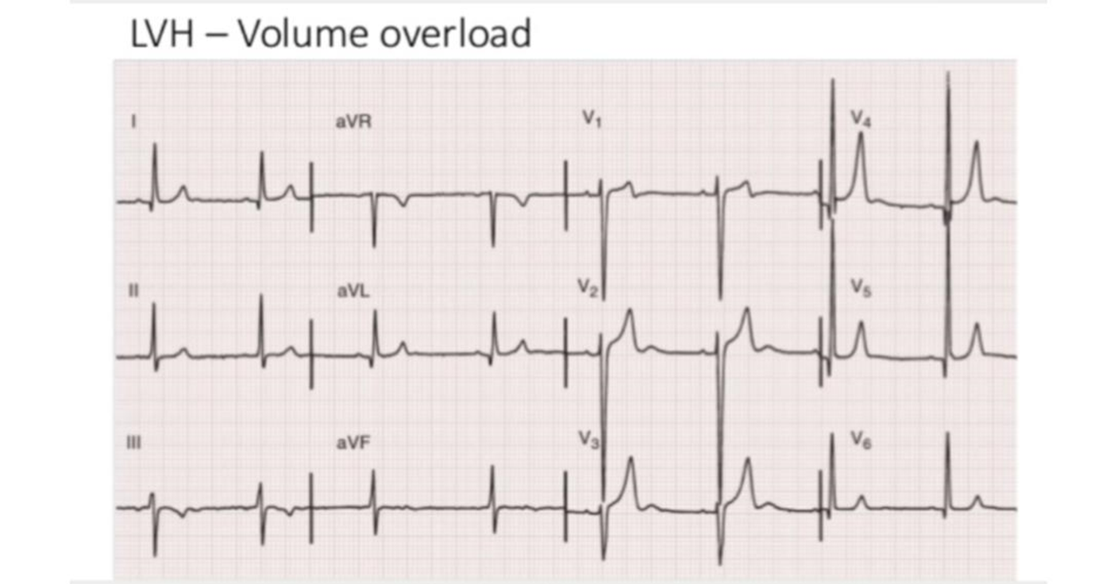

Slide 14
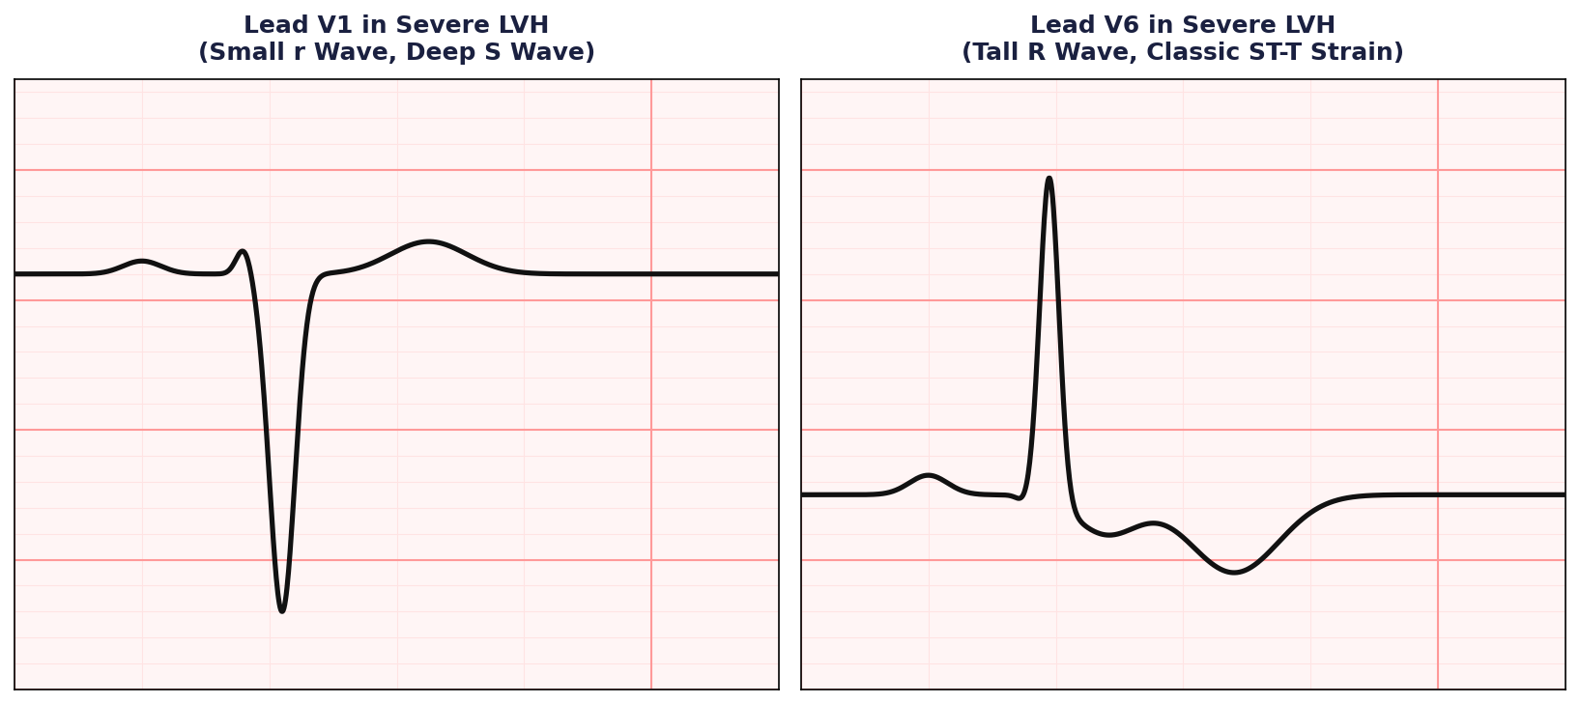
QRS Vector and Axis Rotation in LVH
Axis Deviation
• Frontal Plane QRS Axis: With uncomplicated LVH, the QRS axis remains normal or shifts moderately leftward. A frontal axis pointing to 0° or aVL is typical.
• Mean T Wave Vector: In systolic overload, the mean T wave vector points in a direction opposite (180° difference) to the mean QRS vector, leading to QRS-T angle widening.
• Horizontal Plane Rotation: There is usually a marked counterclockwise rotation. The electrical transition zone shifts to the right (e.g., V2 or V3), with deep S waves persisting in V1.

Slide 15
Standard QRS Voltage Criteria for LVH
Criterion Index | Voltage Formula & Diagnostic Threshold | Sensitivity | Specificity | Clinical Core Utility
Sokolow-Lyon | S in V1 + R in V5 or V6 >= 3.5 mV (35 mm) (Normal Standardization, 1 mV = 10 mm) | 20% - 30% | 90% - 95% | Excellent for rapid screen; underestimates in obesity
Cornell Voltage | S in V3 + R in aVL > 2.0 mV (20 mm) [Women] S in V3 + R in aVL > 2.8 mV (28 mm) [Men] | 30% - 40% | 95% - 98% | Corrects for gender anatomical differences and body habitus
Cornell Product | (S in V3 + R in aVL) * QRS Duration (For women, add 8 mm to voltage). Threshold: > 2440 mm*ms | 45% - 50% | 95% - 97% | Gold standard for ventricular mass regression tracking

Slide 16
The Sokolow-Lyon Index
• Sokolow-Lyon Formula: S in V1 + R in V5 or V6 >= 3.5 mV (35 mm) with normal standardization.
• Alternative Limb Standard: R in aVL > 1.1 mV (11 mm).
Key Clinical Pitfalls
• Chest Wall Thickness: Voltage is inversely proportional to the square of the distance from the myocardium to the electrode. Highly sensitive in thin young adults, but very poor in obese patients.
• Pulmonary Insufficiency: Emphysema and COPD increase air volume, attenuating the electrical signals and causing false negatives.
• Cardiac Orientation: Horizontal or vertical anatomical heart rotation shifts the maximal depolarization vector away from standard precordial electrodes, yielding lower amplitudes.

Slide 17
Cornell Voltage & Product
The Cornell Voltage Criterion
• Formula: S in V3 + R in aVL > 2.0 mV (20 mm) in women, or > 2.8 mV (28 mm) in men.
• Gender Adjustment: Women have smaller thoracic dimensions and lower ventricular masses. Without gender adjustment, standard voltage criteria suffer from very low sensitivity in women.
• Anatomical Advantage: Lead V3 looks directly at the interventricular septum, while lead aVL reflects the high lateral wall, capturing the early and late superior vectors.

Slide 18
The Cornell Product Index
• Mathematical Index: Cornell Product = [S(V3) + R(aVL)] * QRS duration. For women, add 8 mm to the voltage first.
• Diagnostic Threshold: > 2440 mm*ms (or 244 mV*ms) is diagnostic of LVH.
• Clinical Benefit: Integrates conduction slowing (QRS widening) with voltage magnitude. It is the most sensitive criteria for assessing the regression of left ventricular mass during medical therapy.

Slide 19
Total QRS Voltage & Activation Delays
Total 12-Lead QRS Voltage
• The Threshold: The sum of the total QRS voltages in all 12 standard leads exceeding 17.5 mV (175 mm).
•.

Slide 20
Ventricular Activation Time (VAT)
• Definition: The time interval measured from the very beginning of the QRS complex to the peak or apex of the R wave (onset of intrinsicoid deflection).
• Pathological Cutoff: Delayed onset of the intrinsicoid deflection to >= 50 ms (0.05 seconds) in left precordial leads (V5 or V6).
• Systolic vs. Diastolic: VAT is prolonged significantly in pressure (systolic) overload. In contrast, volume (diastolic) overload typically shows normal or only slightly increased activation times.

Slide 21
The Romhilt-Estes Point Score System
ECG Diagnostic Category | Specific Electrocardiographic Criteria | Points
QRS Voltage Abnormality | R or S in limb leads >= 20 mm, OR S in V1/V2 >= 30 mm, OR R in V5/V6 >= 30 mm | 3 Points
ST-T Segment 'Strain' | Classic asymmetric ST-T depression/inversion in left-oriented leads (Reduced to 1 point if the patient is taking digitalis / digoxin) | 3 Points
Left Atrial Abnormality (LAA) | Terminal negative deflection of P wave in V1 >= 1 mm in depth AND >= 40 ms (0.04 s) in duration | 3 Points
Left Axis Deviation | Mean QRS electrical axis in the frontal plane directed to -30 degrees or more leftward | 2 Points
Ventricular Activation Time | Onset of intrinsicoid deflection (VAT) >= 50 ms (0.05 s) in lead V5 or V6 | 1 Point
QRS Duration | Prolongation of total QRS duration to >= 90 ms (0.09 s) in any of the 12 leads | 1 Point

Slide 22
Romhilt-Estes scoring
Interpretation Rules
• Score >= 5 Points: Diagnostic of Left Ventricular Hypertrophy (LVH).
Specificity exceeds 95% ( against echocardiographic and autopsy standards.)
• Score = 4 Points: Probable Left Ventricular Hypertrophy. Represents early or transitional remodeling.
• The Digitalis Caveat: Because digitalis glycosides mimic ST-T segment depression, the ST-T point allocation must be downgraded from 3 points to 1 point if the patient is actively taking digitalis.

Slide 23
Right Ventricular Hypertrophy

Slide 24
Right Ventricular Hypertrophy
Anatomical Baseline Constraints
• The Massive Discrepancy: Because the normal LV mass is three times that of the RV, early RVH is completely masked on ECG. The RV must hypertrophy significantly before it alters standard electrical vectors.
• Regional Hypertrophy: Hypertrophy of the right ventricle may involve three major regions: (1) the right paraseptal region, (2) the right ventricular free wall, and/or (3) the basal outflow tract.
• Pulmonary Circuit: Normally a low-pressure, low-resistance system. The RV is highly sensitive to abrupt or chronic increases in pulmonary vascular resistance.

Slide 25
RVH Vector
• Vector Reversal: Severe RVH generates increased QRS forces directed anteriorly, rightward, and either superiorly or inferiorly, reversing the normal left-dominant patterns.
• Mean Frontal Axis: The mean frontal plane QRS axis deviates strongly to the right, typically between +90 degrees and +180 degrees (Right Axis Deviation).
• Electrical Rotation: Clockwise electrical rotation around the longitudinal axis shifts the horizontal transition zone to the left, causing deep S waves to persist in V5 and V6.

Slide 26
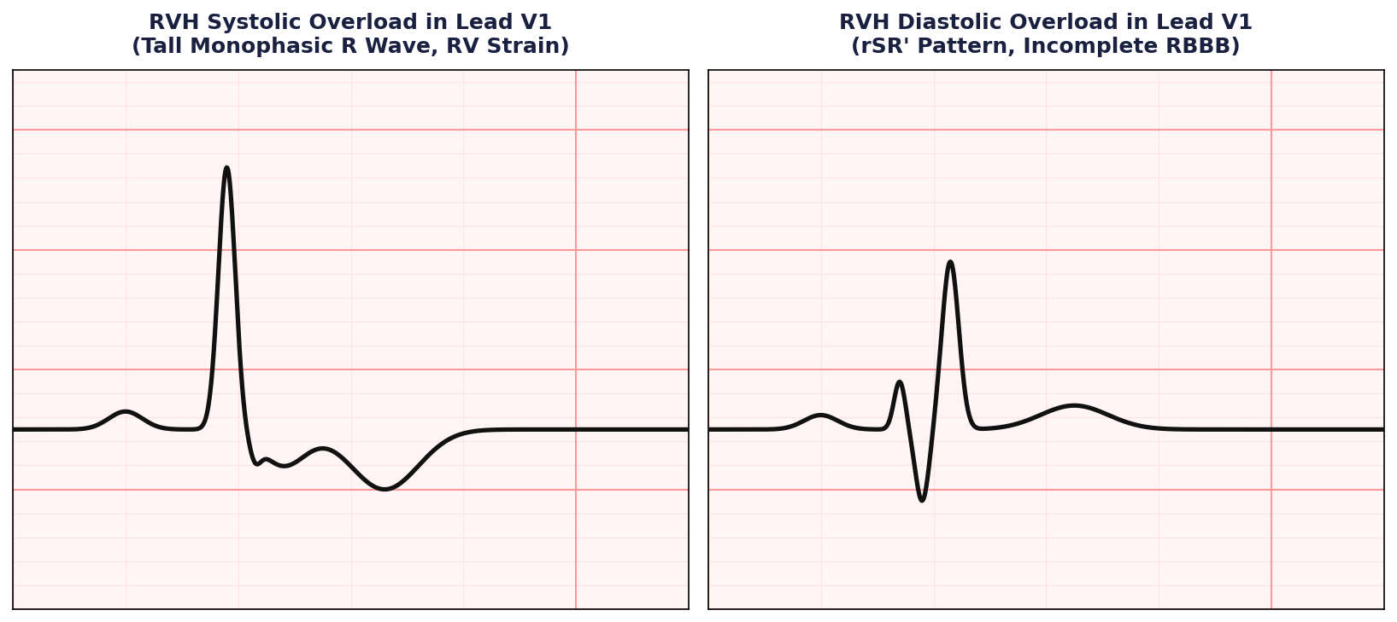
RVH Systolic Overload & Precordial Strain
Pressure overload of the right ventricle and repolarization changes
RV Systolic Overload ECG
• Etiology: Severe pressure overload (e.g., severe pulmonic valve stenosis, primary pulmonary arterial hypertension, Eisenmenger syndrome).
• Lead V1 Morphology: A tall, monophasic R wave or qR complex is observed in lead V1 (amplitude frequently exceeding 10-15 mm).
• Right Precordial 'Strain': Asymmetric ST-segment depression (with an upward convexity) and deep, inverted T waves in leads V1 through V3/V4.
• Frontal T wave axis: Deviation of the frontal T wave axis away from the right ventricle, resulting in upright T waves in leads I and aVL.

Slide 27
RVH Chest Lead QRS Manifestations
Right Precordial Leads (V1-V2)
• Tall R Waves: A dominant R wave develops in V1, with an R:S ratio greater than 1.0 (reversing the normal rS pattern).
• aVR: A tall, dominant R wave or qR complex develops in lead aVR, with an R wave amplitude exceeding 5 mm (0.5 mV).
• Intrinsicoid Deflection: A delay in the ventricular activation time (VAT) to >= 35 ms in lead V1, representing delayed conduction through the thickened RV free wall.
Left Precordial Leads (V5-V6)
• Persistent Deep S Waves: The S wave in leads V5 and V6 becomes unusually deep and broad, reflecting the dominant, rightward-receding electrical vectors.
• Low R wave Amplitude: R waves in V5 and V6 are attenuated and smaller than normal, with an R:S ratio in V5 or V6 falling below 1.0.
• Limb Leads I & aVL: Lead I and aVL show deep S waves accompanying the prominent right-axis deviation.

Slide 28
RVH repolarization: ST, T, and U Wave Changes
Repolarization Forces
• T wave Vector Shift: In severe RV pressure overload, the repolarization T wave vector is directed posteriorly and leftward, away from the right ventricle.
• Precordial T Inversion: Produces deep, symmetrical T wave inversions in leads V1, V2, and V3. These waves are indistinguishable from myocardial ischemia on a standalone basis.
• U Wave Behavior: The U wave may become diminished in amplitude or inverted in the right precordial leads (V1-V2).

Slide 29
RVH Diastolic Overload & Volume Strain
RV Diastolic Overload ECG
• Etiology: Ventricular volume overfilling (e.g., atrial septal defect, severe tricuspid or pulmonary valve regurgitation, anomalous pulmonary venous return).
• Lead V1 Hallmark: The classic rSR' or rsR' pattern is observed in lead V1. The secondary R' wave is usually taller than the initial r wave.
• Conduction delay: Frequently presents as an incomplete or complete right bundle branch block (RBBB) due to localized conduction slowing in the stretched right ventricle.
• T wave orientation: T waves in lead V1 are typically upright or only mildly inverted, preserving the normal repolarization direction.

Slide 30
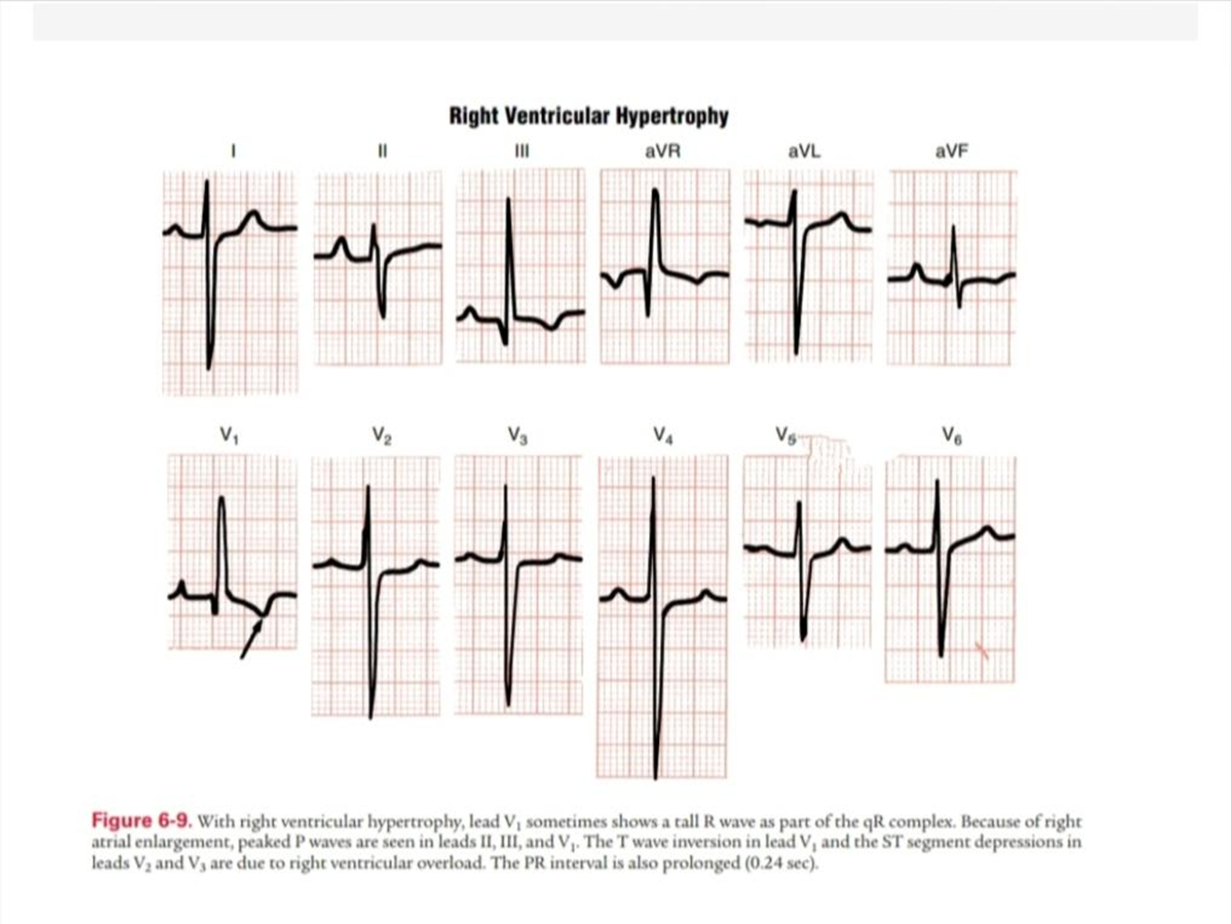

Slide 31
Biventricular Hypertrophy

Slide 32
Biventricular Hypertrophy
The Vector Cancellation Challenge
• Opposing Forces: The massive electrical vectors generated by the hypertrophied left and right ventricles are oriented in opposite directions, tending to cancel each other out.
• ECG Masking: A patient with severe biventricular hypertrophy may present with a completely normal 12-lead ECG due to this mutual vector cancellation.
• Clinical Pitfall: standard single-chamber criteria has an extremely low diagnostic sensitivity for biventricular disease.

Slide 33
Diagnostic Strategy
• Indirect Indicators: Because vectors cancel, clinicians must look for indirect markers, such as specific combinations of axis deviation, chest lead voltage, and atrial abnormalities.
• The 'Discrepancy' Rule: Look for findings that are contradictory for a single-chamber pathology (e.g., LVH voltage on chest leads but profound Right Axis Deviation on limb leads).
• Autopsy Correlation: In autopsy studies, up to 50% of confirmed BVH cases showed only single-chamber hypertrophy on the pre-mortem ECG.

Slide 34
Combining Axis and Voltage in BVH
LVH Voltage with Right Axis Deviation
• The Contradiction: Left ventricular hypertrophy normally causes a normal or leftward-shifted frontal axis. Right Axis Deviation is highly abnormal in isolated LVH.
• Diagnostic Rule: If a patient meets standard voltage criteria for LVH in the chest leads (e.g., Sokolow-Lyon >= 35 mm) but displays Right Axis Deviation (axis >= +90 degrees) in the limb leads, suspect BVH.
• Electrophysiological Basis: The chest leads capture the increased LV mass (tall R in V5, deep S in V1), while the limb leads capture the rightward frontal vector shift of the RVH.
RVH Voltage with Left Axis Deviation
• The Contradiction: Right ventricular hypertrophy normally causes prominent right axis deviation. Left Axis Deviation is highly abnormal in isolated RVH.
• Diagnostic Rule: If a patient meets criteria for RVH in the right precordial leads (e.g., tall R wave in V1 with R:S > 1.0) but displays Left Axis Deviation (axis <= -30 degrees) in the limb leads, suspect BVH.
• Electrophysiological Basis: The rightward chest leads capture the RV free wall hypertrophy, while the limb leads capture the leftward frontal vector shift of co-existing LVH.

Slide 35
The Katz-Wachtel Phenomenon
Electrophysiological Basis
• The Hallmark: Characterized by giant, balanced, biphasic QRS complexes in the midprecordial transition leads (leads V2 through V4).
• QRS Amplitude: The combined amplitude of the tall R wave and the deep S wave in a single lead must equal or exceed 5.0 mV (50 mm with normal standardization).
• Biphasic Waveforms: The R and S waves are of roughly equal magnitude, representing massive, sequential depolarization forces from both ventricles.
Clinical Significance
• Congenital Shunts: Highly associated with large left-to-right shunts (e.g., ventricular septal defects, patent ductus arteriosus) that cause both LV and RV volume overload.
• Eisenmenger Syndrome: Serves as an important diagnostic clue as pulmonary vascular resistance rises, triggering secondary right ventricular pressure overload.
• Specificity: While sensitivity is moderate, the finding of giant biphasic complexes is exceptionally specific (>95%) for biventricular hypertrophy in pediatric and young adult populations.

Slide 36
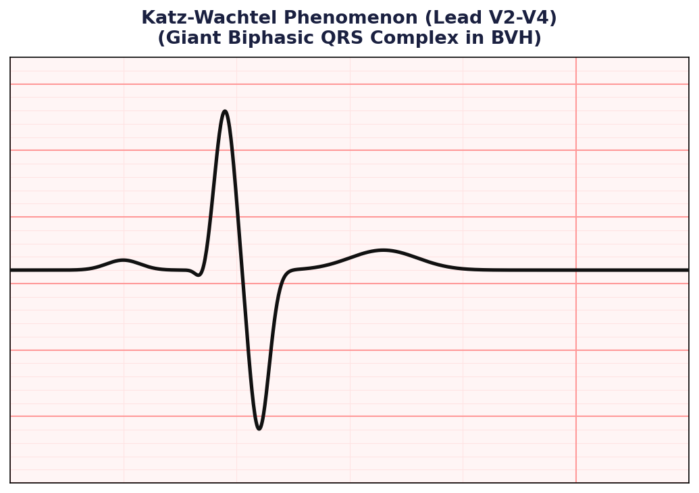
Katz-Wachtel Phenomenon ecg
• Midprecordial Location: Most prominently observed in leads V2, V3, and V4, where the electrodes sit directly over the interventricular septum and both ventricular free walls.
• Sequential Depolarization: The giant R wave represents massive depolarization forces of the LV, immediately followed by a giant S wave representing massive, late forces of the RV free wall.
• No Baseline Shift: The ST-segment and T waves are often remarkably preserved, without the classic strain patterns seen in single-chamber hypertrophy.
• Diagnostic Cutoff: R + S amplitude >= 50 mm (5.0 mV) is diagnostic.

Slide 37
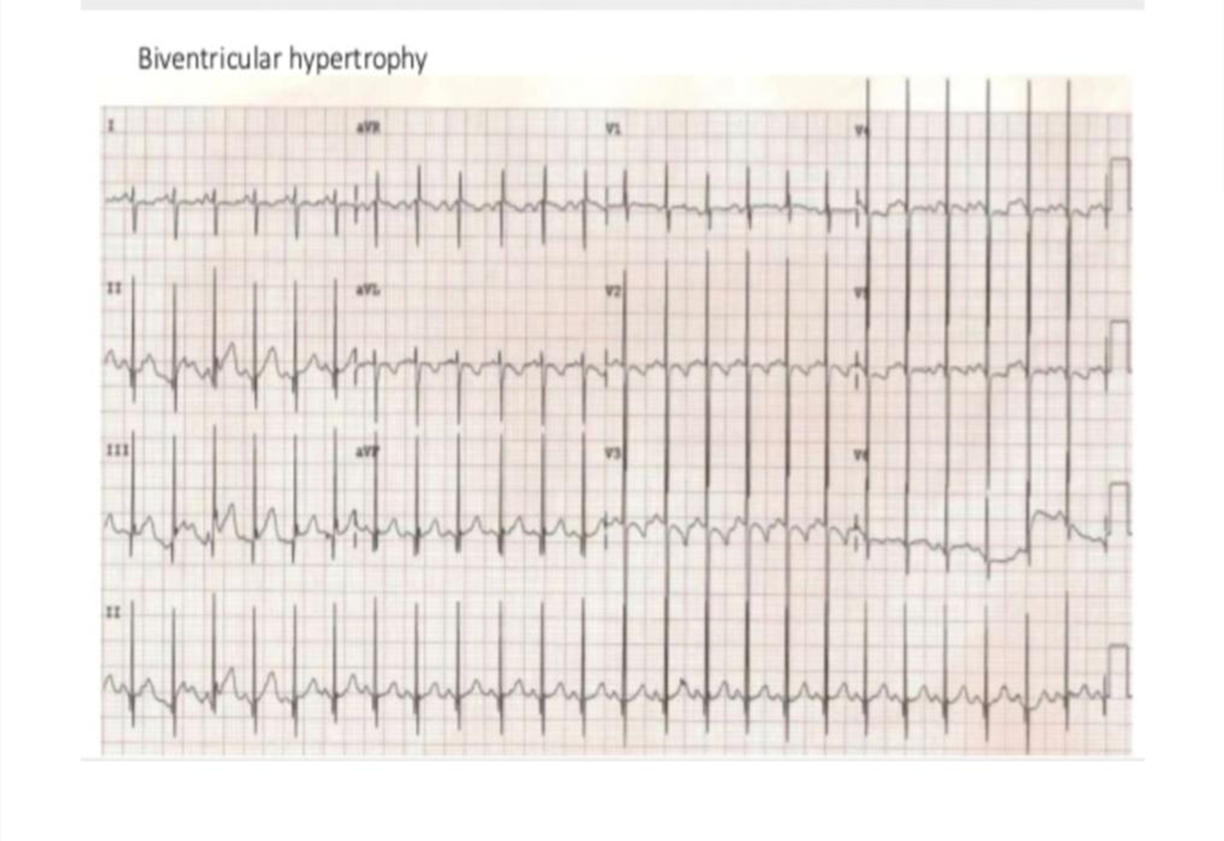

Slide 38
ATRIAL ENLARGEMENT
LAE vs. RAE

Slide 39
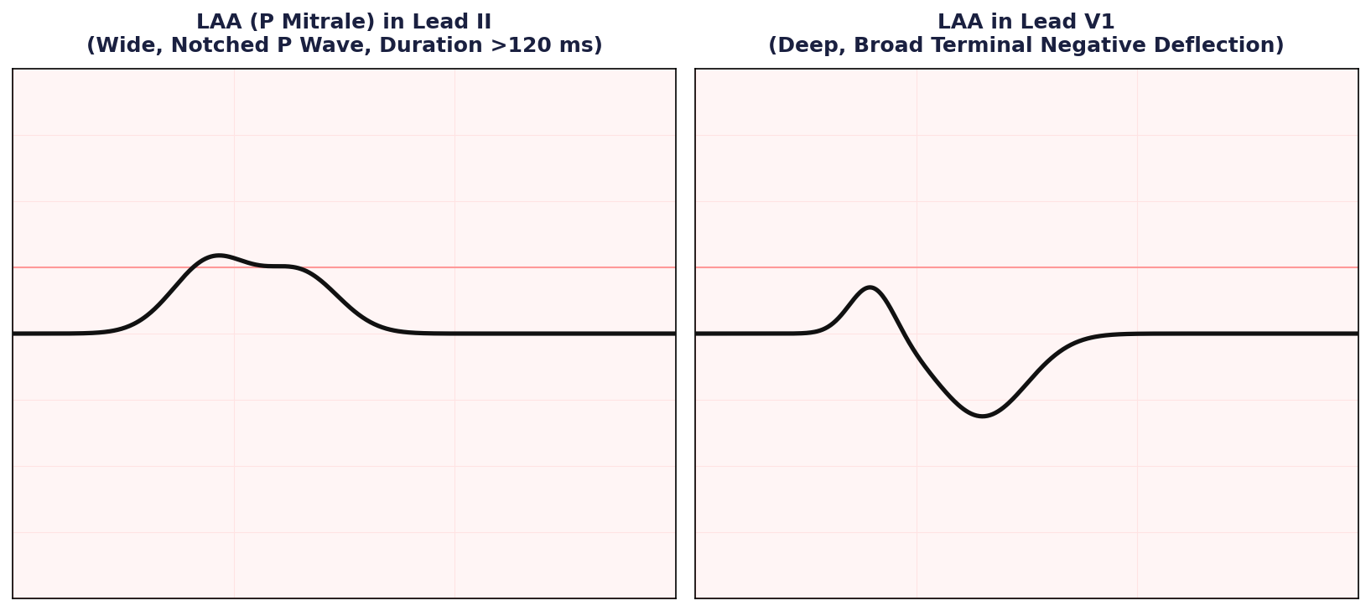
ECG Characteristics of Left Atrial Abnormality
LAA Diagnostic Thresholds
• P Mitrale (Lead II): P wave duration is prolonged to >= 120 ms (0.12 s). The P wave is notched or 'M-shaped' with a peak-to-peak distance of >= 40 ms.
• Lead V1 Terminal Deflection: The P wave is biphasic. The terminal negative deflection must be >= 1 mm deep AND >= 40 ms (0.04 s) in duration
• Frontal P Wave Axis: The mean frontal P wave axis may shift leftward, typically between +45 degrees and -30 degrees.
• Conduction block: The interatrial conduction is delayed across Bachmann's bundle, accentuating the notches.

Slide 40
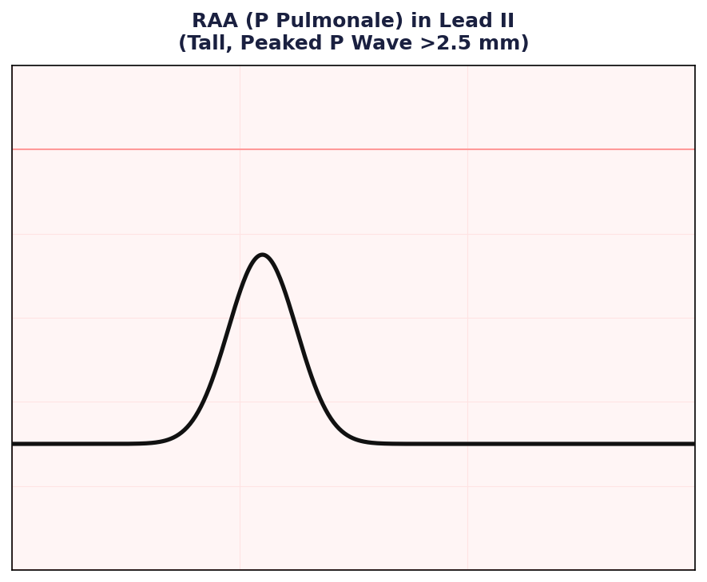
Right Atrial Abnormality (P Pulmonale)
RAA Diagnostic Thresholds
• P Pulmonale (Lead II): The P wave is tall, peaked, and symmetrical in inferior leads (II, III, aVF) with an amplitude exceeding 2.5 mm (0.25 mV).
• Lead V1 Morphology: The P wave may be biphasic, but with a dominant, tall initial positive deflection exceeding 1.5 mm in amplitude.
• Duration: Unlike LAA, the total P wave duration is normal (< 120 ms) because left atrial conduction remains unaffected.
• Clinical Correlation: Highly associated with chronic pulmonary disease (COPD, asthma), pulmonary hypertension, tricuspid stenosis, and congenital heart disease.

Slide 41
Diagnostic Matrix: LAA vs. RAA
Electrocardiographic Parameter | Left Atrial Abnormality (LAA / P Mitrale) | Right Atrial Abnormality (RAA / P Pulmonale) | Clinical Core Etiologies
P Wave Duration | Prolonged to >= 120 ms (0.12 s) in limb leads | Normal (< 120 ms; typically 80-100 ms) | LAA: Mitral valve disease RAA: Pulmonary disease
P Wave Amplitude | Normal (typically < 2.0 mm / 0.2 mV) | Markedly elevated (> 2.5 mm / 0.25 mV) in II, III, aVF | LAA: Hypertension, aortic stenosis RAA: Pulm. hypertension, COPD
Morphology in Lead II | Notched or 'M-shaped' with peak-to-peak > 40 ms | Tall, peaked, and highly symmetrical | LAA notched = Bachmann's delay RAA peaked = Right atrial mass
Morphology in Lead V1 | Biphasic; terminal negative deflection >= 1 mm deep and >= 40 ms wide | Biphasic; initial positive deflection > 1.5 mm in height | LAA = posterior vector shift RAA = anterior vector shift

Slide 42

Morris Index
Macruz Index
The Macruz Index is the ratio of P-wave duration and PR segment duration.
P-wave duration: From the beginning to the end of the P wave.
PR segment duration: From the end of the P wave to the beginning of the QRS complex
Abnormal values>1.6 → Suggestive of left atrial enlargement (LAE)
ECG criterion used to detect left atrial enlargement (LAE).
It is the product of Depth (mm) and Duration (seconds) of the terminal negative portion of the P wave in V1.
Normal value -Less negative than −0.04 mm·s
Positive Morris Index -suggestive of LAE

Slide 43
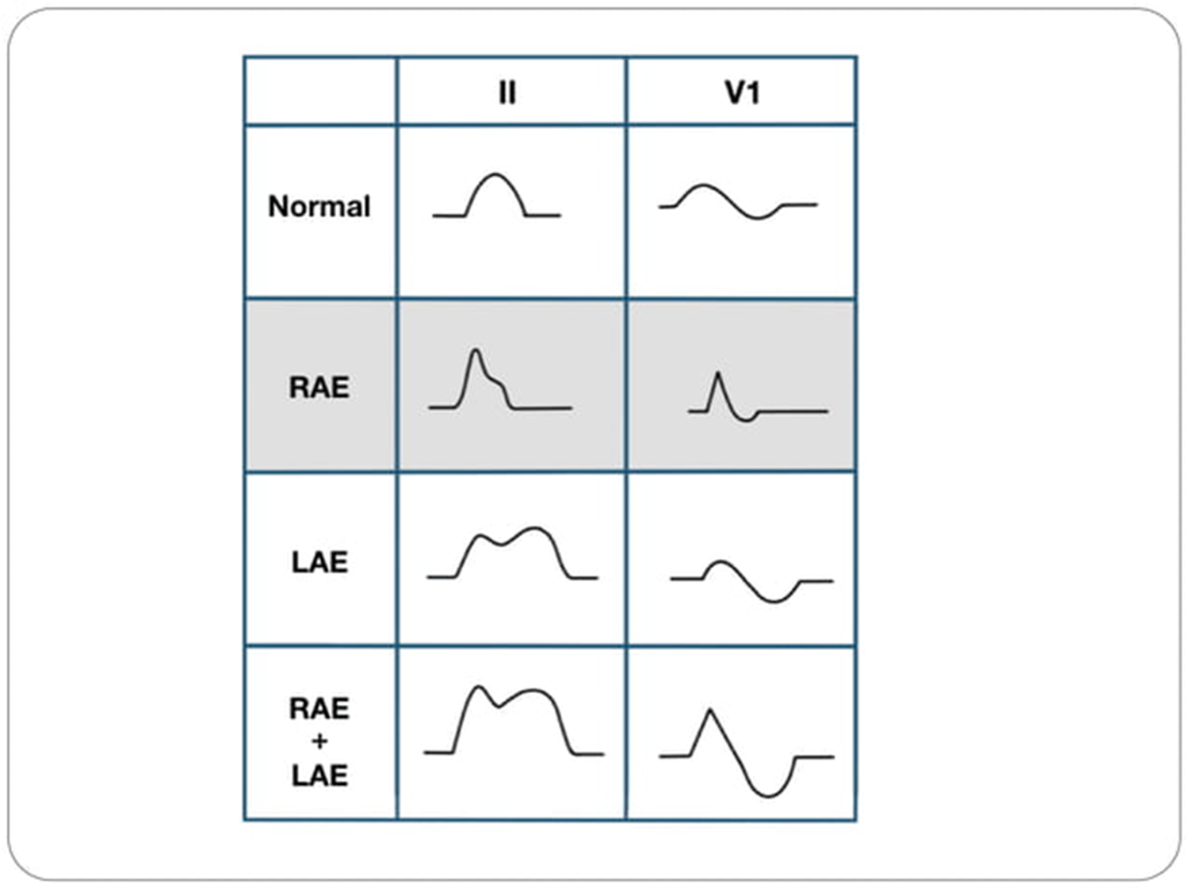

Slide 44
Summary
Left Ventricular Hypertrophy (LVH)
• Sokolow-Lyon Index: S in V1 + R in V5 or V6 >= 3.5 mV (35 mm)
• Cornell Voltage: S in V3 + R in aVL > 20 mm in women; > 28 mm in men
• Cornell Product: [S(V3) + R(aVL) (+8 mm for women)] * QRS duration > 2440 mm*ms
• Romhilt-Estes Scoring: >= 5 points is diagnostic; 4 points is probable LVH
• Left Atrial Abnormality (LAA): P wave notched >= 120 ms in II, or terminal negative P deflection >= 1 mm deep & >= 40 ms wide in V1
Right & Biventricular Hypertrophy (RVH & BVH)
• RVH Chest Leads: Tall R wave in V1 (R:S ratio > 1.0), and deep S wave in V5 or V6 (R:S ratio < 1.0)
• RVH Axis Deviation: Mean frontal QRS axis shifted to the right (+90 degrees to +180 degrees)
• RVH Systolic Overload: Tall R in V1 with right precordial ST depression and T wave inversion (RV Strain)
• RVH Diastolic Overload: rsR' or rSR' pattern in lead V1 (incomplete RBBB pattern)
• Katz-Wachtel (BVH): Giant biphasic QRS complexes in leads V2-V4 with R + S amplitude >= 50 mm (5.0 mV)

Slide 45
Q&A
In Romhilt & Estes point score system,
A score of _______ or more indicates LVH
a) 6 points
b) 5 points
c) 8 points

Slide 46
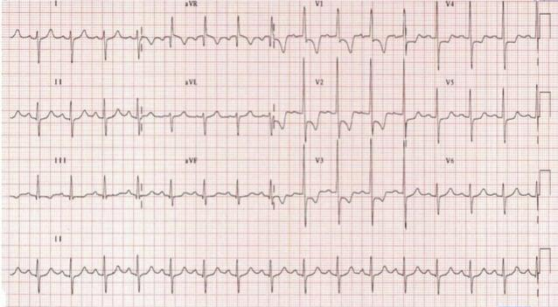
ECG shows,
a) Right ventricular hypertrophy
b) Left ventricular hypertrophy
c) Biventricular hypertrophy

Slide 47

3. ECG shows,

Slide 48

4. ECG shows

