Slide 1
ECHOCARDIOGRAPHIC ASSESSMENT OF AORTIC REGURGITATION
DR. MITHUN ANILKUMAR
SR CARDIOLOGY
TDMC

Slide 2
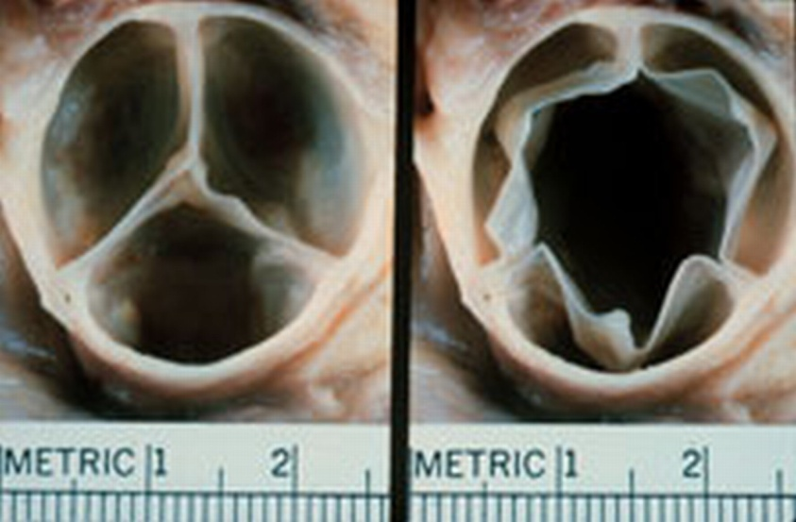
NORMAL AORTIC VALVE
Three cusps, crescent shaped 3 commissures
3 sinuses
supported by fibrous annulus
3.0 to 4.0 cm²

Slide 3
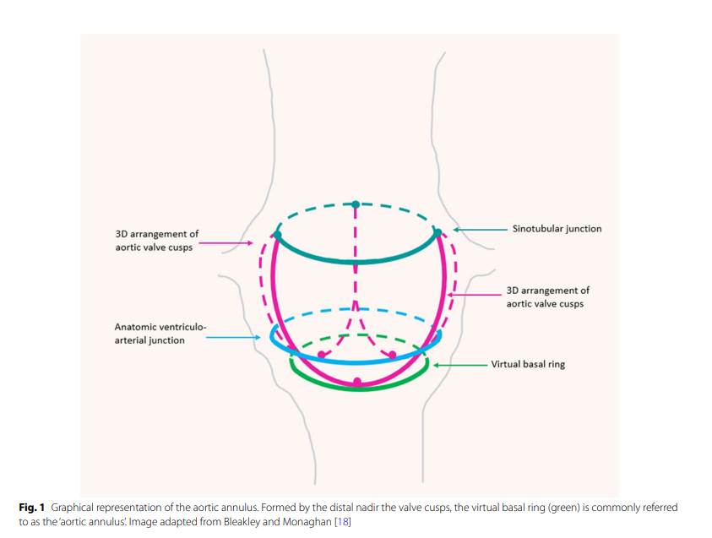

Slide 4
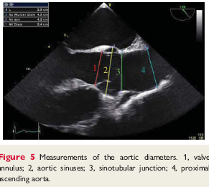

Slide 5
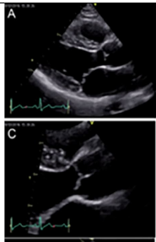
PLAX
RIGHT CORONARY CUSP
NON CORONARY CUSP

Slide 6
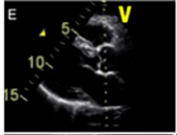
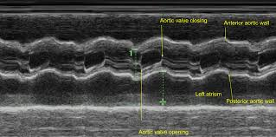
M MODE ACROSS AORTIC VALVE

Slide 7
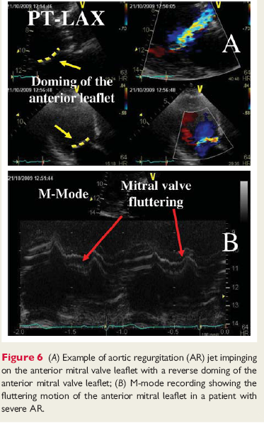
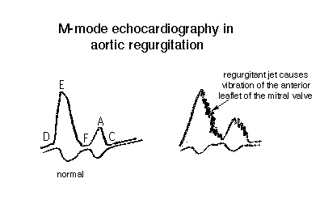

Slide 8
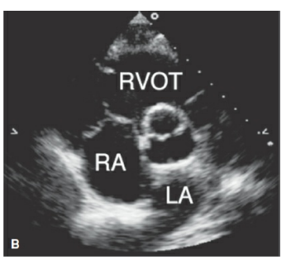
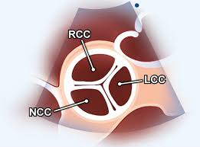
PSAX

Slide 9
Etiology of AR
LEAFLET ABNORMALITIES
- Congenital bicuspid valve
-Calcific valve disease
-Rheumatic valve disease
-Myxomatous valve disease
-Endocarditis
-Nonbacterial thrombotic endocarditis

Slide 10
Etiology of AR
ABNORMALITIES OF THE AORTA
-Marfan syndrome
-Bicuspid aortic valve disease
-Hypertensive aortic dilation
-Cystic medial necrosis
-Aortic dissection
-Systemic inflammatory diseases

Slide 11
FUNCTIONAL CLASSIFICATION OF AR LESIONS
DYSFUNCTION
ECHO FINDINGS
Enlargement of the aortic root with normal cusps
Dilatation of any components of the aortic root(aortic annulus, sinuses of Valsalva , sinotubular junction)

Slide 12
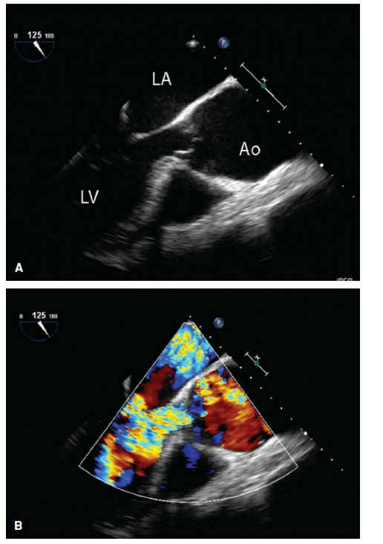
Dilation and effacement of the sinotubular junction
Color Doppler demonstrates severe aortic regurgitation

Slide 13
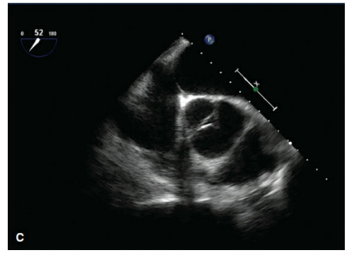
Failure of complete coaptation the three aortic cusps is seen.

Slide 14
2a:Cusp prolapse
with eccentric AR jet
Cusp flail
Partial cusp
prolapse
Complete eversion of a cusp into the LVOT in long axis views
Distal part of a cusp prolapsing into the LVOT(clear bending of the cusp body on long axis views and presence of a small circular structure near the cusp free edge on short axis views)

Slide 15
Whole cusp prolapse
2b:Free edge fenestration with eccentric AR jet
Free edge of a cusp overriding the plane of aortic annulus with billowing of the entire cusp body into the LVOT(Presence of a large circular or oval structure immediately beneath the valve on short axis views)
Presence of an eccentric AR jet without definite evidence of cusp prolapse

Slide 16
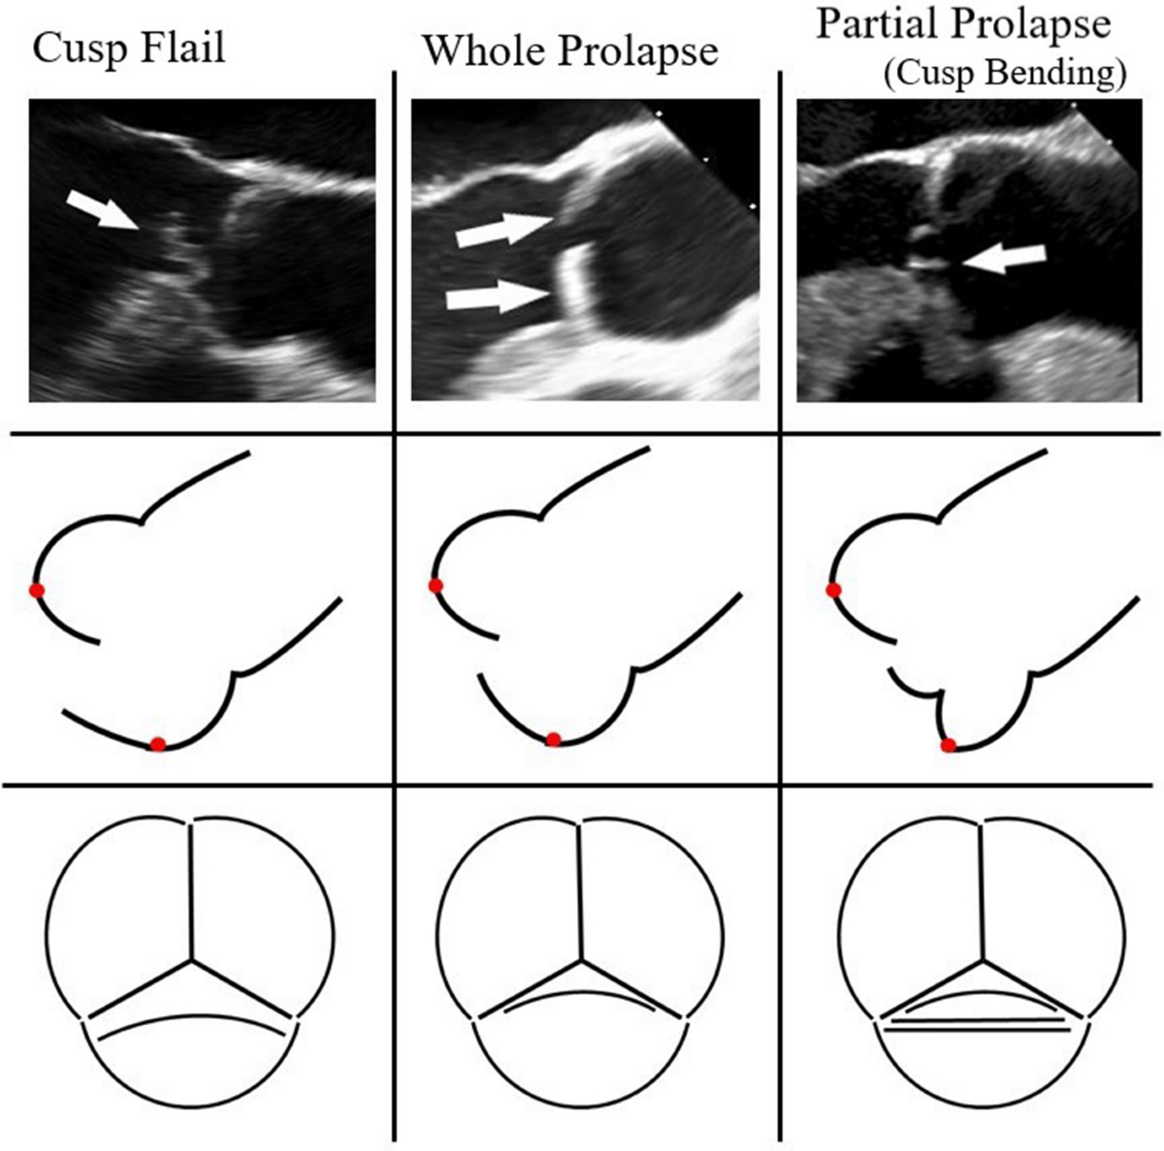

Slide 17
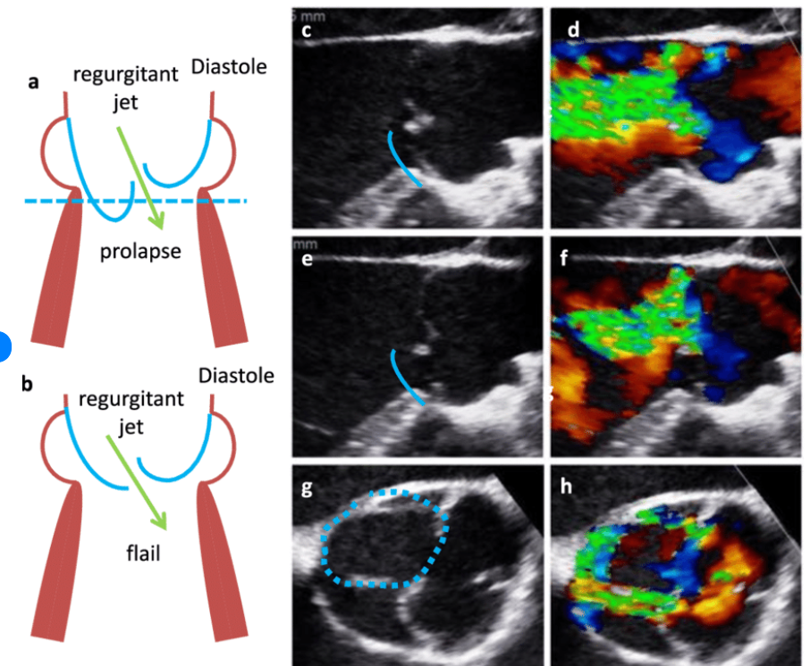
TEE VIEWS

Slide 18
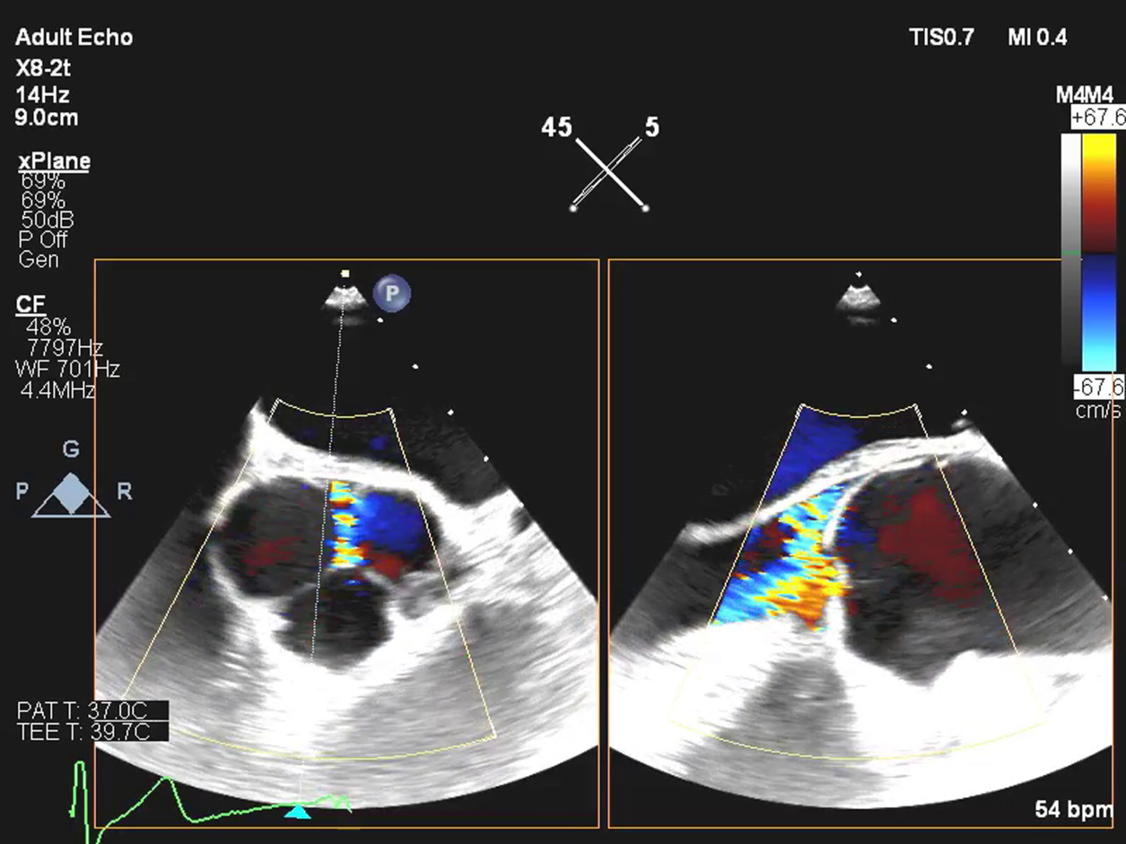
Free edge fenestration with eccentric AR jet

Slide 19
3: Poor cusp quality or quantity
Thickened and rigid valves with reduced motion
Tissue destruction (endocarditis)
Large calcification spots/extensive calcifications of all cusps interfering with cusp motion

Slide 20
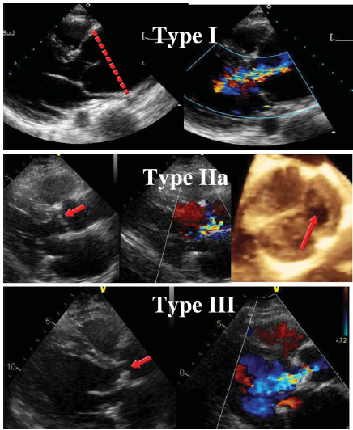

Slide 21
CHRONIC VERSUS ACUTE AORTIC REGURGITATION
PARAMETER | CHRONIC | ACUTE
ETIOLOGY(examples) | BICUSPID VALVE HYPERTENSION | ENDOCARDITIS AORTIC DISSECTION
LV Size | DIALATED | NORMAL
LV EDP | NORMAL | ELEVATED
PULSE PRESSURE | WIDE | NARROW
CW DOPPLER SLOPE | FLAT | STEEP

Slide 22
ECHO ASSESSMENT OF AR
Valve anatomy and aortic root
Assessment of LV size and function.
Aortic dimensions
Doppler methods
Colour flow doppler
Pulsed wave doppler
CW Doppler

Slide 23
Assessment of LV size and function
M-mode echo-leading edge method for linear measurements
End systolic diameter
End diastolic diameter
2D measurements in abnormally shaped LV.
LV volume and EF-modified Simpsons method
EF less reliable indicator of LV dysfunction.

Slide 24
Assessment of LV size and function
In the context of chronic AR, the left ventricle (LV) is exposed to increased preload, leading to adaptive changes including progressive dilatation and eccentric left ventricular hypertrophy (LVH).
A normal indexed LV volume in and of itself therefore almost always rules out severe AR, except in rare circumstances including acute AR.

Slide 25
Assessment of LV size and function
Global longitudinal strain (GLS)- Global longitudinal strain (GLS) obtained using speckle tissue tracking may provide an indication of early LV dysfunction .
As with other forms of heart valve disease, GLS in patients with AR becomes reduced as the disease progresses

Slide 26
Aortic dimensions
A comprehensive assessment of the aorta (Ao) is essential in the context of AR.
Firstly, because aortic dilatation may itself be the cause of the regurgitation (Type I AR)
Secondly, variant anatomy such as BAV is associated with aortic enlargement
Finally, the presence and pattern of aortic dilatation radically alters the potential approach to aortic valve intervention.

Slide 27
Aortic root (AoR) and ascending aorta (AscAo) should be measured from the PLAX window at three levels: the Sinus of Valsalva (SoV); the sino-tubular junction (STJ); and the AscAo defined as a level 1cm above the STJ.
The aorta shape and contours as well as the absence or presence of an aortic dissection flap should be described.

Slide 28
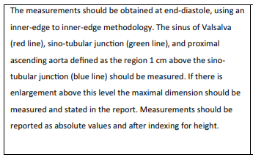
Yellow line

Slide 29
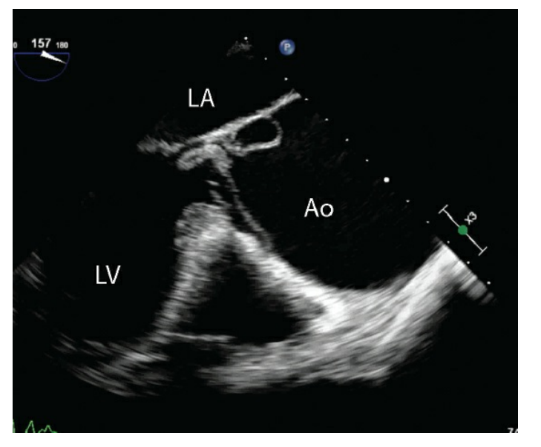
Type A aortic dissection causing severe aortic regurgitation in a patient with bicuspid aortic valve.
During diastole, the dissection flap herniates through the aortic valve into the left ventricular outflow track

Slide 30
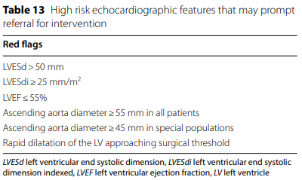
Special populations such as patients with Marfan syndrome, a BAV or aortic coarctation have a lower threshold, ranging between 45-50mm (and rarely 40mm).
An aortic dimension≥45mm in the presence of severe AR would usually prompt concomitant AoR replacement at the time of aortic valve intervention

Slide 31
COLOUR FLOW DOPPLER
REGURGITANT LESION HAS 3 COMPONENTS
FLOW CONVERGANCE
VENA CONTRACTA
JET DIRECTION AND SIZE
Jet area and jet length –not recommended
Jet width
Jet width/LVOT ratio>65%-SEVERE AR

Slide 32
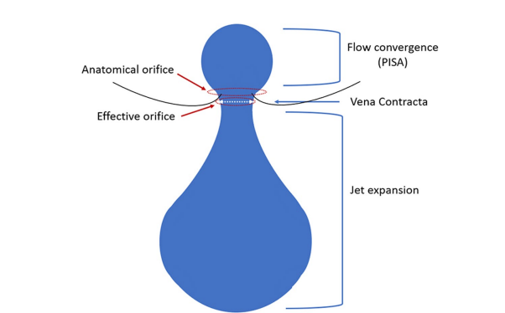

Slide 33
COLOUR FLOW DOPPLER
Parasternal views are preffered
Jet area and length are weakly correlated with severity
Visual assessment
Over estimated in apical view
Affected by aorta to LV diastolic pressure gradient and LV compliance.

Slide 34
COLOUR FLOW CONVERGENCE
Crude qualitative visual approach.
It is based on the principle that a small hemisphere of CFC with small jet expansion corresponds with mild regurgitation, whereas a large hemisphere of CFC with large jet expansion predicts severe AR
Several limitations associated with using this technique including jet momentum, jet direction, and orifice geometry ->lead to under- or over-estimation.

Slide 35
COLOUR FLOW CONVERGENCE
In the setting of
confined flow convergence zones (such as perforation and commissural lesions) and
Obtuse flow convergence angles (such as cusp prolapse), assessment of AR severity using the CFC zone should be treated with caution.
When using this approach, there may be value in utilizing a multi-plane function so that the CFC zone can be visualized in two orthogonal planes simultaneously .

Slide 36
COLOUR FLOW CONVERGENCE
Particularly for eccentric jets, multi-plane imaging may optimise the visualisation of the three components of the colour jet, essential for measurement of the CFC radius.
Off axis imaging should also be considered where needed.

Slide 37
COLOUR FLOW CONVERGENCE
Proximal colour flow convergence (CFC) is best measured from an apical 5 (A5CH) or 3-chamber (A3CH) view.
In this view, the regurgitant jet direction is best aligned with the imaging plane.
A parasternal long axis (PLAX) view may be more appropriate in the setting of eccentric jets.
Visually, the CFC should be evaluated as small or large.

Slide 38
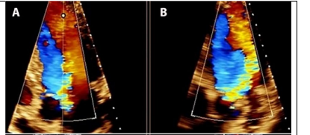
Central jet of AR with a large CFC hemisphere using a multi- plane view from an apical view.

Slide 39
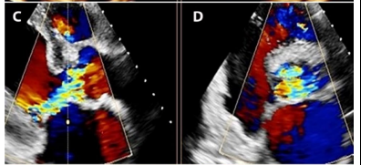
Eccentric jet of AR with a large CFC hemisphere from a parasternal view

Slide 40
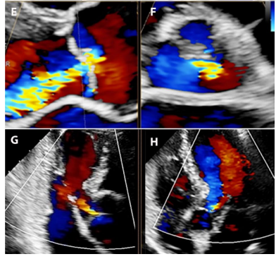
Small CFC hemisphere likely consistent with moderate aortic regurgitation

Slide 41
No clear CFC hemisphere likely consistent with mild or less AR.

Slide 42
JET WIDTH/LVOT RATIO
Jet width immediately below aortic valve
Proportional to the aortic valve defect
Jet width/LVOT ratio more accurate
Jet width/LVOT ratio>65% severe AR

Slide 43
VENA CONTRACTA
Regurgitant jets have three constituent parts: the flow convergence zone, the vena contracta (VC), and jet expansion .
The VC represents the narrowest portion or the ‘neck’ of the jet, and it is directly related to the size of the regurgitant orifice.

Slide 44
VENA CONTRACTA
VC does not occur at the level of the cusp tips, but immediately downstream: when blood flows through an orifice, the jet continues to ‘contract’ for a short duration.
The anatomical orifice is what allows regurgitation to occur, and whilst the effective orifice is smaller (as the jet initially contracts prior to expansion), it is the effective orifice or effective regurgitant orifice area (EROA) that correlates with AR severity and prognosis .
VC width provides a surrogate measure for the EROA when the effective orifice is circular

Slide 45
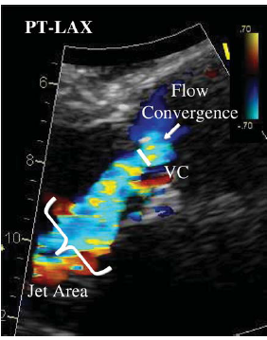

Slide 46
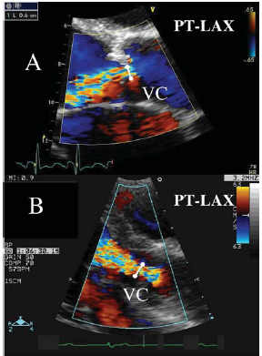

Slide 47
VENA CONTRACTA
Vena contracta <3mm-mild AR, >6mm severe AR using a niquist limit of 50-60cm/sec.
Not useful in multiple jets and if the regurgitant orifice is not circular

Slide 48
PISA METHOD
Image the flow convergance zone in
apical three or five chamber
parasternal long axis
upper right parasternal views
Area of interest is expanded using zoom mode
Color sector size is reduced to maximize the frame rate
Niquist limit is adjusted to obtain a clearly visible round PISA radius

Slide 49
PISA METHOD
Colour flow velocity scale is shifted towards the direction jet
The PISA radius is measured as the distance between regurgitant orifice and the first aliasing in early diastole
Flow rate (Q) =2лr² х Va
EROA= (6.28 X r² X V_{a}) / Peak V _{reg}

Slide 50
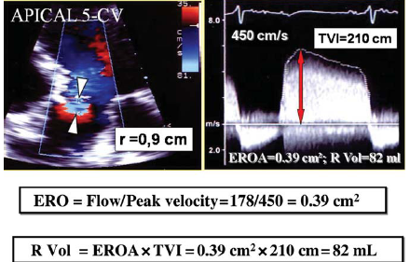

Slide 51
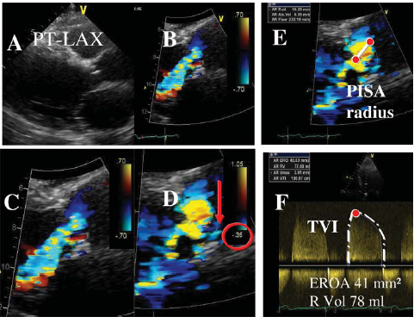

Slide 52
DOPPLER VOLUMETRIC METHOD
Based on comparison of measurement of aortic stroke volume at the LVOT with mitral or pulmonic stroke volume.
Regurgitant volume=SV _{Reg valve} – SV _{Comp Valve}
RegurgitaFraction=SV _{Reg Valve} – SV _{CompValve}/Sv _{Reg Valve}
Systemic stroke volume=LVOT area(Лd2/4=0.785d2) X LVOT VTI

Slide 53
AR regurgitant volume=LVOT stroke volume(total)-Mitral inflow volume(competent valve)
EROA =Regurgitant volume /TVI of regurgitant jet
Regurgitant fraction=Regurgitant volume /Total flow

Slide 54
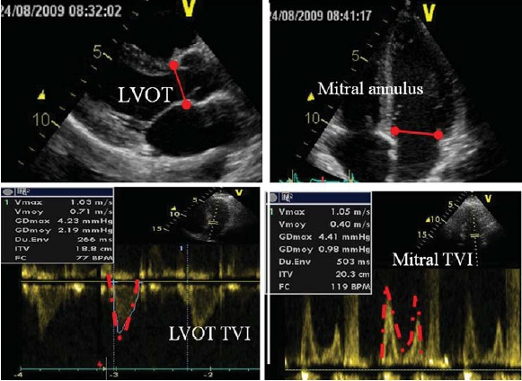

Slide 55
CONTINUOUS WAVE DOPPLER
Signal density
reflects volume of regurgitation
Faint spectral display-mild AR
Dense display-mod to severe AR
overlap between mod to severe AR
Imperfect indicator of severity

Slide 56
DIASTOLIC DECELERATION AND PHT
Rate of deceleration and the derived PHT reflect rate of equalizatiaon of aortic and LV diastolic pressure.
Shape of deceleration slope provides semi quantitative measure of severity of AR
Flat slope indicates mild AR
Steep slope indicates severe AR
PHT <200-severe AR,>500 –mild AR

Slide 57
The more severe the AR, the faster the equalisation of pressure, the steeper the AR deceleration slope and the shorter the PHT .
An accurate assessment of PHT requires a complete CW envelope; as such, a poorly aligned Doppler cursor, eccentric jets and multiple jets will impact on the accuracy of this measurement.

Slide 58
Another important limitation is that when LV diastolic filling pressure is increased, the pressure difference between the Ao and LV is reduced, resulting in a short PHT even in the absence of severe AR.

Slide 59
FLOW REVERSAL IN THE DESCENDING THORACIC AORTA AND ABDOMINAL AORTA
If the AR regurgitant volume is sufficiently large, blood flow in the aorta (Ao) will reverse during diastole.
As AR becomes progressively more severe, diastolic flow reversal lasts proportionately more of diastole.
Holodiastolic flow reversal with an end diastolic velocity≥20cm/s in the descending thoracic Ao is both sensitive and highly specific for severe AR, whereas non-holodiastolic flow reversal is consistent with moderate AR

Slide 60
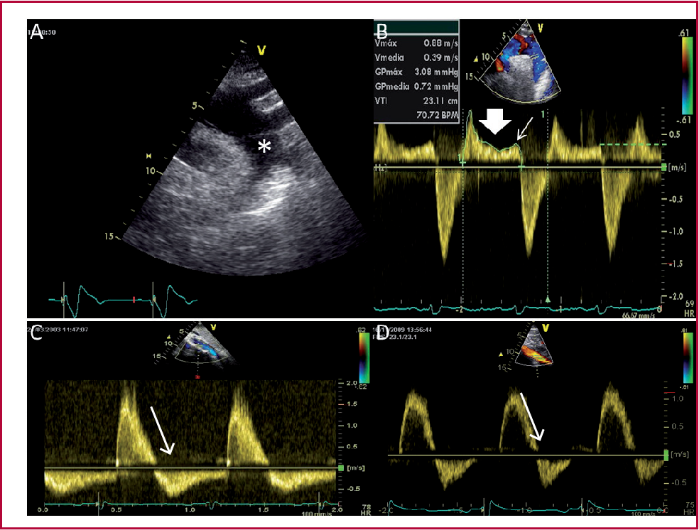
From a suprasternal window, the descending aorta (DAo) should be opened out with colour Doppler imaging used to demonstrate forward flow.
The pulsed wave (PW) sample volume should be placed within the proximal DAo just distal (approx. 10mm) to the origin of left subclavian artery. Diastolic flow reversal is evident above the baseline on the spectral Doppler display

Slide 61
It is important to appreciate that flow reversal is occasionally seen in the setting of rapid elastic recoil of the descending Ao and/or aortic stiffness of the abdominal Ao even in the absence of important AR.

Slide 62
PARAMETERS | MILD | MODERATE | SEVERE
SEMI QUANTITATIVE
VC Width(mm) | <3 | Intermediate | >6
Pressure half time (ms) | >500 | Intermediate | <200
QUANTITATIVE
EROA(mm²) | <10 | 10-19; 20-29 | >30
R Vol (mL) | <30 | 30-44; 45-59 | >60

Slide 63
ACUTE SEVERE AR
Infective endocraditis,aortic dissection.
ECHO:
Vegetations
LV size normal
High frequency fluttering of AML
Premature closure of mitral valve
diastolic MR
CW doppler steep slope

Slide 64
Asymptomatic AR
Follow up:
Asymptomatic mild AR, normal EF ,no LV dilatation-> ECHO every 2-3 yrs.
In severe AR ,LV EDD 60-65mm,normal systolic function every 12 months.
Every 6 months in patients with LVEDD 70mm,
End systolic diameter 50mm.

Slide 65
GRADING THE SEVERITY OF AR
PARAMETERS | MILD | MODERATE | SEVERE
QUALITATIVE
Aortic valve morphology | Normal/ abnormal | Normal/abnormal | Abnormal/flail/ large coaptation defect
Colour flow AR jet width | Small in central jets | Intermediate | Large in central jet, variable in eccentric jets
CW signal of AR jet | Incomplete/faint | Dense | Dense
Diastolic flow reversal in descending aorta | Brief,protodiastolic flow reversal |  | Holodiastolic flow reversal(end diastolic velocity >20cm/s)

Slide 66
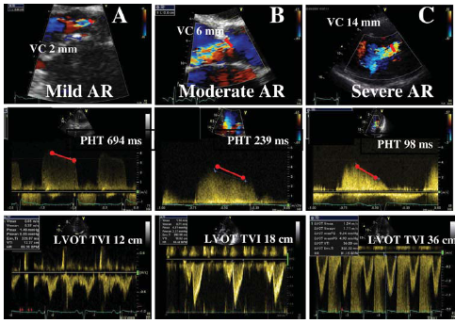

Slide 67
MCQ 1
According to functional classification, AR due to infective endocarditis falls into
a.type1
b.type2a
c.type3
d.type2b

Slide 68
MCQ 2
2.All are true about venacontracta in AR except
a. venacontracta >6mm indicates severe AR
b. useful in multiple jets
c. obtained in central jets
d. it provides an estimate of the size of EROA

Slide 69
MCQ 3
3. True about mild AR
a. venacontracta >3mm
b. pressure half time <500
c. EROA <10mm2
d. regurgitant volume >30ml

Slide 70
MCQ 4
4. Severe AR is characterised by all except
a. jet width/ LVOT width >65%
b. regurgitant volume >60ml/beat
c. regurgitant fraction >30
d. PHT >200

Slide 71
MCQ 5
5. True about colour flow doppler in AR are all except
a. parasternal views are preferred over apical views
b. jet area and length are strongly correlated with severity of AR
c. jet width to LVOT ratio >65 indicates severe AR
d. central jet suggestive of rheumatic disease

Slide 72
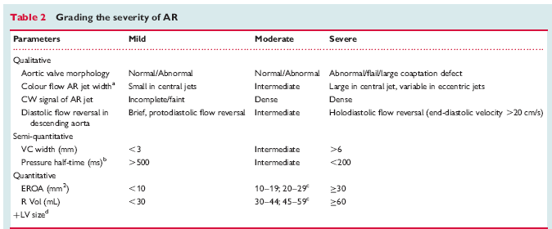

Slide 73
THANK YOU

