Slide 1
DEVELOPMENT OF INTERATRIAL AND INTERVENTRICULAR SEPTUM
POOJA VENU

Slide 2
Heart embryology
Right and left Endocardial heart tubes
Both fuse together
The single tube- series of dilatations
Bulbus cordis
Primitive Ventricle
Primitive atrium
Sinus venosus

Slide 3
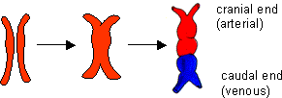

Slide 4
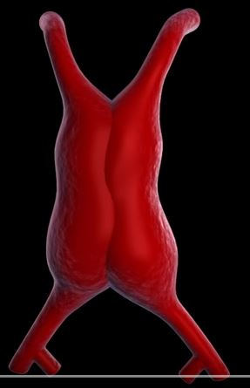

Slide 5

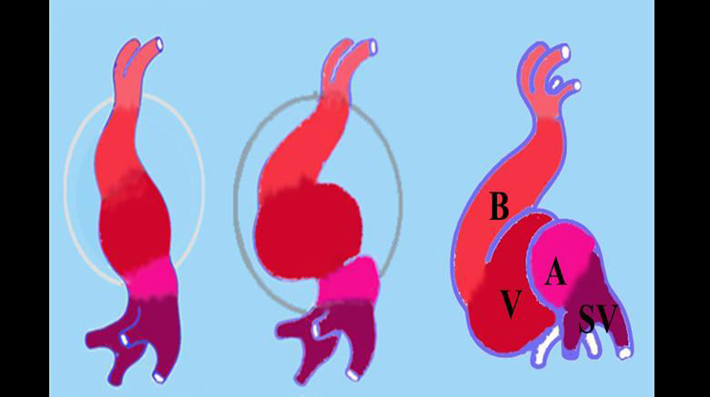
During the 4th week, the folding of the heart tube takes place.
The formation of the AV canal and the endocardial cushions also take place around the same time.

Slide 6
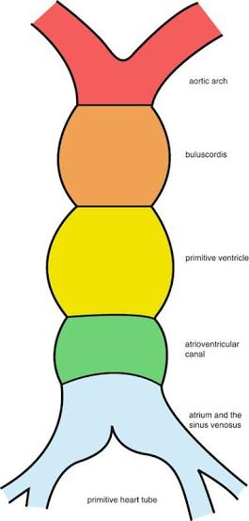

Slide 7
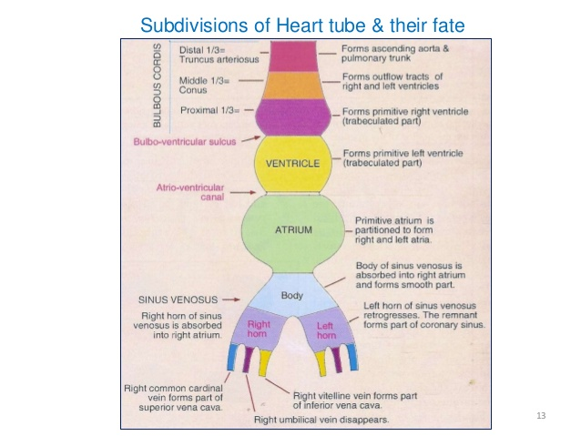

Slide 8
Sinus venosus and its absorption into the right ventricle
This is the caudal most part of the primitive heart tube.
It represents a body with two prolongations that are referred to as its right and left horns
Vitelline vein
Umbilical vein
Common cardinal vein / duct of cuvier
Initially both horns are of equal size

Slide 9
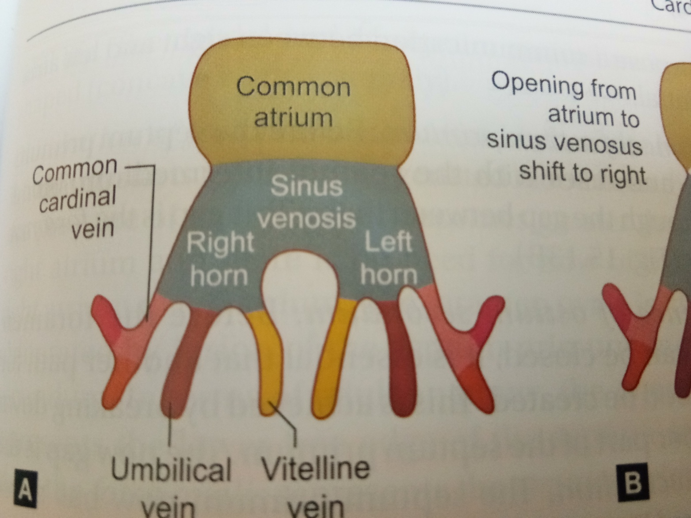

Slide 10
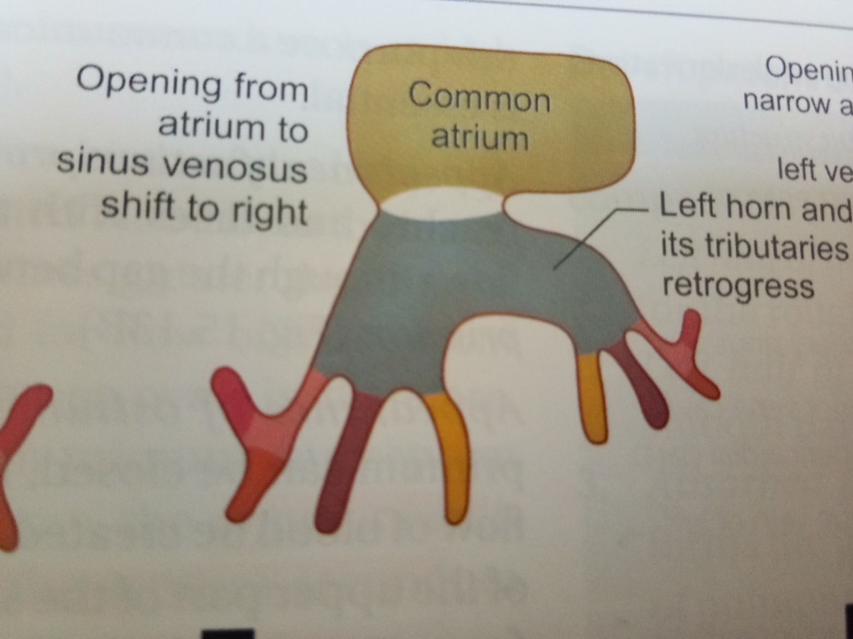

Slide 11
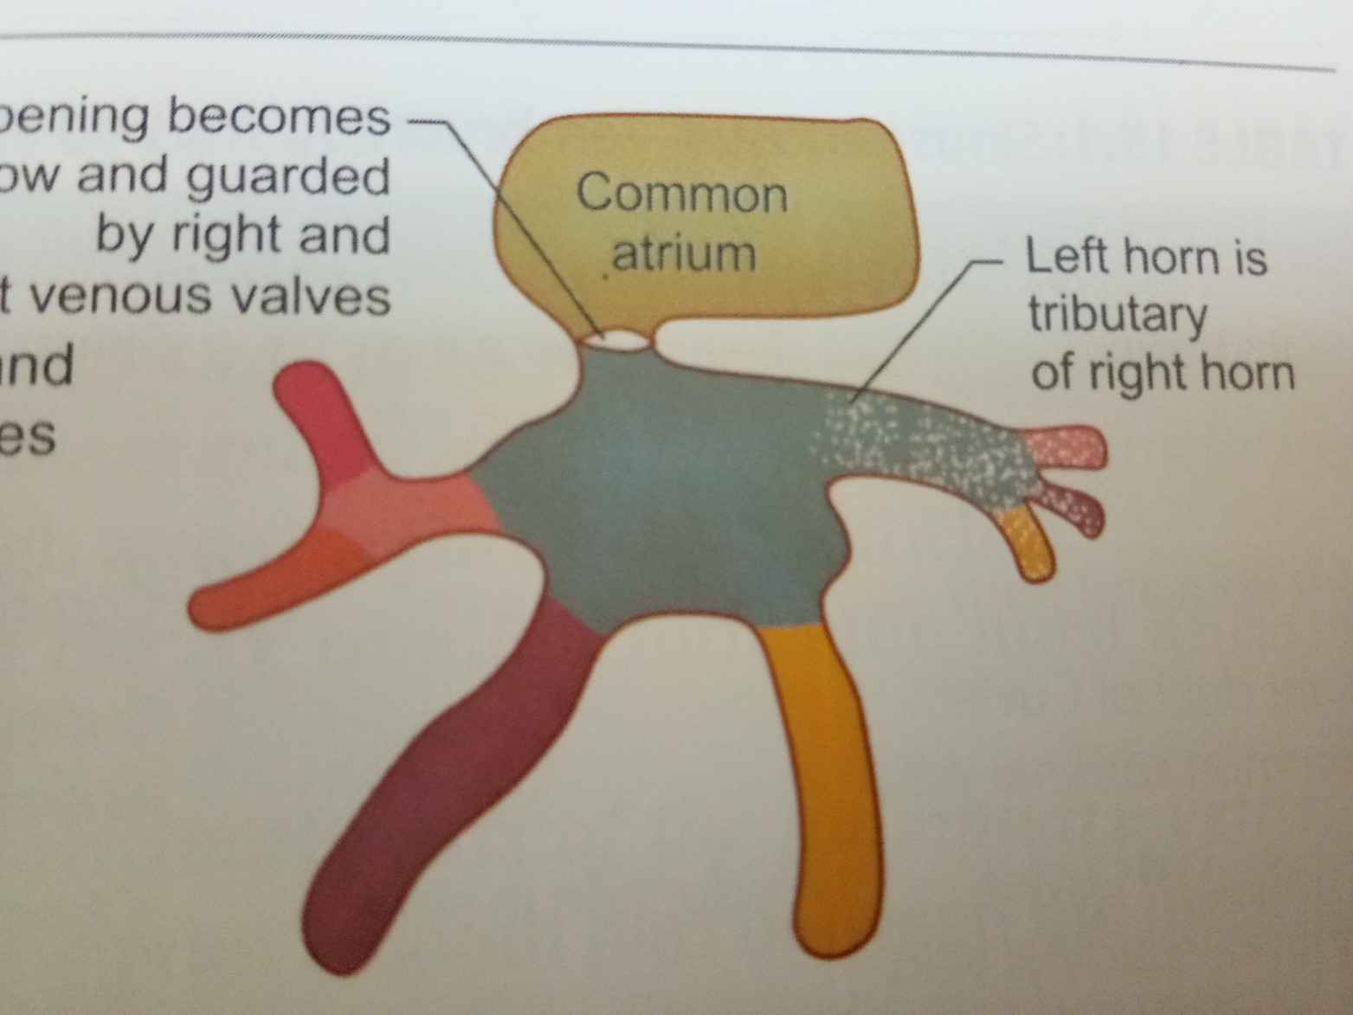

Slide 12
Regression of left horn and its tributaries-
The right groove remains shallow but the left one becomes very deep
It results in that left part becomes completely separated from the atrial chamber.
The left horn becomes reduced in size and appears like a tributary of the right horn of sinus venosus.
The left horn becomes part of coronary sinus

Slide 13
Sinoatrial orifice
Initially sinoatrial orifice- transverse, larger and median in position
Later the opening becomes narrow and shifts to the right and onto the dorsal aspect of the atrium
It changes its orientation from transverse to oval and finally to vertical with a narrow slit

Slide 14
Fate of tributaries of sinus venosus
Embryonic part | Adult part
Left horn and body | Coronary sinus
Right common cardinal vein | SVC
Right vitelline vein | IVC

Slide 15
The major septa of the heart are formed between the 27th and 37th days of development.
When the embryo grows in length from 5 mm to approx. 16 to 17 mm.
Septum formation can involves-
Endocardial cushions formation
Passive expansion of chambers

Slide 16
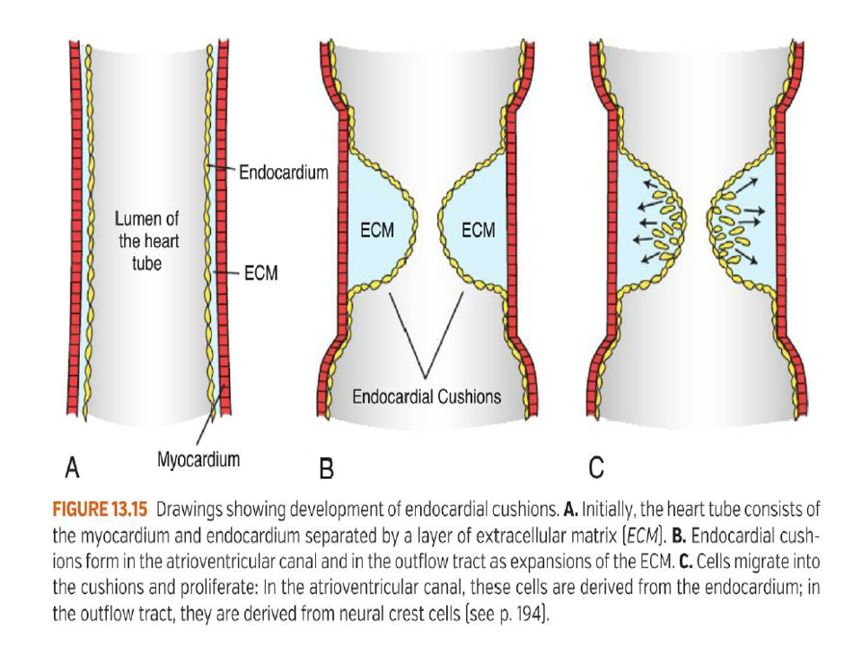

Slide 17
Formation of the Cardiac Septa
The Atrioventricular (AV) septum
Atrial septum
Interventricular septum
Aorticopulmonary septum

Slide 18
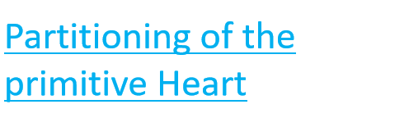
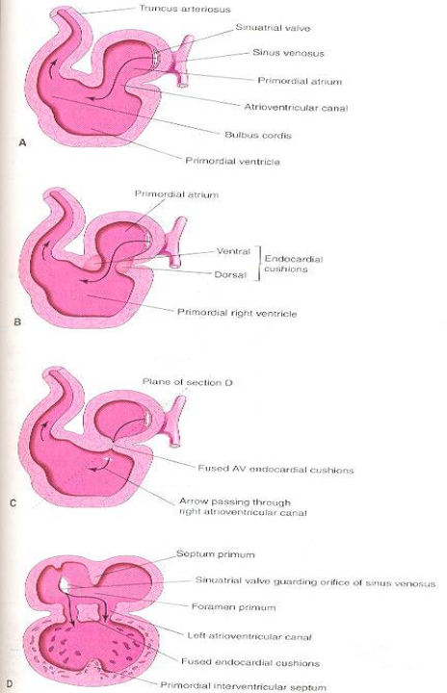
Division of A-V canal , primitive atrium & primitive ventricle begins at the middle or end of 4th week and completed by the end of 5th week.
These processes occur concurrently.
At the end of 4th week, 2 endocardial cushions on dorsal & ventral walls of atrioventricular canal , develop from mesenchymal cells of cardiac jelly.

Slide 19
During 5th week, the AV- endocardial cushions meet and unite in the mid line to form a septum and divide the common A-V canal into right & left A-V canals.
Endocardial cushions also form the AV- valves + membranous septa of interventricular septum.
Note in D, coronal section ,begining of development of interatrial & intervent. septa.

Slide 20
Atrial septation
The primary atrial septum (septum primum) forms by active growth of a myocardial septum
Initially the primordium of this septum can be seen as a ridge in the medial roof of the common atrium.
The leading edge of the ridge is covered with a mesenchymal cap termed the spina vestibuli, which is contiguous superiorly with the superior AV cushion and inferiorly with the inferior AV cushion

Slide 21
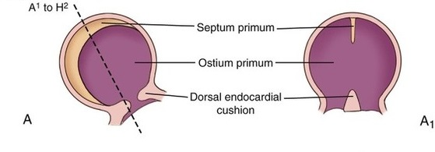

Slide 22
Concomitantly, perforations appear in the superior aspect of the primary atrial septum.
These perforations coalesce, resulting in the secondary atrial foramen (or ostium secondum).
Next the secondary atrial septum develops as an infolding of the atrial roof located between the primary septum and the left venous valve.
The foramen ovale is the opening bordered by the free edge of the septum secondum

Slide 23
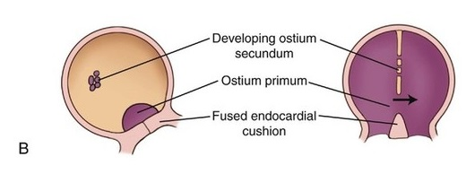

Slide 24
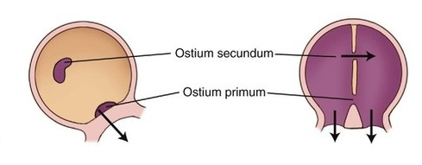

Slide 25
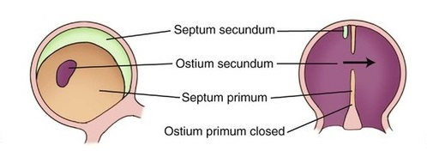

Slide 26
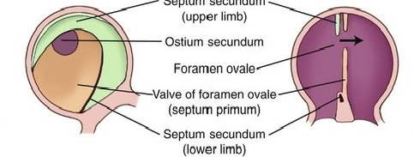

Slide 27
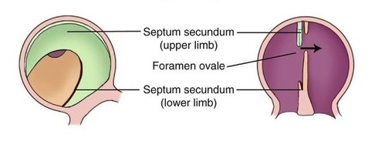

Slide 28
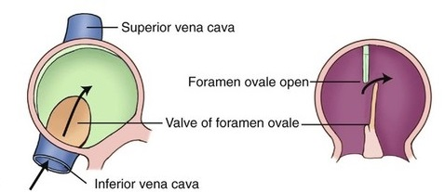

Slide 29
As the primary septum descends from the roof of the atrium toward the AV canal, thereby decreasing the size of ostium primum, the mesenchymal leading edge continues to fuse with the AV cushions, which themselves are also in the process of fusing.
These events result in closure of the primary interatrial formanen (ostium primum) and the formation of the central fibrous body

Slide 30
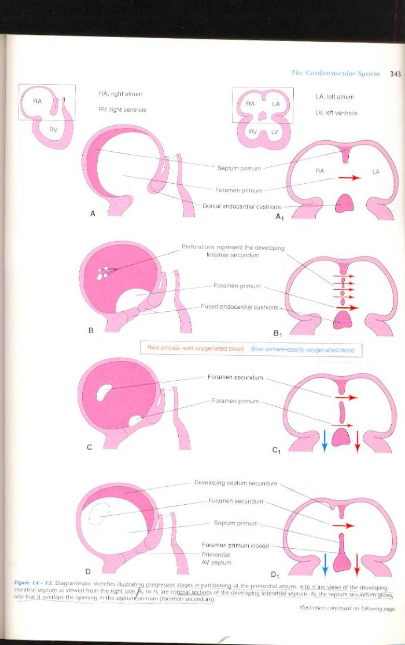

Slide 31
Once the two septa overlap blood has to flow through the interval between the septa. This gap is the foramen ovale
It is an oblique valvular passage that allows blood to flow from right to left but not left to right.
This is patent throughout fetal life

Slide 32
Obliteration of the foramen ovale
After birth of the baby, the left atrium starts receiving oxygenated blood from the lungs, the pressure of this chamber becomes greater than that of right atrium and there is no need for flow of blood from right atrium to left atrium.
The foramen ovale is, therefore, obliterated by fusion of the septum primum and septum secondum.
Annulus ovalis represents the lower free edge of the septum secondum while the fossa ovalis represents the septum primum

Slide 33
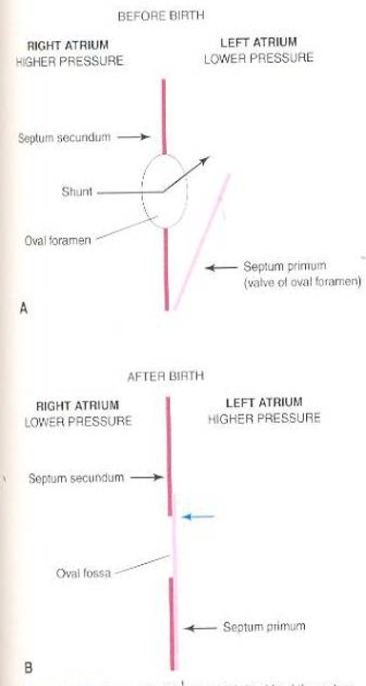

Slide 34
Multiple genetic factors including Tbx5, Nkx-2.5, Evc and Prk-AR1, have been identified in patients with abnormal atrial morphogenesis and septation

Slide 35
The fossa ovalis oocupies about 28% of the septal area, irrespective of the age, and is bordered by a limbus and guarded by a valve.
After birth the patent foramen ovale closes via fusion of its valve with the limbus of fossa ovalis as left atrial pressure exceeds right atrial pressure.
The incidence of persistent patency of foramen ovale declines from about 1/3 during the first three decades of life to about ¼ during fourth to eighth decades
Redundancy of the valve of the foramen is responsible for an atrial septal aneurysm

Slide 36
AV CANAL
Division of the AV canal into left and right sided orifices occurs as a result of fusion of the superior and inferior AV cushions.

Slide 37
Atrioventricular canal
This is the communication between common atrial chamber and ventricle.
The AV canal divides into right and left halves as follows-
The AV canal is circular in shape initially and later becomes traverse.
Two thickenings, the AV endocardial cushions appear on the dorsal and ventral walls of AV canal by proliferation of subendocardial mesenchymal cells around right and left AV canals.

Slide 38
They grow toward each other and fuse. The fused cushions form the septum intermedium.
The AV endocardial cushions take part in the formation of interatrial and interventricular septa

Slide 39
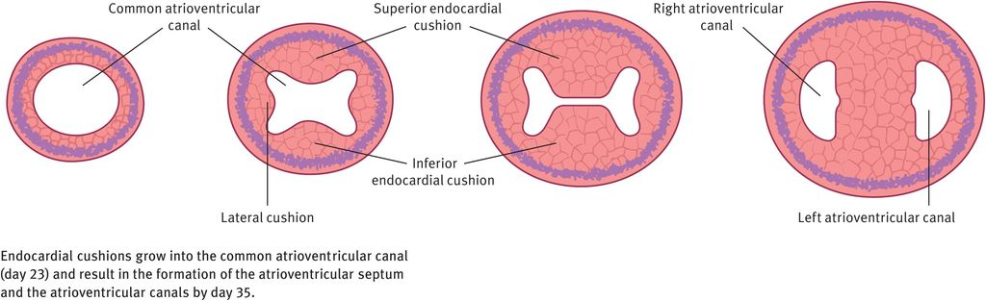

Slide 40
Interventricular septum formation
The ventricular cavity formed after the conus and the proximal one third of bulbus cordis has merged into the primitive ventricle and has to be subdivided into right and left halves in such a way that each half communicates with the corresponding atrium
The interventricular septum consists of three parts that develop from different sources.
1.muscular
2.bulbar
3.membranous

Slide 41
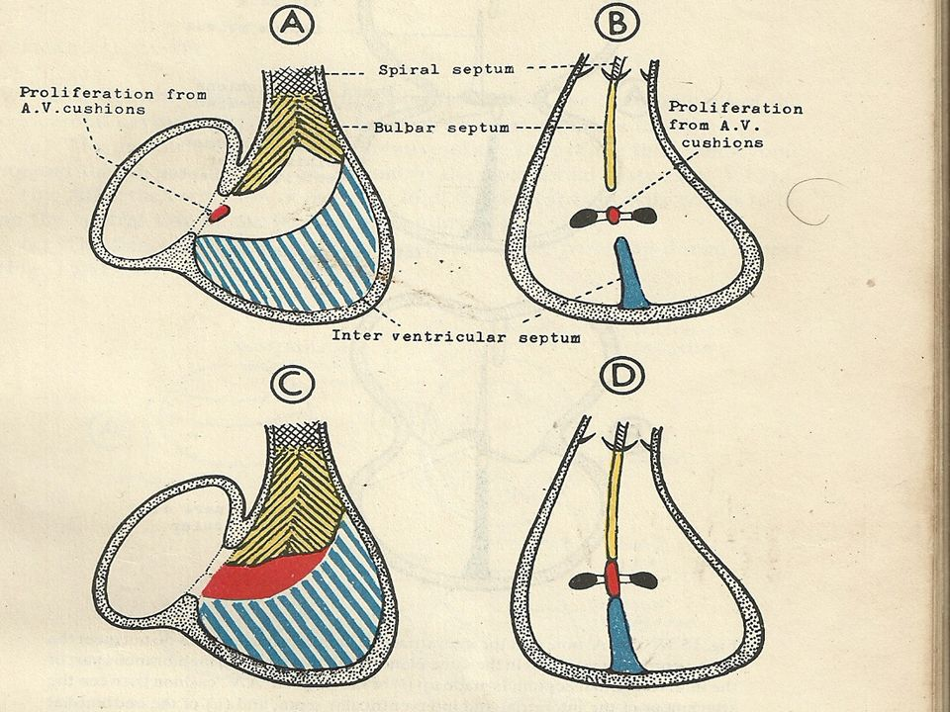

Slide 42
Muscular – a septum called interventricular septum grows upward from the floor of the bulboventricular cavity and divides the lower dilated part of this cavity into right and left halves.
Passive dilatation of bulboventricular cavities on either side of the septum and hemodynamic forces are responsible for this formation
It meets the fused AV cushions (septum intermedium) and partially fuses with them.
On external surface of the heart, the site of formation of the interventricular septum corresponds to the bulboventricular sulcus

Slide 43
The cephalic margin of the septum is free, concave and twisted.
It presents a dorsal and a ventral horn. The dorsal horn fuses with right edge of dorsal AV cushion and the ventral horn fuses with the left edge of ventral AV cushion.
An interventricular foramen appears between the two ventricles at the upper margin of interventricular septum.

Slide 44
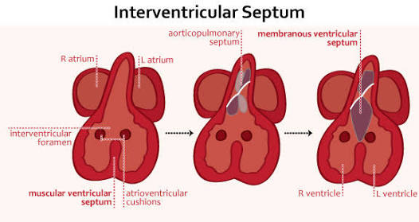

Slide 45
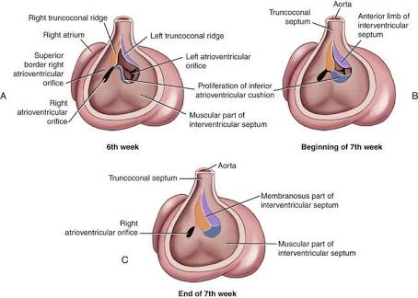

Slide 46
The closure of interventricular foramen is facilitated by septum intermedium and proximal bulbar septum
This foramen closes by the end of 7th week as the 2 bulbar ridges fuse with the endocardial cushion.

Slide 47
Bulbar part
Two ridges termed the right and left bulbar ridges arise in the wall of the bulboventricular cavity (in the part derived from the conus)
The right ridge arises from the dorsal and right wall and is cephalic to right AV orifice. The left ridge arises from the ventral and left wall.
These ridges grow toward each other and fuse to form a bulbar septum.
The right ridge is in line with the dorsal horn and the left ridge with the ventral horn of muscular part of AV septum.

Slide 48
Fusion of right and left bulbar ridges forms the proximal bulbar septum.
The bulbar septum grows downward toward the muscular part of interventricular septum but does not quite reach it, with the result that a gap is still left between the two.

Slide 49
Membranous part
The gap between the upper edge of interventricular septum and the lower edge of the bulbar septum is filled by proliferation of tissue from the right side of the AV cushions and the right and left bulbar ridges.
The membranous part of the interventricular septum is divisible into an anterior part which separates the right and left ventricles and a posterior part which separates the left ventricle from the right atrium ( also called AV septum).

Slide 50
The anterior part is derived from the proliferation of tissue from the endocardial cushions
The interatrial and interventricular septa do not meet the AV cushions in the same line.
As a result, a part of these cushions separates the left ventricle from the right atrium. This part of the AV cushions forms the posterior part of the membranous septum

Slide 51
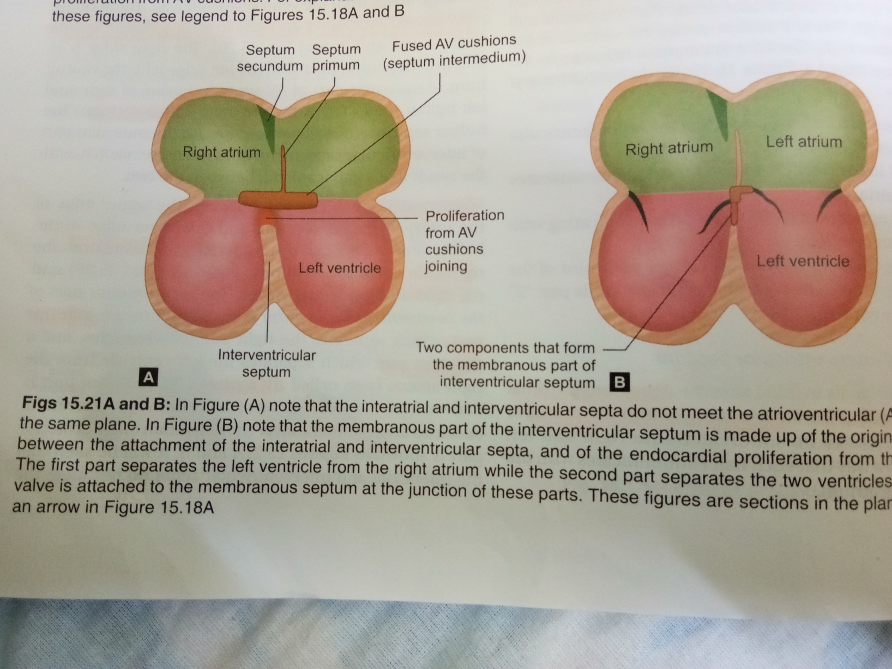

Slide 52
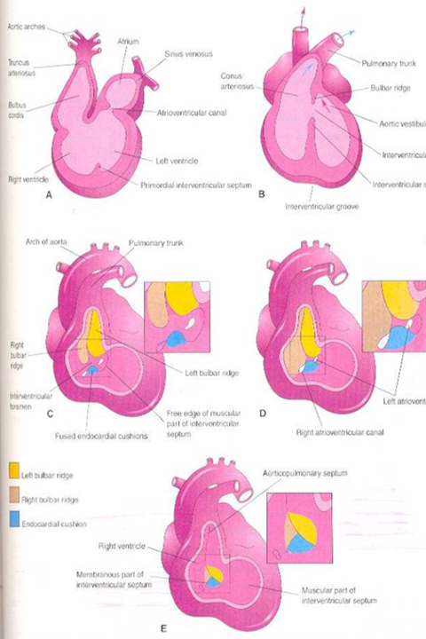
B, coronal s. at 6th w. after incorporation of the proximal part of bulbus cordis into the ventricles.
C,5th w., showing the bulbar ridges & fused endocardial cushions.
D,6th w., proliferation of endocardial cushions to diminish I V foramen.
E,7th w., fusion of bulbar ridges + extensions of endocardial cushions upward with aortico-pulmonary septum and down with muscular I V septum to close I V foramen , so memb. IV septum is formed

Slide 53
MCQS

Slide 54
Left horn of the sinus venosus becomes?
SVC
IVC
Coronary sinus
Left atrium

Slide 55
Ans: coronary sinus

Slide 56
Mcq 2
Ostium secundum develops due to ?
A. fusion of septum primum and septum secundum
B.apoptosis/perforation in upper part of septum primum
C.perforation in septum secundum
D.resorption ofendocardial cushions

Slide 57
B.apoptosis/perforation in upper part of septum primum

Slide 58
Mcq 3
The initial interventricular septum is incomplete due to presence of ?
A.ostium primum
B.ostium secundum
C.interventricular foramen
D.foramen ovale

Slide 59
C.interventricular foramen

Slide 60
thank u

