Slide 1

Cardiac Arrhythmias
BY RESHMA TANIA

Slide 2
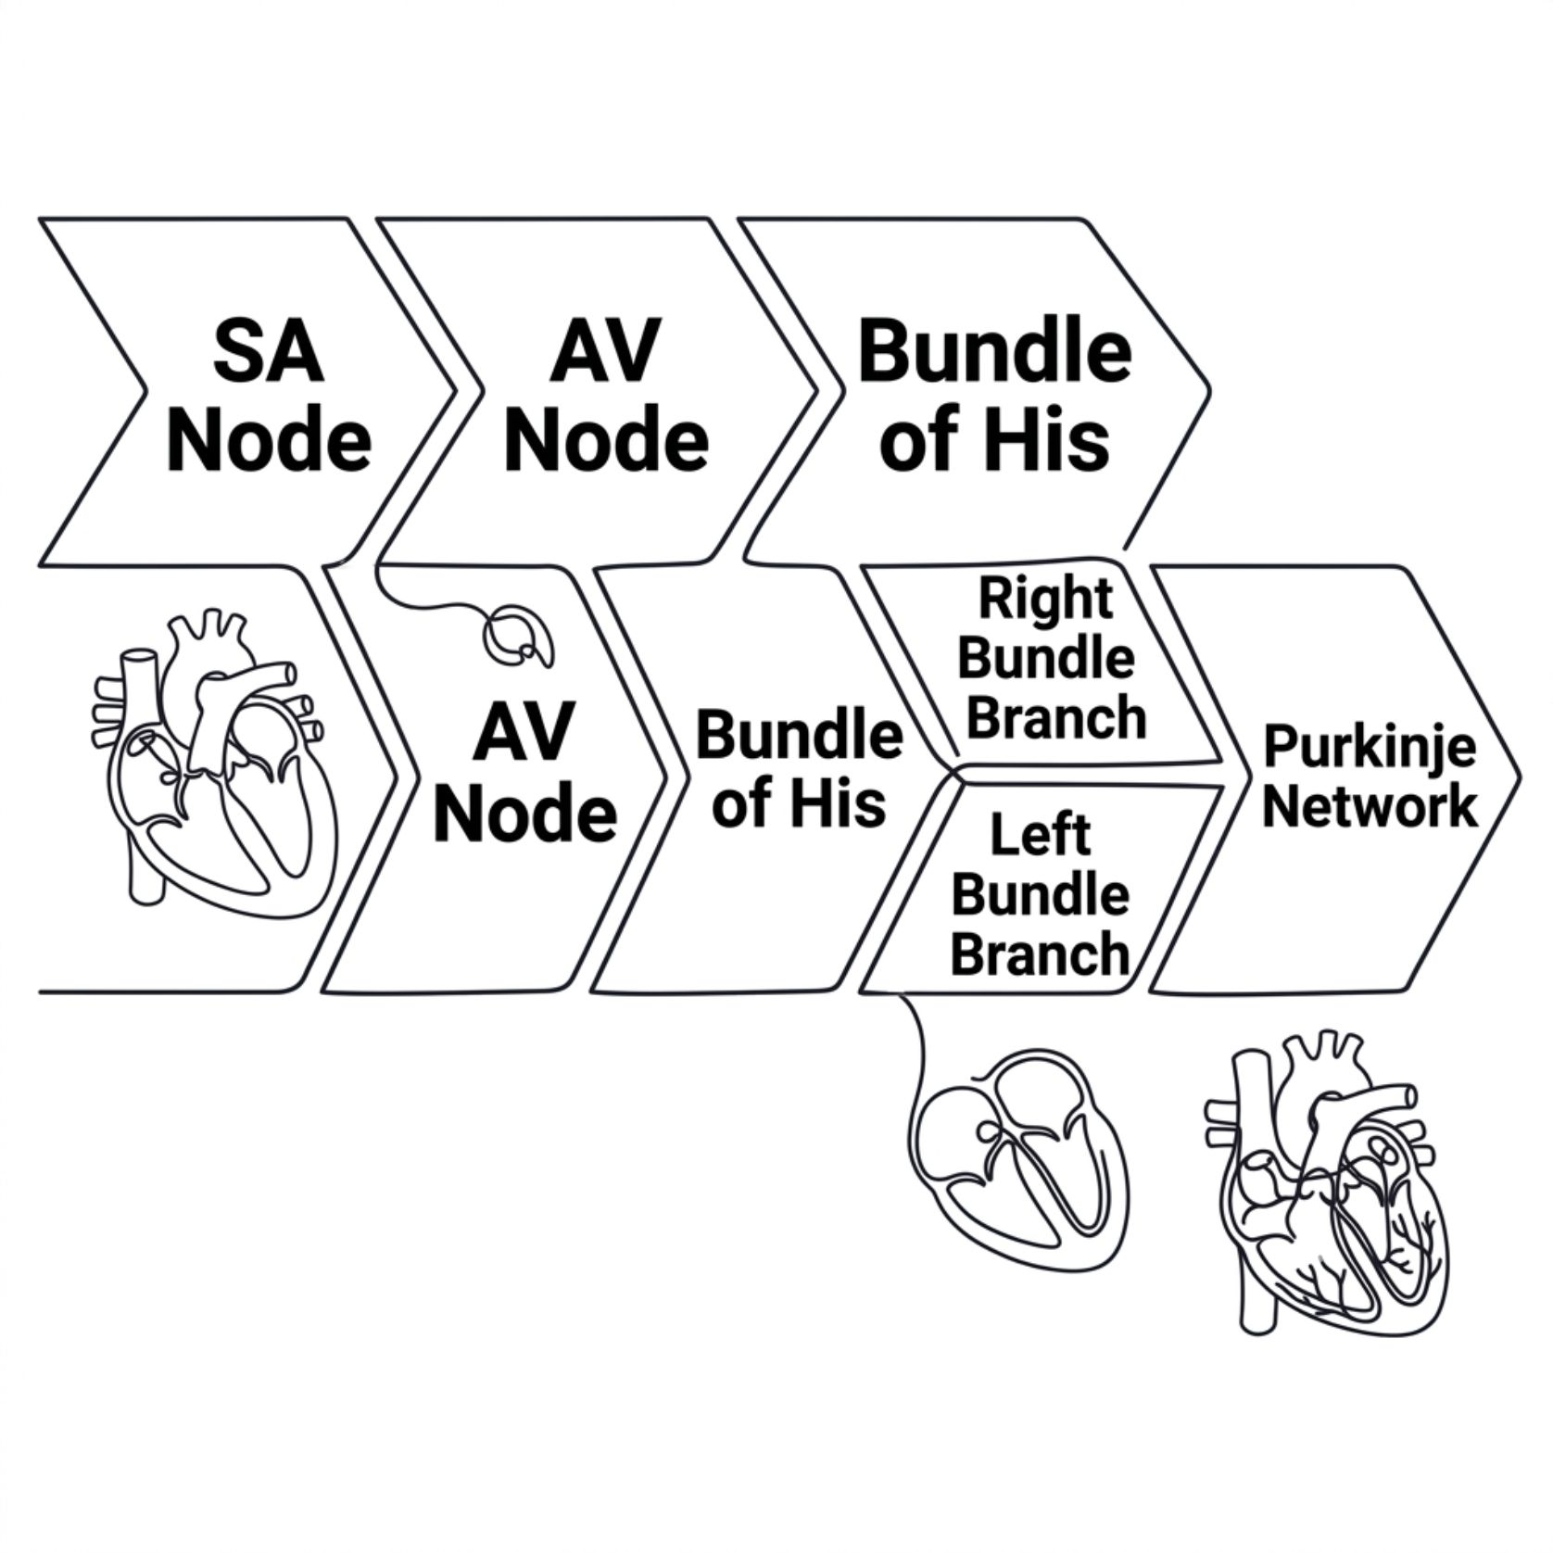
Anatomy of the Cardiac Conducting System
Key Anatomical Notes
SA node: Located along the crista terminalis; primary pacemaker site
AV node: Introduces the critical PR interval conduction delay
Bundle of His: Passes through the membranous interventricular septum
Purkinje network: Activates ventricular muscle from endocardium outward to epicardium

Slide 3
Autonomic Regulation of the SA Node
Vagal Dominance
↑ Vagal Tone
The SA node is primarily under vagal (parasympathetic) influence — the dominant regulator of resting heart rate
Increased vagal activity slows heart rate — as seen during rest, sleep, and Valsalva manoeuvre
↓ Vagal Tone
Sympathetic Role
Decreased vagal activity accelerates heart rate — physiological response during activity or emotion
Sympathetic tone plays a secondary, modulatory role — amplifying rate increases under stress or exertion

Slide 4

Hierarchy of Cardiac Pacemakers
70–80
~60
SA Node
AV Node
Dominant pacemaker — beats/min
Secondary pacemaker — beats/min
~50
30–40
Bundle of His
Purkinje / Ventricular
Tertiary pacemaker — beats/min
Slowest, most distal — beats/min
Clinical Principle
The more distal the pacemaker from the SA node, the slower its inherent rate — ensuring a single dominant pacemaker governs the heart at all times.
This rate hierarchy is the electrophysiological basis of pacemaker dominance and the escape mechanism in conduction failure.

Slide 5
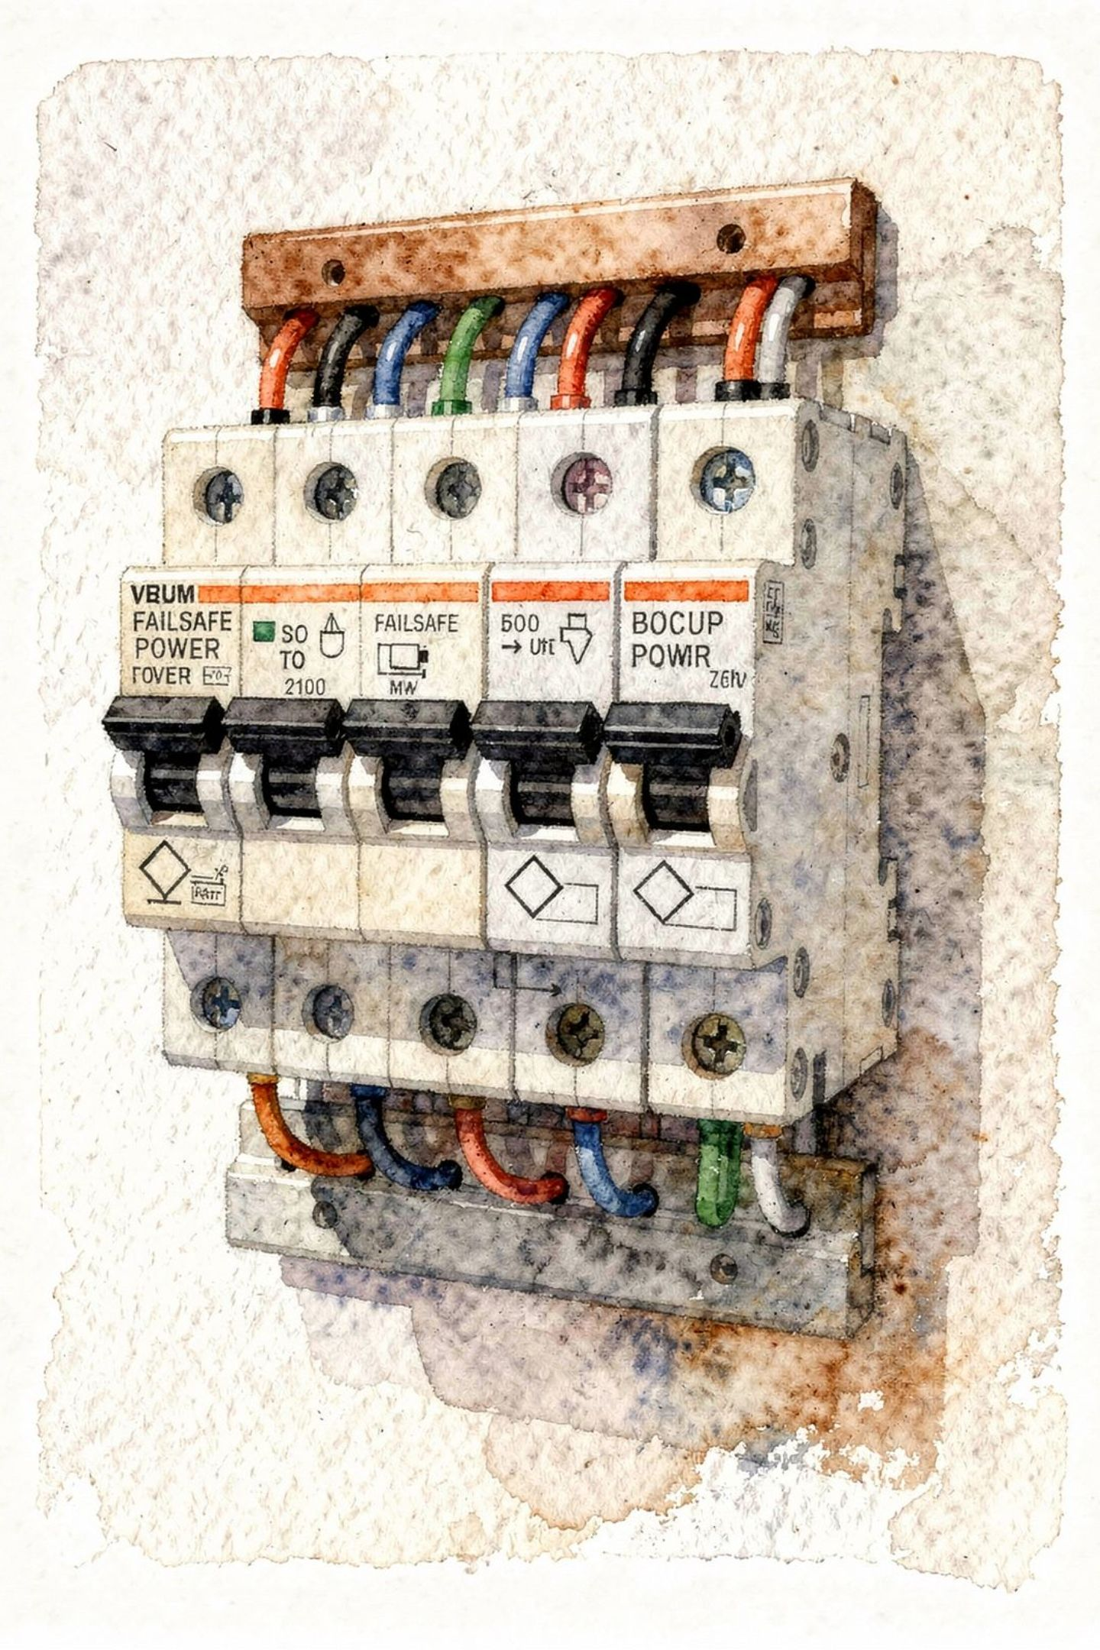
The Concept of Pacemaker Protection
1
Single Governance
Protection ensures only one pacemaker governs the heart at any time — preventing chaotic multi-pacemaker activation
2
Failsafe Takeover
When the fastest pacemaker (SA node) fails, a slower subsidiary pacemaker automatically assumes control
3
Clinical Examples
Marked sinus bradycardia, SA block, or AV block → ventricular escape rhythm activates to maintain cardiac output

Slide 6
Primary vs. Secondary Disorders of Rhythm
Primary Disorders
Secondary Disorders
Reflect a basic, essential abnormality — disturbances of impulse formation or impulse conduction arising intrinsically within the conducting system
Occur only as a result of a primary disorder. Examples include:
Escape rhythms
AV dissociation
Phasic aberrant ventricular conduction
Arrhythmias are classified by both electrophysiological mechanism and anatomic site of origin — the two classifications are complementary and must both be identified.

Slide 7
Disturbances of Impulse Formation
Sinus Rhythms
Atrial Rhythms
Sinus arrhythmia
Sinus tachycardia
Sinus bradycardia
Atrial extrasystoles
Paroxysmal atrial tachycardia
Atrial flutter & fibrillation
AV Junctional Rhythms
Ventricular Rhythms
AV junctional extrasystoles
Junctional ectopic tachycardia
VPCs
Idioventricular rhythm
VT, ventricular flutter, VF
Reciprocal rhythms

Slide 8
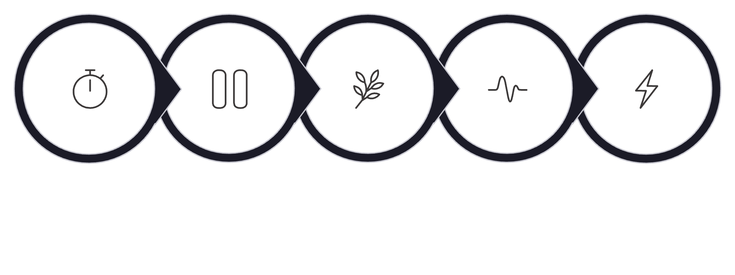
Disturbances of Impulse Conduction
Clinical Summary
SA block: Failure of impulse exit from the SA node
AV block: Delayed or failed conduction through the AV node
Bundle branch blocks & hemiblocks: Impaired conduction in the His-Purkinje system
Non-specific intraventricular conduction abnormalities: Diffuse conduction delay not meeting BBB criteria
WPW syndrome: Accessory pathway pre-excitation — bypass of normal AV delay
SA Block
AV Block
Bundle Branch
Intraventricular Abnl
WPW Syndrome

Slide 9
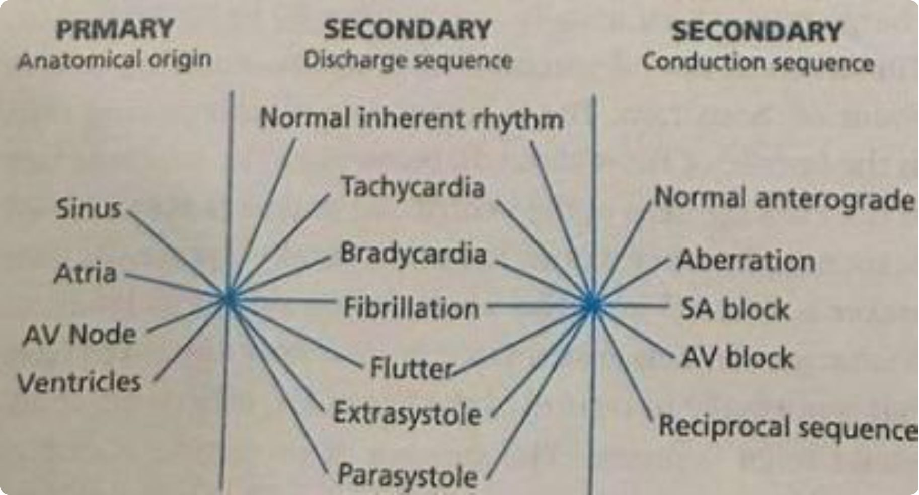
Classification of Arrhythmias: Overview
Three Classification Axes
Primary Anatomical Origin
Sinus node, Atria, AV Node, or Ventricles — the most critical determinant
Secondary Discharge Sequence
Normal rhythm, tachycardia, bradycardia, flutter, fibrillation, extrasystole, or parasystole
Secondary Conduction Sequence
Normal anterograde, aberration, SA block, AV block, or reciprocal sequence

Slide 10




Three Fundamental Properties of Every Cardiac Rhythm
1. Anatomical Origin
SA node, atria, AV node, or ventricles — the most critical single aspect of any rhythm diagnosis
2. Discharge Sequence
Normal inherent rhythm, tachycardia, bradycardia, extrasystole, flutter, or fibrillation
3. Conduction Sequence
e.g., 2:1 AV block, complete AV block, 2:1 SA block — must be specified precisely
.

Slide 11
Diagnostic Approach to Abnormal Heart Rhythms
Define the Atrial Deflection
Determine the Atrial Rate
Assess Regularity of Atrial Rhythm
Normal P wave, ectopic P' wave, flutter (F) wave, or fibrillation (f) wave — the starting point of every rhythm analysis
Calculate from PP intervals using the standard ECG rate methods
Regular, regularly irregular, or irregularly irregular — critical for narrowing the differential
Relationship of P to QRS
Analyse QRS Configuration
Determine the relationship of atrial deflections to QRS complexes — fixed, variable, or absent association
Narrow vs. wide, morphology and axis — determines ventricular conduction and origin of the rhythm

Slide 12
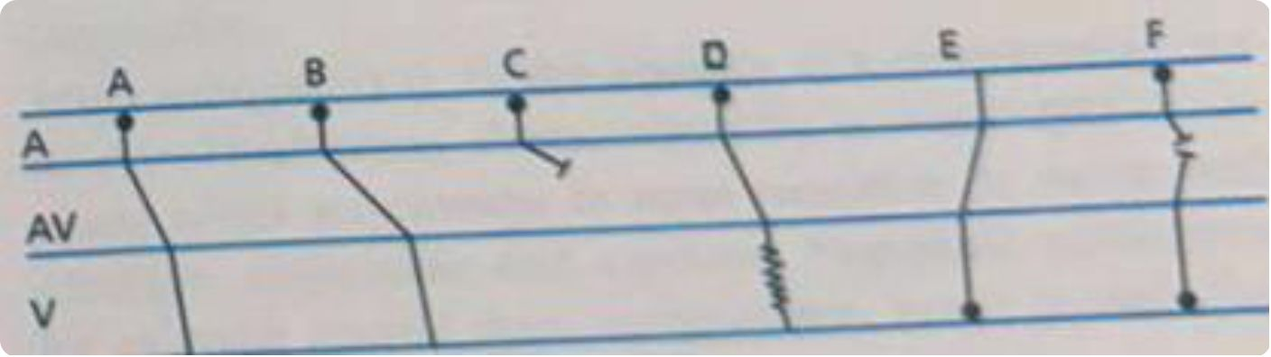
The Ladder Diagram: Visualising Intracardiac Conduction
How to Read a Ladder Diagram
Ordinate: Anatomical levels — Atria (A), AV node (AV), Ventricles (V)
Abscissa: Time — slope of each line reflects conduction speed
Six Depicted Scenarios
A: Normal anterograde conduction
B: Delayed AV conduction (prolonged PR)
C: AV block — failed conduction
D: Aberrant ventricular conduction
E: Ectopic ventricular impulse with retrograde conduction
F: AV dissociation by interference

Slide 13
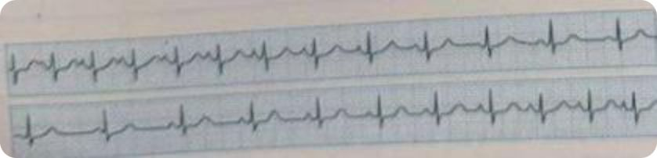
Normal Sinus Rhythm & Sinus Arrhythmia
Normal Sinus Rhythm
Rate 60–100 bpm in the adult. Normal P waves are positive in leads I, aVL, and inferior leads. Sequential P-QRS-T complexes appear with consistent morphology.
Sinus Arrhythmia
Irregular SA node discharge caused by a fluctuating vagal reflex mediated by lung receptors. Rate increases at end of inspiration and slows at end of expiration. Normal variant — all P-QRS-T morphologies remain unchanged.

Slide 14
Sinus Tachycardia
Definition
Common Causes
Anxiety, thyrotoxicosis
Fever (rate ↑ ~8 bpm/°C)
Cardiac failure, hypoxia
Drugs: adrenaline, atropine, caffeine
SA node rate >100 bpm. Normal P-QRS-T complexes in rapid succession. Gradual slowing occurs with carotid sinus compression — distinguishes it from paroxysmal tachycardias.
Inappropriate Sinus Tachycardia
No identifiable cause. Attributed to abnormal sinus node automaticity or autonomic imbalance — including sinoatrial reentry. Diagnosis of exclusion.

Slide 15
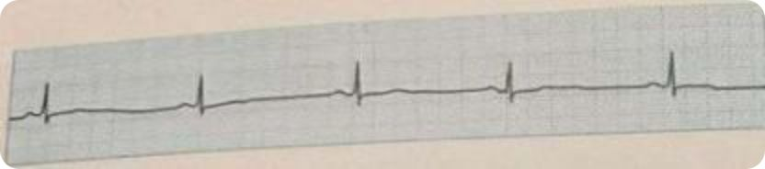

Sinus Bradycardia
Definition
SA node rate <60 bpm. Normal P-QRS-T complexes in slow succession; commonly associated with respiratory sinus arrhythmia.
Causes
Physiological: athletes, sleep
Metabolic: myxoedema, obstructive jaundice, uraemia
Neurological: raised intracranial pressure
Drugs: beta-blockers, digitalis
Persistent unexplained bradycardia → consider Sick Sinus Syndrome (structural SA node disease).

Slide 16
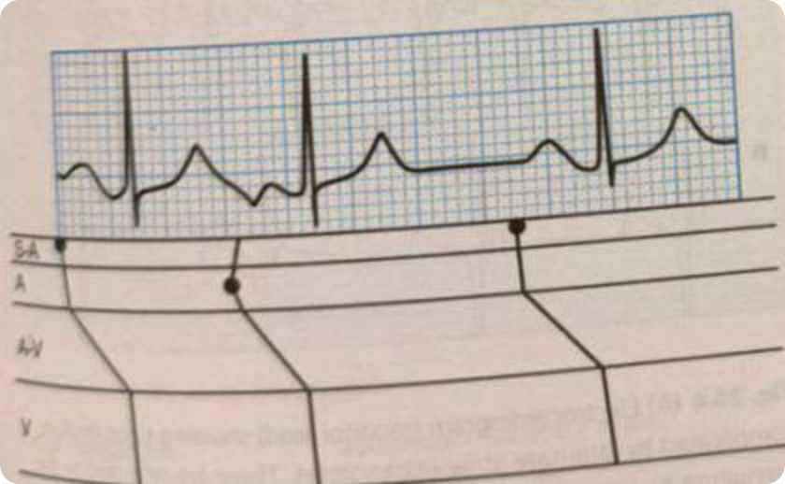
Atrial Extrasystoles: Mechanism & ECG Features
Mechanism & ECG Hallmarks
An atrial extrasystole arises from the premature discharge of an ectopic atrial focus. The activation front travels by unusual pathways, producing an abnormal P' wave that is pointed, notched, emphatic, or inverted — clearly different from the sinus P wave.
Compensatory Pause
The ectopic impulse resets the SA node, creating an incomplete compensatory pause: the sum of the pre- and post-ectopic intervals is less than two consecutive normal sinus intervals.
Unifocal extrasystoles show fixed coupling intervals
Multifocal extrasystoles show varying P' morphologies

Slide 17
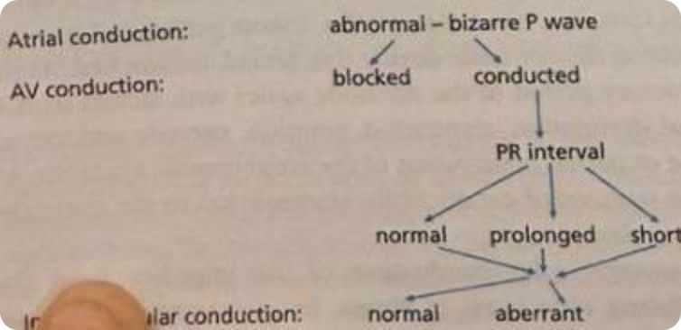
Atrial Extrasystoles: Conduction Pathways
AV Nodal Conduction Variants
Normal PR: Node fully recovered
Prolonged PR: Partially refractory AV node
Short PR: Low atrial ectopic focus
Blocked (no QRS): Very early impulse meets refractory AV node; P' may be hidden within the preceding T wave
Intraventricular Conduction
Normal QRS: Both bundle branches recovered
Aberrant QRS: Bundle branch block pattern if one branch remains refractory
.

Slide 18
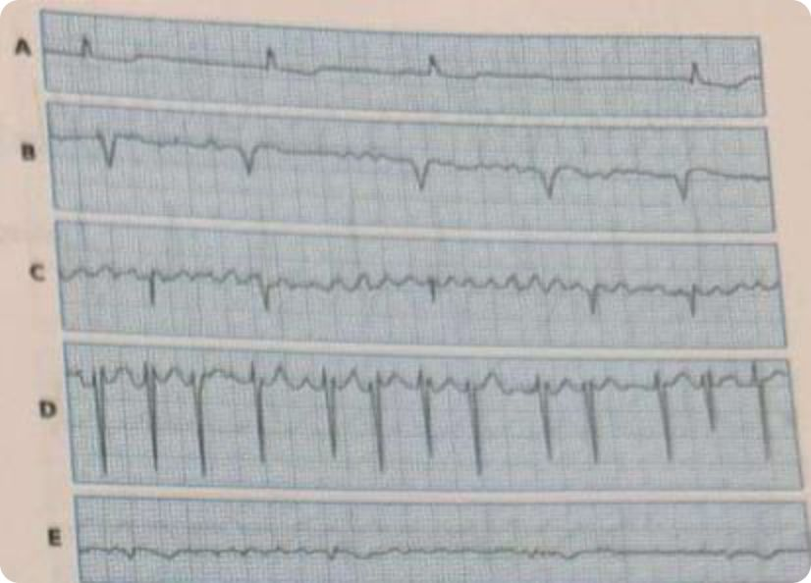
Atrial Fibrillation
Mechanism
Chaotic, disorganized atrial excitation generating 400–600 impulses/min reaching the AV node. The node conducts only a fraction irregularly, producing a ventricular response of 120–150 bpm in untreated cases.
ECG Features
Ragged, undulating baseline with fibrillary waves
Varying shape, height, and width of atrial deflections
No discernible P waves
Irregularly irregular ventricular rhythm
.

Slide 19
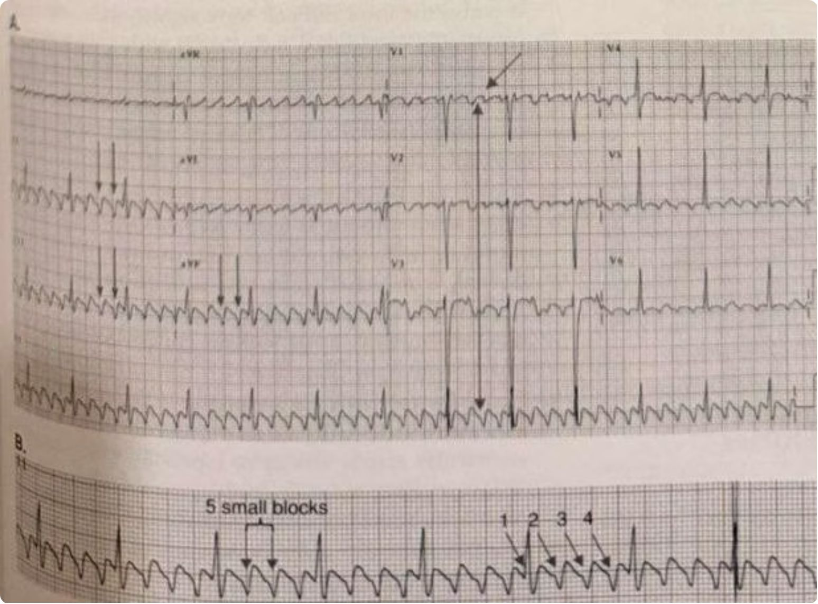
Atrial Flutter
Atrial flutter is a supraventricular arrhythmia driven by a reentrant circuit within the atria. It produces a characteristic rhythm with a regular atrial rate of 300 ± 50 beats per minute — one of its most defining and diagnostically critical features.
The hallmark on ECG is the sawtooth or picket fence appearance of flutter waves: very regular, uniform deflections that replace the isoelectric baseline. In the typical form, flutter waves are inverted in leads II, III, and aVF and upright in V₁. The baseline between flutter waves is characteristically wavy and undulating — never truly flat.
QRS complexes are narrow in the absence of preexisting bundle branch block or aberrant conduction. When conduction through the ventricles is normal, each QRS complex represents a conducted atrial impulse, filtered through the AV node.

Slide 20
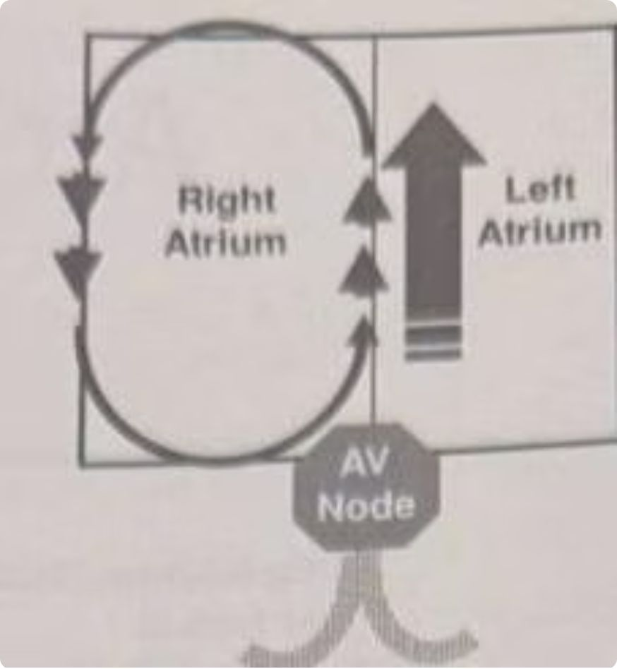
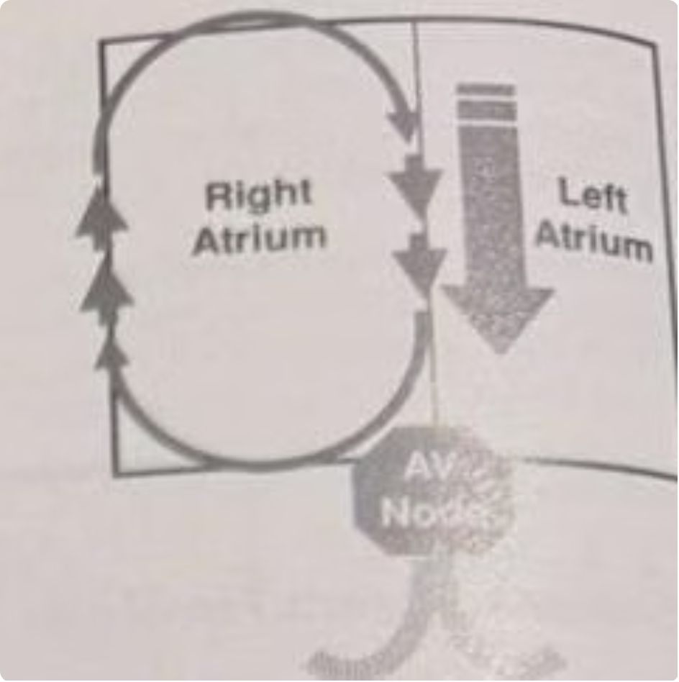
Types of Atrial Flutter
10% OF CASES
90% OF CASES
Typical Atrial Flutter
Reverse Typical Atrial Flutter
The reentrant impulse travels counterclockwise: descending down the lateral wall of the right atrium and ascending up the atrial septum. The critical anatomical substrate is the cavotricuspid isthmus — the standard target for radiofrequency catheter ablation.
ECG pattern: Flutter waves inverted in lead II and upright in V₁. The negative deflection in II, III, aVF creates the classic sawtooth morphology.
The reentrant impulse travels in the clockwise direction: descending down the atrial septum and ascending up the lateral wall of the right atrium. The same cavotricuspid isthmus is involved, but activation proceeds in the opposite direction.
ECG pattern: Flutter waves are upright in lead II and inverted in V₁ — the reverse of the typical form. This reversal of polarity is the key differentiating feature.
Notes:
The major vector is directed upwards so ii, iii, avf is negative and v 1 directed towards right the

Slide 21
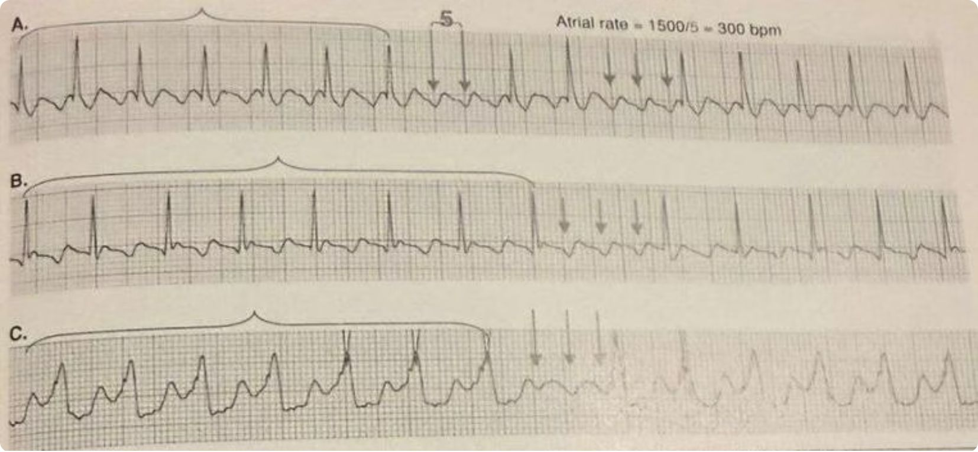

Calculating the Atrial Rate
,Count the number of small boxes between two consecutive flutter wave peaks, then divide into 1,500.
The typical atrial rate in untreated atrial flutter is 300 ± 50 bpm, with a minimum of approximately 250 bpm.
Rates below this threshold should raise suspicion for antiarrhythmic drug effect or atrial tachycardia.
Patients on quinidine, sotalol, or amiodarone may have atrial rates that fall below 250 bpm — do not exclude flutter on rate alone. The morphology of flutter waves (inverted in II) remains the distinguishing feature.
The baseline between flutter waves is wavy and undulating, never truly isoelectric..
The atrial rate remains the single most important feature for differentiating atrial flutter from other supraventricular arrhythmias.

Slide 22
AV Conduction Patterns in Atrial Flutter
1
1:1 AV Conduction
Every atrial impulse followed by a QRS. Ventricular rate = 250–350 bpm. Rare; hemodynamically dangerous.
2
2:1 AV Conduction
Every other impulse conducted. Ventricular rate ≈ 150 bpm. Most common; most commonly missed.
3
3:1 AV Conduction
Three flutter waves per QRS. Ventricular rate ≈ 100 bpm. First flutter wave often buried in the QRS.
4
4:1 AV Conduction
Four flutter waves per QRS. Ventricular rate ≈ 75 bpm. Easiest pattern to recognize.
5
Variable AV Block
Irregular R-R intervals due to beat-to-beat variation in AV nodal conduction. Flutter waves per QRS changes continuously.
6
Complete AV Block
No flutter impulses conducted. Ventricular escape rate ≈ ~33–40 bpm. R-R intervals are regular and independent of atrial activity.

Slide 23
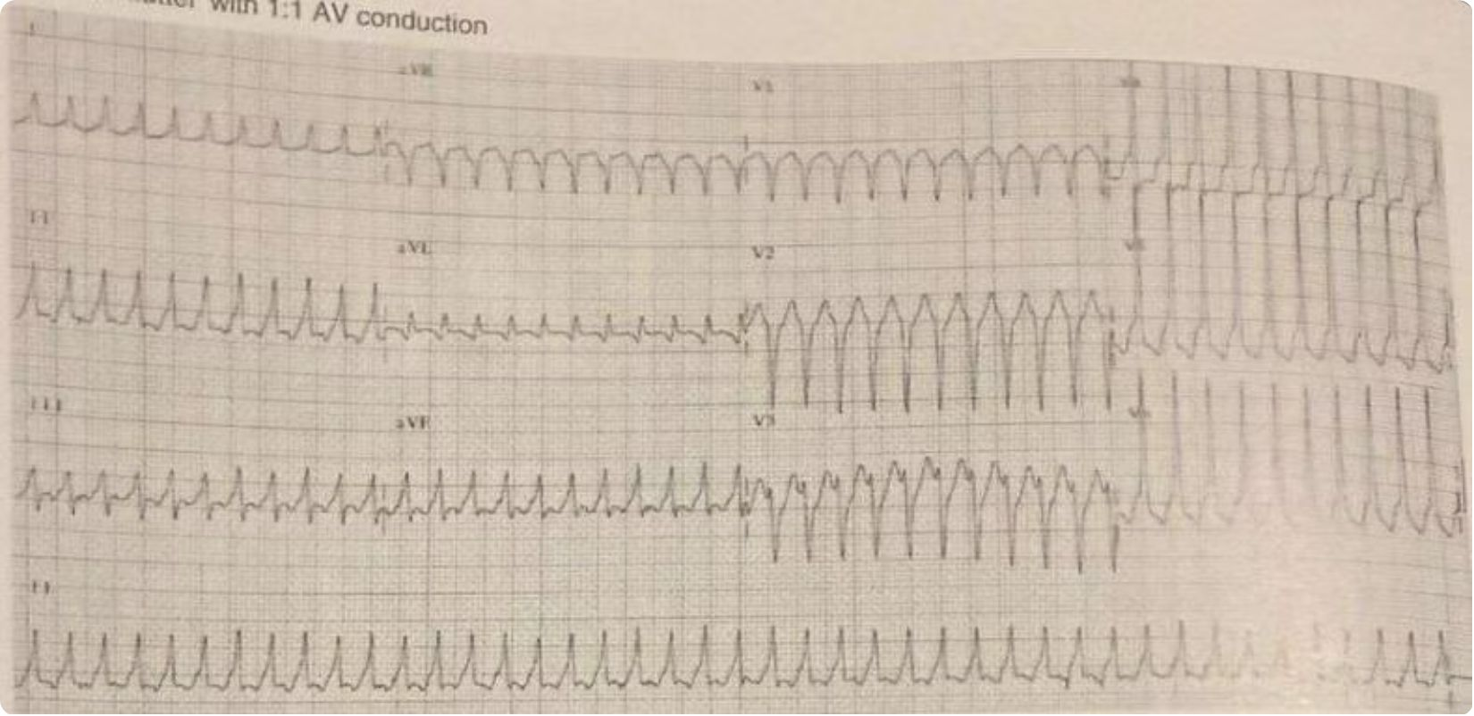
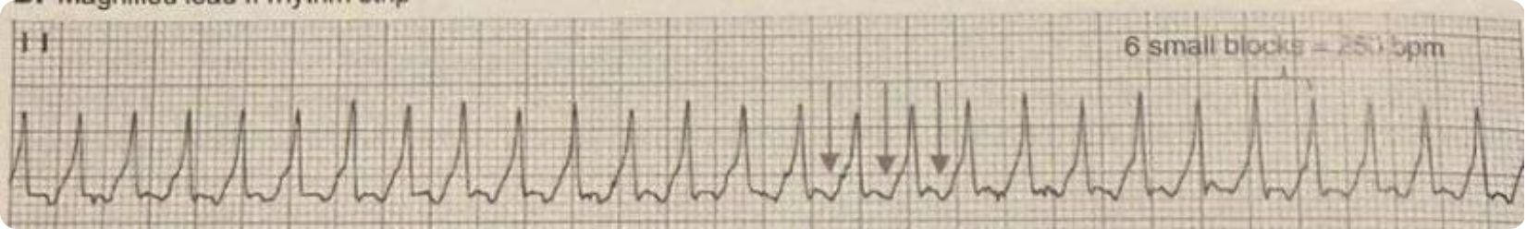
Atrial Flutter with 1:1 AV Conduction
In 1:1 AV conduction, every atrial flutter impulse is transmitted through the AV node and followed by a QRS complex. This results in a ventricular rate equal to the atrial rate: 250–350 bpm. This is a rare but life-threatening presentation requiring urgent management.
On ECG, flutter waves are inverted in lead II at a rate ≥ 250 bpm. Because each flutter wave is immediately followed by a QRS, the typical sawtooth appearance may be obscured, making recognition challenging at high ventricular rates.
This pattern is most commonly seen in the setting of:
Accessory pathway (bypass tract) bypassing AV node delay
Enhanced AV nodal conduction (e.g., catecholamine excess)
Drug effect (e.g., class IC antiarrhythmics slowing atrial rate allowing 1:1 conduction)

Slide 24
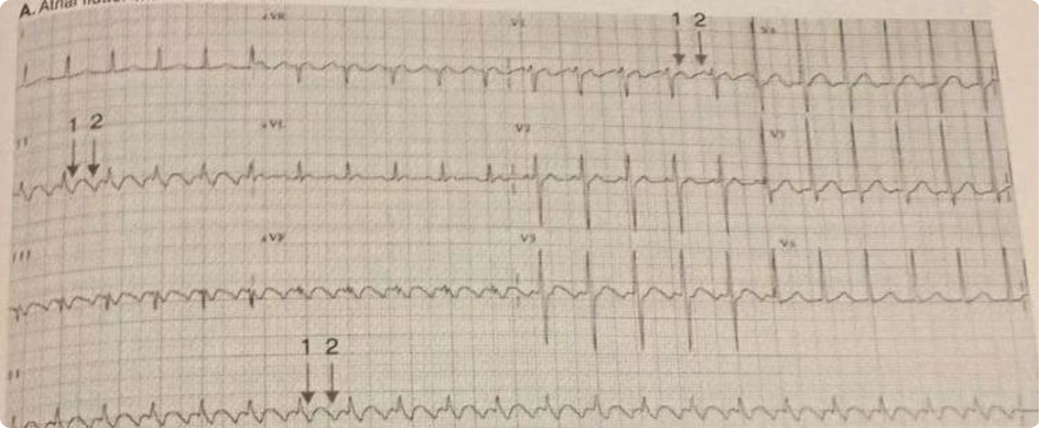
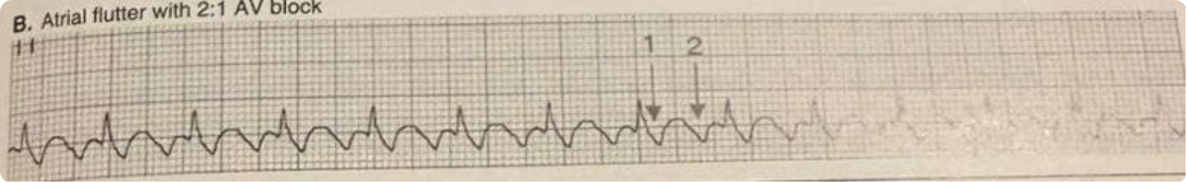

Atrial Flutter with 2:1 AV Block
Most common presentation of atrial flutter in the acute setting.
Approximately 10% of tachycardias diagnosed as SVT are in fact atrial flutter with 2:1 block.
The ventricular rate is approximately 150 bpm — exactly half the atrial flutter rate of 300 bpm.
This fixed relationship is the single most important diagnostic clue: any regular narrow complex tachycardia at 150 bpm must be considered atrial flutter until proven otherwise.
Key diagnostic clue: Regular narrow complex tachycardia at ~150 bpm with inverted deflections in lead II immediately after the QRS — think atrial flutter first.

Slide 25
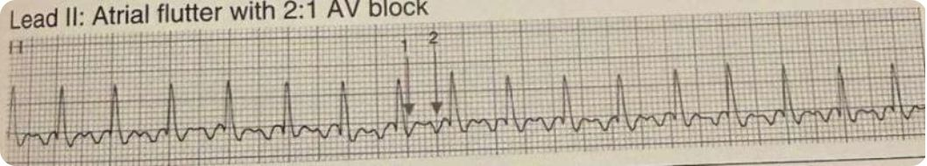
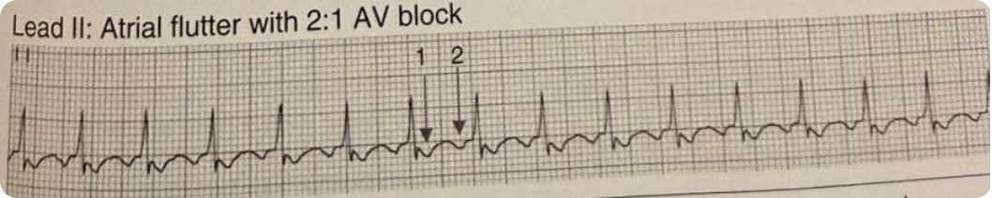
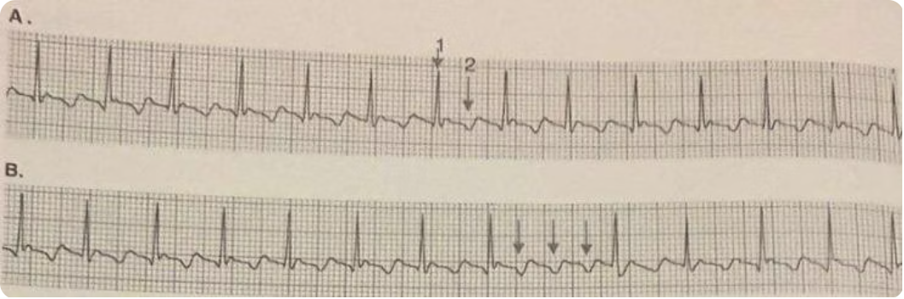
Pitfalls: Recognizing 2:1 AV Block
Three classic ECG patterns in which 2:1 atrial flutter is easily misidentified. Each illustrates how the second flutter wave camouflages itself within or adjacent to the QRS-T complex.
— Pseudo-S Wave
— Pseudo-ST Depression / T-wave Inversion
— Buried Flutter Waves
The first flutter wave deforms the terminal portion of the QRS complex, creating a deflection easily mistaken for a physiologic S wave. The regular rate at 150 bpm is the key to unmasking the diagnosis.
The flutter wave falls in the ST segment and is misread as ST depression or a deep inverted T wave.
The sawtooth regularity in long-rhythm strips is diagnostic.
Flutter waves are completely buried within the QRS complex. Diagnosis is only possible when the ventricular rate spontaneously slows, allowing flutter waves to emerge from concealment. AV nodal blockade (vagal maneuver, adenosine) may be required.

Slide 26
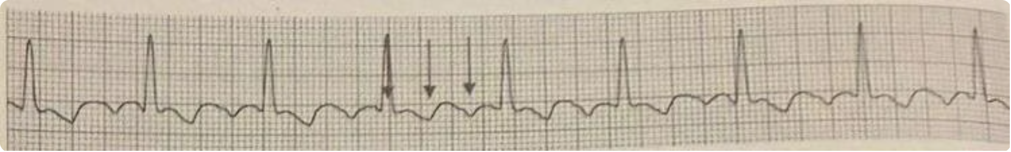
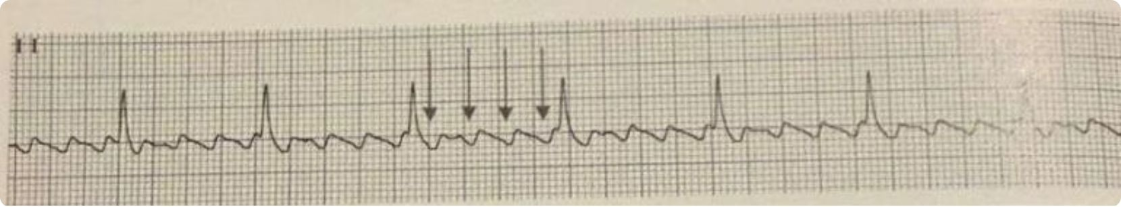
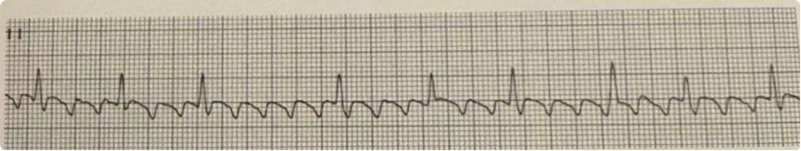
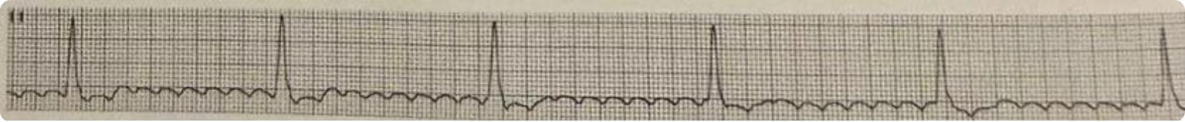
Higher-Degree & Variable AV Block
As the degree of AV block increases, more flutter waves become visible between QRS complexes, making recognition easier — with the exception of 3:1 block, where the first flutter wave may still be buried.
3:1 AV Block — Ventricular Rate ≈ 100 bpm
4:1 AV Block — Ventricular Rate ≈ 75 bpm
Three flutter waves per QRS. The first flutter wave is typically buried within the QRS, with two visible flutter waves in the interval between conducted beats. Can simulate sinus rhythm if not carefully analyzed.
Four flutter waves per QRS. This is the easiest pattern to recognize as the classic sawtooth waveform is clearly visible in the spaces between conducted QRS complexes.
Complete AV Block — Ventricular Rate ≈ 33 bpm
Variable AV Block — Irregular R-R
The number of flutter waves per QRS complex varies beat to beat, producing an irregularly irregular ventricular rhythm. The flutter wave rate remains constant despite the irregular ventricular response.
No flutter impulses are conducted. A ventricular escape rhythm with regular R-R intervals (~33 bpm) operates independently of the atrial rate. Flutter waves continue at 300 bpm in the background.

Slide 27
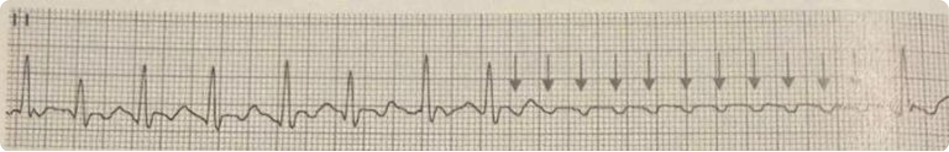
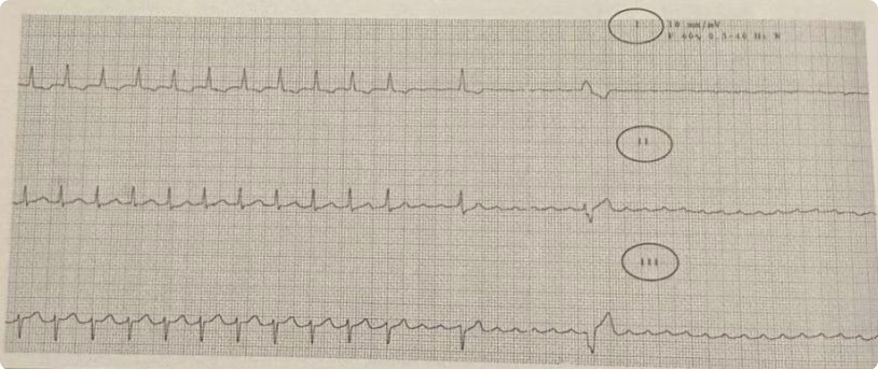
Differentiating Atrial Flutter from SVT
Approximately 10% of tachycardias clinically diagnosed as paroxysmal SVT are in fact atrial flutter with 2:1 AV block. The distinction is critical because the treatment strategies differ substantially.
Response to Vagal Maneuvers / Carotid Sinus Pressure
In atrial flutter, vagal maneuvers and carotid sinus pressure increase AV nodal block — slowing the ventricular rate and unmasking flutter waves — but do not convert to sinus rhythm. The arrhythmia persists; only the ventricular rate changes. In true SVT (AV nodal reentry or AV reentry), these maneuvers may terminate the arrhythmia entirely by interrupting the reentrant circuit.
Response to Adenosine / Verapamil
These agents slow AV nodal conduction. In atrial flutter, they produce transient ventricular rate slowing, revealing flutter waves — but the flutter itself is not terminated. In reentrant SVT, they typically convert the arrhythmia to sinus rhythm. This differential response is diagnostically valuable.

Slide 28
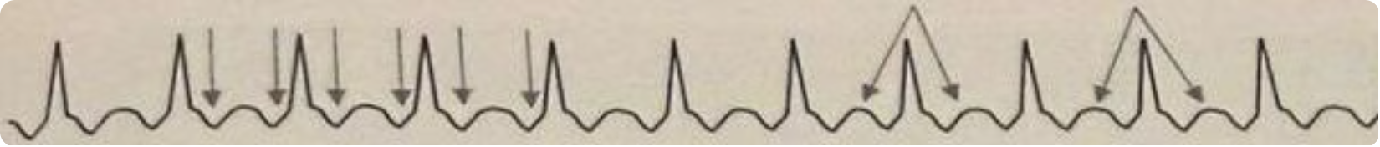
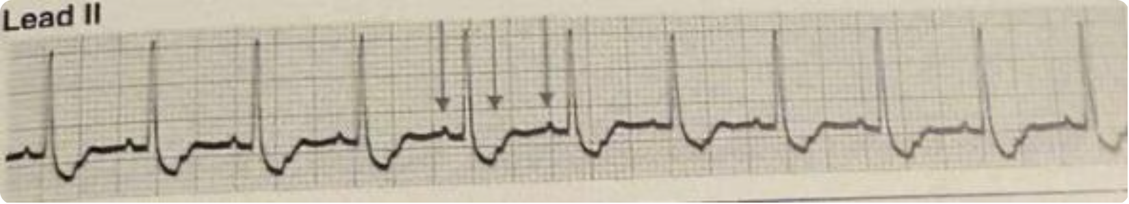
Atrial Flutter vs. Atrial Tachycardia with 2:1 AV Block
Feature | Atrial Flutter (2:1) | Atrial Tachycardia (2:1)
Atrial Rate | 300 ± 50 bpm (min 240–250) | 200 ± 50 bpm (150–250)
P/Flutter Wave in Lead II | Inverted (negative deflection) | Upright (positive P waves)
Baseline Appearance | Wavy / undulating | Isoelectric / flat
Common Etiology | Structural heart disease, post-cardiac surgery | Usually digitalis toxicity
Ventricular Rate | ≈ 150 bpm | ≈ 100 bpm
Atrial flutter with 2:1 AV block — note inverted flutter waves and undulating baseline in lead II
Atrial tachycardia with 2:1 AV block — upright P waves with flat, isoelectric baseline between deflections

Slide 29
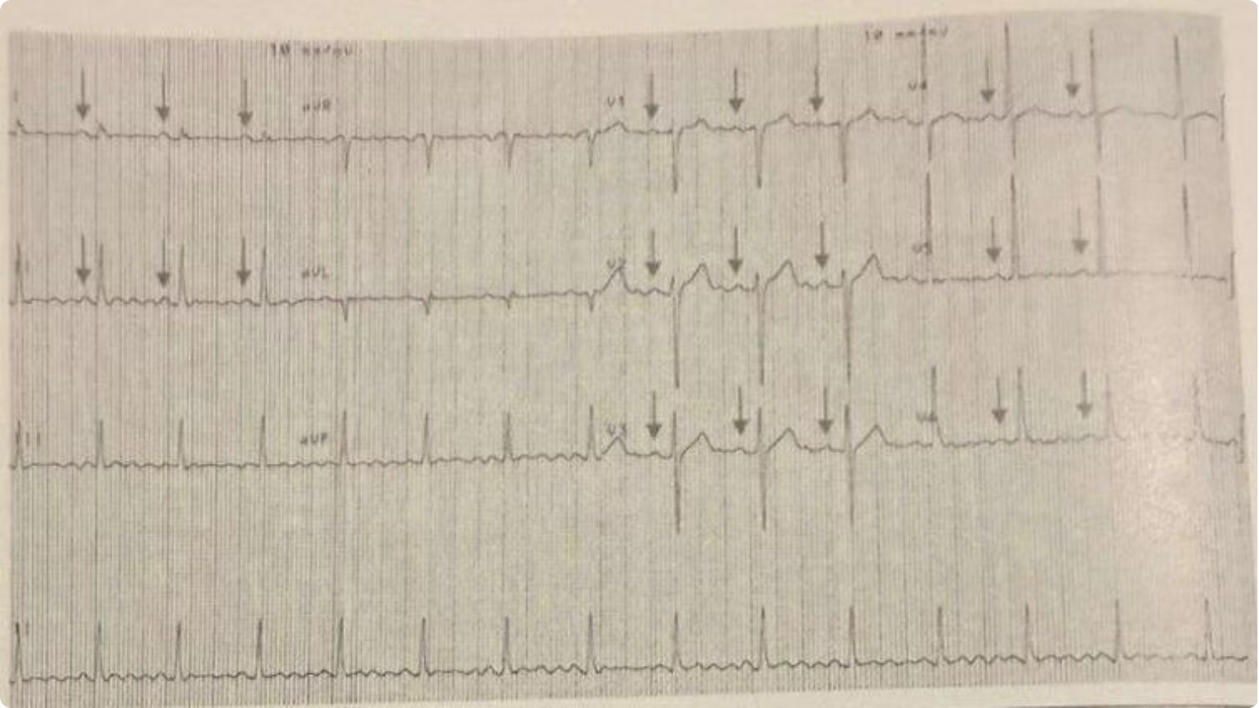

Common Mistakes: Artifacts Mimicking Atrial Flutter
Motion Artifact — Parkinson's Disease Tremor
High-frequency tremor in Parkinson's disease can produce rhythmic, regular baseline oscillations that closely mimic the sawtooth morphology of atrial flutter waves. The critical distinguishing feature: identifiable P waves before each QRS complex confirm sinus rhythm. The tremor-induced artifact is superimposed on, but does not replace, normal P-QRS-T activity.
Always look for P waves with a consistent PR interval in suspected artifact. Stabilizing electrodes and repeating the ECG after positioning adjustments will typically resolve the artifact.

Slide 30
ECG Findings Summary: Atrial Flutter
1
Atrial Rate: 300 ± 50 bpm
Minimum 250 bpm in untreated patients. Below 250 bpm suggests antiarrhythmic drug effect — evaluate morphology, not rate alone. Use the 1,500 ÷ (small boxes between flutter waves) formula to calculate precisely.
2
Sawtooth / Picket Fence Flutter Waves
Very regular, uniform flutter waves with a wavy, undulating baseline. The characteristic morphology that distinguishes flutter from all other supraventricular arrhythmias. Never truly isoelectric between deflections.
3
Flutter Wave Polarity
Inverted in leads II, III, aVF; upright in V₁ in 90% of cases (typical counterclockwise flutter). Reversed polarity (upright in II, inverted in V₁) in 10% of cases (reverse typical, clockwise flutter).
4
Variable Ventricular Rate
Determined by AV nodal conduction ratio: 1:1 (250–350 bpm), 2:1 (~150 bpm, most common), 3:1 (~100 bpm), 4:1 (~75 bpm), variable (irregular R-R), or complete AV block (~33–40 bpm escape rhythm).
5
Narrow QRS Complexes
Present unless complicated by preexisting bundle branch block, aberrant conduction, or accessory bypass tract. Wide QRS flutter must be distinguished from ventricular tachycardia using standard criteria.

Slide 31
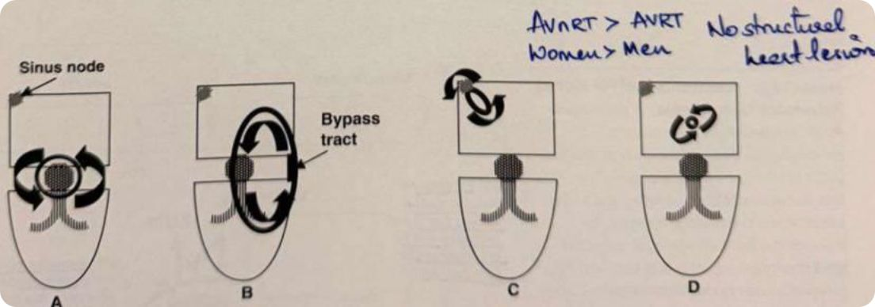
Overview: Four Types of Reentrant SVT
Reentrant SVT accounts for 80–90% of all sustained SVT. All four types require two pathways with different electrophysiologic properties.
AVNRT ~60%
AVRT ~30%
SART — Rare
IART — Rare
Reentrant circuit around the AV node; most common reentrant SVT
Involves a bypass tract connecting atrium directly to ventricle
Circuit involves sinus node and adjacent atrium
Micro-reentrant circuit confined within the atrium

Slide 32
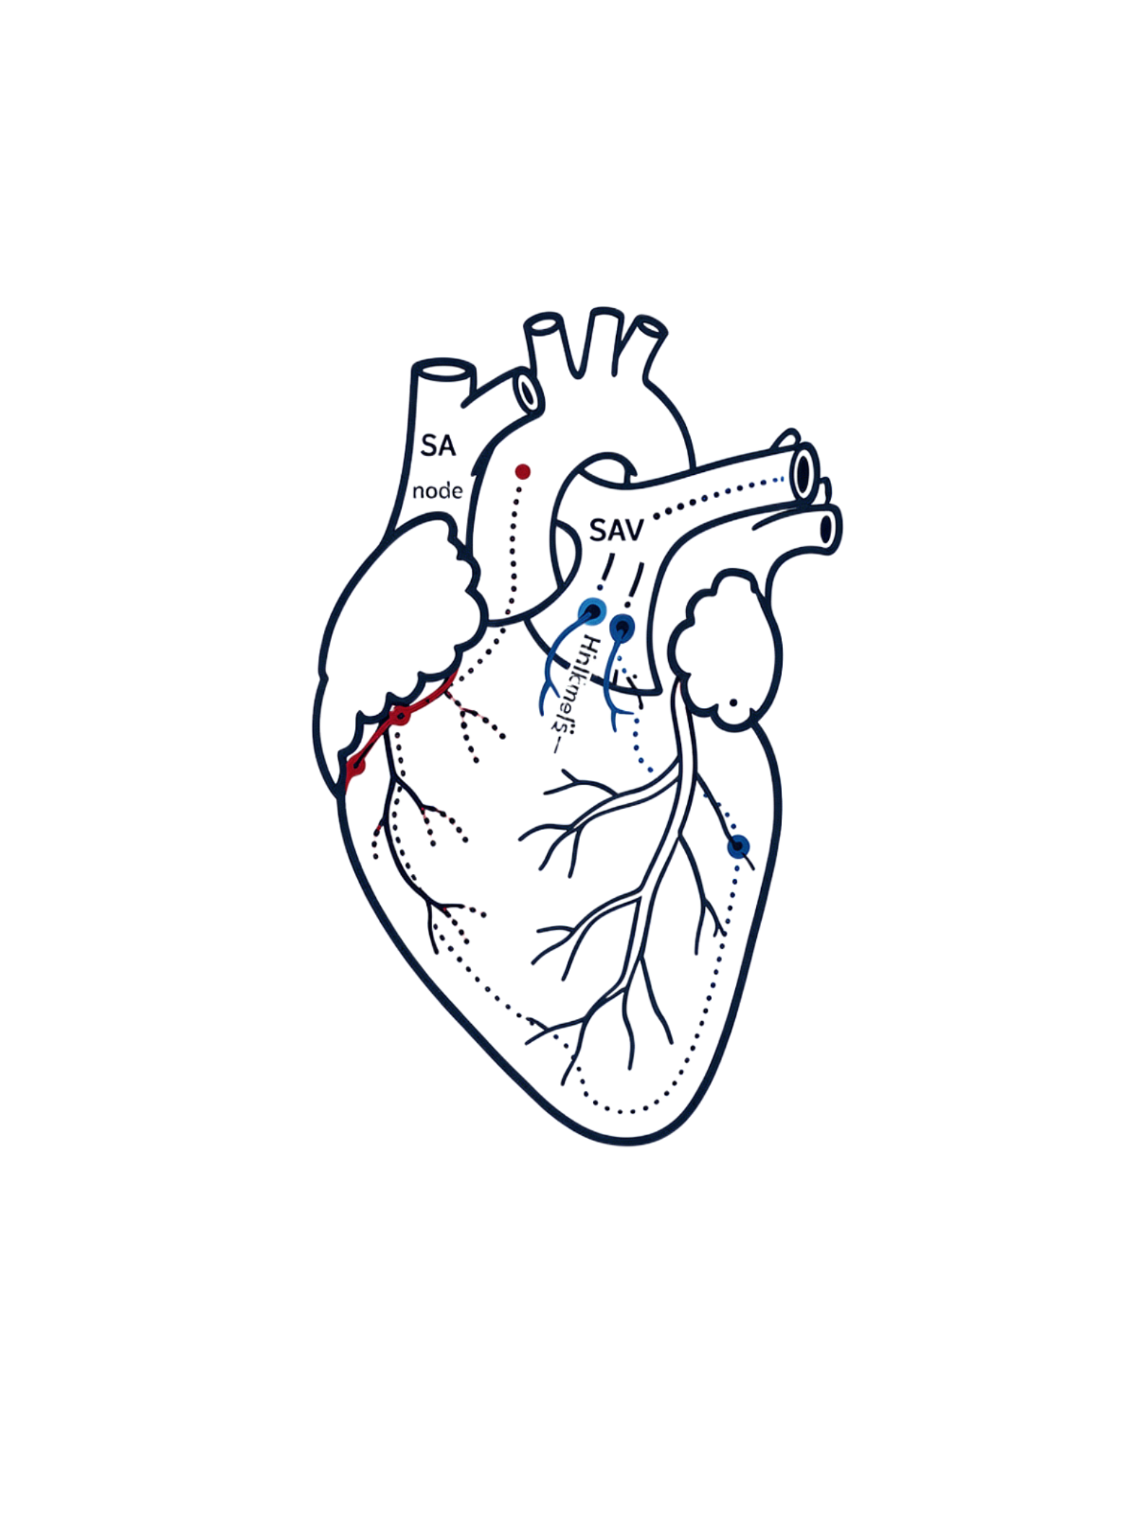
AVNRT: AV Nodal Reentrant Tachycardia
The most common cause of paroxysmal SVT

Slide 33
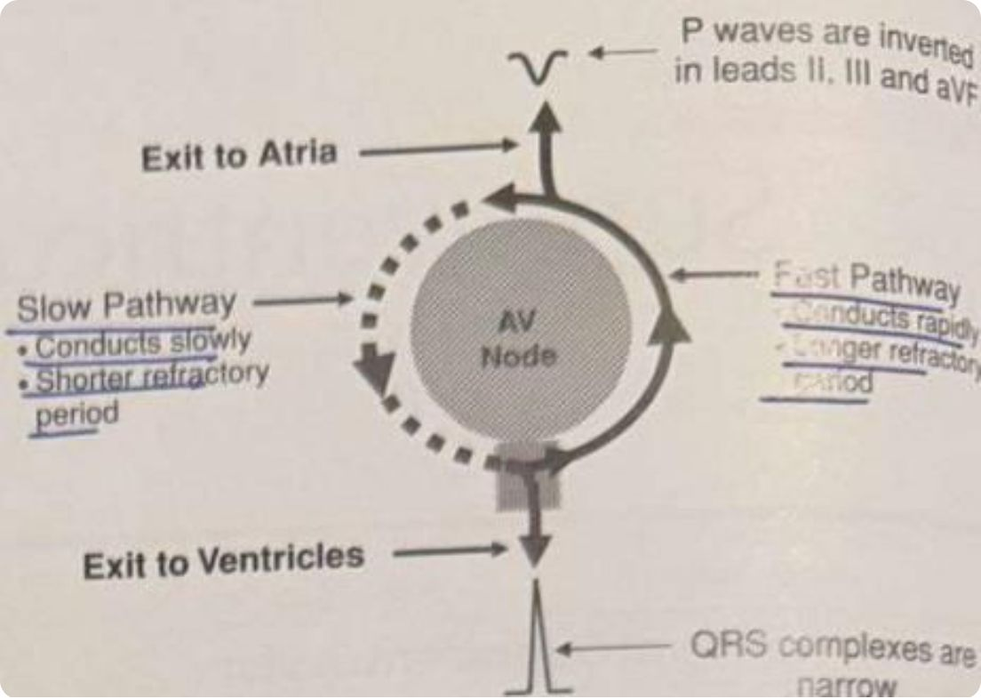
AVNRT: Circuit
Most common SVT; 2× more frequent in women; typically no underlying structural heart disease.
Atria activated caudocranially → P waves inverted in II, III, aVF; QRS typically narrow.
Slow Pathway
Fast Pathway
Conducts anterogradely to ventricles; shorter refractory period — the usual antegrade limb
Conducts retrogradely to atria; longer refractory period — the usual retrograde limb

Slide 34
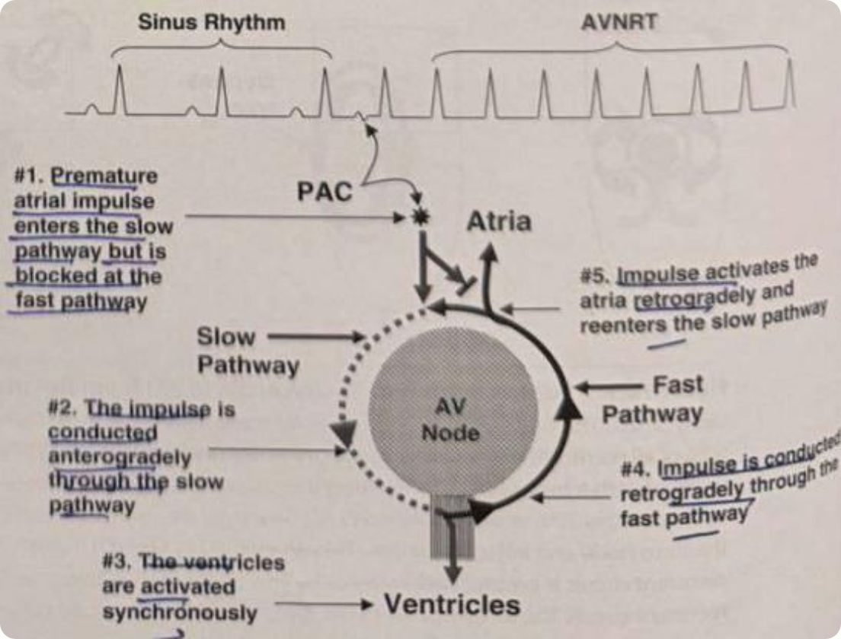

AVNRT: Mechanism of Initiation
The Triggering PAC
Initiation requires a premature atrial contraction (PAC) timed precisely when:
The fast pathway is refractory — blocks antegrade conduction
The slow pathway has recovered — permits antegrade conduction
The PAC conducts anterogradely via the slow pathway → activates ventricles → returns retrogradely via the fast pathway → re-enters the slow pathway → sustains tachycardia.
The key insight: unidirectional block in the fast pathway + adequate slow pathway conduction = initiation of reentry.

Slide 35
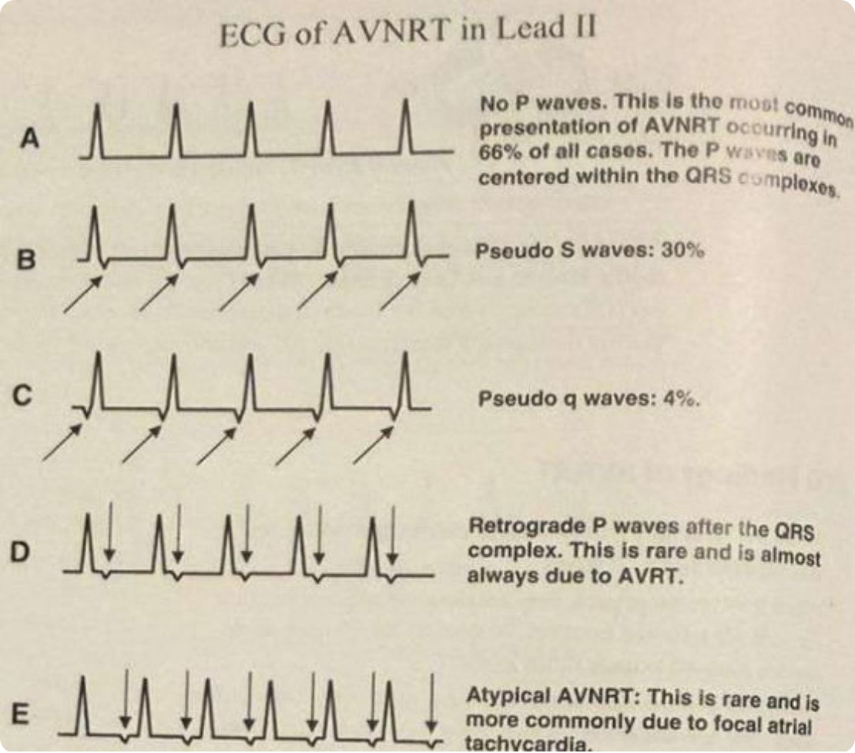
AVNRT: ECG Patterns
1
2
No P Waves (66%)
Pseudo-S / Pseudo-r' (30%)
P waves buried within QRS — most common presentation; nearly simultaneous atrial and ventricular activation
Retrograde P deforms terminal QRS; pseudo-S in inferior leads, pseudo-r' in V₁
3
4
Pseudo-q Waves (4%)
Atypical AVNRT (Rare)
Retrograde P deforms initial QRS in leads II, III, aVF
Fast/slow circuit; retrograde P precedes QRS; R-P > PR interval

Slide 36
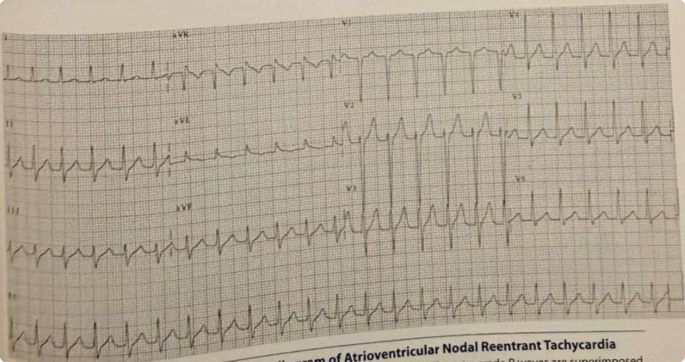
AVNRT: 12-Lead ECG Examples
Rate & Rhythm
Diagnostic Clue
Clinical Pearl
Narrow complex tachycardia, regular R-R intervals, rate 110–250 bpm
Pseudo-S in lead II and pseudo-r' in V₁ disappear on conversion to sinus rhythm — confirms AVNRT
Consider AVNRT in any narrow complex regular tachycardia regardless of P wave visibility

Slide 37
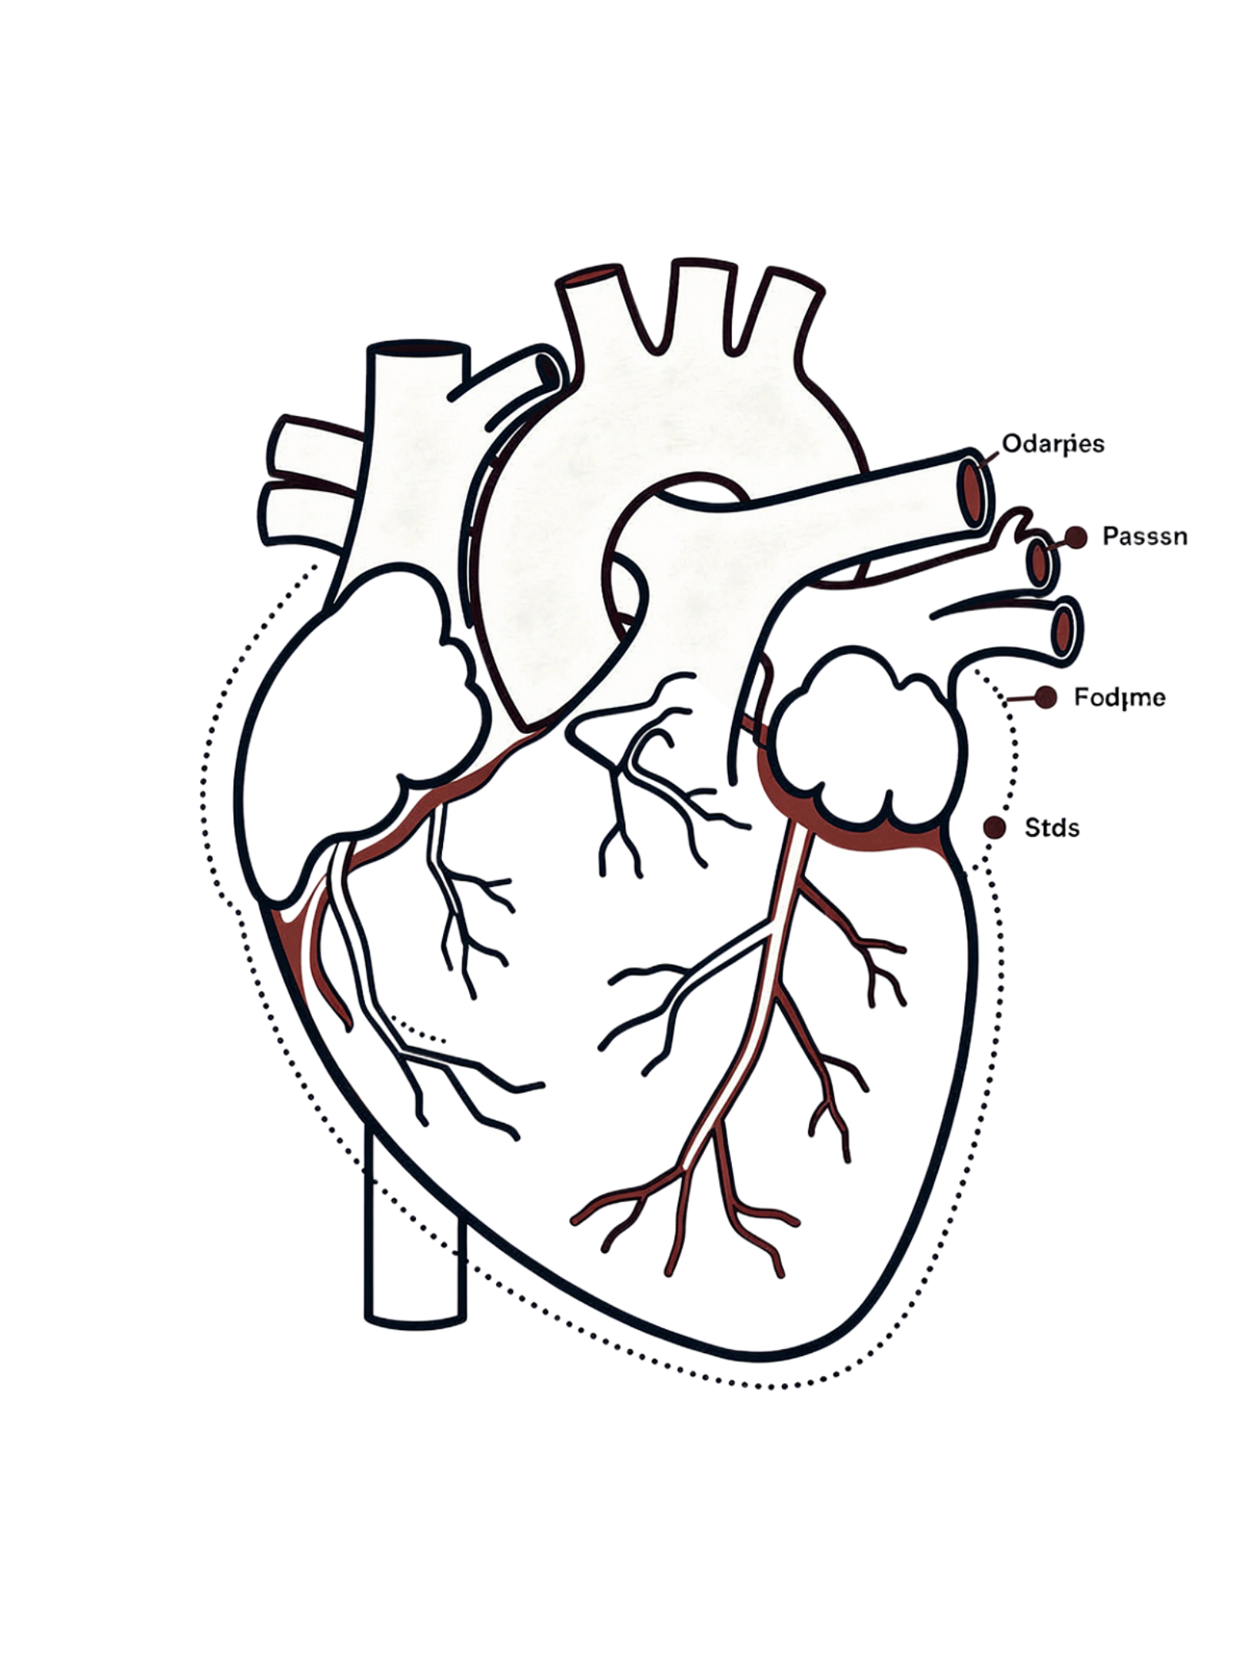
AVRT: AV Reciprocating Tachycardia
The second most common reentrant SVT — driven by an accessory bypass tract that bypasses normal AV nodal conduction.

Slide 38
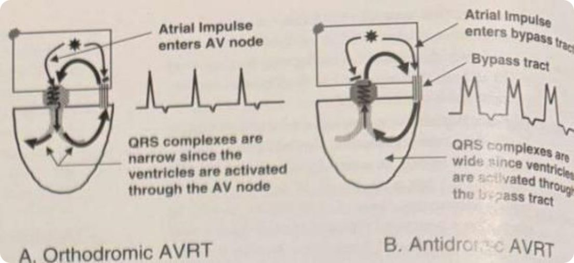
AVRT: Bypass Tract & Circuit Types
Orthodromic (Narrow QRS)
Antidromic (Wide QRS)
Anterograde via AV node → retrograde via bypass tract. Virtually all cases of AVRT. Normal QRS morphology unless aberrant conduction.
Anterograde via bypass tract → retrograde via AV node. Produces fully pre-excited, wide QRS — mimics VT. Discussed in WPW chapter.

Slide 39
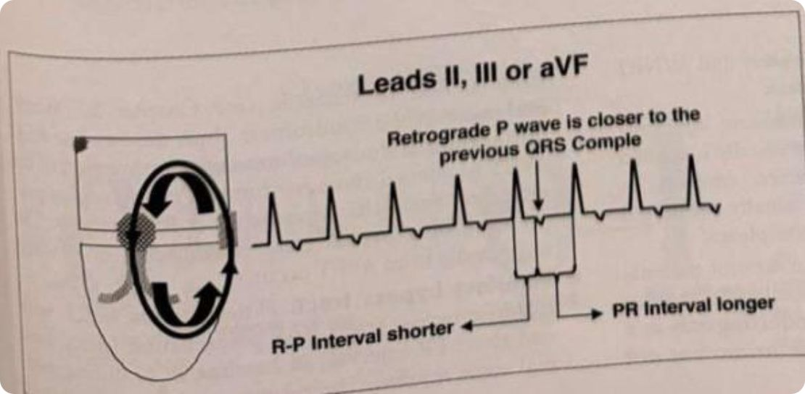

AVRT: Mechanism & ECG Findings
Macro-Reentry Circuit
Atria → AV node → His → bundle branches → ventricles → bypass tract → atria
Typical AVRT
Retrograde P inscribed after QRS, deforming the ST/T wave
R-P ≥ 80 ms and R-P < PR interval
Atypical AVRT
Slowly conducting bypass tract
Retrograde P precedes QRS; R-P > PR (rare)
Key differentiator: AV block terminates AVRT — the AV node is an essential limb of the circuit.

Slide 40
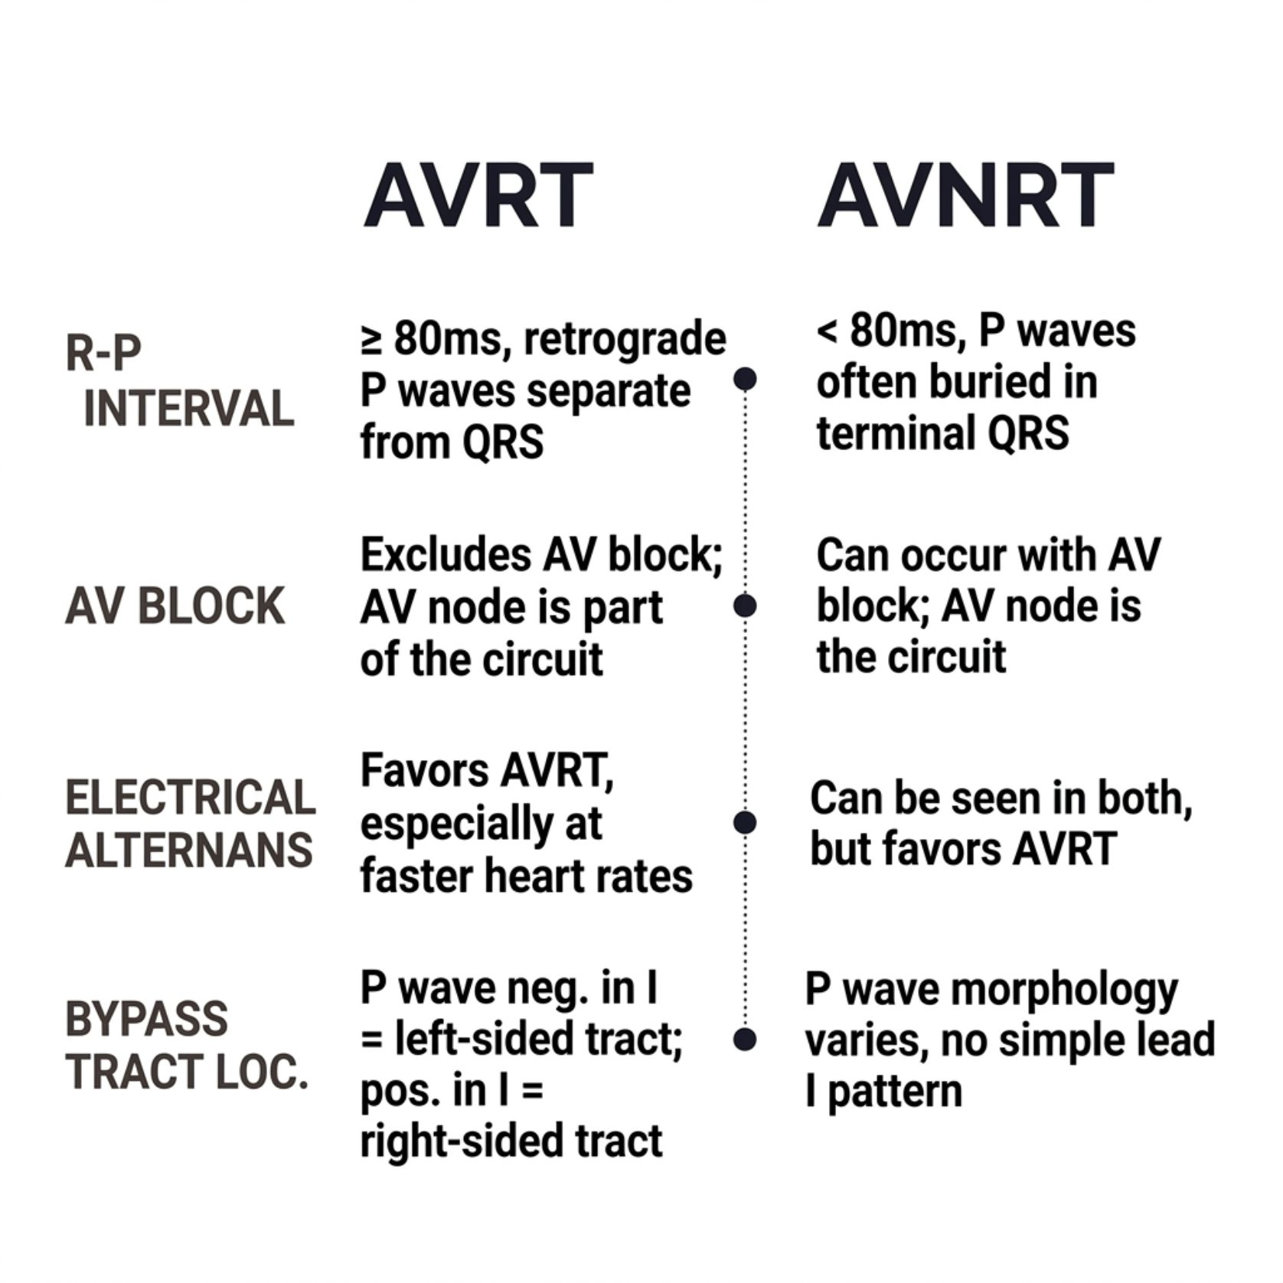
AVRT vs. AVNRT: Key Differentiators
R-P Interval
AV Block
AVRT ≥ 80 ms — retrograde P is separate from QRS, deforms ST/T
AVNRT < 80 ms — P buried within or at terminal QRS
Possible in AVNRT (AV node not required for circuit)
Excludes AVRT — AV node is essential limb
Electrical Alternans
Bypass Tract Side
Favors AVRT at faster rates —
but not exclusive
P negative in lead I → left-sided tract
P positive in lead I → right-sided tract

Slide 41
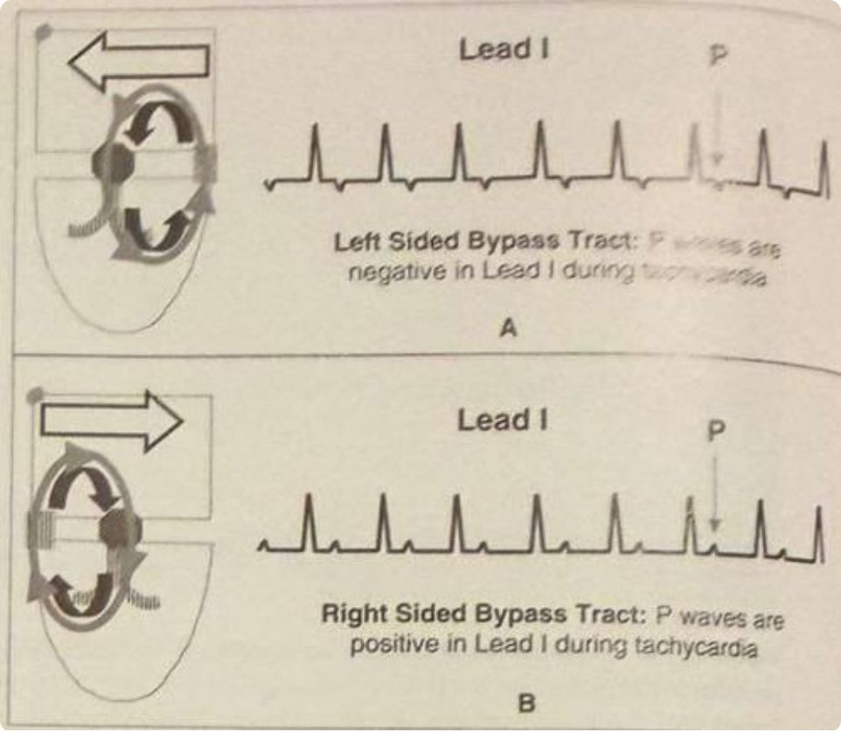

Localizing the Bypass Tract in AVRT
50%
25%
LV Free Wall
Posteroseptal
Most common location; 50–60% of all bypass tracts
Second most common; 20–30% of bypass tracts
15%
5%
RV Free Wall
Anteroseptal
10–20% of bypass tracts
Least common; ~5% of bypass tracts

Slide 42
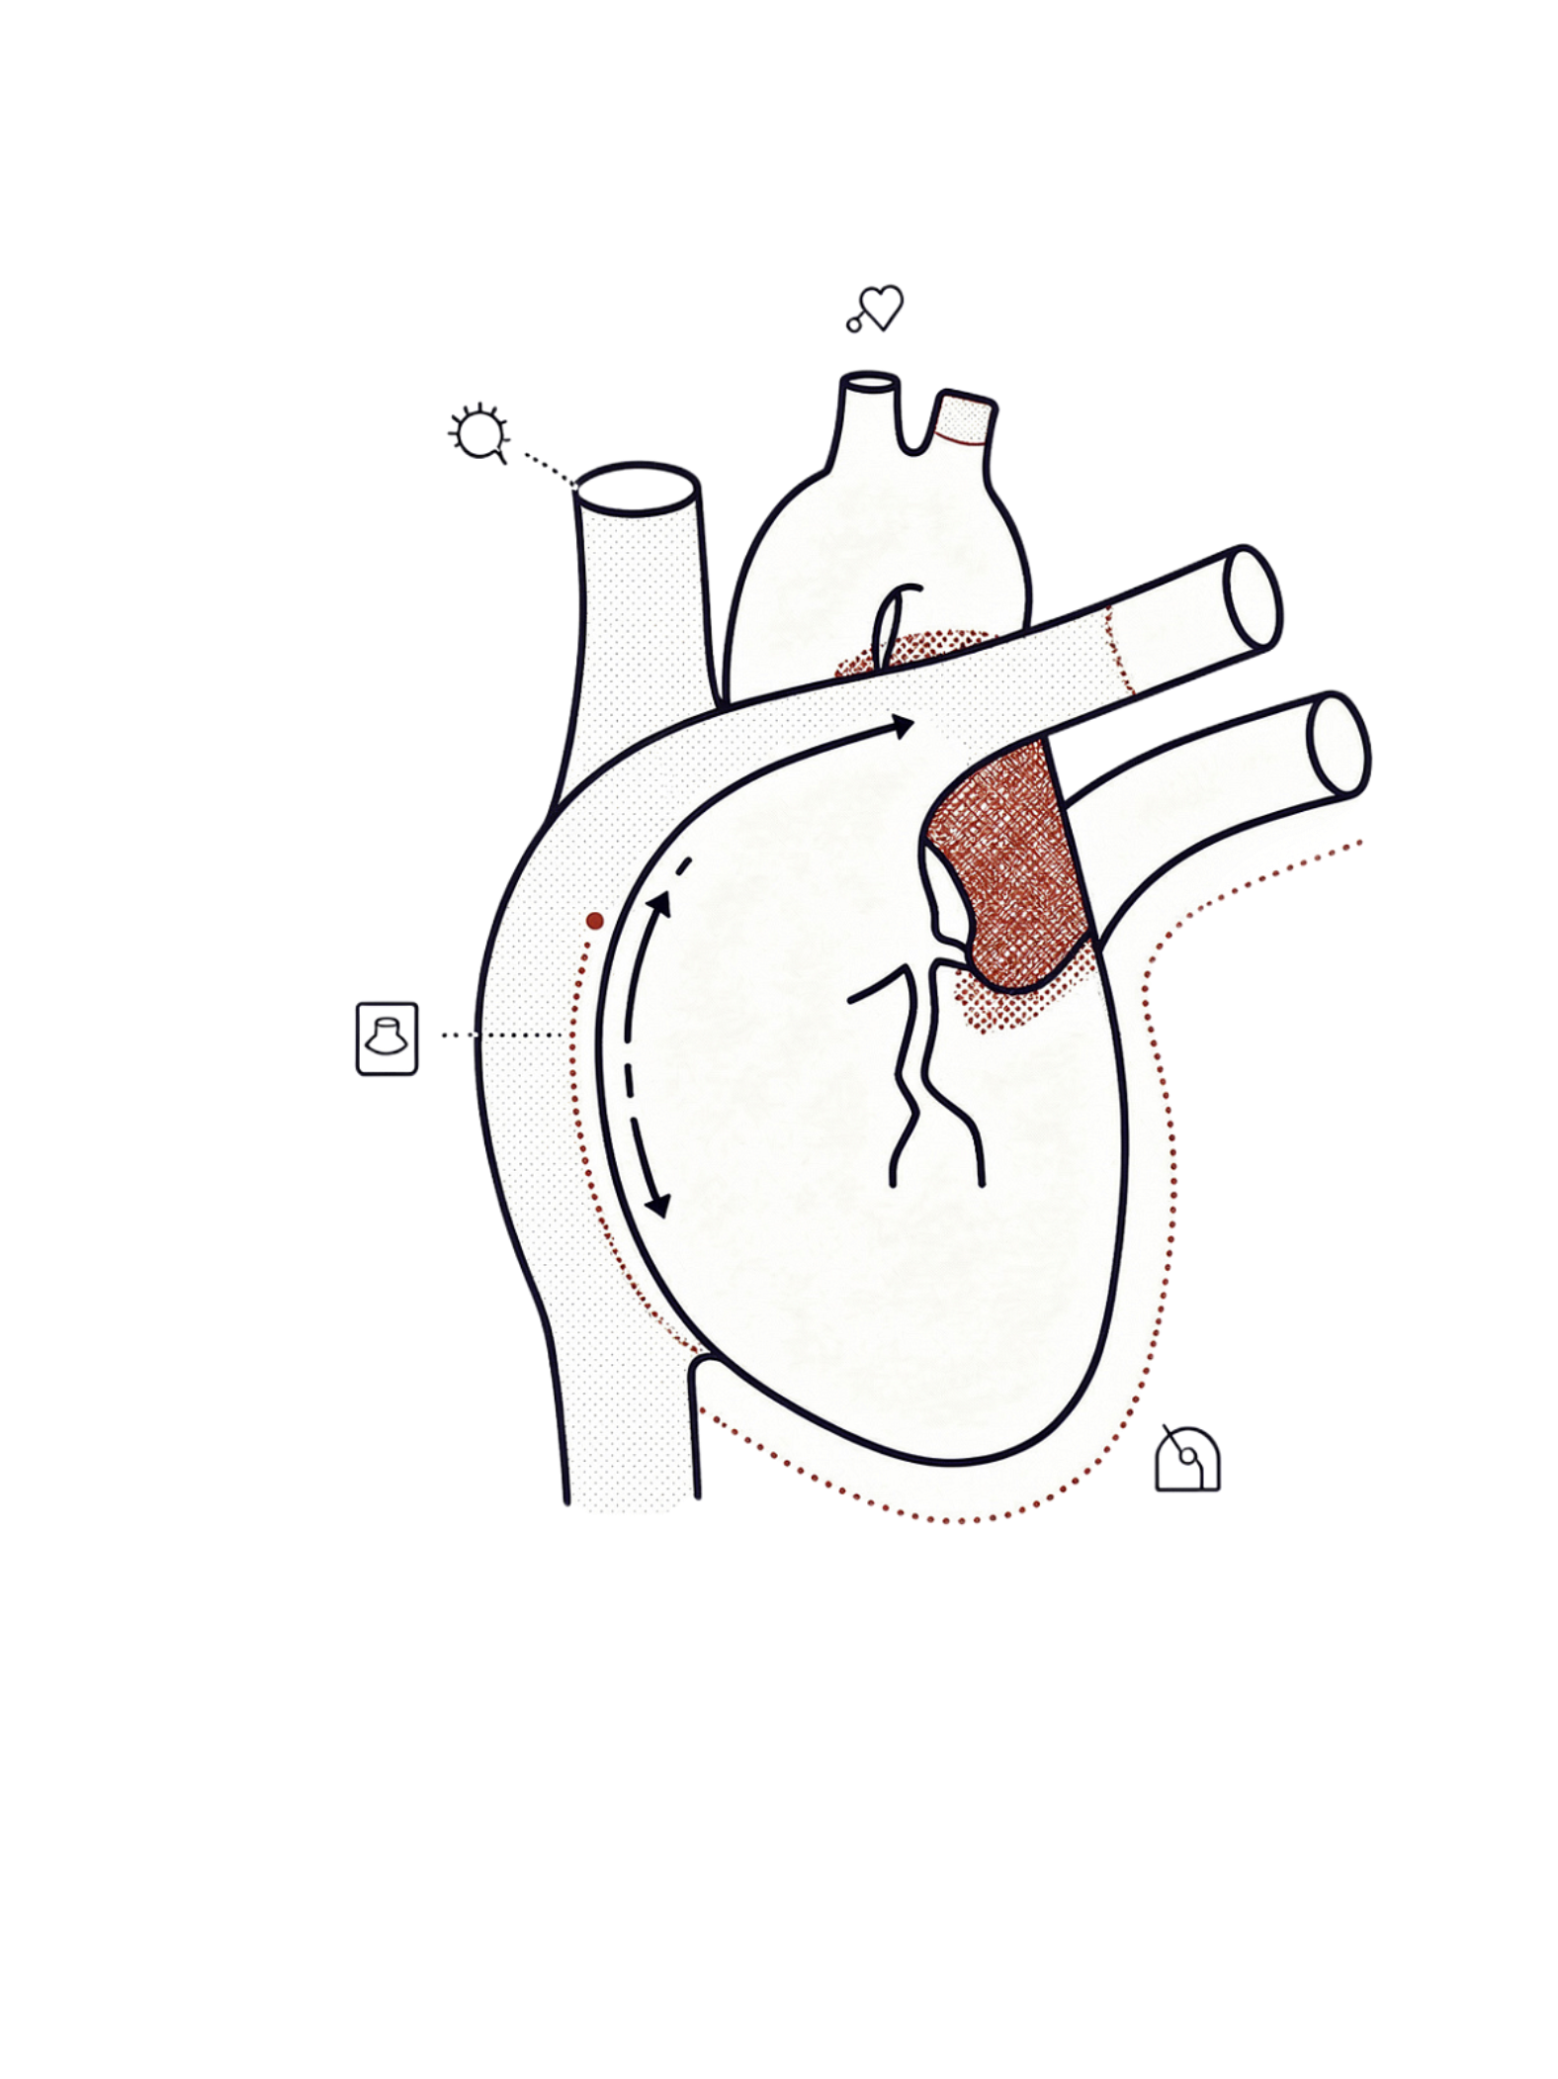
SART & IART: Rare Reentrant SVTs
Uncommon but clinically important — both mimic focal atrial tachycardia on ECG and require electrophysiologic study for definitive diagnosis.

Slide 43
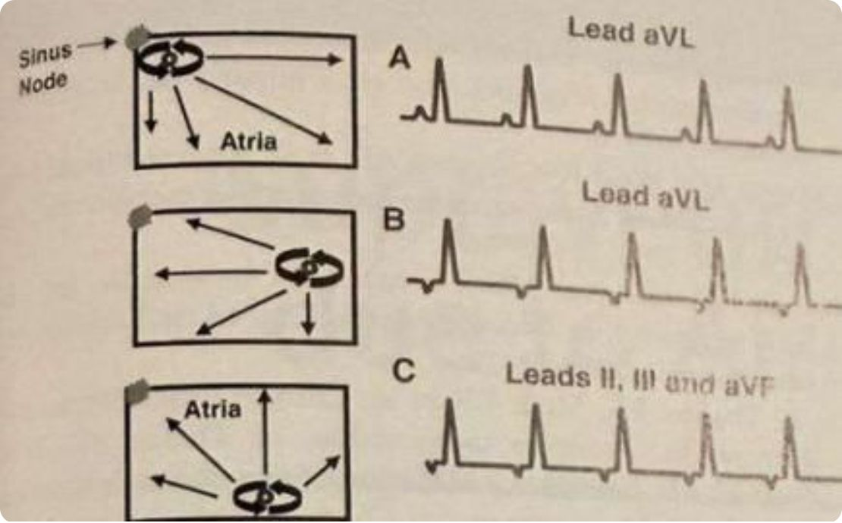
SART & IART: Mechanisms and ECG
SART — Sinoatrial Reentrant Tachycardia
IART — Intra-Atrial Reentrant Tachycardia
Circuit: sinus node + adjacent atrium
P wave morphology resembles sinus P — key ECG feature
Associated with structural cardiac disease
Responds to adenosine and vagal maneuvers
Micro-reentrant circuit within atrium — often around scar or surgical incision
P waves precede QRS (PR ≥ 120 ms)
AV block can occur — AV node not part of circuit
Both SART and IART are ECG-indistinguishable from focal atrial tachycardia — classified under focal AT for clinical purposes.

Slide 44
Supraventricular Tachycardia due to Altered Automaticity

Slide 45
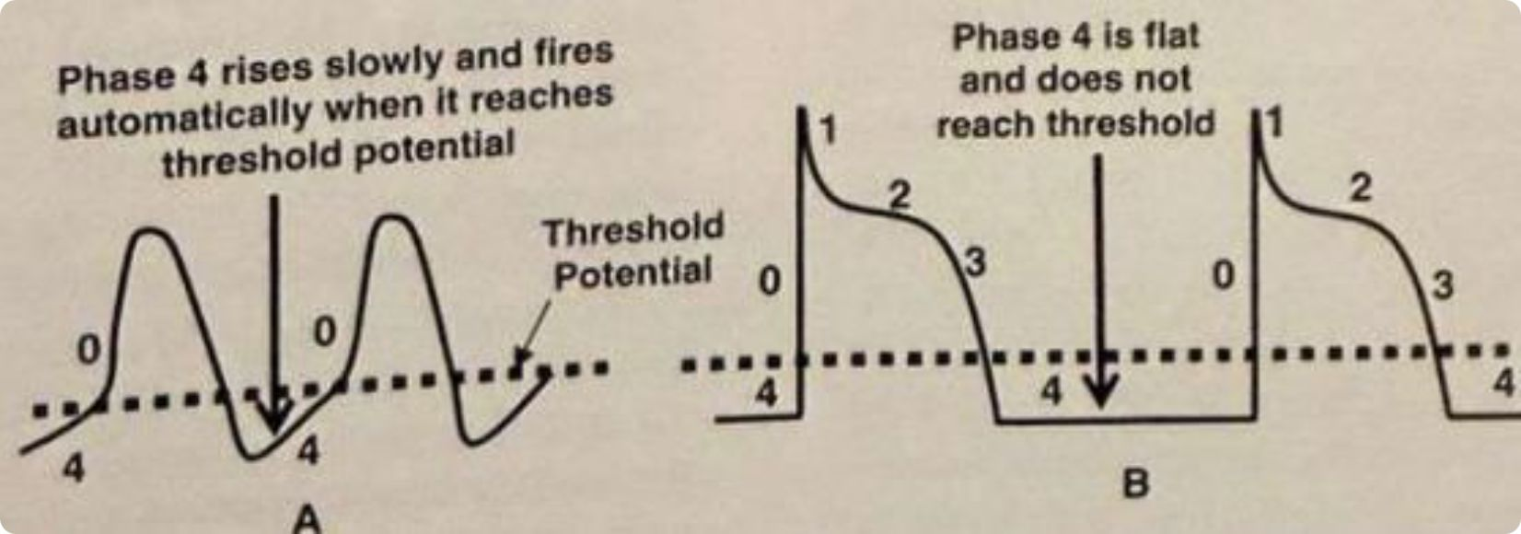
Introduction: Mechanisms of SVT
SVT can occur via enhanced automaticity and triggered activity — not only reentry.
Phase 4 Depolarization
SVT from enhanced automaticity depends on cells with automatic properties exhibiting diastolic depolarization (phase 4 of the action potential). Once threshold potential is reached, cells discharge automatically.
Non-Pacemaking Cells
Non-pacemaking cells have a flat phase 4 — their resting potential never reaches threshold under normal conditions.
Pathologic Automaticity
Ordinary working myocytes may develop automaticity when pathologic conditions arise — such as ischemia or myocardial injury — enabling abnormal impulse generation.

Slide 46
Types of Automatic SVT
Pathologic Sinus Tachycardia
Focal Atrial Tachycardia
Enhanced automaticity of sinus node cells. Clinically difficult to differentiate from physiologic sinus tachycardia without additional workup.
Originates from a single focus in the atria or contiguous venous connections — pulmonary veins, vena cava, or coronary sinus.
Multifocal Atrial Tachycardia (MAT)
AV Junctional Tachycardia
Several ectopic foci present in the atria simultaneously, producing irregular P waves of varying morphology.
Arises from the AV node down to the bifurcation of the bundle of His. Can be paroxysmal or nonparoxysmal in presentation.

Slide 47
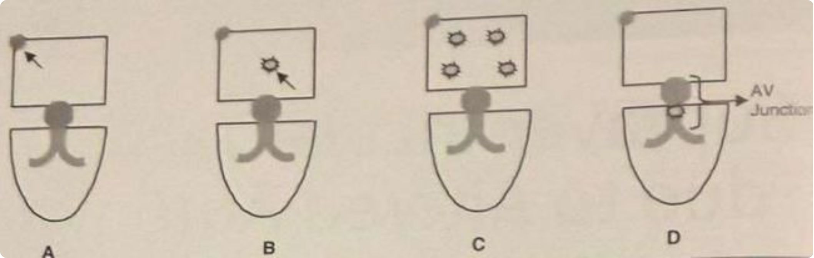

Slide 48
Focal Atrial Tachycardia: Overview
Key Epidemiology
Mechanism & Origin
Sustained focal atrial tachycardia is rare, occurring in <0.5% of symptomatic patients referred for evaluation. The incessant form — persisting >12 hours/day — can cause tachycardia-mediated cardiomyopathy, one of the few reversible causes of dilated cardiomyopathy.
Tachycardia arises from a single location; the atrial impulse spreads circumferentially regardless of the underlying mechanism. The mechanism may be enhanced automaticity, intra-atrial micro-reentry, or triggered automaticity — these are indistinguishable on the 12-lead ECG.
Common Foci
Mitral and tricuspid annulus
Atrial appendages
Crista terminalis
Ostium of coronary sinus
Pulmonary veins

Slide 49
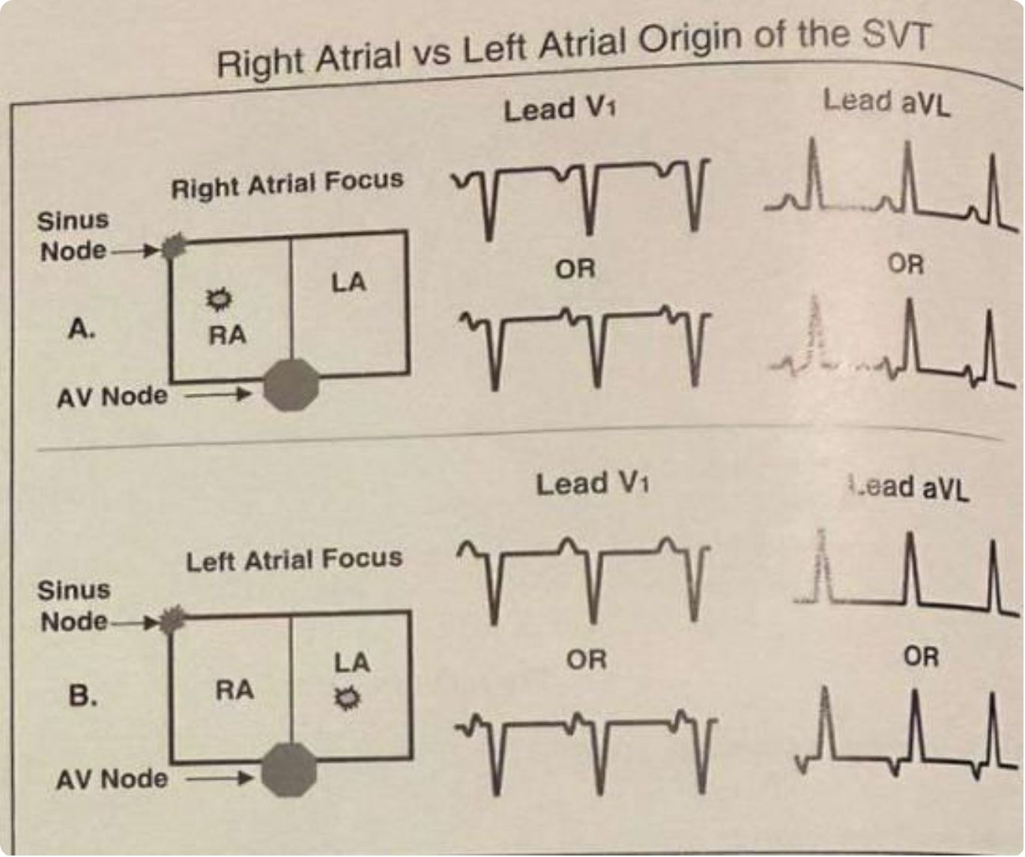
Localizing the Origin: Right vs. Left Atrium
The most useful leads for atrial localization are V₁ and aVL.
Right Atrial Origin
P waves inverted in V₁ (or biphasic: initially upright, terminally negative)
P waves upright or biphasic in aVL
Left Atrial Origin
P waves upright in V₁ (or biphasic: initially negative, terminally upright)
P waves isoelectric or negative in aVL

Slide 50
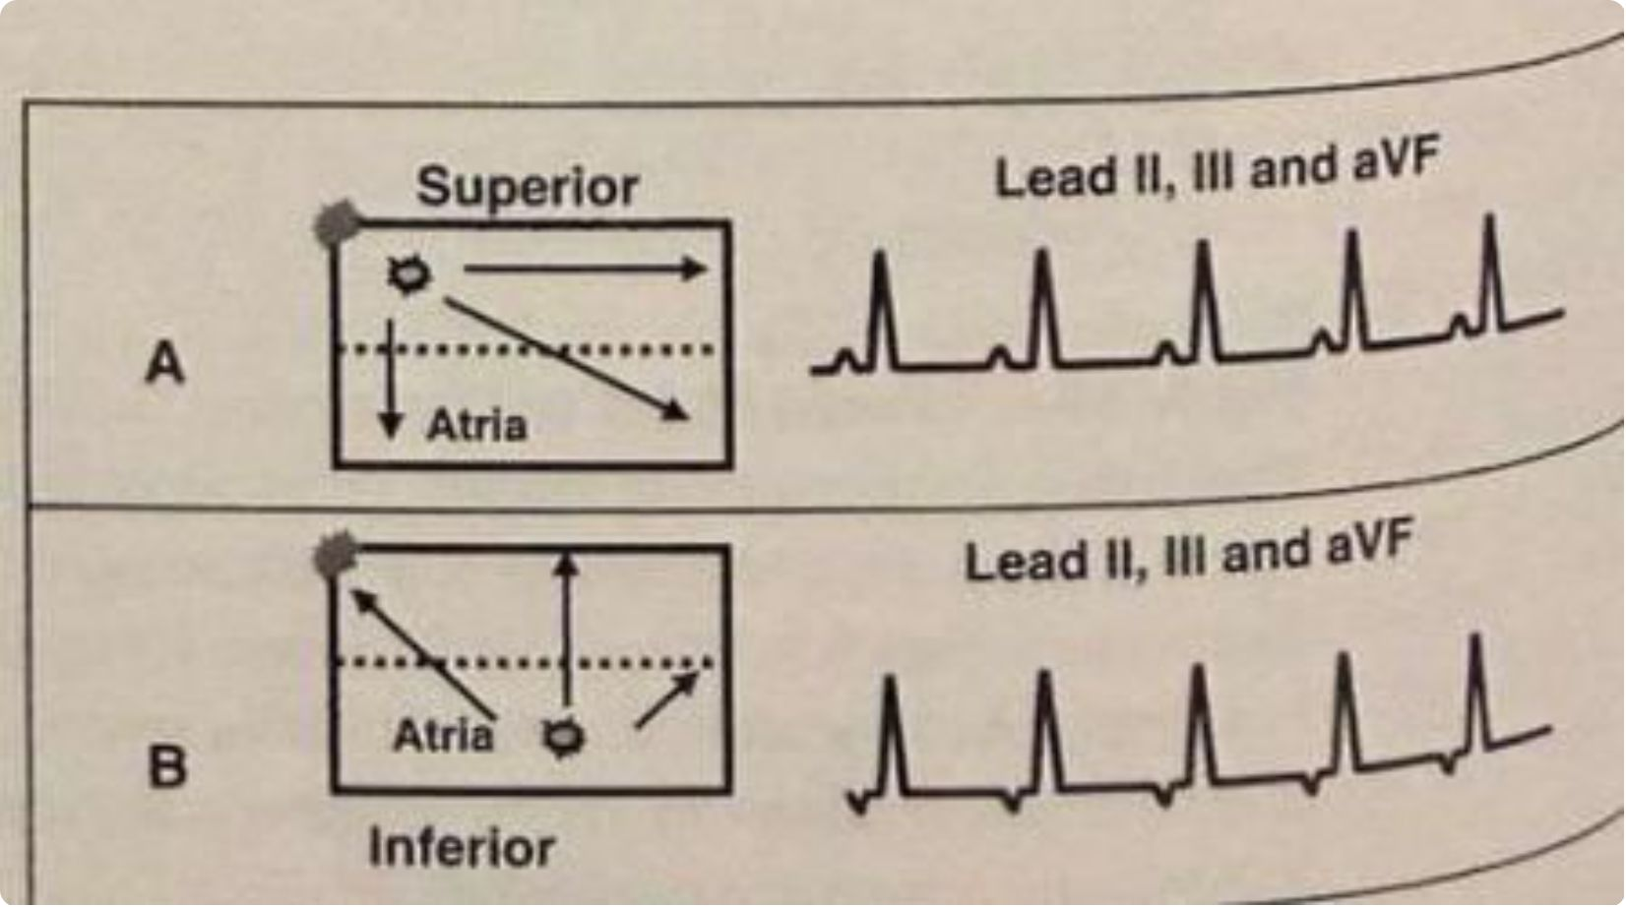
Localizing the Origin: Superior vs. Inferior
Leads II, III, and aVF determine the superior vs. inferior axis of the tachycardia focus.
Superior Origin
P waves upright in II, III, aVF. Includes atrial appendages and superior pulmonary veins. May closely mimic sinus tachycardia on surface ECG.
Inferior Origin
P waves inverted in II, III, aVF. Includes inferior vena cava, coronary sinus orifice, and inferior pulmonary veins.
Combining V₁/aVL (right vs. left) with II/III/aVF (superior vs. inferior) allows precise anatomic localization of the tachycardia focus prior to ablation.

Slide 51
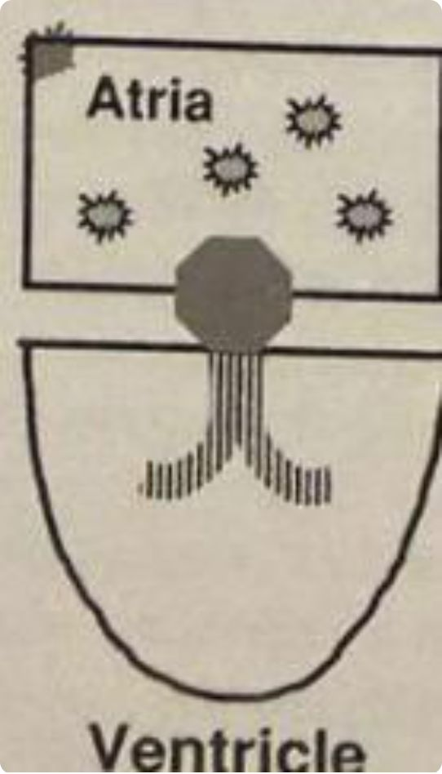

Multifocal Atrial Tachycardia (MAT)
Diagnostic Criteria
1
≥3 consecutive P waves of different morphologies
2
Isoelectric baseline between P waves
3
Rate >100 bpm
Variable PR and R-R intervals are characteristic. Mechanism is enhanced automaticity from multiple independent automatic foci in the atria firing simultaneously.
Often mistaken for atrial fibrillation due to irregular heart rate — the key distinction is the presence of distinct, identifiable P waves with isoelectric baseline in MAT.

Slide 52
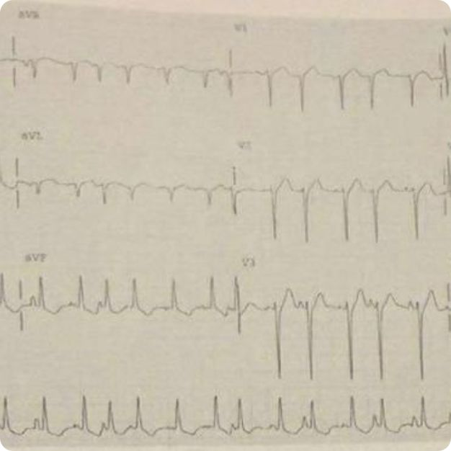
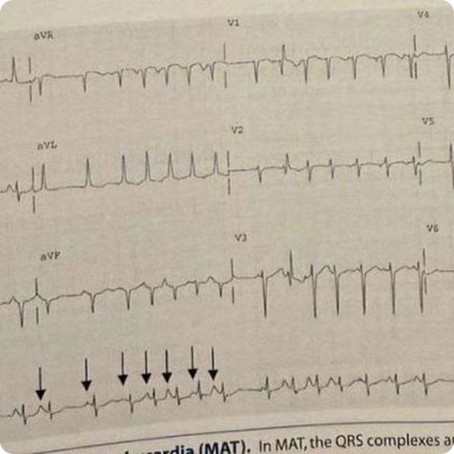
MAT: ECG Examples
At least three consecutive P waves with varying morphologies at rate >100 bpm. Variable PR and R-R intervals with isoelectric baseline between P waves.

Slide 53

Junctional Tachycardia: Overview
Repetitive impulses originating from the AV node or bundle of His; follows normal AV conduction producing narrow QRS complexes.
Nonparoxysmal Junctional Tachycardia
Rate: 70–120 bpm
Slow onset and gradual termination
Due to enhanced automaticity or triggered activity
Also called accelerated junctional rhythm at lower rates
Paroxysmal (Focal) Junctional Tachycardia
Rate: 110–250 bpm
Sudden onset and abrupt termination
Rare; more common in children
Difficult to differentiate from AVNRT on surface ECG

Slide 54

ECG Findings: Junctional Tachycardia
QRS Morphology
Narrow QRS complexes unless preexisting bundle branch block or aberrant conduction is present.
P Wave Relationships
P waves may be synchronous with QRS (not visible), or retrograde (inverted in II, III, aVF). Retrograde P waves before QRS: PR <0.12 sec (pseudo-Q waves). Retrograde P waves after QRS: R-P interval ≤0.20 sec.
AV Dissociation
Complete AV dissociation may occur — the tachycardia does not require the atria or ventricles for maintenance.
With Atrial Fibrillation
Can occur in the presence of atrial fibrillation → produces regularization of the R-R interval, an important diagnostic clue.

Slide 55

Normal AV Conduction vs. WPW: The Core Distinction
Normal Conduction
Atria and ventricles are electrically isolated by a dense fibrous AV ring. The only pathway for impulse transmission is through the AV node → His-Purkinje system, which imposes physiologic delay before ventricular activation.
WPW Mechanism
An accessory pathway (bundle of Kent) bridges the atrium directly to the ventricle across the AV groove, bypassing the AV node entirely — eliminating the physiologic delay and allowing premature ventricular activation.
Dual Pathway Consequence
The sinus impulse reaches the ventricles via both the AV node (with delay) and the bypass tract (without delay), creating a fusion QRS complex — the hallmark of preexcitation.
Reentry Substrate
Beyond preexcitation, the bypass tract serves as a critical limb of reentrant tachycardia circuits — the primary mechanism driving symptomatic WPW syndrome and its associated arrhythmias.

Slide 56

Ventricular Preexcitation: Step-by-Step Mechanism
1
Atrial Activation
Normal sinus P wave; atrial activation is entirely unaltered — preexcitation begins below the atria.
2
Bypass Tract Conduction
Impulse travels directly atrium → ventricle via the accessory pathway with no AV nodal delay → PR interval shortens, typically <0.12 s.
3
Delta Wave Formation
Premature ventricular activation occurs by slow, cell-to-cell myocardial spread at the bypass tract insertion site → produces the slurred initial QRS upstroke (delta wave).
4
AV Node Breakthrough
Impulse finally emerges from AV node → activates remaining ventricles rapidly via His-Purkinje → terminal QRS is normal in morphology.
5
Fusion Complex & ST-T Changes
The QRS = delta wave (bypass tract) + normal terminal deflection (AV node). Secondary repolarization abnormalities are directed opposite to the delta wave.

Slide 57

Classic ECG Triad of WPW
1. Short PR Interval
2. Delta Wave
Bypass tract conducts faster than AV node → PR typically <0.12 s. Critically, ~25% of patients with preexcitation have a normal PR interval (≥0.12 s) — do not exclude WPW on this basis alone.
Slow, slurred initial QRS deflection representing myocardial conduction at the bypass tract insertion site. Size varies with tract location and relative AV nodal conduction speed.
3. ST-T Wave Abnormalities
Wide QRS & Clinical Pearl
Secondary changes directed away from the delta wave; these are not indicative of ischemia and should not be misinterpreted as primary repolarization pathology.
Total QRS duration is prolonged due to fusion. WPW ECG pattern ≠ WPW syndrome — syndrome requires both the ECG pattern AND a symptomatic tachyarrhythmia.

Slide 58

Intermittent Preexcitation
Definition & ECG Appearance
Clinical Significance
Bypass tract conduction is not constant — preexcitation alternates with normal conduction on the same ECG recording. Some QRS complexes show short PR + delta wave; others display normal PR + narrow QRS within the same rhythm strip.
Intermittent preexcitation generally implies a longer bypass tract refractory period, which may confer lower risk of rapid ventricular response during atrial fibrillation — a favorable prognostic indicator.
Mechanism
Variability in bypass tract refractoriness or competing AV nodal conduction speed. When AV nodal conduction is faster, it depolarizes the ventricle before bypass tract activation reaches the myocardium.

Slide 59

Delta Wave Size: Determinants and Significance
: Delta wave size reflects the proportion of ventricular myocardium activated via the bypass tract before AV nodal breakthrough occurs.
Small / Inconspicuous Delta Wave
Left-sided bypass tract (farther from sinus node → longer atrial travel time → less myocardium preexcited before AV node fires); also seen with enhanced AV nodal conduction. May be subtle enough to miss
Large / Prominent Delta Wave
Right-sided bypass tract (closer to sinus node → earlier preexcitation → more myocardium activated before AV nodal breakthrough); also seen with delayed AV nodal conduction (e.g., first-degree AV block).
Diagnostic Implication
A barely visible delta wave does not exclude WPW. Left-sided tracts account for 50–60% of all bypass tracts and characteristically produce subtle preexcitation — the most common location, yet the most easily missed.

Slide 60
Localizing the Bypass Tract
ECG-based anatomical localization using the Olgin-Zipes algorithm — V1 morphology, frontal axis, and limb lead patterns
Step 1
Step 2
Step 3
V1 QRS Morphology: Left vs. Right
Inferior Leads & Frontal Axis: Sub-localization
Lateral Lead Pattern: Free Wall vs. Septal

Slide 61



Bypass Tract Distribution: Anatomical Overview
Key anatomical constraint: Left anteroseptal bypass tracts are extremely rare — the aortic root occupies that space, preventing accessory pathway formation at the left anteroseptal junction.

Slide 62


Step 1: Left vs. Right — The V1 Rule
Left-Sided Bypass Tract (Type A)
Right-Sided Bypass Tract (Type B)
Left ventricle activated first → impulse spreads left → right toward V1 → tall R or Rs complex in V1.
May mimic: RBBB, RVH, posterior MI. Accounts for the majority of WPW cases.
Right ventricle activated first → impulse spreads right → left away from V1 → QS or rS complex in V1.
May mimic: LBBB, LVH, anteroseptal MI. Always verify PR interval and delta wave before attributing these findings to other etiologies.

Slide 63

Left-Sided Bypass Tracts: ECG Patterns
V1 hallmark: Tall R or Rs complex (positive delta wave) — confirms left-sided location. Sub-localization then depends on the limb lead pattern and frontal axis.
LV Free Wall
Left Posteroseptal
Isoelectric or negative delta wave in leads I, aVL, V5, V6 — impulse traveling away from lateral leads. QS complexes in I and aVL may mimic lateral MI.
Deep Q waves in II, III, aVF — impulse traveling away from inferior leads — combined with tall R in V1. Pattern closely mimics inferior MI; distinguish by delta wave and clinical context.
ECG Summary
Free wall: Tall R in V1 + QS in I and aVL.
Posteroseptal: Tall R in V1 + deep Q in II, III, aVF.

Slide 64


Right-Sided Bypass Tracts: ECG Patterns
Right Posteroseptal
QS complexes in II, III, aVF + QS in V1. Closely mimics inferior MI. Inferior axis on frontal plane. Most common right-sided location.
Right Anteroseptal
QS or rS in V1/V2 + inferior axis (>+60)
Key differentiator: Frontal plane axis distinguishes posteroseptal (inferior axis) from free wall (left axis) from anteroseptal (inferior axis with specific lead pattern) right-sided tracts.
RV Free Wall
QS or rS in V1 + left axis deviation (axis −30° to −60°). Tall R waves in I and aVL. LBBB-like pattern. Axis is the critical differentiator from right posteroseptal tracts.

Slide 65
WPW ECG Pattern vs. WPW Syndrome
WPW ECG Pattern (Asymptomatic Preexcitation)
WPW Syndrome
Risk Stratification
Short PR + delta wave on ECG without any tachyarrhythmia symptoms. Incidental finding — the patient has the anatomical substrate but has not experienced symptomatic arrhythmia. Estimated prevalence ~0.1–0.3% of the general population.
ECG pattern plus symptomatic paroxysmal tachycardia (palpitations, presyncope, syncope, or cardiac arrest). Only ~10% of individuals with the WPW ECG pattern will develop symptomatic WPW syndrome over their lifetime.
Electrophysiology study (EPS) is the gold standard — evaluates bypass tract refractory period and inducibility of tachyarrhythmia.
High-Risk Features
Lower-Risk Features
Short bypass tract refractory period; multiple accessory pathways; history of AF with rapid ventricular response; prior cardiac arrest or resuscitation.
Intermittent preexcitation (implies longer refractory period); absence of inducible tachyarrhythmia on EPS; loss of preexcitation with exercise.
Associated Conditions
~10% of WPW patients have Ebstein's anomaly (characteristically right-sided, often multiple bypass tracts). Also associated with hypertrophic cardiomyopathy and mitral valve prolapse. Always screen for structural heart disease.

Slide 66
THANK YOU

