Slide 1
ECHOCARDIOGRAPHIC ASSESSMENT OF PULMONARY HYPERTENSION
DR FAZIL KT

Slide 2
Pulmonary hypertension (PH) is a disorder that may involve multiple clinical conditions and may be associated with a variety of cardiovascular and respiratory diseases.
Heterogenous ds involving remodelling of pulmonary Vasculature leading to increased resistance
mean pulmonary arterial pressure (mPAP) >20 mmHg at rest

Slide 3
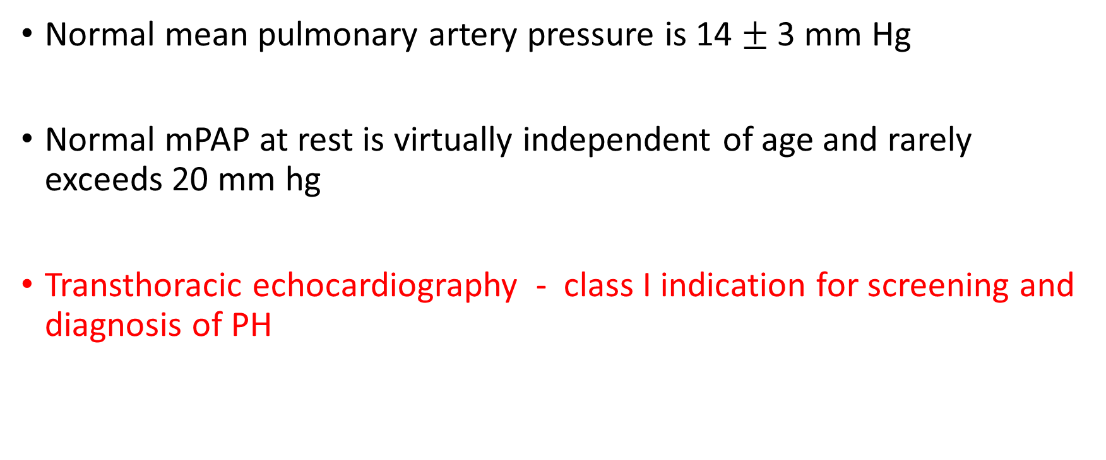
Normal mean pulmonary artery pressure is 14 $±$ 3 mm Hg
Normal mPAP at rest is virtually independent of age and rarely exceeds 20 mm hg
Transthoracic echocardiography - class I indication for screening and diagnosis of PH

Slide 4
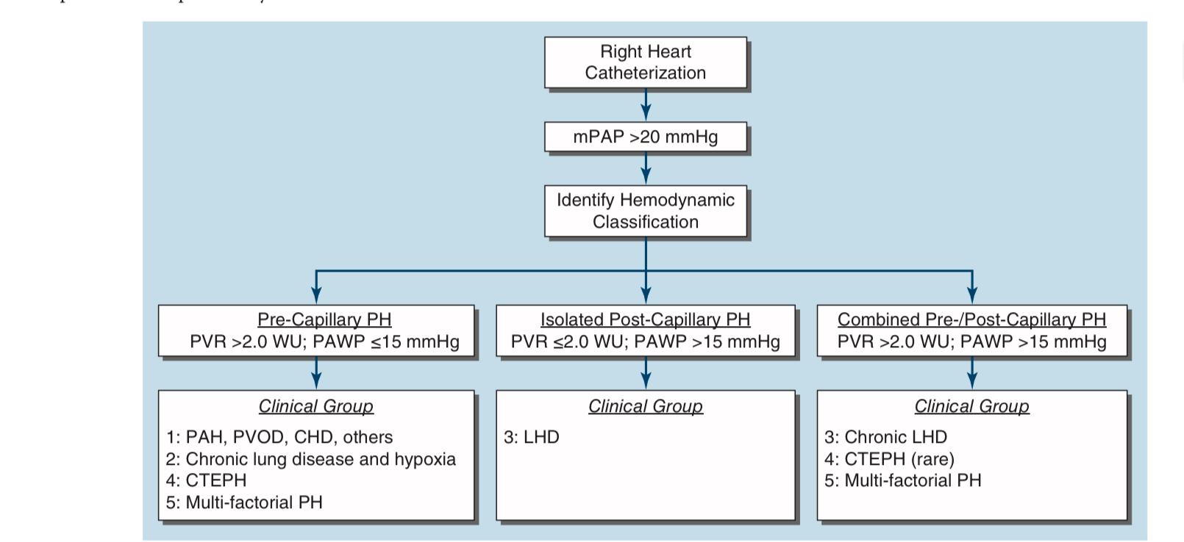
Right Heart Catheterization is considered to be the ‘‘gold standard’’ for the diagnosis of PH

Slide 5
Haemodynamic definitions of pulmonary hypertension

Slide 6
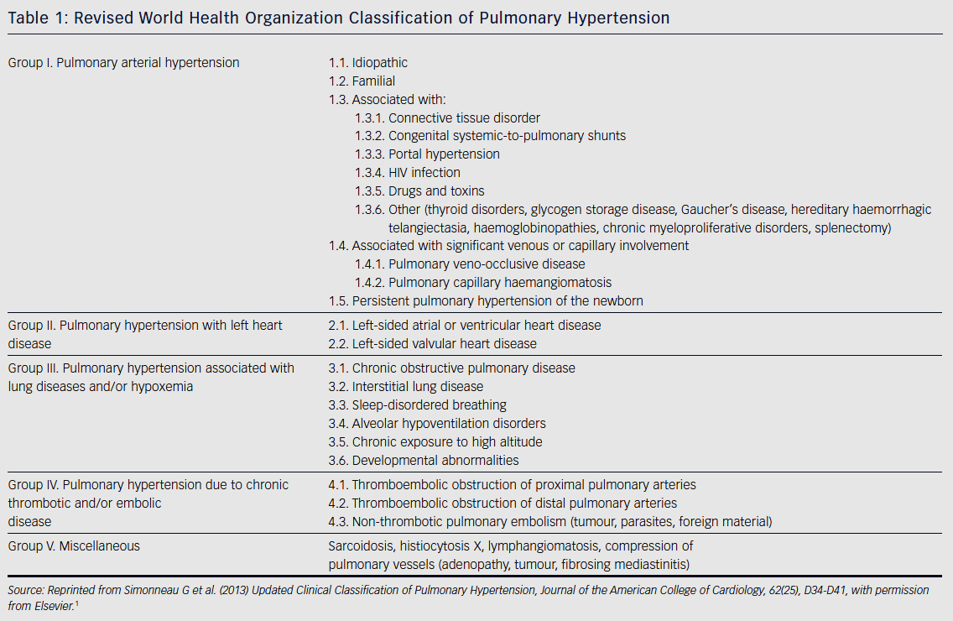

Slide 7
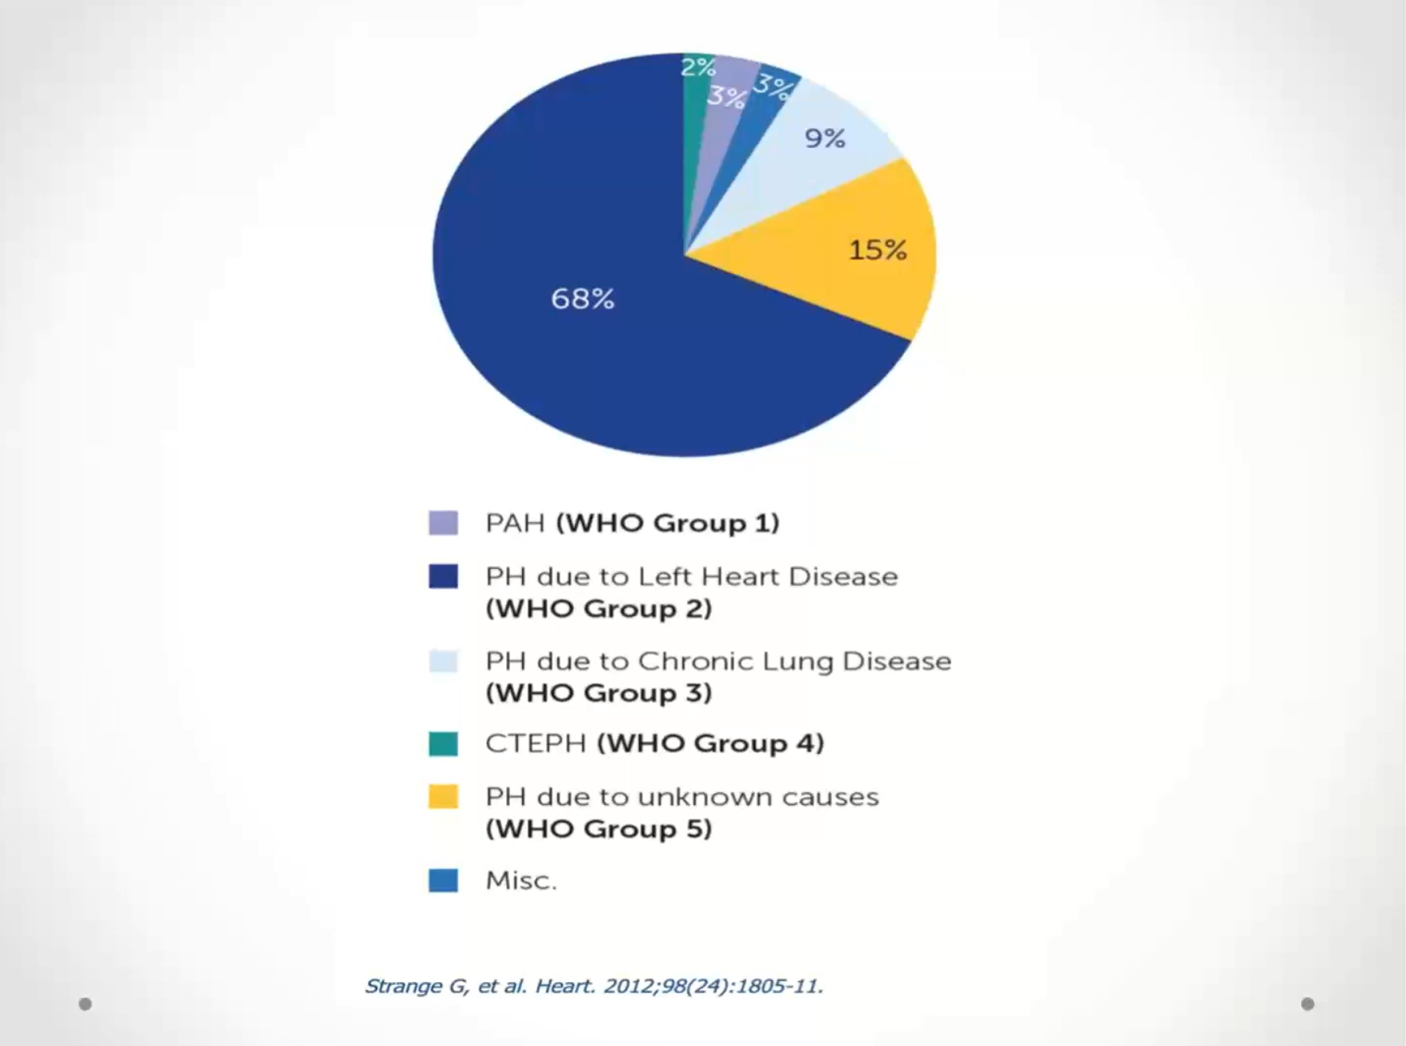

Slide 8
ECHO in PH
Screening
Severity / prognostication
Etiology classification

Slide 9
Screening
Goals of screening - establish the probability of PH on TRV & additional signs of PH
All pts with clinically suspected PH should undergo a TTE

Slide 10
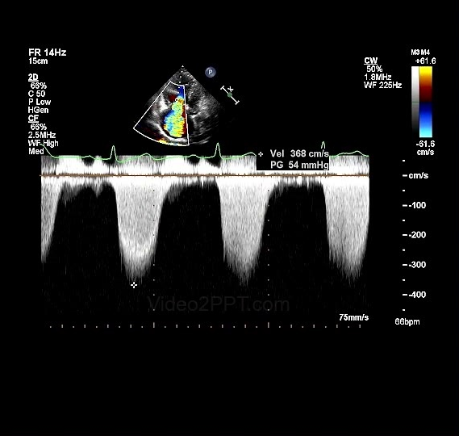
PEAK TR VELOCITY
The primary screening tool is the peak tricuspid regurgitation (TR) velocity
Minimum requirement needed to assess the probability of PHTN
High Probability: TR velocity > 3.4 m/s

Slide 11
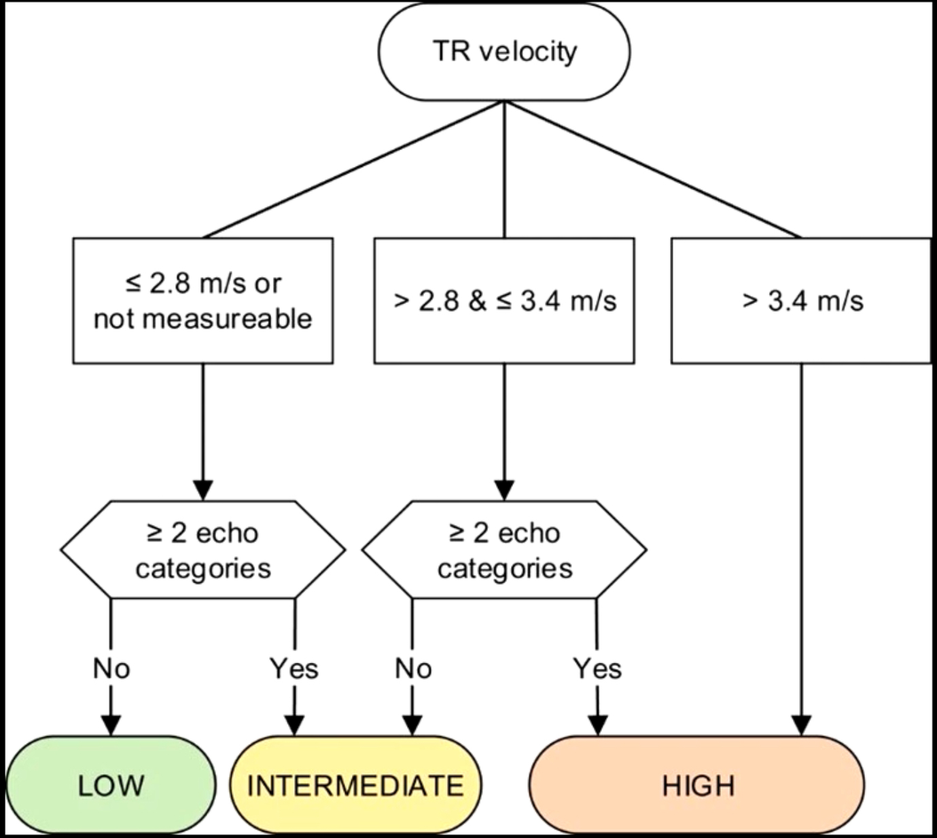

Slide 12
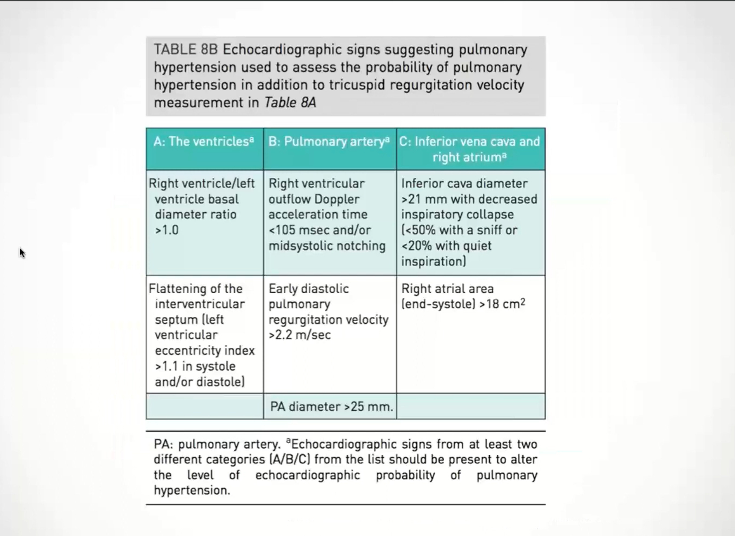

Slide 13
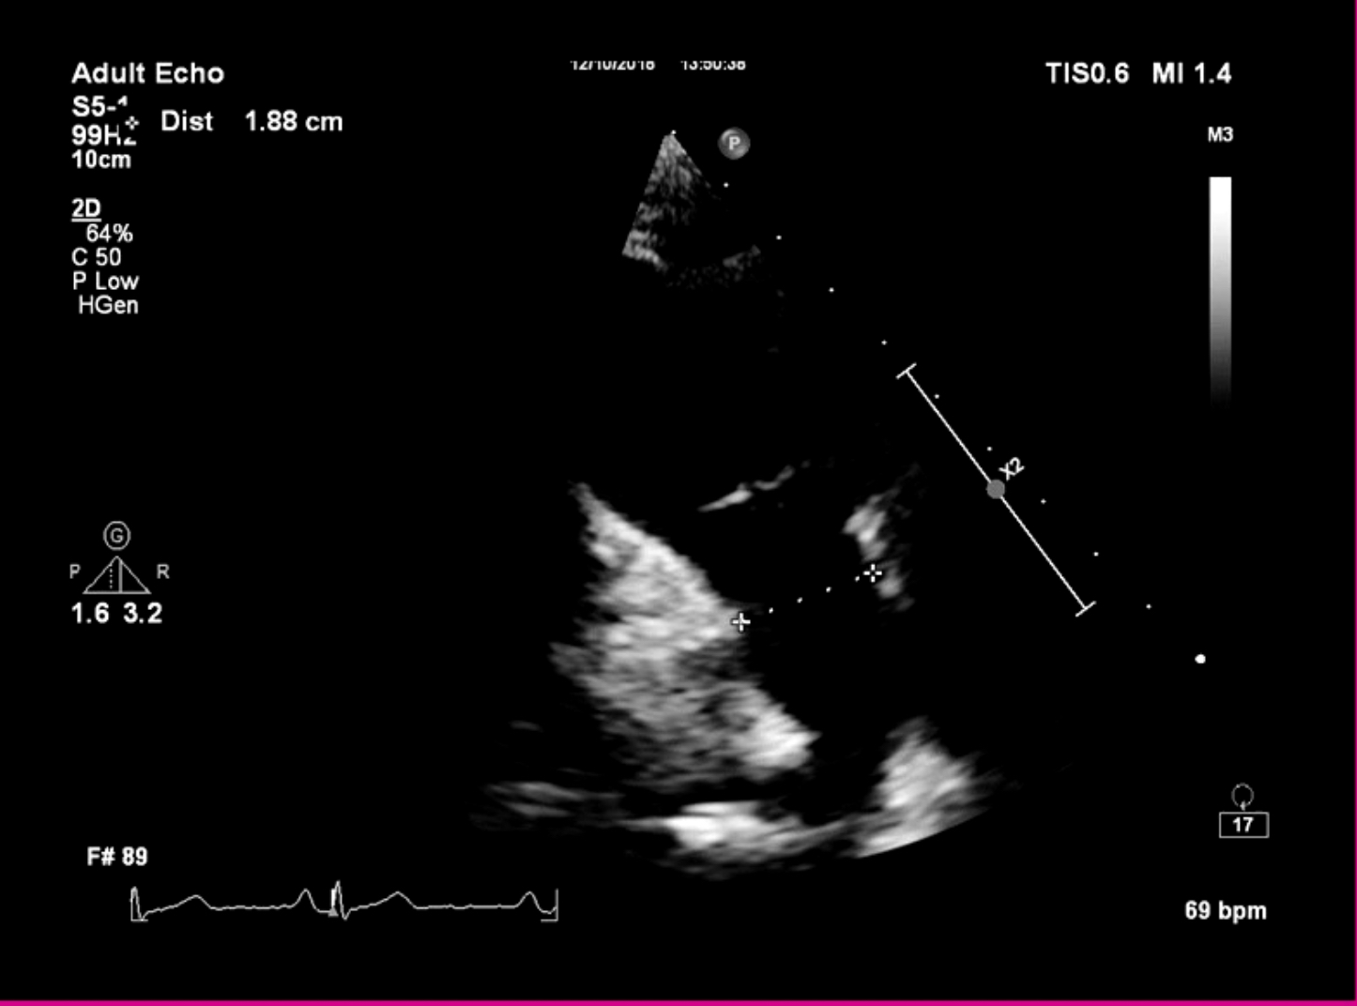
PULMONARY ARTERY DIAMETER
PA dilates in response to volume & pressure overloads
Diameter > 25 mm is considered abnormal

Slide 14
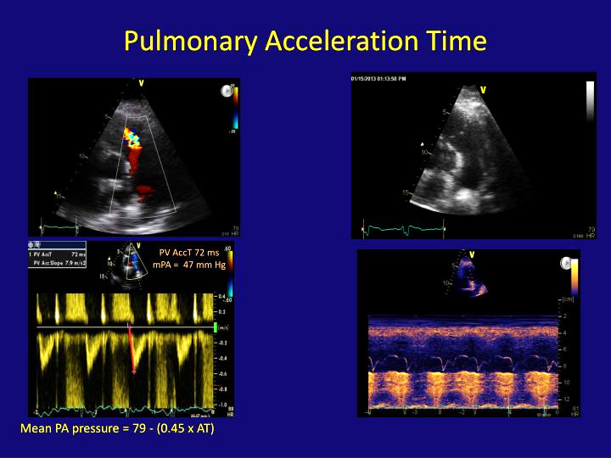
RVOT acceleration time
Measurement of RVOT acceleration time
  Parasternal short axis view
  End expiration
  PW doppler just proximal to Pulmonary valve
  Doppler beam aligned with pulmonary forward flow beam
  Normal RVOT AT > 130 msec
  In PHT RVOT AT < 105 msec

Slide 15
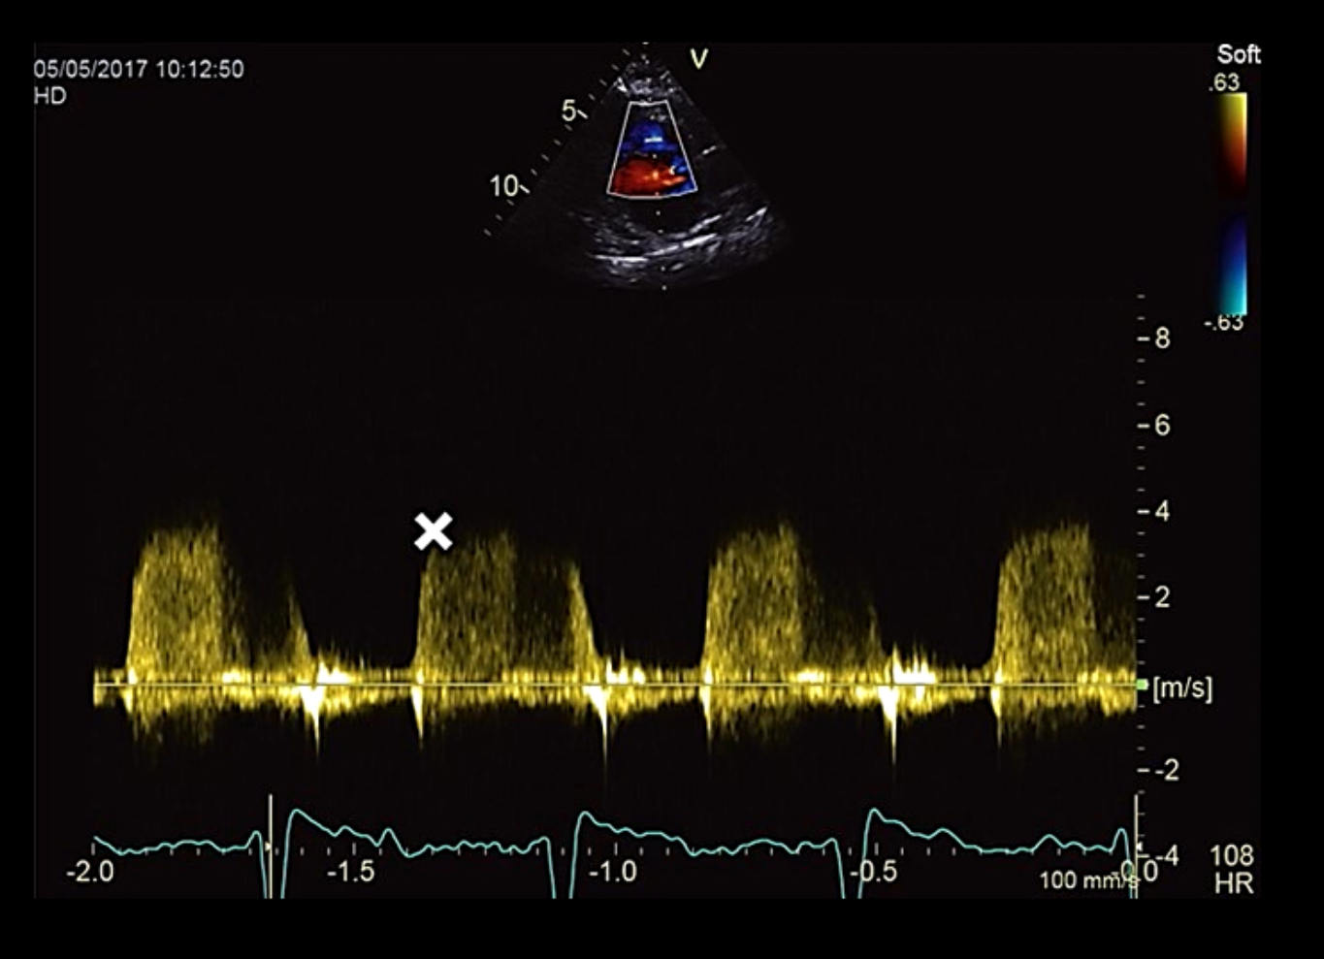
Early diastolic pulmonary regurgitation velocity
Early PR velocity >2.2 m/s is considered a marker of raised mean PAP
This may have additional value when TR velocity cannot be used or relied upon

Slide 16
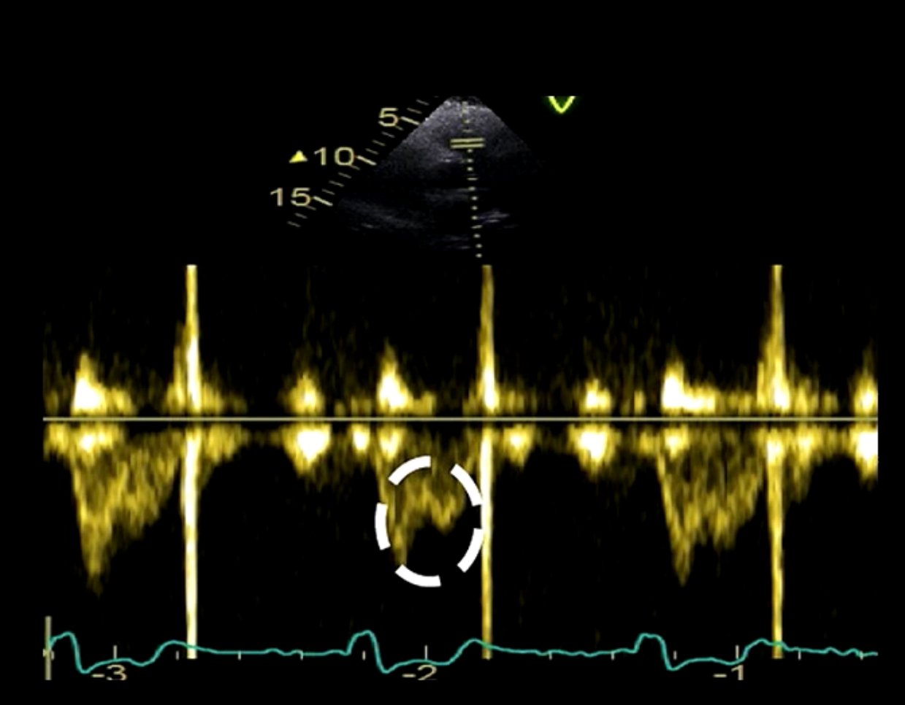
Pulmonary artery systolic notch
Increased PA resistance and PA stiffness can cause reflection of waves which return towards RV during systole - causing notching in doppler profile
considered as marker of raised PAP

Slide 17
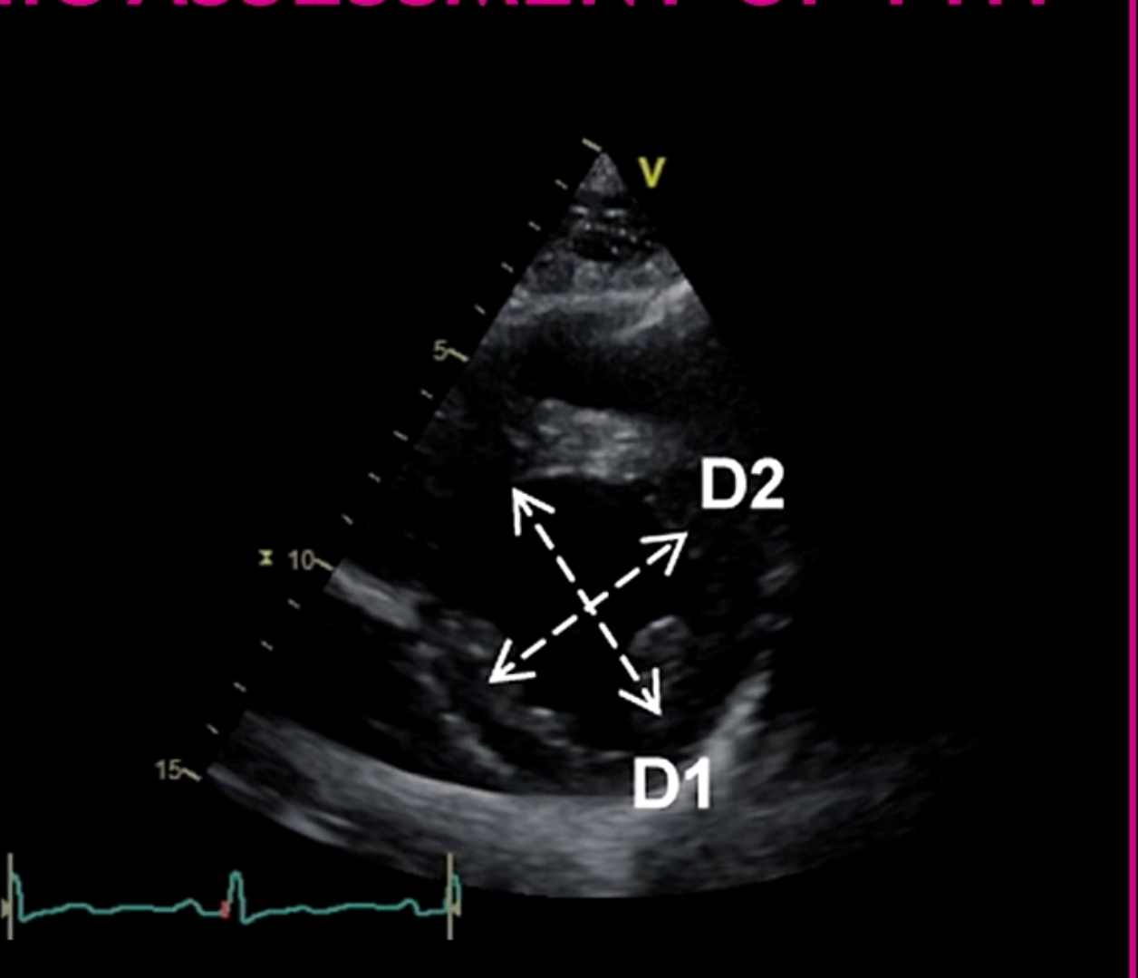
Eccentricity Index (EI)
RV pressure and volume overload can lead to an abnormal shape and function of the IV septum , resulting in flattening
ratio of the minor axis of the LV parallel to the septum (D2) divided by the minor axis perpendicular to the septum (D1)
Left ventricular eccentricity index > 1.1 is considerd abnormal

Slide 18
measured in parasternal short-axis view at level of the LV papillary muscles in both end diastole and end systole
D shape LV during diastole – RV Volume overload
D shaped LV during systole – RV pressure overload
D shape during both – combined overload of RV
LV diastolic eccentricity index > 1.7 - prognostic of mortality in patients with idiopathic PAH

Slide 19
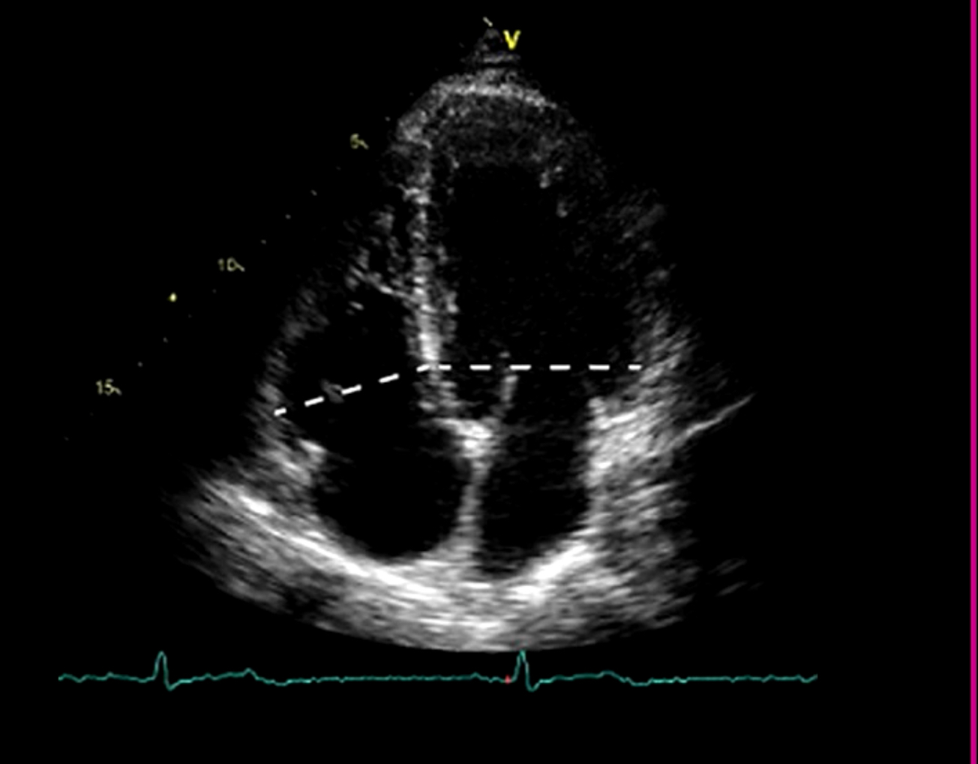
RV /LV basal diameter ratio
Ratio of >1 measured at end diastole suggests right ventricular dilation

Slide 20
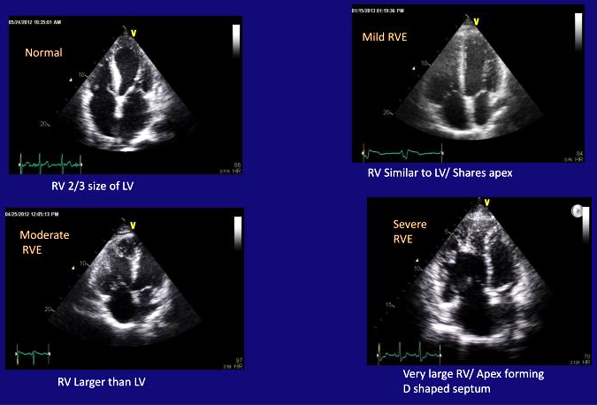
Qualitative assessment of RV size

Slide 21
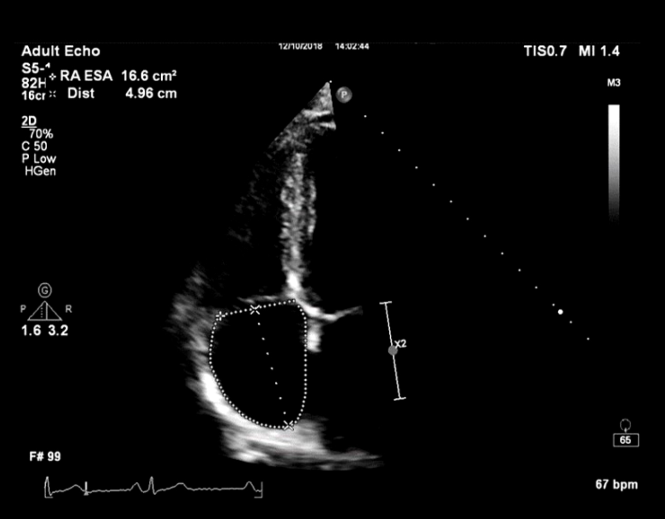
Right atrial area (RAA)
4 chamber view
Area trace
DILATED RA = WHEN RA AREA > 18 cm² at end systole
POOR PROGNOSTIC SIGNS IN PHT : RA AREA > 26 cm²

Slide 22
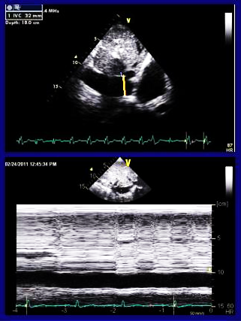
IVC diameter
Subcostal view - M mode
  0.5 – 3.0 cm from its opening into RA
  Just before the junction of hepatic vein into IVC.
  End expiration
  IVC diameter > 21 mm with < 50 % inspiratory collapse is considered abnormal

Slide 23
RA pressure using ivc
IVC Diameter | Inspiratory Collapse | Estimated RAP
≤ 2.1 cm | > 50% | 3 mmHg (normal)
> 2.1 cm | < 50% | 15 mmHg (elevated)
Mixed findings (small IVC + poor collapse OR large IVC + good collapse) | — | 8 mmHg (intermediate)

Slide 24
ESTIMATION OF PA SYSTOLIC PRESSURE
The echocardiographic calculation for RVSP relies on the Modified Bernoulli Equation:
P = 4v^2
Delta P -pressure difference between the RV and the Right Atrium (RA) derived from the TR jet velocity
BY Adding RA Pressure, we arrive at the peak pressure in the RV.

Slide 25
In the absence of RVOT obstruction
RVSP = SYSTOLIC PAP
RVSP Calculated using the formula (4 x TRV²) + RAP.
Central jet - A4C view / RV focused view.
Eccentric jet - RV inflow view.
Underestimated in RV failure , poor alignment of jet and mild TR

Slide 26
Severity of pulmonary HTN based on RVSP
PHTN | PASP
Mild | 36–50 mmHg
Moderate | 51–70 mmHg
Severe | >70 mmHg

Slide 27
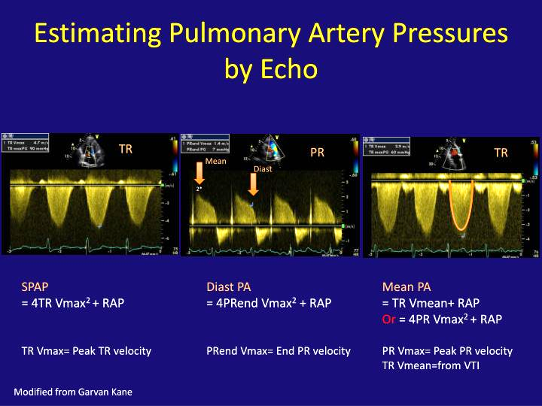

Slide 28
PA DIASTOLIC PRESSURE
4 x PR Ved² + RAP
MEAN PAP
4 x PR Vmax² + RAP
0.61 x SPAP + 2 mm Hg
TR VTI + RAP
mPAP = 2/3 SPAP
mPAP = PADP + 1/3 (PASP – PADP )

Slide 29
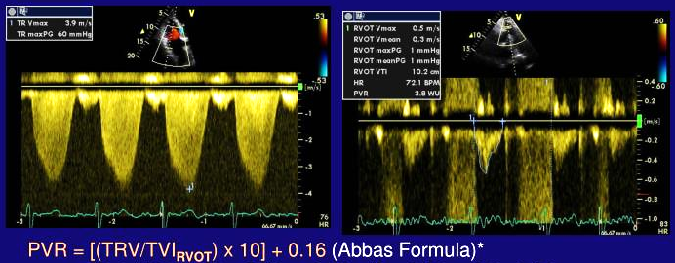
PULMONARY VASCULAR RESISTANCE
( TRVmax / RVOT VTI ) x 10 + 0.16
WHEN VALUE > 0.2 → PVR > 2 WU
WHEN VALUE < 0.15 → PVR NORMAL.
Less accurate in patients with severe pulmonary hypertension, severe tricuspid regurgitation, very low cardiac output, or poor Doppler alignment.

Slide 30
Role of echo in determining types of PHTN group
Left sided origin | Right-sided Origin
LVH, LAE | Normal LV, LA size
Normal RV size | RV dilatation
No interventricular septal bowing | Right to left interventricular septal bowing
Atrial septum neutral or bowed to right | Atrial septum bowed to left
Usually normal RV function | Usually RV dysfunction+
No pericardial effusion | Mild to moderate pericardial effusion
Moderate to severe mitral valve disease | No or minimal mitral valve disease
Moderate to severe LV D/D | Normal or mild LV D/D
Absence of notched pattern in RVOT doppler signal | Notched doppler signal in RVOT

Slide 31
ECHO vs RHC
Janda et al. (2011)
Systematic review comparing Echo with RHC
Included approximately 29 studies (>1,900 patients)
Correlation coefficient ≈ 0.70
Sensitivity: ≈83%
Specificity: ≈72%
Conclusion:
  Echocardiography is useful for screening.
  Accuracy is insufficient to replace right heart catheterization for diagnosis.

Slide 32
Fisher MR et al., 2009
Title: Accuracy of Doppler Echocardiography in the Hemodynamic Assessment of Pulmonary Hypertension
Major findings:
Echo frequently overestimated or underestimated pulmonary artery pressure.
Difference from RHC exceeded ±10 mmHg in many patients.
Echo should not replace RHC.

Slide 33
Rich JD et al., 2011
Studied the reliability of echocardiographic estimation of PASP.
Conclusion:
Large variability exists.
Clinical decisions should not rely on RVSP alone.

Slide 34
THANK YOU

Slide 35
According to current echocardiographic guidelines, pulmonary hypertension is considered unlikely when the peak TR velocity is:
A. >3.4 m/s
B. 2.9–3.4 m/s
C. ≤2.8 m/s
D. >4.0 m/s
Answer: C

Slide 36
Pulmonary acceleration time (PAT) less than ______ suggests pulmonary hypertension.
A. 160 ms
B. 140 ms
C. 105 ms
D. 80 ms
Answer: C

Slide 37
Which statement is TRUE regarding echocardiography in pulmonary hypertension?
A. Echocardiography alone confirms the diagnosis.
B. Right heart catheterization is the gold standard.
C. PASP always equals mean PAP.
D. Normal TR velocity excludes PH
Answer: B

